Slide 1
Ivy: A Read/Write Peer-to-Peer File System
Athicha Muthitacharoen, Robert Morris, Thomer M. Gil, and Benjie Chen
OSDI 2002

Slide 2
Overview
Motivation
Introduction
Challenges
Design
Implementation
Performance
Discussion

Slide 3
Motivation
Existing file systems (e.g. NFS, xFS, Harp) exist
Limitation: Centralization of data or metadata.
Their solution: A P2P storage system
Previous P2P systems (e.g. CFS, PAST)
Limitation: Mostly read-only or allow only the publisher to modify
Their solution: Support multiple writers

Slide 4
Introduction
Ivy is a multi-user read/write peer-to-peer file system.
Uses DHash for storage.
Does NOT rely on peer storage.
Does NOT trust the users.
Has NO centralized component.

Slide 5
Distributed Hashing
DHash is a distributed peer-to-peer hash table mapping keys to arbitrary values.
DHash stores each key/value pair on a set of Internet hosts determined by hashing the key.

Slide 6
Challenges
Consistency when there are multiple writers
P2P participants are unreliable. Cannot rely on locking.
Untrusted participants impose data integrity challenges.
Can you UNDO or IGNORE undesired modifications?
It has to deal with network partitions and conflicting updates.

Slide 7
Design
Ivy uses a set of logs.
Linked list of immutable records.
Contains changes to the file system
Both metadata and data
One per participant
Records are appended to local log.
Records are read from all logs.

Slide 8
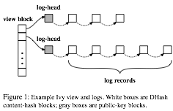
Design
Logs are arranged in views
A view represents file system state
Logs are stored in blocks
Each record is a block.
Log-head block contains the most recent record
View block points to log-heads from each participant

Slide 9
Design
Logs blocks are stored in DHT
Interface: put(key, value), get(key)
Log-head is a mutable block
Identified by the public key of a participant
Immutable blocks are content-hashed and cached by participants

Slide 10
Design
Logs are stored in DHT
Per-record replication and authentication
Cryptographically signed for verification
Each participant stores
DHash key of log-head and prev record.
Ivy uses version vectors for ordering of logs

Slide 11
Design
Each log record represents updates from a single file system operation
Stores 160-bit i-numbers for identifying files and dirs
Stores attributes and permissions in log record.
However, not used to enforce permissions. Relies on encryption.
Logs are stored indefinitely for security reasons.

Slide 12
Design
File system creation (mounts as NFS)
Creates Inode record for root dir
File creation
Creates Inode and Link records
Lookup operation
Checks for Unlink record.
File read operation
Checks for Write records. Ignores SetAttrs records.
File attributes
Maintains: mtime, size, ctime, link count
Dir listing
Checks Link records. Ignores Unlink/Rename

Slide 13
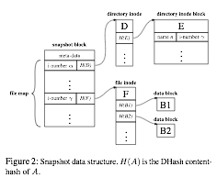
Design
Users create periodical snapshots of the system
Incremental and persistent. Stored in DHT
Obviates the need for reading entire log.
Only the participants in the view are trusted.
System can recover from malicious modifications using logs.

Slide 14
Design
Provides NFS-like semantics
close-to-open consistency
writes are deferred until close()
DHT allows replication
In partitioned state, participants can independently modify files. Allows concurrent updates.
Exclusive updates done similar to two-phase commit (Prepare record)
Uses versioned logs to handle conflicts automatically.
Looks for concurrent version vectors.

Slide 15
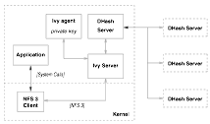
Architecture
Ivy appears as a file system (similar to NFS)
Acts as loop-back NFS server with in-kernel client.
Built as a distributed application on top of DHT + Chord.

Slide 16
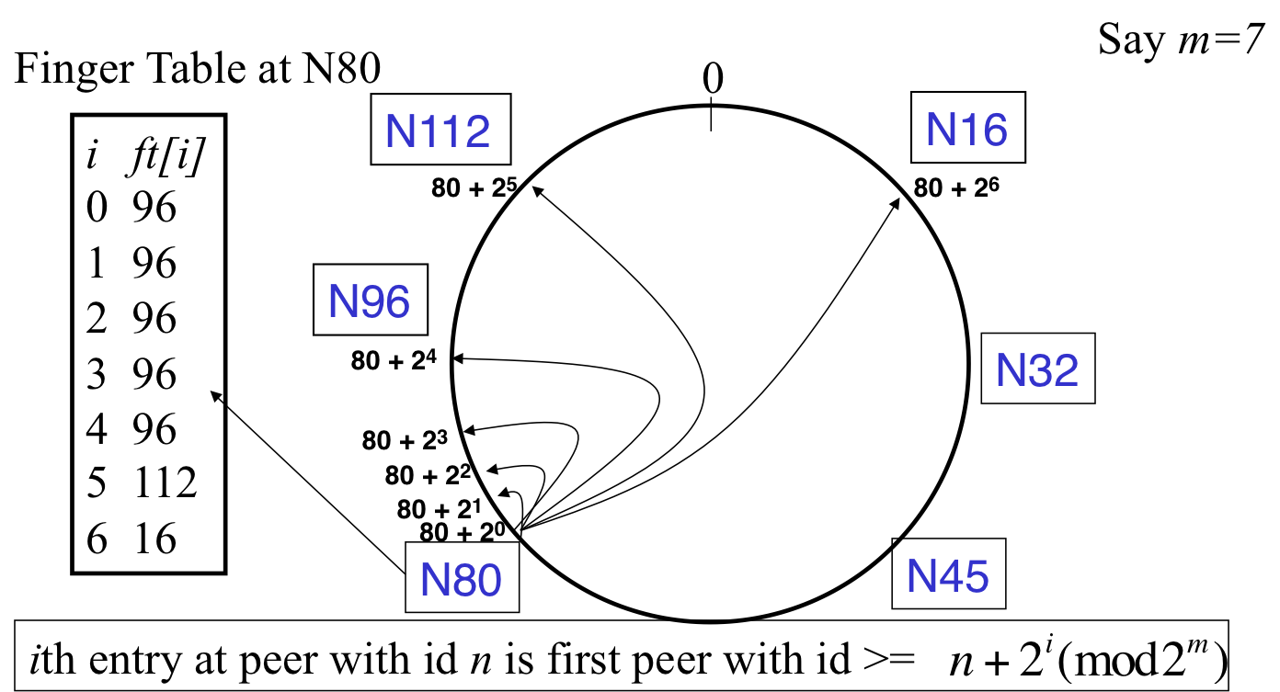
Chord
Interface: lookup(key) → IP
O(log N) messages per lookup

Slide 17
Evaluation
Workload
Modified Andrew Benchmark (MAB)
create dir tree,
copy files into dir tree,
walk dir tree and stat each file,
read files,
compile files

Slide 18
Evaluation
Setup
Block cache size: 512 blocks
MAB and Ivy server run on GHz AMD Athlon running FreeBSD 4.5
DHash nodes are PlanetLab/RON nodes running FreeBSD 4.5 on 733MHz PIII.
No replication (incomplete)

Slide 19
Evaluation
Configurations
Local vs WAN
Function of number of:
Users,
DHash nodes,
Concurrent writers,

Slide 20
Evaluation
Single User MAB on LAN
386 NFS RPCs
508 log updates
Ivy inserts 8.8MB for 1.6MB data
SHA1 expensive
Single User MAB on WAN
(DHT RTT 9, 16, 82 ms)
1 NFS req causes 3 log-head fetches
(total fetches: 3346, bounded: 82ms)
Ivy slower due to more n/w trips

Slide 21
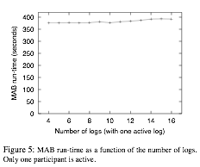
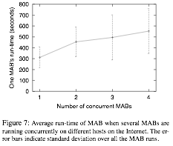
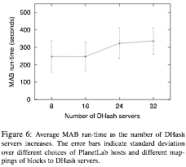
Evaluation
Many logs, one writer
Little impact: logs are fetched in parallel
Many DHash Servers
(host to servers avg rtt: 32ms)
Runtime grows due to rtf to servers
Many Writers
Runtime grows because participants fetch each other’s log heads

Slide 22
Discussion
Ivy does not reclaim log storage space
Ivy relies on logs to make updates. Discarding logs to reclaim space can hurt data security.
With storage getting cheaper now, this design decision may not turn out to be too expensive

Slide 23
Discussion
Ivy provides automatic, application-specific conflict resolution when partition heals.
Uses application tools for resolution
This may not work for all applications.

Slide 24
Discussion
160-bit i-numbers are generated randomly for files independently at each participant to minimize the probability of collision.
What if the same i-numbers are allocated for different files.

