Slide 1
GentleRain: Cheap and Scalable Causal Consistency with Physical Clocks
Jiaqing Du | Calin Iorgulescu | Amitabha Roy | Willy Zwaenepoel
École polytechnique fédérale de Lausanne (EPFL)
Published in the Proceedings of the 5th ACM Symposium on Cloud Computing, 2014
Presented By: Aditya Rastogi

Slide 2
GentleRain
A Geo-Replicated data store
Provides Causal Consistency
Motivation: No need for dependency check messages, use a single physical timestamp instead
Benefit: Achieve greater throughput
Tradeoff: Delayed visibility of updates at remote replicas

Slide 3
What is Causal Consistency ?
Strict Consistency
Causal Consistency
Eventual Consistency
Causal Consistency: Operations that are causally related ( happens before relationship ) are seen by every node in the same order.
From the point of view of a client : If a certain version of a data item is visible, then all of its causal dependencies ( all versions that happen before this version) are also visible.

Slide 4
Application ?
Social Network Updates
Order of display of unrelated status updates does not matter. (concurrent events)
But Comments in response to a post must not be shown before the post! (causally related events)

Slide 5
GentleRain Protocol
Timestamp all updates with physical clock value at originating server
Local updates are immediately visible
Remote updates are visible only when older than a global timestamp determined by Global Stable Timestamp (GST)
All updates across different partitions and replicas totally ordered by update timestamp

Slide 6
System Model
N partitions containing keys assigned by hash value
Each partition replicated by M replicas (datacenters)
Servers with physical clocks with monotonically increasing timestamps
Put(key,val) : Create / modify key
Get(key) : Get value for the key
Sn_read(keys) : Returns a causally consistent snapshot containing values for all the keys.
Ro_trx(keys) : Returns values for a causally consistent read only transaction

Slide 7
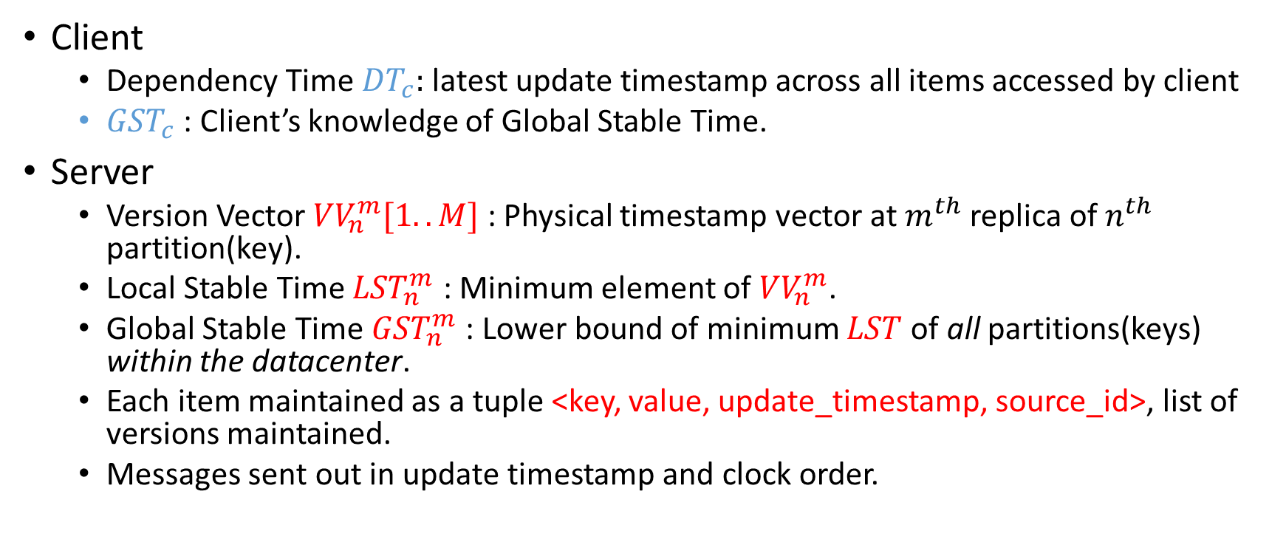
Client and Server States
Client
  Dependency Time ${DT}_{c}:$latest update timestamp across all items accessed by client
  ${GST}_{c}$ : Client’s knowledge of Global Stable Time.
Server
  Version Vector ${VV}_{n}^{m}[1..M]$ : Physical timestamp vector at $m^{th}$ replica of $n^{th}$ partition(key).
  Local Stable Time ${LST}_{n}^{m}$ : Minimum element of ${VV}_{n}^{m}$.
  Global Stable Time ${GST}_{n}^{m}$ : Lower bound of minimum $LST$ of all partitions(keys) within the datacenter.
  Each item maintained as a tuple <key, value, update_timestamp, source_id>, list of versions maintained.
  Messages sent out in update timestamp and clock order.

Slide 8








Get Operation (Local Reads)
$${GST}_{c}=5$$
$${GST}_{c}≔5(max⁡({GST}_{c},{GST}_{n}^{m}))$$
$${DT}_{c}=3$$
$${DT}_{c}:=4(max⁡({DT}_{c},ut))$$
Client
$$get(k, {GST}_{c}=5)$$
$$(b,ut=4, {GST}_{n}^{m}=5)$$
R1/Source
k
(#1,a,2)
(#2,b,4)
$${GST}_{n}^{m}=4$$
$${GST}_{n}^{m} :=5(max⁡({GST}_{c},{GST}_{n}^{m}))$$
R2
R3
Notes:
Client(assume it is the coordinator) sends get request with key and GSTc to replica
Server then updates its GST if its < GSTc
If the server is source replica ( i.e. the key was last updated here) then return the key and the server GST

Slide 9



Get Operation (Non-Local Reads)
$${GST}_{c}=5$$
$${GST}_{c}≔5(max⁡({GST}_{c},{GST}_{n}^{m}))$$
$${DT}_{c}=3$$
$${DT}_{c}:=2(max⁡({DT}_{c},ut))$$
Client
$$get(k, {GST}_{c}=5)$$
$$(b,ut=2, {GST}_{n}^{m}=5)$$
R1/Source
k
(#1,a,2)
(#2,b,6)
$${GST}_{n}^{m}=4$$
$${GST}_{n}^{m} :=5(max⁡({GST}_{c},{GST}_{n}^{m}))$$
R2
R3
Notes:
Client(assume it is the coordinator) sends get request with key and GSTc to replica
Server then updates its GST if its < GSTc
If the server is not source replica, then it gives the latest version < GSTs

Slide 10

















Put Operation
$${GST}_{c}=2$$
$${DT}_{c}=3$$
$${DT}_{c}≔5 (max⁡({DT}_{c},ut))$$
$${GST}_{c}=3$$
Client
$$put(k,c,{DT}_{c}=3)$$
$$(ut=5)$$
$$get(k, {GST}_{c}=3)$$
R1/Source
(#1,a,2)
(#2,b,4)
[4,7,6]
$$local clock=1$$
$local clock=5$>3
$$(a,ut=3, {GST}_{n}^{m}=3)$$
$$wait$$
$${VV}_{n}^{m} ≔[5(lc),7,6]$$
$$addkey(\#3,c,ut=5)$$
R2
(#1,a,3)
(#2,b,7)
[4,7,6]
$${VV}_{n}^{m} ≔[ut=5,7,6]$$
$${GST}_{n}^{m}=5$$
$$addkey(\#3,c,ut=5)$$
R3
(#1,a,3)
(#2,b,6)
[4,7,6]
$${VV}_{n}^{m} ≔[ut=5,7,6]$$
$$addkey(\#3,c,ut=5)$$
Notes:
Client(assume it is the coordinator) sends get request with key and DTc to replica
Server checks if DTc < Physical clock time, wait until it is so
Server updates its local copy and the version vector with the physical clock time.
Server sends a reply with the update time of the newly created item
Client sets its DT to be larger of the update time and the current DT
Server asynchronously replicates update to other servers
However reads from remote servers only become visible when GSTs > update timestamp

Slide 11












Snapshot Read (Across Partitions)
$${GST}_{c}=5$$
$${GST}_{c} :=6(max⁡({GST}_{c},gst′))$$
$${DT}_{c}=3$$
$${DT}_{c} :=3(max⁡({DT}_{c},ut′))$$
Client
$$sn_read([k,j], {GST}_{c}=5)$$
$$([a,A],ut^{′}=3, gst^{′}=5)$$
P1
k
(#1,a,3)
(#2,b,6)
$${GST}_{k}^{m}=4$$
$${GST}_{k}^{m} :=5(max⁡({GST}_{c},{GST}_{k}^{m}))$$
$$ut^{′}:=3\left(\max\left({ut}_{a}=3,{ut}_{A}=2\right)\right)$$
$$st:= {GST}_{k}^{m}=5$$
$$get(j, st=5)$$
$$gst^{′}:=6\left(\max\left(5,6\right)\right)$$
$$(A,ut=2, {GST}_{j}^{m}=6)$$
P2
j
(#1,A,2)
(#2,B,6)
$${GST}_{j}^{m}=6$$
$${GST}_{j}^{m}:=6(max⁡(6,5))$$
P3
replicas for
both k,j
Notes:
Client(assume it is the coordinator) sends get request with keys and GSTc to coordinating partition (replica for one of the requested keys)
Server then updates its GST if its < GSTc
Server initializes the snapshot time with latest GST at the server
Server then contacts other partitions to get other keys (like j)
At each partition , Latest item version with an update time < st is returned
The values , the update timestamp and the GST are sent back to coordinating partition
The coordinating partition, in its response, sets the update time to max of ut of all keys and the GST to be sent to the client
And return gst To the max of GSTs of all paritions(keys)
Note that GST can be different for different partitions

Slide 12








Read-Only Transactions
$${GST}_{c}=5$$
$${GST}_{c} :=max⁡({GST}_{c},gst′)$$
$${DT}_{c}=3$$
$${DT}_{c} :=max⁡({DT}_{c},ut′)$$
Client
$$ro_trx([k,j], {GST}_{c}=5,{DT}_{c}=3)$$
P1
k
(#1,a,3)
(#2,b,6)
$${GST}_{k}^{m}=2$$
$${ DT}_{c}−{GST}_{k}^{m}≤ α(=1)$$
$${GST}_{k}^{m}=4$$
$$Execute Snaphsot Read Protocol$$
$$wait for {GST}_{k}^{m} to ↑$$
P2
j
(#1,A,2)
(#2,B,6)
$$Execute RO transaction protocol Eiger et. al.$$
P3
replicas for
both k,j
Notes:
Client(assume it is the coordinator) sends get request with keys ,GSTc and DTc to coordinating partition (replica for one of the requested keys)
If the DTc is upto alpha ahead of GSTs, the server waits till GSTs > DTc and then initiates a snapshot protocol
Otherwise the server runs ro- protocol for causally consistent ro snapshots in Eiger[24]

Slide 13
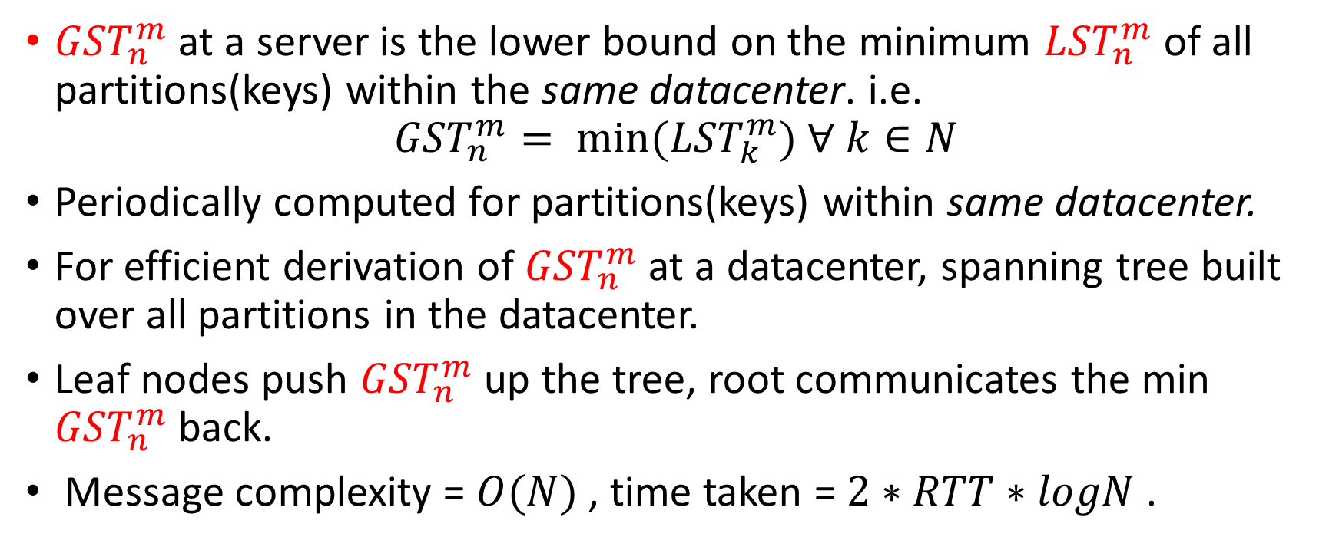
GST Derivation
${GST}_{n}^{m}$ at a server is the lower bound on the minimum ${LST}_{n}^{m}$ of all partitions(keys) within the same datacenter. i.e.
$${GST}_{n}^{m}= {min⁡(LST}_{k}^{m}) ∀ k∈N$$
Periodically computed for partitions(keys) within same datacenter.
For efficient derivation of ${GST}_{n}^{m}$ at a datacenter, spanning tree built over all partitions in the datacenter.
Leaf nodes push ${GST}_{n}^{m}$ up the tree, root communicates the min ${GST}_{n}^{m}$ back.
Message complexity = $O(N)$ , time taken = $2∗RTT∗logN$ .
Notes:
A spanning tree is built at startup for the datacenter.
Leaf nodes periodically send their GST to parent nodes , who aggregate the min and push it up the tree
The root then disseminates the GST to all the nodes

Slide 14
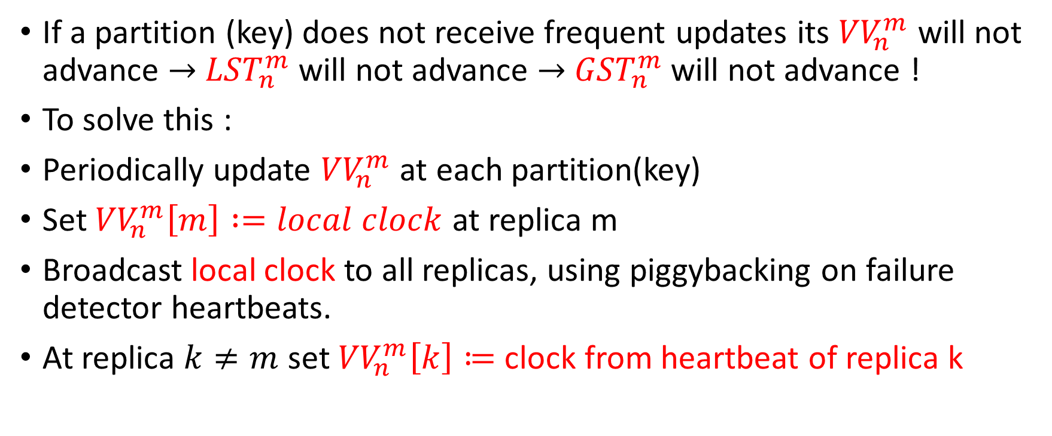
Heartbeats
If a partition (key) does not receive frequent updates its ${VV}_{n}^{m}$ will not advance $→$ ${LST}_{n}^{m}$ will not advance $→$ ${GST}_{n}^{m}$ will not advance !
To solve this :
Periodically update ${VV}_{n}^{m}$ at each partition(key)
Set ${VV}_{n}^{m}\left[m\right] :=local clock$ at replica m
Broadcast local clock to all replicas, using piggybacking on failure detector heartbeats.
At replica $k≠m$ set ${VV}_{n}^{m}\left[k\right]≔$ clock from heartbeat of replica k

Slide 15
Garbage Collection
Partitions within the same datacenter periodically exchange snapshot timestamp of oldest active snapshot read.
If a partition does not have any active snapshot read, it sends out GST.
Partitions choose minimum timestamp of all such snapshot timestamps for garbage collection.
Keep only the latest item versions just before this timestamp , discard earlier versions.

Slide 16
Conflict Detection
Remember, even in causal ordering, you can have concurrent events !
Conflict happens when causally unrelated updates to same key are done at two different replicas.
Updates that need to be replicated carry update time and source replica id of previous version.
Replicate operation at a server applied only if the previous version at server = previous version in replicate message.
Otherwise conflict reported to client which dictates the order of conflicting updates in a consistent manner across servers.

Slide 17
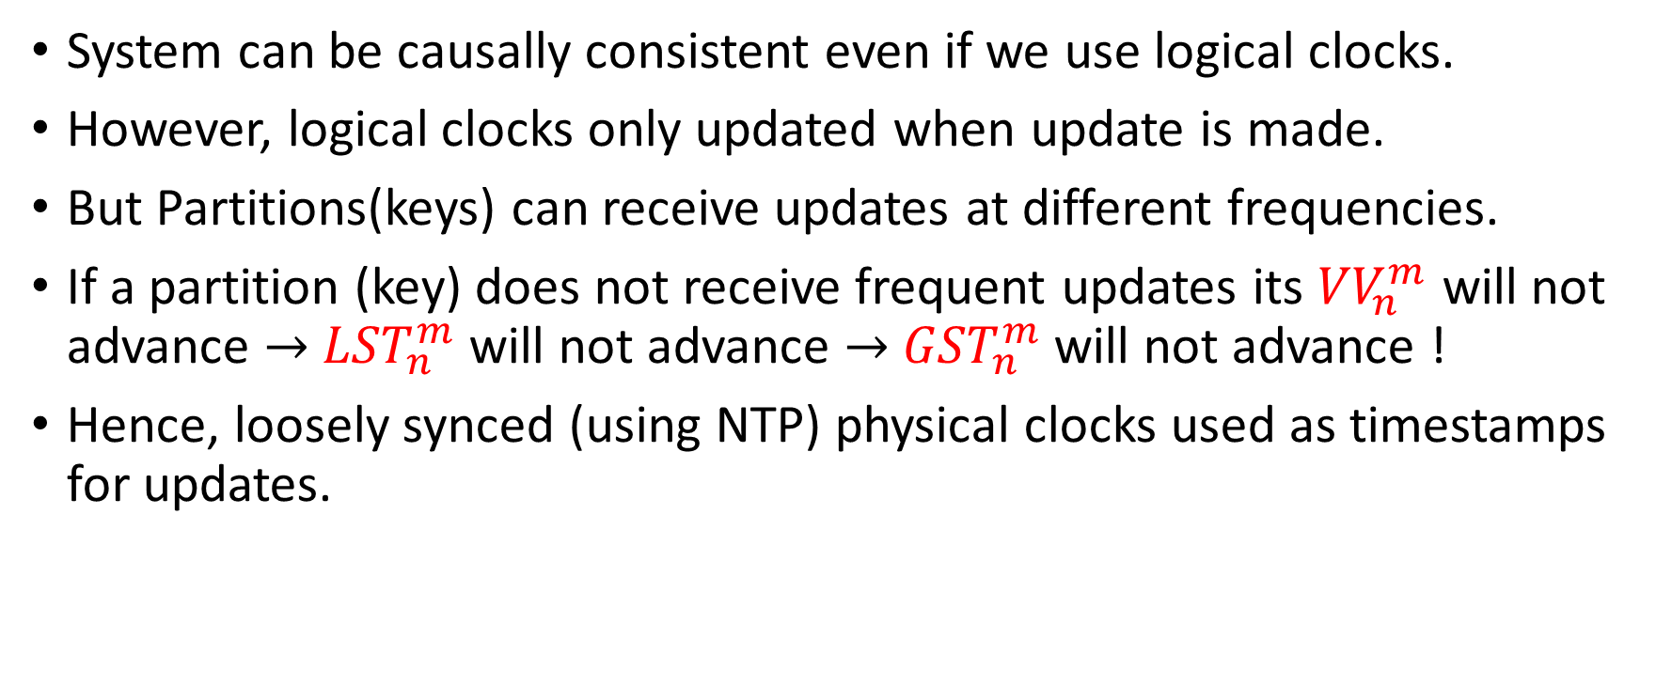
Why Physical Clocks?
System can be causally consistent even if we use logical clocks.
However, logical clocks only updated when update is made.
But Partitions(keys) can receive updates at different frequencies.
If a partition (key) does not receive frequent updates its ${VV}_{n}^{m}$ will not advance $→$ ${LST}_{n}^{m}$ will not advance $→$ ${GST}_{n}^{m}$ will not advance !
Hence, loosely synced (using NTP) physical clocks used as timestamps for updates.

Slide 18
Results
System Evaluated in terms of throughput and remote update visibility
Compared to data stores providing Eventual Consistency and Causal Consistency
Each partition replicated at three Amazon EC2 datacenters – Oregon (O), Ireland (I) and Virginia(V)

Slide 19
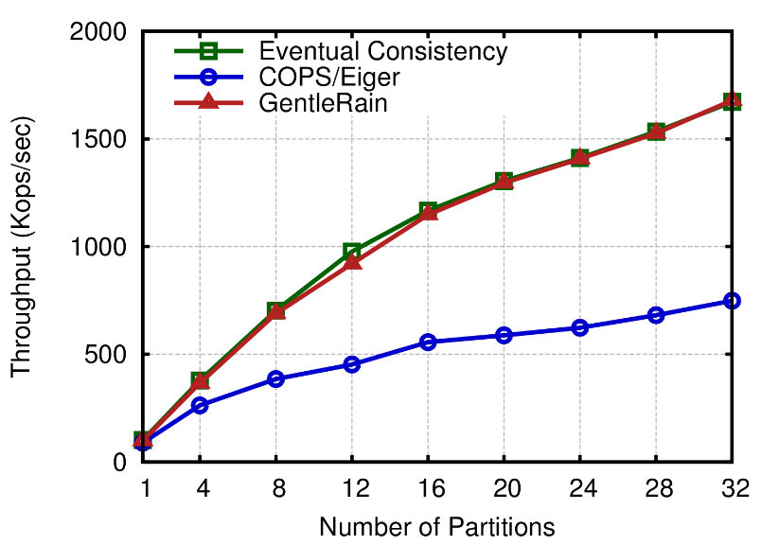
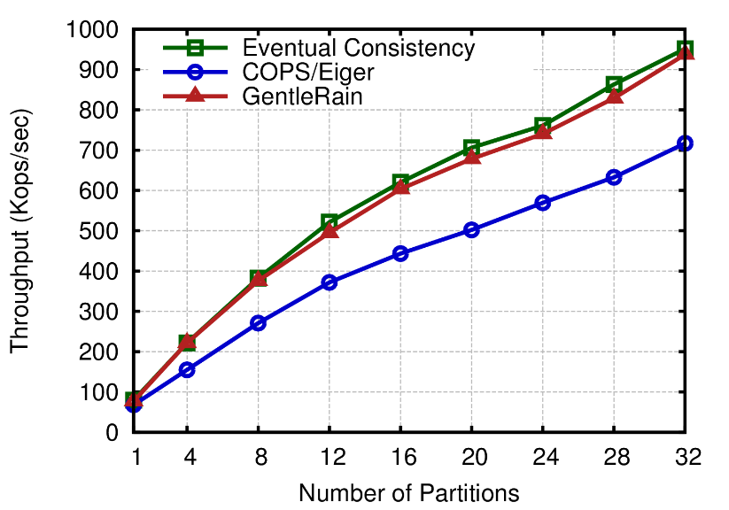
Results - Throughput
Left: Read a randomly selected item from every partition and update a randomly selected item at one partition.
  Much better throughput than COPS which needs to send dep-check messages to all partitions
Right: Update a randomly selected item in each partition in round-robin fashion
  GAP in throughput smaller due to lesser no of dep-check messages in COPS

Slide 20
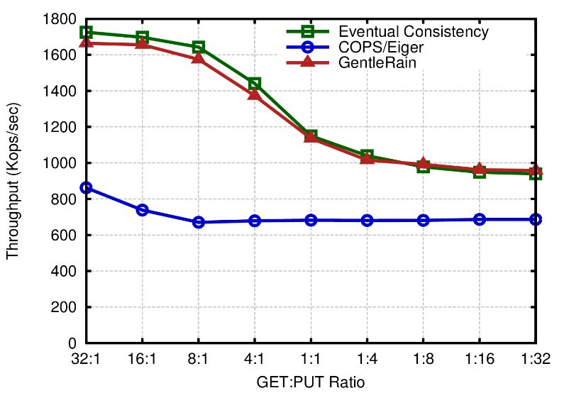
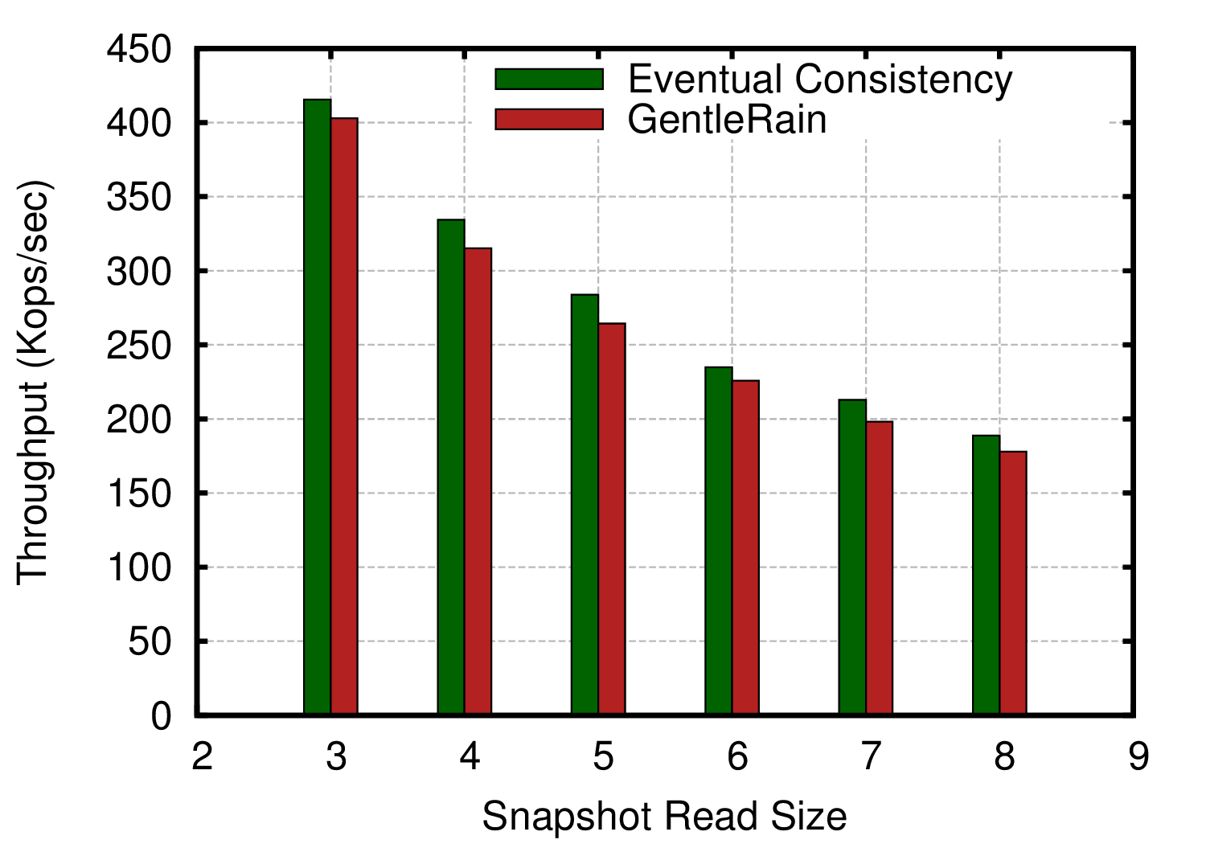
Results - Throughput
Left: Read N randomly selected items from randomly selected partitions and write one random item to each of M randomly selected partitions.
  GAP in throughput narrows as COPS does not need to track a lot of dependencies.
Right: Causally Consistent snapshot reads in GentleRain and reads in Eventually Consistent systems. Nearly identical throughput.

Slide 21
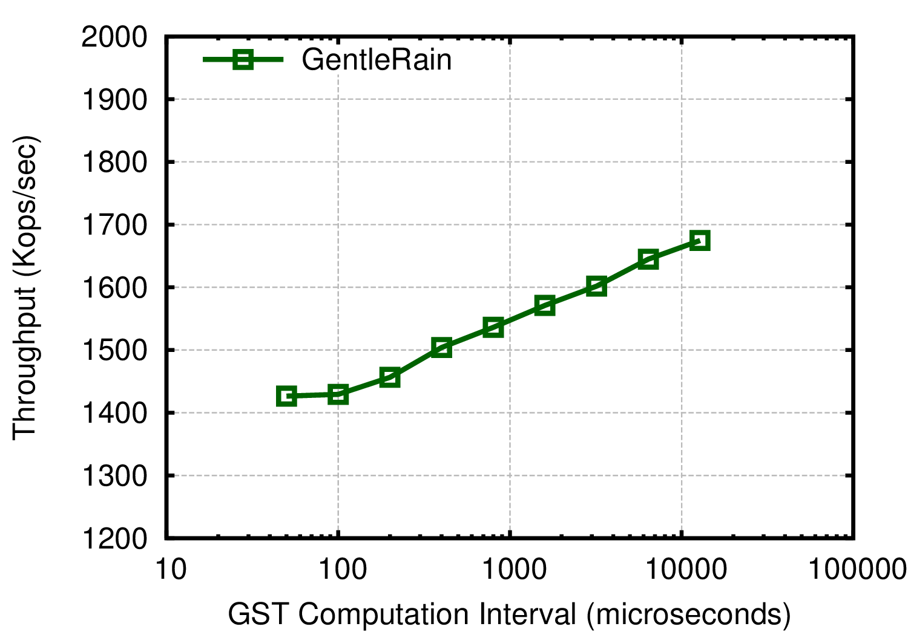
Results – Impact of GST update
Increasing the time between GST updates leads to marginal increase in Throughput.
Increase of 256x in GST causes increase of only 1.15x in throughput.
GST message exchange traffic contained within datacenter.

Slide 22
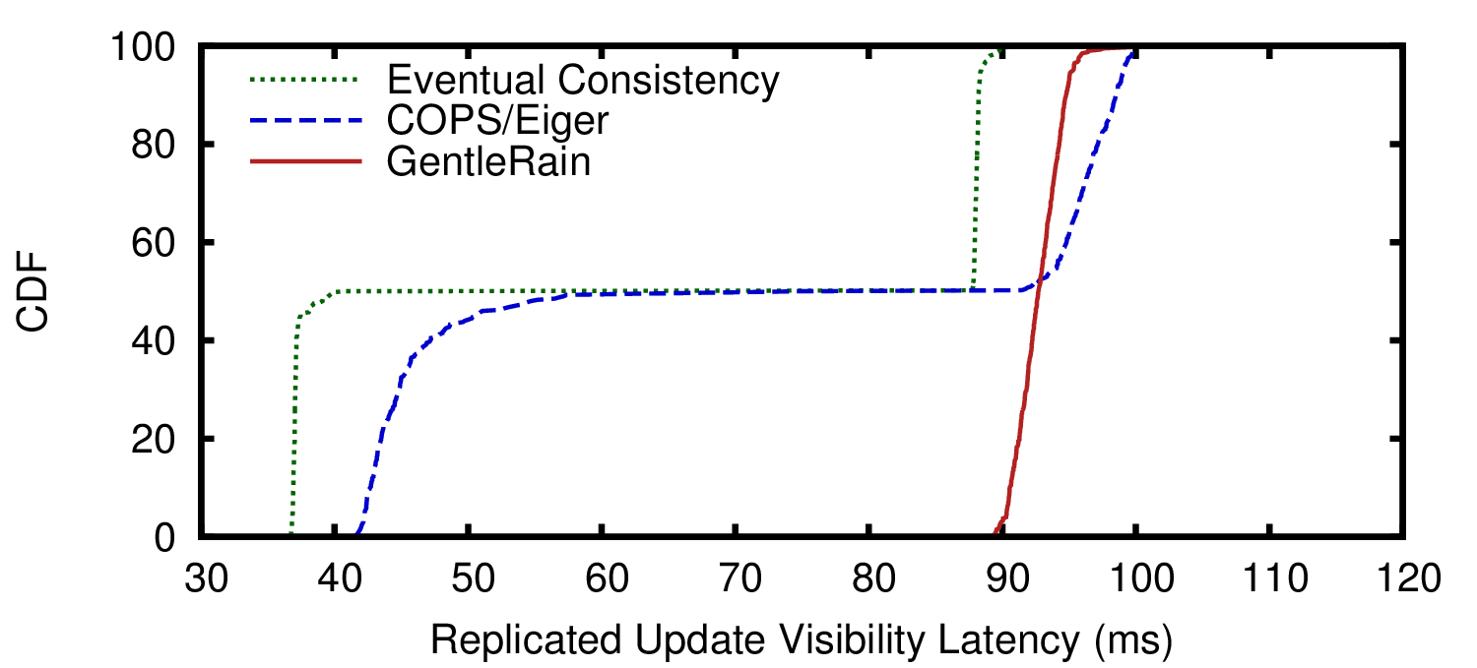
Results – Update Visibility Latency
Measured as the time difference between physical update time at the origin replica and the time when update becomes visible at remote replica.
Updates replicated from I & V to O
Update Visibility equal to longest network travel time ( between O & I)

Slide 23
Pros
Throughput comparable to Eventually consistent data stores .
Idea of using physical clocks instead of logical – system built on top of existing clock sync protocols like NTP
Message size and bandwidth savings through elimination of dependency check messages.
Conflict detection

Slide 24
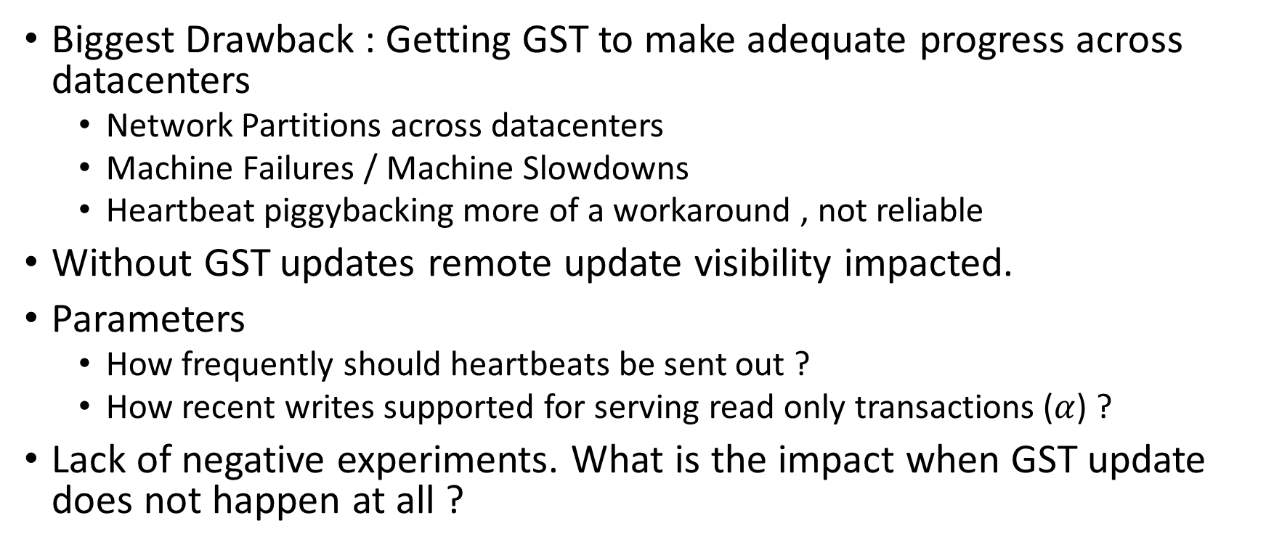
Improvements
Biggest Drawback : Getting GST to make adequate progress across datacenters
  Network Partitions across datacenters
  Machine Failures / Machine Slowdowns
  Heartbeat piggybacking more of a workaround , not reliable
Without GST updates remote update visibility impacted.
Parameters
  How frequently should heartbeats be sent out ?
  How recent writes supported for serving read only transactions ($α$) ?
Lack of negative experiments. What is the impact when GST update does not happen at all ?

Slide 25
Related Work
Spanner
  Serializable transactions with external consistency (defn)
  Relies on synchronized GPS and atomic clocks to bound time uncertainty
  Relies on the
COPS
  Used as baseline for comparison
  Implements causal consistency in partitioned replicated datastore.

Slide 26
Your Thoughts
Questions from Piazza - TBD

