Slide 1
f4: Facebook’s Warm BLOB Storage System
Vaijayanth Raghavan
(vraghvn2@Illinois.edu)

Slide 2



What is a Blob?
???
???

Slide 3
What is a Blob?
Binary Large Objects
Immutable binary data
Created once, read many times, never modified and sometimes deleted
Includes photos ,videos ,documents (visible to the user) and others like heap dumps, source code (internal to FB)
As of Feb 2014, 400 billion photos
(huge storage footprint)

Slide 4
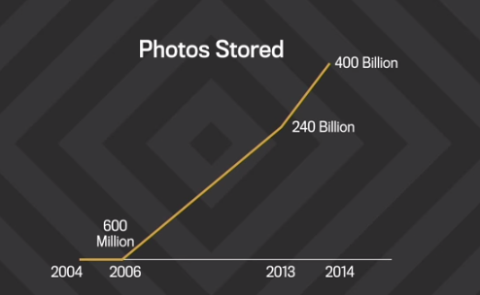
FB photo growth
400 billion and growing !!!

Slide 5
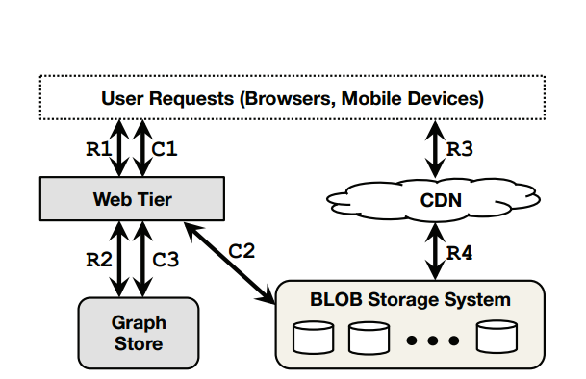
Overall architecture
Reduces load on storage system
Haystack and f4

Slide 6
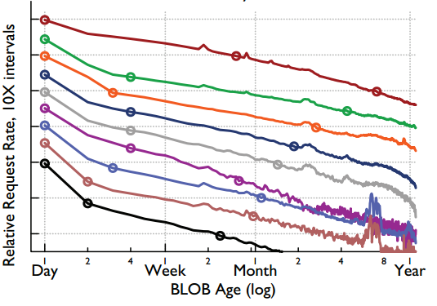
Why Warm Storage?
Presence of temperature zones
Two week-trace- random 0.1% reads, 10% creates, 10% deletes
Points in graph represent
decrease in request rates by an order of magnitude

Slide 7
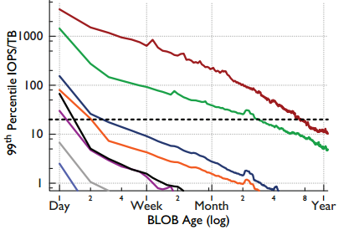
Hot or Warm?
When to move content to warm storage
7 of 9 content types- less than a week
Photos- three months, Profile photos- 1 year
Warm content continuing to grow

Slide 8
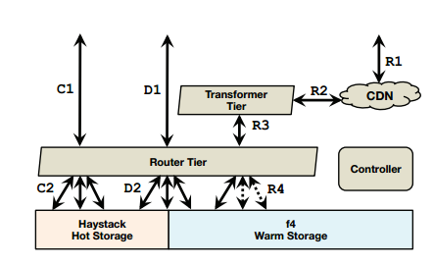
Overall Blob Storage Design
Creates and deletes handled by Haystack
Reads handled by either Haystack or f4

Slide 9
Overall Blob Storage Design
Controller- maintenance tasks, compaction,gc
Router Tier- hides storage implementation from clients, mapping information
Router tier enables addition of f4
Transformer tier- handles transformations like resizing and cropping photos, takes these away from the storage systems

Slide 10
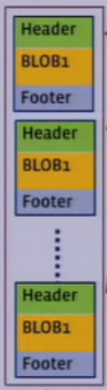
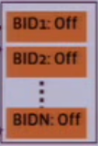
Hot Storage using Haystack
Volumes are series of blobs
Unlocked volumes: support reads, creates and deletes
Once 100GB reached, transitioned into locked and no longer allows creates
Volumes contain data file, index file and a journal file
In memory index
Volume

Slide 11
Hot Storage using Haystack
Creates only a small number of files (~100)
Bypasses underlying file system for most metadata access
Minimal set of metadata for identifying BLOBs, kept in memory
Reduces IOPS for metadata fetches
Fault tolerance to disk, host, rack and datacenter failure through triple replication of data and hardware RAID-6(1.2X replication)
Good fault tolerance and high throughput
But, effective-replication-factor 3*1.2=3.6 (not suitable for warm storage, which should be storage efficient !)

Slide 12
Warm Storage using f4
Design goal 1: Storage efficiency
Reduce the effective-replication-factor, while maintaining high degree of reliability and performance
Effective-replication-factor of 3.6 is too high
Design goal 2: Fault tolerance
Drive failure, at low single digit annual rate
Host failure, periodically
Rack failure, multiple times per year
Datacenter failures, very rare

Slide 13
F4 Cell
Basic building block of f4 storage
Entirely fits into a datacenter
Contains 14 racks of 15 hosts with 30 4TB drives per host
Treated as a single unit of acquisition and deployment.
Fault tolerant to disk, host and rack failures
Because of using Reed Solomon Encoding (next slide)
Components
  Name node
  Storage node
  Backoff node
  Rebuilder node
  Coordinator node

Slide 14
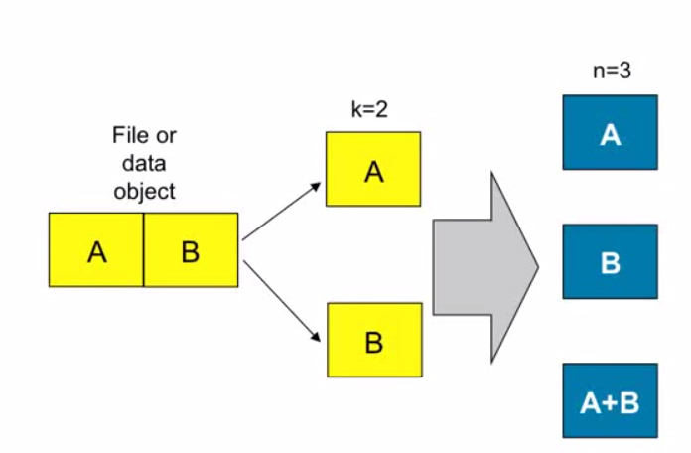
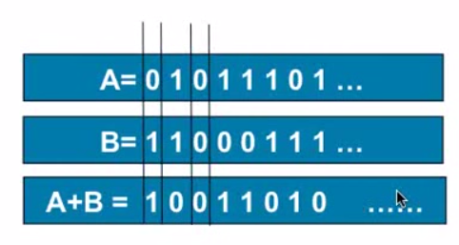
Simple Erasure Coding
A (n,k) erasure code provides a way to:
Take k blocks and generate n blocks of the same size
Any k of n sufficient to reconstruct the original k
Reed-Solomon a type of erasure code

Slide 15
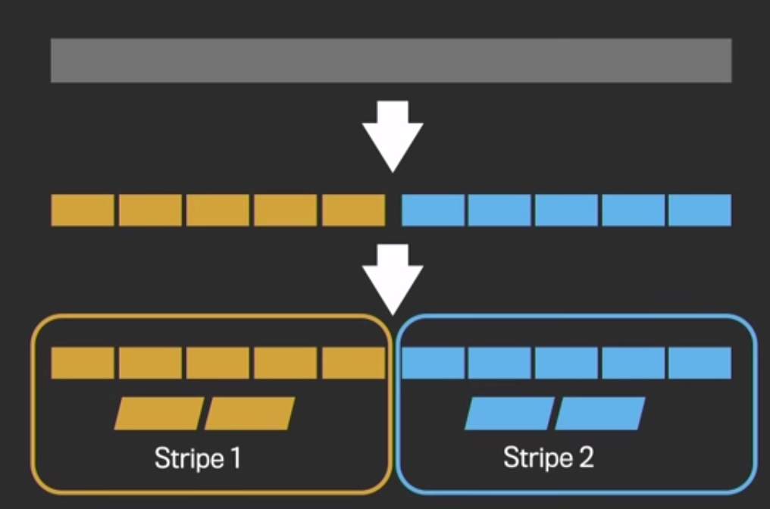
Reed Solomon Encoding
A popular eraser coding technique
Has effective replication factor of 1.4x
In production, RS(10,4) is used
Tolerates 4 rack failures, and therefore 4 disks/hosts
10 GB Volume
1GB Data blocks
Data blocks
Parity blocks

Slide 16
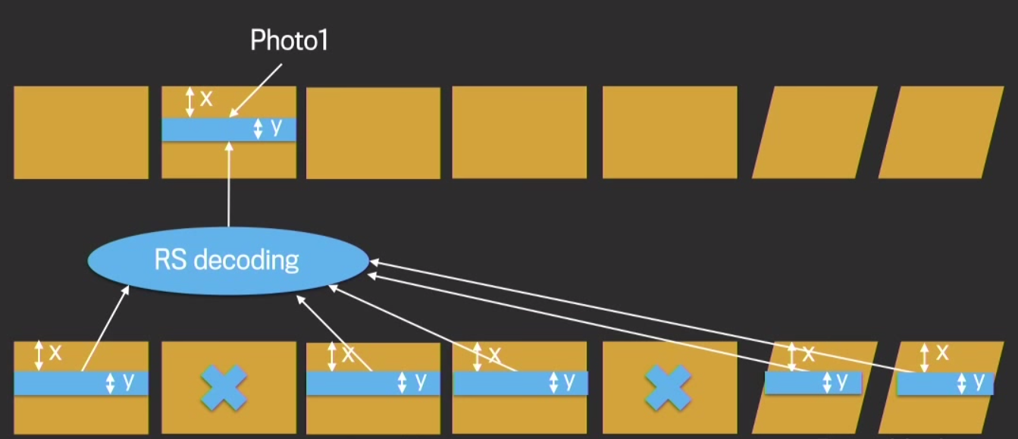
Reed Solomon Rebuilding
Recovery of a block in case of failure
Entire blocks not needed for recovery of a BLOB
X- Offset of photo1 in its block
Y- Size of Photo1

Slide 17
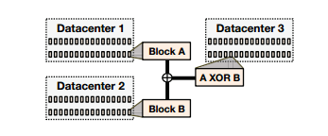
Geo-replication
Initially data center level double replication, resulting in effective replication factor of 2.8
Using XOR coding and accepting the tradeoff of reduced throughput for BLOBs stored at failed data center, effective replication factor reduced to 2.1

Slide 18
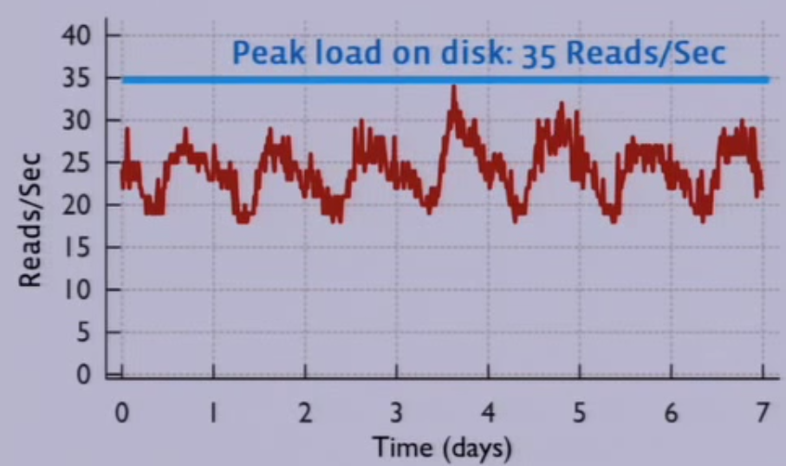
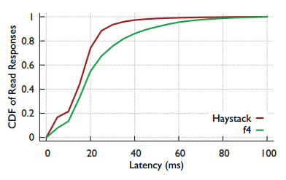
Evaluation
Peak load on the most overloaded cluster
Still < 80 Reads/sec

Slide 19
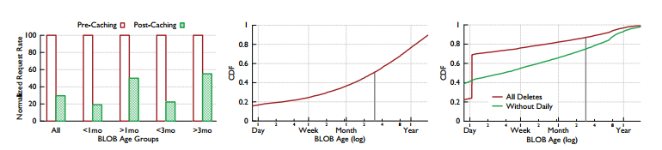
Evaluation

Slide 20
Evaluation summary
f4 able to handle near worst case loads with lower throughput
f4 is resilient to failure at all levels
f4 saves storage:
  Current corpus 65PB
  Saves 39PB for 2.8 erf
  Saves 87PB for 2.1 erf
f4 provides low latency for reads:
  Less than 30ms for 80%
  Less than 80ms for 99%

Slide 21

Comments or criticism
  Need to factor in the popularity of the profile, not solely based on the age
  What about the overhead of reconstruction done by backoff and rebuilder nodes
  Why is the transition to warm storage permanent?
  Ambiguous about the exact time period in which various BLOB types are moved to f4 from Haystack

