Slide 1
Heading off Correlated Failures through Independence-as-a-Service
Ennan Zhai, Ruichuan Chen, David Isaac Wolinsky, and Bryan Ford
Presenter: Ron Wright

Slide 2
Motivation
Cloud services depend on redundancy to ensure high reliability
However, components that appear to be independent may share subtle dependencies, leading to unexpected correlated failures
Redundant systems may contain risk groups (RGs), or sets of components that can cause a service outage if all the components fail simultaneously
Notes:
Two examples of cloud services that utilize redundancy in their system include Amazon S3 and iCloud. Amazon S3 uses multiple racks to replicate each data object, whereas iCloud rents infrastructure from multiple third-party providers, such as Amazon EC2 and Microsoft Azure, for redundancy purposes.

Slide 3
What Can Go Wrong?
The availabilities of racks A, B, and C all depend on the availability of the aggregation switch. This common dependency introduced an unexpected RG.
Service
Service
Service
Service
Aggregation Switch
Rack A
Rack B
Rack C
Service
Service
Service
Notes:
Suppose you have a service and three racks A, B, and C. The service is replicated among the three racks, but often overlooked among service providers is a shared infrastructure component such as an aggregation switch. If the switch fails, then the service is considered to have failed. The availabilities of racks A, B, and C all depend on the availability of the aggregation switch, and the switch is nevertheless a single point of failure. This common dependency introduced an unexpected RG, which is a smaller than expected RG. Despite redundancy efforts, unexpected RGs can disable the entire service.

Slide 4
Documented Examples
Amazon AWS
  One glitch on an EBS server disabled entire service across Amazon’s US-East region
  This, in turn, caused correlated failures among EC2 instances utilizing the EBS server, which disabled applications designed for EC2 redundancy
Google Storage
  “Close to 37% of failures are truly correlated”
  No tools to identify failure correlations systematically
iCloud
  A storm in Dublin disabled both Amazon and Microsoft clouds in that region for hours

Slide 5
Independence-as-a-Service (INDaaS)
Architecture that proactively collects and audits structural dependency data to evaluate independence of redundant systems before any failures occur
  Dependency acquisition modules collect dependency data
  Auditing modules quantify independence of redundant systems and pinpoint common dependencies that may cause correlated failures

Slide 6
Main Contributions
Evaluates independence of redundant systems before or during deployment
Provides fault graph analysis to enable the evaluation of dependencies at multiple levels of detail
Uses scalable fault graph analysis
Supports efficient PIA through private set intersection cardinality
Provides realistic case studies with a prototype implementation
Notes:
PIA = Private Independence Auditing

Slide 7
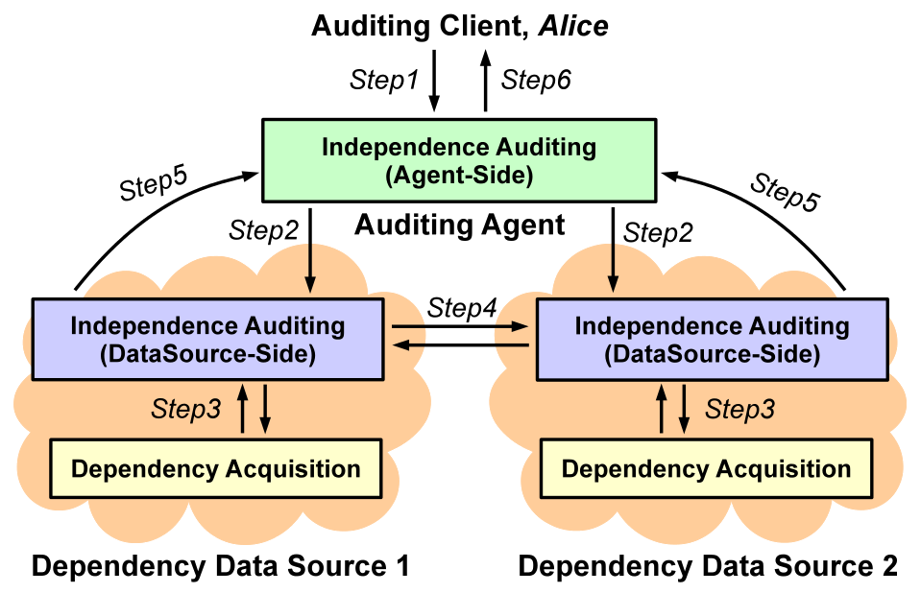
Architecture
Notes:
Auditing client
Auditing agent for independence auditing
Independence auditing

Slide 8
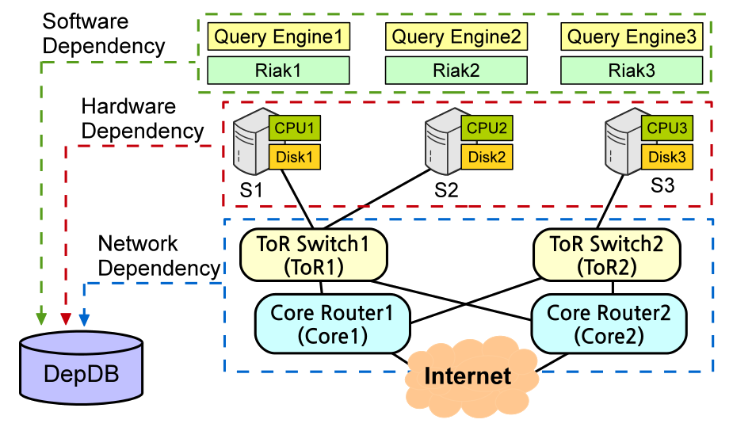
Dependency Data Representation
Type | Dependency Expression
Network | <src=“S” dst=“D” route=“x,y,z”/>
Hardware | <hw=“H” type=“T” dep=“x”/>
Software | <pgm=“S” hw=“H” dep=“x,y,z”/>
Hardware dependencies of S1 and S2:
<hw="S1" type="CPU" dep="S1-Intel(R)X5550@2.6GHz"/>
<hw="S1" type="Disk" dep="S1-SED900"/>
<hw="S2" type="CPU" dep="S2-Intel(R)X5550@2.6GHz"/>
<hw="S2" type="Disk" dep="S2-SED900"/>
Network dependencies of S1 and S2:
<src="S1" dst="Internet" route="ToR1,Core1"/>
<src="S1" dst="Internet" route="ToR1,Core2"/>
<src="S2" dst="Internet" route="ToR1,Core1"/>
<src="S2" dst="Internet" route="ToR1,Core2"/>
Software dependencies of S1 and S2:
<pgm="QueryEngine1" hw="S1" dep="libc6,libgccl">
<pgm="Riak1" hw="S1" dep="libc6,libsvn1">
<pgm="QueryEngine2" hw="S2" dep="libc6,libgccl">
<pgm="Riak2" hw="S2" dep="libc6,libsvn1">

Slide 9
Structural Independence Auditing (SIA)
Assumes data sources are willing to share full dependency data with each other
Involves generating a dependency graph, finding and ranking risk groups, and generating an audit report
Notes:
Useful for Amazon because they use multiple racks that they own and don’t rely on multiple cloud providers

Slide 10
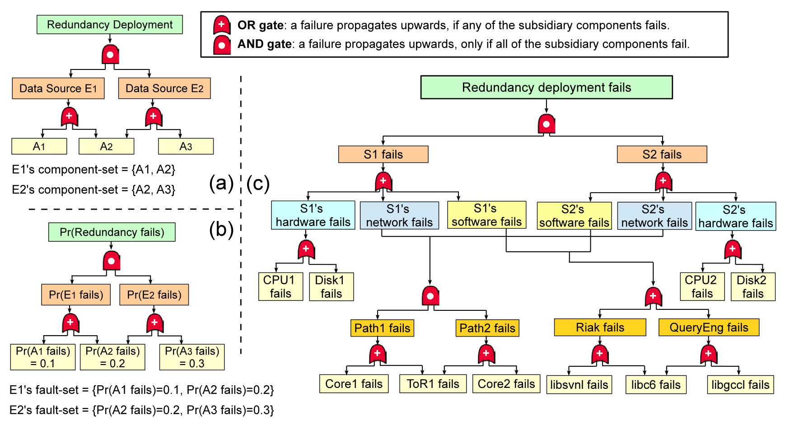
Dependency Graph
top event
1
intermediate
events
2
3
3
4
4
5
6
basic
events
(a) Component-set (b) Fault-set (c) Fault graph
Notes:
Component set: Most fundamental concepts are components
Fault set: Add weights to each component
Fault graph: Introduces more level of detail
To construct the dependency graph:
Find failure of entire deployment and make it the top of the graph
Obtain dependency information from DepDB
Each server failure event represented as child node of top event
AND gate connects top event with child nodes representing redundant servers
Obtain network, hardware, and software dependencies from DepDB, connect with OR gate
Connect hardware event with deps’ failure events using OR gate
Connect network event with deps’ failure events
Connect software event with deps’ failure events

Slide 11
Risk Groups in Dependency Graphs
{A1, A3}
{A1, A2}
minimal
RGs
{A1, A2, A3}
{A2}
{A2, A3}
{TOR1 fails}
{Core1 fails, Core2 fails}
(a) Component-set (b) Fault-set (c) Fault graph

Slide 12
Algorithms for Finding Risk Groups
Minimal RG algorithm
  Directly computes minimal RGs using reverse breadth-first traversal
  Pros
    Results are exact
  Cons
    Algorithm is NP hard!
Failure sampling algorithm
  Randomly assigns 0s and 1s to basic events to test for deployment failure and generate the appropriate RGs
  Pros
    Linear time complexity
  Cons
    Non-deterministic
    No guarantee that any RG is minimal

Slide 13
Ranking Risk Groups
Size-based ranking
  Ranks RGs based on the number of components in each RG
  The smaller the number of components in the RG, the higher the rank
Failure probability ranking
  Ranks RGs based on their relative importance,
  I_{c} = Pr(C) / Pr(T)
    Pr(C) represents probability of any given failure event C
    Pr(T) represents probability of any given failure event T
  Pr(T) computed by inclusion-exclusion principle involving all minimal RGs of T

Slide 14
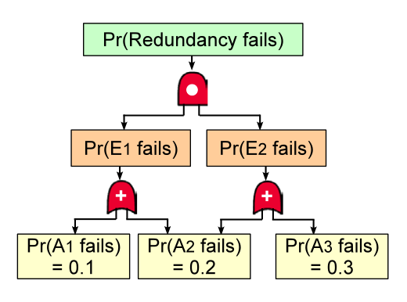
Failure Probability Ranking Example
Pr(T) = Pr(A1 and A3 fail, or A2 fails) = 0.1 · 0.3 + 0.2 – 0.1 · 0.3 · 0.2 = 0.224
I_{A2 fails} = Pr(A2 fails) / Pr(T) = 0.2 / 0.224 = 0.8929
I_{A1 fails, A3 fails} = Pr(A1 fails, A3 fails) / Pr(T) = 0.1 · 0.3 / 0.224 = 0.1339
Therefore, the RG {A2 fails} is ranked higher than the RG {A1 fails, A3 fails}.

Slide 15

Generating the Audit Report
Let R denote a specific redundancy deployment
Let c_{i} denote the i-th RG in R’s RG-ranking list
Size-based ranking algorithm
  $indep\left(R\right)=\sum_{i=1}^{n}{size(c_{i})}$
Failure probability ranking algorithm
  $indep\left(R\right)=\sum_{i=1}^{n}{I_{c_{i}}}$
Computed independence scores, returned to the client, can be used to choose the most independent deployment for a particular service, for example

Slide 16
Private Independence Auditing (PIA)
Allows auditing to take place, even across two cloud providers unwilling to share full dependency data with each other
Trust assumptions
  Auditing clients may be malicious and would like to know as much as possible about the providers’ dependency data
  Cloud providers and auditing agents are honest but curious
  No collusion among cloud providers and auditing agents
Notes:
Useful for iCloud because they rely on multiple cloud providers
Two approaches
Secure multi-party computation (SMPC)
Compute & reveal overlap of multiple cloud providers without revealing any data
Poor scalability in practice
Private set intersection cardinality
Operates only at component-set level of detail
Jaccard similarity used to quantify independence of configurations

Slide 17
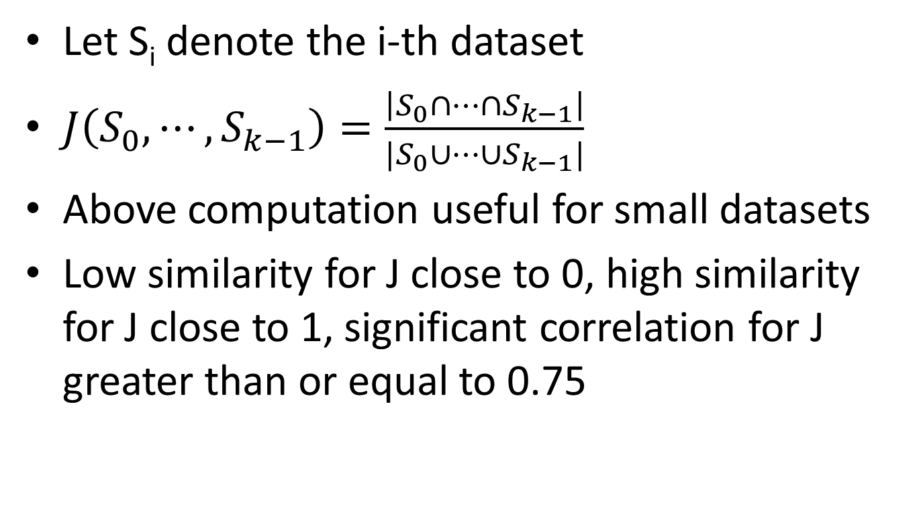
Jaccard similarity
Let S_{i} denote the i-th dataset
$J\left(S_{0},⋯,S_{k−1}\right)=\frac{\left|S_{0}∩⋯∩S_{k−1}\right|}{|S_{0}∪⋯∪S_{k−1}|}$
Above computation useful for small datasets
Low similarity for J close to 0, high similarity for J close to 1, significant correlation for J greater than or equal to 0.75

Slide 18
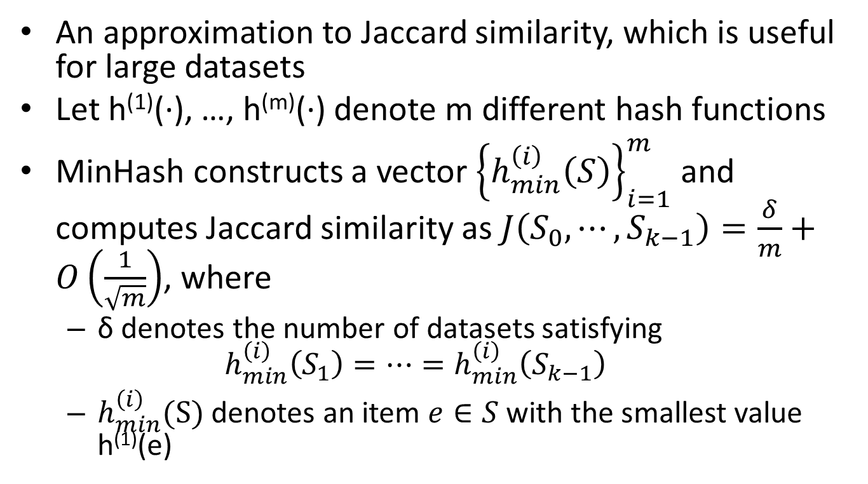
MinHash
An approximation to Jaccard similarity, which is useful for large datasets
Let h⁽¹⁾(·), …, h^{(m)}(·) denote m different hash functions
MinHash constructs a vector ${\left\{h_{min}^{\left(i\right)}\left(S\right)\right\}}_{i=1}^{m}$ and computes Jaccard similarity as $J\left(S_{0},⋯,S_{k−1}\right)=\frac{δ}{m}+O\left(\frac{1}{\sqrt{m}}\right)$, where
  δ denotes the number of datasets satisfying
  $h_{min}^{\left(i\right)}\left(S_{1}\right)=⋯=h_{min}^{\left(i\right)}\left(S_{k−1}\right)$
  $h_{min}^{\left(i\right)}(S)$ denotes an item $e∈S$ with the smallest value h⁽¹⁾(e)

Slide 19































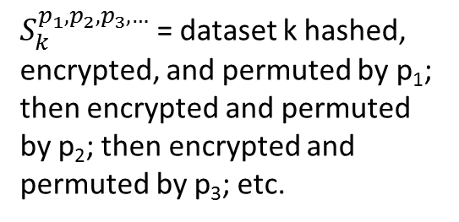






P-SOP
Key assumptions:
Each party encrypts the datasets using commutative encryption
Each party permutes its dataset elements using a fixed permutation function
All parties agree on the same hash function
$$S_{1}$$
$$S_{1}^{A}$$
$$S_{4}^{D}$$
$$S_{4}^{D,A}$$
$$S_{3}^{C,D}$$
$$S_{3}^{C,D,A}$$
$$S_{2}^{B,C,D}$$
$$S_{2}^{B,C,D,A}$$
Alice
$$S_{4}$$
$$S_{4}^{D}$$
$$S_{1}^{A,B,C,D}$$
$$S_{2}^{B,C,D,A}$$
$$S_{2}$$
$$S_{2}^{B}$$
$$S_{3}^{C}$$
$$S_{3}^{C,D}$$
Dave
$$S_{3}^{C,D,A,B}$$
$$S_{4}^{D,A,B,C}$$
Bob
$$S_{1}^{A}$$
$$S_{1}^{A,B}$$
$$S_{2}^{B,C}$$
$$S_{2}^{B,C,D}$$
All parties share the above datasets with each other
$$S_{4}^{D,A}$$
$$S_{4}^{D,A,B}$$
$$S_{1}^{A,B,C}$$
$$S_{1}^{A,B,C,D}$$
$$S_{3}^{C,D,A}$$
$$S_{3}^{C,D,A,B}$$
$S_{k}$ = the original dataset k
Carol
$S_{k}^{p_{1},p_{2},p_{3},…}$ = dataset k hashed, encrypted, and permuted by p₁; then encrypted and permuted by p₂; then encrypted and permuted by p₃; etc.
$$S_{3}$$
$$S_{3}^{C}$$
$$S_{2}^{B}$$
$$S_{2}^{B,C}$$
$$S_{1}^{A,B}$$
$$S_{1}^{A,B,C}$$
$$S_{4}^{D,A,B}$$
$$S_{4}^{D,A,B,C}$$
Notes:
All parties form a logical ring.
Each party has its own public/private key pair for commutative encryption.
Let E_{X}(M) be X’s public key to encrypt message M. Commutative encryption satisfies $E_{K}\left(E_{J}\left(M\right)\right)=E_{J}\left(E_{K}\left(M\right)\right)$

Slide 20
Dependency Graph & Audit Report
Each provider first generates local dependency graph at component-set level
Each provider normalizes generated component-set S_{i} using two types of components with common correlated failures
  Third-party routing elements (e.g., ISP routers)
    Accessible IP addresses used as unique identifiers
  Third-party software packages (e.g., OpenSSL)
    Standard names plus software versions used as unique identifiers
Report consists of rankings of Jaccard similarities

Slide 21

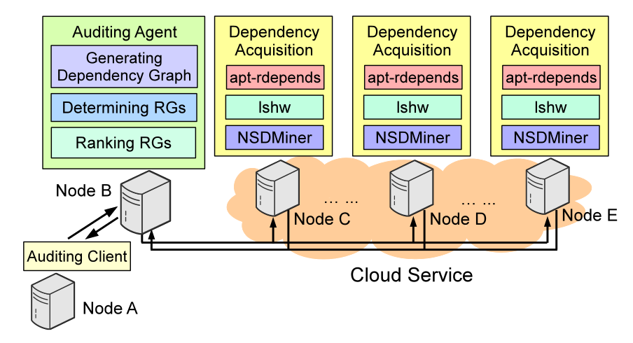
SIA Implementation & Deployment
with NetworkX
SSH links
On each dependency acquisition node:
NSDMiner used for network dependencies
lshw used for hardware dependencies
apt-rdepends used for software dependencies

Slide 22
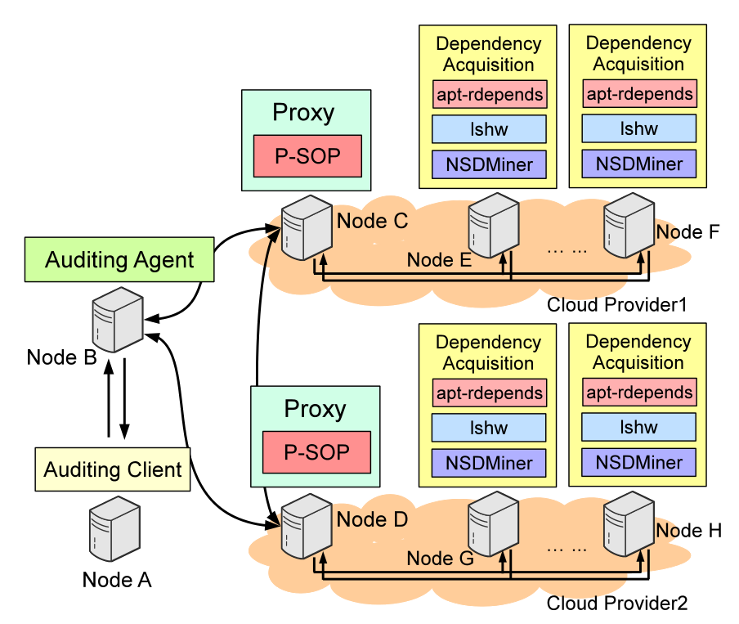

PIA Implementation & Deployment
with NetworkX
SSH links

Slide 23
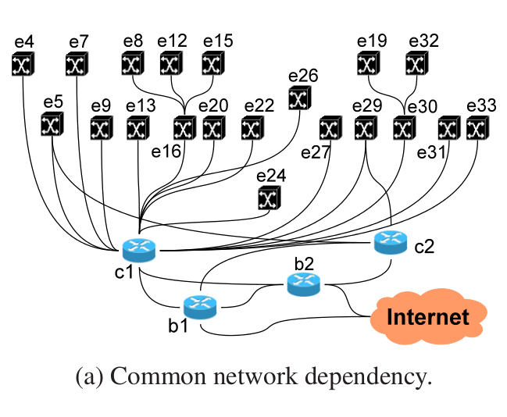
Network Dependency Case Study
Racks
Switches
{Rack 5, Rack 29} most independent deployment
Notes:
The purpose of the case studies is to examine the practicality of INDaaS.

Slide 24
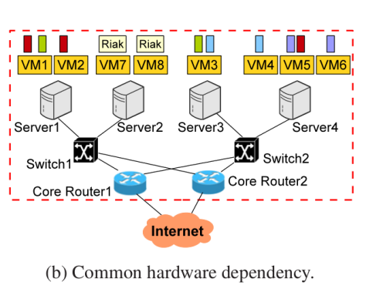
Hardware Dependency Case Study
Top-ranking RGs:
1. {Server2}
2. {Switch1}
3. {Core1, Core2}
4. {VM7, VM8}

Slide 25
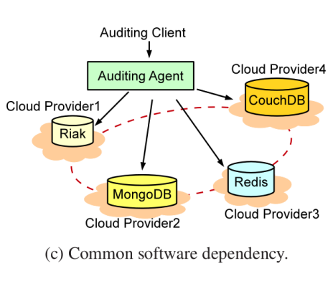
Software Dependency Case Study
Rank | 2-Way Redundancy | Jaccard
1 | Cloud2 & Cloud4 | 0.1419
2 | Cloud2 & Cloud3 | 0.1547
3 | Cloud1 & Cloud4 | 0.2081
4 | Cloud1 & Cloud3 | 0.2939
5 | Cloud3 & Cloud4 | 0.3489
6 | Cloud1 & Cloud2 | 0.5059
Rank | 3-Way Redundancy | Jaccard
1 | Cloud2 & Cloud3 & Cloud4 | 0.1128
2 | Cloud1 & Cloud2 & Cloud4 | 0.1207
3 | Cloud1 & Cloud3 & Cloud4 | 0.1353
4 | Cloud1 & Cloud2 & Cloud3 | 0.1536
Notes:
For 2-way redundancy deployment, Clouds 2 and 4 rank lowest (with greatest independence), and Clouds 1 and 2 rank highest (with smallest independence).
For 3-way redundancy deployment, Clouds 2, 3, and 4 rank lowest, and Clouds 1, 2, and 3 rank highest, although, as seen by the Jaccard similarities, 3-way redundancy is less likely to contain correlated failures than 2-way redundancy.

Slide 26
Performance Evaluation Configuration
Performance of INDaaS was evaluated on 40 workstations containing Intel Xeon Quad Core HT 3.7 GHz CPUs and 16 GB of RAM.
 | Topology A | Topology B | Topology C
# switch ports | 16 | 24 | 48
# core routers | 64 | 144 | 576
# agg switches | 128 | 288 | 1,152
# ToR switches | 128 | 288 | 1,152
# servers | 1,024 | 3,456 | 27,648
Total # of devices | 1,344 | 4,176 | 30,528

Slide 27
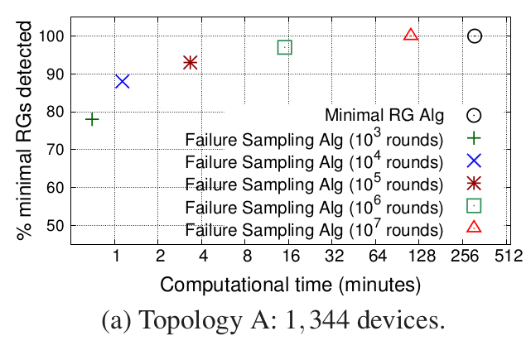
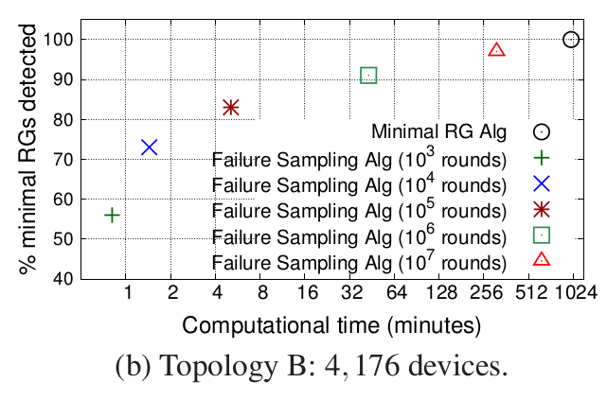
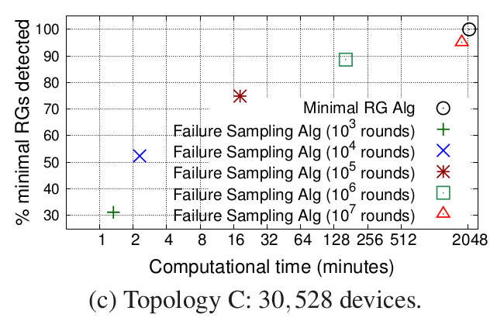
SIA Performance Evaluation Results
(Roughly) linear computation performance seen for failure sampling algorithm in all topologies
Tradeoff exists between linear time complexity and logarithmic percentage of minimal RGs detected
Notes:
On y-axis for all plots: percentage of minimal RGs detected
On x-axis for all plots: computational time in minutes
In topologies A and B, we can easily see roughly linear computation performance for failure sampling algorithms with respect to the number of rounds. But at the same time, we can easily see a tradeoff between this and the logarithmic percentage of minimal RGs detected.

Slide 28
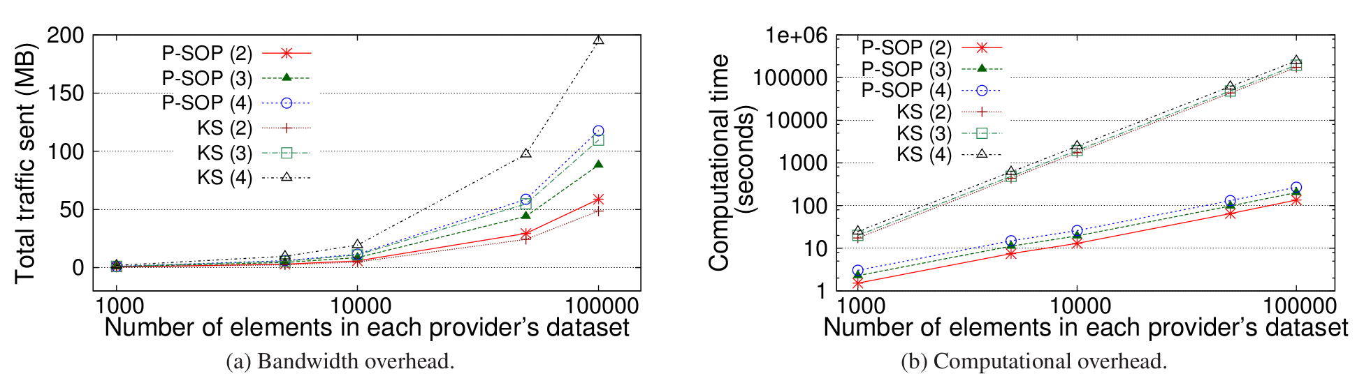
PIA Performance Evaluation Results
1024-bit keys were used for all types of encryption
P-SOP consistently outperforms KS computation-wise.
Large overhead difference
KS
P-SOP
Small overhead difference
Notes:
On y-axis of plot for bandwidth overhead: Total traffic sent in megabytes
On y-axis of plot for computation overhead: Computation time in seconds for computation overhead
On x-axis of both plots: Number of elements in each provider’s dataset
KS = Kissner and Song
Cryptographic operations main source of bottleneck

Slide 29
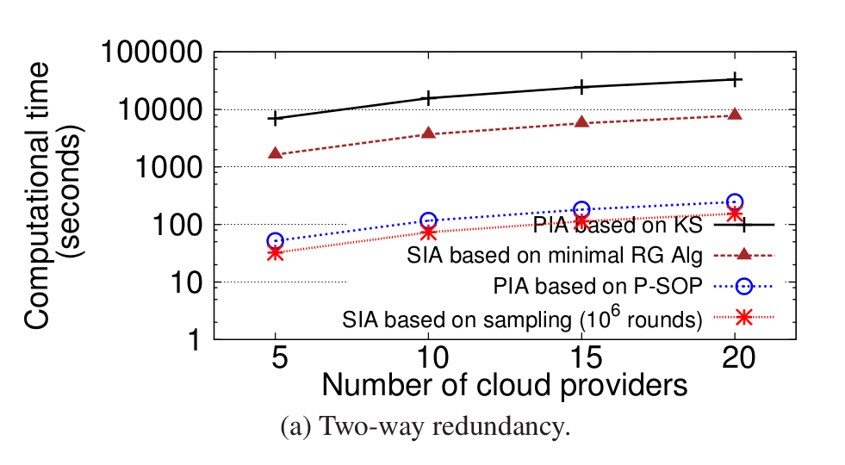
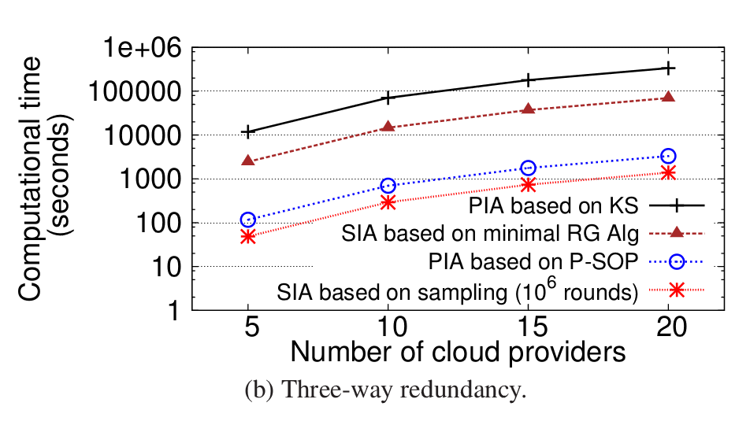
Comparing Performance of SIA & PIA
In both cases
P-SOP outperforms KS
10⁶ rounds of random sampling outperform minimal RG algorithm
Minimal RG algorithm and KS do not scale well
Large overhead
Small overhead
Large overhead
Small overhead
Notes:
Performance of SIA and PIA was studied for two-way redundancy and three-way redundancy.
On y-axis for both plots: Computation time in seconds
On x-axis for both plots: Number of cloud providers

Slide 30
Comments & Criticisms
Pros
  Risk group ranking makes it easy for users to identify potential correlated failures in deployment configurations
  Flexible in allowing cloud providers to decide whether to share their dependency data with other cloud providers
Cons
  For large enough deployments, in some cases, failure sampling algorithm may run longer with much fewer minimal RGs than the minimal RG algorithm
  Cannot be used for complex dependency acquisition
  Trust assumptions may not hold in reality (e.g., cloud providers may behave maliciously)
  Cannot have fault-set level dependency graphs and failure probability-based ranking without accurate failure probability information
  INDaaS is not fault tolerant in itself (e.g., the P-SOP nodes in PIA and the auditing agent are single points of failure)

Slide 31
Piazza Comments & Criticisms
Pros
  Dependency acquisition modules are pluggable
  Fault graphs serve as intuitive models
  Useful for people who have no prior knowledge of correlated failures in system
Cons
  Only considers static dependencies
  Failure probabilities, required by INDaaS, may be difficult to obtain, and their accuracy is questionable
  Cloud providers may not have enough incentives to share data
  Auditing is time-consuming

Slide 32
Thank you!

Slide 33
BACKUP SLIDES

Slide 34
Minimal RG Algorithm
End
Yes
Gather all basic events
Enqueue basic events into initially empty Q
Is Q empty?
No
Dequeue front event from Q
Start
Were the event’s RGs already generated?
Yes
Generate RG containing only the basic event
Does event represent basic event?
No
Yes
No
Advantage
Results are exact.
Enqueue all parent events into Q if any exist
Is input gate of event OR?
Add all RGs from children
Yes
Disadvantage
Algorithm is NP hard!
No
Add all RGs resulting from all possible combinations of Cartesian products of children’s RGs
Is input gate of event AND?
Assertion failure!
Yes
No

Slide 35
Failure Sampling Algorithm
Yes
Gather all basic events
Enqueue basic events into initially empty Q
Is Q empty?
No
Dequeue front event from Q
Start
No
End
Add RG containing basic events assigned 1 values if top event has value 1
Terminate?
Yes
Does the event have a value?
Yes
Does event represent basic event?
No
Randomly assign 1 or 0 as its value
Yes
Advantage
Linear time complexity
No
Enqueue all parent events into Q if any exist
Is input gate of event OR?
Disadvantages
Non-deterministic
No guarantee that any RG is minimal
Set value as OR of all children’s values
Yes
No
Set value as AND of all children’s values
Is input gate of event AND?
Assertion failure!
Yes
No

