Slide 1
Adaptive Stream Processing using Dynamic Batch Sizing
Tathagata Das, Yuan Zhong, Ion Stoica, Scott Shenker

Slide 2
Big Data- The 3 V’s

Slide 3
Batched stream Processing
Batch interval – Size of the batch in seconds
Examples: Comet, Spark Streaming
Run streaming computations as a number of short, deterministic batch jobs
Spark- State between batches kept in memory as Resilient Distributed Datasets

Slide 4
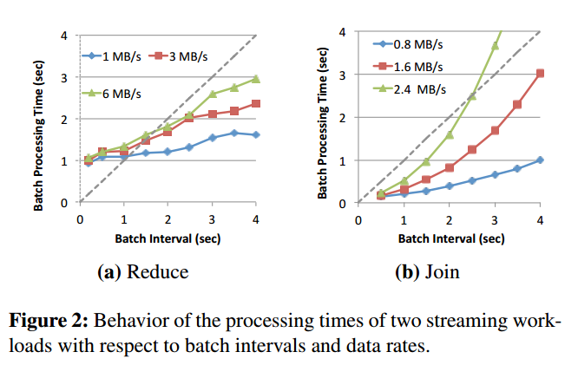
Latency = Batching delay + Queueing delay + Processing time
Lower batch intervals lead to lower latency
Stability- batch processing time must not exceed the batch interval
Stability Condition Line

Slide 5
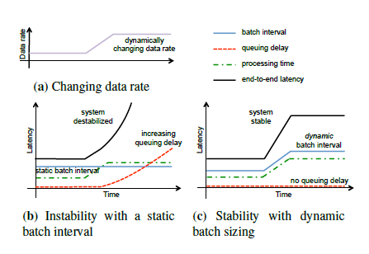
Static batch intervals- Offline Learning
Limitations
Specific to cluster resources
Unpredictable changes in incoming
data rates hard to model

Slide 6
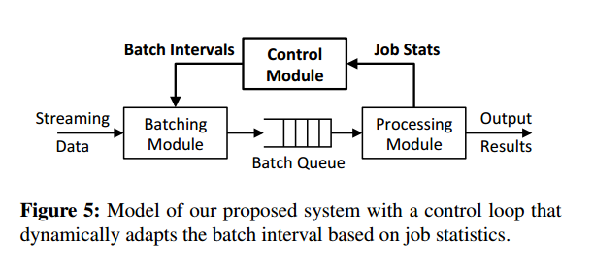
The Control Module
Control Module – Learns behaviour of the system to decide batch interval
Desirable Properties
Low Latency
Agility
Generality
Ease of Configuration

Slide 7
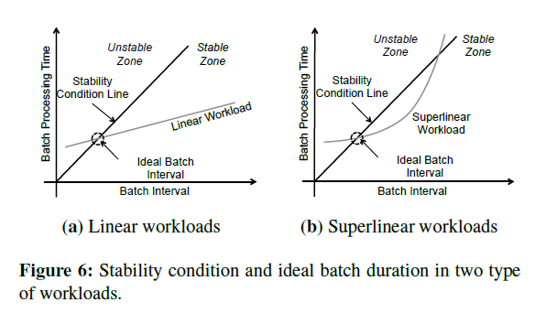
Dynamic Batch Sizing
Goals
- Achieve minimum batch interval
- Ensure system stability
- Speed
- Adapt to changing workloads

Slide 8
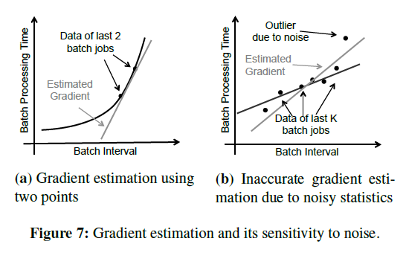
Early Solutions
Controls based on Binary Signals
Controls based on Gradient information
Large Gradient- Reduce the batch interval by a configured step size
Small Gradient- Increase or decrease the batch interval based on operating point

Slide 9
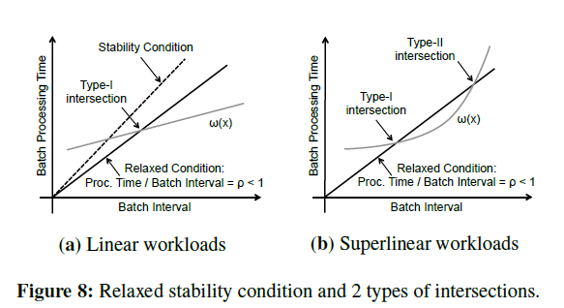
Fixed Point Iteration
Relaxing the requirements
Batch intervals chosen based on the intersection between workload function ω(x) and the condition line batch processing time=px batch size and p<1

Slide 10
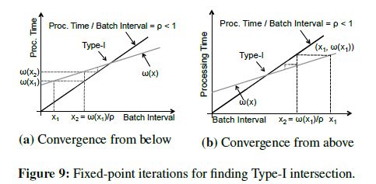
Type I intersections
- Find a point x* such that ω(x*) = px
Type I intersection is reduced to solving the fixed point function f(x) = ω(x) /p such that f(x*) = ω(x*) /p = x*
Start with an initial guess x₁
Iterate using x_{n+1} = f(x_{n}) = ω(x*) /p for n=1,2,…
- Converges quickly

Slide 11
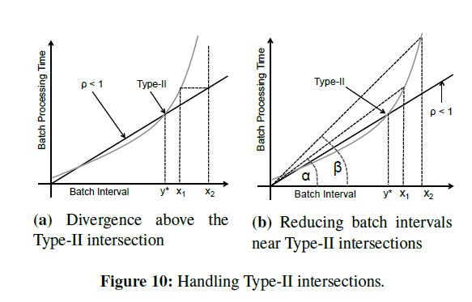
Type II intersections
Condition:
ω(x₁) /x₁ < ω(x₂) /x₂
ω(x₁) > px₁ and ω(x₂) > px₂
Next batch interval
X_{n+1} = (1-r) x min (x_{1,} x₂)

Slide 12
Checking Type II inconclusive if the batch intervals of the last 2 completed jobs are the same
Principle of slow start
Algorithm does not converge if Type I intersection does not exist

Slide 13
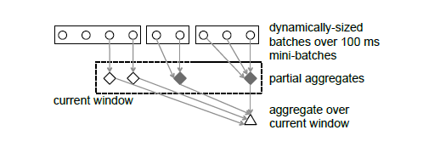
System Architecture
Adaptive window based aggregation

Slide 14
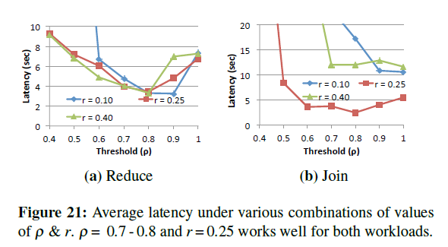
Evaluation
20 m1.x large EC2 instances
p= 0.7
r = 0.25
High vale of p = Greater robustness,
Larger batch intervals
High value of r = Quick Type I
Convergence

Slide 15
Comparisons with static batch intervals
Static data rates
Time varying data rates
Comparison of the end-to-end latency observed with static and time-varying data rates and static/dynamic batch intervals

Slide 16
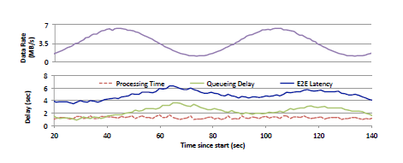
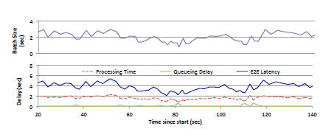
Reduction in queueing delay
Sinusoidal input data rate between 1 and 6.4 MB/s
Static batch interval = 1.3 s
Queueing delay starts building up
Dynamically adapting batch size
Reduction in end to end latency

Slide 17
Changing workloads
Reduce workload
Constant data rate 6MB/s
Number of keys varied between 500 and 40000

Slide 18
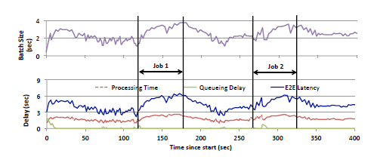
Resource Variations
Background jobs consuming 25% of the
cluster resources
Timeline of batch interval and other times for the reduce workload under variations in the available workload

Slide 19
Comments
+ No prior knowledge of the workload
+ Ability to adapt to a varying number of workloads
+ Achieves low latency, agility and ease of configuration
+ No modifications required to the programming interface
The control loop introduces an overhead
Failure of the control module
Slow start/ Initial parameters
Batching strategy for lost streams and sudden unexpected spikes?

Slide 20
Discussion/Questions
Possible challenges when applied to the continuous operator model?

Slide 22
Comparison with gradient based algorithm

