Slide 1
Eiger: Stronger Semantics for Low-Latency Geo-Replicated Storage
Junle Qian
Feb 25, 2014

Slide 2
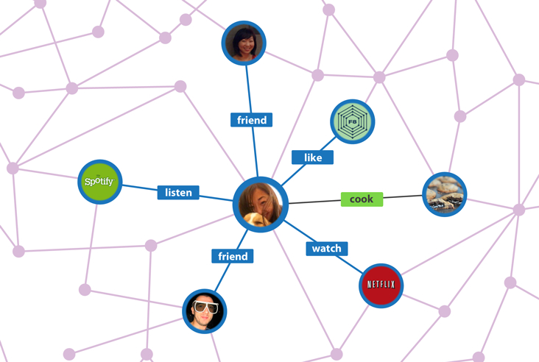
Geo-replicated Data Centers
Is the backend of giant websites and web services

Slide 3
Massive Data Storage across Multiple Servers
Shard data across multiple servers in a data center
E.g., fragmented by alphabetical order of last names
A-D
“Ellen”
E-H
“Leon”
I-K
I-K
L-N
O-T
U-Z

Slide 4
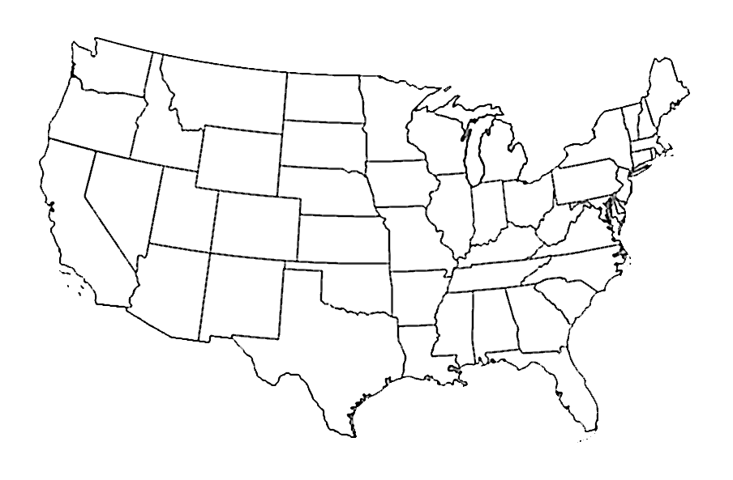
Geo-replicated Data Storage
Effective mitigation to latency: handle request in nearest data center
An increase to availability: higher tolerance
A-D
Seattle
New York
E-H
San Francisco
I-K
I-K
L-N
O-T
U-Z

Slide 5
Web Services to Geo-replicated Data Storage
Front Tier Servers
“clients” to the data storage system

Slide 6
Eiger: Stronger Semantics for Low-Latency Geo-Replicated Storage

Slide 7
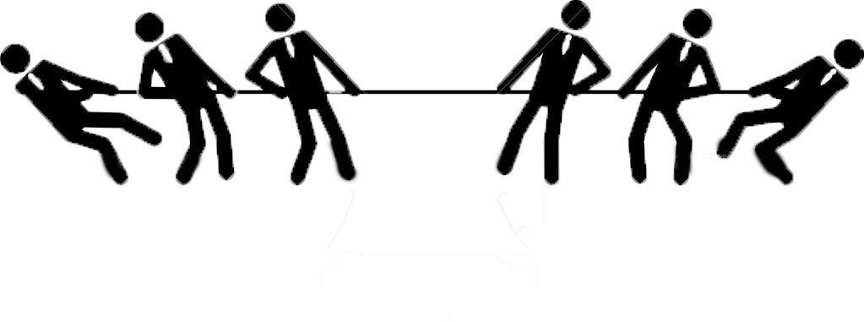
Two Conflicting Goals
Theoretically conflict between strong consistency and low latency:
[Lipton, Sandberg, 1988] PRAM: A Scalable Shared Memory
[Attiya, Welch, 1994] Sequential consistency versus linearizability
Strong Consistency:
Expected and correct responses to user
No anomaly for front tier servers
Simpler programming life
Low Latency
Fast user experience
Less seconds wasted other than computation
Less money wasted

Slide 8
Problems caused by inconsistency
Unfriend Bob (slow)
Alice is in friend list,
display “Bob is…”
Post status(fast):
Bob is such a nerdy guy.

Slide 9
Strong Consistency and Eventual Consistency
Strong Consistency
Eventual Consistency
Satisfies linearizability, serializability, and sequential consistency
E.g., Megastore, Walter, Gemini
Replica convergence
More anomalies
Low Latency
E.g., Dynamo, COPS, Eiger
Notes:
Two different research directions: ensure strong consistency and compensate for mitigation of latency, or ensure low latency and compensate for the loss of consistency

Slide 10
Comparison with COPS
 | COPS | Eiger
Data model | Key-value(basic) | Column-family (richer)
Read-only transactions | Causal data stores only | All types of data stores
Write-only transactions | N/A | Proposed algorithm
Performance | Good | Better
Failure | Performance degradation | resilient

Slide 11
Contributions of Eiger
Low Latency (compared to strong consistent systems)
Causal Consistency (compared to eventual consistent systems)
Rich data model (compare to basic data model systems)
Limited forms of transactions
Read-only transaction
Write-only transaction

Slide 12
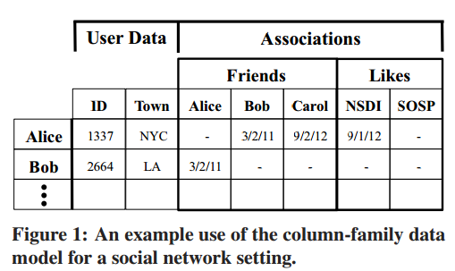
Rich Data Model
Column Family
Column-family data model
Column Family
Super Column
Column
Column
Used in Google’s BigTable
Logical Key

Slide 13
Column-family Data Model
Compound key and value pair
Alice:Associations:Friends:Bob -> 3/2/11
Scale to one access per location
Good data abstraction
Causal for:
Update/read many columns
Range access columns with deletes
Counter columns

Slide 14
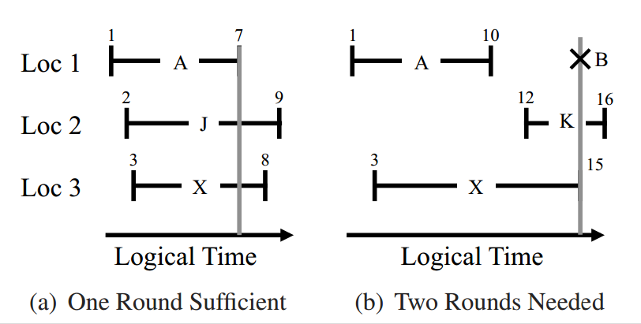
Read-only Transaction
Consistent view of multiple
Keys across many servers in the
local data center
Leftmost: earliest valid time
Right most: latest valid time
Vertical line: effective time
EVT
LVT
EffT
Max of LVT < Min of EVT
=> Not a consistent view

Slide 15
Read-only Transaction
Condition to fire the second round
Maximum of earliest valid time(EVT) > the minimum of latest valid time
Worst case: two rounds
One fold of “low latency”

Slide 16
Write-only Transaction
Allows a client to atomically write many columns across many servers
2.5 RTT locally, no locks (for low latency)
A variant of traditional 2PC (2 phase commit)

Slide 17
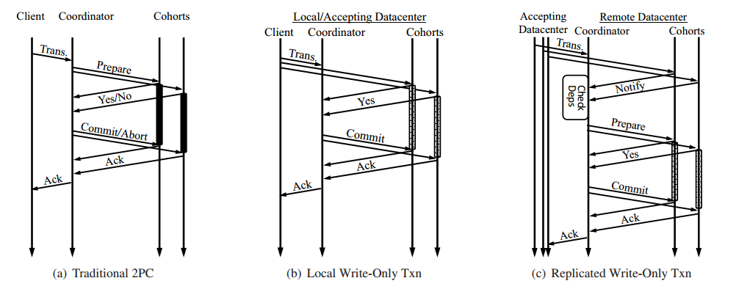
Write-only Transaction
dependencies
of operations
“centralism” in a distributed system
No “abort”

Slide 18
Check nearest dependencies
COPS
Eiger
Dependency check based on values
Multiple checks per value
Dependency check based on operations
One check per value
Dep_check function does block Loosely blocks behind the local data center

Slide 19
Dependency examples
COPS
Eiger
Nearest dependency check:
…
Nearest: w3
only one check
v6 check?
y1 check?

Slide 20
Failure Tolerance
Both transient and permanent datacenter failures will cause meta-clients to reconnect to different datacenters.
Reconnection will avoid previously disconnected data centers
Failure resilience
Assuming transient datacenter failure will be rare
Long transient datacenter failure will be rare
Permanent ones will be even rare

Slide 21
Overhead
Causal Consistency overhead
Dependency metadata carried by write operations
Read-only Transaction overheads
Double latency if second round is always needed
Version storage
Write-only Transaction overheads
Write column twice (2PC)

Slide 22
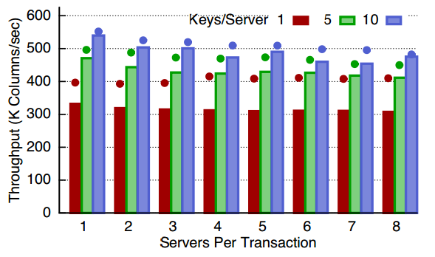
Throughput
More keys per server, more throughput
Due to overhead, throughput is less than a standard-Cassandra
Cassandra
Eiger

Slide 23
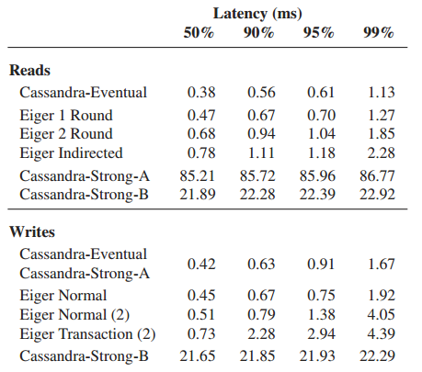
Latency Micro-benchmark
Setup: VICCI test bed, Linux Vserver
2x6 core Intel Xeon X5650 CPUs, 48GB RAM, and 2x1GigE network ports
Median of operations
on single 1Byte columns
Greater latency

Slide 24
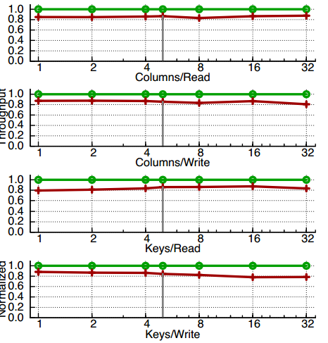
Dynamic Workloads
Generated by dynamic workload generator
Less performance from different dimensions
Normalized Cassandra to 1.0
~20% degradation from different dimensions
Cassandra
Eiger

Slide 25
Facebook workload overhead
Setup:
Synthetic workload
On TAO system[53]
Max overhead: 6.6%

Slide 26
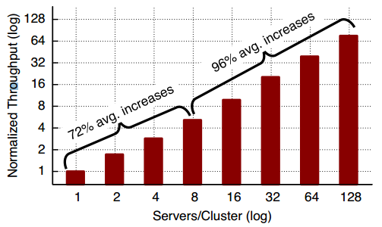
Scalability
Almost perfectly
scale out
Fine scalability

Slide 27
Summary
Low Latency in sense of:
geographical distance
quick local response, no locks in one datacenter
tracking dependencies on operations rather than values
Worst case 2-round read-only transaction algorithm
Stronger consistency in sense of:
Causal consistency that avoids erroneous front-end behavior
Stronger than eventual consistency in previous works
Richer data model in sense of:
Column-family data model
A more practical abstraction
Great Scalability

Slide 28
Thank you! Questions?

