Slide 1
Starfish: A Self-tuning System for Big Data Analytics

Slide 2
Motivation
As the Hadoop ecosystem has evolved, it has become accessible to a wider and less technical audience.
E.g., data analysts as opposed to programmers
However, creating optimal configurations by hand is entirely infeasible
Starfish seeks to automatically provide an optimal configuration given the characteristics of given workloads, workflows, and MapReduce jobs.

Slide 3
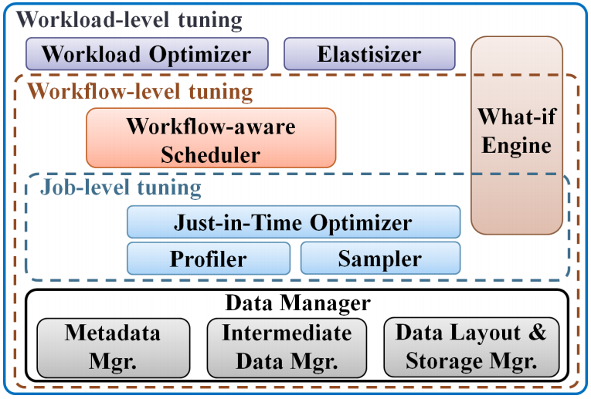
Starfish Architecture
Given a workload and a set of constraints, the Elastisizer determines an optimal deployment
Workload Optimizer transforms submitted workflows to logically equivalent, but optimized, workflows
What-if Engine answers hypothetical queries from other Starfish modules
Workflow-aware scheduler determines the optimal data layout
Just-in-Time Optimizer recommends job configuration parameter values
Profiler monitors execution of jobs to generate job profiles
Sampler generates approximate job profiles based on brief sample executions

Slide 4
Lastword
Lastword is Starfish’s language for reasoning about data and workloads
Analogous to Microsoft’s .NET
Not actually used by humans
Allows data analysts to write workflows in higher-level language (e.g. Pig, Hive, etc)

Slide 5
Job-Level Tuning
In Hadoop, MapReduce jobs are controlled by over 190 configuration parameters
No “one-size-fits-all” configuration.
Bad performance often due to poorly-tuned configurations
Even “rule-of-thumb” configurations can result in very bad performance

Slide 6
Job-Level Tuning
Just-in-Time Optimizer
Automatically selects optimal execution technique when job is submitted
Is assisted by information from Profiler and Sampler
Profiler
Performs dynamic instrumentation using Btrace
Generate a job profiles
Sampler
Collects statistics about input, intermediate, and output data
Samples execution of MapReduce jobs
Enables Profiler to generate approximate job profiles, without complete execution

Slide 7
Job Profiles
Capture information at task- and subtask-level information
Map Phase
Reading, Map Processing, Spilling, and Merging
Reduce Phase
Shuffling, Sorting, Reduce Processing, and Writing
Expose three views
The timings view details how much time is spent in each subtask
The data-flow view provides the amount of data processed at each subtask
The resource-level view presents usage trends of various resources (i.e., CPU, memory, I/O, and network) over the execution of the subtasks
Using data provided through job profiles, optimal configurations can be calculated

Slide 8
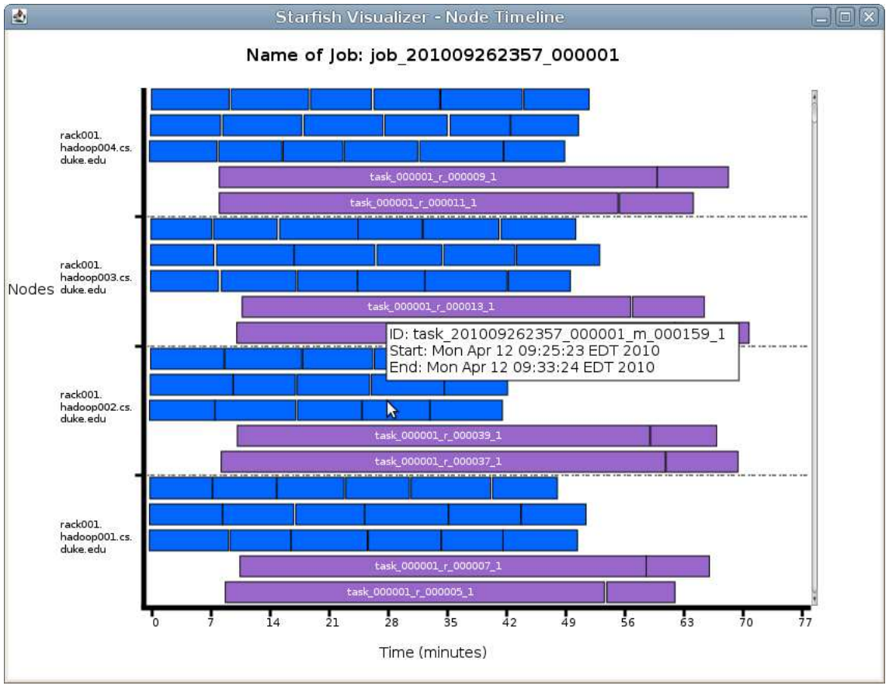
Job Profiles

Slide 9
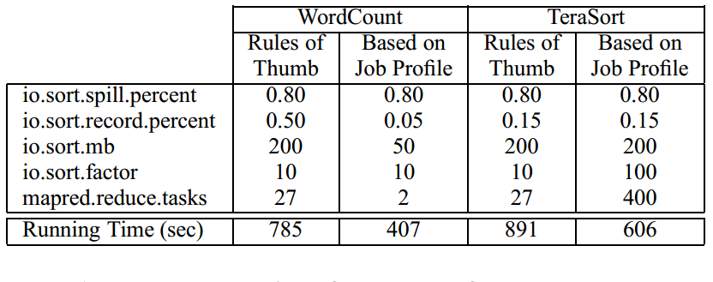
Job-Level Tuning
% of io.sort.mb dedicated to tracking record boundaries
buffer utilization % at which point data begins spilling to disk
total amount of buffer memory to use while sorting files, in MB
# of streams to merge at once while sorting files
default # of reduce tasks per job

Slide 10
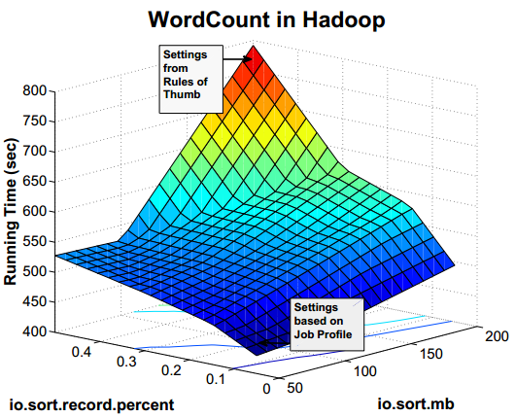
Job-Level Tuning
% of io.sort.mb dedicated to tracking record boundaries
total amount of buffer memory to use while sorting files, in MB

Slide 11
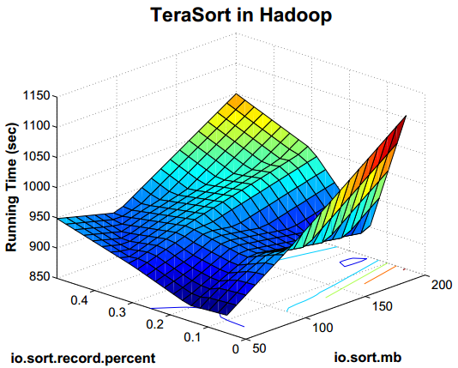
Job-Level Tuning
% of io.sort.mb dedicated to tracking record boundaries
total amount of buffer memory to use while sorting files, in MB

Slide 12
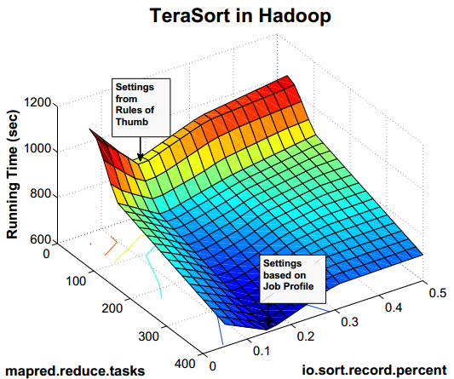
Job-Level Tuning
default # of reduce tasks per job
% of io.sort.mb dedicated to tracking record boundaries

Slide 13
Workflow-Level Tuning
Unbalanced data layouts can result in dramatically degraded performance
Default HDFS replication scheme, in conjunction with data-locality-aware task scheduling can result in overloaded servers

Slide 14
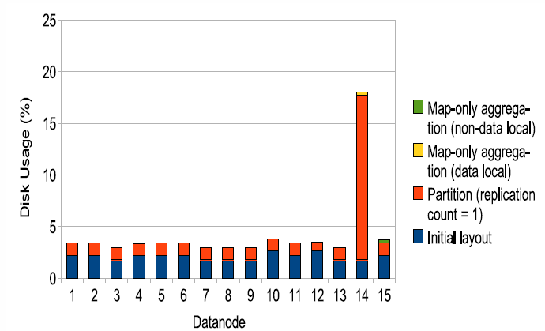
Workflow-Level Tuning

Slide 15
Workflow-Level Tuning
Workflow-aware Scheduler coordinates with
the What-if Engine to determine optimal data layout
the Just-in-Time Optimizer to determine job execution schedule
Workflow-aware Scheduler performs cost-based search over the follow space of choices:
Block placement policy (default HDFS Local Write, or custom Round-Robin)
Replication factor
Optimal size of file blocks
Whether to compress output or not

Slide 16
Workload-Level Tuning
Starfish implements a workload-optimizer
Translates workloads submitted to the system to equivalent, but optimized, collections of workflows
Optimizes three areas
Data-flow sharing
Materialization
Reorganization

Slide 17
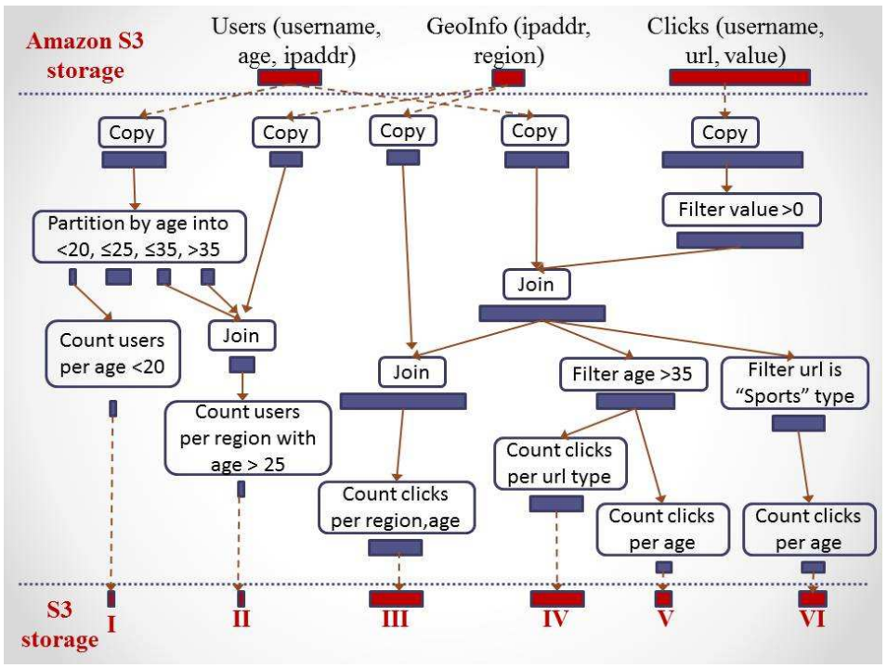
Example Workload

Slide 18
Workload-Level Tuning
Starfish Elastisizer
Given multiple constraints, provides optimal configuration
E.g., complete in a given amount of time while minimizing monetary costs
Performs cost-based search over various cluster configurations

Slide 19
Feedback and Discussion
People seem to appreciate the transparent nature and cross-layer optimizations
How effective might the Sampler be?
Is the motivation strong enough?
Unbalanced data layout example is a bit contrived
Missing analysis of overhead introduced by Starfish
Paper leaves out a lot of details

