Slide 1
Small is Better: Avoiding Latency Traps in Virtualized Data Centers
Yunjing Xu, Michael Bailey, Brian Noble, Farnam Jahanian
Presented by: Gopalakrishna Holla

Slide 2
Quick summary of the paper
Problem being addressed – Reducing tail latency in virtualized data centers.
Current state of the art techniques - Co-operation of guest VMs required.
Contribution - Holistic host centric approach.
Central theme - Leverage SRTF at multiple levels to achieve lower latency at the tail for small flows.
Results - Median latency of small flows down by 40%, improvements in tail of almost 90% and throughput hit less than 3%

Slide 3
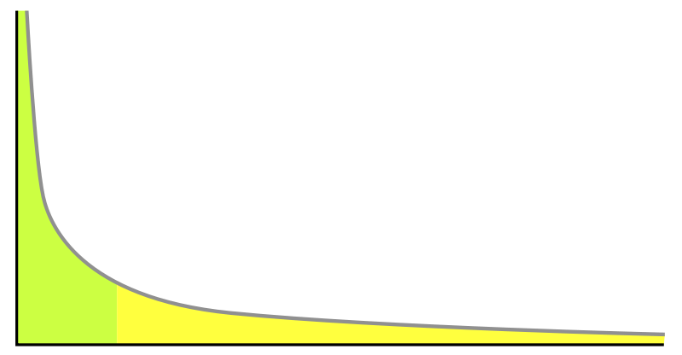
Some definitions
SRTF – Shortest remaining task first
‘Tail of a distribution’
Heavy tail – sub exponential distribution (decays slower than exponential – ‘wild’ randomness instead of ‘mild’ randomness)
Flow completion time – Time between the client sending a query and receiving a complete response.
Flows- defined later in detail
Virtualized data centers – Data centers which have physical machines which run multiple VMs (as opposed to “dedicated” DC)s.

Slide 4
The problem
Latency distributions are heavy tailed.
Median latency not enough, tail is the driver to user perception.
Real world example – Amazon’s pages might call more than 150 services, high latency in one can slowdown all others.
Latency being sacrificed for throughput gains.
Most dedicated data center techniques don’t work in virtualized data centers.
Notes:
Why is tail of latency distribution to key driver to user perception? If lots of machines then even one not responding forces a tradeoff between responsiveness and quality of result

Slide 5
From the authors’ presentation at SOCC ‘13

Slide 6
Why is this problem interesting?
Virtualized data centers have many tenants running on a single physical machine.
Cannot trust these guest VMs to conform to rules and cannot trust them to cooperate.
Need a host only solution but most current solutions require some sort of modification in the software stack. Need to address this ‘semantic gap’.
Reasons for latency – Mostly bad co-tenants
Sources of latency – Xen’s VM scheduling, host network stack filling up, switch overload

Slide 7
All the culprits
Notes:
Authors do evaluation to show problem exists

Slide 8
Switch and VM queuing delay
Primarily a case of scheduling latency
When a VM receives an interrupt, the amount of time it takes to get CPU resources contributes to latency.
Such delay is usually less than 1 ms. But we are interested in the tail! Sometimes can be 10s of ms.
Congested links and switches can contribute to latency
VMs with bad cotenants can experience latency even if they are using only a fraction of their bandwidth

Slide 9
Most experiments are indirect.
VM Scheduling – Get the same client to contact many VMs to do the same task. VMs are otherwise similar except that they might lie in different physical machines.
Measure FCTs per server contacted. Some VMs have higher tail latency than others.
Reasoning is that they share cores with ‘bad’ VMs.
Switch queuing delay – Use VMs of second account to congest the shared access link with the client VM
Notes:
Hard to congest EC2 switches. So congesting access link
Links are 1Gbps

Slide 10
`
Relative impact

Slide 11
Key observations
Switch queuing delay has large impact on both body and tail.
VM scheduling delay affects mostly the tail.
Switch queuing delay alone – 2X at 50th percentile and 10X at the tail!
VM Scheduling another 2X at the tail independently.

Slide 12
Host network queuing delay
Host has a network stack. Gets full if someone is consistently sending out large amounts of data.
Linux already tackles this problem but the intent of this experiment is to show these techniques fall short for virtualized data centers.

Slide 13
Host network queuing delay
Host network stack has two places where a queue is maintained. One is the NIC and the other is the kernel network stack.
BQL – byte queue limits take care of the NIC. They fix the size of the queue as bandwidth delay product. Instead of dealing with packets, it deals with bytes
CoDel – determines when to tell upper layer to slow down by tracking how long packets have spent time in the queue.
Dynamically calculates the target queuing time to compare against.
Notes:
4. Doesn’t matter how occupied the queue is.

Slide 14
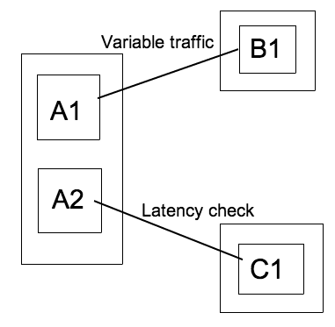
Demonstration!
Experiment has three machines. First one runs two VMs A1 and A2 (senders). Two other physical machines have one VM each (B1 and C1 – receivers)
A2 pings C1 to check latency.
Three scenarios. A1 and B1 sit idle, A1 sends bulk traffic (iperf) to B1 without BQL and CoDel, does the same with BQL and CoDel

Slide 15
Results
Time in ms
Normal linux techniques work to an extent, but authors say it can be better
Congestion managed is still 5 times the latency of no congestion at the 99th percentile.

Slide 16
Is there a solution?
Current solutions – kernel centric (change TCP, OS), application-centric (provide scheduling hints), operator centric (use different VMs, deployments for different workloads)
Everything involves guest VMs. Host helpless if guest is not nice.
Notes:
DCTCP, HULL – kernel centric – new TCP congestion algos
D³, D²TCP, DeTail, PDQ – application centric – need tags
Bobtail – operator changes deployment
EyeQ – needs hypervisor feedback, needs bandwidth headroom
VM Scheduling algos – need guest operation or use ‘graybox’ approaches where they monitor guest I/O – extra overhead
No extra hardware required

Slide 17
A ‘holistic’ solution
VM Scheduling – 2X, Switch delay – 10X, Host Queuing – 4-6X
Need to tackle them all to have significant gains.
No silver bullet – ‘death by a thousand cuts’
This paper tries to leverage SRTF and tries to cut latency in three areas – VM scheduler, host network stack and data center switches.

Slide 18
Principles
Don’t trust guest VMs – they will be greedy
SRTF – known to minimize queuing time (but may hit throughput)
No undue harm to throughput – supported by two previous works which state “Flow size is heavy-tailed in many data centers” and “No undue harm if task size is heavy-tailed”

Slide 19
Reducing impact of VM Scheduling delay
Xen scheduler implements “sort of” SRTF. Gives out “credits” (PCPU slots) to VCPUs every 30 ms.
CPU intensive VMs burn these credits easily and get into OVER state. I/O bound VMs are usually in the UNDER state.
VM in UNDER state which receives an interrupt can get itself scheduled. This state is called BOOST.
BOOSTed VMs can’t preempt each other!
A VCPU can sleep for some time, accumulate credits, receive an interrupt and hog the CPU.

Slide 20
The solution?
One line of code!
Allow BOOSTed VMs to preempt each other
The flip side? Too many preemptions. Loss in throughput

Slide 21
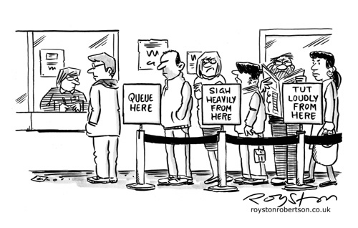
The host network queue…
Authors say the root cause of delay in bandwidth bound VMs is that the network requests are too large and hard to preempted.
Xen has a ‘frontend’ and a ‘backend’ through which guest VMs send packets to the dom0 VM (the one who controls the actual physical resources)
Packet copy for bulk transferring is very CPU intensive, so Xen allows consolidation of packets up to 64KB.
Solution is straightforward, split the packets. Challenge is to decide where to do it.
This place has to be after the memcopy but just before CoDel receives the packets (“as late as possible”).
Going to incur some extra CPU usage.
Notes:
This means that before the kernel network stack can tell the upper layer to stop, it already has too much in the queue. Large jobs block the head of the queue.
CoDel and BQL lose their effectiveness if packets are too large!
(it is implemented as a memory copy)
Consolidation was allowed because splitting is CPU intensive
CPU intensive but 6-12%

Slide 22
Finally the switches
Make switches prefer “small” flows over “large” flows.
Infer how “small” or “large” a flow is based on bandwidth usage.
Hard to do this at the switch, so the host has to tag the flows.
How do you define a flow? How do you define flow size? How to classify flows based on the size?

Slide 23
All about flows
For the purpose of this design, flow is defined as the collection of any IP packets belonging to a (source, destination) pair.
Ignore natural boundaries between TCP or UDP connections.
New problem – flows can be never ending according to this new definition
Use sending rate as an approximation of flow size.
Flow tagging done at host but switches need to support priority queuing.
Notes:
1. (i.e (source, destination) pair uniquely defines a flow.)
2. (i.e even if you open a new TCP connection to same destination, still counts as a part of the same flow)
3. Flow size – “instant size of a message the flow contains instead of the absolute size.” (say what?)
4. This semantic definition is just so that we can use sending rate as an approximation!
5. If a flow uses a small fraction of the link capacity and in small bursts, it’s a “small” flow. (low sending rate)
6. Latency of small flows decreased but so is the throughput of the large ones.
Classifying by rate is better than classifying by absolute size of TCP connection.
If we define it by absolute size, a connection can never be tagged as “small” once past the boundary of “large”; even if TCP congestion control kicks in, causing it to starve.
With rate, after TCP congestion control comes into effect, a bandwidth heavy flow also starts sending at a lower rate and gets tagged as “small”.

Slide 24
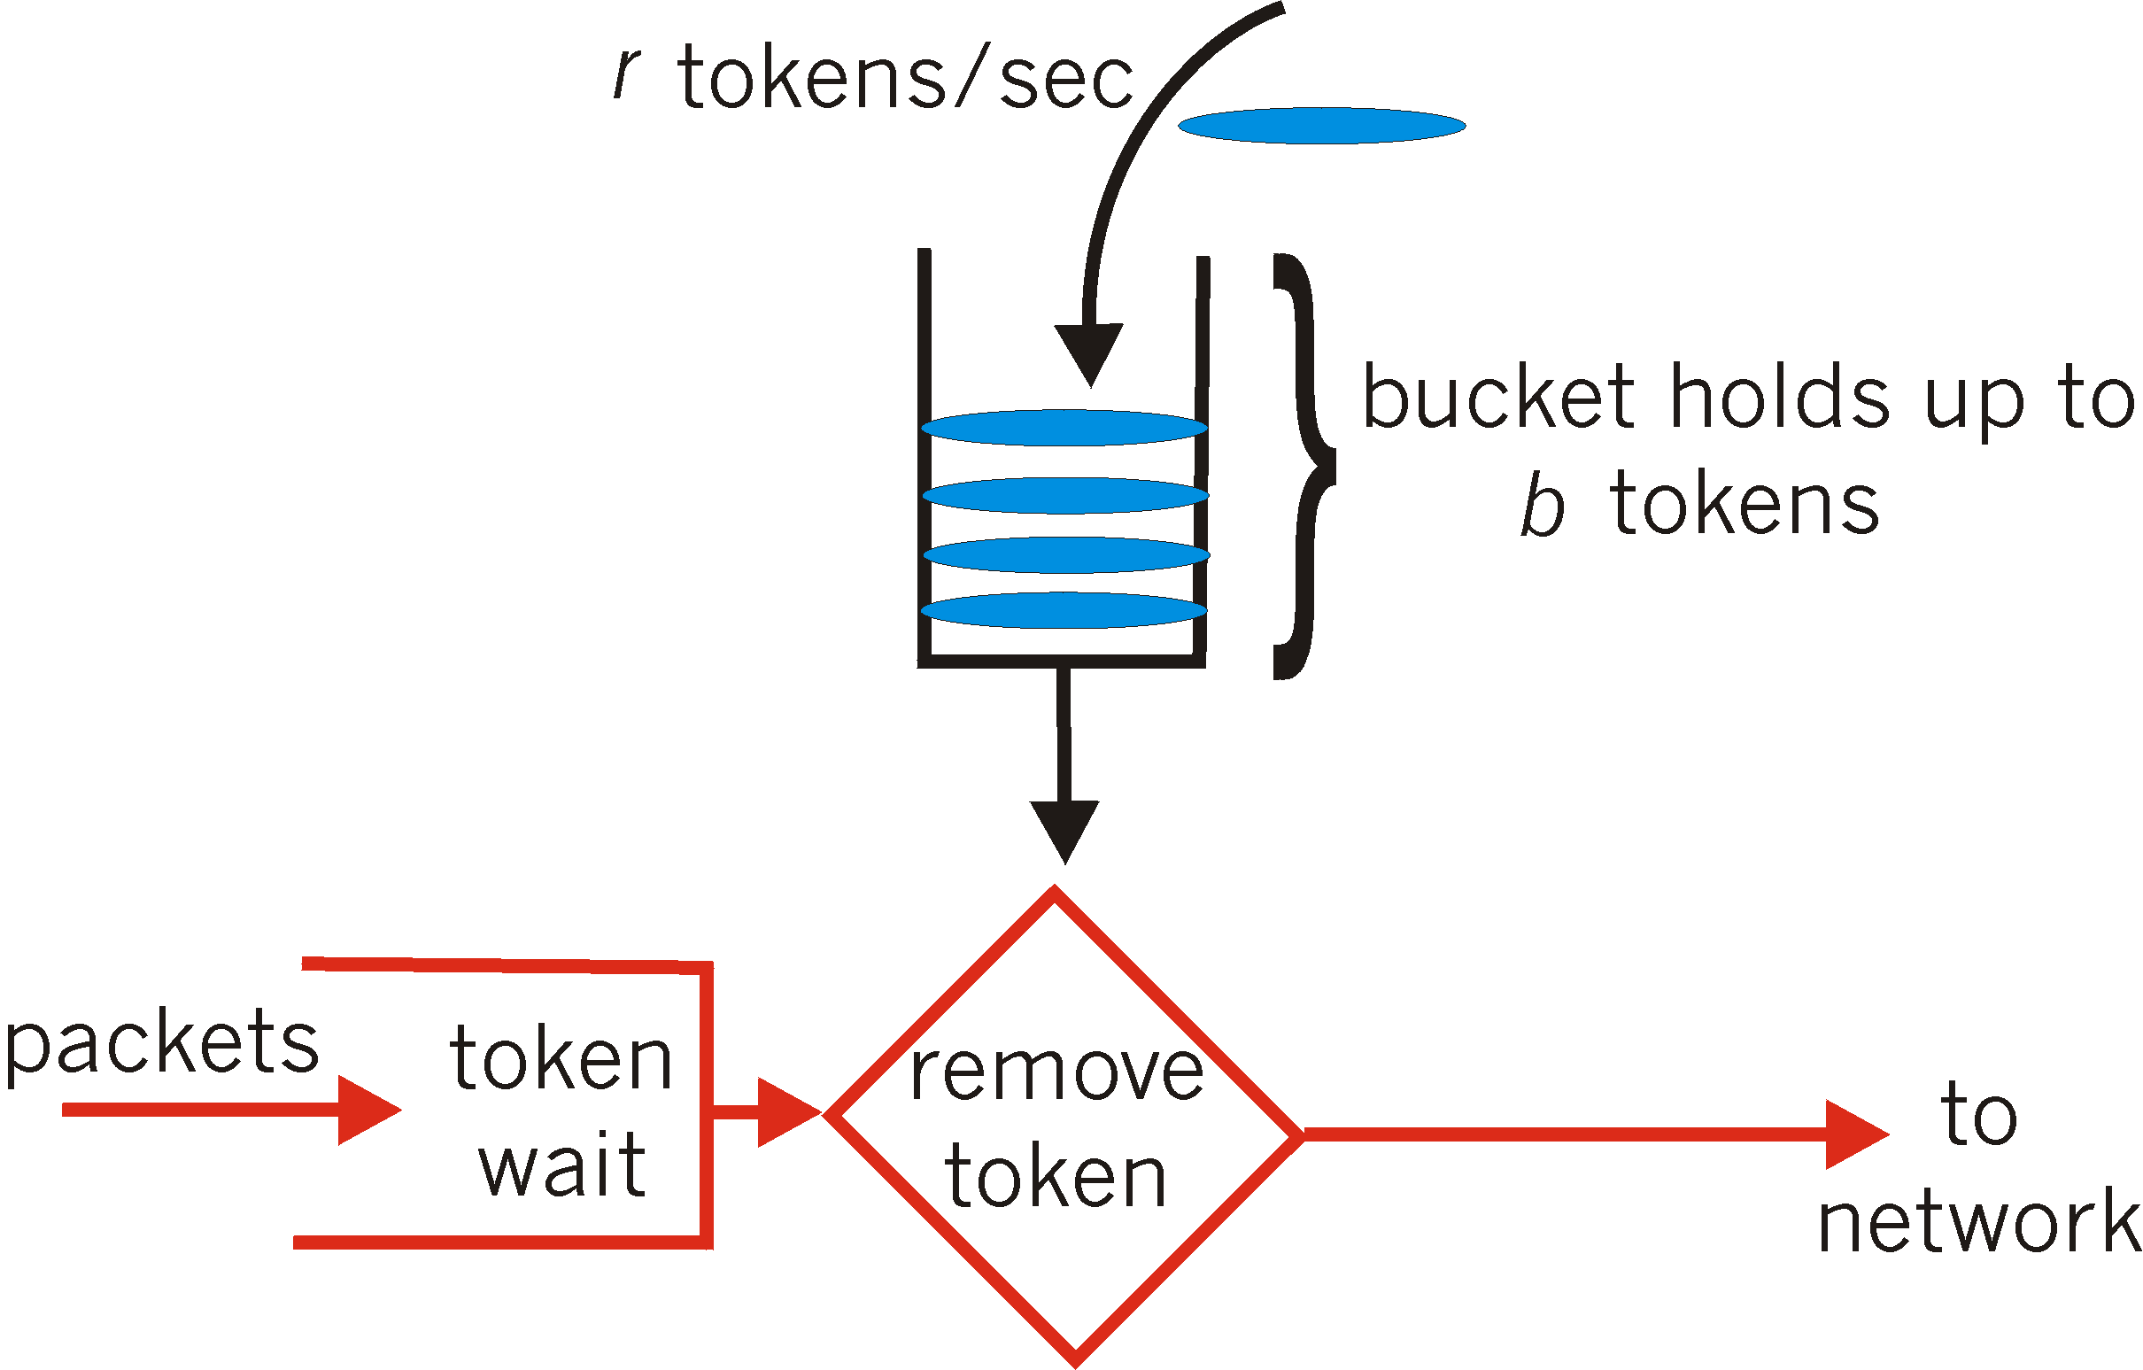
Implementation details
Coded into the “backend” of the dom0 switches since it receives every packet.
Use token buckets with “rate” and “burst” parameters.
If flow has tokens, then tagged as “small”.
Otherwise it is tagged as “large” and only best effort guaranteed.
Notes:
Each flow gets a bucket it can put its packets into.
This bucket has a “rate”. This is the rate at which tokens are handed out. Tokens are consumed when packets are put in the queue.
Burst determines the maximum tokens that can be accumulated (to prevent an application from stockpiling tokens and monopolizing later)
Periodic check to see if large flowhas become small

Slide 25
Evaluation
A1 – E1: Small responses, A2-B1: bulk traffic (iperf), A3,A4: CPU bound tasks
A3, A4 can cause VM scheduling delay, A2 causes host network queuing delay
C,D – E2: exchange large flows that can congest E’s access link
E1 – 2KB query response every 5ms , E2 – 10MB query response every 210ms (40% utilization of link)
Main parameters – rate, burst – depends on workload but set at 10Mbps and 30KB for the evaluation
Other parameters – timers for rechecking low priority flows and cleaning up inactive flows.
Notes:
Five four core physical machines
Cisco Catalyst switch

Slide 26
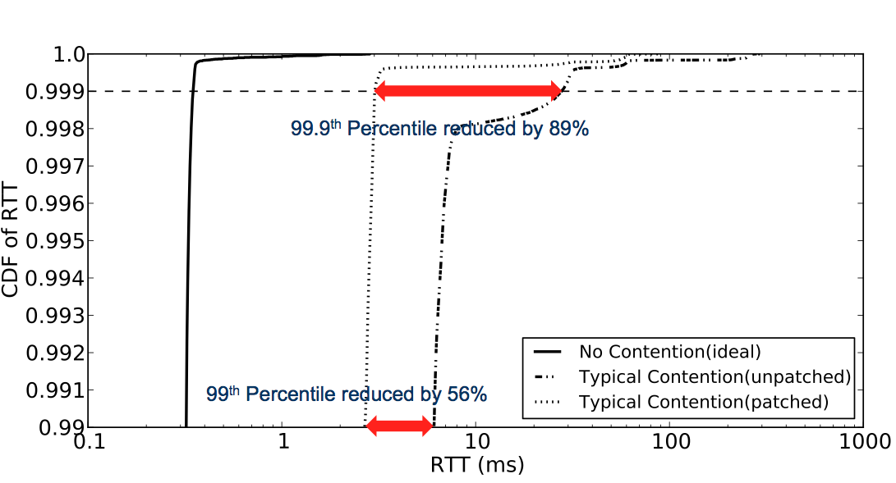

Slide 27
Specific experiments
VM Scheduling only – Pin A1 and A3 to a core.
But since A3 has to use 90% of its CPU time and not 100%, make it sleep for a while after some CPU operations.
CPU operation is to scan L2 cache sized block repeatedly. Fast if not preempted. Slow if preempted.

Slide 28
Specific experiments
Host network queuing delay – Same setup as the evaluation to prove the problem

Slide 29
Specific experiments
Switch queuing delay – A1, B1 – E1 : Small flows, C1, D1 – E2: Large flows
The large flows are varied to control utilization.
Larger flows have more delay (and less throughput) though – the assumption is that larger flows are less sensitive to latency

Slide 30
Results of large scale simulation
128 simulated hosts – 4 pods
Each pod – Four 8-port edge switches, four aggregation switches
8 switches connect all pods together.
1Gbps between hosts and edge switches, 10Gbps between switches.
FCT measured here is one way flow only
Each host has an open TCP connection to every other host and chooses destination at random
Flow sizes chosen using a pareto random variable
Notes:
FCT for small flows in 99.9th percentile a magnitude higher compared to testbed.
This is explained by the fact that flow sizes are generated at random and the tagger cannot always tag the flow correctly.
Algorithm assumes that small flows stay small and large flows stay large but this is not true for the simulation (though the authors say this is a not an unreasonable assumption for real workloads).
Latencies for large flows show opposite behavior compared to testbed results. Attributed to simulated switches being primitive compared to Cisco switches. Also simulated switches have different queues for small and large flows and do not drop packets in the large flow.

Slide 31
Sensitivity of burst size and flow rate
Rate fixed at 10Mbps
Burst size fixed at 30KB
Notes:
High flow rate can be abused by guests
All parameters depend on workload

Slide 32
Putting it together
Solution proposed | The Good | The Bad | The Ugly?
VM Preemption | Low latency for I/O bound latency sensitive tasks | More preemption and more usage of CPU because of context switch | Too many preemptions? Malicious co-tenant?
Host network stack packet breakup | Lets BQL and CoDel be effective at what they do | More CPU usage | Taking up CPU time that could have been given to the guest VMs
Tagging packets | Low latency for small flows | Hits throughput of large flows | Adds complexity to an already CPU intensive operation
Notes:
Xen has a rate limit – limit on number of preemptions but can still provide room for exploitation

Slide 33
Discussion points
SRTF penalizes large workloads.
Workload trace is synthetic.
Testbed is not big and general enough to cover all data center cases.
Some data center studies the paper refers to say that network links inside data centers are mostly under utilized (except for the core). So how true is the occurrence of switch queuing delay?
Hard to do a cost vs benefit study.
The motivation for Xen Credit Scheduler having a rate limit is the fact that latency sensitive applications have computations that run into only microseconds. The lowest rate limit is 1 swap every ms. Will this result in underutilization of CPU? The effect of starvation of a CPU intensive job needs to be investigated more thoroughly.
Solution seems simple enough. What is the harder task here? Finding the problem? Evaluating good solutions?
Rate and burst for token bucket implementation is something that must be tuned. Given diverse data center workloads, how feasible is this?
Notes:
Solution specific to Xen?

