Slide 1
Rhea: automatic filtering for unstructured cloud storage
Christos Gkantsidis, Dimitrios Vytiniotis, Orion Hodson, Dushyanth Narayanan, Florin Dinu, and Antony Rowstron
Presented by Gourav Khaneja

Slide 2
Motivation: Unstructured data
Relational Databases had well-defined schema
Unstructured “text” data (or loose structure): The structure of data is implicit in the application (flexibility)

Slide 3
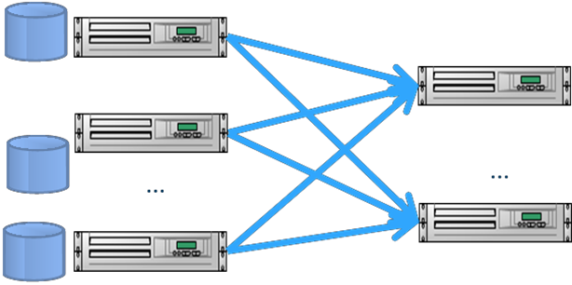
Cluster design for data analytics
Hadoop, Dryad, Map Reduce co-locate Storage and Compute

Slide 4
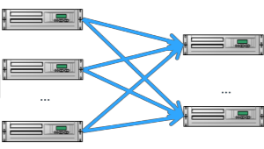
Elastic Cloud
Scalable storage
DC Network
Elastic compute
Amazon S3 & EC2: Amazon Elastic MapReduce
Microsoft Azure Storage and computer cloud: Hadoop

Slide 5
Why separate clusters ?
Scalable storage
Elastic compute
Security & Performance Isolation
Independent Evolution (scalability & provisioning)
(User) don’t pay for compute to keep data alive

Slide 6
Bottleneck
Scalable storage
Bottleneck
Elastic compute
Core DC bandwidth: Scarce & oversubscribe

Slide 7
Execute Mapper on storage ?
Intuition: Mappers throw away a lot of data, but
Data reduction not guaranteed
Difficult to stop mappers during storage overload
Storage nodes have to execute complicated logic (Hadoop system & protocol)
Dependencies on runtime environment, libraries, etc

Slide 8
Solution: Rhea
Filters unnecessary data at storage nodes
Through static analysis of java byte code of mappers
Filters are executable java code

Slide 9
Rhea: Design
Input Job
Filter
Generator
Filter descriptions
Filter
Proxy
Job Data
Network
Job Data
Hadoop Cluster
Storage
Extract row (select) & column (project) filters

Slide 10
public void map(… value …)
{
String[] entries = value.toString().split(“\t”);
String articleName = entries[0];
String pointType = entries[1];
String geoPoint = entries[2];
if (GEO_RSS_URI.equals(pointType)) {
StringTokenizer st = new StringTokenizer(geoPoint, " ");
String strLat = st.nextToken();
String strLong = st.nextToken();
double lat = Double.parseDouble(strLat);
double lang = Double.parseDouble(strLong);
String locationKey = ………
String locationName = ………
geoLocationKey.set(locationKey);
geoLocationName.set(locationName);
outputCollector.collect(geoLocationKey, geoLocationName);
}
}
Row Filters

Slide 11
public void map(… value …)
{
String[] entries = value.toString().split(“\t”);
String articleName = entries[0];
String pointType = entries[1];
String geoPoint = entries[2];
if (GEO_RSS_URI.equals(pointType)) {
StringTokenizer st = new StringTokenizer(geoPoint, " ");
String strLat = st.nextToken();
String strLong = st.nextToken();
double lat = Double.parseDouble(strLat);
double lang = Double.parseDouble(strLong);
String locationKey = ………
String locationName = ………
geoLocationKey.set(locationKey);
geoLocationName.set(locationName);
outputCollector.collect(geoLocationKey, geoLocationName);
}
}
1. Label output lines.

Slide 12
public void map(… value …)
{
String[] entries = value.toString().split(“\t”);
String articleName = entries[0];
String pointType = entries[1];
String geoPoint = entries[2];
if (GEO_RSS_URI.equals(pointType)) {
StringTokenizer st = new StringTokenizer(geoPoint, " ");
String strLat = st.nextToken();
String strLong = st.nextToken();
double lat = Double.parseDouble(strLat);
double lang = Double.parseDouble(strLong);
String locationKey = ………
String locationName = ………
geoLocationKey.set(locationKey);
geoLocationName.set(locationName);
outputCollector.collect(geoLocationKey, geoLocationName);
}
}
2. Collect all control flow path that reach to output labels
(loops, conditional statements creates branches in the control flow)

Slide 13
public void map(… value …)
{
String[] entries = value.toString().split(“\t”);
String articleName = entries[0];
String pointType = entries[1];
String geoPoint = entries[2];
if (GEO_RSS_URI.equals(pointType)) {
StringTokenizer st = new StringTokenizer(geoPoint, " ");
String strLat = st.nextToken();
String strLong = st.nextToken();
double lat = Double.parseDouble(strLat);
double lang = Double.parseDouble(strLong);
String locationKey = ………
String locationName = ………
geoLocationKey.set(locationKey);
geoLocationName.set(locationName);
outputCollector.collect(geoLocationKey, geoLocationName);
}
}
3. Create a flow map:
For each instruction, for each variable referenced in that instruction: what instruction affects that variable.

Slide 14
public void map(… value …)
{
String[] entries = value.toString().split(“\t”);
String articleName = entries[0];
String pointType = entries[1];
if (GEO_RSS_URI.equals(pointType)) {
outputCollector.collect(geoLocationKey, geoLocationName);
}
}
4. Keep only the statements which are reaching destination for control flow statements.

Slide 15
public void map(… value …)
{
String[] entries = value.toString().split(“\t”);
String articleName = entries[0];
String pointType = entries[1];
if (GEO_RSS_URI.equals(pointType)) {
return true;
}
return false;
}
5. Disjunction of paths: Return true for control reaching output labels.
*This is a simplified version. The actual Rhea-generated code differs in terms of variable names and condition check.

Slide 16
Column Filters
StringTokenizer, String.split based on regular expressions.
Can be extended to other APIs.
Conservative: do not filter otherwise
Replace irrelevant tokens
Generate fillers dynamically

Slide 17
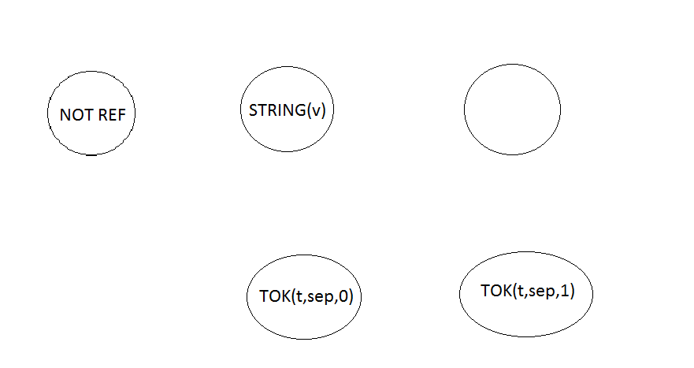
State machine for column filter
v=value.toString()
T=v.split(sep)
START
t=new StringTokenizer(t,sep)
t.nextToken()
t.nextToken()
…

Slide 18
Filter Properties
Correct
Isolation and safety: No system calls, I/O call etc.
Fully Transparent. Thus, best effort: can be killed anytime.
Stateless: less memory usage (unlike mappers)
Guarantee output < input : unlike mappers
Termination: proof ?

Slide 19
Evaluation: Job Selectivity
Many Jobs are very selective either on rows or columns or both
Many Jobs are very selective either on rows or columns or both
30 % of data transferred
Normalized selectivity of example jobs

Slide 20
Job Run Time
Job run time normalized to baseline execution (without Rhea)
Discussion: Filter time not included.

Slide 21
Throughput of Filtering Engine
OK for a 2 core machine, transmitting at full line rate of 1 Gbps
Optimizations only for column filter

Slide 22
Across Datacenters: WAN is the bottleneck
Similar results as for LAN
For a few jobs, LAN is a bottleneck instead of WAN

Slide 23
Dollar costs
Why compute cost is reduced ?
Per second compute cost (instead of per dollars)

Slide 24
Discussion
The example jobs might be biased towards selectivity.
How does system generalize beyond Hadoop/Java (Pig, Spark, streaming) ?
Experiments to study computing availability at storage nodes.
Not optimal (throughput-wise, selectivity-wise). False-positive rate ?
Debugging becomes harder, in case of mapper bugs.

Slide 25
Stateful Mappers
Statements may modify mapper state
Example: A mapper emitting every nth row
Solution:
Treat state accessing statements as output labels

Slide 26
Optimizations
Merge control paths if all the branches lead to output labels (loops and conditions)
if (GEO_RSS_URI.equals(pointType)) {
…
}else{
…
}
While(condition){ … }
outputCollector.collect(geoLocationKey, geoLocationName);

Slide 27
Evaluation
Input data size and run time for 9 example jobs without Rhea
Out of 160 mappers, 50% (26%) gives non-trivial row (column filters)

Slide 28
DC bandwidth: Scarce & oversubscribe
631 Mbps
230 Mbps

