Slide 1
Storage management and caching in PAST, a large-scale, persistent peer-to-peer storage utility
Antony Rowstron, Peter Druschel
Presented By Wes Panther

Slide 2
Introduction to PAST
Motivated by earlier P2P systems
Internet-based peer-to-peer global storage utility
Attempts to provide strong persistence, high availability, scalability, and security
This paper focuses on some of the techniques PAST uses to increase utilization and improve performance

Slide 3
Overview
Nodes can send and route requests, optionally contribute storage
Differences from traditional filesystem
Eliminates need for explicit mirroring
Allows sharing of bandwidth and storage
Files are immutable
Provides 3 operations to clients
fileId = Insert(name, owner-credentials, k, file)
file = Lookup(fileId)
Reclaim(fileId, owner-credentials)

Slide 4
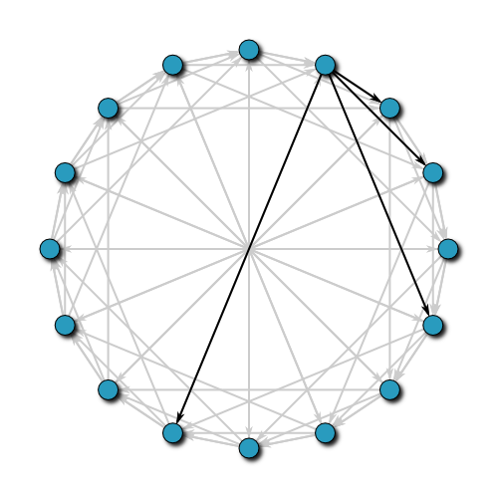
Overview
Each node has a 128-bit id
Each file has a 160-bit id
A file is stored on the k nodes with closest NodeId
Both nodeId and fileId are uniformly distributed
Provides load balancing and caching
Built on Pastry
FileId = 9C6DFC8675A7FF64EA400F7819E2A6EE4CD27495

Slide 5
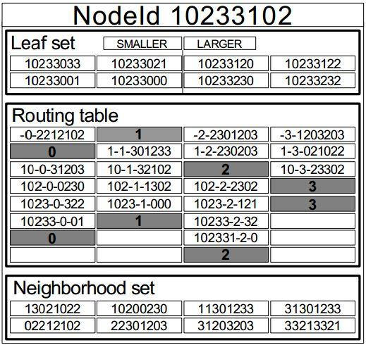
Pastry
Routes to the numerically closest Node
Less than log_{2^b}N steps under normal operation
Routing table, leaf set, and neighborhood set stored at each node
In each step, the message is routed to a node with a longer prefix
Entries in the routing table are chosen to be “close”
Pastry dynamically maintains node state
File with Id: 10303302

Slide 6
Operations and Security
PAST operations
Insert
Lookup
Reclaim
Smartcards are used for security
Randomized routing can be used to prevent denial of service

Slide 7
Storage Management
PAST aims for high storage utilization and graceful degradation
PAST storage management must:
Balance remaining space as utilization increases
Maintain k copies of a file
Uses two techniques to achieve these goals
Replica diversion
File diversion

Slide 8
Storage Imbalance
Causes of storage imbalance
Statistical variation in nodeIds and fileIds
Variation in file sizes
Differences in storage capacity
Assumptions made by PAST
Controls storage capacity

Slide 9
Replica Diversion
Aims to balance the free storage space in a leaf set
When a node gets a file, it attempts to store it and sends the message to other nodes
Instead, can divert the file to another node and store a pointer
Diverted replicas must maintain availability
What if the node with the diverted replica fails?
What if the node with the pointer fails?

Slide 10
Replica Diversion Example
1 | 2 | 3 | 4 | 5 | 6 | 7

Slide 11
Considerations
Not necessary to balance when utilization is low
Better to divert a large file
Replica should be diverted to a node with more free space than average
Three replica diversion policies

Slide 12
1. When should we accept a replica into a node’s local store?
Uses the metric S_{d}/F_{n}
Node N rejects a file D if S_{d}/F_{n} > t
Same idea for those that are not in the closest k
Two thresholds, t_{pri} and t_{div}
t_{pri} > t_{div}
F_{n} {
Used Storage

Slide 13
2. How do we select a node to store the replica?
We want to choose the node with the most remaining free space that:
Is in the leaf set of N
Has a nodeId that is not in the closest k
Does not already have a replica
New nodes can reject as well

Slide 14
3. When should we divert a file into another part of the nodeId space?
When the utilization in a leaf set is high
When a node in the closest k declines, and the node to hold the replica declines

Slide 15
File Diversion
Balance the free space in the nodeId space
Negative acknowledgment sent to client
Hash file with different salt
Repeats this up to 3 times
Can try again with
Smaller file
Fewer replicas
X

Slide 16
Maintenance and File Encoding
K copies of the file must be maintained
Neighboring nodes exchange keep-alive messages
Joining node causes adjustments
Node with pointer and replica may be in different leaf sets
NodeId space may be too full for replica
Quotas ensure demand does not exceed supply
File encoding can be used
Increases storage efficiency
Can improve bandwidth

Slide 17
Caching?
Goal of caching
Minimize client access latency
Maximize throughput
Balance query load
Maintaining k replicas can help
Popular files may need more than k
Files may be popular among local clusters

Slide 18
Caching
PAST caches in the unused portion of node disk space
Unused disk space improves performance, and caching degrades gracefully
A file is cached at a node if its size is less than a fraction of the node’s unused space
Cache replacement based on GreedyDual-Size policy
Each cached file has a weight H_{d}, set to c(d)/s(d)
File with smallest weight is evicted and weights adjusted
Cache hit restores weight

Slide 19
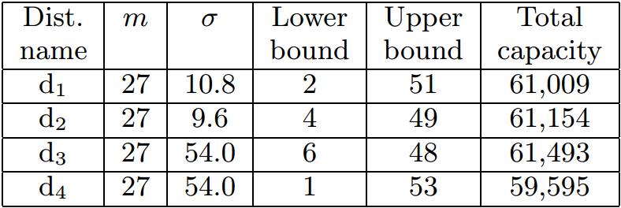
Experimental Results
Experiments were performed in an emulated network
Used two datasets
8 web proxy logs from NLANR - 4,000,000 entries 1,863,055 URLs, 18.7 GBytes of content
Files from authors’ home institutions - 2,027,908 files, 166.6 GBytes of data
Appropriate workload?
With k=5, b=4, N=2250
Storage reduce by factor of 1000
First - disable storage management
51.5% of insertions failed
Utilization was 60.8%

Slide 20
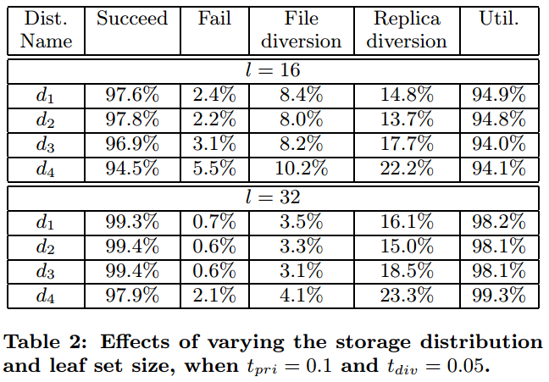
Result 2 - Varying Distribution and Leaf Set Size
Utilization increased
Success increased
Use l = 32

Slide 21
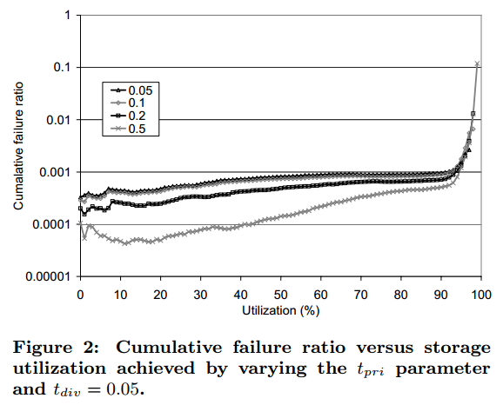
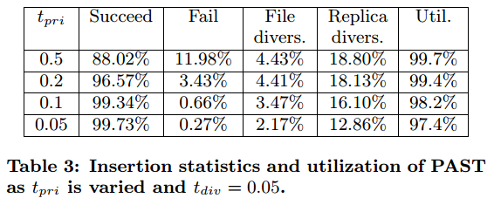
Result 3 - Varying t_{pri}
Larger t_{pri} => more utilization, but less insertion success
Use t_{pri} = 0.1

Slide 22
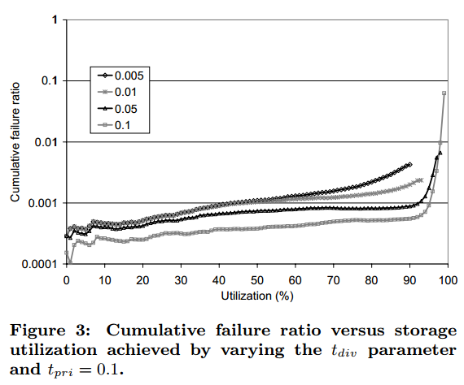
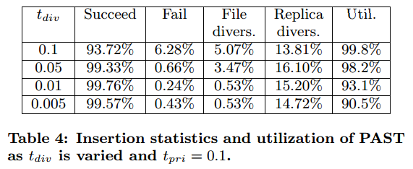
Result 4 - Varying t_{div}
Similar to the last experiment
Use t_{div} = 0.05

Slide 23
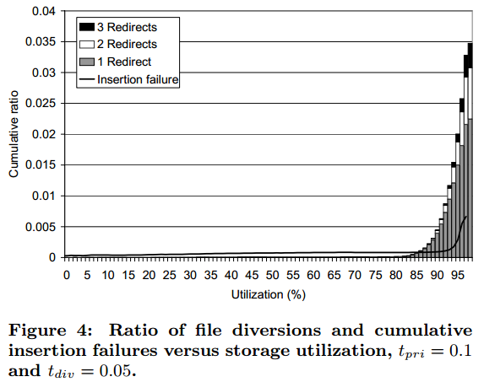
Result 5 - File Diversions and Failure Vs. Utilization
Under 83% utilization, file diversions are negligible

Slide 24
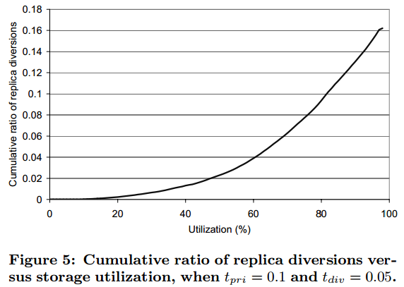
Result 6 - Replica Diversions Vs. Utilization
At 80% utilization, <10% of replicas are diverted
These results show the storage management overhead

Slide 25
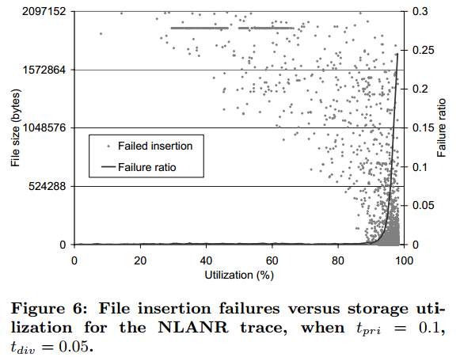
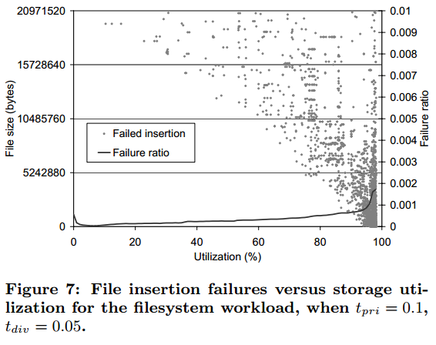
Result 7 - File Insertion Failure Vs. Utilization
Average file size succeeds until about 90.5% utilization

Slide 26
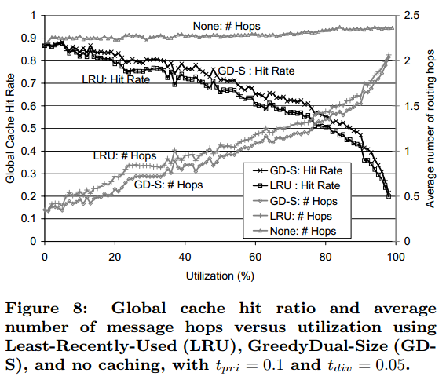
Cache Hit Ratio and Message Hops Vs. Utilization
Hit rate decreases as utilization increases
GD-S performs slightly better than LRU
After 80% utilization, hops increase more rapidly

Slide 27
Discussion
Are P2P systems still as important?
Problems in the system
Disadvantages?
Security concerns?
Are the assumptions made in the paper realistic?
Using trace and filesystem data to approximate P2P file size distributions
Storage size differs by no more than 2 orders of magnitude
Is this system practical? In what case would it be used?

Slide 29
Extra Slide - Related Work
Early systems - Gnutella, Napster, FreeNet
OceanStore
FarSite
Tapestry
Chord
CAN
CFS
xFS

Slide 30
Summary
PAST is an Internet based global peer-to-peer storage utility
Storage nodes and files are assigned uniformly distributed identifiers
Replicas of a files are stored at k nodes with numerically close fileId
Storage management imposes little overhead, increases utilization while rejecting few requests
Allows utilization > 98% and failed file insertion < 5% at 95% utilization
Caching improves network performance

