Slide 1
Hive – A Warehousing Solution Over a Map-Reduce Framework
Presented by:
Atul Bohara
Feb 18, 2014

Slide 2
Outline
Cloud Programming
Background and Motivation
Hive
Introduction
Database Design
Hive Query Language
Architecture
Analysis
Conclusion and Discussion

Slide 3
Cloud Programming
Applications built for cloud computing
Handle large data sets
Distributed and parallel processing
Hadoop, Hive, Pig, HBase, Cassandra, Storm, Spark are some of the most popular systems
Notes:
Cloud computing’s massive scale and data intensive properties
We will see design principles and usage two such systems: Apache Hive and Naiad

Slide 4
Background and Motivation
Data, data and more data
FB warehouse grows half PB per day*
Traditional warehousing solutions Insufficient and Expensive
Hadoop (map-reduce and HDFS)
Scale out, available, fault-tolerant
Problem: map-reduce programming model is low level
Hard to maintain and reuse
Limited expressiveness, no schema
Solution: Hive
*source: http://en.wikipedia.org/wiki/HDFS#Hadoop_distributed_file_system
Notes:
FB had largest hadoop cluster in 2010 with 21 PB storage. That grew to 100 PB by June 2012. They claim that FB warehouse grows half PB per day*
What is this ‘data’?
Raw data collected from operations (e.g. daily activity on facebook/amazon)
Convert this data into meaningful information (trends, statistics, reports)
Traditional (e.g. Oracle, DB2)
Hadoop
Store and process large data sets on clusters
Uses HDFS
Business Intelligence?? Warehousing solutions??
Expensive: need to scale up, centralize architecture
The entire data processing infrastructure in Facebook prior to 2008 was built around a data warehouse built using a commercial RDBMS, which was slowing down the analysis because of increasing amount of data (was not scalable)
Scalable analysis on large data sets has been core to the functions of a number of teams at Facebook – both engineering and non-engineering.
Cost of analysis and storage on proprietary system does not scale. Limited scalability

Slide 5
What is Hive?
Open-source data warehousing solution built on top of Hadoop.
Notes:
Originally developed by facebook, now an active apache project

Slide 6
Conceptual Data Flow
Frequency of status updates based on gender
Frequency of status updates based on school
Top 10 most popular status memes per school
Hive
Web servers
Users
Data Engineer/ Analyst
Hadoop
RDBMS or
File System
Notes:
In Facebook, status and updates are logged into flat files in NFS directory /logs/status_updates
Load this data into Hive on daily basis

Slide 7
Example: StatusMeme
Creating Table
CREATE TABLE
status_updates (userid int, status string, ds string)
PARTITIONED BY (ds string)
CLUSTERED BY (userid) SORTED BY (ds) INTO 32 BUCKETS
STORED AS SEQUENCEFILE
profiles(userid int, school string, gender int)
Notes:
Partition keys (columns), determine how the data is stored. Works both as a storage unit and also helps in identifying specific rows. For e.g. here each unique value of partition keys defines a partition. US data from ‘2009-12-23’ is one partition. Run query on this particular partition and speed up the queries.
Partition columns are virtual columns, not part of the data itself but are derived on load.
Comments can be both at column level and at table level
By default the data in the files is assumed to be delimited with ASCII 001(ctrl-A) as the field delimiter and newline as the row delimiter.
the table is clustered by a hash function of userid into 32 buckets. Within each bucket the data is sorted in increasing order of viewTime. Such an organization allows the user to do efficient sampling on the clustered column - in this case userid. The sorting property allows internal operators to take advantage of the better-known data structure while evaluating queries with greater efficiency.
STORED AS SEQUENCEFILE indicates that this data is stored in a binary format (using hadoop SequenceFiles) on hdfs: flat file containing binary key value pairs
Other possible format is pain text format
https://cwiki.apache.org/confluence/display/Hive/Tutorial

Slide 8
Hive Data Model
ds=‘2009-03-20’
status_
updates
Part-00000
ds=‘2009-03-21’
ds=‘2009-03-22’
Part-00001
HDFS Directory
Sub-directories
Files
Notes:
*Databases: Namespaces
*Tables: Homogeneous units of data which have the same schema.
*Partitions: Each Table can have one or more partition Keys which determines how the data is stored. Partitions - apart from being storage units - also allow the user to efficiently identify the rows that satisfy a certain criteria. For example, a date_partition of type STRING and country_partition of type STRING. Each unique value of the partition keys defines a partition of the Table. You can run that query only on the relevant partition of the table thereby speeding up the analysis significantly. Partition columns are virtual columns, they are not part of the data itself but are derived on load.
*Buckets (or Clusters): Data in each partition may in turn be divided into Buckets based on the value of a hash function of some column of the Table. These can be used to efficiently sample the data.
Buckets and partitions allow hive to prune large portion of unnecessary data during a query processing

Slide 9
StatusMeme (contd.)
Loading Data
LOAD DATA LOCAL INPAT ‘/logs/status_updates’ INTO TABLE status_updates PARTITION (ds=‘2009-03-20’)
Notes:
Other possible input data sources: Full URI or relative path to user’s working directory (LOCAL is not specified)
Load Data Inpath moves the file into table’s hdfs directory

Slide 10
StatusMeme (contd.)
Frequency of status updates based on gender?
Frequency of status updates based on school?
Multi-table Insert and Join
FROM (SELECT a.status, b.school, b.gender
FROM status_updates a JOIN profiles b
ON (a.userid = b.userid and a.ds=‘2009-03-20’)
) subq1
INSERT OVERWRITE TABLE gender_summary PARTITION(ds=‘2009-03-20’)
SELECT subq1.gender, COUNT(1) GROUP BY subq1.gender
INSERT OVERWRITE TABLE school_summary PARTITION (ds=‘2009-03-20’)
SELECT subq1.school, COUNT(1) GROUP BY subq1.school
Notes:
Scans the joined data once and inserts it at many places, runs other queries
Insert Into is also available without overwrite, that appends the data to table. Starting Hive 0.8

Slide 11
StatusMeme (contd.)
Top 10 most popular status memes per school?
HiveQL Map-Reduce Constructs
REDUCE subq2.school, subq2.meme, subq2.cnt USING ‘top10.py’ AS (school, meme, cnt)
FROM (SELECT subq1.school, subq1.meme, COUNT(1) AS cnt
FROM (MAP b.school, a.status
USING ‘meme_extractor.py’ AS (school, meme)
FROM status_updates a JOIN profiles b
ON (a.userid = b.userid)
) subq1
GROUP BY subq1.school, subq1.meme
DISTRIBUTE BY school, meme
SORY BY school, meme, cnt desc
) subq2;
<(school, meme), cnt>
Notes:
Distribute By is used to distribute map output to reducers based on particular column. Here based on (school, meme). So rows having same value of these two columns will go to same reducer

Slide 12
Hive Query Language
SQL-like query language called HiveQL
DDL: Create, Drop, Alter (tables/partitions/columns)
DML: Load and insert Data, select, project, join, aggregate, union all
Primitive and complex data types
Operators and functions
Support for variety of file formats
Notes:
DDL Data Definition Language:
DML Data Manipulation Language;
Now also support updating and deleting rows
UDF: User Defined Functions
UDAF: User Defined Aggregation Functions
*Hive has the ability to define function. In order to create a new UDF classes, it needs to inherit from this UDF class. All UDF classes need implements one or more methods named "evaluate" which will be called by Hive. "evaluate" should never be a void method. However it can return "null" if needed.
*After compile it, you have to include it in the hive classpath and then, after hive is started up, you have to register the function.
*Finally you use the fuction in some sentence.
Custom mappers and reducers to do more sophisticated analysis that may not be supported by built-in capabilities

Slide 13
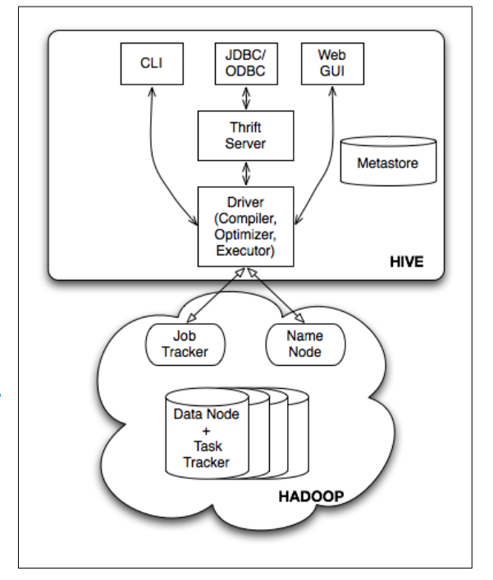
Hive Architecture

Slide 14
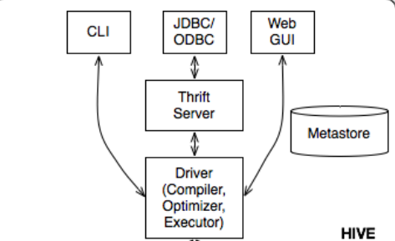
Hive Architecture
External Interfaces
User interfaces like CLI, web UI
APIs like JDBC and ODBC
Other interfaces like Microsoft HDInsight

Slide 15
Hive Architecture
Thrift Server
Exposes a simple client API to execute HiveQL statements
Thrift is a framework for cross-language services
Delegates client requests for metadata to metastore or hadoop file system

Slide 16
Hive Architecture
Metastore
Stores metadata and statistics for databases, tables, partitions
A relational database or file system optimized for random accesses and updates
Consistency between metadata and data should be maintained explicitly
Notes:
Consistency achieved using versions and consistency checks: https://issues.apache.org/jira/browse/HIVE-3764
Bottleneck:
Handled by underlying dbms or file system
RDBMS like mysql can handle 2^32 concurrent connections

Slide 17
Hive Architecture
Driver
Manages life cycle of HiveQL statement: compilation, optimization and execution
Uses a session handle to keep track of a statement

Slide 18
Hive Architecture
Compiler
Translate query statements into a ‘Plan’
Metadata operations (DDL statements)
HDFS operations (LOAD statement)
DAG of map-reduce jobs (insert/query)

Slide 19
Hive Architecture
Optimizer
Combines multiple joins
Adds repartition operator (ReduceSinkOperator)
Minimize data transfers and pruning
User hinted optimizations
Notes:
Scans intermediate output from compiler, the logical plan, which is a tree of logical operators (abstract syntax tree)
Rule based optimizations like Pruning non referenced columns from table scans

Slide 20
Hive Architecture
Execution Engine
Runs DAG of map-reduce jobs on Hadoop in proper dependency order

Slide 21
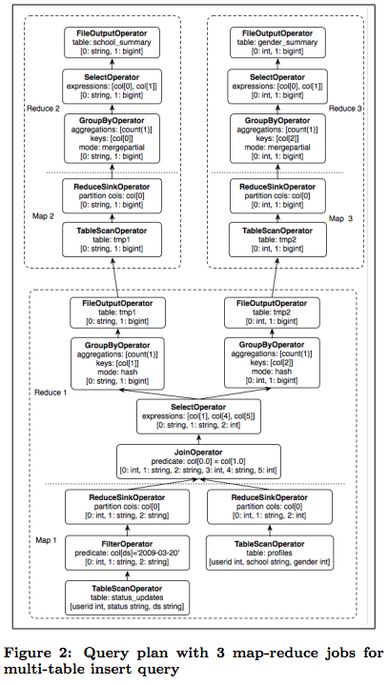
Query Plan generated by the compiler for StatusMeme Example

Slide 22
Analysis
Hive performance benchmark Experiment
To compare performance of Hadoop, Hive and Pig
Executed 4 queries (2 select, 1 aggregation and 1 join query)
Data set:
Grep table, 2 columns, 50 GB data
Rankings table, 3 columns, 3.3 GB data
Uservisits table, 9 columns, 60 GB data
Source: Hive performance benchmark: https://issues.apache.org/jira/browse/HIVE-396
Notes:
Experiment details: 3 tables grep (2 columns), rankings (3 columns), uservisits (9 columns)
containing data 50 GB, 3.3 GB, 60 GB respectively
Data are pre-loaded into HDFS, load times are not considered
Query 1: single job, 380 mappers, 0 reducers
Query 2: single job, 30, 0
Query 3: single, 450, 60

Slide 23
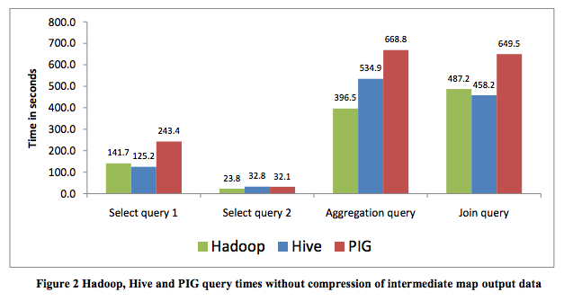
Analysis
Hive performance benchmark results
Source: Hive performance benchmark: https://issues.apache.org/jira/browse/HIVE-396
Notes:
Data are pre-loaded into HDFS, load times are not considered
Query 1: single job, 380 mappers, 0 reducers
Query 2: single job, 30, 0
Query 3: single, 450, 60
Performance of Hive is better than Pig, and comparable to Hadoop
Benchmark results with LZO compression of same data (intermediate map output) also available, but compression does not affect query time significantly

Slide 24
Conclusion
Data warehousing solution on top of Hadoop
Usability (HiveQL, intuitive and precise code)
Extensibility (custom map-reduce scripts, User defined data types and functions)
Interoperability (support for variety of file and data formats)
Performance (optimizations in data scan, data pruning)
Hive use cases
Reporting (summarization, ad hoc queries)
Data mining and machine learning
Business intelligence
Hive Adopters
Facebook, Netflix, Yahoo, Taobao, cnet, hi5 and many more…
Notes:
Hive usecases: Reporting eg. Daily/weekly aggregation of impression/clicks count, measures of user engagement, strategy reporting
Ad hoc analysis
Machine learning and assembling training data: Ad optimization, user engagement as function of user attributes
Yahoo uses both Pig and Hive, as they quote, “The widespread use of Pig at Yahoo! has enabled the migration of our data factory processing to Hadoop. With the adoption of Hive, we will be able to move much of our data warehousing to Hadoop as well.”

Slide 25
Discussion
Hive is not suitable for OLTP
No real time queries and row level updates
Latency of minutes for small queries
Map-reduce vs Hive (Pig)
Map-reduce
complex and sophisticated data processing
Full control to minimize map-reduce jobs
Better in performance than Hive most of the times
Writing Java code for map-reduce is difficult and time consuming
Hive
More suited for ad-hoc queries
Intuitive and easy to write SQL like queries
Notes:
Writing Hive takes 5% time as compared to map reduce
We need MapReduce when we need very deep level and fine grained control on the way we want to process our data. Sometimes, it is not very convenient to express what we need exactly in terms of Pig and Hive queries
The benefit is that you only need to write much fewer lines of code, thus reducing overall development and testing time. The rule of thumb is that writing Pig scripts takes 5% of the time compared to writing MapReduce programs in Java, while reducing runtime performance by only 50%. Although Pig and Hive scripts generally don’t run as fast as native Java MapReduce programs, they are vastly superior in boosting productivity for data engineers and analysts.
http://stackoverflow.com/questions/17950248/pig-vs-hive-vs-native-map-reduce

Slide 26
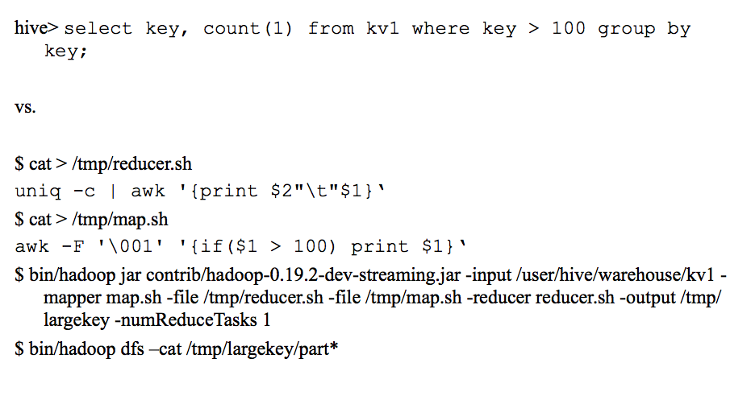
Discussion
Notes:
Source: http://www.sfbayacm.org/wp/wp-content/uploads/2010/01/sig_2010_v21.pdf

Slide 27
Discussion
Hive vs Pig
Hive is more natural to database developers and Pig is convenient for script/perl developers
Hive gives better performance than Pig
Pig is more suited for ETL and data movement, while Hive is better for ad hoc queries
Notes:
Pig: large-scale data processing system
Scripts are written in Pig Latin, a dataflow language
Developed by Yahoo!, now open source
Roughly 1/3 of all Yahoo! internal jobs
don’t use Hive for the automated batch jobs that move data between HDFS and other systems. Pig is better. Pig has better control in ETL.
Pig is procedural and Hive is declarative. Hive code will be lesser than Pig.
http://www.hadoopwizard.com/when-to-use-pig-latin-versus-hive-sql/
http://developer.yahoo.com/blogs/hadoop/comparing-pig-latin-sql-constructing-data-processing-pipelines-444.html
http://www.hadoopwizard.com/when-to-use-pig-latin-versus-hive-sql/

Slide 28
Discussion
“Hive is evolving as a parallel SQL DBMS which happens to use Hadoop as its storage and execution architecture”
Increasing HiveQL Capabilities
Insert, update and delete with full ACID support
REGEX support in selecting files for External Table
Support for ‘dual’ table, information_schema
Improving ‘Explain’
Optimization Techniques
Cost-based optimization
Performance Improvements
Adoption of RCFile for data placement, and most recently the ORC
Integration with other Frameworks
Support with HBase, Cassandra
Notes:
Cost based optimization: cost-model which can give a good estimate various plans before hand (using some meta-data already collected) and we can choose the best plan which incurs the least cost
https://issues.apache.org/jira/browse/HIVE-1938
RCFile: Record Columnar File http://en.wikipedia.org/wiki/RCFile http://www.cloudera.com/content/cloudera-content/cloudera-docs/Impala/1.0.1/Installing-and-Using-Impala/ciiu_rcfile.html
OCR: optimized Row Columnar file format, that is even more optimized than RCFile
Current version 0.12.0 released Oct 2013
http://www.slideshare.net/jsichi/hive-evolution-apachecon-2010
https://issues.apache.org/jira/browse/HIVE-5317
https://issues.apache.org/jira/browse/HIVE-951
https://issues.apache.org/jira/browse/HIVE-1558
https://issues.apache.org/jira/browse/HIVE-1010
https://issues.apache.org/jira/browse/HIVE-153
Hbase, Cassandra: https://issues.apache.org/jira/browse/CASSANDRA-913

Slide 29
References
[1] Hive paper
http://www.vldb.org/pvldb/2/vldb09-938.pdf
[2] Hive wiki
https://cwiki.apache.org/confluence/display/Hive/Home
[3] Hive performance benchmarks
https://issues.apache.org/jira/browse/HIVE-396
[4] Hive Facebook presentation
http://www.sfbayacm.org/wp/wp-content/uploads/2010/01/ sig_2010_v21.pdf
[5] Hive vs Pig: Yahoo developers
http://developer.yahoo.com/blogs/hadoop/pig-hive-yahoo-464.html
[6] Hive Apache JIRA page
https://issues.apache.org/jira/browse/HIVE

Slide 30
Backup Slides
Extra Material

Slide 31
HiveQL Capabilities
Simple and partition based queries
Joins
Aggregations
Multi-table or File inserts
Dynamic-partition inserts
Local file insert
Sampling
Union all
Array operations
Custom map-reduce scripts
Notes:
Mostly each select query’s result is inserted into tables
wiki hive tutorial https://cwiki.apache.org/confluence/display/Hive/Tutorial

Slide 32
Hive Data Model
External Tables
Point to existing data directories in HDFS, NFS or local directories
Used for data filtering
Serialization/De-serialization (SerDe)
Tables are serialized before storing into directories
Built-in formats using compression and lazy de-serialization
User defined (de)serialize methods are supported, called SerDe’s
Notes:
External Tables: If the data is not in table schema format, it is first staged (loaded) into external tables for filtering and then inserted into main tables for querying and analysis
SerDe:
short name for "Serializer and Deserializer."
Hive uses SerDe (and !FileFormat) to read and write table rows.
HDFS files --> InputFileFormat --> <key, value> --> Deserializer --> Row object
Row object --> Serializer --> <key, value> --> OutputFileFormat --> HDFS files
Note that the "key" part is ignored when reading, and is always a constant when writing. Basically row object is stored into the "value".
Some SerDef formats: Plain text, sequence files/binary files
Lazy Deserialize: only do when required for that object

Slide 33
Compilation Process
Parser
Converts query string to parse tree
Semantic Analyzer
Converts parse tree to block-based internal query representation
Verification, expansion of select * and type checking
Logical Plan Generator
Converts internal query to logical plan
Optimizer
Combines multiple joins
Adds repartition operator (ReducedSinkOperator)
Minimize data transfers and pruning
User hinted optimizations
Physical Plan Generator
Converts logical plan into physical plan (DAG of map-reduce jobs)

