Slide 1
GRAPH PROCESSING
Notes:
Hi, I am Mayank and the second presenter for today is Shadi.
We will be talking about Graph Processing.

Slide 2
Why Graph Processing?
Graphs are everywhere!
Notes:
Let’s start from the very basic question.
Why do we need graph processing?
The answer is simple and I am sure all of you already know.
Graphs are everywhere! We have the web, indexed web used by search engines, social networks-Facebook, Twitter, road networks and biological networks like brain networks, spread of disease networks, graphs representing relationship between genomic sequences and so on.

Slide 3
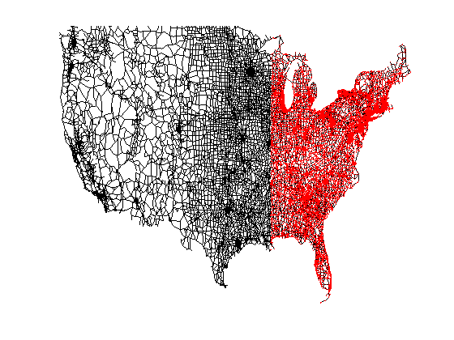
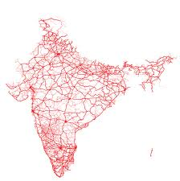
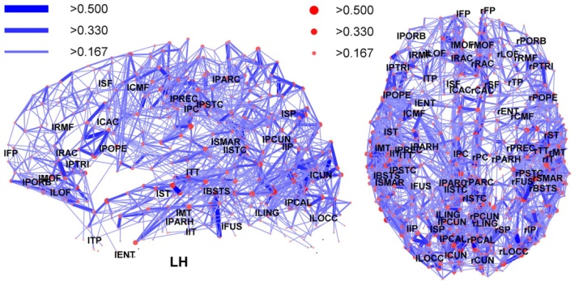
Why Graph Processing?
Notes:
Let’s start from the very basic question.
Why do we need graph processing?
The answer is simple and I am sure all of you already know.
Graphs are everywhere! We have the web, indexed web used by search engines, social networks-Facebook, Twitter, road networks and biological networks like brain networks, spread of disease networks, graphs representing relationship between genomic sequences and so on.

Slide 4
Why Distributed Graph Processing?
They are getting bigger!
Notes:
Another simple question is why do we need distributed graph processing?
Because these graphs are getting bigger!
Let me give you an idea of the scale that we are talking about!

Slide 5
Road Scale
>24 million vertices
>58 million edges
*Route Planning in Road Networks - 2008
Notes:
Starting from the scale of road networks
About 24 million vertices and 58 million edges in the US road network

Slide 6
Social Scale
>1 billion vertices
~1 trillion edges
*Facebook Engineering Blog
~41 million vertices
>1.4 billion edges
*Twitter Graph- 2010
Notes:
The social scale is bigger with about a billion vertices and nearly trillion edges

Slide 7
Web Scale
>50 billion vertices
>1 trillion edges
*NSA Big Graph Experiment- 2013
Notes:
The web scale is even bigger with an estimated 50 billion vertices

Slide 8
Brain Scale
>100 billion vertices
>100 trillion edges
*NSA Big Graph Experiment- 2013
Notes:
However, the biggest scale is the brain network scale with over 100 billion vertices and 100 trillion edges.
Moving on to the challenges that arise in parallel graph processing when dealing with such large scale graphs.

Slide 9
Challenges in parallel graph processing
Lumsdaine, Andrew, et al. "Challenges in parallel graph processing." Parallel Processing Letters 17.01 -2007
Notes:
Now, MapReduce is a very popular framework for batch processing of data. A natural question came up-why not simply use MapReduce for parallel graph processing. The framework will handle distribution and fault tolerance, speculative execution and all and everything will be perfect.
But, there are some unique properties of graphs that makes using MapReduce harder or lets say expensive and that paradigm is not a perfect match for graph processing.
I will be talking briefly about this paper published in the Parallel Processing Letters highlighting both software and hardware challenges for parallel graph processing. Remember, I am giving a brief history about how graph processing ahs evolved over the years.
I will discuss only the software challenges here. Some of them also highlight why MapReduce is not a perfect fit for graph processing.

Slide 10
Challenges
1
2
Structure driven computation
Data Transfer Issues
Irregular Structure
Partitioning Issues
*Concept borrowed from Cristina Abad’s PhD defense slides
Notes:
The first is that graph computations are data-driven in the sense that they incorporate the graph structure into the computations.
This gives rise to two issues:
It is not clear how the graph should be partitioned across the machines (Remember with MapReduce-partitioning files is easy)
Since, graph processing involves computation over the graph structure, these frameworks will incur a high overhead in the resultant data transfer. If it is not clear how data transfer comes into the picture more with graphs, it will become clear once I move onto how graphs are actually processed.
The next challenge is that graph data is irregular. Real world graphs like social graphs are Power law like graphs (The reason why I say power law like and not power law will also become clear in this presentation). What this means that there are some vertices with high degrees while others with low degrees.
This irregularity gives rise to two concerns:
It is not clear how partitioning should be performed – some vertices require more processing while others require less – how do you incorporate this into MapReduce.
Scalability of a MapReduce cluster will take a hit due to difficulty in achieving a good load balancing.
The next challenge is achieving locality with graph processing. Since the data is irregular, it is difficult to predict the access patterns of vertices – which vertex will be processed when, which vertex will require more data to be fetched over the network, how do you take these issues into account in MapReduce.

Slide 11
Overcoming the challenges
1
2
Extend Existing Paradigms
BUILD NEW FRAMEWORKS!
Notes:
Now, what possible solutions did the community come up with.
The solutions proposed can be classified into two broad categories:
Extend MapReduce and make changes to solve these challenges
Come up with novel paradigms and frameworks.
This talk is mainly about the second solution but let me give you just a brief example of how the community tried to shoehorn graph processing in
MapReduce.

Slide 12
Build New Graph Frameworks!
Key Requirements from Graph Processing Frameworks
Notes:
Moving on to the second approach i.e. coming up with paradigms/frameworks that handle graph processing by themselves. Paradigms designed just for graph processing.
Before I discuss graph processing frameworks, what are the key requirements from these frameworks.

Slide 13
1
2
3
Less pre-processing
4
5
Low and load-balanced computation
Low and load-balanced communication
Low memory footprint
Scalable wrt cluster size and graph size
Notes:
First Depends on number and distribution of vertices and edges across servers
Second depends on quantity and distribution of data exchanged among vertices across servers
Third for quick initialization of the graph

Slide 14
Pregel
Malewicz, Grzegorz, et al. "Pregel: a system for large-scale graph processing.“ ACM SIGMOD -2010.
Notes:
This started with Google coming up with a vertex centric form of computation called Pregel. The idea is simple – you have to think like a vertex.

Slide 15
Life of a Vertex Program
Iteration 0
Iteration 1
Placement
Of Vertices
Computation
Computation
Communication
Communication
Barrier
Barrier
Barrier
Time
*Concept borrowed from LFGraph Slides
Notes:
Think like a vertex
If you visualize how graph processing works – there is some computation done at the vertex which passes along the computation results along the edges.
I will explain this with an example.
Let us first look at the life of a vertex centric program.
The entire computation is broken down into iterations/supersteps. In each iteration, there is a computation phase and a communication phase. During the computation phase, the vertices perform computation and during the communication phase, they transfer the results of the computation to their neighbors.
More concretely, In each superstep, a vertex receives messages sent to the vertex in superstep S-1, performs some computation in a user defined function compute() and sends messages to either its neighbors or any other vertex with a known identifier (these messages are received in superstep S+1)
But the core idea is that the programmer should just have to worry about what each vertex does and the framework does the rest itself. The framework will ensure that these vertex programs are executed parallely and the messages are delivered to the right vertices. Fault tolerance is also handled by the framework, things like speculative execution of a vertex program are handled.
Overlapping computation and communication

Slide 16
Sample Graph
B
D
A
C
E
*Graph Borrowed from LFGraph Paper
Notes:
Let us take the example if single source shortest paths to make this clear. This is a sample graph with five vertices – All edge weights are same and equal to 1.
Each vertex has an id and a value. The value denotes the shortest path distance to source.
In superstep 0, no messages received. The value is either initialized to 0 (if vertex is source) or MAX (otherwise) and advertized to neighbors
In other supersteps, the vertex determines the minimum value of all the messages received. If this minimum is smaller than the value that the vertex currently holds, the value is updated and advertized to neighbors

Slide 17
Shortest Path Example
B
D
A
C
E
Notes:
The aim is to compute the distance from a single source – in this case B. Initially, all vertices have this distance as infinity.

Slide 18
Iteration 0
B
0
D
∞
Message (0+1)
A
∞
C
∞
E
∞
Notes:
In iteration zero, each vertex checks if it is the source. If it is, it makes its value 0. Otherwise, the value remains infinity.
If the value of a vertex changes, it forwards the value plus the edge value along all outgoing edges.
In this case, B sends a message with value 1 towards A.

Slide 19
Iteration 1
B
0
D
∞
Message (1+1)
A
1
Message (1+1)
C
∞
E
∞
Notes:
In the next iteration, A simply takes the minimum of values received in the messages (minimum because only the minimum value matters).
If the minimum is smaller than the value that the vertex already had, it makes its value as that smaller value. In this case, A makes its value 1. Since, there was a change in its value. It propagates the change to its neighbours.
If you all haven’t already guessed – this is basically breadth first search happening iteratively.

Slide 20
Iteration 2
B
0
D
2
A
1
C
∞
E
2
Notes:
This continues till no more values change.

Slide 21
Can we do better?
GOAL | PREGEL
Computation | 1 Pass
Communication | ∝ #Edge cuts
Pre-processing | Cheap (Hash)
Memory | High (out edges + buffered messages)
Notes:
What was the problem with this simple yet powerful paradigm?
The main problem is that vertices communicate with each other. Hence, A sends its values to both D and E even though they are on the same server.
Pregel provides an abstraction called combiners where all messages being sent to a particular vertex from the same server are combined. For example, in the single source shortest paths case, the vertex does not need to receive all messages, it just needs to receive the message which has the smallest value. Combiners do this. However, they need an additional pass over messages.

Slide 22
Lfgraph – Yes, we can!
Hoque, Imranul, and Indranil Gupta. "LFGraph: Simple and Fast Distributed Graph Analytics”. TRIOS-2013
Notes:
So came LFGraph with the aim of minimizing the three requirements memory, computation and communication.

Slide 23
Features
B
D
Cheap Vertex Placement: Hash Based
A
C
E
Low graph initialization time
Notes:
Next feature that I have already touched upon is the cheap hash based initial vertex placement. This reduces the time required for the initialization of the graph.

Slide 24
Features
B
D
Publish Subscribe fetch once information flow
A
C
E
Low communication overhead
Notes:
Moving on to the four main features of LFGraph that helps it achieve superior performance as compared to the exisiting frameworks.
The first is the fetch once behavior achieved using the publish subscribe lists. Server 2 needs to fetch the value of Vertex A only once and not the case like in Pregel where each vertex receives the value in a message.

Slide 25
Subscribe
B
D
A
C
E
Subscribing to vertex A
Notes:
The first step is partitioning. LFGraph chooses to use a cheap partitioning strategy (unlike PowerGraph and GraphLab) that perform expensive initial vertex partitioning. We will see the benefits from this cheap initial partitioning in the experiments section. The cheal partitioning used is simple hashing.
Next, servers subscribe for vertices. Server 2 realizes that its vertices need the value of vertex A so it communicates this to Server 1.

Slide 26
Publish
B
D
A
C
E
Publish List of Server 1: (Server2, A)
Notes:
Based on this communication, each server builds a publish list. For each server, values of which vertices need to be sent to that server. This is maintained for each server and at each server.

Slide 27
LFGraph Model
B
D
A
Value of A
C
E
Notes:
Next, the vertex centric computations are performed on each server. And, at the end of the iteration, each server simply looks at the publish list and sends the values of vertices that each server needs.
I did not discuss one important aspect of computation. When computation is performed, the values of vertices may change. This changed value is stored in one place while the original values are kept in another place. These two copies are required because a vertex may have edge to another vertex on the same server. For example, here the value of A may change during computation – so the vertices B and C should read the value that existed before the iteration started. The other way to do this is to lock the vertices. Locking is much more expensive than maintaining two copies. LFGraph opts for computation savings in this case at the cost of extra memory overhead. However, the authors show that the space overhead of keeping these values is not much.

Slide 28
Features
B
D
Only stores in-neighbor vertices
A
C
E
Reduces memory footprint
Notes:
LFGraph needs to store only the in-neighbors. Out neighbors are not required since each vertex that has in neighbors on other servers uses the publish subscribe list to inform the server.

Slide 29
In-neighbor storage
B
D
Remote in-neighbor – read locally available value
A
Local in-neighbor – simply read the value
C
E
Notes:
The first step is partitioning. LFGraph chooses to use a cheap partitioning strategy (unlike PowerGraph and GraphLab) that perform expensive initial vertex partitioning. We will see the benefits from this cheap initial partitioning in the experiments section. The cheal partitioning used is simple hashing.
Next, servers subscribe for vertices. Server 2 realizes that its vertices need the value of vertex A so it communicates this to Server 1.

Slide 30
Iteration 0
B
0
D
∞
A
∞
C
∞
E
∞
Notes:
In iteration zero, each vertex checks if it is the source. If it is, it makes its value 0. Otherwise, the value remains infinity.
If the value of a vertex changes, it forwards the value plus the edge value along all outgoing edges.
In this case, B sends a message with value 1 towards A.

Slide 31
Iteration 1
B
0
D
∞
Read value 0
A
∞
A
1
Value of A
Read value ∞
C
∞
Value change in duplicate store
E
∞
Notes:
In the next iteration, A simply takes the minimum of values received in the messages (minimum because only the minimum value matters).
If the minimum is smaller than the value that the vertex already had, it makes its value as that smaller value. In this case, A makes its value 1. Since, there was a change in its value. It propagates the change to its neighbours.
If you all haven’t already guessed – this is basically breadth first search happening iteratively.

Slide 32
Iteration 2
B
0
D
∞
D
2
Local read of A
A
1
Local read of A
C
∞
E
∞
E
2
Notes:
This continues till no more values change.

Slide 33
Features
B
D
Single Pass Computation
A
C
E
Low computation overhead
Notes:
The third feature is the single pass computation. The framework just makes one pass over the vertices during the computation phase. An additional pass is obviously required in the communication phase. I hope I am clear about passes in computation. In each computation phase, the framework needs to go through the list of vertices and execute the vertex centric program once for each vertex.

Slide 34
Life of a Vertex Program
Iteration 0
Iteration 1
Placement
Of Vertices
Computation
Communication
Computation
Communication
Barrier
Barrier
Barrier
Time
*Concept Borrowed from LFGraph Slides
Notes:
Think like a vertex
Unlike Pregel, decouples computation and communication – independent growth of each other.
If you visualize how graph processing works – there is some computation done at the vertex which passes along the computation results along the edges.
I will explain this with an example.
Let us first look at the life of a vertex centric program.
The entire computation is broken down into iterations/supersteps. In each iteration, there is a computation phase and a communication phase. During the computation phase, the vertices perform computation and during the communication phase, they transfer the results of the computation to their neighbors.
More concretely, In each superstep, a vertex receives messages sent to the vertex in superstep S-1, performs some computation in a user defined function compute() and sends messages to either its neighbors or any other vertex with a known identifier (these messages are received in superstep S+1)
But the core idea is that the programmer should just have to worry about what each vertex does and the framework does the rest itself. The framework will ensure that these vertex programs are executed parallely and the messages are delivered to the right vertices. Fault tolerance is also handled by the framework, things like speculative execution of a vertex program are handled.

Slide 35
How everything Works
Notes:
Explain this?

Slide 36
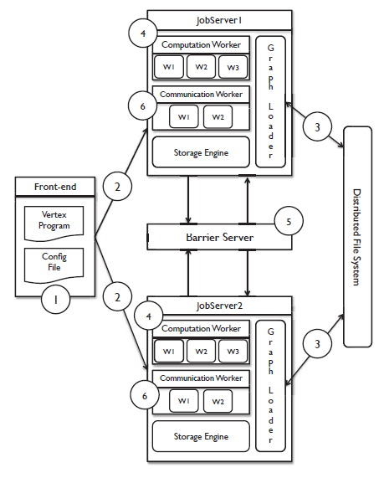
Notes:
Front End servers: Store vertex program and configuration file (regarding graph data, number of servers, ips, ports, number of computation and communication job servers etc)
It sends the vertex program and configuration file to all the servers
Graph Loaders load the graph parallely across servers and store it in storage engine
Each server then enters the barrier
Barrier waits for all servers to enter and then signals them to continue
Job Server spawns multiple workers to compute on a part of the graph – shard
Job Server enters barrier at the end of all worker thread completion
After signal from Barrier Server, communication phase just like computation phase
And repeat

Slide 37
GraphLab
Low, Yucheng, et al. "Graphlab: A new framework for parallel machine learning”. Conference on Uncertainty in Artificial Intelligence (UAI) - 2010

Slide 38
GraphLab Model
B
D
D
A
A
C
E
E
Notes:
Next came GraphLab. The idea here is to create ghost vertices. The idea is to have zero communication within an iteration. Ghost vertices are created for vertices that have an edge from a vertex on another server. In this example- A has an edge to D and E. So a ghost vertices D and E is created on Server 1. Similarly, a ghost vertex is created for vertex A on Server 2. All the values that the vertices on each server need are present with the server. However, if the value of D changes after an iteration, it needs to be communicated to all its ghost vertices. In this example, if the value of A changes on server 1 in iteration s, that new value will be communicated to server 2 after iteration s and before iteration s+1.

Slide 39
Can we do better?
GOAL | GRAPHLAB
Computation | 2 passes
Communication | ∝ #Vertex Ghosts
Pre-processing | Cheap (Hash)
Memory | High (in & out edges + ghost values)
Notes:
The communication overhead here is proportional to the number of ghosts. Additionally, the servers need to store both in and out vertices to handle the ghost vertices. Also, there is a 2 pass computation with one pass for value updates and one for neighbor activation (i.e. determine if a vertex needs to perform any computation – performs computation only if it has an active neighbor/ i.e. it is receiving a message)

Slide 40
PowerGraph
Gonzalez, Joseph E., et al. "Powergraph: Distributed graph-parallel computation on natural graphs." USENIX OSDI - 2012.

Slide 41
PowerGraph Model
B
D
A1
A2
C
E
Notes:
Next came PowerGraph, the idea here is mirrors. Instead of creating ghost vertices, the vertices which have edges on multiple servers have mirrors on all the servers. For example, the vertex A creates two mirrors – one on Server 1 and another on Server 2. Now, just like ghost vertices, the values of mirrors need to be accumulated.
It assigns a master mirror that collects all values and sends the final value to all mirrors.

Slide 42
Can we do better?
GOAL | POWERGRAPH
Computation | 2 passes
Communication | ∝ #Vertex Mirrors
Pre-processing | Expensive (Intelligent)
Memory | High (in & out edges + mirror values)
Notes:
Therefore, here the communication overhead is twice the number of mirrors.
All these are excellent approaches but can we do better?
The problem is that there are three major requirements from a graph framework – low memory overhead, low computation overhead and low communication overhead. But all of them do not go hand in hand. Can we minimize each in a single framework. The frameworks that we discussed till now trade one for another. I will discuss the comparison between all the frameworks in a later slide.

Slide 43
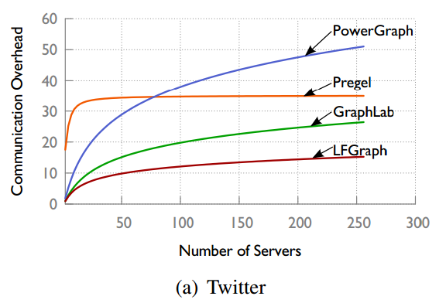
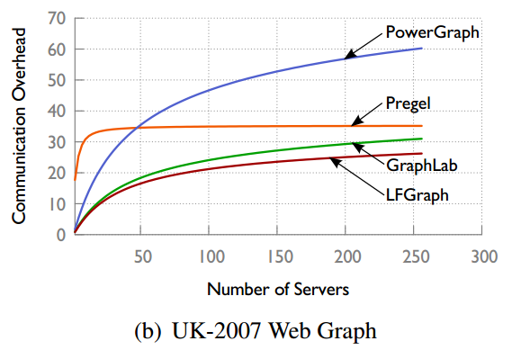
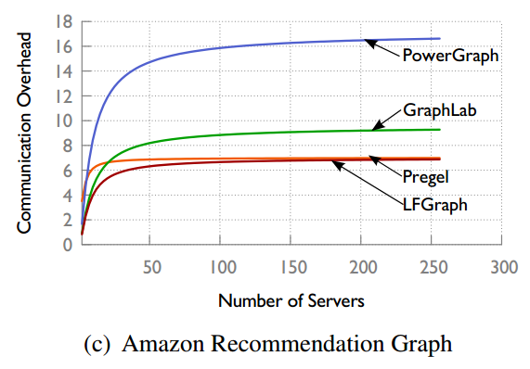
Communication Analysis
External
on edge cuts
Mirrors -
in and out neighbors
Ghost vertices -
in and out neighbors
External in neighbors
Notes:
The authors used the equations that they derived to calculate the expected communication overhead as the number of servers increases for real world graphs. This is Twitter.
LFGraph is better than all.
But one interesting observation is that LFGraph is still increasing at 250 while Pregel plateaus. No matter how many servers, the probability of having neighbors on other servers is uniform

Slide 44
Computation Balance Analysis
Power Law graphs have substantial load imbalance.
Power law graphs have degree d with probability proportional to d^{-α}.
Lower α means a denser graph with more high degree vertices.
Notes:
I mentioned before that Cheap hash based partitioning is better than expensive intelligent partitioning. Let us discuss exactly why this is the case.
It has been shown in several studies that Power Law graphs have substantial load imbalance if we use a random hash based partitioning. People have used this to motivate the need for an intelligent partitioning strategy up front to reduce the imbalance. Remember that more the imbalance more is the execution time. Since there are barriers, each iteration is only as fast as the slowest worker.
However, are real world graphs same as ideal power law graphs.

Slide 45
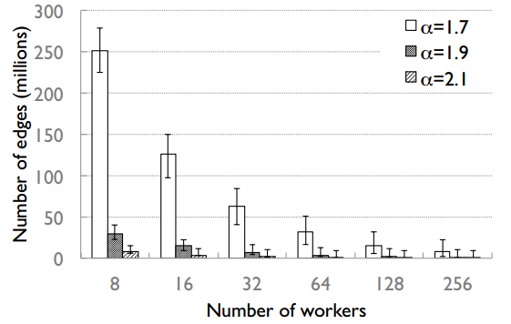
Computation Balance Analysis
Notes:
The runtime of a computation worker during an iteration is proportional to the total number of in edges processed by that worker
If we use synthetic ideal power law graphs, it is true the imbalance is high.

Slide 46
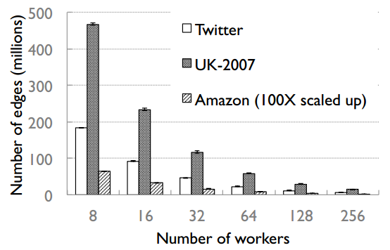
Computation Balance Analysis
Notes:
However, if we use real world graphs, the imbalance is low. So whats the difference between power law graphs and real world graphs.

Slide 47
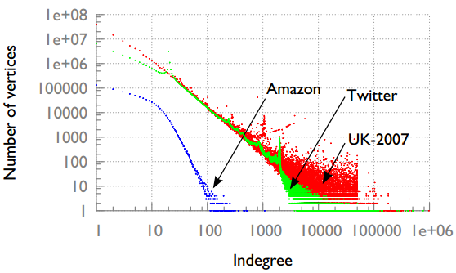
Real World vs Power Law
Notes:
While ideal power-law graphs have a straight tail in their log-log plot, each of the real graphs has a funnel at its tail.
This indicates that in real graphs there are lots of the highest degree vertices – so they spread out and become load-balanced across
servers, because the servers are far fewer in number than vertices. On the other hand, in an idealized power-law graph, there is only one of the very highest degree vertex and this causes unbalanced load.

Slide 48
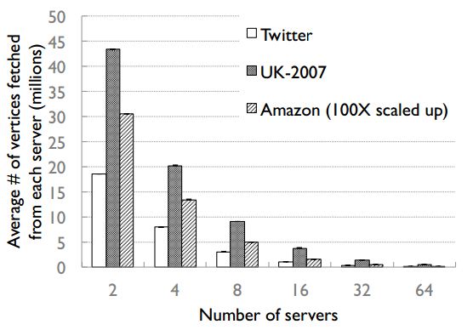
Communication Balance Analysis
Notes:
If we plot the total number of vertices fetched during the communication phases, we observe very little imbalance across the workers showing that communication is balanced in LFGraph.

Slide 49
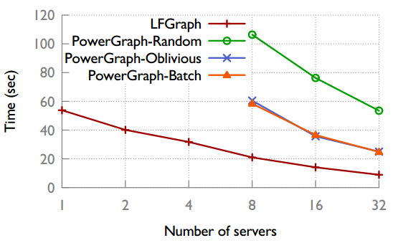
PageRank – Runtime w/o partition
Notes:
Random – randomly place edges across machines
Batch (greedy partitioning without global coordination) – In a greedy manner, place the next edge on the machine that minimizes the number of mirrors /replication factor - with global co-ordination using a global table
Oblivious (greedy partitioning with global coordination) – Each machine locally decides – no global coordination
LFGraph is 2x faster than the best PowerGraph variant

Slide 50
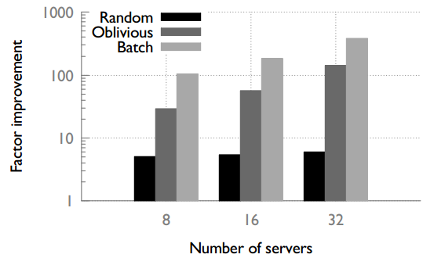
PageRank – Runtime with partition
Notes:
In a small cluster with 8 servers, LFGraph is between 4x to 100x faster than the PowerGraph variants.
In a large cluster with 32 servers the improvement grows to 5x–380x.
We observed that PowerGraph’s intelligent partitioning schemes contributed 90% –99% to the overall runtime for the PageRank benchmark.
In a small cluster, distributed graph processing is compute-heavy thus intelligent partitioning
(e.g., in PowerGraph) has little effect. In a large cluster, intelligent partitioning can speed up iterations – however, the partitioning cost itself is directly proportional to cluster size and contributes sizably to runtime.

Slide 51
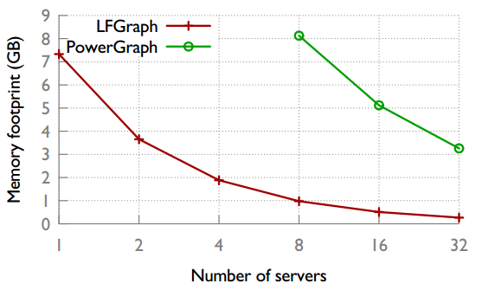
PageRank – Memory footprint
Notes:
Used smem tool to measure memory footprint for LFGraph
Heap Space reported in the Debug Logs to estimate memory footprint
LFGraph uses 8x to 12x less memory than PowerGraph.

Slide 52
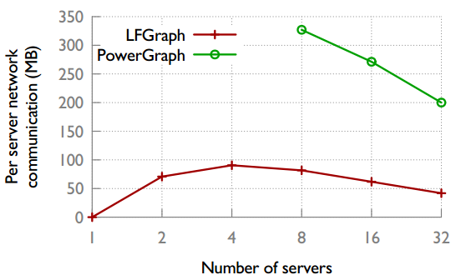
PageRank – Network Communication
Notes:
LFGraph transfers about 4x less data per server than PowerGraph
As the cluster size is increased, there is first a quick rise in the total communication overhead (see Section 4 and Figure 3).
Thus the per-server overhead rises at first. However as the total communication overhead plateaus out, the cluster size increase takes over, thus dropping the per-server overhead. This creates the peak in between.
*Emulab has full-bisection badwidth

Slide 53
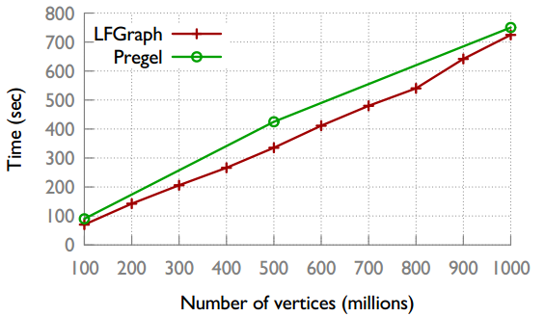
Scalability
Notes:
We create 10 synthetic graphs vary ing in number of vertices from 100M to 1B, and with up to 128B edges. We run the SSSP benchmark on it.
mu =4 and sigma =1.3
However, different numbers of servers for Pregel and LFGraph and different configurations on these servers
300 servers with 800 workers vs 12 servers with 96 workers

Slide 54
X-Stream: Edge-centric Graph Processing using Streaming Partitions
* Some figures adopted from author’s presentation

Slide 55
Motivation
Can sequential access be used instead of random access?!
Can large graph processing be done on a single machine?!
X-Stream
Notes:
Sequential access by far faster than random access.

Slide 56
Sequential Access: Key to Performance!
Medium | Read (MB/s) |  |  | Write (MB/s)
 | Random | Sequential | Speed up | Random | Sequential | Speed up
RAM (1 core) | 567 | 2605 | 4.6 | 1057 | 2248 | 2.2
RAM (16 core) | 14198 | 25658 | 1.9 | 10044 | 13384 | 1.4
SSD | 22.5 | 667.69 | 29.7 | 48.6 | 576.5 | 11.9
Magnetic Disk | 0.6 | 328 | 546.7 | 2 | 316.3 | 158.2
Speed up of sequential access over random access in different media
Test bed: 64 GB RAM + 200 GB SSD + 3TB drive
Notes:
Sequential access beats random access for every medium
Increasing performance for slower media
Even in ram faster because of pre fetching!
Random write better than read:
RAM: write coalescing buffers in the architecture of the used RAM
Write cache on disk ( absorbing writes, letting next write to be done while the previous is outstanding)
Why 16 less than 1?
We need to use 16 to saturate the memory
Why increasing for slower media?
Of their architectur moving head is expensive, ram is designed for random access

Slide 57
How to Use Sequential Access?
Edge-Centric Processing
Sequential access …

Slide 58
Vertex-Centric
Scatter
U
{state}
for each vertex v
if state has updated
for each output edge e of v
scatter update on e
Update u1
Update u2
Update un
Notes:
State stored in vertices
Scatter updates along outgoing edge
Gather updates from incoming edges

Slide 59
Vertex-Centric
Gather
Update v1
for each vertex v
for each input edge e of v
if e has an update
apply update on state
Update v2
V
{state}
V
{state2}
Update vn
Notes:
State stored in vertices
Scatter updates along outgoing edge
Gather updates from incoming edges

Slide 60
Vertex-Centric
SOURCE | DEST
1 | 3
1 | 5
2 | 7
2 | 4
3 | 2
3 | 8
4 | 3
4 | 7
4 | 8
5 | 6
6 | 1
8 | 5
8 | 6
Lookup Index
1
6
3
V
1
2
3
4
5
6
7
8
7
2
5
8
4
BFS

Slide 61
Edge-Centric
Scatter
A
Update u1
for each edge e
if e.source has updated
scatter update on e
B
C
Update un
= Updated Vertex
Notes:
State stored in vertices
Scatter updates along outgoing edge
Gather updates from incoming edges

Slide 62
Edge-Centric
Gather
Update u1
X
X
for each update u on edge e
apply update u to e.destination
Update u2
Y
Y
Update un
Z
Z
= Updated Vertex
Notes:
State stored in vertices
Scatter updates along outgoing edge
Gather updates from incoming edges
Scatter and gather in a loop until termination criterion is met
When edge set >> vertex set the benefit of streaming rather than accessing randomly increases

Slide 63
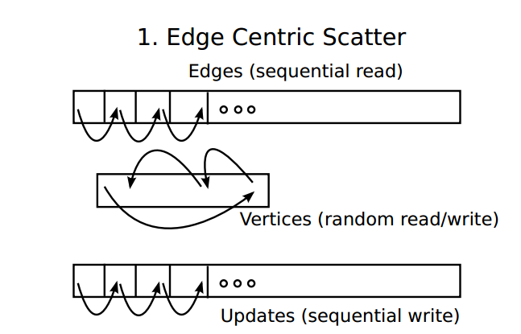
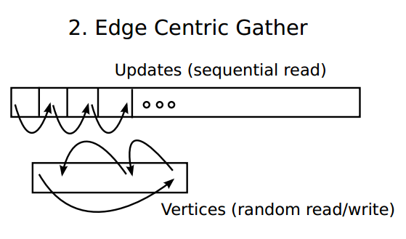
Sequential Access via Edge-Centric!
In Slow Storage
In Fast Storage
In Slow Storage
Notes:
Streaming data from slow storage

Slide 64
Fast and Slow Storage

Slide 65
Edge-Centric
SOURCE | DEST
1 | 3
1 | 5
2 | 7
2 | 4
3 | 2
3 | 8
4 | 3
4 | 7
4 | 8
5 | 6
6 | 1
8 | 5
8 | 6
Lots of wasted reads!
1
6
3
V
1
2
3
4
5
6
7
8
Large Diameter makes
X-Stream slow and wasteful
7
2
5
8
4
Most real world graphs have small diameter
BFS
Notes:
Wasted edges!

Slide 66
Order is not important
SOURCE | DEST
1 | 3
1 | 5
2 | 7
2 | 4
3 | 2
3 | 8
4 | 3
4 | 7
4 | 8
5 | 6
6 | 1
8 | 5
8 | 6
SOURCE | DEST
1 | 3
8 | 6
5 | 6
2 | 4
3 | 2
4 | 7
4 | 3
3 | 8
4 | 8
2 | 7
6 | 1
8 | 5
1 | 5
No pre-processing (sorting and indexing) needed!
=
Notes:
No index
No clustering
No sorting

Slide 67
But, still …
Random access for vertices
Vertices may not fit into fast storage
Streaming Partitions

Slide 68
Streaming Partitions
V=Subset of vertices
Mutually disjoint
E=Outgoing edges of V
Constant set
U=Incoming updates to V
Changing in each scatter phase
Notes:
Union of Vs must create all vertices
V must fit in fast storage → The number of partition is important for the performance
3 streaming files

Slide 69
Scatter and Shuffle
Fast Memory
V1
Load
Vertex set
v1
v2
v3
…
E1
Read source
Input buffer
e1
e2
e3
…
U1
Stream
Add update
Update buffer
u1
u2
u3
…
…
Shuffle
Vn
Output buffer
u'1
u'2
u'3
…
En
Append to updates
Un
Notes:
They have an extra in and out buffer for streaming

Slide 70
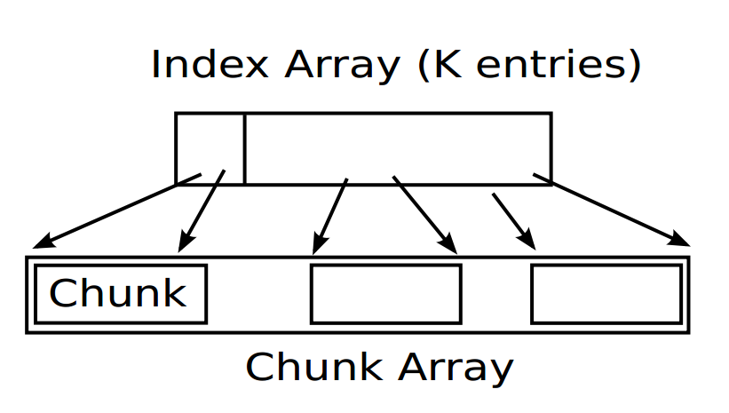
Shuffle
Stream Buffer with k partitions
Notes:
Static allocation!
Create index array
Copy updates to partition chunks

Slide 71
Gather
Fast Memory
V1
Load
Vertex set
v1
v2
v3
…
E1
Apply update
U1
Stream
Update buffer
u1
u2
u3
…
No output!

Slide 72
Parallelism
State stored in vertices
Disjoint vertex set in partitions
Compute partitions in parallel
Parallel scatter and gather

Slide 73
Experimental Results

Slide 74
X-Stream Speedup over Graphchi
Mean Speedup = 2.3
Speedup without considering the pre-process time of Graphchi
Notes:
Why some less?? Higher waste -> either the algorithm it self or bigger diameter
Wcc: weakly connected components
Belief propagation:
Pagerank:
Als alternating Least Squares
Graphchi uses “shards”
Partitions edges into sorted shards
First to bring notion of sequential access
V and in/out edges of the shard need to be in memory at the same time! → more shards!
Needs pre sorting( based on src) , are resorting of updates
X-Stream uses sequential scans
Partitions edges into unsorted streaming partitions
Without pre sorting time

Slide 75
X-Stream Speedup over Graphchi
Mean Speedup = 3.7
Speedup considering the pre-process time of Graphchi
Notes:
Mainly bacuse of re-sorting ( to destination)60%
Incomplete use of available streaming bandwidg from ssd ( more shardes fits edges as well)

Slide 76
X-Stream Runtime vs Graphchi Sharding
Notes:
X-Stream returns answers before Graphchi finishes sharding In 3/4

Slide 77
Disk Transfer Rates
Metric | X-Stream | Graphchi
Data moved | 224 GB | 322 GB
Time taken | 398 seconds | 2613 seconds
Transfer rate | 578 MB/s | 126 MB/s
Data transfer rates on Page Rank algorithm on Twitter workload
SSD sustain reads = 667 MB/s, writes = 576 MB/s
Notes:
X-Stream uses all available bandwidth from the storage device

Slide 78
Scalability on Input Data size
256 Million V, 4 Billion E, 33 mins
4 Billion V, 64 Billion E,
26 hours
8 Million V, 128 Million E, 8 sec
RAM
SSD
Disk
Notes:
Weakly connected components
Log-log -> linear linear
Unordere graph -> easily ahndles bigger graphs
330M edges added at time WCC
Why 3 out of 16?

Slide 79
Discussion
Features like global values, aggregation functions, asynchronous computation missing from LFGraph. Will the overhead of adding these features slow it down?
LFGraph assumes that all edge values are same. If the edge values are not, either the receiving vertices or the server will have to incorporate that value. Overheads?
LFGraph has one pass computation but then it executes the vertex program at each vertex (active or inactive). Trade-off?

Slide 80
Discussion
Independent computation and communication rounds may not always be preferred. Use bandwidth when available.
Faul Tolerance is another feature missing from LFGraph. Overheads?
Three benchmarks for experiments. Enough evaluation?
Scalability comparison with Pregel with different experiment settings. Memory comparison with PowerGraph based on heap values from logs. Fair experiments?

Slide 81
Discussion
Could the system become asynchronous?
Could the scatter and gather phase be combined into one phase?
Does not support iterating over the edges/updates of a vertex. Can this be added?
How good do they determine number of partitions?
Can shuffle be optimized by counting the updates of each partition during scatter?
Notes:
In partitions number they assume uniform distribution of updates. How realistic? In traversal algorithms?

Slide 82
Thank you for listening! Questions?

Slide 83
Backup Slides

Slide 84
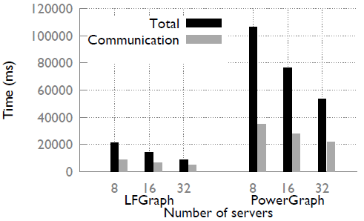
Reason for Improvement
Notes:
In LFGraph, computation and communication phases are independent. Independent growth of each phase + Communication can be batched
In PowerGraph, the two phases overlap ->Communication negatively impacts computation

Slide 85
Qualitative Comparison
GOAL | PREGEL | GRAPHLAB | POWERGRAPH | LFGRAPH
Computation | 2 passes, Combiners | 2 passes | 2 passes | 1 pass
Communication | ∝ #Edge cuts | ∝ #Vertex Ghosts | ∝ #Vertex Mirrors | ∝ #External in-neighbors
Pre-processing | Cheap (Hash) | Cheap (Hash) | Expensive (Intelligent) | Cheap (Hash)
Memory | High (out edges + buffered messages) | High (in & out edges + ghost values) | High (in & out edges + mirror values) | Low (in edges + remote values)
Notes:
Here is the table given in the paper pointing out the qualitative comparison between various frameworks. As you can see, LFGraph achieves the minimum overheads across the categories. I will not spend time on the table too much but it is clear.

Slide 86
Backup Slides

Slide 87
Read Bandwidth - SSD
Notes:
Gather-> all read . No write-> write=0
Scatter -> bursty
Sequential access bandwidth
Graphchi shard
All vertices and edges must fit in memory
X-Stream partition
Only vertices must fit in memory
More Graphchi shards than X-Stream partitions
Makes access more random for Graphchi

Slide 88
Write Bandwidth - SSD

Slide 89
Scalability on Thread Count
Notes:
Wcc bfs traversal

Slide 90
Scalability on Number of I/O Devices
Notes:
HDD RMAT:30
SSD RMAT:27
Take advantage of extra disk!

Slide 91
Sharding-Computing Breakdown in Graphchi

Slide 92
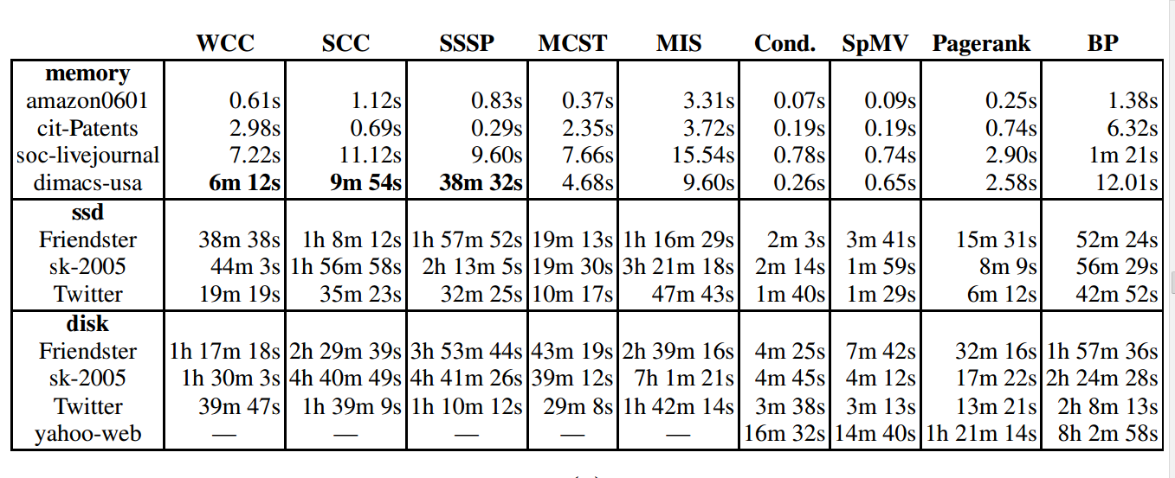
X-Stream not Always Perfect

Slide 93
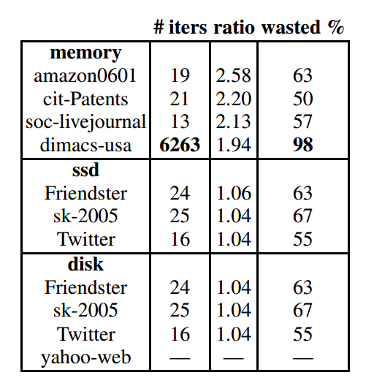
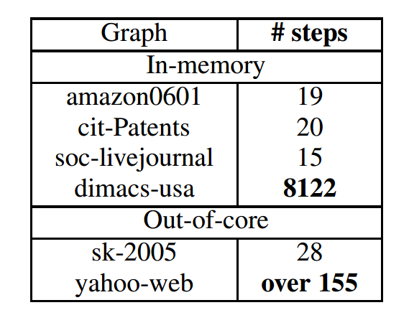
Large Diameter makes X-stream Slow!
Notes:
Ratio of execution to streaming

Slide 94
In-Memory X-Stream Performance
Notes:
Less difeernce since more cores -> differnce random decreases

Slide 95
Ligra vs. X-Stream
Notes:
Pre processing only once, used many times!
Xstrema not always the best especially traversal algoritms ( high waste)
Pre 7-8x more than xstream

Slide 96
Discussion
The current implementation is on a single machine, can it be extended to clusters?
Would it still perform good
How to provide fault tolerance and synchronization?
The waste rate is high (~65%). Could this be improved?
Can the partition be more intelligent? Dynamic partitioning?
Could all vertex-centric programs be converted to edge-centric?
When does streaming outperform random access?
Notes:
There is waste reads with streaming, but streaming is faster than random access. When to choose which? If more edges -> more random access → makes slower, but more wastage at the same time
Intelligent partition:
try to put vertices that have the same output vertex set together
try to have same edge list size of the set for load balancing
dynamic can cause a high overhead
This would cause overhead, and we want low overhead!

