Slide 1
CloudScale: Elastic Resource Scaling for Multi-Tenant Cloud Systems
Zhiming Shen, Sethuraman Subbiah, Xiaohui Gu, John Wilkes

Slide 2
CloudScale: Background
Background and Motivation
Infrastructure as a Service(Iaas) providers like Amazon EC2 uses virtualizations to provide isolation among users
Service Level Objective(SLO)
An agreement between a service provider and a customer, about the performance of service provider in terms of measurable characteristics (e.g. 90% of the requests are fulfilled within 100ms)
VM1
VM2
Physical Host
Notes:
Introduce SLO

Slide 3
CloudScale
Automatic resource scaling system
Goal: meet Service Level Objective(SLO) requirements of the applications with minimum resource and energy cost

Slide 4
The CloudScale System Architecture
Resource demand prediction
Host
Prediction error correction
CloudScale
Virtual Machine
Virtual Machine
Virtual Machine
Scaling conflict handling
Dom 0
Xen hypervisor
Predictive frequency/voltage scaling
Graph adapted from original paper

Slide 5
Module 1: Resource Demand Prediction
Goal: predict future resource demand based on past
Signature-driven resource demand prediction
Pattern Windows
P₁
P₂
P₃
P₄
P₅
If all pairs of pattern windows P_{i} and P_{j} are similar(determined by Pearson correlation), CloudScale uses the average values over all pattern windows to make its prediction.
Pearson Correlation(X,Y) = $\frac{Cov(X,Y)}{SD\left(X\right)SD(Y)}$

Slide 6
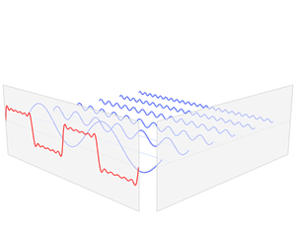
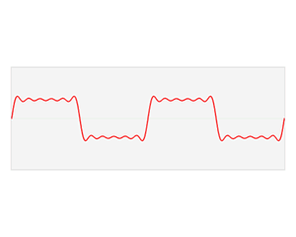
Module 1: Resource Demand Prediction
How to determine the size of pattern window?
Apply Fast Fourier Transform
Resource Usage
Time
Frequency components
f_{d} = frequency of the frequency component with most signal power
Signal power of f = $\lim_{T→∞}{\frac{1}{T} \int_{−T/2}^{T/2}{\left(\left|f\left(t\right)\right|\right)2}dt)}$
Pattern window size = $\frac{r}{\text{f}\text{d}}$, r is sampling rate
Graphs from http://en.wikipedia.org/wiki/Frequency_domain

Slide 7
Module 1: Resource Demand Prediction
State-driven resource demand prediction
Used when no signature is found
State-transition matrix P_{ij}
 | State 1 | State 2 | State 3
State 1 | 0.5 | 0.3 | 0.2
State 2 | 0.2 | 0.6 | 0.2
State 3 | 0.3 | 0.4 | 0.3
State 2
CPU [30 %, 60%)
State 1
State 3
CPU [0 %, 30%)
CPU [60 %, 100%)

Slide 8
The CloudScale System Architecture
Resource demand prediction
Host
Predicted Resource demands
Prediction error correction
CloudScale
Virtual Machine
Virtual Machine
Virtual Machine
Scaling conflict handling
Dom 0
Xen hypervisor
Predictive frequency/voltage scaling
Graph adapted from original paper

Slide 9
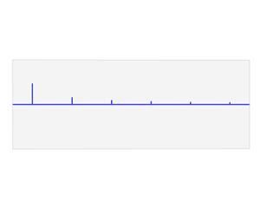
Module 2: Prediction Error Correction
Why? Avoid under-estimation correction
Proactive Approach : Burst-based Padding
Frequency Domain
Amplitude
Frequency
Frequency components
Apply Reverse Fast Fourier Transform
Top k frequencies in frequency spectrum
Graphs from http://en.wikipedia.org/wiki/Frequency_domain

Slide 10
Module 2: Prediction Error Correction
Burst density: percentage of positive values in burst pattern
If burst density > 50%, CloudScale uses maximum of all burst values as padding value

Slide 11
Module 2: Prediction Error Correction
Proactive Approach : Remedial Padding
Prediction Errors (e_{1,} e₂ … ) = Real Resource Demand – Predicted Resource Demand
Remedial Padding Value = Weighted Moving Average of | (e_{1,} e₂ … ) |
Padding Value = max(Burst-based value, Remedial Padding)

Slide 12
Module 2: Prediction Error Correction
Reactive Approach: Fast Under-estimation Correction
Challenge: real resource demand is unknown during under-provisioning
Real Resource Demand

Slide 13
Module 2: Prediction Error Correction
When to trigger reactive error correction?
Let P = $\frac{Resource Usage}{Resource Cap}$ , i.e. resource pressure
Trigger under-estimation when P ≥ P_{under} (90%, etc)
How to determine α (resource scale-up ratio)?
α $= \frac{\text{P} − \text{P}\text{under}}{1 −\text{P}\text{under}} ∗($α_{max} – α_{min}) + α_{min}
Pre-defined parameters for maximum and minimum of scale-up ratio
Notes:
Alpha SLO

Slide 14
The CloudScale System Architecture
Resource demand prediction
Host
Resource demands
Prediction error correction
CloudScale
Virtual Machine
Initial resource caps
Virtual Machine
Virtual Machine
Scaling conflict handling
Dom 0
Xen hypervisor
Predictive frequency/voltage scaling
Graph adapted from original paper

Slide 15
Module 3: Scaling conflict handling
Conflict Prediction
Conflict Duration
Conflict Degree

Slide 16
Module 3: Scaling conflict handling
Two Approaches
Local conflict handling
Used when conflict duration is short and conflict degree is small
Migration conflict handling
Used when conflict duration is long and conflict degree is large

Slide 17
Module 3: Scaling conflict handling
Local conflict handling
Uniform scheme: set resource cap for each application in proportion to its resource demand
Differentiated scheme: satisfy the resource demand of high priority application first
Resource Under-provisioning Penalty (RP)
SLO penalty for application VM caused by one unit resource under-provisioning
Total Resource Under-provisioning Penalty(Q_{RP})
Q_{RP} = RP * total units of resource under-provisioning over the duration of conflict, of all VMs

Slide 18
Module 3: Scaling conflict handling
Migration-based conflict handling
Key observation: trigger migration after the conflict already happened is too late since host is already overloaded
Solution: trigger migration before conflict
Leverage conflict prediction to trigger migration T seconds before the predicted conflict happens
To avoid migration for transient conflicts, only migrate if conflict duration is larger than K seconds
Total Migration Penalty (Q_{M})
Migration Penalty(MP) : SLO penalty during migration per time unit
migration penalty for VM_{i} = MP_{i *} Migration Time
Aggregate migration penalties over all VMs

Slide 19
Module 3: Scaling conflict handling
Total Under-provisioning Penalty (Q_{RP}) vs Total Migration Penalty (Q_{M})
If Q_{RP} > Q_{M,} trigger migration conflict handling
If Q_{M} > Q_{RP,} trigger local conflict handling
Q_{M} > Q_{RP}
Local conflict handling
Yes
No
Migration

Slide 20
The CloudScale System Architecture
Resource demand prediction
Host
Resource demands
Prediction error correction
CloudScale
Virtual Machine
Initial resource caps
Virtual Machine
Virtual Machine
Scaling conflict handling
Dom 0
Adjusted resource caps
Xen hypervisor
Predictive frequency/voltage scaling
Graph adapted from original paper

Slide 21
Module 4: Predictive Frequency/Voltage Scaling
Goal: save energy without affecting application SLOs
Max CPU frequency
frequency i
Adjust the resource caps for VMs accordingly
frequency j
Real Demand
frequency 2
frequency 1
CPU resource demand
CPU frequency

Slide 22
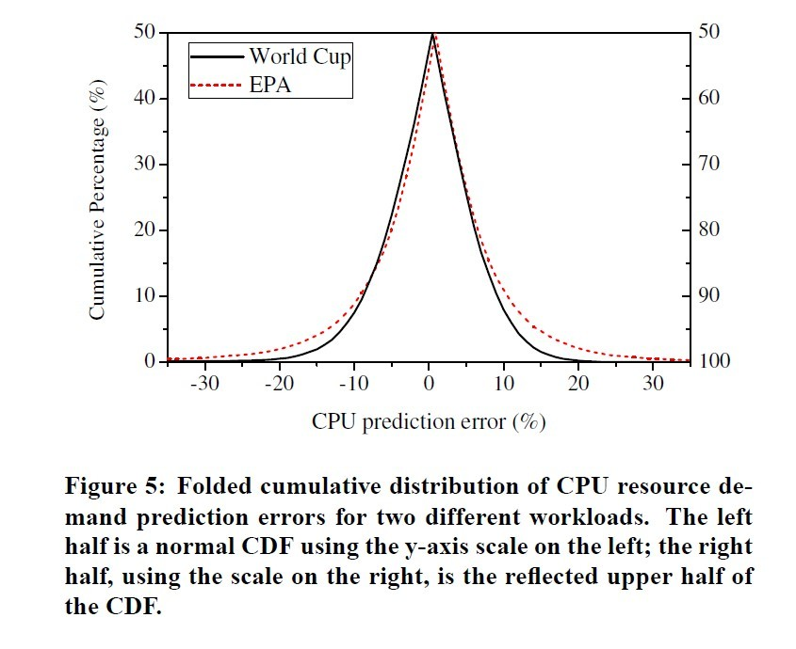
Evaluation: CPU prediction error
World Cup and EPA are two 6-hour workloads. EPA has more fluctuations than World Cup
For World Cup, CloudScale makes less than 5% significant prediction errors (|e| > 10%)
For EPA, CloudScale makes less than 10% significant prediction errors (|e| > 10%)

Slide 23
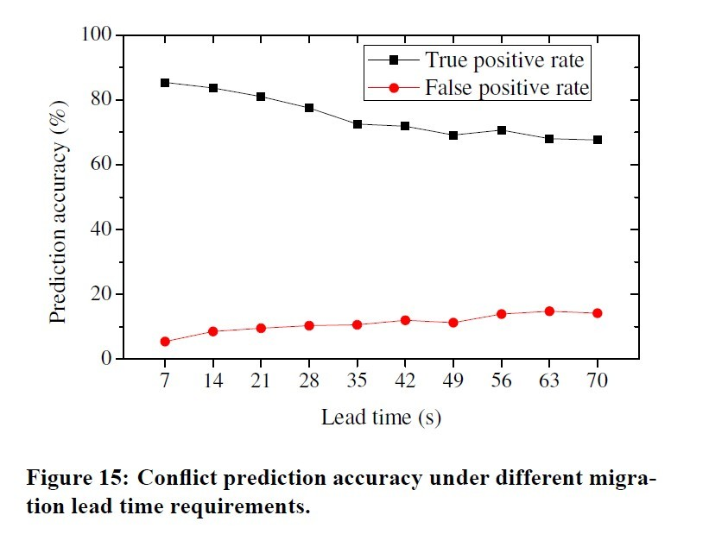
Evaluation: Migration Prediction Accuracy
Lead time: how early CloudScale triggers the migration (e.g. migrate T seconds before the conflict happens)

Slide 24
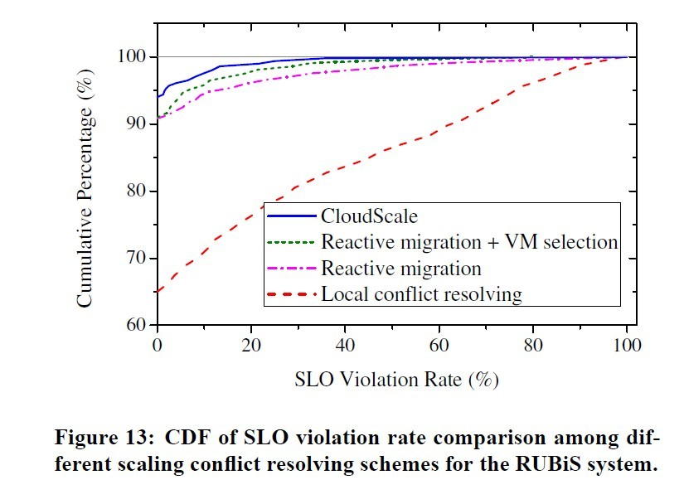
Evaluation: Conflict Resolving Schemes vs SLO violation rate
RUBiS: an online auction benchmark
Settings:
two RUBiS web server VMs on the same host, maintain 75% resource pressure
Memory size: VM1 = 1GB VM2 = 2GB
Schemes:
Local conflict resolving
Uniform Scheme
Reactive migration
Always migrate VM2
VM selection
Selects the VM with less migration penalty(VM1)
CloudScale
Predictive migration
70s before conflict

Slide 25
Discussion
In related work section the authors claims that compared to previous work, CloudScale does not require ANY offline tuning. But the current CloudScale does need migration lead time, the duration of conflict to trigger migration, as well as resource pressure threshold.
Coordinated multi-metric resource scaling (CPU, memory, network, disc, etc)
Coordinated multi-tier resource scaling (host-level,etc)
Prioritize resource to applications which have not violated SLO yet, assuming SLO violation is binary.
Fairness: how to ensure applications are providing real SLO feedback and migration penalty?

Slide 27
Backup Slides

Slide 28
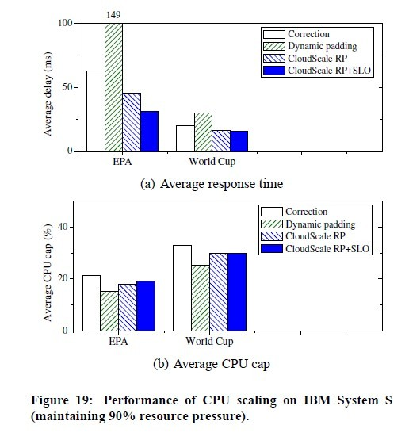
Average Delay vs Average CPU cap
Schemes
Correction: the scaling system performs resource pressure triggered prediction error correction only
Dynamic padding: dynamic padding only
CloudScale RP: both dynamic padding and scaling error correction, scaling error correction is triggered by resource pressure(90%) only
CloudScale RP + SLO: scaling error correction is also triggered by SLO feedback (5%)

Slide 29
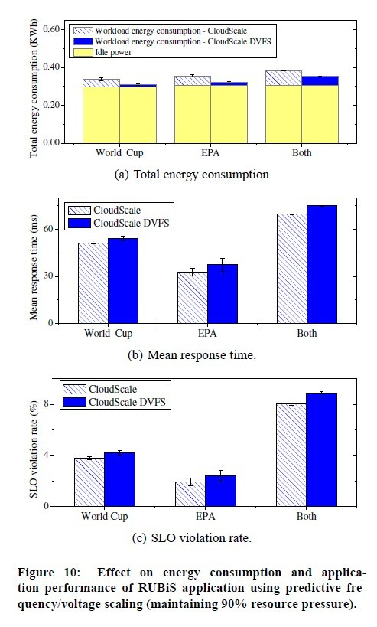
Energy Saving
Total energy saving is 8-10% and idle energy consumption are dmoninating.

Slide 30
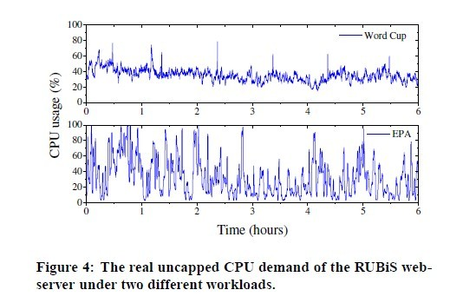
Evaluation: two workloads

Slide 31
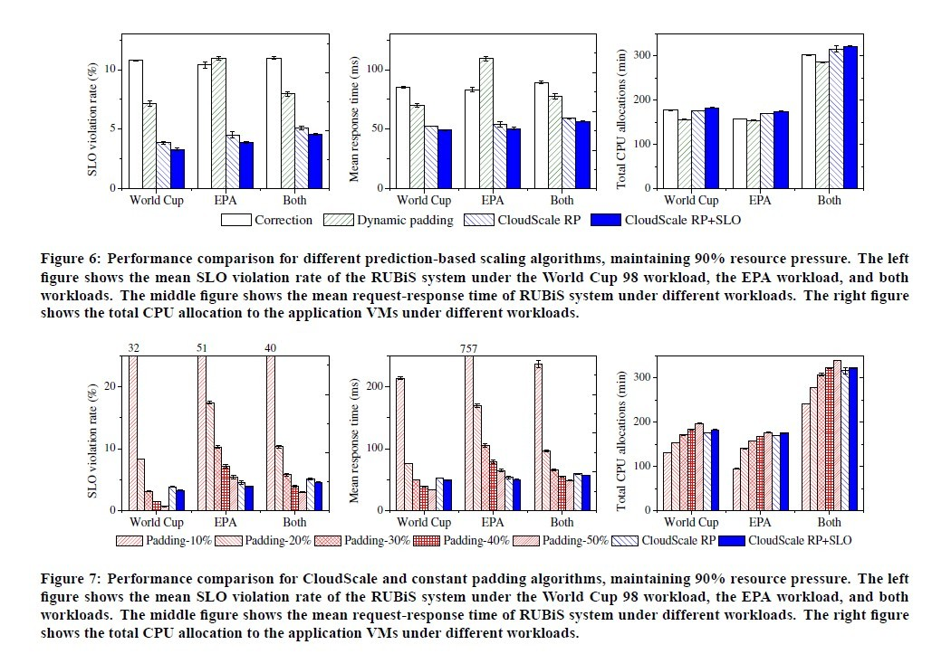
Evaluation: 90% resource pressure

Slide 32
Evaluation: 75% resource pressure

Slide 33
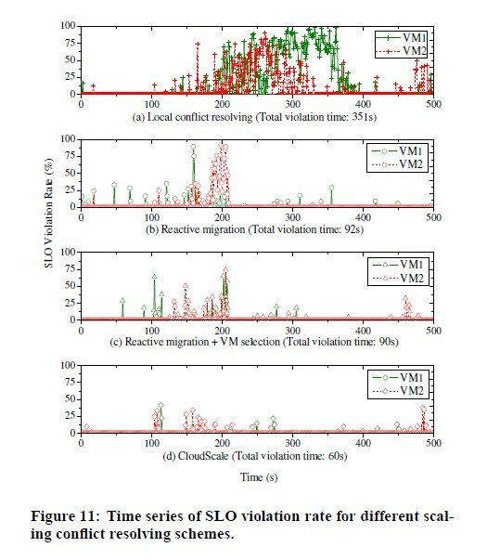
SLO Violation for Different Scaling Schemes
Schemes:
Local conflict resolving
Uniform Scheme
Reactive migration
Always migrate VM2
VM selection
Selects the VM with less migration penalty(VM1)
CloudScale
Predictive migration
70s before conflict

Slide 34
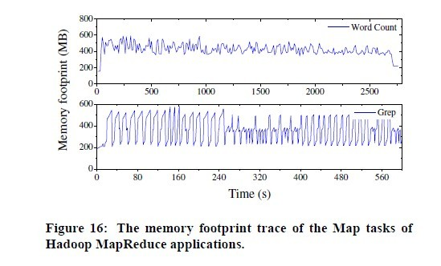
Memory footprint trace for Hadoop MapReduce

Slide 35
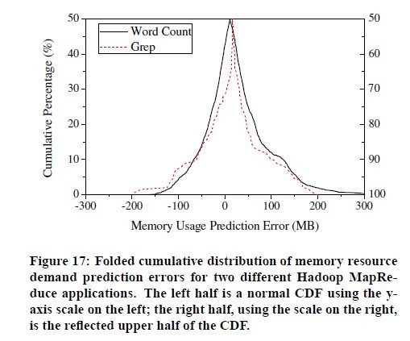
Memory Resource Prediction Error

Slide 36
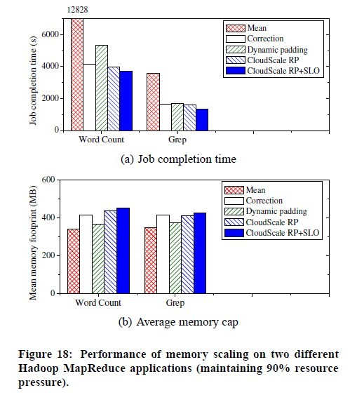
Performance of Memory Scaling
Schemes
Mean: allocating average value over memory footprint trace

Slide 37
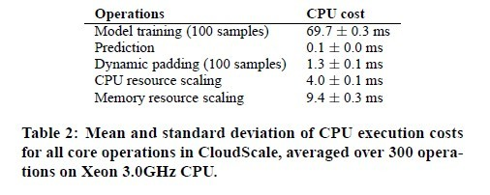
Overhead

