Slide 1
Discretized Streams: Fault-Tolerant Streaming Computation at Scale
Wenting Wang
Notes:
Hi, I’m wenting wang. Today, I’am gonna present a paper called Discretized Streams: fault-tolerant Streaming Computation at scale from UC berkeley.
The project is based the their previous work called Spark a batch processing system.

Slide 2
Motivation
Many important applications must process large data streams in real time
Site activity statistics, cluster monitoring, spam filtering,...
Would like to have…
Second-scale latency
Scalability to hundreds of nodes
Second-scale recovery from faults and stragglers
Cost-efficient
Previous Streaming frameworks don’t meet these 2 goals together
Notes:
Motivation for this project is that many important application must receive and process data SASP, For example, page view statistic, click strings on ads, intrusion detection and spam filtering. These sort of applications require the result of the processing to be provided as soon as possible, as soon as the data is received with the system. So that leads to the first requirement of stream processing system. Real time or low latency of processing.
As the data increases, we need to scale the systems to a lot more nodes, possibly hundreds of nodes. The problem in scaling this applications to 100s of nodes are actually 2 folds: 1 is fault tolerant. It’s not just for faults, but as well as for stragglers. It is very necessary that since there is a very harsh time bound, about 1-2 seconds, you need to provide results within that time bound. Any fault or stragglers in the system need to be resolved. And results need to be represented even there have been crashes and stragglers. So the system need to be very agile dealing with crashes and stragglers. Provide results in a timely manner. And second is cost efficient, when scaling to 100x of nodes, you need to cost-efficient. But the problem is the current streaming framework do not meet both these goal together. They meet one or the other.

Slide 3
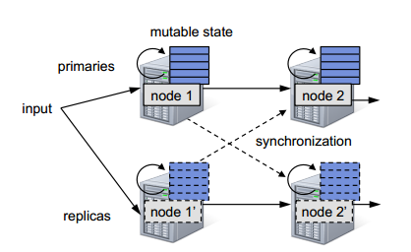
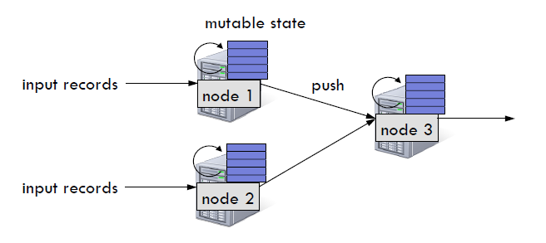
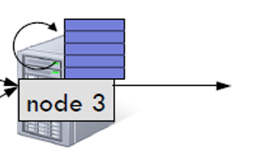
Previous Streaming Systems
Record-at-a-time processing model
Fault tolerance via replication or upstream backup
Replication
Fast Recovery, but 2x hardware cost
Upstream Backup
No 2x hardware, slow to recovery
Neither handles stragglers
Notes:
So traditional streaming processing systems follow a particular model as we called record at a time processing model where each record is processed individually.
So whenever a system received a particular record from live stream, each node in the cluster that is processing the stream maintain some mutable state. Whenever a new record is received, the processor updates the state of the record and forward the modified record to the next node in the cluster.
The challenge here becomes how to make these mutable state fault tolerant. Typically, there area 2 ways streaming systems make these mutable state tolerant for faults. 1 methods is replication where there 2 sets of nodes that in parallel processing the same stream. So one is primary, the other acts like a standby. If one of the node fails in the primary systems, the standby system automatically takes over. So here the recovery from fault is fast, because it does take much time to switch over. It incurs 2x hardware cost because it maintains 2 completely different sets of nodes. ….
2 Method streaming systems use is called upstream backups where there is no replication, but each upstream node buffers the records until the downstream nodes process them completely. And whenever a particular downstream node fails, a new node is brought up to act in its place and all upstream nodes replayed the records to the new downstream node. So after replaying, the new downstream node has the same mutable state as the failed node has. While this does not require 2x handware, but the recovery is slow because you have to replay … exactly the same order to the new downstream node. So you can see either is not cheap, not cost-effective or slow recover. And neither of the systems acutally handle the stragglers scenarios which are quite possible in a cluster at large size of 100s of nodes.

Slide 4
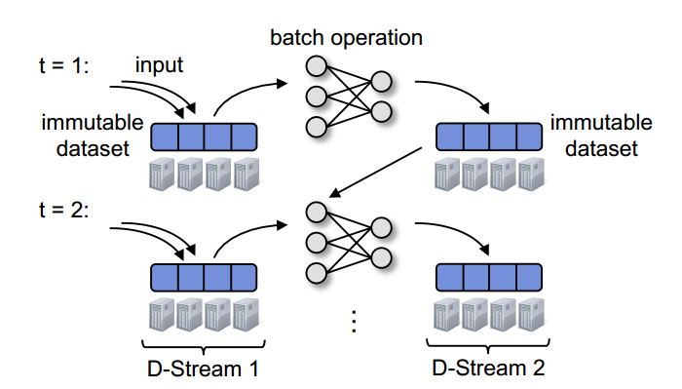
Discretized Streams
A streaming computation as a series of very small, deterministic batch jobs
immutable dataset (output or state); stored in memory
as Spark RDD
Notes:
So the authors started to look back at batch processing system.like MapReduce. They have a very clear and efficient fault-tolerant strategies.
…………
So the idea for Discretized Stream is to chop live stream of data into very small batch of data. So imagine you are processing a stream of data. Instead of processing a data record each at a time, what we’d like to do is to divide the whole tweet stream into say like one-second batches, collect all the tweet received in one second, treat that tweet like a Hadoop file and run MapReduce on it. And what comes out is immutable datasets. as they called them RDD. I will talk what is RDD is within 2 slides. Now you can view them as the state data as the tranditional stream processing system have. Now in the next sec, this state data is combined with the input data and batch operation apply on them again. To create next version of state data. So these continuous sequence of batches and state data or RDD actually form a stream. Left is an input stream. And right is the stream of state data.

Slide 5
Resilient Distributed Datasets(RDDs)
An RDD is an immutable, in-memory, partitioned logical collection of records
RDDs maintain lineage information that can be used to reconstruct lost partitions
lines = spark.textFile("hdfs://...")
lines
errors=lines.filter(_.startsWith(“ERROR”))
errors
HDFS_errors=filter(_.contains(“HDFS”)))
HDFS errors
HDFS_errors=map(_.split(‘\t’)(3))
time fields
Notes:
RDD is 1) distributed partitioned in multiple nodes
2) RDD is in-memory data structure.
3) RDD is immutable. Which means every time you make update/change to a RDD, you create a new RDD. There is an ex that a web service is experiencing errors and you want to search terabytes of logs in the Hadoop ﬁlesystem (HDFS) to ﬁnd the cause. Line 1 creates an RDD from by an HDFS ﬁle (as a
collection of lines of text), while line 2 filter out all lines started with “ERROrs”. Line 3 then filter all the errors with key word “HDFS” and line 4 Return the time fields of errors mentioning HDFS (assuming time is field number 3 in a tab-separated format):
Each box here is an RDD, they are created by either from source data or by transforming from other RDDs.
Each RDD maintain lineage information to reconstruct lost data. The lineage information includes its father RDDs and the operations leads to it. If part data of a RDD is lost,(because RDD is distributed in multiple node, so one node’s crash could lost a partition of RDD.) With this dependency graph or information, a RDD can be fast recovered with the if some part of the data is lost.

Slide 6
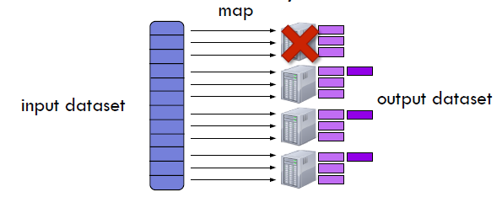
Fault Recovery
All dataset Modeled as RDDs with dependency graph
Fault-tolerant without full replication
Fault/straggler recovery is done in parallel on other nodes
fast recovery
Notes:
Now since all of these data is modeled as RDDs, and we’ve seen already that RDDs remember the lineage operations led to it, each RDDS know how to create the RDD whenever a part has failed using the dependency graph. All the data presented as the input data or the state data is by definition fault tolerant without full replication. So whenever there is fault or stragglers, recovery from that fault or straggler becomes very easy because all the data can be recovered in parallel just like batch operation.
So since each of RDD knows how to create itself, so whenever there is a fault or straggler, recovery from that fault or straggler is very fast and easy because RDDs can be calculated in parallel just like batch operation. For example, this node dies, and the state that was presented on this node goes away. You can actually recreate that state data because they are RDDs in parallel on the other nodes. This result in fact that the recovery is very fast.
As for Dstream processing system, since each batch is modeled as a RDD, and each state data is modeled as RDD. All the data used in Dstream in by definition fault tolerant. the recovery of any batch data no matter whether from a crash or a straggler can be very fast.

Slide 7
Discretized Streams
Faults/Stragglers recovery without replication
State between batches kept in memory
Deterministic operations→ fault-tolerant
Second-scale performance
Try to make batch size as small as possible
Smaller batch size → lower end-to-end latency
A rich set of operations
Combined with historical datasets
Interactive queries
live data stream
DStream
Processing
batches of X seconds
Spark
processed results
Notes:
A rich set of operators
Interactive query model
Integrated with historical dataset
( And now since we are doing these batch jobs, we are deterministicly batch job on 1 sec batch, we are automatically get the fault tolerant properties that computation have. )
Now the challenge is how to achieve as low as end-to-end latency as possilble by this process. To achieve that, it is important to understand that end-to-end latency directly depends on batch size. Lower the batch size, lower the end-to-end latency is. So if you processing 10 second batches, then you have to wait the whole 10 seconds for the whole batch to be collected. You have to wait at least 10 sec, But if you do 1 sec batch, then you only have to wait 1 sec for the data to be collected. So the challenging to make this batch as small as possible. That is one. Now the mutable state between batches we are talking about is the data need to be in memory, and operator that produce this state data, is expressed as deterministic stateful operations. Because it is deterministic, these stateful data is also fault-tolerant. Which I will explain it later.
….

Slide 8
Programming Interface
Dstream: A stream of RDDs
Transformations
Map, filter, groupBy, reduceBy, sort, join…
Windowing
Incremental aggregation
State tracking
Output operator
Save RDDs to outside systems(screen, external storage… )
Notes:
Let’s look at the programming interface. I want to show you how intuitive and easy to program on this platform. So similar to RDDs, the abstraction we have here is Dstream which is nothing but a sequence of RDDs. The API is very similar to RDDs, it has the same map reduce that you have seen in RDDS. Similar to RDDs, Dstream can be created from either the data source which in this case is a live stream from network, or hard disk or a sequence of iterated files, or by transforming other DStream. Lets look more details into the operator. Again, just like RDDS there are 2 sets of operations we can do, one is transformation which create new streams from existing streams. These transformation include the existing RDD operations, plus we have introduced a new set of operations we called the stateful operators which we will talk details very soon. Then there are output operators which allow data can be sent out to the external world.either saving to external storage or print to screem. Whatever you want to do with it.

Slide 9
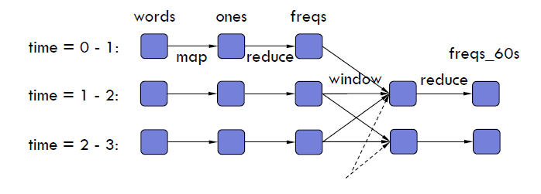
Windowing
Count frequency of words received in last 5 seconds
words = createNetworkStream("http://...”)
ones = words.map(w => (w, 1))
freqs_5s = ones.reduceByKeyAndWindow(_ + _, Seconds(5), Seconds(1))
DStream
Transformation
Sliding Window Ops
freqs_5s
Notes:
So let us start with a very simple example of how windowing works
Imgine there is a stream of words coming in from a particular url.and you want to count the frequency of each word. You want to see the frequency of the word in last 5 second. So what you can do is you can use operator called window which essentially aggregate all the words,all the frequency it received, all the 1-sec frequency into a 5-sec-frequency. To explain the detail of the operator, this window is a sliding window. The size of the window is 5 sec. and it moves every sec. it will aggregate the frequency in last 60 seconds every sec. and once again you are doing reducebykey on them, to get the final aggregate frequency. And what happen essentially is all the 1-second freqeuency are aggregated together within the window created by redcued. This is very common operation that stream processing would like to do.

Slide 10
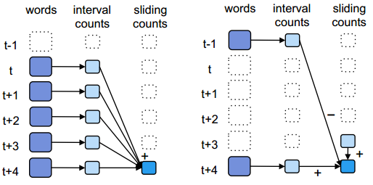
Incremental aggregation
Aggregation Function
freqs = ones.reduceByKeyAndWindow
(_ + _, Seconds(5), Seconds(1))
Invertible aggregation Function
freqs = ones.reduceByKeyAndWindow
(_ + _, _ - _, Seconds(5), Seconds(1))
Notes:
This reducebywindow operation can be implemented in incremental fashion. So for example, the window operation that I showed si very native in a sence that all previous 1-second frequency are added together to get the 5 second frequency. A optimal way to calculate the aggregated frequency, take the previous 5 second frequency, add the new 1 sec frequency that got introduced to the window and substract the privous 1 second frequency. This reduce the amount of operation you need to do significantly. But it also require a constraint. Not all aggregation operation can be implemented in this manner. It requires a invertible function which in this case is a substration, substract the previous frequency. So only aggregation invertible can be implement in this way. But in the api, we allow this function as specified as well. We allow programmer create aggregation as well as invertible aggregation. This give more control for developer to optimize the stream processing.

Slide 11
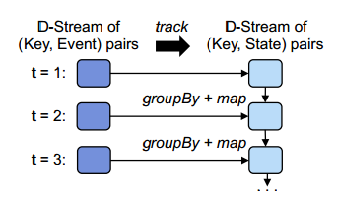
State Tracking
A series of events → state changing
sessions = events.track(
(key, ev) => 1, // initialize function
(key, st, ev) => // update function
ev == Exit ? null : 1,
"30s") // timeout
counts = sessions.count() // a stream of ints

Slide 12
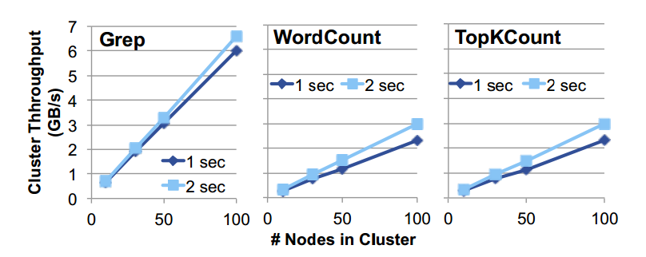
Evaluation
Throughputs
Linear scalability to 100 nodes
Notes:
So we build a system on Spark as we call it spark streaming. And we find that this prototype can acutally process we scale it to 100 nodes 4GB per sec all within a end-to-end latency less than 1 sec. let digger deeper into the result. If you look at the cluster throughputs, the workload we use is a grep. We basically received a stream of words, and grep them for a particular key word. And received the key owrd in 1 sec. and you can see that depending one what latency requirement you have, you can get higher or low throughputs. If you want 1 sec latency you will get a slightly low throughput can it can be achieved using the system. You want a 2 sec latency, you can get a higher throughput. So there is latency throughput tradeoff in the sys. But the cool thing is given with divided batches, you can achieve 1-2 latency which is acceptable in the app we’ve seen. We also did comparison with other sys.in particular with storm and S4. And the performance of spark is largely unaffected. While in case of storm, it also follow the record-at-a-time processing model, there is certain overhead, on the per record bases. As record size decreases, the total number of records increases, therefore the total throughput decreases. S4 is limited to a lower record level, around 7k. other commercial system are not open sourced, report around 100 k records per sec. so we are pretty much at the acceptable range 100k 400 records per sec.

Slide 13
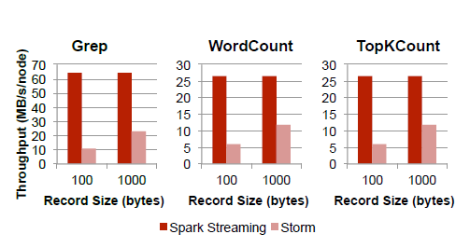
Evaluation
Compared to Storm
Storm is 2x slower than Discretized Streams

Slide 14
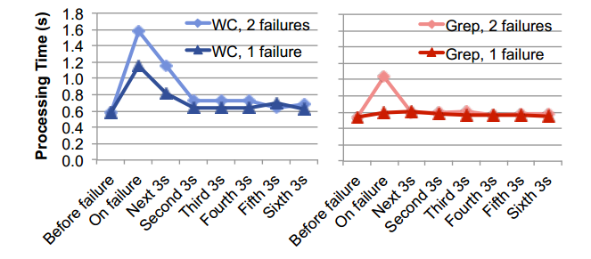
Evaluation
Fault Recovery
Recovery is fast with at most 1 second delay
Notes:
How fast can the system recover from fault.
These are the time line which shows processing time of each 2 sec batch of data. And you can see here we actually introduce fault to the node. This is what done in a 10 node cluster.and you can see that the time increase out here. But not so much. It actually took less than 1 sec. throught this red area, we can see the affect of the fault. But after that it comes down to the usual processing time level. You can see that the system can be very agile in recovering from fault. We have similar result for stragger as well.

Slide 15
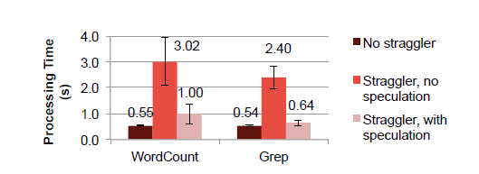
Evaluation
Stragglers recovery
Speculative execution improves response time significantly.

Slide 16
Comments
Batch size
Minimum latency is fixed based on batching data
Burst workload
Dynamic change the batch size?
Driver/Master fault
Periodically save master data into HDFS, probably need a manual setup
Multiple masters, Zookeeper?
Memory usage
Higher than continuous operators with mutable state
It may possible to reduce the memory usage by storing only Δ between RDDs
Notes:
Master store 1) the graph of user Dstream operations 2) time of the last checkpoint of each Dstream 3) IDs of RDDs
To keep up with stream / or changed based on end user requirement of latency?

Slide 17
Comments
No latency evaluation
How does it perform compared to Storm/S4
Compute intervals need synchronization
the nodes have their clocks synchronized via NTP

