Slide 1
Distributed Graph Analytics
Imranul Hoque
CS525 Spring 2013

Slide 2

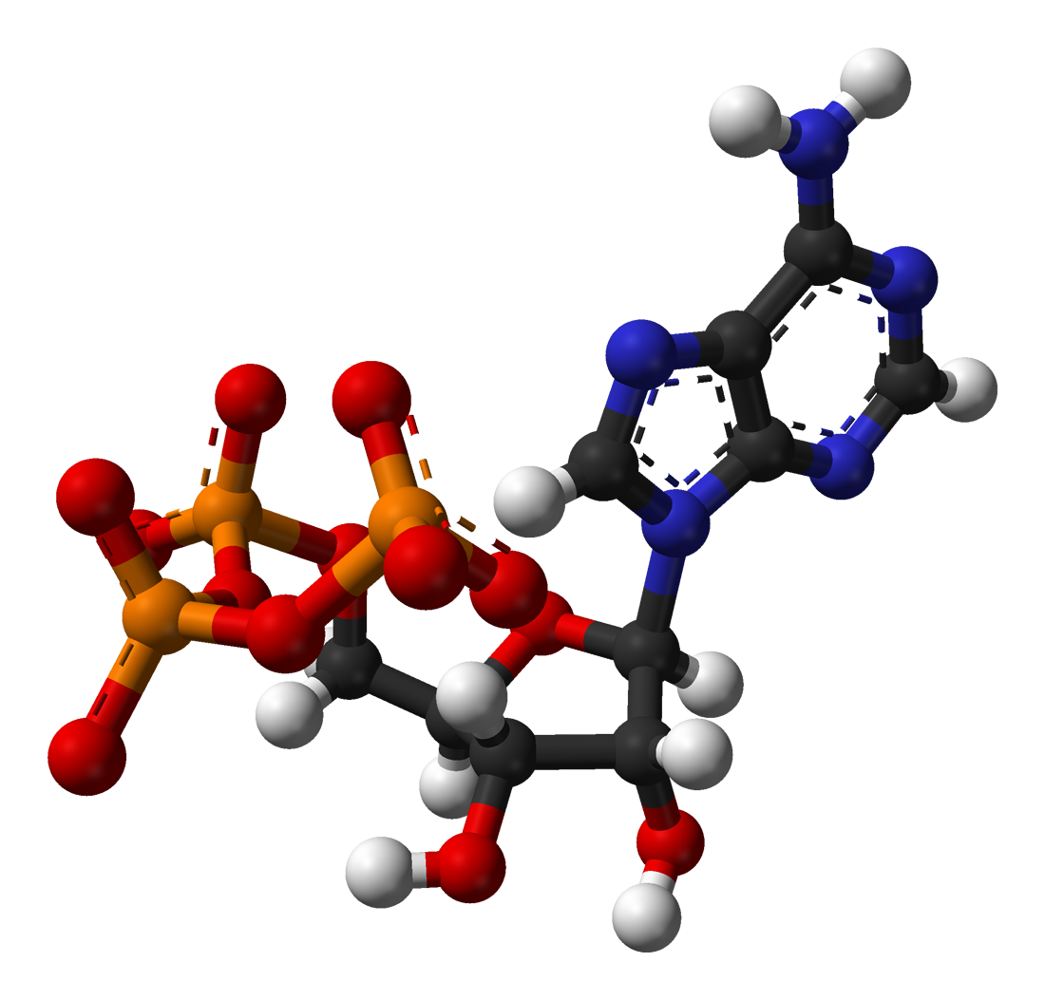






Social Media
Science
Advertising
Web
Graphs encode relationships between:
Big: billions of vertices and edges and rich metadata
People
Products
Ideas
Facts
Interests

Slide 3
Graph Analytics
Finding shortest paths
  Routing Internet traffic and UPS trucks
Finding minimum spanning trees
  Design of computer/telecommunication/transportation networks
Finding max flow
  Flow scheduling
Bipartite matching
  Dating websites, content matching
Identify special nodes and communities
  Spread of diseases, terrorists
Notes:
Routing internet traffic, UPS trucks
Google Fiber
Scheduling
Spread of disease, influencers
Dating website

Slide 4
Different Approaches
Custom-built system for specific algorithm
  Bioinformatics, machine learning, NLP
Stand-alone library
  BGL, NetworkX
Distributed data analytics platforms
  MapReduce (Hadoop)
Distributed graph processing
  Vertex-centric: Pregel, GraphLab, PowerGraph
  Matrix: Presto
  Key-value memory cloud: Piccolo, Trinity

Slide 5
The Graph-Parallel Abstraction
A user-defined Vertex-Program runs on each vertex
Graph constrains interaction along edges
  Using messages (e.g. Pregel [PODC’09, SIGMOD’10])
  Through shared state (e.g., GraphLab [UAI’10, VLDB’12])
Parallelism: run multiple vertex programs simultaneously

Slide 6
PageRank Algorithm
Rank of user i
Weighted sum of neighbors’ ranks
Update ranks in parallel
Iterate until convergence

Slide 7
The Pregel Abstraction
Vertex-Programs interact by sending messages.
Pregel_PageRank(i, messages) :
// Receive all the messages
total = 0
foreach( msg in messages) :
total = total + msg
// Update the rank of this vertex
R[i] = 0.15 + total
// Send new messages to neighbors
foreach(j in out_neighbors[i]) :
Send msg(R[i] * w_{ij}) to vertex j
i
Malewicz et al. [PODC’09, SIGMOD’10]

Slide 8
Pregel Distributed Execution (I)
Machine 1
Machine 2
A
Sum
B
+
D
C
User defined commutative associative (+) message operation

Slide 9
Pregel Distributed Execution (II)
Machine 1
Machine 2
A
B
D
C
Broadcast sends many copies of the same message to the same machine!

Slide 10
The GraphLab Abstraction
Vertex-Programs directly read the neighbors state
GraphLab_PageRank(i)
// Compute sum over neighbors
total = 0
foreach( j in in_neighbors(i)):
total = total + R[j] * w_{ji}
// Update the PageRank
R[i] = 0.15 + total
// Trigger neighbors to run again
if R[i] not converged then
foreach( j in out_neighbors(i)):
signal vertex-program on j
i
  Low et al. [UAI’10, VLDB’12]

Slide 11
GraphLab Ghosting
Machine 1
Machine 2
A
A
B
D
B
D
C
Ghost
C
Changes to master are synced to ghosts

Slide 12
GraphLab Ghosting
Machine 1
Machine 2
A
A
B
D
B
D
C
C
Ghost
Changes to neighbors of high degree vertices creates substantial network traffic

Slide 13
PowerGraph Claims
Existing graph frameworks perform poorly for natural (power-law) graphs
  Communication overhead is high
    Partition (Pros/Cons)
  Load imbalance is caused by high degree vertices
Solution:
  Partition individual vertices (vertex-cut), so each server contains a subset of a vertex’s edges
  (This can be achieved by random edge placement)

Slide 14
Distributed Execution of a PowerGraph Vertex-Program
Machine 1
Machine 2
Master
Gather
Y’
Y’
Y’
Y’
Σ₁
Σ
Σ₂
+ + +
Mirror
Apply
Y
Y
Y
Y
Machine 3
Machine 4
Scatter
Σ₃
Σ₄
Mirror
Mirror

Slide 15
Constructing Vertex-Cuts
Evenly assign edges to machines
  Minimize machines spanned by each vertex
Assign each edge as it is loaded
  Touch each edge only once
Propose three distributed approaches:
  Random Edge Placement
  Coordinated Greedy Edge Placement
  Oblivious Greedy Edge Placement

Slide 16
Random Edge-Placement
Randomly assign edges to machines
Machine 1
Machine 2
Machine 3
Balanced Vertex-Cut
Y
Spans 3 Machines
Y
Y
Y
Y
Y
Z
Y
Z
Y
Y
Y
Z
Z
Spans 2 Machines
Not cut!

Slide 17
Greedy Vertex-Cuts
Place edges on machines which already have the vertices in that edge.
Machine1
Machine 2
A
B
B
C
A
B
D
E
Can this cause load imbalance?

Slide 18
Computation Balance
Hypothesis:
  Power-law graphs cause computation/communication imbalance
  Real world graphs are power-law graphs, so they do too
Maximum loaded worker 35x slower than the average worker

Slide 19
Computation Balance (II)
Substantial variability across high-degree vertices ensures balanced load with hash-based partitioning
Maximum loaded worker only 7% slower than the average worker

Slide 20
Communication Analysis
Communication overhead of a vertex v:
  # of values v sends over the network in an iteration
Communication overhead of an algorithm:
  Average across all vertices
  Pregel: # of edge cuts
  GraphLab: # of ghosts
  PowerGraph: 2 x # of mirrors

Slide 21
Communication Overhead
GraphLab has lower communication overhead than PowerGraph!
Even Pregel is better than PowerGraph for large # of machines!

Slide 22
Meanwhile (in the paper …)
Natural Graph with 40M Users, 1.4 Billion Links
Communication
Runtime
Total Network (GB)
Seconds
Reduces Communication
Runs Faster
32 Nodes x 8 Cores (EC2 HPC cc1.4x)

Slide 23
Other issues …
Graph storage:
  Pregel: out-edges only
  PowerGraph/GraphLab: (in + out)-edges
  Drawback of storing both (in + out) edges?
Leverage HDD for graph computation
  GraphChi (OSDI ’12)
Dynamic load balancing
  Mizan (Eurosys ‘13)

Slide 24
Questions?

