Slide 1
Epidemics
Michael Ford
Simon Krueger

Slide 2
It’s just like Telephone!

Slide 3
Epidemic Convergence
If there are n nodes and each node gossips to log(n)+k other nodes on average, then the probability that everyone gets the message converges to e^(-e^(-k)).
A. Ganesh, A.-M. Kermarrec and L. Massoulie, Peer-to-peer membership management for gossip-based protocols, IEEE Transactions on Computers 52 (2003) (2), pp. 139–149.
P. Erdös and A. Renyi, “On the Evolution of Random Graphs,” Mat Kutato Int. Közl, vol. 5, no. 17, pp. 17-60, 1960.

Slide 4
Bimodal Multicast (pbcast)
Kenneth P. Birman, Mark Hayden, Oznur Ozkasap, Zhen Xiao, Mihai Budiu, and Yaron Minsky

Slide 5
Motivation
Best-Effort Protocols
Increased scalability
No end-to-end delivery guarantee
Hard to reason about system state during failures
Reliable Protocols
Strong atomic guarantees – “all or nothing”
Throughput is not resilient to slow nodes
One bad apple spoils the bunch
Background overhead reaches “meltdown” levels
Notes:
Reliability vs. Performance

Slide 6
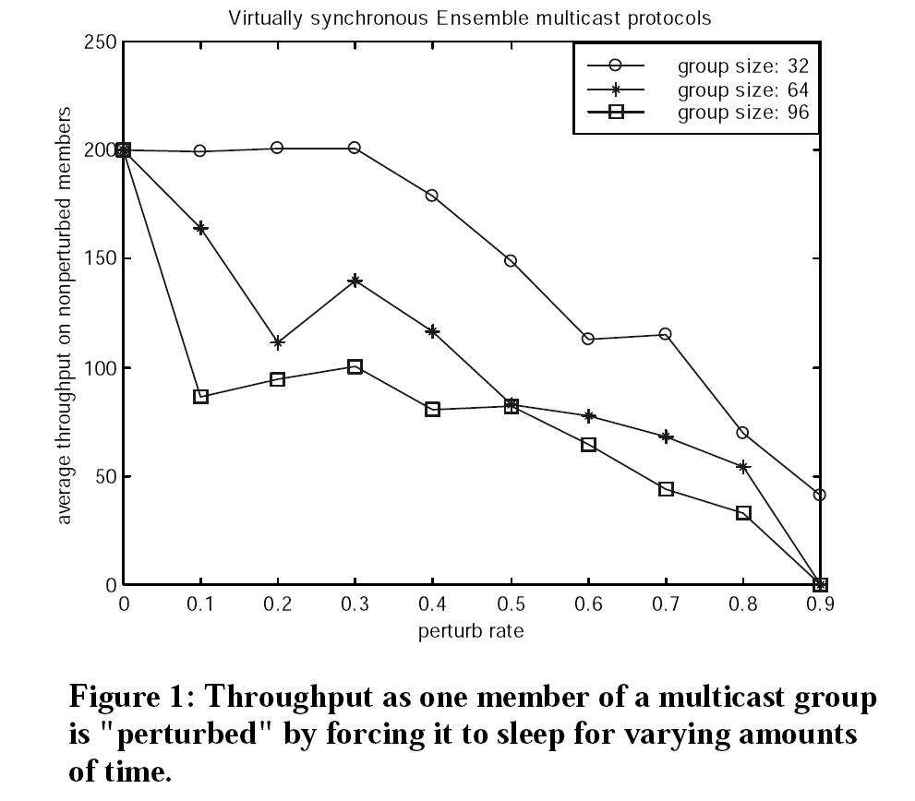
Throughput Stability
Notes:
Of a strong protocol

Slide 7
Bimodal Multicast (pbcast)
Atomicity – almost all or almost none
Throughput Stability – low variance
Ordering – per sender FIFO
Multicast Stability – minimal message buffer
Lost Message Detection
Scalability – “Costs are constant or grow slowly as a function of the network size”

Slide 8
Pbcast details
Best-effort broadcast
IP Multicast
or Multicast Tree
Anti-entropy
Gossip a message list summary
Detect message loss
Pull messages if needed
Why not push?
Notes:
Pulling is better than pushing as long as link outages are low(er)
Not the reason for “Bimodal”

Slide 9
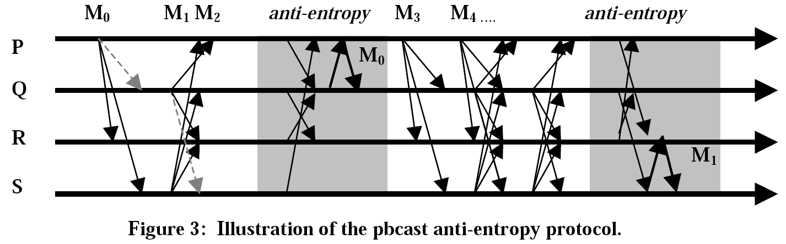
Pbcast Example
Note: Broadcast and Anti-entropy stages occur concurrently.

Slide 10
Assumptions
Faults
Network errors are independent and identically distributed
Known, bounded, link delays
No Byzantine failures
System
Each node knows every other node

Slide 11
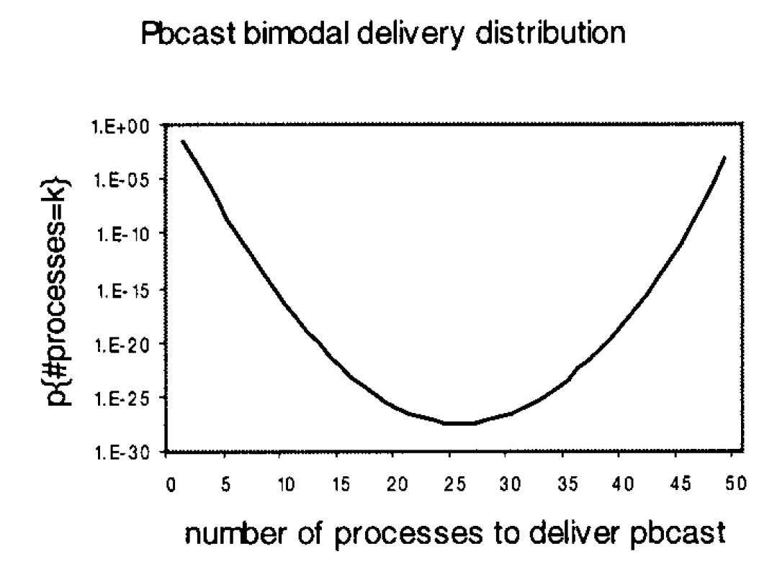
Computational Results
Bcast unsuccessful
5% message loss
0.1% crash rate for run
What is the ideal shape?
Notes:
First send fails. Message loss is 5%. Process crash fails in a run 0.1% of the time.

Slide 12
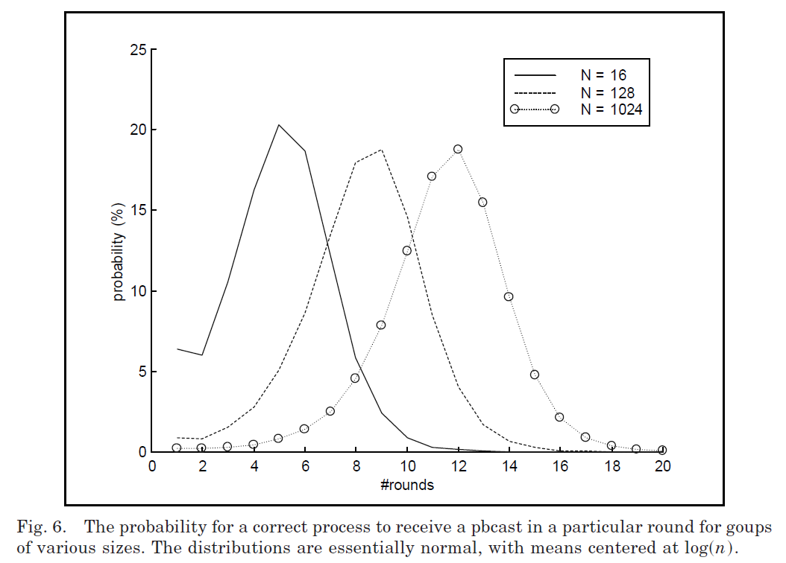
Rounds to Delivery

Slide 13
Issues
Are slow processes always going to fall behind and slow down other processes?
What if a processes receives multiple message queries?
How do you determine when to stop buffering a message? (Scalability)
Random gossip through a router can be a bottleneck.
How does membership management affect scalability?

Slide 14
Optimizations
Soft-Failure Detection – Retransmit only in the round that request was received
Round retransmission limit – Cap data per round
Cyclic Retransmissions – Avoid repeat message retransmissions from previous rounds
Most-Recent-First Retransmission – Stops processes from permanently lagging
Independent Numbering of Rounds – No synchronization needed among processes
Random Graphs for Scalability – Gossip only to a subset of the processes
Multicast for Some Retransmissions – Multicast upon receiving multiple requests for the same message

Slide 15
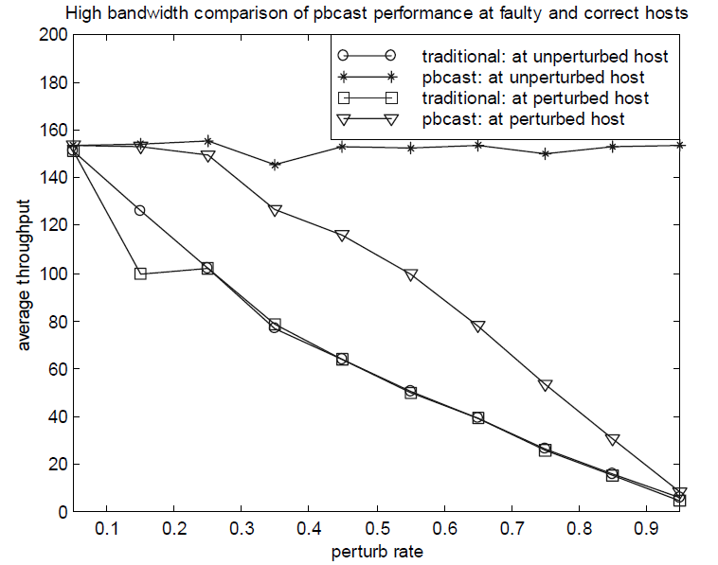
Comparison to a Strong Protocol
The effects of Soft faults on Throughput
Notes:
Soft Faults

Slide 16
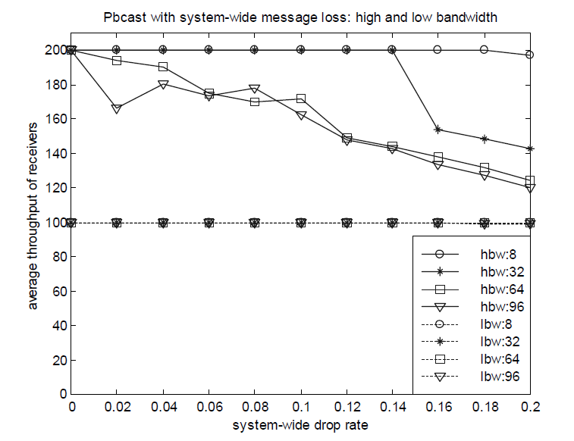
Effects of Network Congestion
The effects of Link faults on Throughput
Notes:
Link failures

Slide 17
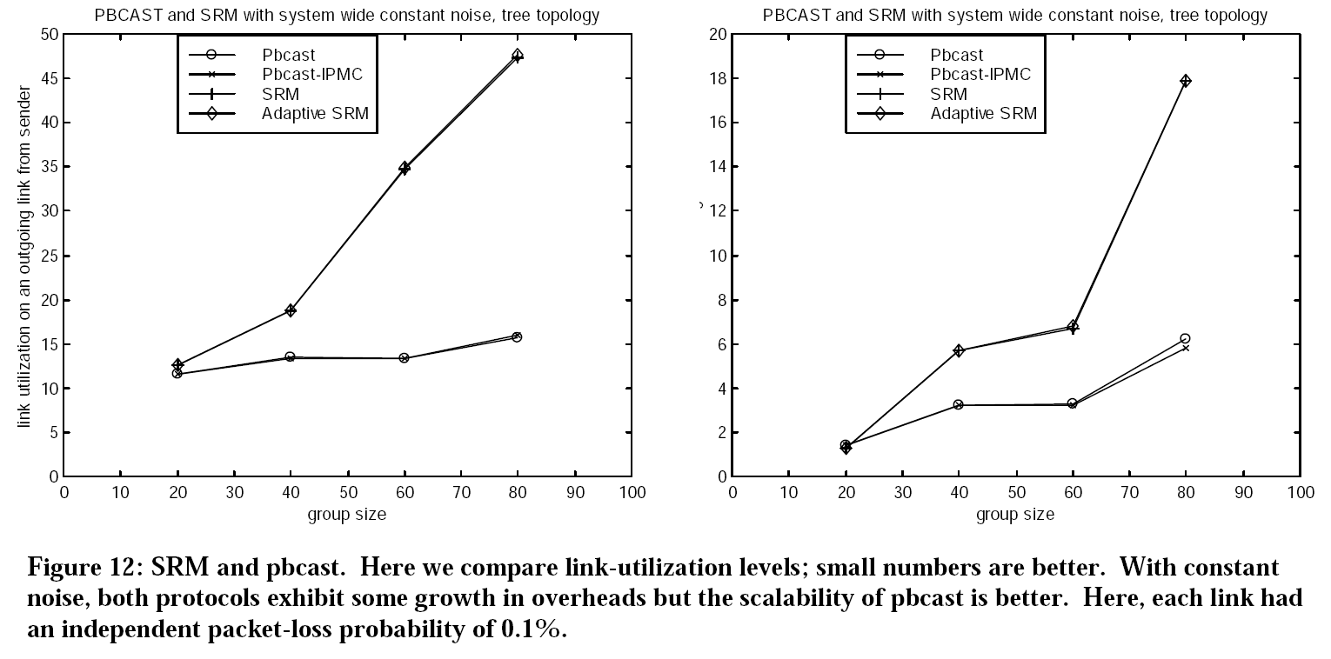
Comparison to SRM
Why compare pbcast to SRM (a reliable protocol) and not a best effort protocol?
Notes:
SRM: IP Multicast with acks.

Slide 18
Questions?

Slide 19
Exploring the Energy-Latency Trade-off for Broadcasts in Energy-Saving Sensor Networks
M. Miller, C. Sengul, I. Gupta, ICDCS 2005
Presented By
Simon Krueger

Slide 20
Outline
Motivation and Background
The Problem
Existing Solutions
Core Ideas
Probability-Based Broadcast Forwarding
Experimental Results
Reliability
Energy
Latency
Energy-Latency Trade-off
Discussion
20

Slide 21
The Problem
Wireless Sensor Networks (WSNs) use Motes that have a battery lifetime of a few weeks
Message broadcast is useful for applications in WSNs
Disseminating software updates (e.g., Trickle)
Forwarding sensor observations
Increasing reliability and performance causes greater depletion of battery
Designers need flexibility between reliability and performance
21
Notes:
Question: What are some applications that use message broadcast in WSNs?
Answer: 1) Disseminating software updates 2) Forwarding sensor observations

Slide 22
Existing Solution(s): Energy Efficient Medium Access Control (MAC) protocols
Active-sleep cycle
Active Time
Sleep Time
IEEE 802.11 Power Safe Mode (PSM)
Synchronized active sleep schedule
S-MAC
Virtual clusters of synchronized active sleep schedules
T-MAC
Dynamic active sleep schedule
22
Notes:
Questions: What is an alternative hardware related approach to Active-sleep cycle?
Answer: Use a low powered wake up radio to wake up nodes

Slide 23
Broadcast in IEEE 802.11 PSM
1
2
3
A
D1
B
B
Node 1
B
A
D1
Node 2
Node 3
A
D1
ATIM window
ATIM window
ATIM window
23
Notes:
Question: What are two problems with this approach?
Answer: 1) If a node needs to send a broadcast after the ATIM window it has to wait for the next ATIM window thus increasing latency. 2) When Node 2 rebroadcasts both Node 1 and Node 3 will receive redundant packets and thus increase energy consumption.

Slide 24
Probability-Based Broadcast Forwarding (PBBF)
Design a broadcast protocol on top of existing energy efficient MAC layer protocols that allows a designer to tune energy and latency at different levels of reliability
24

Slide 25
PBBF Adds Two New Parameters
p is the probability that a node rebroadcasts a packet immediately
q is the probability that a given node stays awake instead of sleeping
25

Slide 26
PBBF Demonstration
1
2
3
p
ID
B
Node 1
p
B
ID
B
Node 2
q
Node 3
A
D
ATIM window
ATIM window
ATIM window
26
Notes:
What would the protocol look like if p = 1 and q = 1? What would it look like if p = 0 and q = 0?

Slide 27
PBBF (cont.)
p presents a tradeoff in latency and reliability
As p ⬆, latency ⬇
As p ⬆, fraction of nodes receiving a broadcast ⬇(unless q = 1)
q represents a tradeoff in energy and reliability
As q ⬆, energy consumption ⬆
As q ⬆, fraction of nodes receiving a broadcast ⬆ (unless p = 0)
27
Notes:
Question: What happens if p = 1? Is the Energy affected? Why or Why Not?
Answer: The latency decreases because there is a chance that the message gets received immediately. The energy is not affected because the node would of stayed awake anyway to send the data.
Question: What happens if q = 1?
Answer: Energy consumption increases but there is a higher chance that latency will decrease.

Slide 28
Experimental Data
Assumptions:
Ideal MAC layer
Ideal physical layer with no collisions or interference
IEEE 802.11 PSM
Grid network topology (i.e., a square lattice)
Broadcast source is near the center of the grid
28

Slide 29
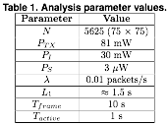
N is the number of nodes
λ is the source’s broadcast rate
PTX is power to transmit
PI is power to idle/receive
PS is power to sleep
L1 is the latency
29

Slide 30

Bond Percolation Theory
D
Open Road
Closed Road
S
Source
D
Destination
S
30
Notes:
Question: What is the fraction of open roads needed to go from S to D?

Slide 31
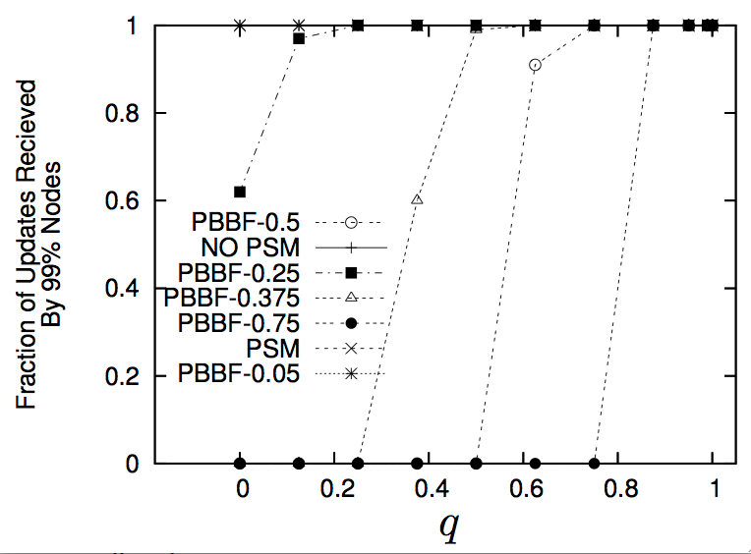
Reliability
31

Slide 32
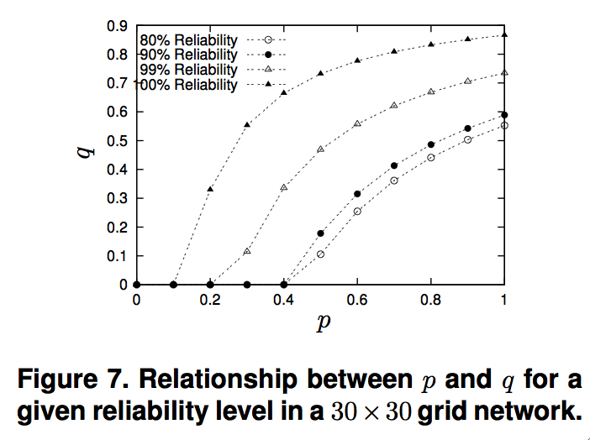
Reliability
≥99% Reliability
≈100% Reliability
≥80% Reliability
≥90% Reliability
32

Slide 33
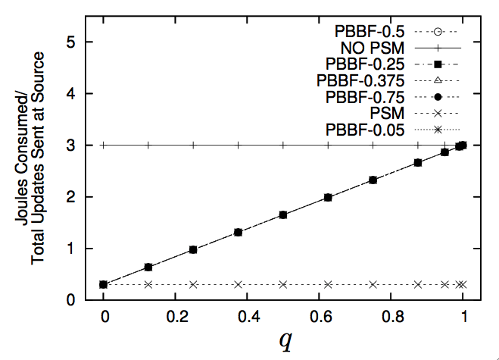
Average Energy Consumption
33
Notes:
Question: What is something interesting about all the different PSM?
Answer: Energy consumption does not depend on p

Slide 34
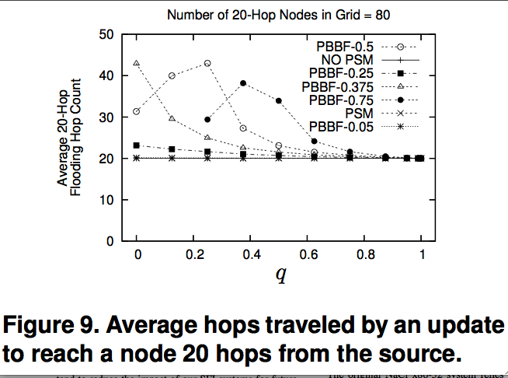
Latency
D
20 Hops
S
34
Notes:
Question: Why are the average hops so high when q < 1 and p >= 0.25?
Answer: Because other nodes farther away from the direct path from the source to the destination are probabilistically forwarding the broadcast.

Slide 35
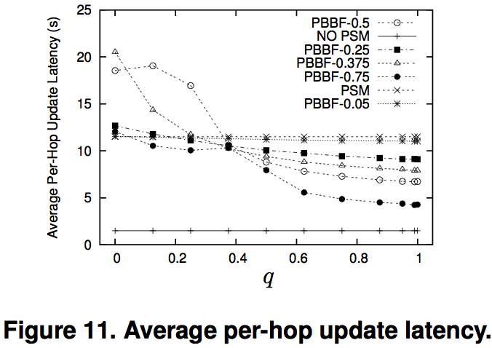
Latency
35
Notes:
The q = 0.4 spot is interesting because all p values have the same latency

Slide 36



Energy-Latency Tradeoff
36

Slide 37
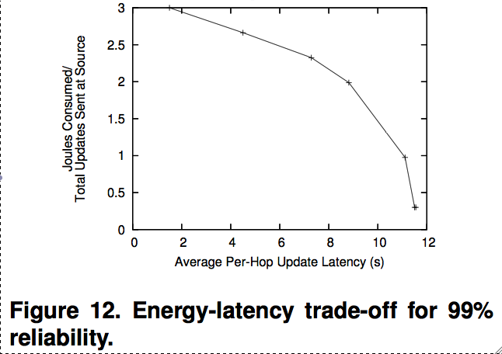
Energy-Latency Trade-off
37

Slide 38
Code Distribution Application
Study Trade Off Between Energy, Latency, and Reliability
ns-2 network simulator
Collisions and interference present

Slide 39
Discussion
Why use IEEE 802.11 PSM for simulation results?
How well would this work for other protocols like S-MAC and T-MAC?
When studying reliability, why use Bond percolation theory over Site percolation theory?
39
Notes:
Site percolation theory is when the whole site has a probability of being removed and this corresponds more to normal gossip-based routing analysis since either a node broadcasts to all of it’s neighbors or none.

