Slide 1

TAG: A Tiny Aggregation Service for Ad-Hoc Sensor Networks
Samuel Madden, et. Al
OSDI 2002
Presented by: Curtis Wang

Slide 2
What is Tiny AGgregation?
Service that allows for efficient, distributed aggregation in wireless sensor networks (WSN)
Provides a SQL-like declarative interface
Ultimately, want to be able to treat WSN like a database, where each mote is equivalent to a tuple
Significantly reduces communication between motes
Notes:
Mote – wireless sensor device

Slide 3
Motivation
Most sensor network applications use aggregations instead of raw sensor data.
Sending data using radio is energy-intensive compared to computation.
  Centralized approach requires lots of data transmission
  Transmitting one bit of data is equivalent to 800 instructions
Programming in TinyOS is difficult.
Notes:
- Applications of sensor networks? Building monitoring for earthquakes, environmental monitoring, data center temperature and power usage monitoring
TinyOS – operating system used on the motes
nesC – low-level C-like language for TinyOS

Slide 4
Design Considerations
Limited battery
Ad-hoc networks: Changing topology
High link-level losses during radio communication (~20%)
Bandwidth limitations
Notes:
Even though ideas are used from the database community, WSNs have several additional challenges

Slide 5
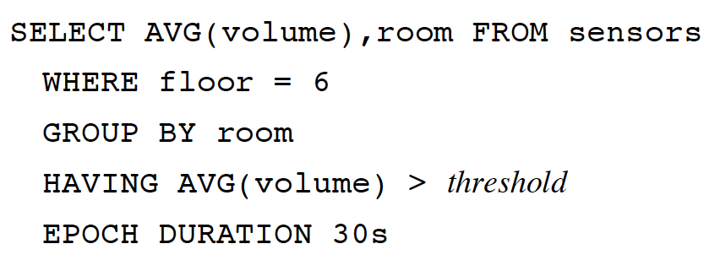
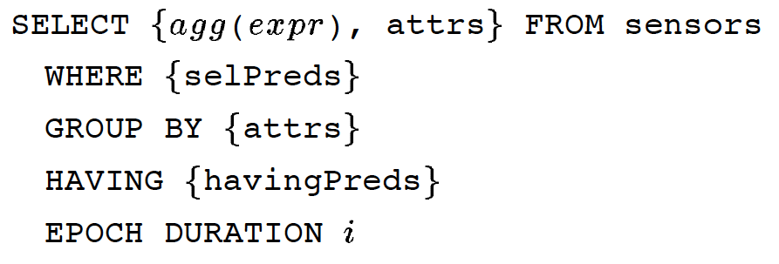
Query Model
SQL-style queries over a single table (called sensors).
Epoch – time interval for computing an aggregate record
Differences from SQL: Stream of values vs. single value; <group id, aggregate value> per group per epoch
Example Query: Monitoring occupancy in conference rooms on a certain floor
General Query
Notes:
Example: Monitoring occupancy in conference rooms on a certain floor
Differences from SQL
Stream of values vs. single value; <group id, aggregate value> per group per epoch

Slide 6
Tree-based Routing
Base Station
A
Propagate Query:
nodeID, level
Set level
Set parent
B
C
Rebroadcast
D
F
E
Notes:
Queries are posed to the basestation – a powered, storage-rich device (e.g. smart phone)
- As data propagates back towards the root, we can aggregate the data
Routing messages periodically rebroadcast to ensure continuous topology discovery

Slide 7
Structure of Aggregates
Aggregate consists of three functions:
Partial State Record: Intermediate record
Ex: AVERAGE; <x> = <SUM,COUNT>
  Merging function: f(<x>,<y>) = <z>
    f(<S1, C1>, <S2, C2>) = < S1 + S2, C1 + C2>
  Initializer: i(x) = <x>
    i(x) = <x, 1>
  Evaluator: e(<x>) = y
    e(<S, C>) = S/C
Notes:
-Partial State Records:
- Represented by <x>, <y>, <z>

Slide 8
Taxonomy of Aggregates
TAG is not restricted to SQL Aggregates
Classify aggregates according to relevant properties
Property | Examples | What does it affect?
Duplicate Sensitivity | MAX/MIN: No AVERAGE: Yes | Routing redundancy
Exemplary/Summary | MAX/MIN: Exemplary COUNT, SUM: Summary | Effects of loss
Monotonicity | COUNT / SUM: Monotonic MEDIAN: Not monotonic | Hypothesis testing, Snooping
Partial State Record Size | MAX/MIN: O(1) MEDIAN: O(n) | Performance of TAG
Notes:
Aggregates with certain properties can have optimizations applied to them
n = size of data

Slide 9
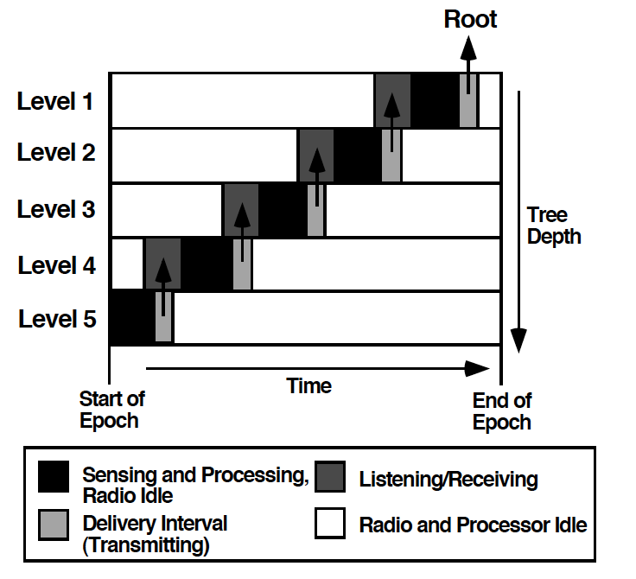
Phases of TAG
Two Phases: Distribution, Collection

Slide 10
Other Advantages of TAG
In most cases, motes transmit only a single message per epoch, regardless of routing tree depth
  In centralized (server-based) approach, messages closer to the root transmit significantly more data than motes at the leaves
Dividing time into epochs allows for processor idling

Slide 11
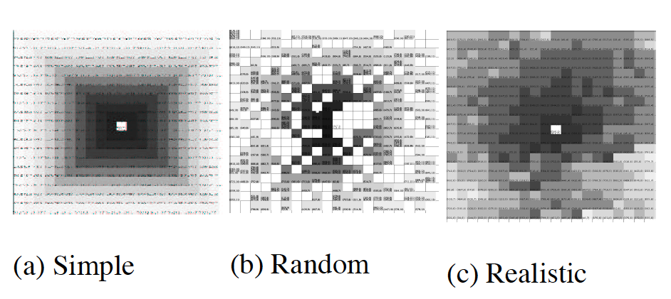
Simulation Environment
Models mote behavior at a coarse level (simulated in Java)
  Time divided into units of epochs, no time to send or decode in model, etc.
Network is modeled as an n x n grid, where each grid represents one mote; shade represents number of radio hops
Three communication models:
  Simple: No loss, Realistic: 20% loss between adjacent nodes
Notes:
-Coarse level: time is divided into units of epochs, messages are encapsulated into Java objects (no time to send or decode)
Problems? Cannot account for low-level properties of the network that are important when considering sensor networks (e.g. radio contention)
Size of network measured by diameter
Also models topology maintenance using heartbeats
How realistic is the simulation?

Slide 12
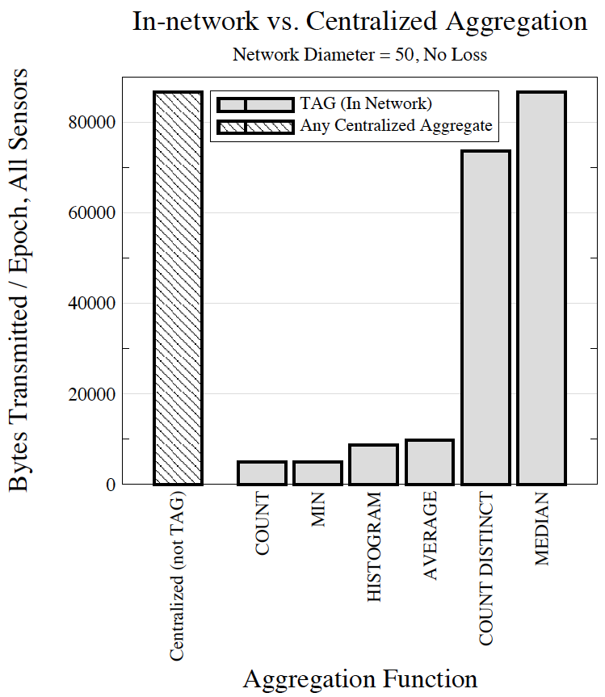
Performance of TAG
Amount of required state affects performance!
Best: Order of magnitude reduction
Worst: Same as centralized approach
What else can affect the performance of TAG?
  Network topology
  Flat, single-hop environment performs the same as centralized approach.
  Line arrangement more effective
Notes:
-Performance is affected by how much state is required. Holistic aggregates
- Network Topology

Slide 13

Optimizations
Basis: Messages are broadcast to all other nodes within range
Snooping: Listen to other motes’ messages
  Node misses aggregate initiation
  Reduce number of messages for some aggregates (e.g. MAX)
I ain’t been droppin’ no eaves…!

Slide 14
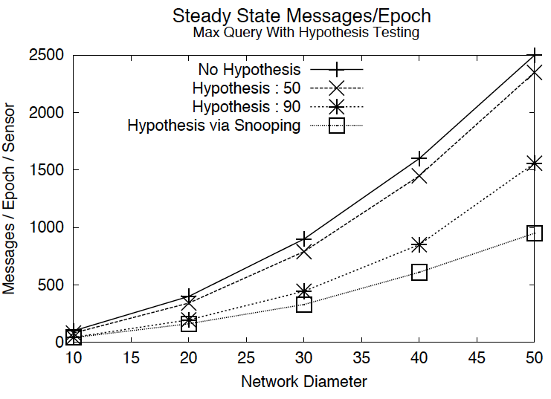
Optimizations
Hypothesis Testing: Present a node with a guess. That node decides whether or not its value will affect the aggregate and doesn’t transmit if it’s value won’t affect the aggregate
  Exemplary, monotonic aggregates; Summary Aggregates
Experiment: Values from [0,100] uniformly distributed, hypothesis made at root
Why does snooping perform the best here?
Simple node distribution is densely packed, giving lots of neighbors to snoop on.
Notes:
-Why does snooping perform the best here?

Slide 15
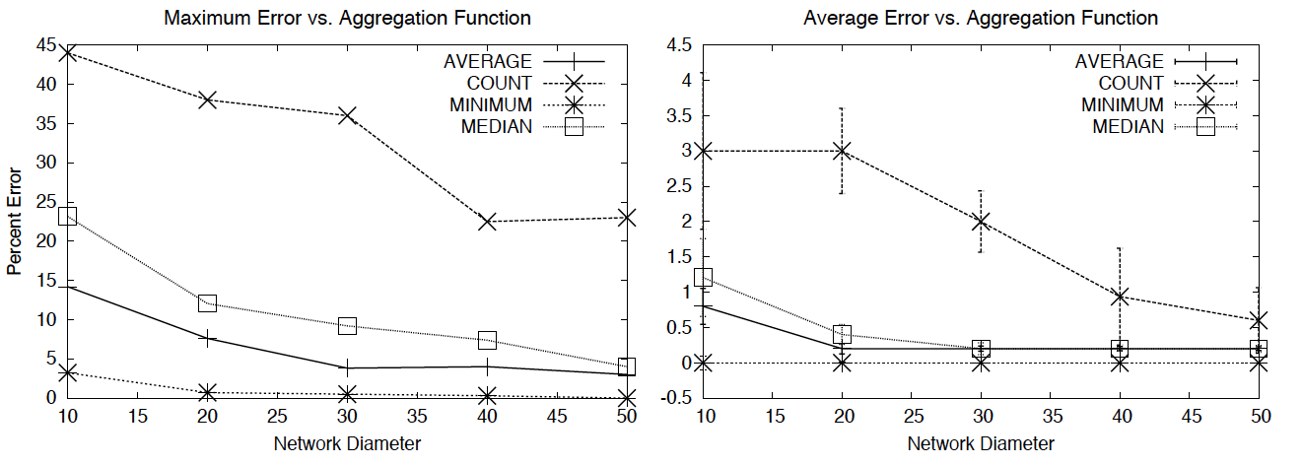
Fault Tolerance
In WSN, communication loss is common
Effects of a single loss: Lose an entire subtree temporarily
Some functions are more easily affected by loss.
Why do errors drop off as diameter increases?
Notes:
-Communication loss not factored into experiments so far
Why do errors drop off as diameter increases?
More leaves in larger trees, more likely to pick a leaf node assuming some sort of uniform distribution

Slide 16
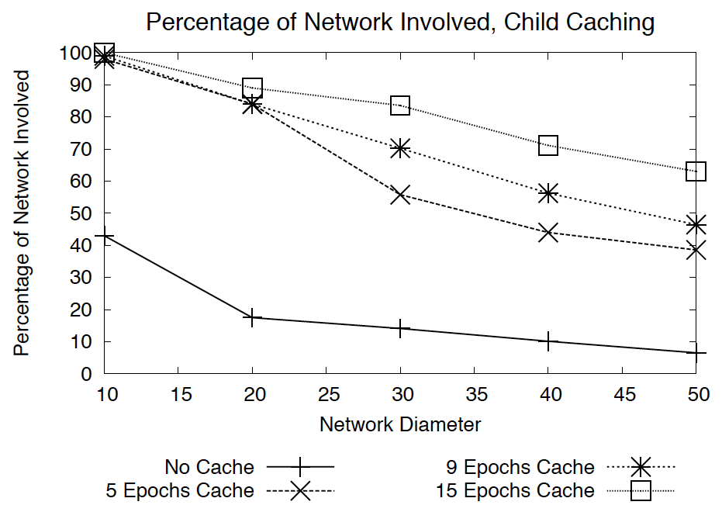
Fault Tolerance
Child Cache: Remember and use children’s partial state record when other children’s messages are lost
Drawbacks: Stale data, uses additional memory

Slide 17
Fault Tolerance
Topology Maintenance/Recovery
  Keep neighbor list. Switch parents if current link quality with parent is bad.
  If parent has not responded for a while, reset parent.
Redundancy: Send messages to multiple parents
  Still uses one message because
  of broadcast
  Decreases variance
Count
B
C
1/2
1/2
A

Slide 18
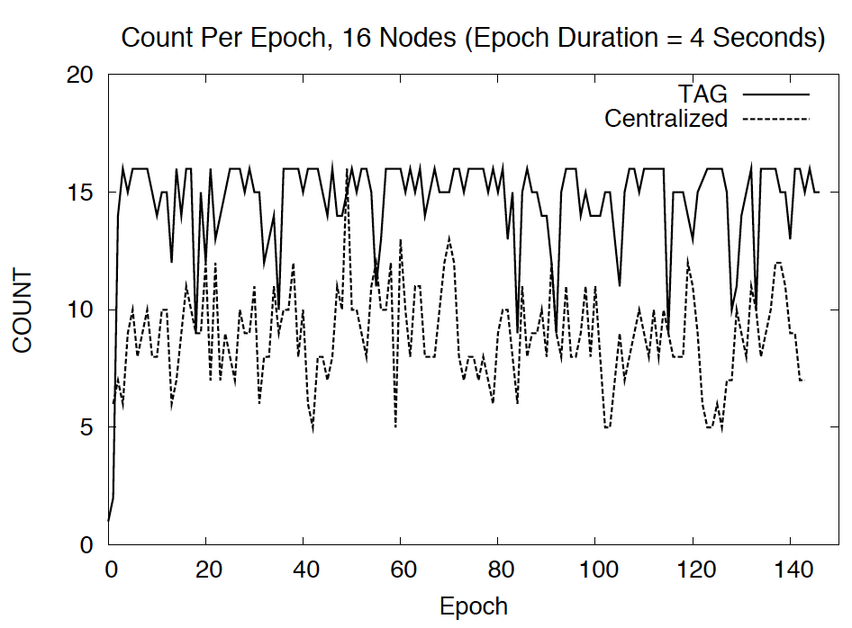
Prototype Implementation
16 TinyOS Mica motes computing COUNT
No child caching or snooping
50% communications reduction using TAG
Notes:
-Quality is better for TAG. Why?
- Reduced radio contention

Slide 19
Discussion
What other topologies other than trees can be considered?
Certain aggregates can be improved significantly (e.g. MAX). How could other types of aggregates be improved?
Notes:
-Most optimizations discussed are for monotonic, exemplary aggregates. Is it possible to improve aggregates like median?
-What does the distribution of nodes look like in real WSN deployments? Bushy trees are optimal, but doesn’t seem likely in applications
- How much energy is actually saved? We have reduced transmissions but must have other maintenance requirements.

Slide 20
Trickle: A Self-Regulating Algorithm for Code Propagation and Maintenance in Wireless Sensor Networks
Philip Levis, Neil Patel, David Culler, and Scott Shenker
Presented by David Lundgren

Slide 21
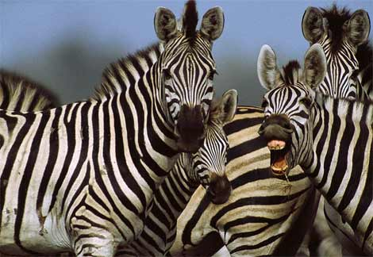

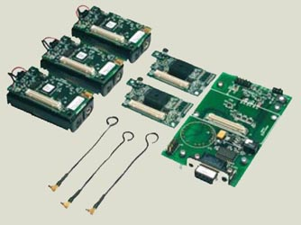
Background
What is a sensor network?
  Small, resource constrained, app specific, long lifecycles, embedded
Why do we need code propagation?

Slide 22
The Problem & Solution Criteria
Low maintenance
  Application specific, embedded, long deployments
Scalability
  Many nodes, transient failures
Rapid propagation
  Code must reach all nodes quickly and efficiently
  Why?

Slide 23
General Assumptions
Motes can compactly describe their code via metadata
Comparison of two different pieces of metadata is enough to determine update necessity
Code propagation is costly; determining when to propagate is costlier
  e.g., Maté routines fit in a single TinyOS packet w/ version number
Motes are always on, listening
Connectivity
Notes:
Are these good assumptions?

Slide 24
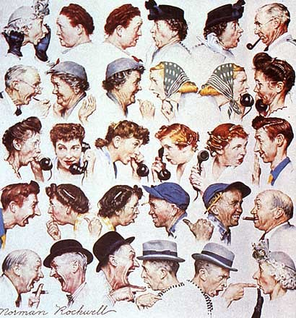
“Polite Gossip”

Slide 25
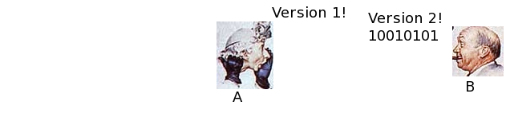
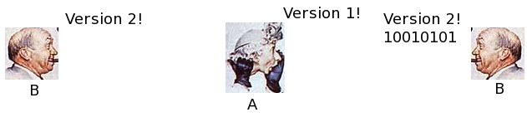
“Polite Gossip”

Slide 26
Trickle(τ, k)
τ – time interval, k – redundancy constant
for each time period τ
t = rand from [0, τ]
c = 0
while in τ
if received.meta is the same as self.meta
++c
if received.meta is older than self.meta
broadcast self.code
at time t, if c < k
broadcast self.meta

Slide 27
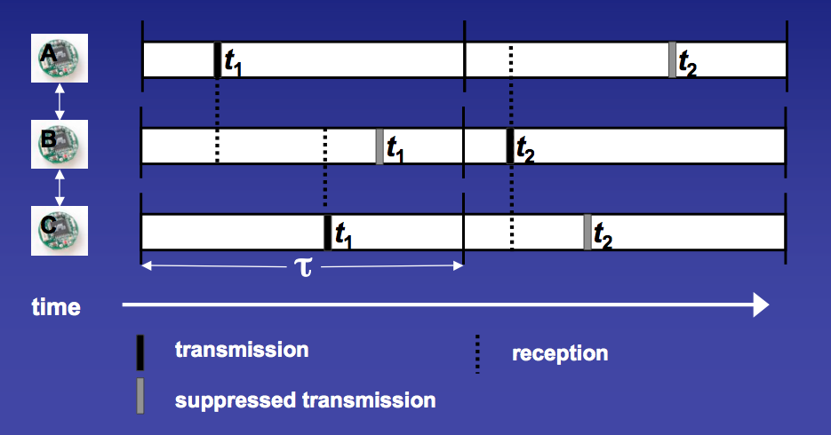
Trickle Example
k = 1

Slide 28
Trickle Example
k = 1

Slide 29
Ideal Maintenance
Assume:
  No packet loss
  Perfect interval synchronization
  Single-hop network topology
km transmissions per τ
Number of transmissions is independent of n
⬆τ = ⬇energy overhead, ⬆discovery latency

Slide 30
Abstract Simulator Experiments
Same as Demo
A message queue for tweaking Trickle’s parameters
Outputs the number of transmissions sent

Slide 31
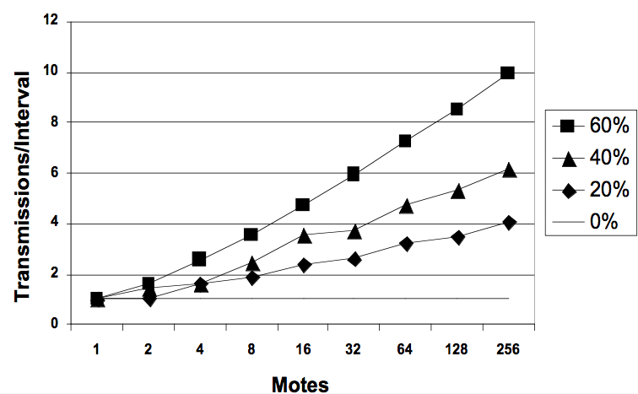
Maintenance with Loss
k = 1, AS
Number of transmissions is O(log(n))

Slide 32
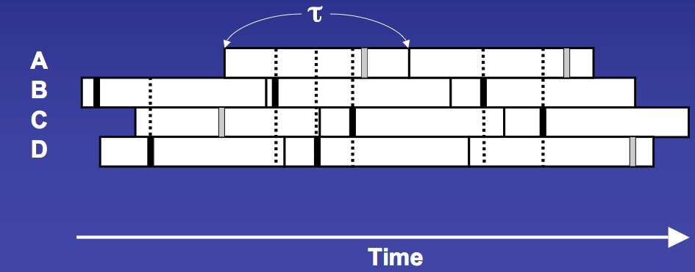
Removing Synchronization, the Short Listen Problem
k = 1
Notes:
Augment with color ellipses, animation, text boxes,

Slide 33
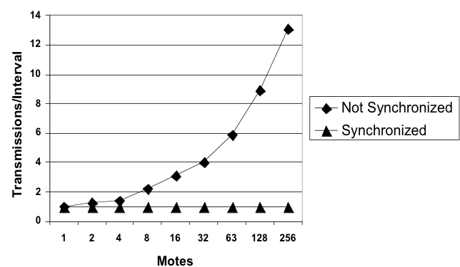
Maintenance without Synchronization
k = 1, AS
Number of transmissions is O(√n)

Slide 34
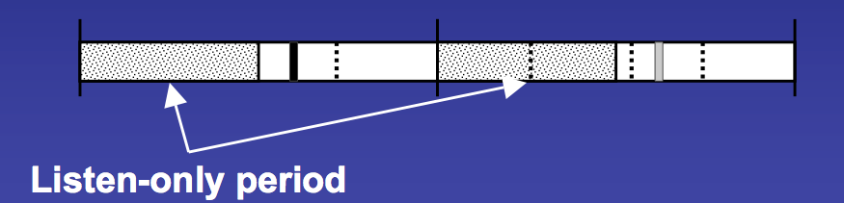
Fixing the Short Listen Problem
k = 1

Slide 35
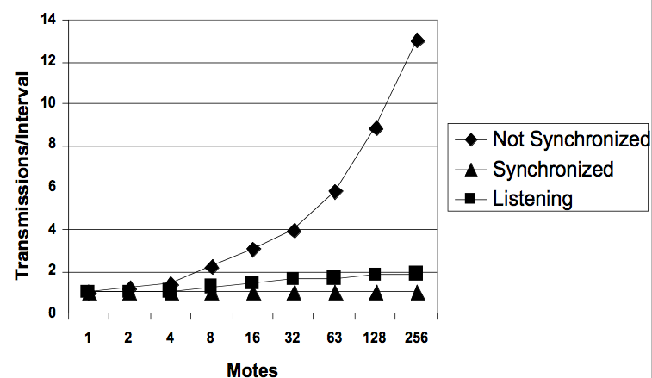
Maintenance without Synchronization
k = 1, AS
Number of transmissions is O(log(n))

Slide 36
TOSSIM Experiments
TinyOS simulator
Simulates programs from application level logic to the network at a bit level
Full TinyOS network stack
Modeled as digraph with asymmetric edge errors
40 packets/second, 36 byte payload
Added a modified TOSSIM for packet-level simulation – needed to detect packet collisions
Notes:
Which MAC layer protocol is best?? 802.11 is horrible, bMAC, zMAC

Slide 37
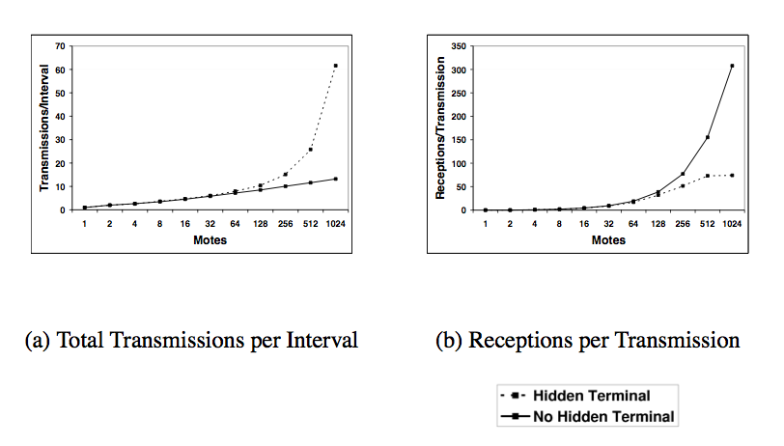
Maintenance in a Multi-hop Network
k = 1, TOSSIM, 50’x50’
Notes:
Add slide 19 to this

Slide 38
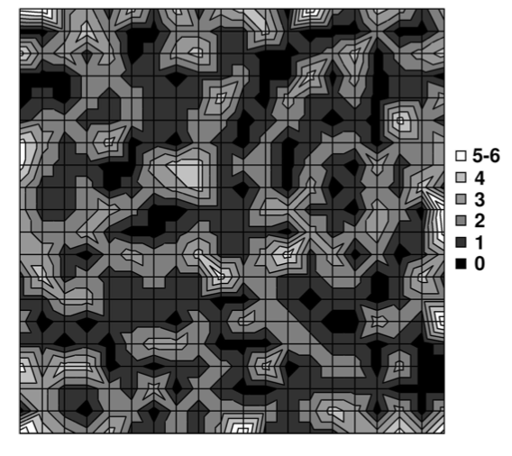
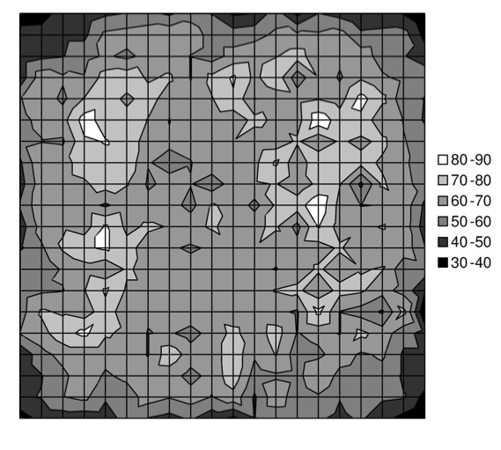
Load Distribution
Transmissions
Receptions
k = 1, TOSSIM

Slide 39
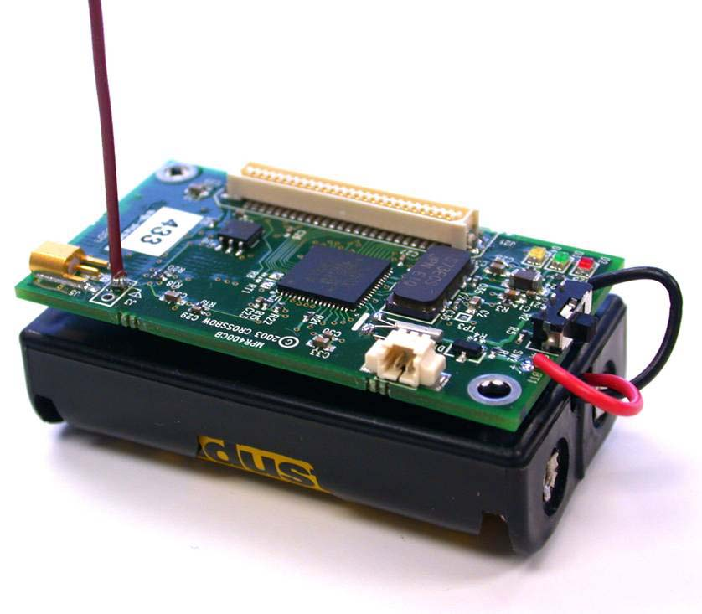
TinyOS Motes Experiments
TinyOS mica2 motes
916MHz radio
128KB program memory
4KB RAM
7MHz 8-bit microcontroller
Same packet rate/size as TOSSIM
One study with a varying number of motes on a table, transmission strength set very low
Second study in a 160’ x 40’ office.

Slide 40
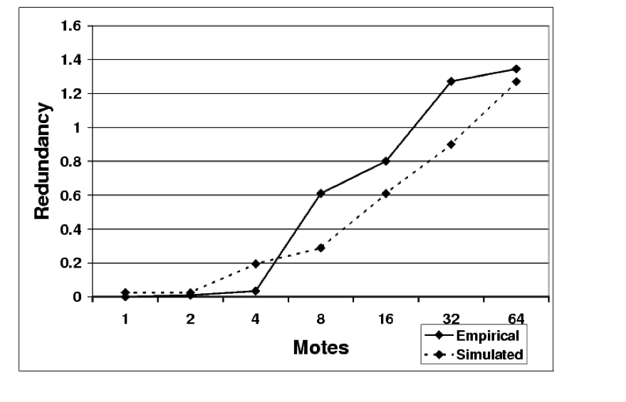
Maintenance in a Multi-hop Network
k = 1, TOSSIM, mica2, table
redundancy = (transmitted + received)/k - 1

Slide 41
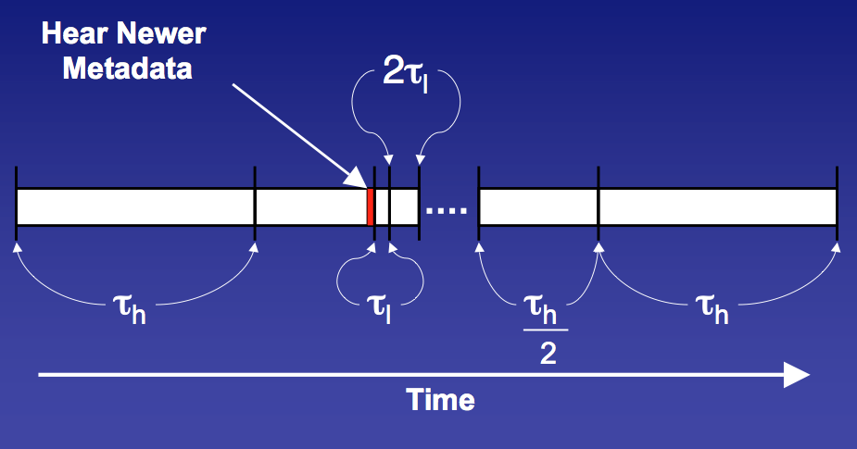
Improving Propagation
Replace static τ with variable τ = [τ_{l}, τ_{h}]

Slide 42
Trickle(τ_{l}, τ_{h}, k)
double each time period τ up to τ_{h}
1. t = rand from [ , τ]
c = 0
while in τ
if received.meta is the same as self.meta
++c
if received.meta is older than self.meta
broadcast self.code
if received.meta is newer than self.meta
set τ to τ _{l} and go to line 1
if received.code is new
set τ to τ _{l} and go to line 1
at time t, if c < k
broadcast self.meta
Notes:
----- Meeting Notes (3/16/11 22:18) -----
I need to update the algorithm

Slide 43
Maté Simulation
Small static set of routines
Each routines fits in a TinyOS packet w/ versioning info
A Maté mote broadcasts updated code at 1, 3, and 7 second intervals upon receipt of old metadata
10Hz timer

Slide 44
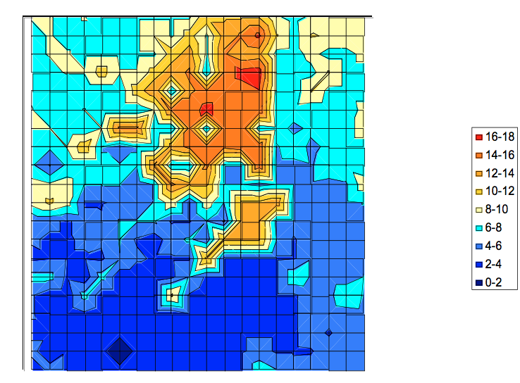
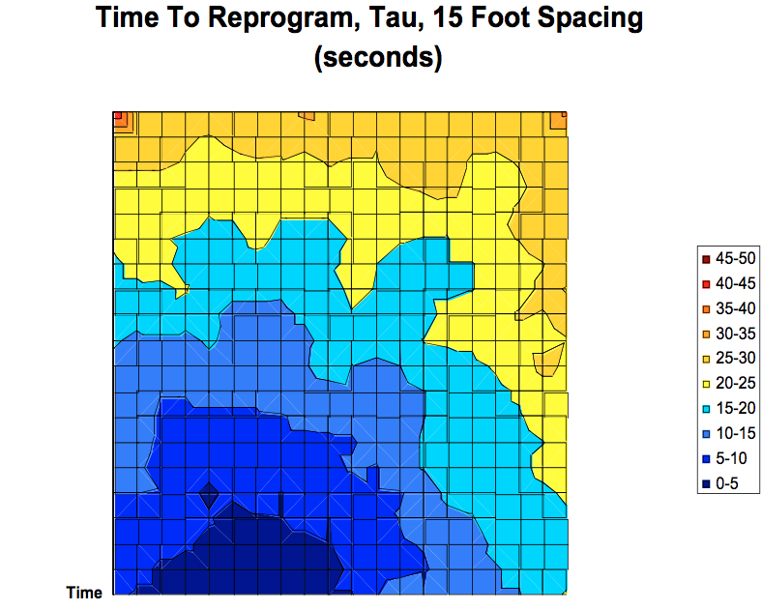
Improving Propagation
k = 1, Maté TOSSIM

Slide 45
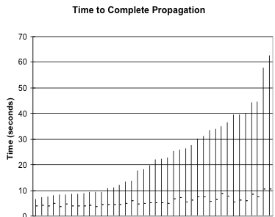
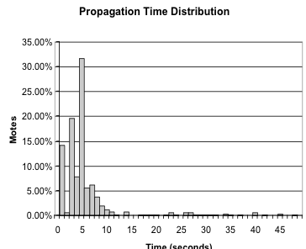
Improving Propagation
k = 1, Maté mica2, office

Slide 46
Summary & Contributions
Low maintenance
  Several sends per hour, variable
Scalability
  Scales to density changes of varying magnitudes
Rapid propagation
  Less than a minute

Slide 47
Discussion
Authors claim Trickle “can be used to disseminate any sort of data.”
  Is this true? Advantages/Disadvantages?
In-order packet arrival and incremental code updates?
Assumption of “always on” seems naïve.
Is bad scaling a “corner case?”
Alternative MAC protocols?

