Slide 1
SPORC: Group Collaboration using Untrusted Cloud Resources
Presented by:
Nipun Sehrawat

Slide 2
Cloud Deployment: Pros & Cons
Focus on user-facing applications
Real-time collaboration
Concurrent access
Anywhere-available
Is Cloud suitable?
Availability, scalability, elasticity, global-accessibility
Trust the cloud providers!

Slide 3
Overall Goals
Deploy user-facing apps on a cloud
Real-time collaboration
Offline operations
Generic servers
Deal with untrusted servers
Data confidentiality
Detect misbehavior
Recovery

Slide 4
Design Overview
Server’s role:
Global order of update messages
Store (encrypted) history
Server
Update message =
“diff” against a particular state in the history
Client 1
Client N
Notes:
Each client locally stores entire history of operations applied.
The server also stores this history, in encrypted form. Ideally, the saved history must be consistent across the clients.
We’ll see how SPORC achieves this consistency later on. Client updates its local state and generates am update message – a diff against a particular consistent state.
Update message is encrypted for privacy from server.
Now we consider potential problems associated to a naïve application of this design. Suggest potential problems? What can server misbehavior lead to?

Slide 5
Problem 1: Consistency
Server
Optimistic Update
Inconsistent State!
Diff applied to wrong
base file.
Client 1
Client N
Notes:
Problems if other clients update their local state before the diff reaches them.

Slide 6
Solution: Operational Transformation
OT allows synchronization of states
No locks
Optimistic local updates
Client 1
Client 2
ABCDE
ABCDE
delete(2)
ACDE
delete(4)
ABCE
delete(4)
ACD
delete(2)
ACE
Notes:
0

Slide 7
Solution: Operational Transformation
OT allows synchronization of states
No locks
Optimistic local updates
Client 1
Client 2
ABCDE
ABCDE
delete(2)
ACDE
delete(4)
ABCE
delete(3)
ACE
delete(2)
ACE
Transform a foreign ops past any new local ops

Slide 8
Problem 2: Malicious Server
Server
- Different Views of the state!
- Histories “Forked”
Client 1
Client N

Slide 9
Solution: Fork* Consistency
Clients send: Update Message + Hash (chain) of its history
Receiving clients compare with their hash, fork if mismatch.
Can forks go undetected?
Notes:
What if a server partitions the clients?

Slide 10
Fork* Consistency
Client 1
Client 2
1
2
3
1
2
3
Some other client generates OP 4 and 5.
Server forks states of client 1 and client 2
1
2
3
4
1
2
3
5
Correct history:
1
2
3
4
5
Fork detected as soon as these clients interact
with some other client

Slide 11
Is Fork* Consistency good enough?
What about banking operations?
Balance in account : $10K
Account information maintained on two machines
Hack the server to fork their states
Withdraw $10K from both machines

Slide 12
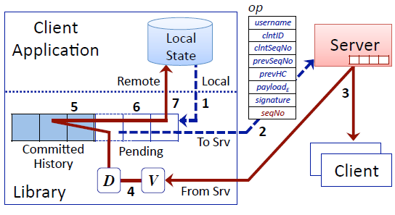
Detailed Design
Invariant 1: Local Coherence
Notes:
Each client maintains committed history – which is the consistent state shared by all clients. Will be exactly the same on all the clients.
Local operation = diff against a particular state in the history.
Client sequence number: Every client keeps track of last client sequence number received from every other client. Shall increase by one – detect forks.
previous seq number: Tells which state in the history was this diff created against.
prevHC: Hash chain when this op was applied – for detecting forks
seqno: Assigned by the server
Single in-flight operation.
Transform all the pending queue also.

Slide 13
Detailed Design
Invariant 2: Fork* consistency
Notes:
Each client maintains committed history – which is the consistent state shared by all clients. Will be exactly the same on all the clients.
Local operation = diff against a particular state in the history.
Client sequence number: Every client keeps track of last client sequence number received from every other client. Shall increase by one – detect forks.
previous seq number: Tells which state in the history was this diff created against.
prevHC: Hash chain when this op was applied – for detecting forks
seqno: Assigned by the server
Single in-flight operation.
Transform all the pending queue also.

Slide 14
Detailed Design
Invariant 3: Client-Order preservation
Notes:
Order assigned (for a particular client) by server shall be same as client’s local ordering

Slide 15
Detailed Design
Committed History = Base File
Update message = Diff wrt a Committed History
Notes:
Each client maintains committed history – which is the consistent state shared by all clients. Will be exactly the same on all the clients.
Local operation = diff against a particular state in the history.
Client sequence number: Every client keeps track of last client sequence number received from every other client. Shall increase by one – detect forks.
previous seq number: Tells which state in the history was this diff created against.
prevHC: Hash chain when this op was applied – for detecting forks
seqno: Assigned by the server
Single in-flight operation.
Transform all the pending queue also.

Slide 16
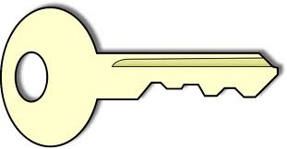
Membership Management
Shared Key (for efficiency)
New Shared Key
Key shared with the new client
New client generates current state
from Ops stores at server
- Old key needed to decrypt updates encrypted using it (new clients)
Notes:
Clients use a shared key for efficiency

Slide 17
Evaluation
Two configurations:
Unloaded: Single client sending updates
Loaded: Every client sending updates
One server, four machines with multiple clients
Experiments on LAN
Metrics:
Latency: “In-flight” time
Server throughput
Client time-to-join
Notes:
Clients and server on different machines

Slide 18
Latency
“Server processing” increases as broadcast to more clients
Client overhead nearly constant
“Client queuing”, “Client processing” increase
“Server Processing” also increases

Slide 19
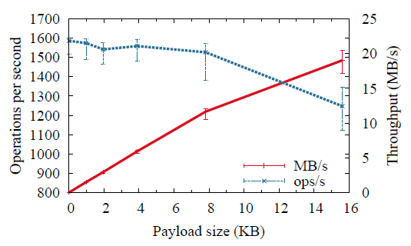
Server Throughput
More payload => More processing/packet
More payload => Processing overhead/byte decreases

Slide 20
Related Work
Venus:
Only for key-value stores
Requires a “core set” of clients to be online
Membership can’t be revoked
Depot:
Applications-logic for conflict resolution
Client eq. to server, can also tolerate faulty clients

Slide 21
Discussion
What are a typical requirement of the targeted apps?
Latency?
Bandwidth?

Slide 22
Discussion
Is the server needed at all?
Limited role:
Assign increasing sequence number to updates – clients receive updates in the same order (TCP used).
Store history.
An alternative architecture?
Timestamp server + P2P communication
Demerits?
Do all clients receive updates in the same order?

Slide 23
Discussion
How can server attack availability of the service?
Any remedies?

Slide 24
Discussion
A new client has to apply all the operations to get current state. Can we do any better?
Check-pointing

Slide 25
Thank you! Questions?

Slide 26
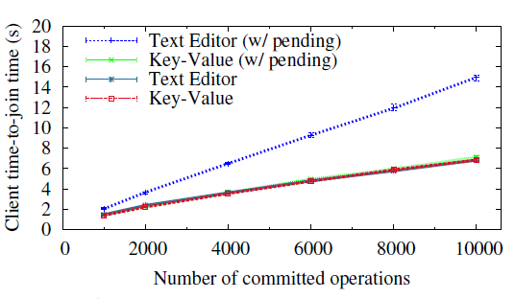
Client Time-to-Join
2000 pending ops
More history => More diffs to apply
Text-Editor: OT is expensive
Key-Value Store: Conflicts only when keys match

Slide 27
Towards Robust Distributed Systems
PODC 2000 keynote
Prof. Eric Brewer
Presented by:
Nipun Sehrawat

Slide 28
Do “classic” Distributed Systems work?
“Working” DS like WWW, Napster etc are not “classic” DS.
No RPC
No modularity
No distributed objects
Notes:
*?Some classic Dses? Amoeba?

Slide 29
Three issues in DS
Where is the state?
Consistency vs Availability
Understanding Boundaries

Slide 30
Where is the state?
Classic DS:
Data centers – consistency + availability
Other locations: primarily for caching state.
Desktops, proxies
DS shall acknowledge location distinctions
Computation
Data
Notes:
?Classical DS focusing on computation eg
?DC?
?Location distinction in DS

Slide 31
Consistency vs Availability
Classic DS: focused on ACID transaction semantics
A: Operation performed on all replicas or none
C: After an operation, all replicas end-up in same state
ACID makes application dev. easier
What can be trade off for better performance and availability?
Notes:
Care for Facebook friend count show off by one, sometimes?

Slide 32
Consistency vs Availability
New paradigm: BASE
Basically Available
Soft-state
Eventually Consistent
Notes:
Basically Available: the system is available, but not necessarily all items in it at any given point in time
After a certain time all nodes are consistent, but at any given time this might not be the case
?Soft-state? – Changing with time (without additional ops)?

Slide 33
Brewer’s Conjecture
Impossible for a web-service to provide following three guarantees simultaneously:
Availability – Non-failing node shall respond to every received request
Consistency – Replicas updated as if all on a single node
Partition Tolerance
CAP theorem: Can have atmost two of these at a time

Slide 34
CAP Theorem
- Single-site clustered database
- Can user 2-Phase Commit

Slide 35
CAP Theorem
- No replication or Quorum
- Don’t reply if response misses
from a data-node
- Distributed databases

Slide 36
CAP Theorem
Easiest!
Just reply with available data
- DNS

Slide 37
The DQ Principle
For a given node:
(Data/query) * (Query/sec) is constant
What can a fault affect?

Slide 38
Discussion
How does SPORC tries to address:
Availability?
Consistency?
Partitions?
Can a wide-area distributed database have both high consistency & availability?
How can we make up for the lost consistency?

Slide 39
Cumulus: Filesystem backup on Cloud Michael Vrable, Stefan Savage, Geoffrey Voelker

Slide 40
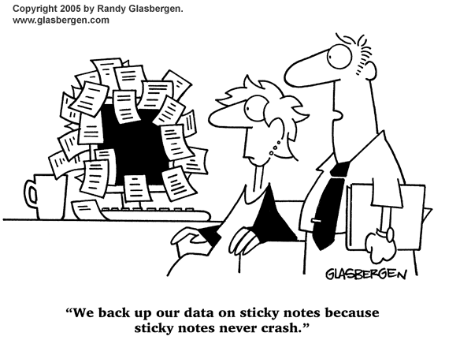
Background
Notes:
There are two aspects to this topic. One is the backup on cloud and the other is evaluating thin vs thick cloud.
Lets talk about backup. Some of us might have had the misfortune of loosing our entire data either due to the computer crash or just a human mistake.
Data loss is very common among users and hence one of the reason to backup data.

Slide 41
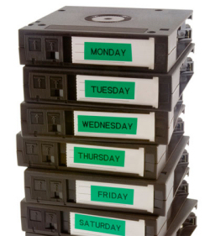
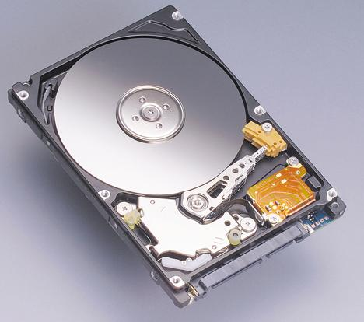
Background
Notes:
Backup technology has been evolving from tapes to disk to optical storage to ssds and to cloud.
Online backup can protect against worst-case scenarios like flood, fire etc. less chance of damage since the providers make backup copies of your backup. Its more convenient since no human intervention is required.

Slide 42
Backup on Cloud
﻿Simple
Reliable
Easy off-site storage
Notes:
It protects against worst case scenarios like flood, fire etc. There is lesser chance of damage since the service providers usually have backups of your backup.

Slide 43
What are the monetary cost of backup on cloud?
Notes:
-Cost of data center storage
-operational bandwidth cost of shipping data back and forth
-on going cost
Apart from that what if the service provider goes out of business?

Slide 44
Thin vs Thick cloud
Thick cloud: Highly integrated service﻿﻿
Greater performance and Efficiency
Reduced flexibility
Locking customers
Thin cloud: Build on top of generic layer
Minimal interface
Portable
Additional overhead
Notes:
The other aspect of the paper is to explore thin vs thick cloud in the context of filesystem backup.
On one end is highly integrated service (SAAS) which has all the resources and logic tighly integrated to provide specific service.
And on the other end is datacenter based infrastructure providers which provide minimal interfaces to very abstract resources. Eg: Amazon's EC2

Slide 45
Thin vs Thick cloud
What is the right choice?
What is the penalty of using a thin cloud service?
Can one build competitive product economy around a cloud of abstract commodity resources or do underlying technical reasons ultimately favor an integrated service-oriented infrastructure?
Notes:
Is there a right choice?
It seems that thin cloud service would increase the competition due to low barrier in switching providers.

Slide 46
Cumulus
Filesystem backup on cloud designed under a thin cloud
Motivation:
Explore thin-cloud vs thick-cloud trade-off in the context of backup

Slide 47
Cumulus
Cloud based backup system
Reliable
Easy offsite storage
Portable
Tuned for cost
Notes:
Feature
-Cumulus designed around a minimal interface (get, put, delete, list)
-Because of the minimal interface, it is portable to any on-line storage service.
-This means application logic must be built into client
-tuned for cost by using Amazon's pricing model

Slide 48
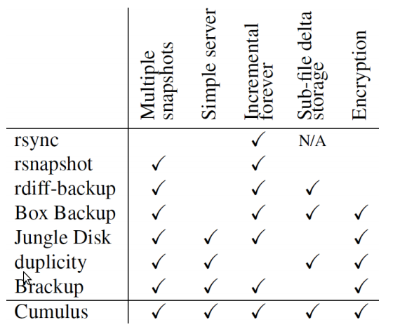
Prior work
Notes:
Cumulus is most similar to Duplicity. But duplicity will have to occasionally re-upload a new full backup.
Brackup doesn't have good support for incremental backups and cumulus performs better storage space cleaning

Slide 49
Design
Storage Server Interface
Snapshot format
Storage Segment
Sub-file incremental
Segment Cleaning
Restoring
Notes:
Now we will take a look at the design that went into designing a service on thin cloud. Since its the design that enables them to be portable and flexible

Slide 50
Storage Server Interface
Minimal interface: get, put, list, delete
Operates on entire files
Write once storage model
Notes:
In this model, they are expecting the server to have only a minimal interface.
-Minimal interface
-The operations operate on entire files which means we can't read or write arbitrary byte ranges within a file
-It can be implemented on top of any number of protocols FTP, SFTP, WebDAV, S3 or nearly any file system
-What is the adv of Write once storage model?
This provides convenient failure guarantees. A failed backup run cannot corrupt old snapshots

Slide 51
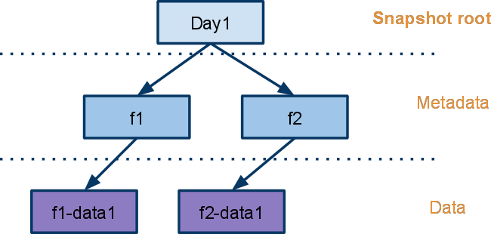
Snapshot format
Snapshot Descriptor
Date: Day1
Root: A/0
Segments: A B
Notes:
Snapshot logically consists of two parts - metadata log and -file data
metadata log lists all the files backed up.
Metadata log entry specifies properties such as modification time, ownership and file permissions. It includes list of pointers to objects containing the file data.
Metadata is stored in text format
Snapshot descriptor contains root object, which is the start of the metadata log. It contains information about what all segments are involved.

Slide 52
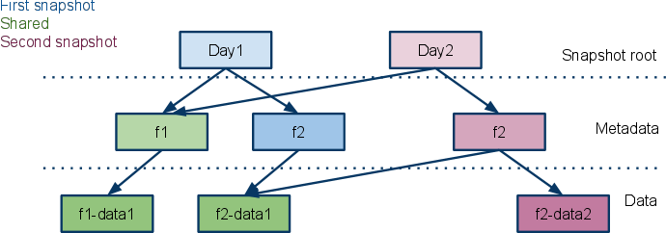
Snapshot format
Notes:
Metadata log might contain pointers to objects containing other pieces of metadata log
metadata log include pointers to cryptographic hashes to validate data.

Slide 53
Snapshot format
What are the benefits of this format?
Notes:
Data blocks are shared between snapshots. This would minimize storage and bandwidth.

Slide 54
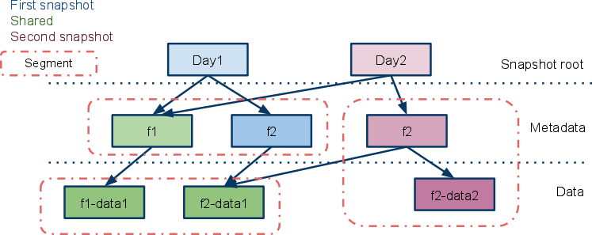
Storage Segment
Notes:
Now lets go to the next question. How is the data stored?
Both metadata and data are broken down into blocks or objects and these objects are then packed together into segments. These segments are compressed as a unit, optionally encrypted and stored on the server.
Imp: Segments become the unit of storage on the server, with each segment stored as a single file. The server sees it as one file.
Segments contain objects which could be metadata or data. Each object is numbered in the segment.
Segment is structured as a TAR file with each file in the archive corresponding to an object.

Slide 55
Storage Segment
What are the benefits of grouping data together into segments?
Is there any downside to grouping data into segments?
Notes:
Aggregating data produces larger files for storage and it is beneficial to
-avoid inefficiencies associated with many small files. large no of small files means higher metadata cost, wasted space from rounding up to block boundaries and more seeks.
-avoid cost in network protocol.
-take advantage of interfile redundancy
-provide additional privacy when encryption is used
-changes to small parts of larger files can be efficiently represented by breaking those files into smaller pieces during backup.
-What If we need a file which occupies only a portion of the segment
-What is the consequence of large segment size?

Slide 56
Sub-File incrementals
Is the design of Cumulus suitable for incremental changes?
Notes:
The contents of each file is specified as a list of objects so new snapshots can continue to point to old objects when data is unchanged. If only a small portion changed, only that portion needs to be stored.

Slide 57
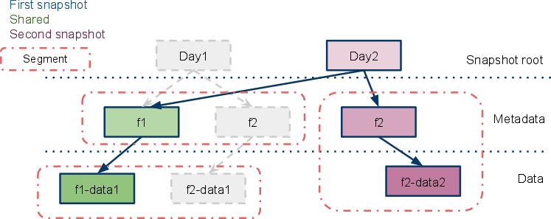
Removing old snapshot
Notes:
When old snapshots are no longer needed, root snapshot descriptor for those snapshots are deleted.
Then unreachable segments are garbage collected.
But since segments are shared between snapshots, they would contain only fraction of useful data and the rest is wasted space.
This space wastage can result in high cost

Slide 58
Segment Cleaning

Slide 59
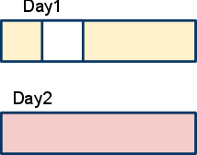
Segment Cleaning

Slide 60
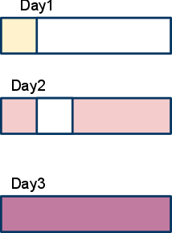
Segment Cleaning

Slide 61
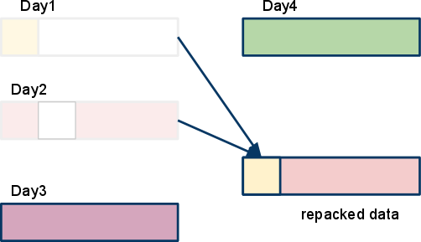
Segment Cleaning
Notes:
When old snapshots are no longer needed, space is reclaimed by deleting root snapshot descriptor, then garbage collection of unreachable segments are done.
It may so happen that small fraction of useful data remains in the segments and the space occupied by data of the deleted snapshot is wasted.
Repacking of this data involves not following write once model. Detailed book keeping must be done to figure out what data is required. Finally, it requires downloading that data, decrypting it and storing it again.

Slide 62
Segment Cleaning
How do we decide when to clean a segment?
What other approaches can be taken to reduce space wastage?
Notes:
A simple policy for selecting segments to clean is to set a minimum segment utilization threshold that triggers cleaning of a segment.
Complex policies like cost-benefit evaluation that favors repacking long-lived segments.
It could use some heuristics to group data by expected lifetime when a backup is first written.
You can repack based on age. The intuition being that they are mostly going to be deleted together.
Instead of referring to data in inefficient segment, write new copies of that data if needed.
Imp: All this cleaning is happening at the client-side.

Slide 63
Alternative Scheme
If a new snapshot is refers to an object in less utilized segment, create copies of that data.
Notes:
A simple policy for selecting segments to clean is to set a minimum segment utilization threshold that triggers cleaning of a segment.
Complex policies like cost-benefit evaluation that favors repacking long-lived segments.
It could use some heuristics to group data by expected lifetime when a backup is first written.
You can repack based on age. The intuition being that they are mostly going to be deleted together.
Instead of referring to data in inefficient segment, write new copies of that data if needed.
Imp: All this cleaning is happening at the client-side.

Slide 64
Segment Cleaning
Clean based on utilization of a segment
utilization threshold = 0; no cleaning
utilization threshold = 1; aggressive cleaning with 100% utilization
What is the right threshold?

Slide 65
Evaluation
Trace based simulation
A fileserver trace : research group setting
A user trace : home setting
Simulator models the process of backing up
Tracks storage, network and segment overhead
Single and multi snapshot scenario
Optimal baseline
No more data is stored or transferred than needed
Transfers entire content of the file if any part changes
Stores only one copy if multiple files have same hash
Notes:
To understand the behavior of the system, they conducted trace based simulations.
They said that to figure out which segments are to be cleaned would not be feasible in reasonable amount of time.

Slide 66
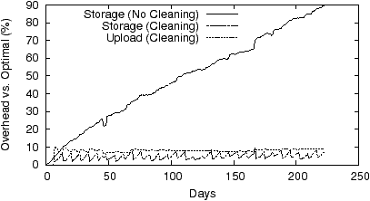
Is cleaning necessary?
Optimal => No space wastage
Notes:
When segments are not cleaned, wasted storage space grows quickly with time and in their simulation at day 223, the size of snapshot is nearly double.
Otherwise the overhead stabilizes to 10% with utilization threshold of 60%

Slide 67
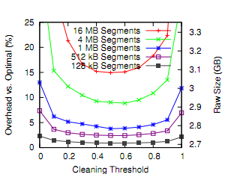
Average Daily storage plot
Larger segment size => larger overhead
Too little cleaning => larger overhead
Too aggressive cleaning => larger overhead
Notes:
This is the fileserver trace which has the same trend as the user trace.
-Large segment increase overhead
-Too little cleaning leads to large overhead
-Aggressive cleaning leads to churn, storage overhead when keeping multiple snapshots
Storage and upload overhead improves with decreasing segment size. But beyond certain size like 1MB, backup requires very large no of segments and limits the benefit of aggregating data. Benefits of aggregating data are
-avoid inefficiencies with small files
-overhead of n/w protocol
Storage overhead increases at higher cleaning threshold. Why is that?
As the segment size increases, the overhead increases because this segment would contain many objects which corresponds to different snapshots so deleting a snapshot would lead to waste space.

Slide 68
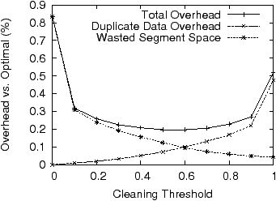
Cleaning Policies
Breakdown of storage overhead when using 16 MB
Notes:
There are two components that contribute towards storage overhead namely duplicate data overhead and wasted segment overhead.
As the cleaning threshold increases, ie its frequently cleaned, the duplicate overhead increases. But as the cleaning threshold increases, the wastage is reduced and its overhead decreases.

Slide 69
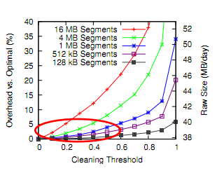
Average daily upload
Larger segment size => larger n/w overhead
Increasing threshold => increases n/w overhead
Notes:
You can notice that for small size segments, less than 1 MB, the cleaning threshold doesn't create much overhead.

Slide 70
Restoring from Backup
Complete restore
Extract all files
Get the root snapshot descriptor
Download all segments referenced
Partial restore
Recover small number of files
Download segments with metadata of snapshot
Locate segments containing file data
Notes:
Cumulus is primarily optimized for complete restore.

Slide 71
Evaluation
What is the penalty of using a thin cloud service?
What are the monetary cost of using remote backup?
What are the additional benefits?
How does this prototype perform?

Slide 72
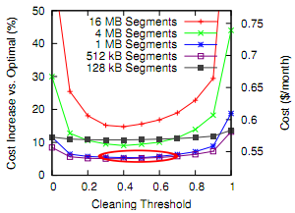
Paying for remote backup
Notes:
﻿Storage cost dominates ongoing cost
Thus changes to storage efficiency will have higher impact on cost
Decreasing segment size increases overhead due to per-file pricing
Cleaning threshold providing the minimum cost is less aggressive around 0.4 .
Price overhead is not very sensitive to cleaning threshold

Slide 73
Prototype evaluation
Prototype built on Amazon S3
Cost comes to $0.19 / per month for 1.26 GB of data storage
Parameters can be tuned to minimize cost
Comparing it to existing tools : Brackup and Jungle Disk
Both will have much higher operation cost
Thick cloud solutions
Mozy: integrated solution
$4 + 0.5 / per GB per month

Slide 74
Thank you!

