Slide 1
Storage: Scaling Out > Scaling Up?
Ankit Singla
Chi-Yao Hong

Slide 2
How Can Great Firms Fail?
C. M. Christensen

Slide 3
Sustain vs. Disrupt
Sustaining technologies
Customer demand driven
Pioneered by incumbent big firms
Disruptive technologies
Often convince people: “You want this!”
Create new markets, new customers
Often pioneered by new firms
Lower On Tech
Bigger On Opportunity

Slide 4
Sustain vs. Disrupt
Sustaining Tech
High-end Demand
Performance
Disrupting Tech
Low-end Demand
Time

Slide 5
A Case for Redundant Arrays of Inexpensive Disks (RAID)
David Patterson, Garth Gibson and Randy Katz

Slide 6
Why RAID?
Performance of SLEDs has increased slowly
Amdahl’s law and the I/O crisis
; 100x faster CPU, 10% I/O time, S?
Large memories / SSDs as buffers don’t work
Transaction processing
Large volume of small requests
Supercomputing-like environments
Small volume of large requests
$$S= \frac{1}{\left(1 −f\right)+f/k}$$

Slide 7
Inexpensive Disks
Lower cost, lower performance
Better price/MB, smaller size, power footprint
Also, lower reliability for same capacity ☹
$$MTTF of a Disk Array= \frac{MTTF of a Single Disk}{Number of Disks in the Array}$$
Add Redundancy!

Slide 8
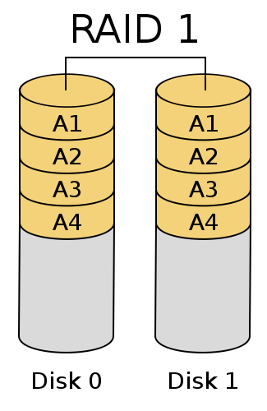
RAID 1
Idea: Just mirror each disk
Better throughput for reads
Huge MTTF
Inefficient / costly

Slide 9
RAID 2
Hamming codes for error detection/correction
Hamming (7, 4) example
So use 3 parity disks with 4 data disks
Inefficient for small data transfers
High cost for reliability
 | P1 | P2 | D1 | P3 | D2 | D3 | D4
P1 | X |  | X |  | X |  | X
P2 |  | X | X |  |  | X | X
P3 |  |  |  | X | X | X | X

Slide 10
RAID 3
Disk controllers know which disk failed
Just use 1 parity disk to fix that disk
Low-enough cost of reliability
RAID 4, 5 improve throughput for small accesses

Slide 11
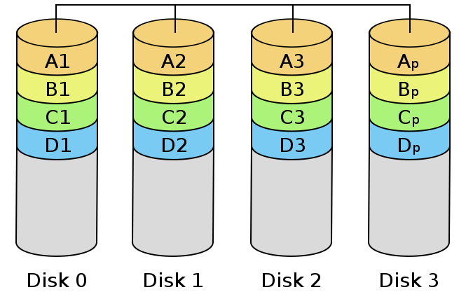
RAID 4
Exploit parallel I/O across disks in a group
Interleave data at sector-level instead of bit-level
Small write to one disk doesn’t access other disks
But the check-disk is the bottleneck
Sectors,
Not Bits

Slide 12
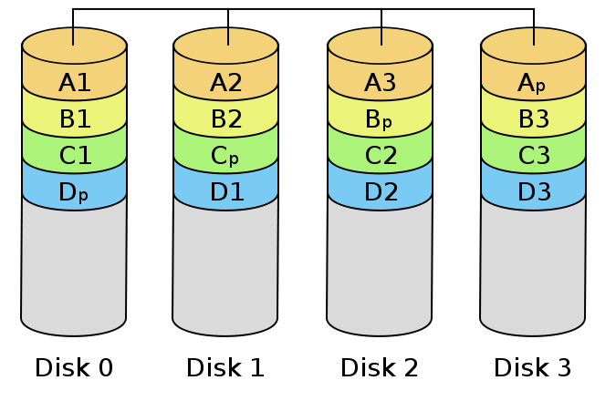
RAID 5
Distribute the parity blocks across disks!
Good performance across small/large reads/writes

Slide 13
RAID vs. SLED
10x performance, reliability, power efficiency
Modular growth
Add groups or even individual disks
Also makes hot-standbys practical
Lower power/MB makes battery-backup for the whole disk array feasible

Slide 14
Comparison of RAID Levels

Slide 15
Discussion
What’s wrong with the below organization?
Other applications for the RAID ideas?
Across data centers or cloud providers?
Better metrics for reliability than MTTF?
File System
RAID
Disk Driver

Slide 16
FAWN: A Fast Array of Wimpy Nodes
David Anderson, Jason Franklin, Michael Kaminsky, Amar Phanishayee, Lawrence Tan, Vijay Vasudevan
(figures adapted from the slides by Vijay Vasudevan)
Notes:
A new design to improve energy efficiency of today’s clusters

Slide 17
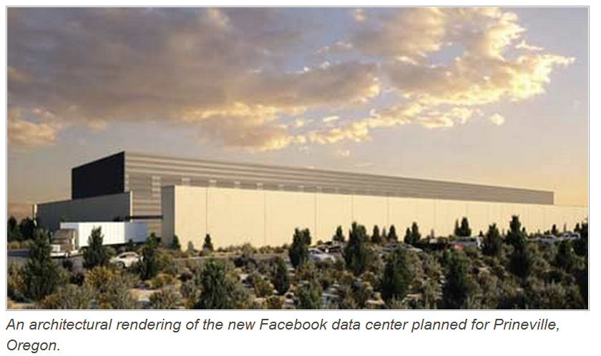
Facebook Relies on Coal Power in Data Center
http://www.datacenterknowledge.com/archives/2010/02/17/facebook-responds-on-coal-power-in-data-center/
Notes:
So the issue of energy in computing becomes a really important problem in the past few years. Those networking companies are now going to spending on power and cooling than on servers the actually do the work. To reduce these cost, companies like google and facebook has chosen to locate their datacenter based on the access of cheap energy. Here we show a facebook datacenter in Oregon, where they could get cheap coal power.
Some public media has great concern on this. Even after they got a criticism, facebook still decided to expand this DC to double its size.

Slide 18
Energy in Computing is a Real Issue
“Google’s power consumption … would incur an annual electricity bill of nearly $38 million” [1]
“Energy consumption by … data centers could nearly double ... (by 2011) to more than 100 billion kWh, representing a $7.4 billion annual electricity cost” [2]
[1] Cutting the Electric Bill for Internet-Scale Systems, SIGCOMM'09
[2] Environmental Protection Agency (EPA) Report 2007
Notes:
[1] SIGCOMM estimation. Conservative.
[2] Just in two years, all datacenter combined will soon be spending $7.4 billion dollars per year on electricity cost. This comprises 3% of total energy of the US.
Given these motivating results, so it’s natural to ask, how could we reduce the power consumption of clusters.

Slide 19
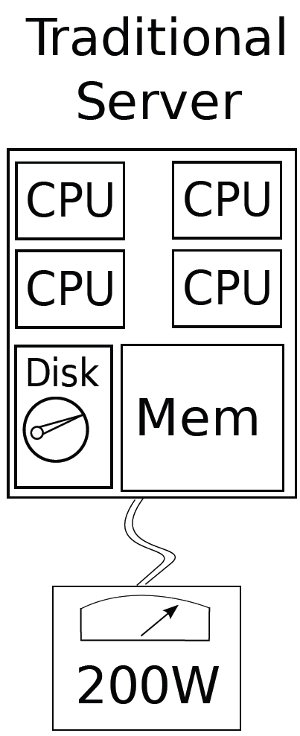
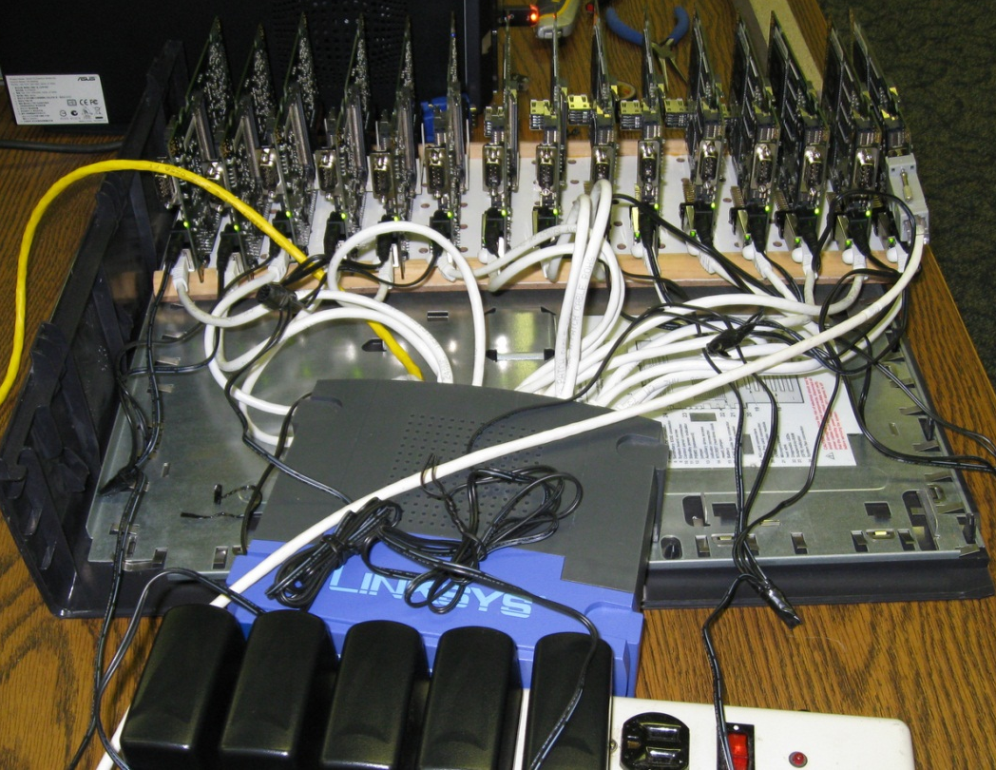
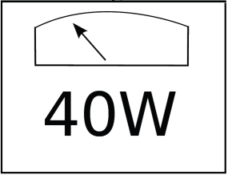
FAWN: A Fast Array of Wimpy Nodes
Notes:
Try to improve the energy efficiency of data-intensive computing by using a large set of low-power load-balanced node.
Mention there is some work to reduce the energy consumption of traditional server

Slide 20
FAWN-KV: An Energy-efficient Cluster for Key-value Store
Goal: Improve Query/Joule
Prototype: PCEngine Alix 3c2 devices
Single-core 500 MHz AMD Geode LX
256 MB DDR SDRAM (freq. = 400 MHz)
100 Mbps Ethernet
4 GB Sandisk Extreme IV CompactFlash device
Challenges:
Efficient and fast failover (to achieve SLA)
Wimpy CPUs, limited DRAM
Flash poor at small random access

Slide 21
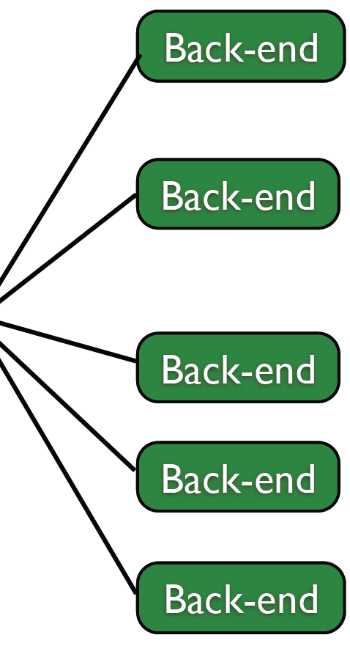
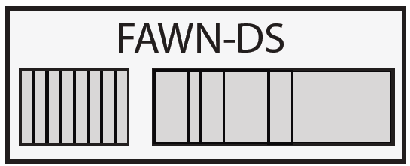
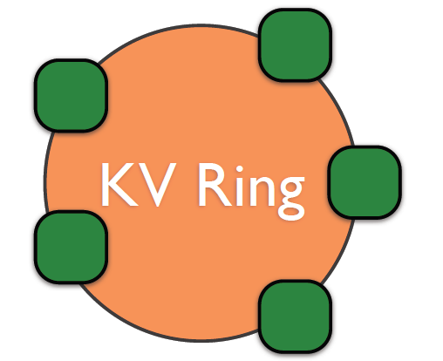
FAWN-KV: Architecture
Manages backends
Acts as Gateway
Routes Requests
Consistent Hashing

Slide 22
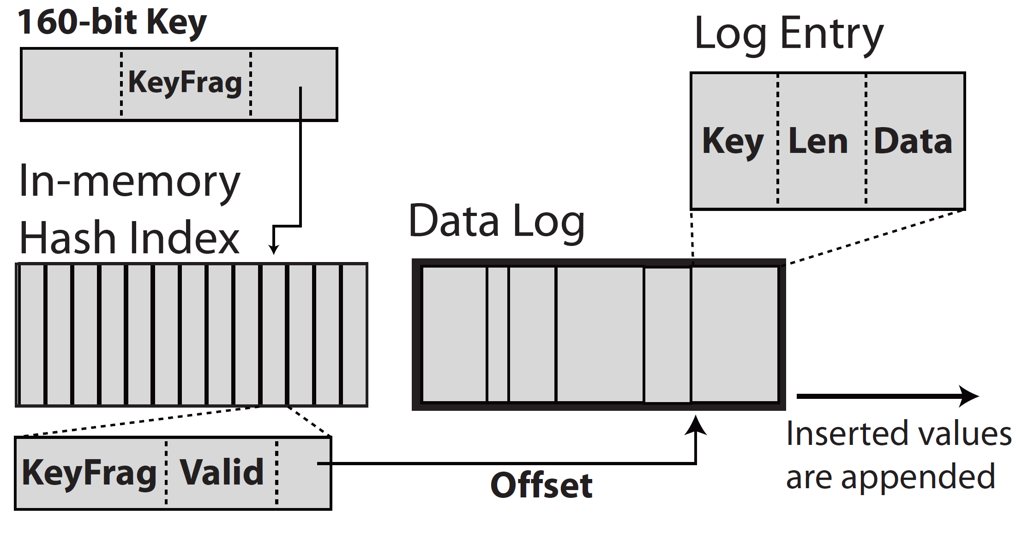
FAWN-KV Uses DRAM Hash Index to Map a Key to a Value
Get -> Random Read
Low probability of multiple Flash reads
Get -> Random Read
Notes:
One lookup in DRAM and one lookup in Flash.
12 bytes per entry

Slide 23
FAWN-DS Uses Log-structure Datastore to Avoid Small Random Writes
Log-structure FS: All updates to data and metadata are written sequentially to a continuous stream, called a log
Put: Append an entry to the log
Delete: Append an entry to the log

Slide 24
Front-end Manages the VID Membership List
Node additions, failures require transfer of key-ranges
Back-end node looks at front-end ID list to choose one to contact to join the ring
Back-end node
O
N
Efficient failover
A
G
H
Consistent Hashing

Slide 25
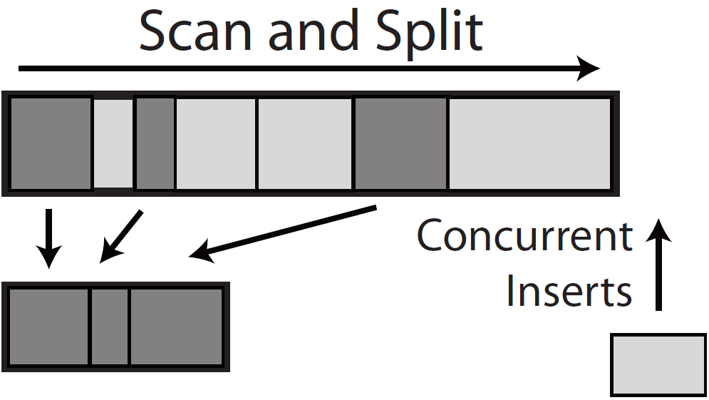
Maintenance Example: How Does FAWN Transfer Data?

Slide 26
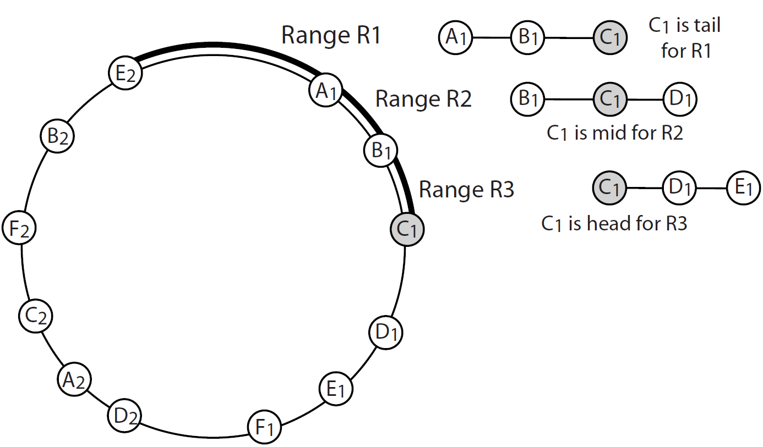
FAWN Uses Replication for Fault Tolerance

Slide 27
FAWN: Join Protocol
Log flush
9
pre-copy
head
mid
tail
0
1
8

Slide 28
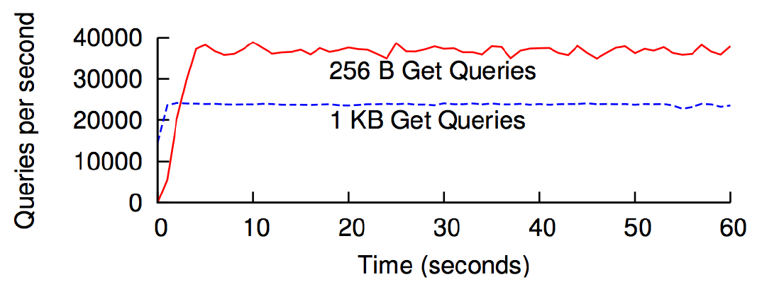
Performance: FAWN Throughput

Slide 29
Performance: FAWN-DS Lookups
System & Storage | Query per Second (QPS) | Watts | QPS/ Watts
Alix3cs Sandisk(CF) | 1,298 | 3.75 | 346
Desktop w/ Mobi (SSD) | 4,289 | 83 | 51.7
Desktop w/ HD | 171 | 87 | 1.96
256 Bytes lookup

Slide 30
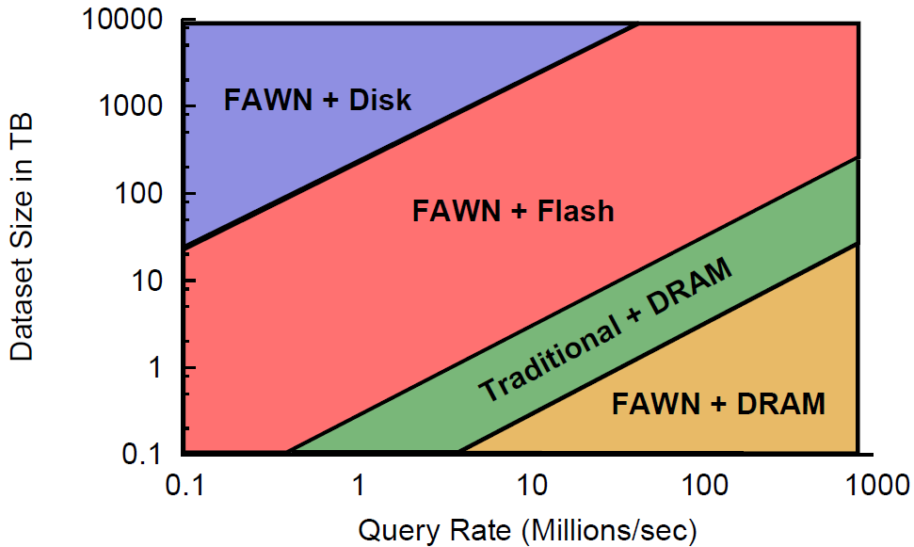
Cost Comparison: FAWN vs. Traditional Servers
Total Cost = Capital Cost + 3 yr Power Cost (0.1$/kWh)
Notes:
Trad: 5-2TB HD 160 GB PCIe SSD 64 GB DRAM
FAWNs: 2TB Disk 32 GB SSD 2 GB DRAM

Slide 31
Discussion
Does FAWN work well for any workload?
Scalability issues?
Query latency could degrade
Potential bottleneck: Networking / CPU

