Slide 1

Overview of Real-Time Computer Graphics
CS 498: Virtual Reality
UNIVERSITY OF ILLINOIS AT URBANA-CHAMPAIGN
Eric Shaffer

Slide 2
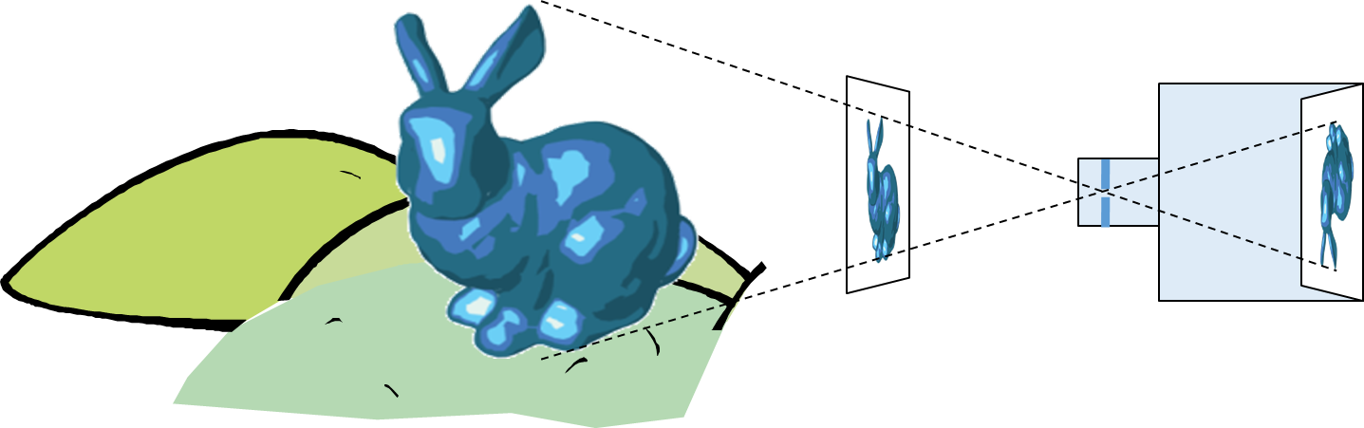
3D Graphics: Image Formation
Goal in CG (usually)is to generate a 2D image of a 3D scene…
  The input data is a scene description
  Output is an image
One approach is to computationally mimic a camera or human eye
In the scene…there are objects…lights…and a viewer

Slide 3
“Chlorophyll”
Light is EM radiation
Usually multiple wavelengths
mixed together in a power spectrum
The spectrum sensed by our eyes gets modified multiple times.
Human perception of color relies on 3 different cell types that sense different regions of the spectrum

Slide 4


Synthetic Camera Model
How can we computationally mimic a camera?
What specific data would you need?
What specific computations would you perform?

Slide 5
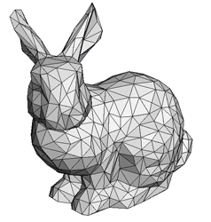
Polygonal Models
Our digital representation of a scene will primarily use polygonal models

Slide 6

Pixel Discretization

Slide 7

Rendering or image synthesis is the automatic process of generating a photorealistic or non-photorealistic image from a 2D or 3D mode
l
Rendering methods generally use one of two approaches
  Rasterization
  (focus of CS 418)
  Ray Tracing
  (focus of CS 419)
  Though, sometimes you can use both….
  …and the are other methods like radiosity
By Gilles Tran - http://www.oyonale.com/modeles.php?lan

Slide 8
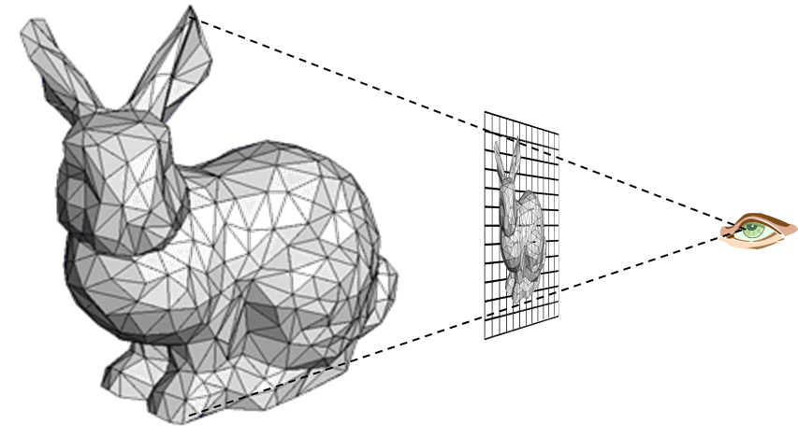
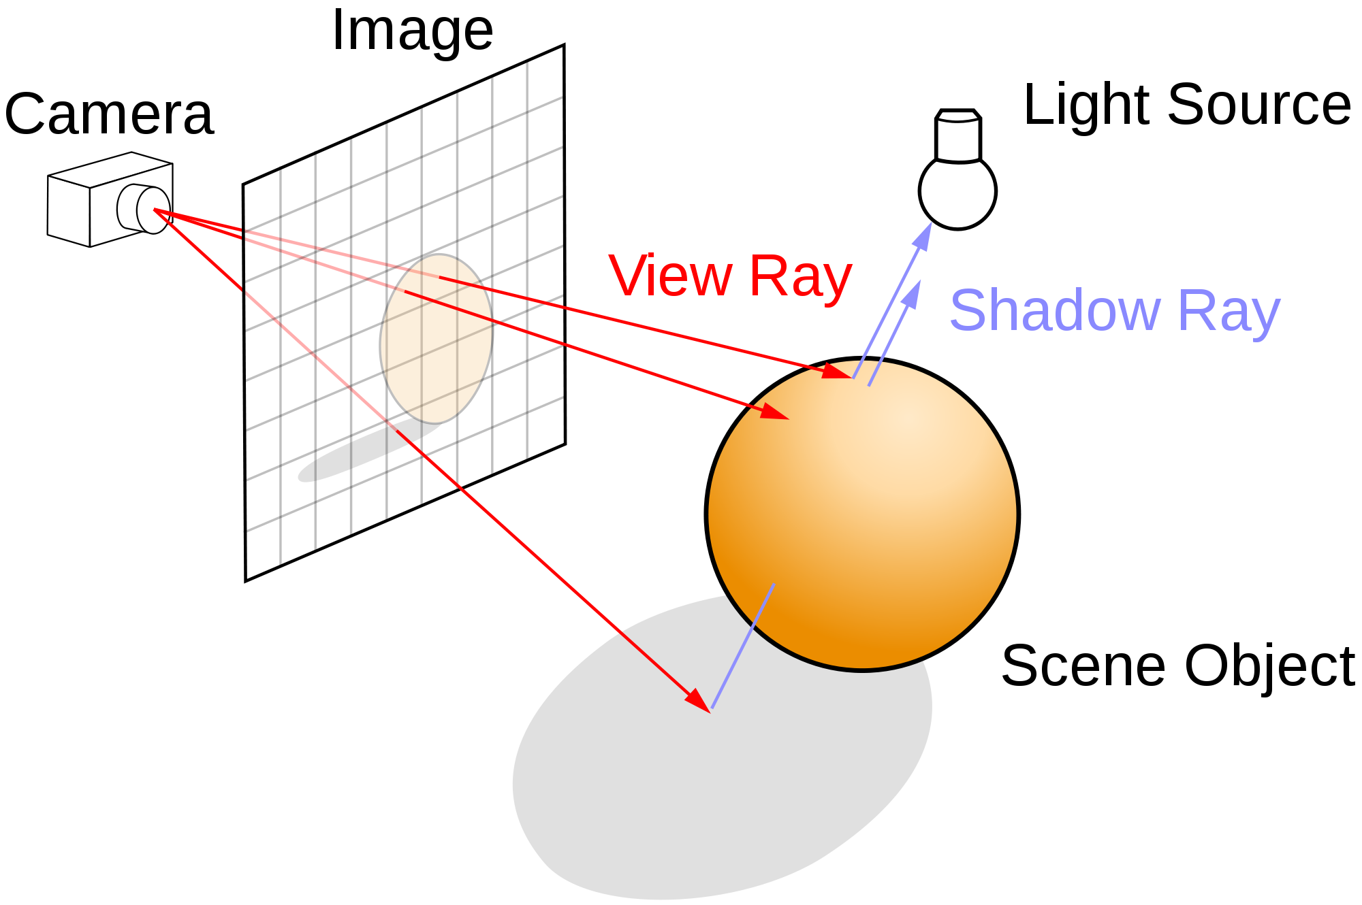
Rasterization versus Ray Tracing
To oversimplify….
In rasterization, geometric primitives are projected onto an image plane and the rasterizer figures out which pixels get filled.
In ray-tracing, we model the physical transport of light by shooting a sampling ray though each pixel in an image plane and seeing what the ray hits in the scene

Slide 9
Ray Tracing
Follow ray of light….
Can trace from an eyepoint through a pixel
See what object the ray hits…
How would you check to see if the object is lit?

Slide 10
Rasterization
For each primitive:
Compute illumination
Project to image plane
Fill in pixels

Slide 11

Global versus Local Illumination
For true photo-realism:
We cannot compute color or shade of each object independently
Why?

Slide 12
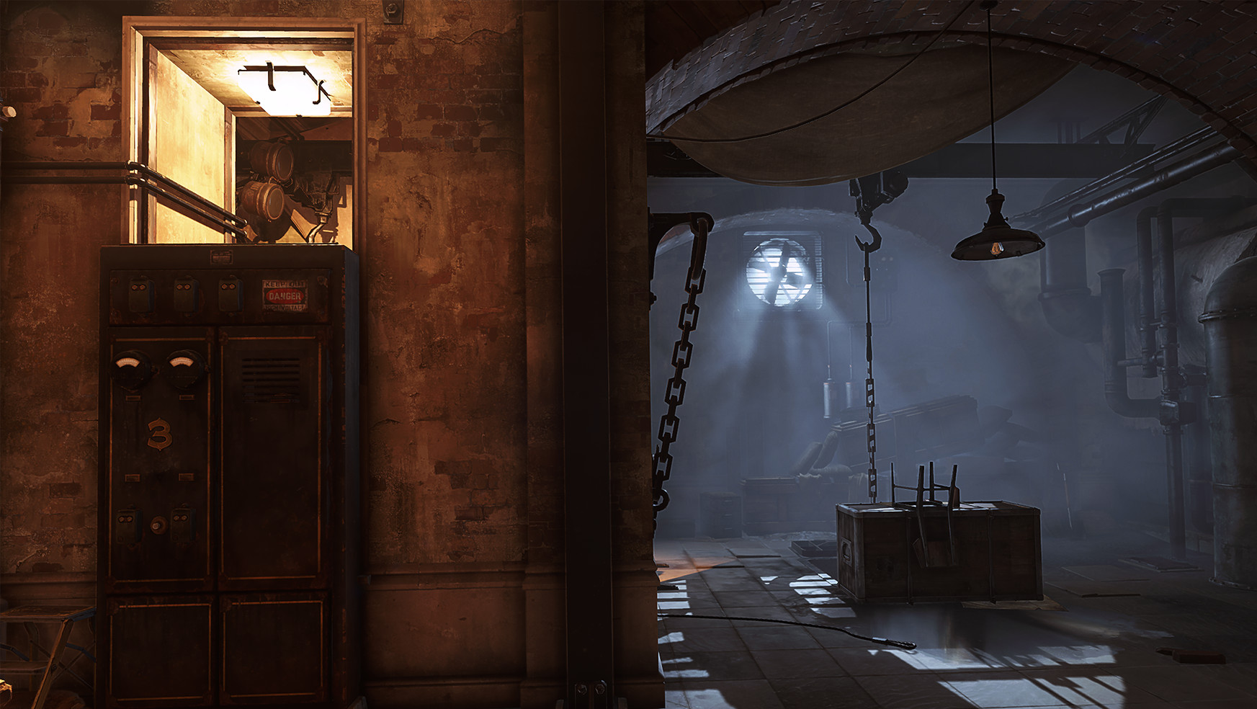
Some objects are blocked from light
Light can reflect from object to object
Some objects might be translucent
Can rasterization produce global lighting effects?
Can ray tracing?
The big advantage of rasterization is…?

Slide 13
Rasterization Engines
Most low-level graphics libraries use a camera model
API typically requires you to specify
  Objects in the scene
  Materials the objects are made of
  Viewer (position, view direction, field of view,…)
  Lights - what parameters do you think typically are used?
The engine (i.e. the library) will use pipeline-style processing
  The input geometry flows through several processing stages
API = Application Programming Interface

Slide 14
Definitions: Pixel and Raster
A pixel is the smallest controllable picture element in an image
A raster is a grid of pixel values
Typically rectangular grid of color values
(1.0, 0.0, 0.0), (0.0, 0.0, 1.0)
(0.0, 0.0, 1.0), (1.0, 0.0, 0.0)
RGB Color Representation
A color is a triple (R,G,B) representing a mix of red, green, and blue light.
Each color channel has a value in [0, 1] indicating how much light is emitted.

Slide 15


3D Graphics Pipeline
Vertex
Processing
Rasterization
Fragment
Processing
Fragments
Are like pixels…but they aren’t necessarily the finalized pixels you see in an image.
Each fragment has a 2D location in a raster and a color.
Final pixel value is typically found by applying hidden surface removal and possibly compositing to a set of fragments.

Slide 16
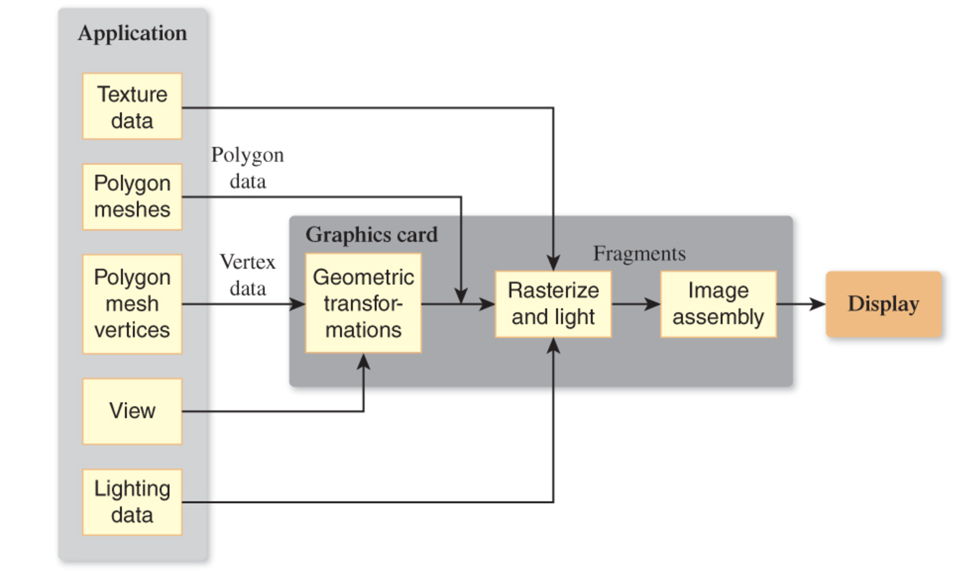
Rasterization is a Pipeline
Data for objects in the scene usually in the form of polygonal meshes
Most of the work to render an image is done on the Graphics Processing Unit (GPU)
GPU code will have at least two parts
  Vertex Shader
  Fragment Shader

Slide 17
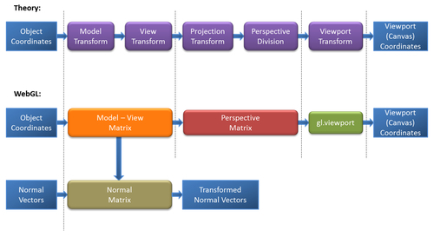
Changing Coordinate Systems
Model Transformation:
Move a model from a local coordinate system to a position in the “world”
View Transformation:
Keeping camera fixed, move all the objects in the world so that they are seen as if from a specific viewpoint
Projection Transformation:
Change coordinates so that a 3D to 2D projection of the geometry is done correctly
Viewport Transformation:
Change from 2D coordinates in [-1,1] to pixel coordinates

Slide 18
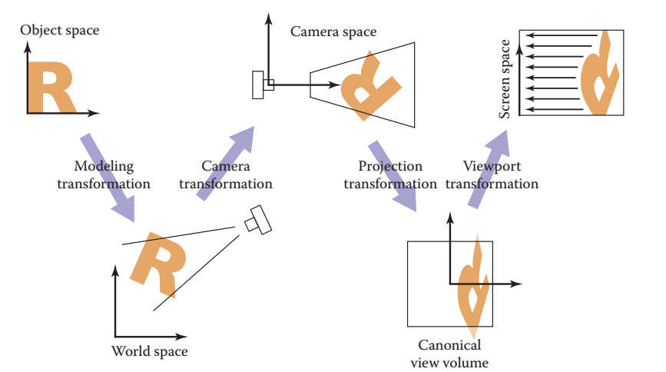
Modeling Transformation
Pretty simple…models are create in model coordinates
  Often centered on the origin
A Modeling Transformation
  moves the model into the correct spot in the World
  It can be any combination of affine transformations
In this diagram, replace “camera transformation”
with “view transformation”.
And “camera space” is
“view space”

Slide 19
Viewing
We often will want to allow the view of our 3D scene to change
We can do so using by applying affine transformations to the geometry
A view matrix is functionally equivalent to a camera
It is a transformation matrix like the Model matrix, but
  Happens after the modeling transformation
  It applies the same transformations equally to every object
    Moving the whole world 5 units towards us = walking 5 units forwards
“The engines don’t move the ship at all. The ship stays where it is and the engines move the universe around it.”
-- Futurama

Slide 20
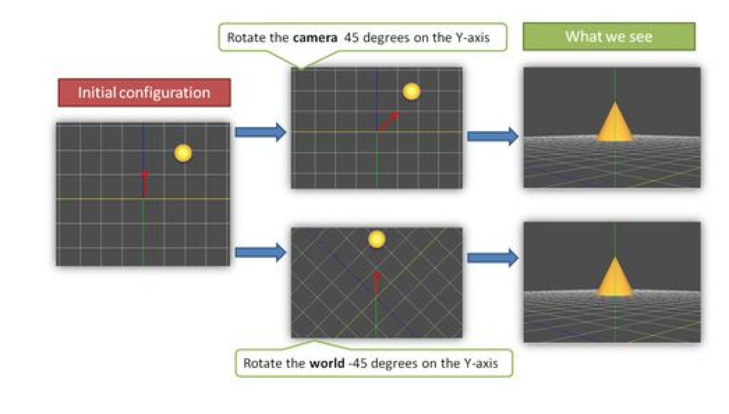
Example
From WebGL Beginner’s Guide by Cantor and Jones

Slide 21
Graphics Pipeline
Model
Coords
Model
Xform
World
Coords
Viewing
Xform
Viewing
Coords
Perspective
Distortion
Homogeneous Divide
Still
Clip
Coords.
Clipping
Clip
Coords.
Window
Coordinates
Window
to
Viewport
Viewport
Coordinates

Slide 22
Graphics Pipeline
Model
Coords
Model
Xform
World
Coords
Viewing
Xform
Viewing
Coords
Perspective
Distortion
Homogeneous Divide
Still
Clip
Coords.
Clipping
Clip
Coords.
Window
Coordinates
Window
to
Viewport
Viewport
Coordinates
M

Slide 23
Viewing Transformation
Model
Coords
Model
Xform
World
Coords
Viewing
Xform
Viewing
Coords
Perspective
Distortion
Homogeneous Divide
Still
Clip
Coords.
Clipping
Clip
Coords.
Window
Coordinates
Window
to
Viewport
Viewport
Coordinates

Slide 24
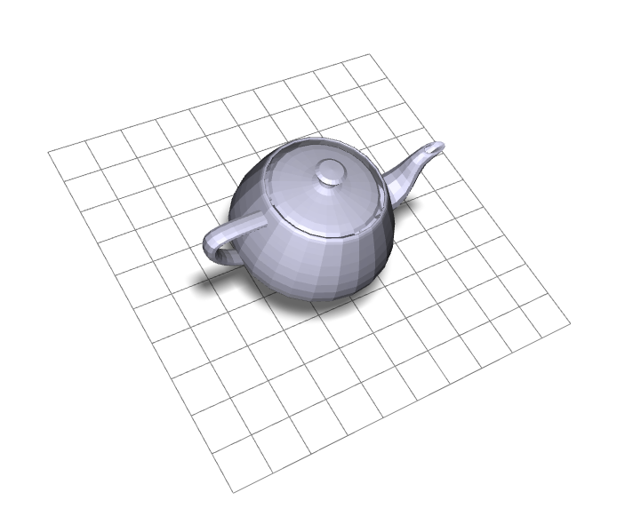
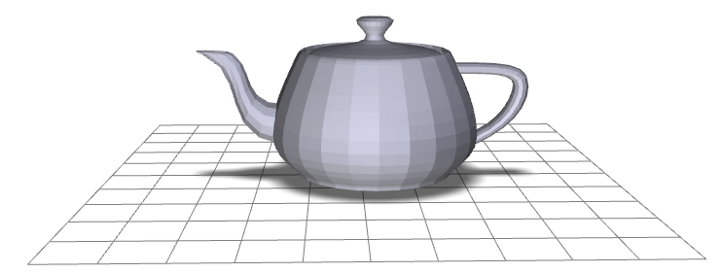
Viewing Transformation
eye
point
lookat
point
y
y
x
x
z
Screen
Coords
Clip
Coords
Viewing
Coords
World
Coords
Model
Coords

Slide 25
Creating a Camera Function
Suppose we want to implement a function that sets up view
…think of it as setting up a camera
There are lots of possible ways to do this…we’ll choose a simple lookat camera
The API we create will require a someone using the function to specify:
The eyepoint (or camera location)
The lookat point (a point in the view direction)
An ”up” vector that we use to specify rotation around the view vector

Slide 26
Deriving the Viewing Transformation
One way to think about what you are doing
  Translate the eyepoint to the origin
  Rotate so that
    lookat vector aligns with –z axis
    up aligns with y
  We move all objects (the world) this way…
Another way to think of it
  Create an orthonormal basis with eye at the origin
  And vectors u, v, w as the basis vectors
  …and then align u,v,w with x,y,z

Slide 27
Constructing a Local Frame
A frame has an origin point and set of basis vectors
Any point can be expressed as coordinates in such a frame
For example (0,0,0) and <1,0,0>, <0,1,0>,<0,0,1>
  And an example of a point in that space:
  (4,0,0)= (0,0,0) + 4 <1,0,0> + 0 <0,1,0> + 0 <0,0,1>

Slide 28
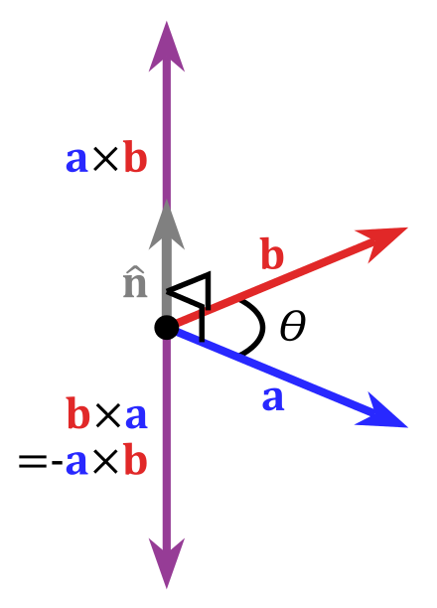
Cross Product of Two Vectors
Important Property:
The cross product yields a vector orthogonal to the original two vectors

Slide 29
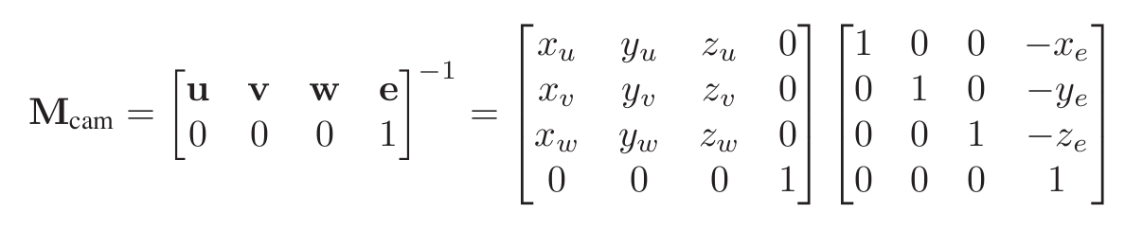
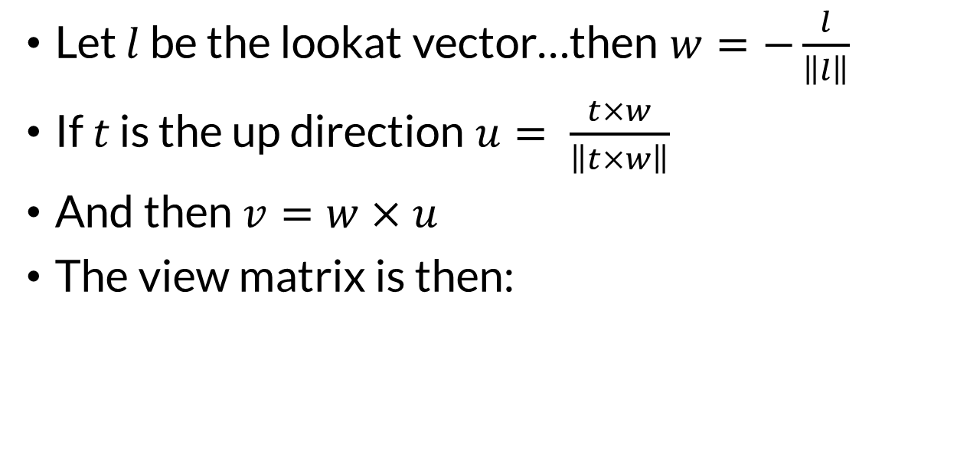

The Orthonormal Basis for View Space
This derivation assumes an right-handed coordinate system and view down the –z axis…how could we change it to look down +z?
Let $l$ be the lookat vector…then $w=−\frac{l}{\left\|l\right\|}$
If $t$ is the up direction $u= \frac{t×w}{\left\|t×w\right\|}$
And then $v=w×u$
The view matrix is then:
$${M_{view}=M}_{cam}^{−1}$$
Why is the matrix inverted?

Slide 30


View Transformation
$M_{cam}$ is referred to as the camera matrix or transformation.
${M_{cam}}^{−1}$ is the view transformation or matrix
You can now look at your scene from any
  Position
  Orientation (almost)
    What lookat and up vector pair won’t work?
…just uses a matrix multiplication
$${M_{view}=M}_{cam}^{−1}=$$

Slide 31
Let’s review the rasterization pipeline
We start out by setting up our geometry in world coordinates
Which transformation does this?

Slide 32
The view transformation
We pick a specific viewing position and direction in worldspace

Slide 33
The view transformation
Actually…in Unity we use a lefthanded coordinate system and look down the +z axis
We transform the world so the view position is at the origin.
For a right-handed coordinate system, the view direction is down the –z axis

Slide 34
The projection transformation
We pick a viewing volume.
This is specified in viewing coordinates.

Slide 35
The projection transformation
The WebGL view volume is a box with clip planes at -1, +1
The z coordinates are negated to flip the z-axis
Our view volume is transformed to fit in the canonical view volume.
Is this actually a projection?

Slide 36
Actual projection….
The rasterization engine does an orthographic projection of the view volume contents to 2D

Slide 37
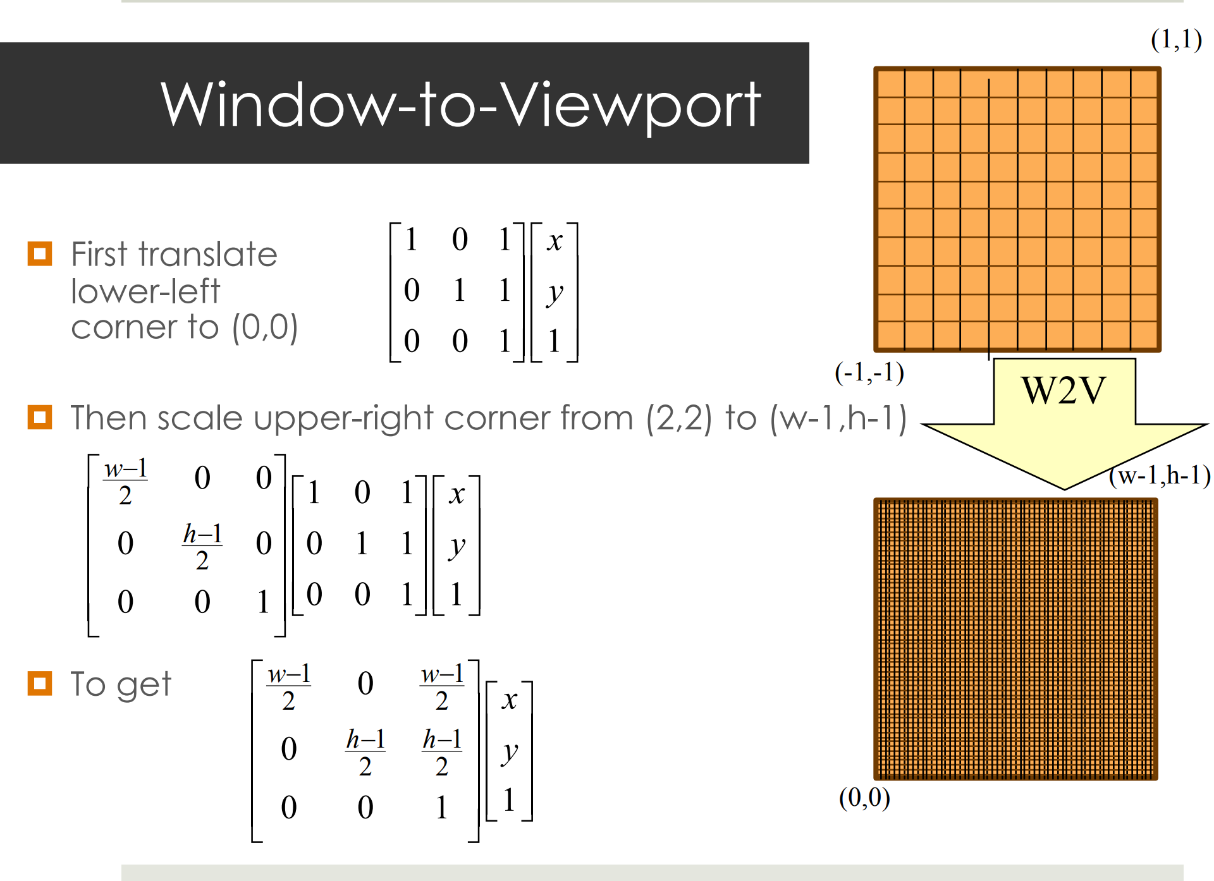
The viewport transformation
Moves from 2D canonical coordinates
  x in [-1,1] and y in [-1,1]
To viewport coordinates
  Integer pixel coordinates
We can do this!
  What affine transforms do we need?

Slide 38
The viewport transformation

