Slide 1
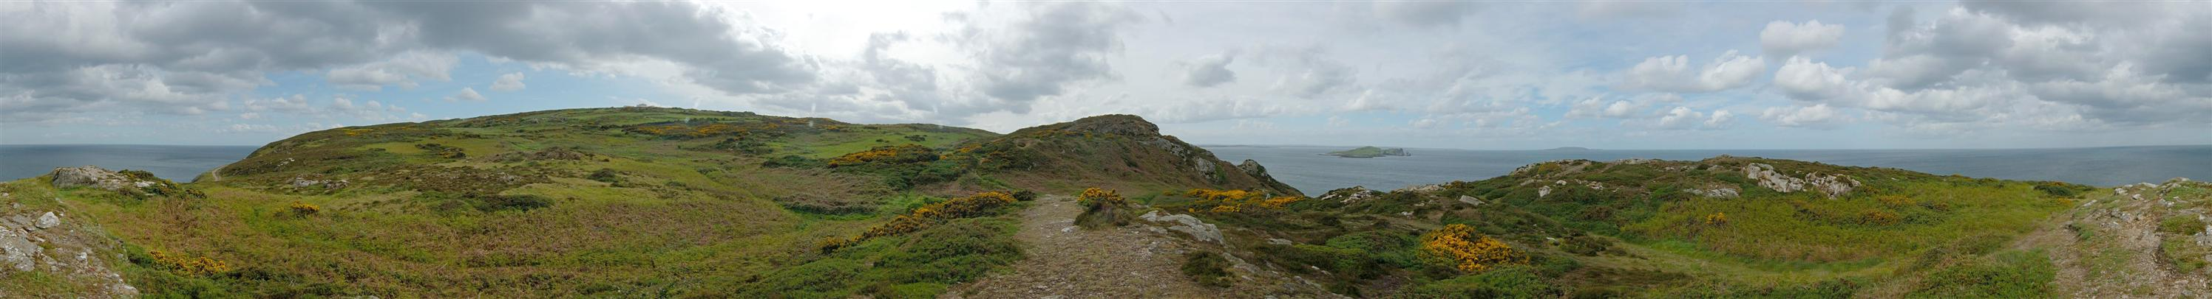
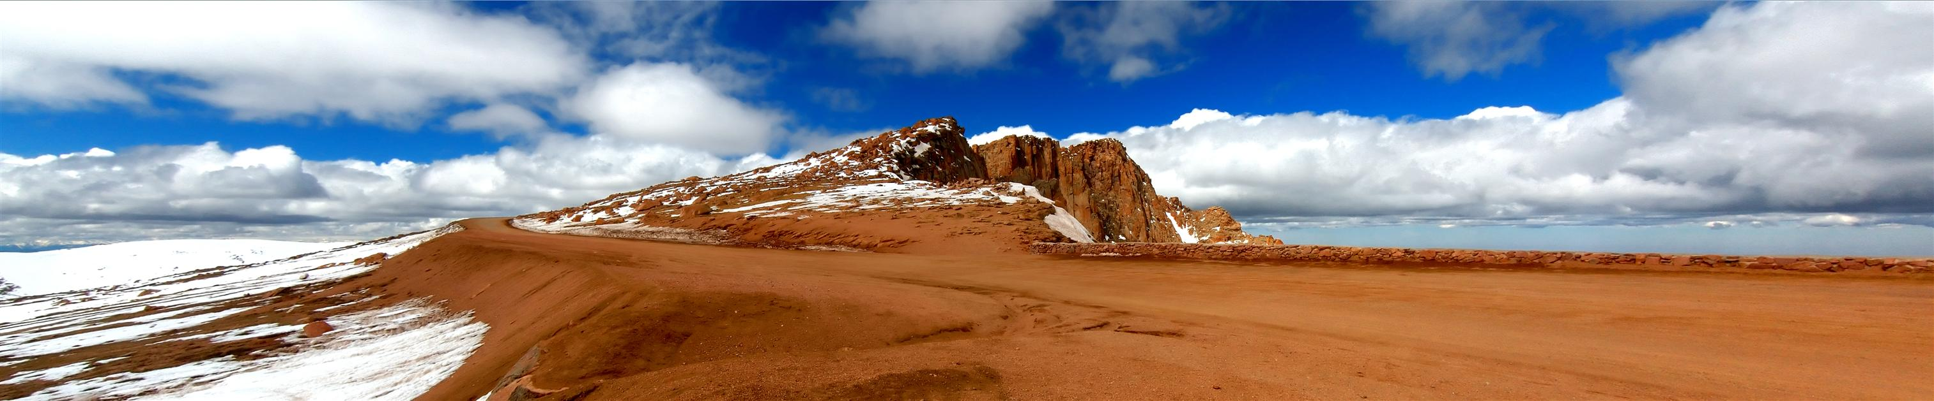
10/28/14
Image Stitching
Computational Photography
Derek Hoiem, University of Illinois
Photos by Russ Hewett

Slide 2
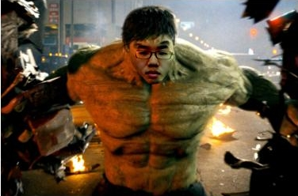
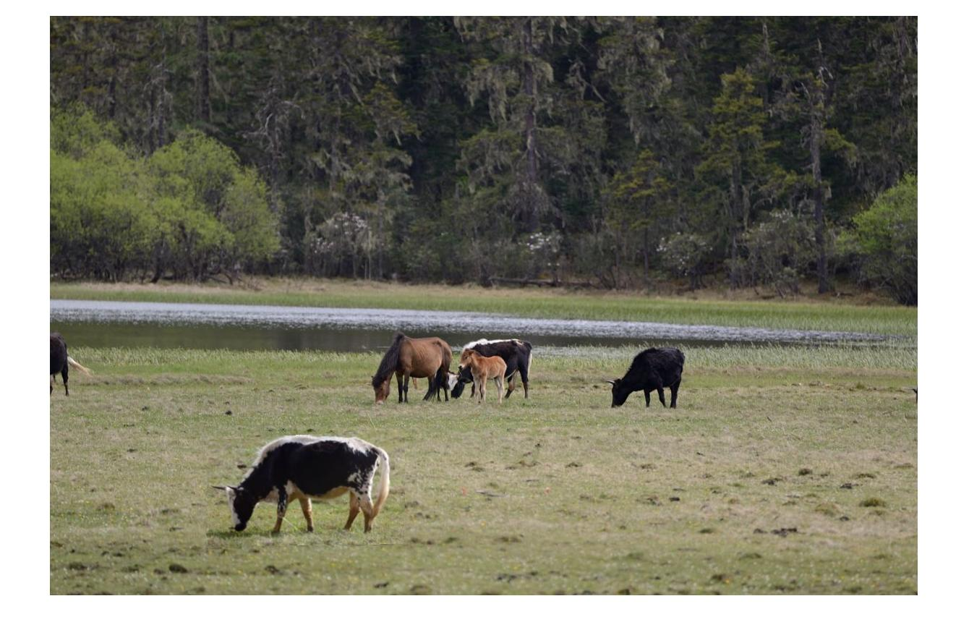
Project 3 Results
Donald Cha
Hao Goa: which one is fake?

Slide 3
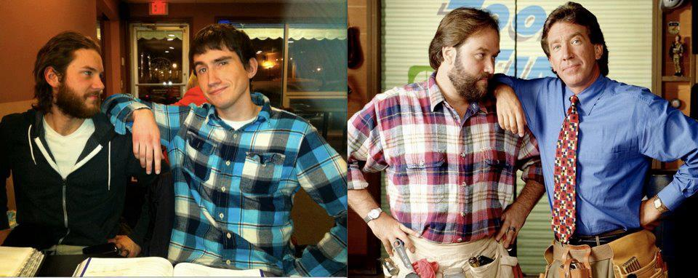

Eric Huber

Slide 4

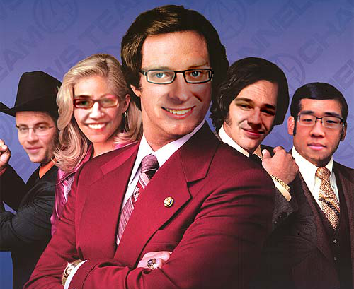
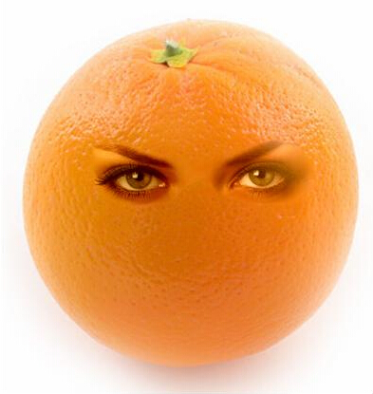
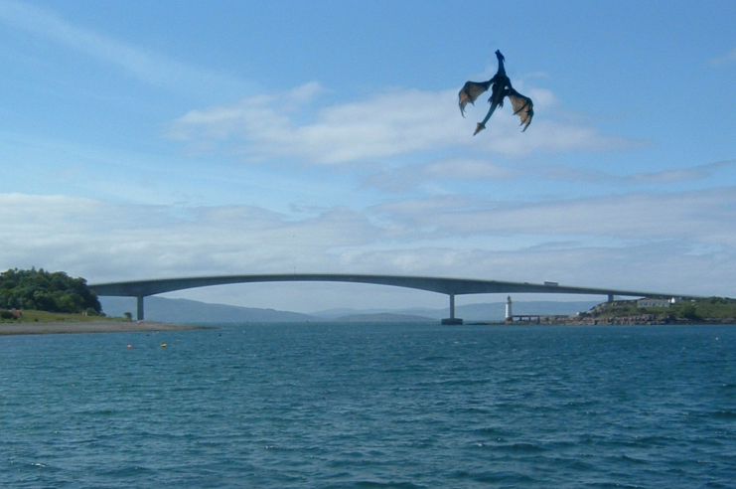
Daeyun Shin
Jane Wang
Yizhi Zhu

Slide 5
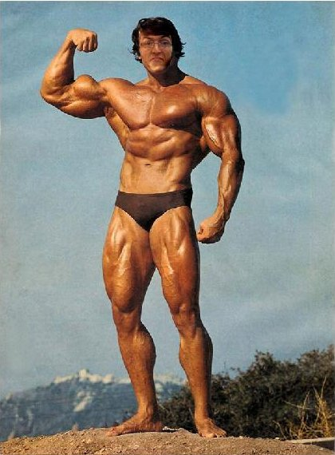
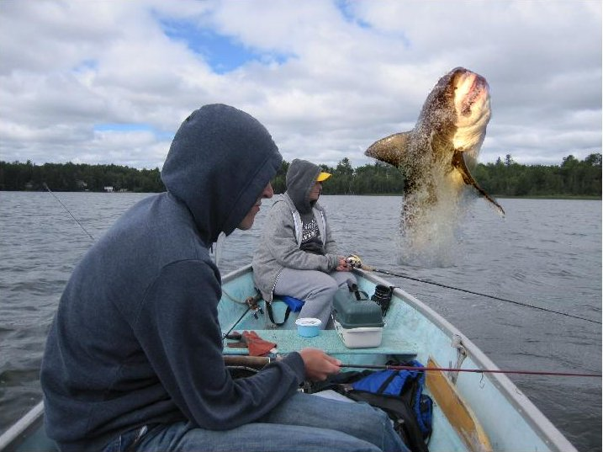
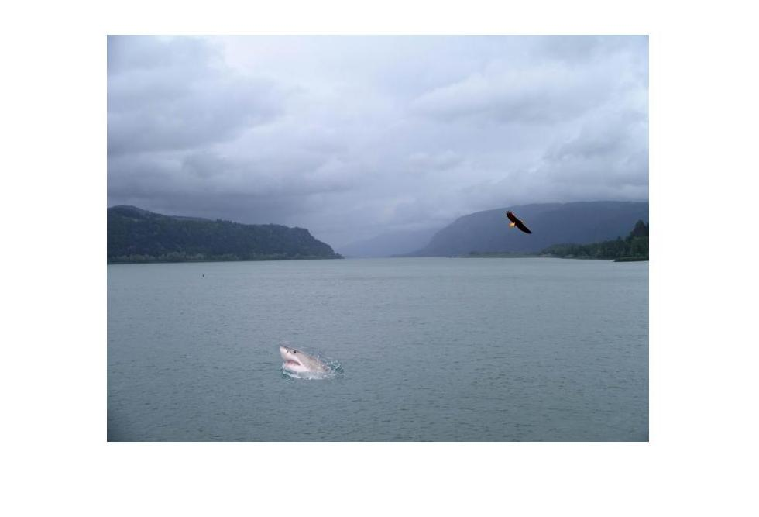
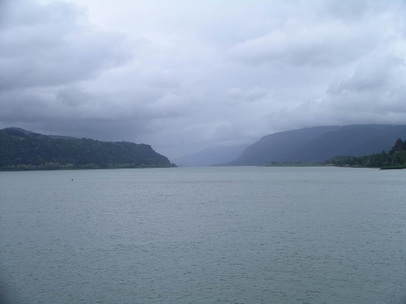
Sam Ricker
Joonyoung Seo

Slide 6
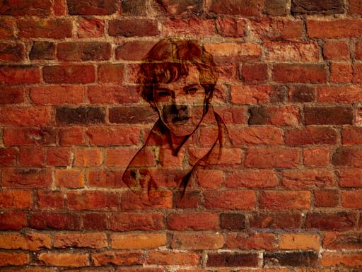
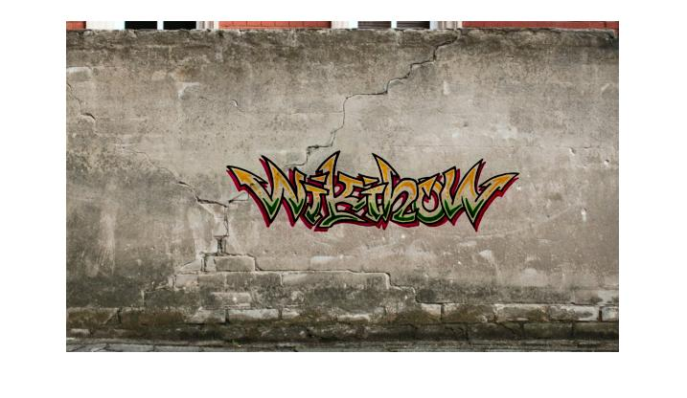
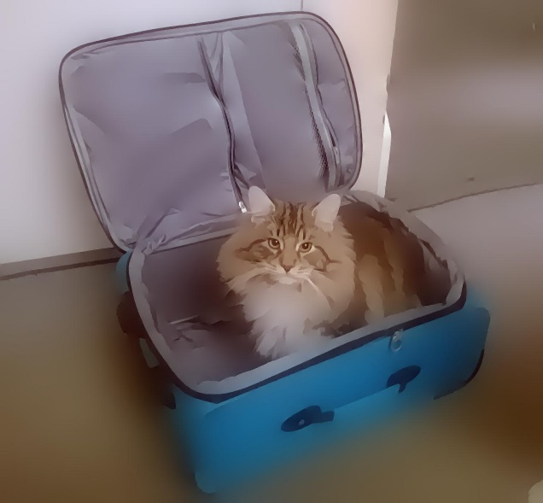
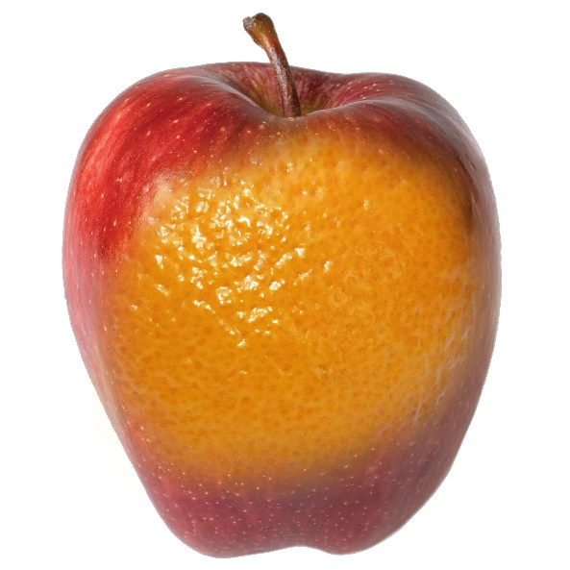
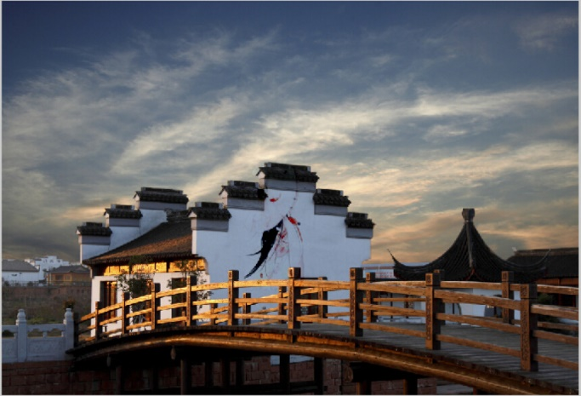
Joonyoung Seo
Rachit Nayudu
Jeremy Goodsitt
Jeremy Goodsitt
Zhang, Ruichuan

Slide 7
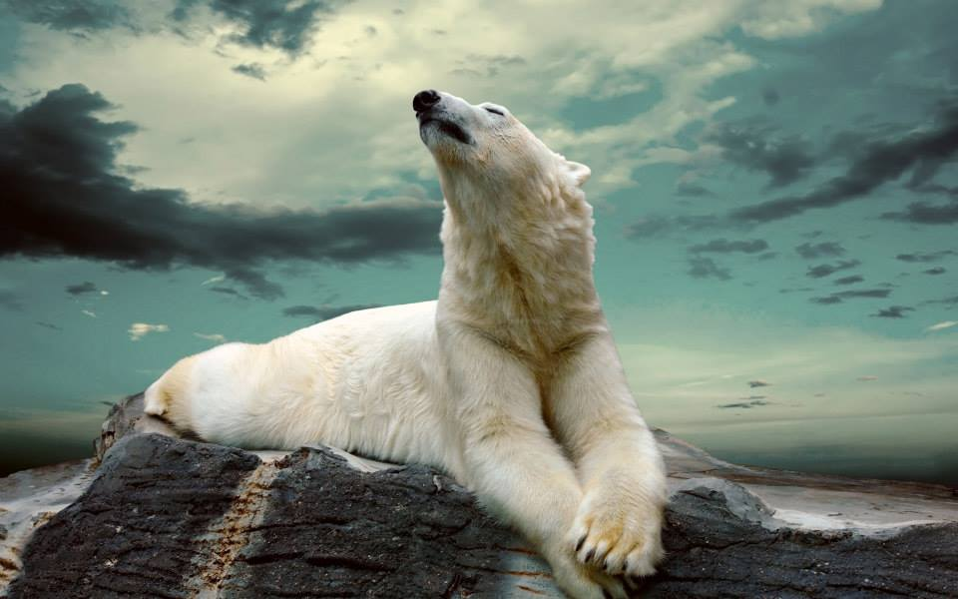
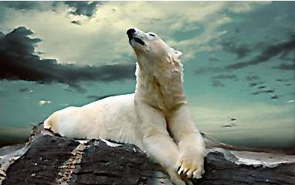
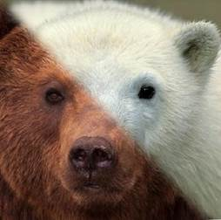
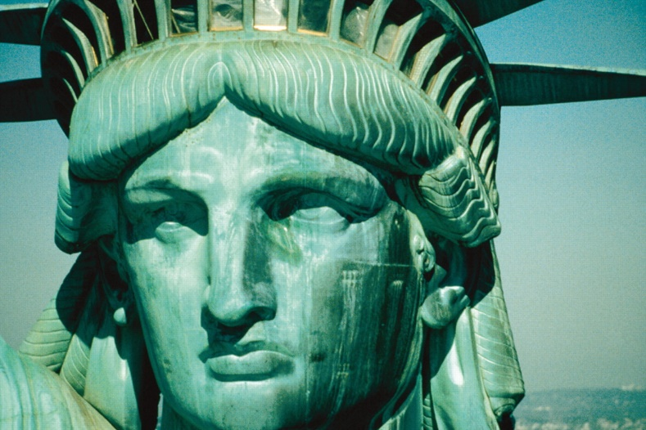
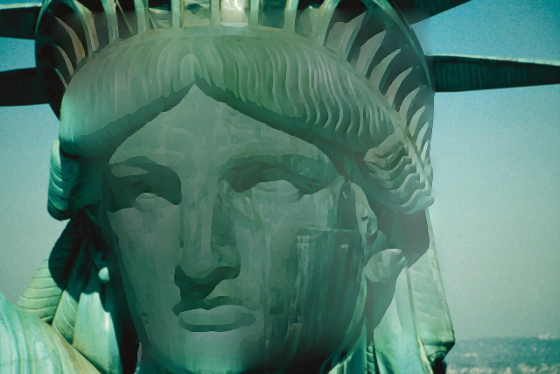
Elizabeth Weeks
Emmanuel Arregoitia-Diaz
Aditya Deshpande

Slide 8
Highlighted projects
Eric Huber: http://web.engr.illinois.edu/~echuber2/cs498dwh/proj3/
Description of several iterations of attempts with various modifications
Sam Ricker: http://web.engr.illinois.edu/~sricker2/cs498dwh/proj3/
Fun results
Daeyun Shin: http://web.engr.illinois.edu/~dshin11/cs498dwh/proj3/
Nice results + extras (maybe)
Elizabeth Weeks: http://web.engr.illinois.edu/~eweeks2/cs498dwh/proj3/
Lots of results, non-photorealistic rendering
Jeremy Goodsitt: http://web.engr.illinois.edu/~goodsit2/cs498dwh/proj3/
Blending comparison, NPR

Slide 9
Project 5
Input video:
https://www.youtube.com/watch?v=agI5za_gHHU
Aligned frames:
https://www.youtube.com/watch?v=Uahy6kPotaE
Background:
https://www.youtube.com/watch?v=Vt9vv1zCnLA
Foreground:
https://www.youtube.com/watch?v=OICkKNndEt4

Slide 10

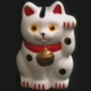


Last Class: Keypoint Matching
1. Find a set of distinctive key- points
A₁
B₃
2. Define a region around each keypoint
A₂
A₃
B₁
B₂
3. Extract and normalize the region content
4. Compute a local descriptor from the normalized region
5. Match local descriptors

Slide 11
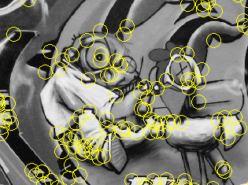
Last Class: Summary
Keypoint detection: repeatable and distinctive
Corners, blobs
Harris, DoG
Descriptors: robust and selective
SIFT: spatial histograms of gradient orientation

Slide 12
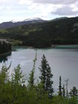
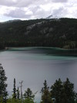
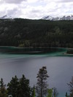
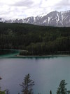
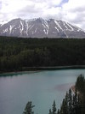
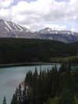
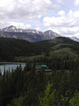
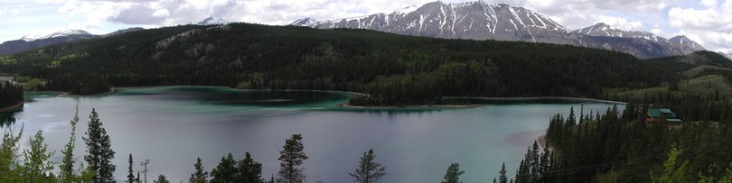
Today: Image Stitching
Combine two or more overlapping images to make one larger image
Add example
Slide credit: Vaibhav Vaish

Slide 13
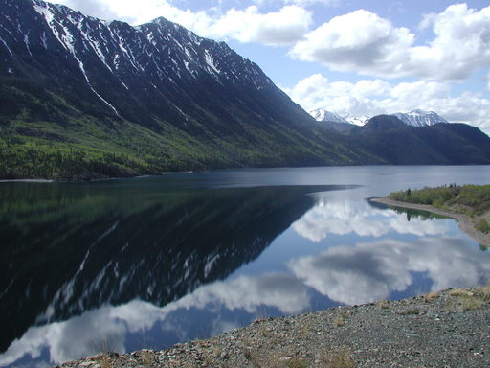
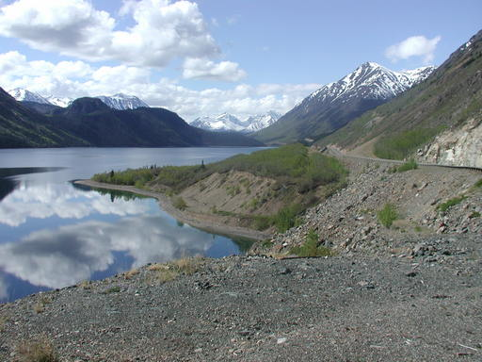
Views from rotating camera
Camera Center

Slide 14
Photo stitching
P
Q
Camera Center

Slide 15
Problem basics
Do on board

Slide 16
Basic problem
x = K [R t] X
x’ = K’ [R’ t’] X’
t=t’=0
x‘=Hx where H = K’ R’ R⁻¹ K⁻¹
Typically only R and f will change (4 parameters), but, in general, H has 8 parameters
.
X
x
x'
f
f'

Slide 17
Image Stitching Algorithm Overview
Detect keypoints
Match keypoints
Estimate homography with four matched keypoints (using RANSAC)
Project onto a surface and blend

Slide 18
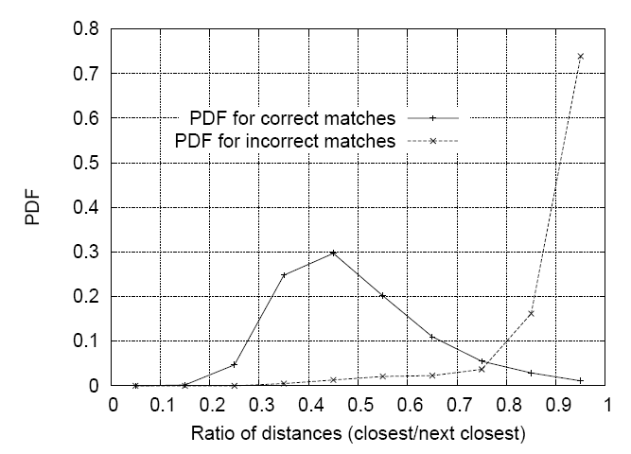
Image Stitching Algorithm Overview
Detect/extract keypoints (e.g., DoG/SIFT)
Match keypoints (most similar features, compared to 2nd most similar)

Slide 19
Computing homography
Assume we have four matched points: How do we compute homography H?
Direct Linear Transformation (DLT)

Slide 20
Computing homography
Direct Linear Transform
Apply SVD: UDV^{T} = A
h = V_{smallest} (column of V corr. to smallest singular value)
Matlab
[U, S, V] = svd(A);
h = V(:, end);
Notes:
SVD gives the homogeneous least squares solution constrained to have a norm of 1

Slide 21
Computing homography
Assume we have four matched points: How do we compute homography H?
Normalized DLT
Normalize coordinates for each image
Translate for zero mean
Scale so that u and v are ~=1 on average
This makes problem better behaved numerically (see Hartley and Zisserman p. 107-108)
Compute using DLT in normalized coordinates
Unnormalize:

Slide 22
Computing homography
Assume we have matched points with outliers: How do we compute homography H?
Automatic Homography Estimation with RANSAC

Slide 23
RANSAC: RANdom SAmple Consensus
Scenario: We’ve got way more matched points than needed to fit the parameters, but we’re not sure which are correct
RANSAC Algorithm
Repeat N times
Randomly select a sample
Select just enough points to recover the parameters
Fit the model with random sample
See how many other points agree
Best estimate is one with most agreement
can use agreeing points to refine estimate

Slide 24
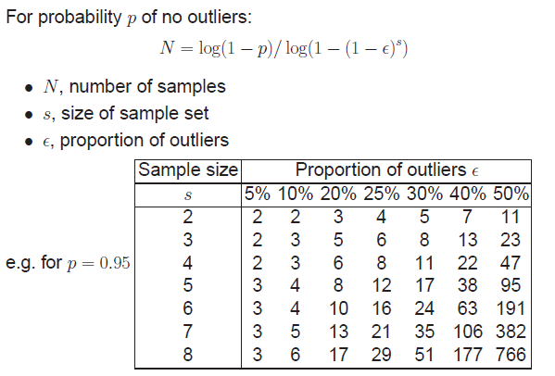
Computing homography
Assume we have matched points with outliers: How do we compute homography H?
Automatic Homography Estimation with RANSAC
Choose number of samples N
HZ Tutorial ‘99

Slide 25
Computing homography
Assume we have matched points with outliers: How do we compute homography H?
Automatic Homography Estimation with RANSAC
Choose number of samples N
Choose 4 random potential matches
Compute H using normalized DLT
Project points from x to x’ for each potentially matching pair:
Count points with projected distance < t
E.g., t = 3 pixels
Repeat steps 2-5 N times
Choose H with most inliers
HZ Tutorial ‘99

Slide 26
Automatic Image Stitching
Compute interest points on each image
Find candidate matches
Estimate homography H using matched points and RANSAC with normalized DLT
Project each image onto the same surface and blend

Slide 27
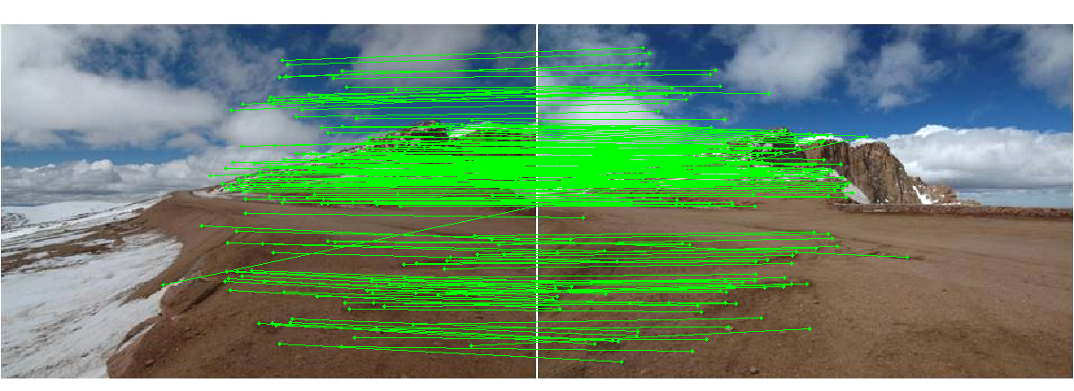
Choosing a Projection Surface
Many to choose: planar, cylindrical, spherical, cubic, etc.

Slide 28
Planar Mapping
x
x
f
f
For red image: pixels are already on the planar surface
For green image: map to first image plane

Slide 29
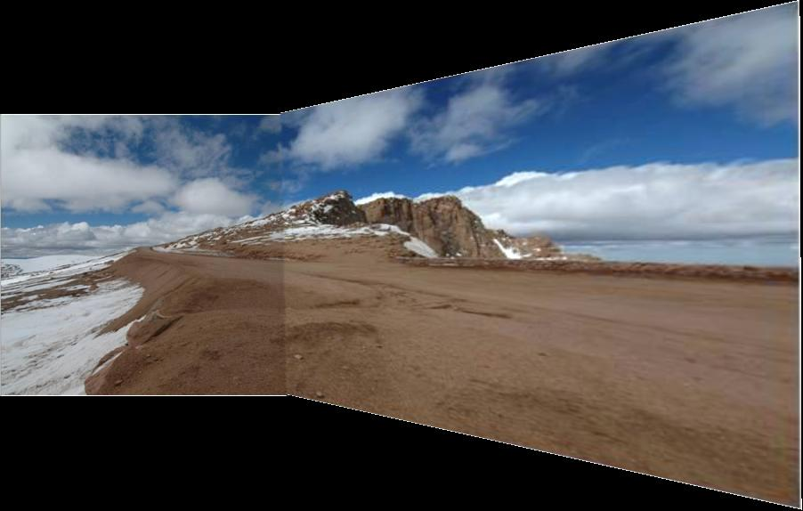
Planar vs. Cylindrical Projection
Planar
Photos by Russ Hewett

Slide 30
Planar vs. Cylindrical Projection
Planar

Slide 31
Cylindrical Mapping
x
x
f
f
For red image: compute h, theta on cylindrical surface from (u, v)
For green image: map to first image plane, than map to cylindrical surface

Slide 32
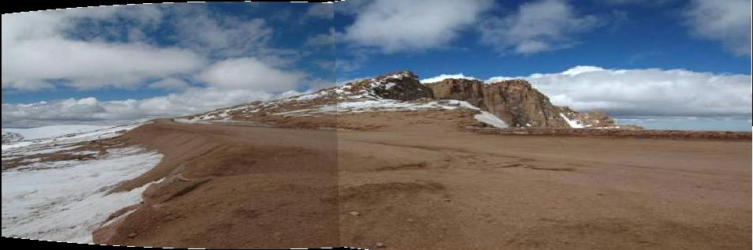
Planar vs. Cylindrical Projection
Cylindrical

Slide 33
Planar vs. Cylindrical Projection
Cylindrical

Slide 34
Planar
Cylindrical

Slide 35
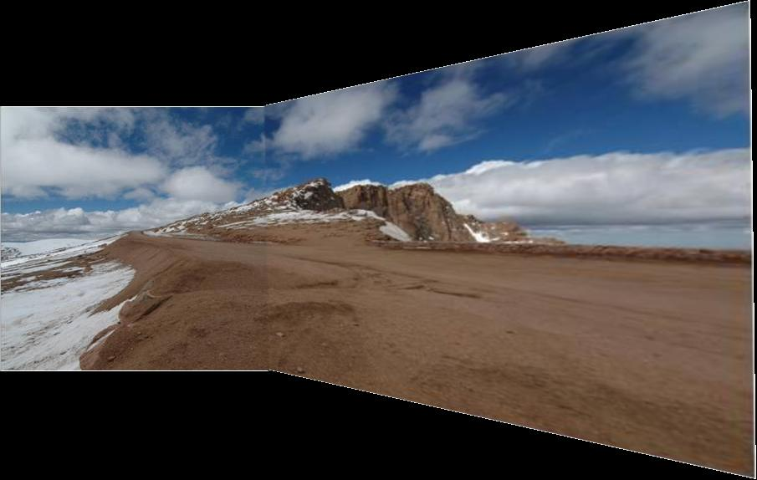
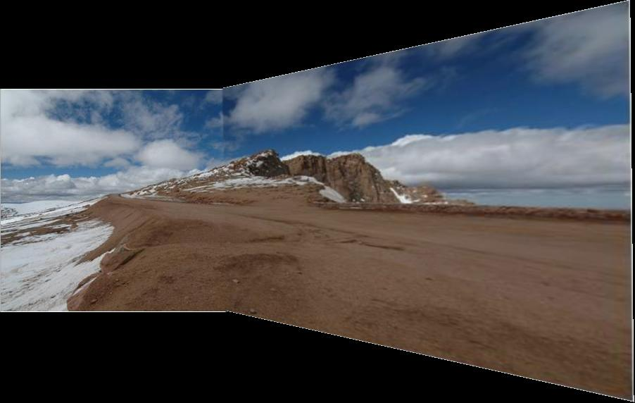
Simple gain adjustment

Slide 36
Automatically choosing images to stitch

Slide 37
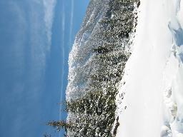
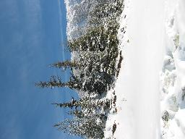
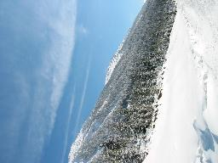
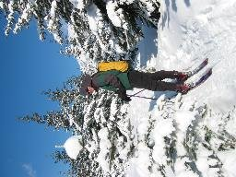
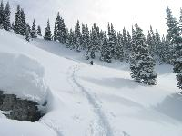
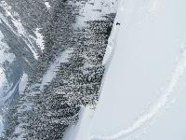
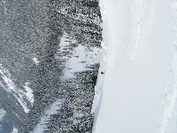
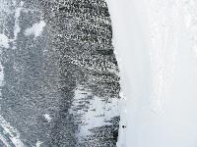
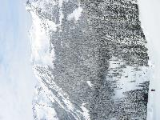



















Recognizing Panoramas
Some of following material from Brown and Lowe 2003 talk
Brown and Lowe 2003, 2007

Slide 38
Recognizing Panoramas
Input: N images
Extract SIFT points, descriptors from all images
Find K-nearest neighbors for each point (K=4)
For each image
Select M candidate matching images by counting matched keypoints (M=6)
Solve homography H_{ij} for each matched image

Slide 39
Recognizing Panoramas
Input: N images
Extract SIFT points, descriptors from all images
Find K-nearest neighbors for each point (K=4)
For each image
Select M candidate matching images by counting matched keypoints (M=6)
Solve homography H_{ij} for each matched image
Decide if match is valid (n_{i} > 8 + 0.3 n_{f} )
# inliers
# keypoints in overlapping area

Slide 40




RANSAC for Homography
Initial Matched Points

Slide 41


RANSAC for Homography
Final Matched Points

Slide 42


Verification

Slide 43

RANSAC for Homography

Slide 44
Recognizing Panoramas (cont.)
(now we have matched pairs of images)
Find connected components

Slide 45
Finding the panoramas

Slide 46
Finding the panoramas

Slide 47
Finding the panoramas

Slide 48
Recognizing Panoramas (cont.)
(now we have matched pairs of images)
Find connected components
For each connected component
Perform bundle adjustment to solve for rotation (θ₁, θ₂, θ₃) and focal length f of all cameras
Project to a surface (plane, cylinder, or sphere)
Render with multiband blending

Slide 49


Bundle adjustment for stitching
Non-linear minimization of re-projection error
where H = K’ R’ R⁻¹ K⁻¹
Solve non-linear least squares (Levenberg-Marquardt algorithm)
See paper for details

Slide 50





































Bundle Adjustment
New images initialized with rotation, focal length of the best matching image

Slide 51

Bundle Adjustment
New images initialized with rotation, focal length of the best matching image

Slide 52
Blending
Gain compensation: minimize intensity difference of overlapping pixels
Blending
Pixels near center of image get more weight
Multiband blending to prevent blurring

Slide 53


Multi-band Blending (Laplacian Pyramid)
Burt & Adelson 1983
Blend frequency bands over range ∝ λ

Slide 54

Multiband blending

Slide 55

Blending comparison (IJCV 2007)

Slide 56

Blending Comparison

Slide 57


Straightening
Rectify images so that “up” is vertical

Slide 58
Further reading
Harley and Zisserman: Multi-view Geometry book
DLT algorithm: HZ p. 91 (alg 4.2), p. 585
Normalization: HZ p. 107-109 (alg 4.2)
RANSAC: HZ Sec 4.7, p. 123, alg 4.6
Tutorial: http://users.cecs.anu.edu.au/~hartley/Papers/CVPR99-tutorial/tut_4up.pdf
Recognising Panoramas: Brown and Lowe, IJCV 2007 (also bundle adjustment)

Slide 59
Tips and Photos from Russ Hewett

Slide 60
Capturing Panoramic Images
Tripod vs Handheld
Help from modern cameras
Leveling tripod
Gigapan
Or wing it
Image Sequence
Requires a reasonable amount of overlap (at least 15-30%)
Enough to overcome lens distortion
Exposure
Consistent exposure between frames
Gives smooth transitions
Manual exposure
Makes consistent exposure of dynamic scenes easier
But scenes don’t have constant intensity everywhere
Caution
Distortion in lens (Pin Cushion, Barrel, and Fisheye)
Polarizing filters
Sharpness in image edge / overlap region

Slide 61



Pike’s Peak Highway, CO
Photo: Russell J. Hewett
Nikon D70s, Tokina 12-24mm @ 16mm, f/22, 1/40s

Slide 62
Pike’s Peak Highway, CO
Photo: Russell J. Hewett
(See Photo On Web)

Slide 63














360 Degrees, Tripod Leveled
Photo: Russell J. Hewett
Nikon D70, Tokina 12-24mm @ 12mm, f/8, 1/125s

Slide 64
Howth, Ireland
Photo: Russell J. Hewett
(See Photo On Web)

Slide 65









Handheld Camera
Photo: Russell J. Hewett
Nikon D70s, Nikon 18-70mm @ 70mm, f/6.3, 1/200s

Slide 66

Handheld Camera
Photo: Russell J. Hewett

Slide 67

Les Diablerets, Switzerland
Photo: Russell J. Hewett
(See Photo On Web)

Slide 68




Macro
Photo: Russell J. Hewett & Bowen Lee
Nikon D70s, Tamron 90mm Micro @ 90mm, f/10, 15s

Slide 69

Side of Laptop
Photo: Russell J. Hewett & Bowen Lee

Slide 70
Considerations For Stitching
Variable intensity across the total scene
Variable intensity and contrast between frames
Lens distortion
Pin Cushion, Barrel, and Fisheye
Profile your lens at the chosen focal length (read from EXIF)
Or get a profile from LensFun
Dynamics/Motion in the scene
Causes ghosting
Once images are aligned, simply choose from one or the other
Misalignment
Also causes ghosting
Pick better control points
Visually pleasing result
Super wide panoramas are not always ‘pleasant’ to look at
Crop to golden ratio, 10:3, or something else visually pleasing

Slide 71




Ghosting and Variable Intensity
Photo: Russell J. Hewett
Nikon D70s, Tokina 12-24mm @ 12mm, f/8, 1/400s

Slide 72


Photo: Russell J. Hewett

Slide 73


Ghosting From Motion
Photo: Bowen Lee
Nikon e4100 P&S

Slide 74


Motion Between Frames
Photo: Russell J. Hewett
Nikon D70, Nikon 70-210mm @ 135mm, f/11, 1/320s

Slide 75


Photo: Russell J. Hewett

Slide 76

Gibson City, IL
Photo: Russell J. Hewett
(See Photo On Web)

Slide 77







Mount Blanca, CO
Photo: Russell J. Hewett
Nikon D70s, Tokina 12-24mm @ 12mm, f/22, 1/50s

Slide 78

Mount Blanca, CO
Photo: Russell J. Hewett
(See Photo On Web)

Slide 79
Things to remember
Homography relates rotating cameras
Homography is plane to plane mapping
Recover homography using RANSAC and normalized DLT
Can choose surface of projection: cylinder, plane, and sphere are most common
Lots of room for tweaking (blending, straightening, etc.)

Slide 80
Next class
Object recognition and retrieval

