Slide 1
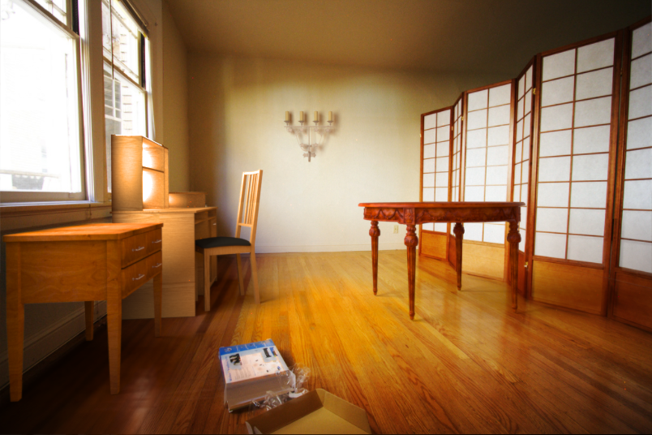
The image as a virtual stage
10/22/13
Computational Photography
Fall 2013
Kevin Karsch

Slide 2
Today
Brief review of last class
Inserting objects into legacy photos
Using Blender

Slide 3
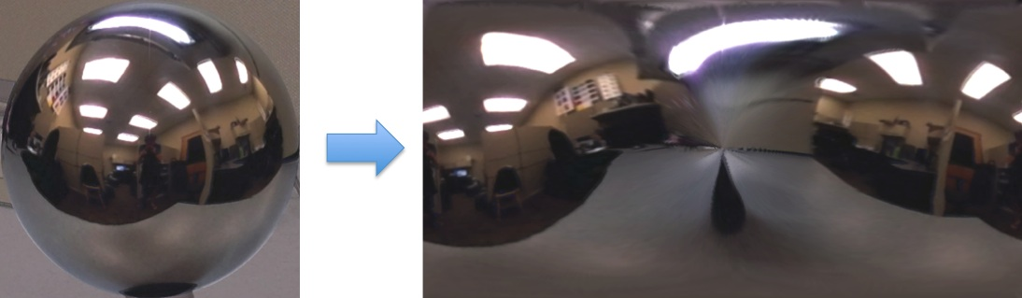
Mirror ball -> equirectangular

Slide 4
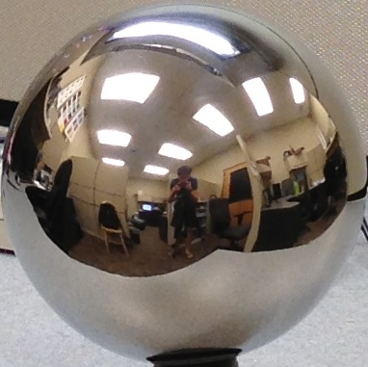


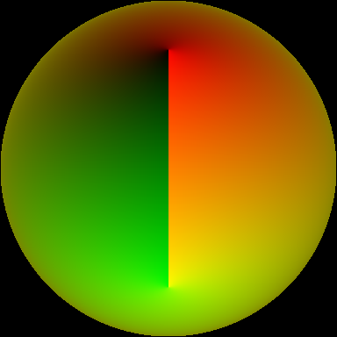
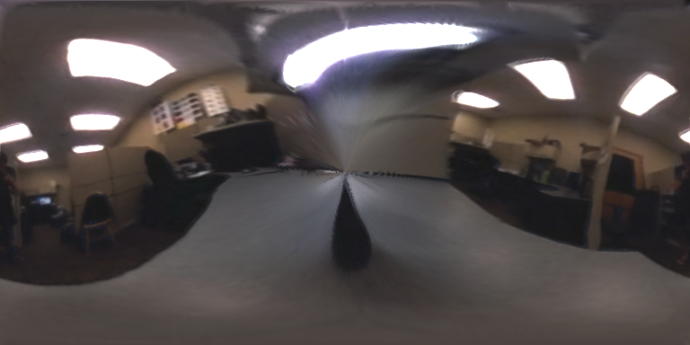

Mirror ball -> equirectangular
Mirror ball
Normals
Reflection
vectors
Phi/theta of reflection vecs
Equirectangular
Phi/theta equirectangular domain

Slide 5
Mirror ball -> equirectangular
Domain transformation in matlab
  Create an interpolation function F with TriScatteredInterp
  Compute values for each pixel in new domain
Pseudocode:
for i=1:d
F = TriScatteredInterp(phi_ball, theta_ball, mirrorball(:,:,i));
latlon(:,:,i) = F(phi_latlon, theta_latlon);
end

Slide 6
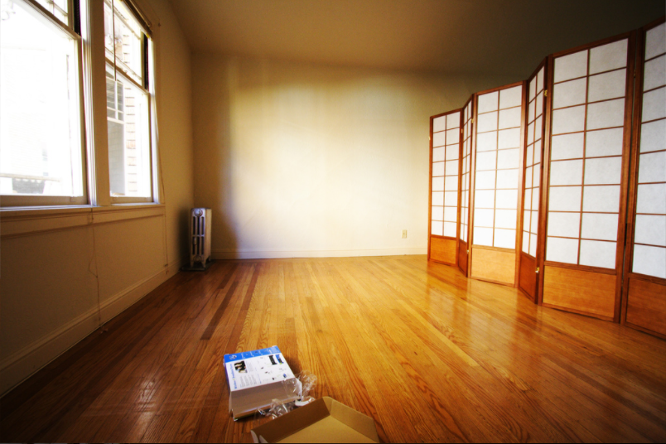

Slide 7
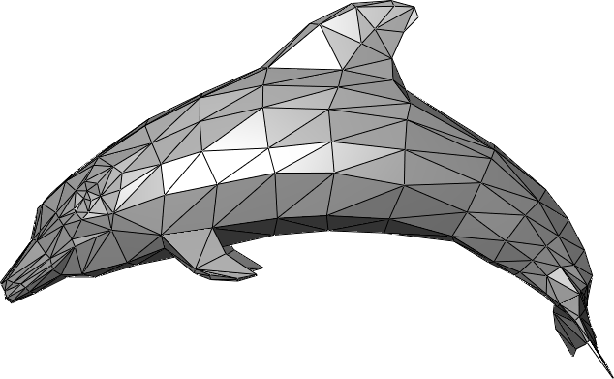
The polygonal mesh
Discrete representation of a surface
  Represented by vertices -> edges -> polygons (faces)

Slide 8
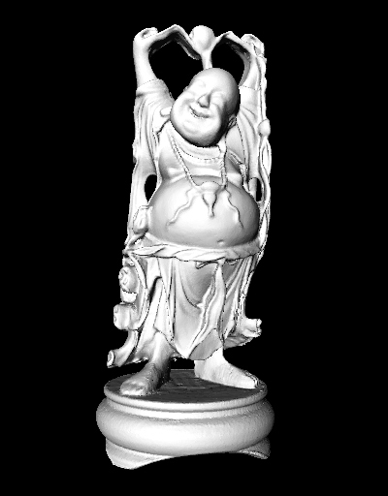
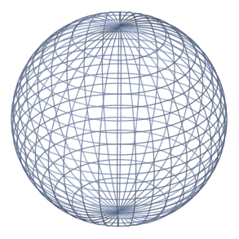
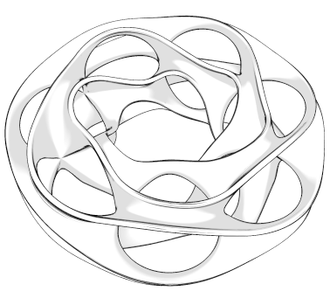
Insert these…

Slide 9
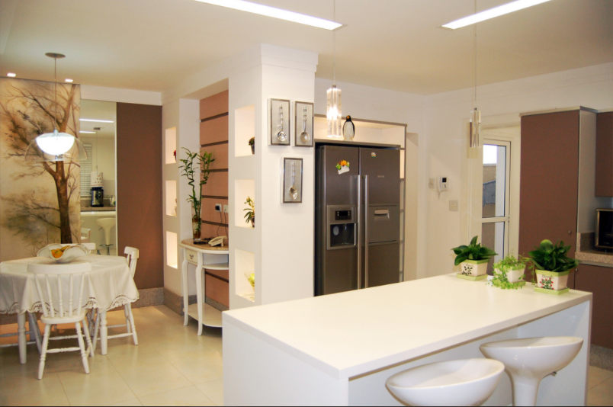
…into this

Slide 10
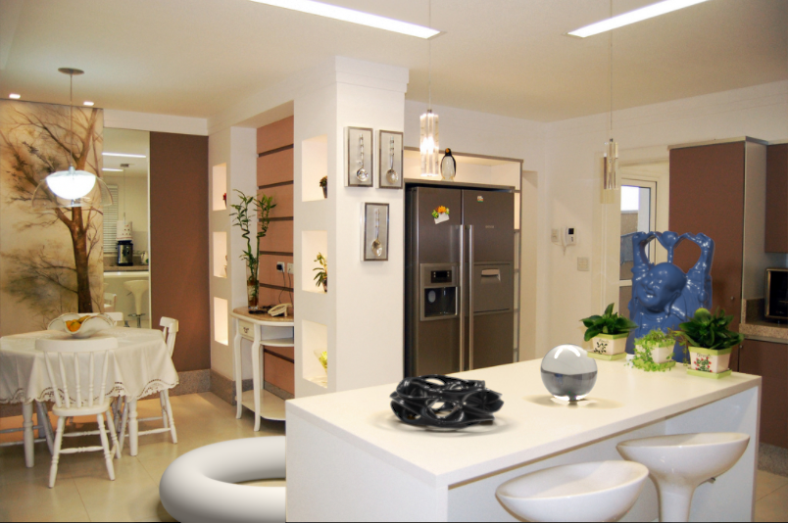
…into this

Slide 11
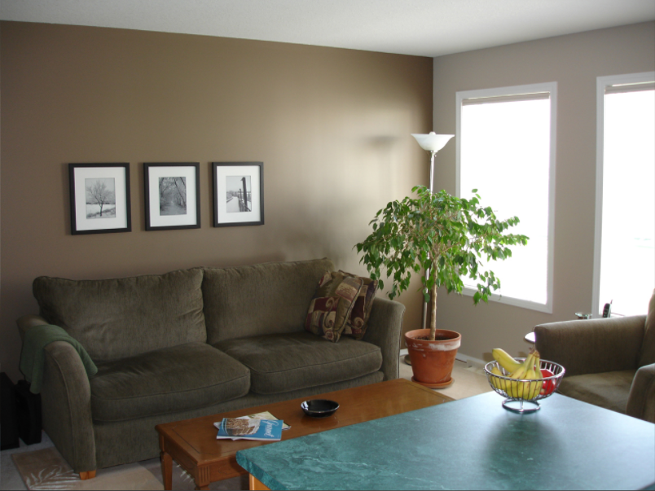
Or, remove this

Slide 12
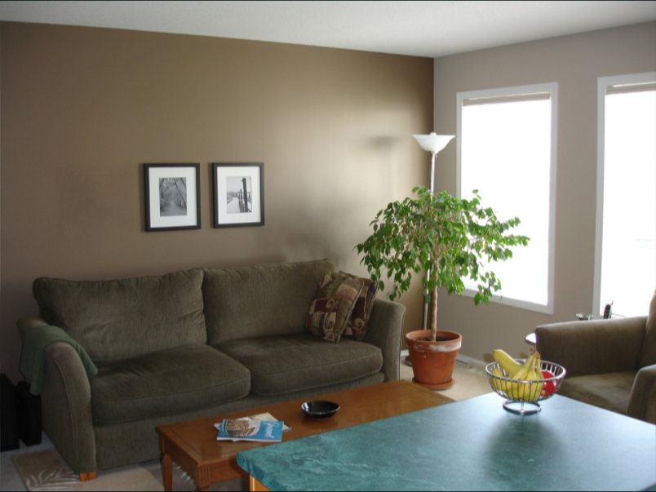
Or, remove this

Slide 13
Problem statement
From a single image, we want to seamlessly insert objects into and delete objects from an image while automatically handling perspective, occlusion, collision, and lighting.

Slide 14
Useful for…
Home planning/redecoration
Movies (visual effects)
Video games

Slide 15
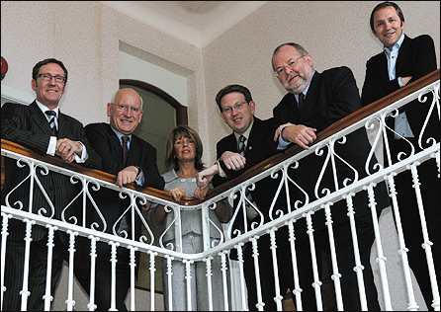

However…
Tedious with current modeling tools
  Blender, Photoshop, etc
Alternatives require scene measurements and/or multiple photographs

Slide 16
What do we need?
A 3D representation of the scene
  Camera parameters (focal length, positioning, etc)
  Scene geometry
  Light positions and intensities
Which requires
  Projective geometry (vanishing pts, homographies, etc) [Camera, geometry]
  Segmentation [Geometry]
  Numerical optimization [Lights]

Slide 17
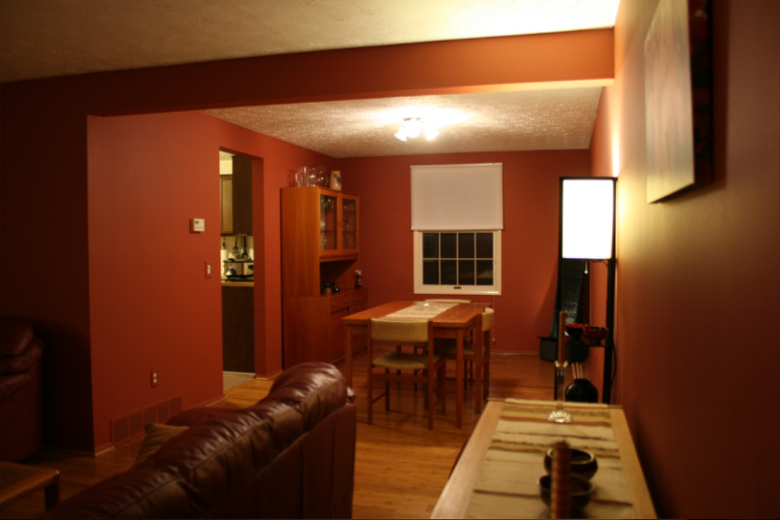
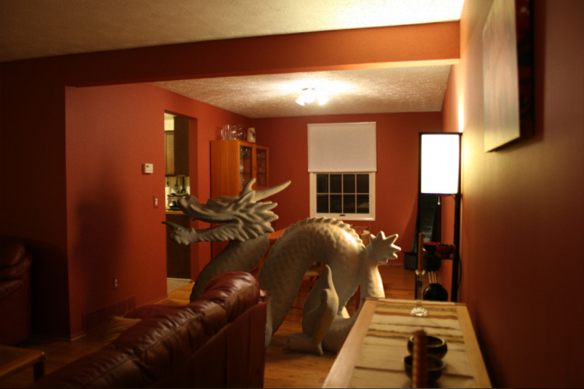
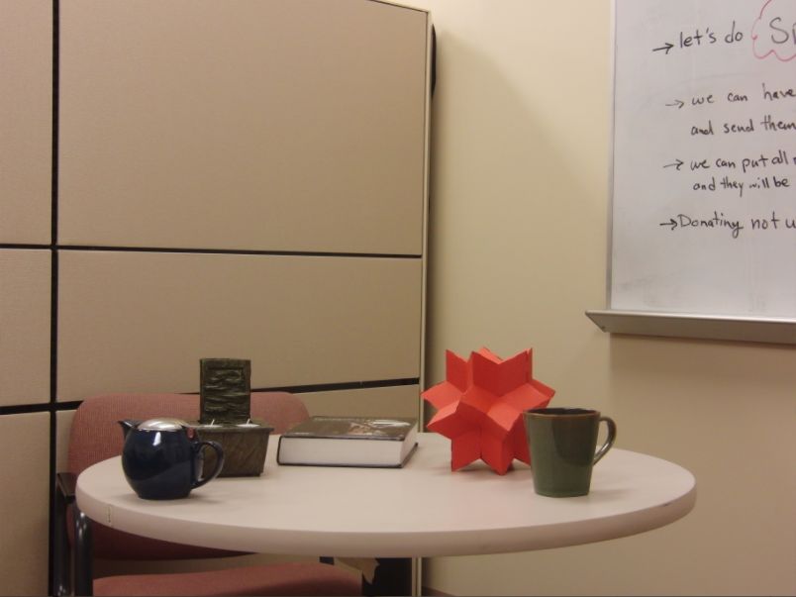
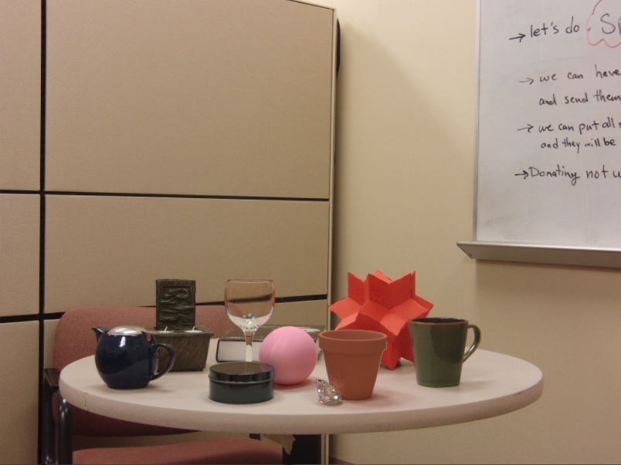
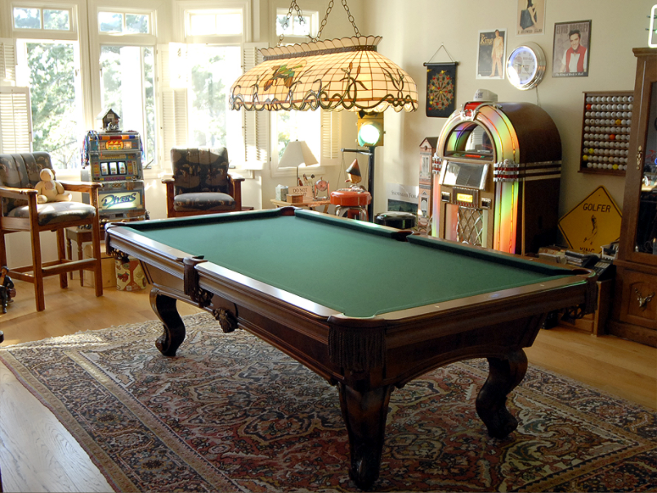
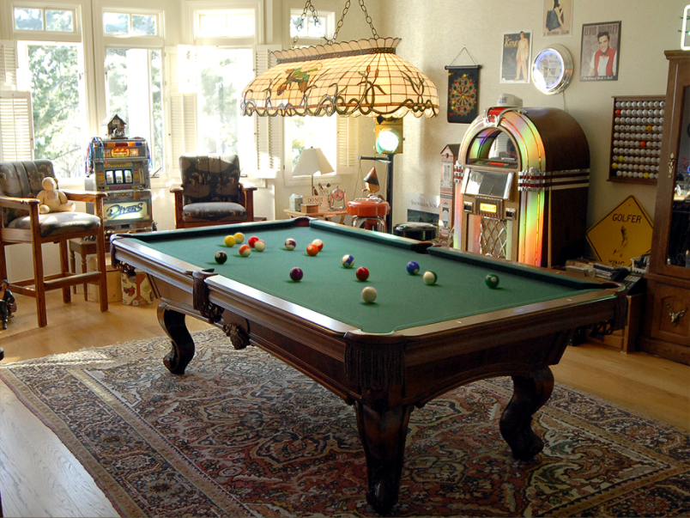
Notes:
Wouldn’t it be nice to interact with a picture as if it were a 3D scene?
You could insert objects into the photo with proper perspective and lighting,
or place objects realistically on surfaces.

Slide 18
Overview
Inserting objects
  Perspective
  Occlusion
  Relighting
Recap
Unsolved problems

Slide 19
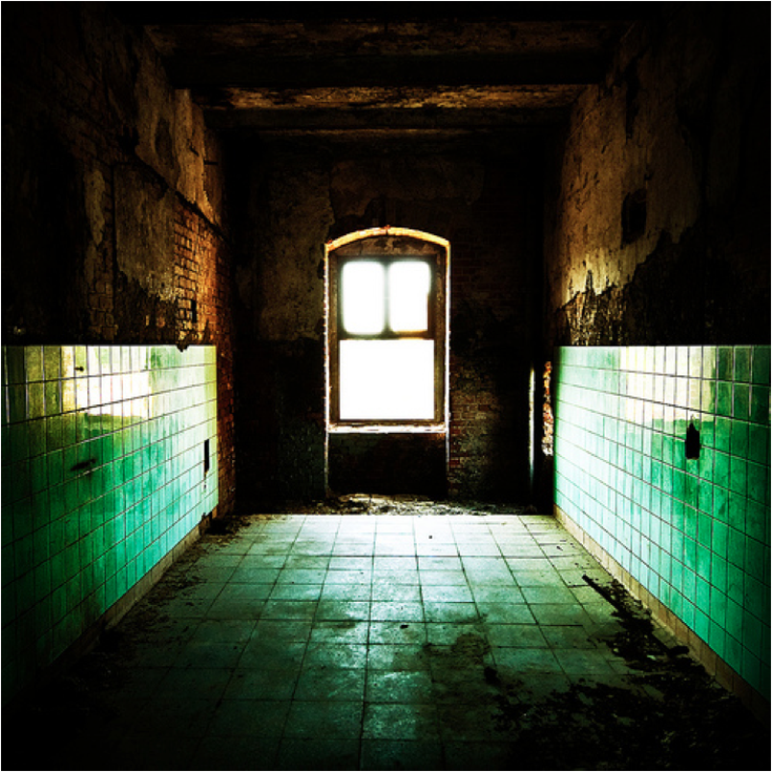
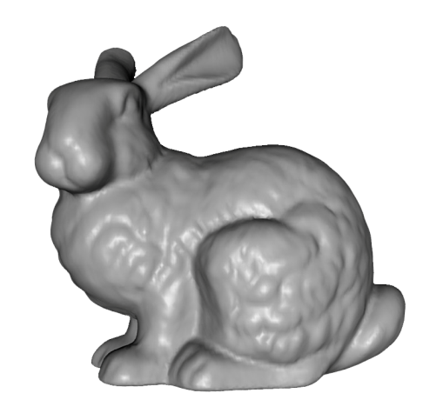
What’s wrong here?

Slide 20

That’s better, sort of…

Slide 21
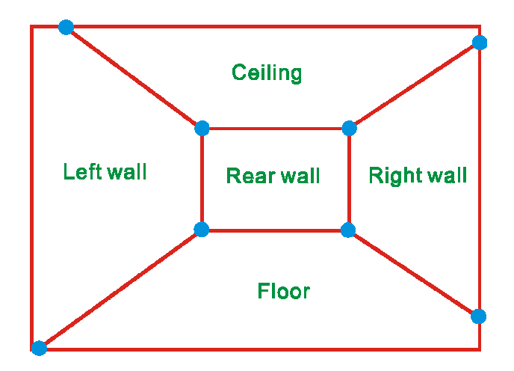
Single view reconstruction
Many scenes can be represented as an axis-aligned box volume

Slide 22
Single view reconstruction
Many scenes can be represented as an axis-aligned box volume

Slide 23
Ideal example

Slide 24
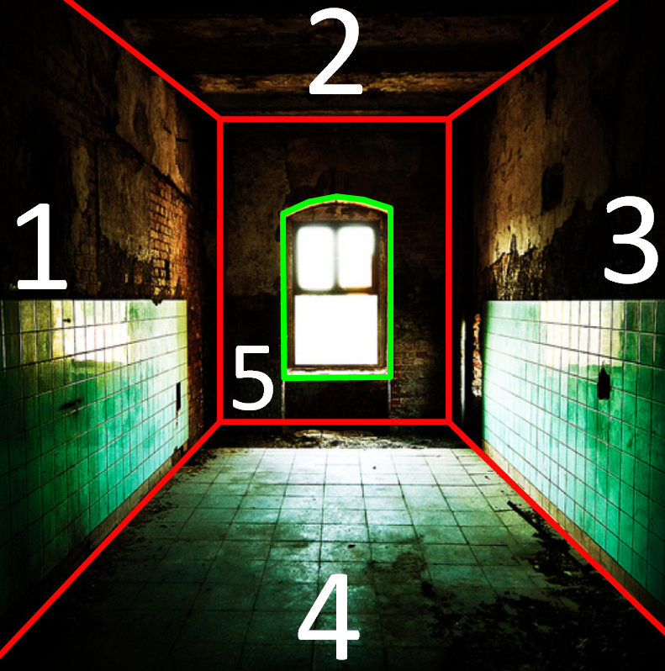
Ideal example

Slide 25
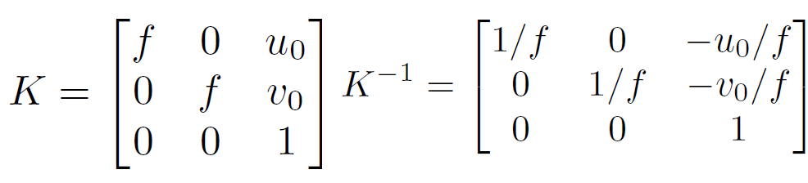
Computing a projection
Given 3 orthogonal VPs (at least two finite), can compute projection operator

Slide 26
Computing a projection
Given 3 orthogonal VPs (at least two finite), can compute projection operator

Slide 27
Computing a projection
Given 3 orthogonal VPs (at least two finite), can compute projection operator

Slide 28
Computing a projection
Given 3 orthogonal VPs (at least two finite), can compute projection operator

Slide 29
Computing a projection
Given 3 orthogonal VPs (at least two finite), can compute projection operator

Slide 30
Computing a projection
Given 3 orthogonal VPs (at least two finite), can compute projection operator

Slide 31
Computing a projection
Given 3 orthogonal VPs (at least two finite), can compute projection operator

Slide 32
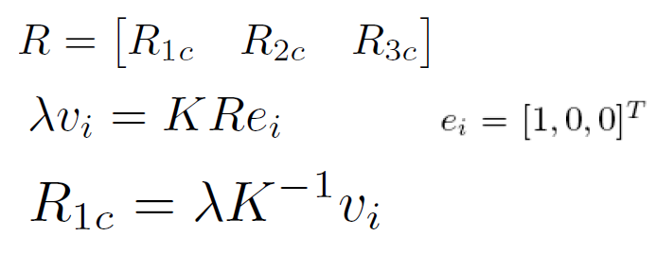
Computing a projection
Given 3 orthogonal VPs (at least two finite), can compute projection operator

Slide 33
Projecting to image space
Given K, R, and a position in 3D (v_object), we can find its corresponding 2D image location:

Slide 34
What about the reverse?
Given K, R, and a 2D position on the image (v_image), what do we know about its 3D location?

Slide 35
What about the reverse?
Given K, R, and a 2D position on the image (v_image), what do we know about its 3D location?
Implies a line along which the 3D point lies
Allows for image space interactions to be localized in 3D!
Notes:
Draw ray example on board

Slide 36
Homographies
A
B’
A’
C
D
B
C’
D’
(Projective warping from one domain to another)

Slide 37
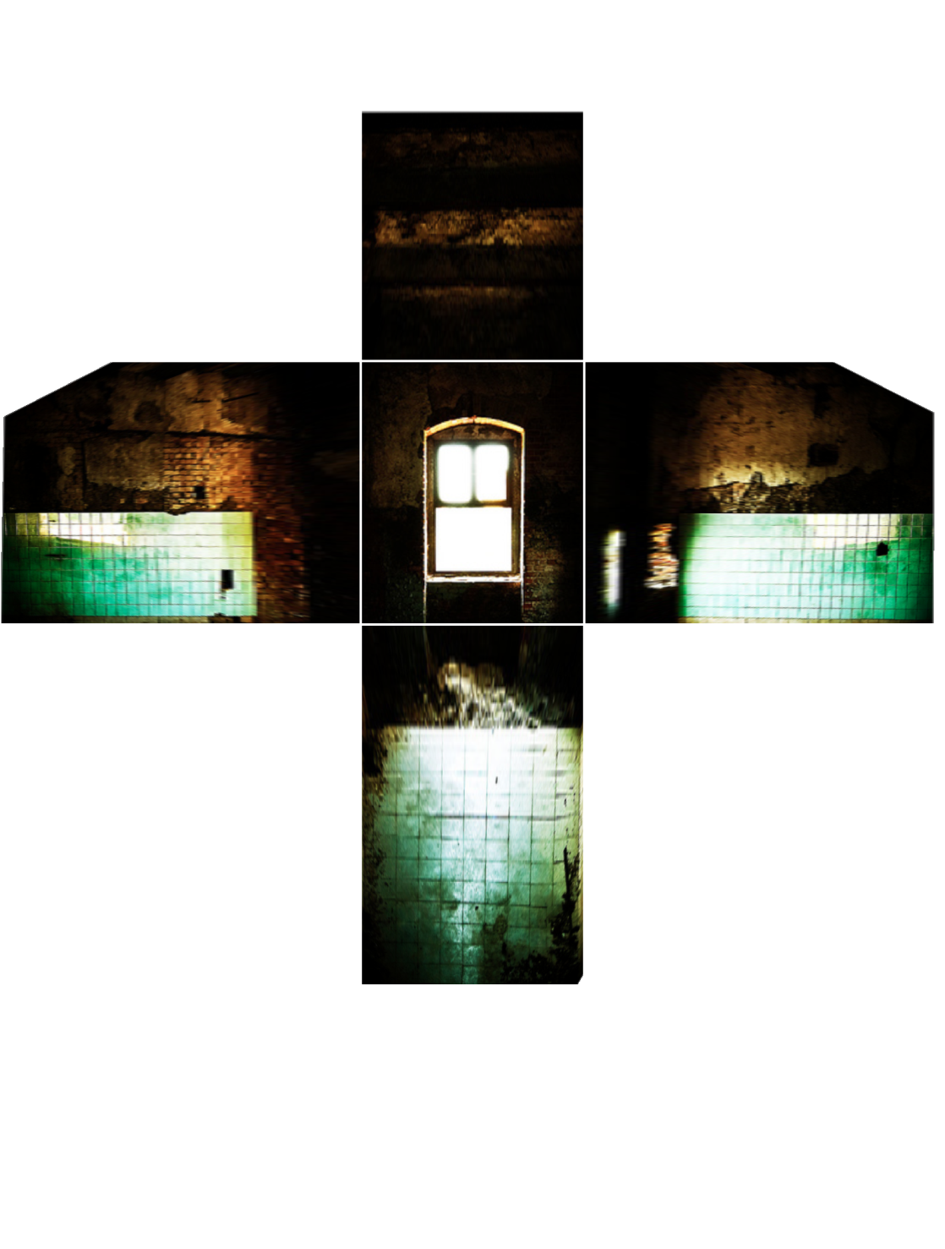
Image Rectification

Slide 38
Overview
Inserting objects
  Perspective & collision
  Occlusion
  Relighting
  Animation
Removing objects
Recap + Unsolved problems

Slide 39
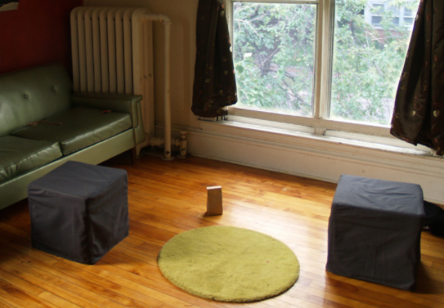
Modeling occlusions

Slide 40
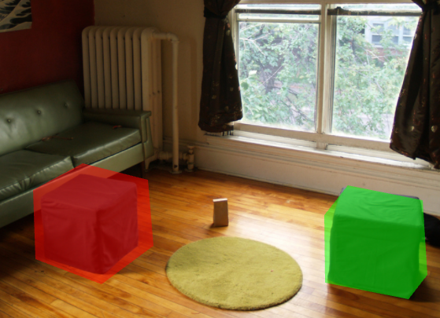
User-defined boundary
Tedious/inaccurate
How can we make this better?

Slide 41
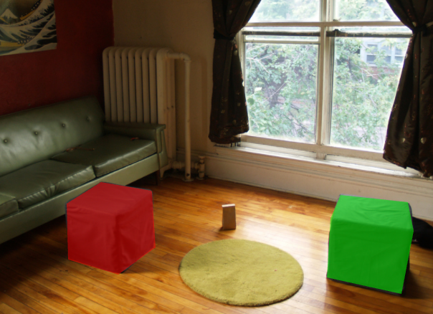
Refined segmentation

Slide 42
Segmentation with graph cuts
Source (Label 0)
Cost to assign to 0
Cost to split nodes
Cost to assign to 1
Sink (Label 1)
Notes:
- Explanation with user initialization + pixel colors

Slide 43
Segmentation with graph cuts
Source (Label 0)
Cost to assign to 0
Cost to split nodes
Cost to assign to 1
Sink (Label 1)

Slide 44
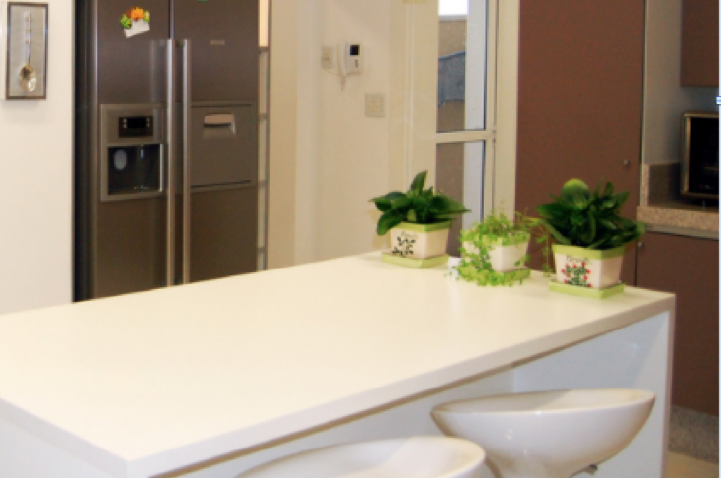
A spectral approach

Slide 45
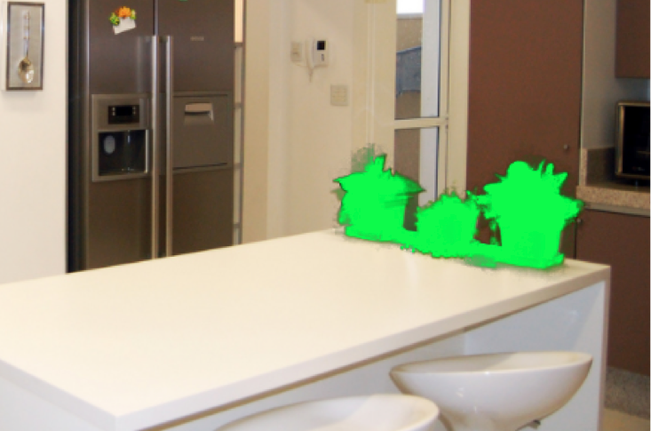
A spectral approach

Slide 46
A spectral approach
Create NxN matrix describing neighboring pixel similarity (Laplacian matrix, L)
Extract “smallest” eigenvectors of L
Segmentation defined by linear combination of eigenvectors
  Scribbles as constraints

Slide 47
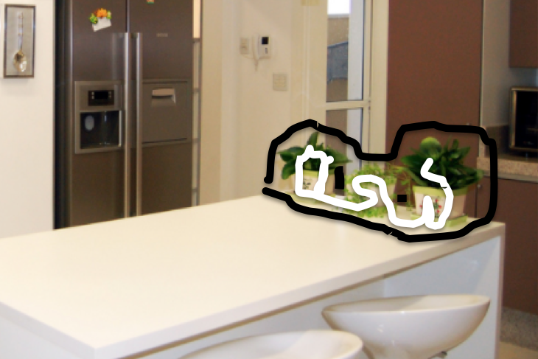
A spectral approach

Slide 48
A spectral approach

Slide 49
Segmentations as “billboards”

Slide 50
Segmentations as “billboards”

Slide 51
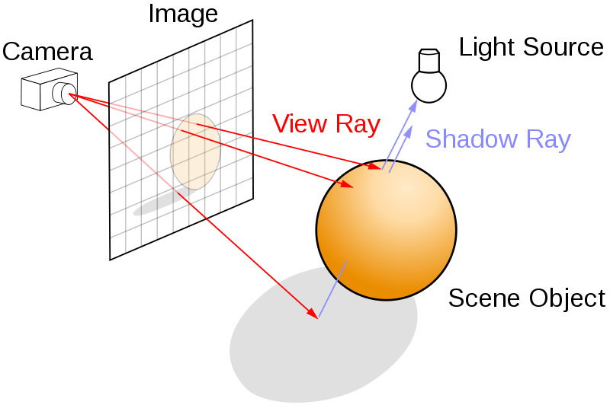
Rendering via ray tracing

Slide 52
Rendering via ray tracing

Slide 53
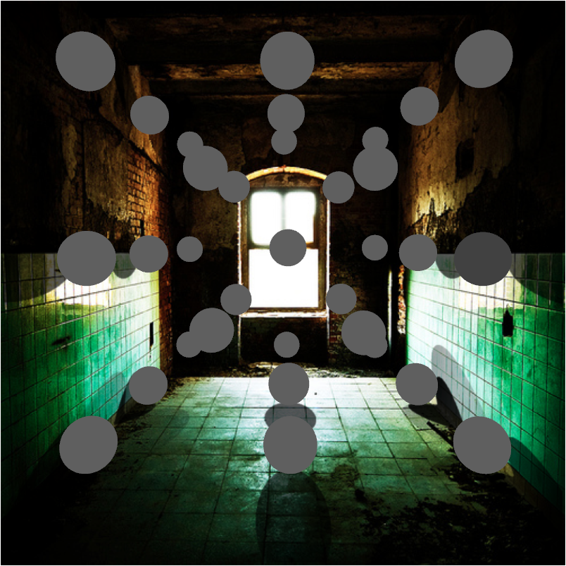
Insertion without relighting

Slide 54
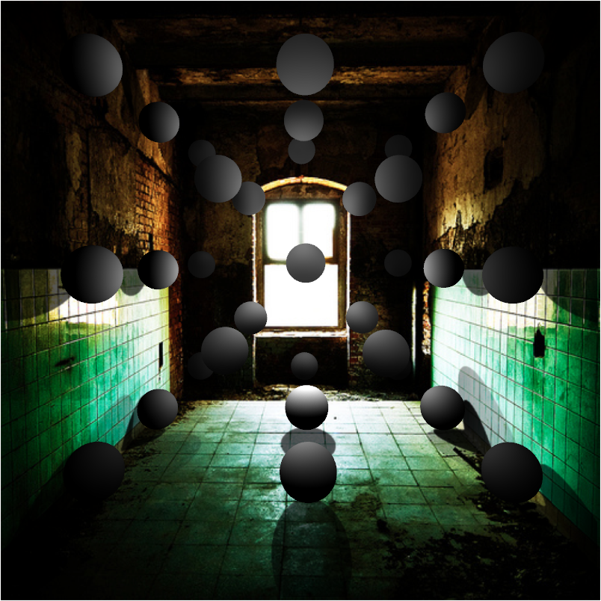
…with relighting

Slide 55
Understanding light: our approach
Hypothesize physical light sources in the scene
  Physical → CG representations of light sources found in the real world (area lights, etc)
Visible sources in image marked by user
  Refined to best match geometry and materials
User annotates light shafts; direction vector
  Shafts automatically matted and refined

Slide 56
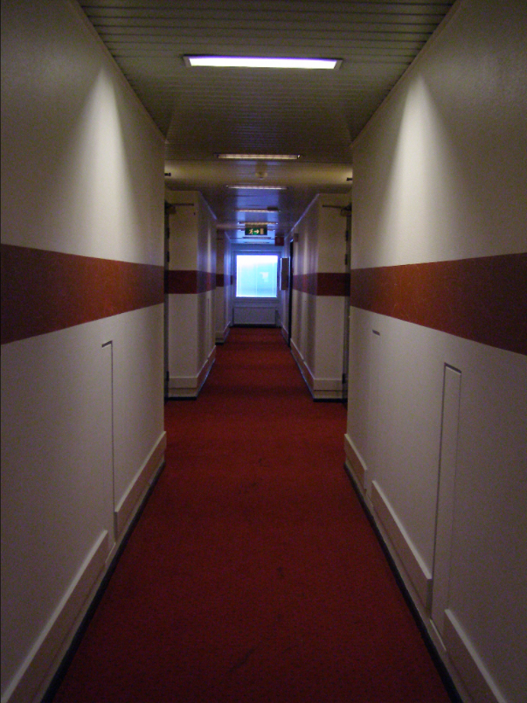
Lighting estimation

Slide 57
Lighting estimation
Actual light position

Slide 58
Lighting estimation
Actual light position
User-initialized light position

Slide 59
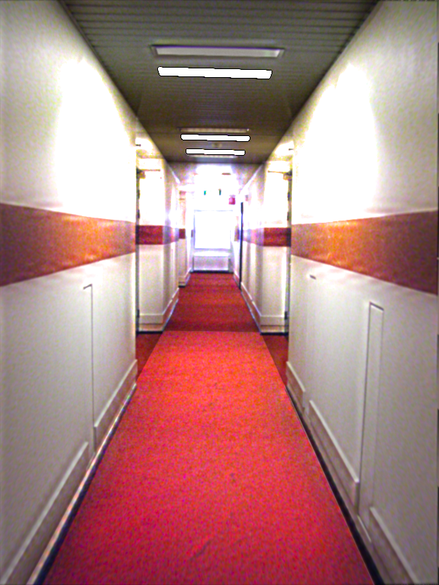
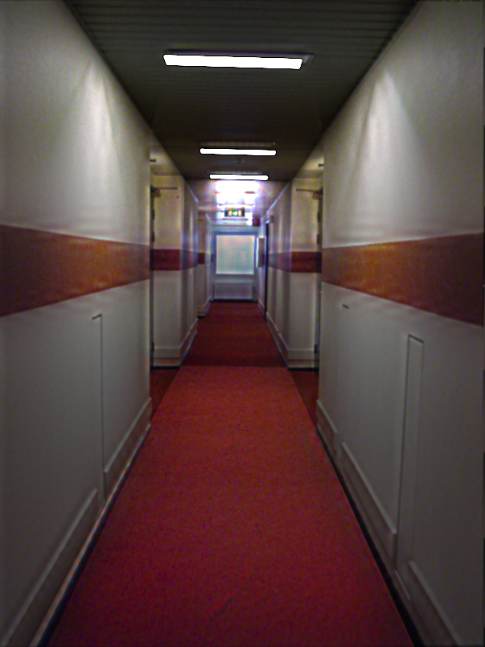
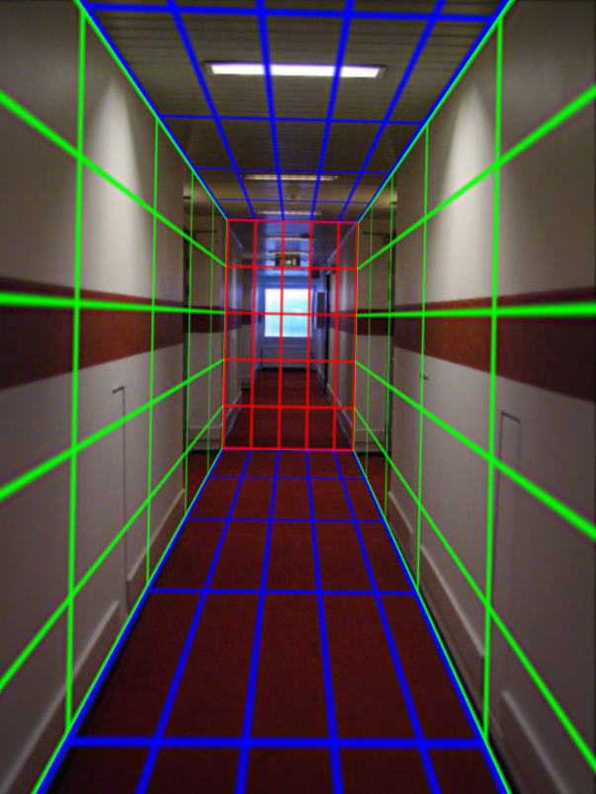
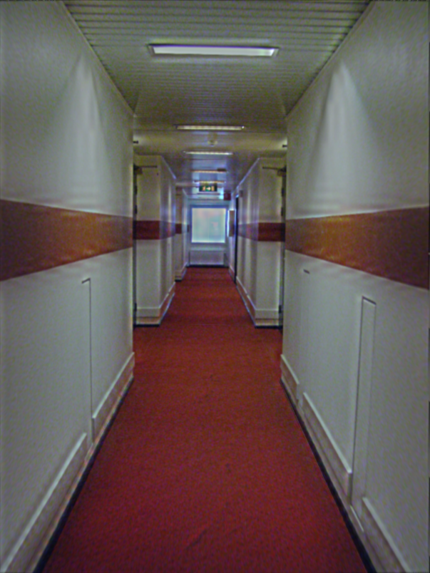
Light refinement
Match original image to rendered image
Match rendered image with input
Trust initial
light parameters

Slide 60
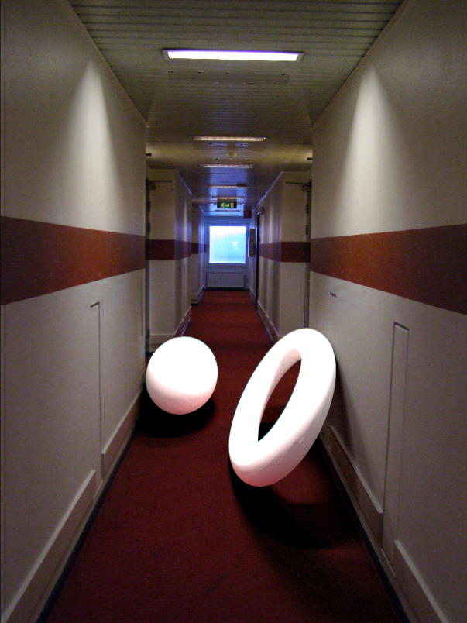
Initial light parameters

Slide 61
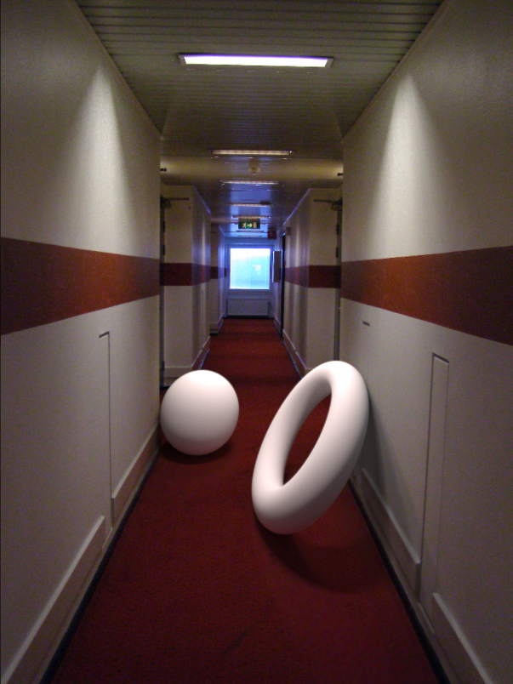
Refined light parameters

Slide 62
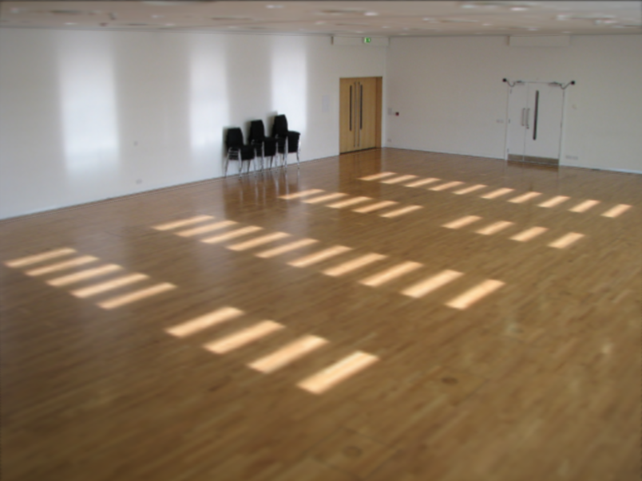
External light shafts

Slide 63
External light shafts
Source bounding box
Shaft bounding box

Slide 64
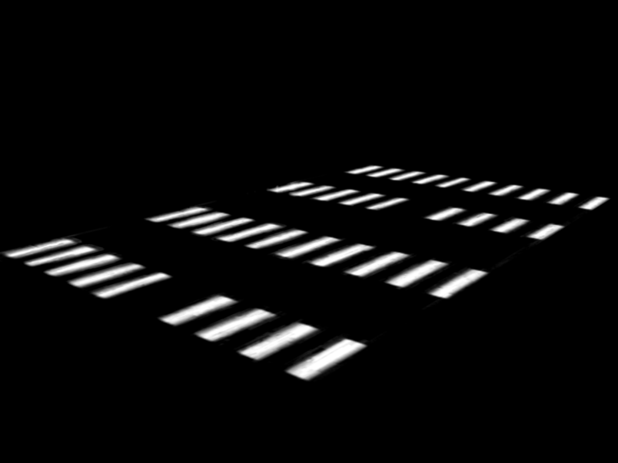

External light shafts
Shadow matting via Guo et al. [2011]

Slide 65
External light shafts
Can we find the direction of the shaft in 3D?
Shaft direction

Slide 66
Example on board

Slide 67
Light shaft result

Slide 68
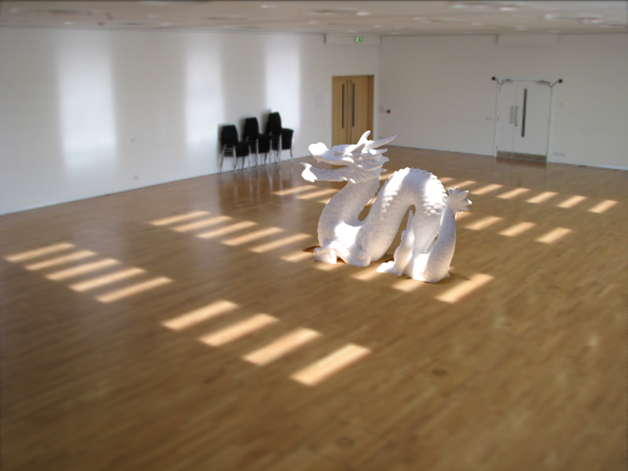
Light shaft result

Slide 69
Inserting objects
Representation of geometry, materials and lights compatible with 3D modeling software
Two methods of insertion/interaction
  Novice: image space editing
  Professional: 3D modeling tools (e.g. Maya)
Scene rendered with physically based renderer (e.g. LuxRender, Blender’s Cycles)

Slide 70
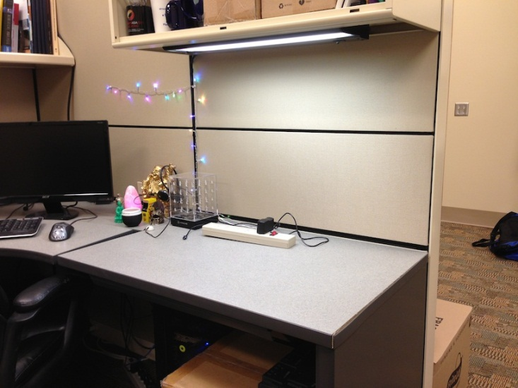
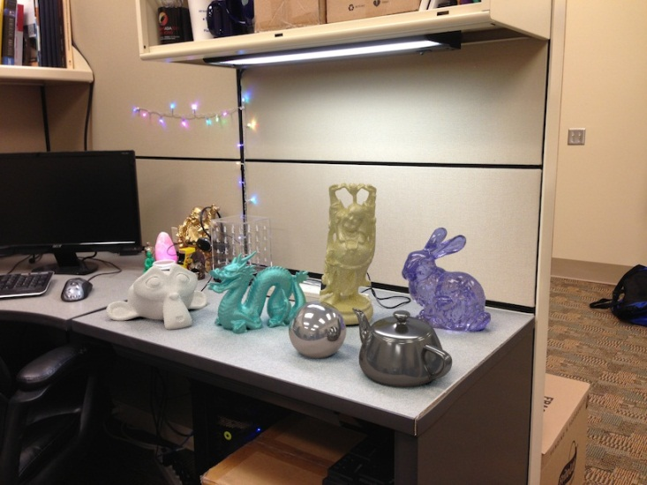
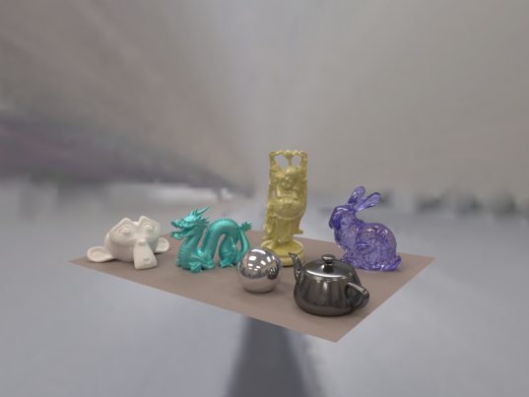


Final composite
Additive differential technique [Debevec 1998]
composite = M.*R + (1-M).*I + (1-M).*(R-E).*c
I (background)
composite
R (rendered)
E (empty)
M (mask)

Slide 71
Final composite

Slide 72
Blender demos

Slide 73
Putting it all together
Video

Slide 74
Unsolved problems
Can we “do better” with
  Multiple images?
  Videos?
  Depth?
Better scene understanding?
How to insert image fragments (Poisson Blending style)?

