Slide 1
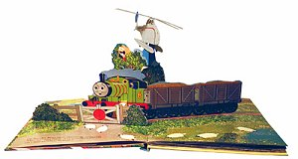
Single-view 3D Reconstruction
10/09/14
Computational Photography
Derek Hoiem, University of Illinois
Some slides from Alyosha Efros, Steve Seitz

Slide 2
Office hours
Amin: today (5pm)
Derek: tomorrow (11am), Monday (2pm)

Slide 3
Message from Google
Looking for people who can develop computational photography algorithms for cameras
E.g., take multiple pictures and do HDR or improve resolution or contrast
Skills include knowledge of algorithms and ability to prototype and implement on camera platform

Slide 4
Project 3
Do in teams of two
Pick your partner now, will hand out mirrored spheres for light probes on Tues

Slide 5
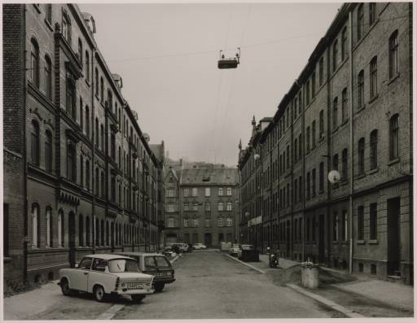
Take-home question
Suppose you have estimated finite three vanishing points corresponding to orthogonal directions:
How to solve for intrinsic matrix? (assume K has three parameters)
The transpose of the rotation matrix is its inverse
Use the fact that the 3D directions are orthogonal
How to recover the rotation matrix that is aligned with the 3D axes defined by these points?
In homogeneous coordinates, 3d point at infinity is (X, Y, Z, 0)
VP_{y}
.
VP_{x}
VP_{z}
Photo from online Tate collection

Slide 6
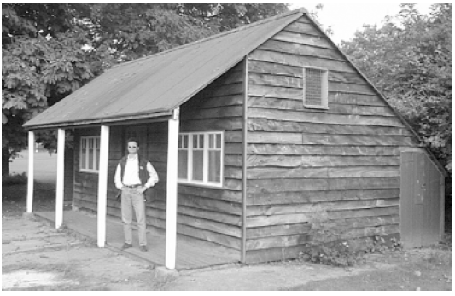
Take-home question
Assume that the man is 6 ft tall.
What is the height of the front of the building?
What is the height of the camera?

Slide 7
Take-home question
Assume that the man is 6 ft tall.
What is the height of the front of the building?
What is the height of the camera?
(0.92+1.55)/1.55*6=9.56
~5’7
0.92
1.55

Slide 8
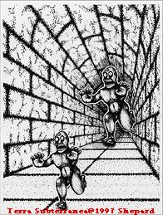

Slide 9
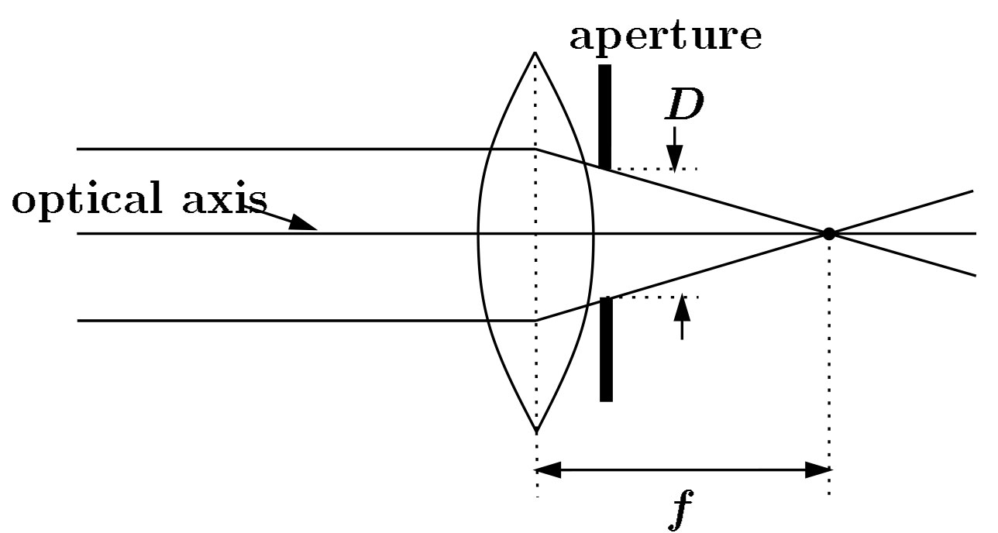
Focal length, aperture, depth of field
F
focal point
optical center
(Center Of Projection)
Increase in focal length “zooms in”, decreasing field of view (and light per pixel), increasing depth of field (less blur)
Increase in aperture lets more light in but decreases depth of field
Slide source: Seitz

Slide 10
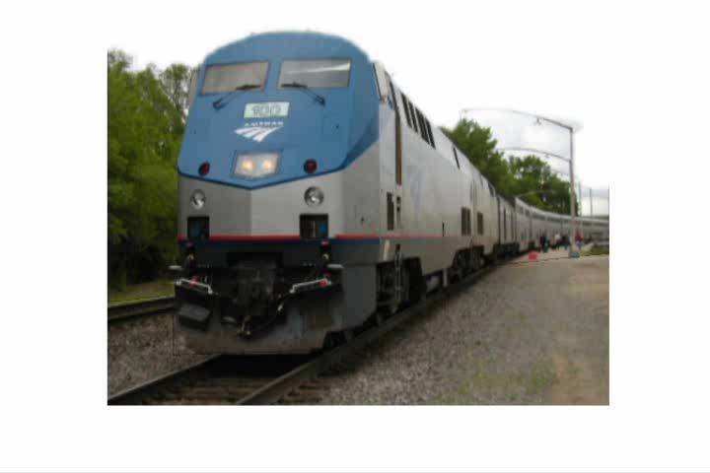
Today’s class: 3D Reconstruction

Slide 11
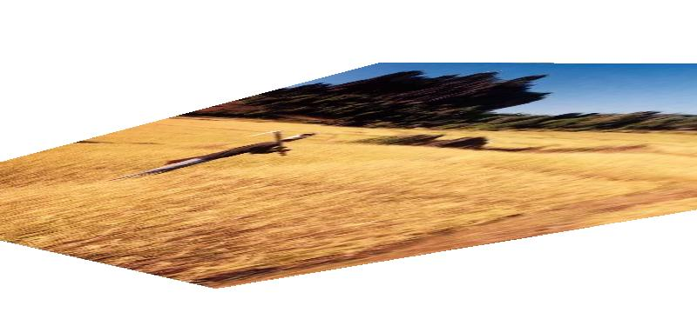
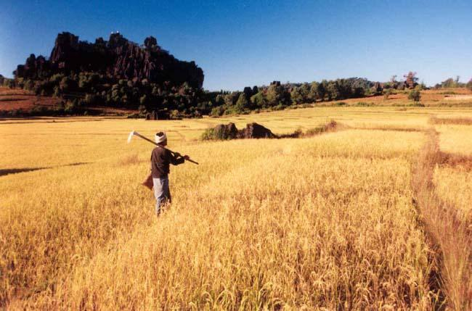
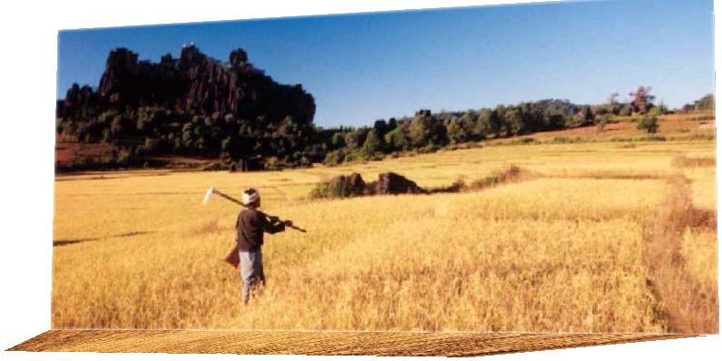
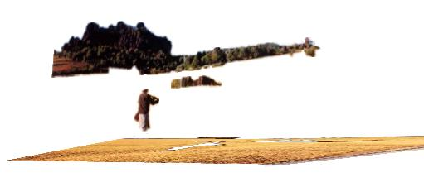
The challenge
One 2D image could be generated by an infinite number of 3D geometries
?
?
?

Slide 12
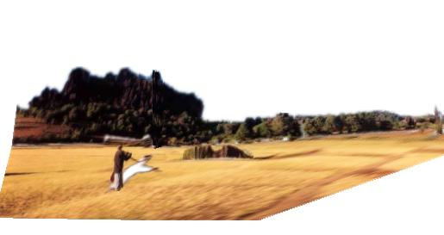
The solution
Make simplifying assumptions about 3D geometry
Unlikely
Likely

Slide 13
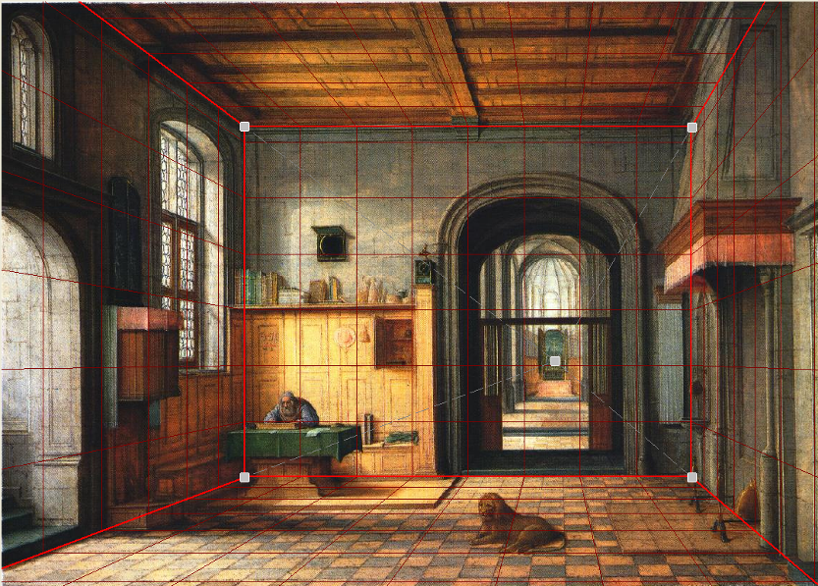
Today’s class: Two Models
Box + frontal billboards
Ground plane + non-frontal billboards

Slide 14
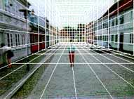
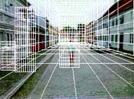
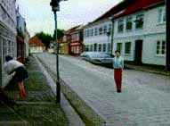
“Tour into the Picture” (Horry et al. SIGGRAPH ’97)
Create a 3D “theatre stage” of five billboards
Specify foreground objects through bounding polygons
Use camera transformations to navigate through the scene
Following slides modified from Efros

Slide 15
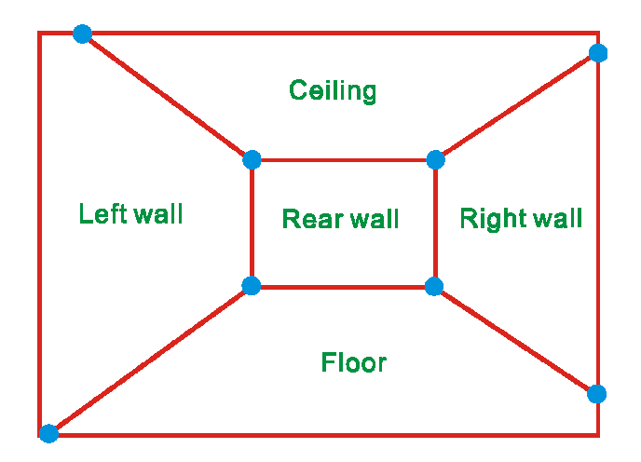
The idea
Many scenes can be represented as an axis-aligned box volume (i.e. a stage)
Key assumptions
All walls are orthogonal
Camera view plane is parallel to back of volume
How many vanishing points does the box have?
Three, but two at infinity
Single-point perspective
Can use the vanishing point
to fit the box to the particular
scene

Slide 16
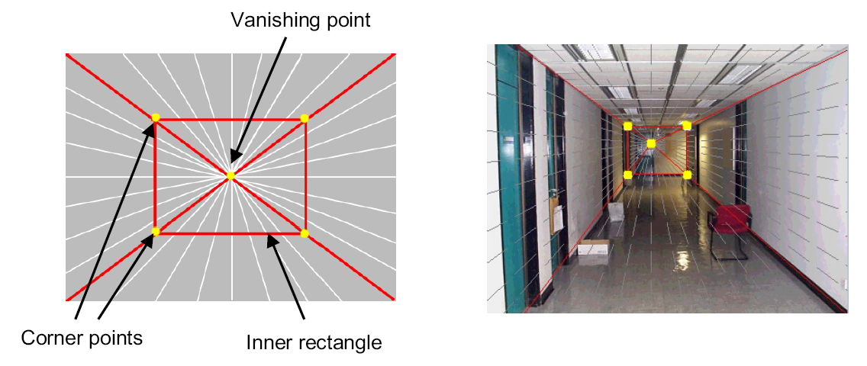
Step 1: specify scene geometry
User controls the inner box and the vanishing point placement (# of DOF?)
Q: What’s the significance of the vanishing point location?
A: It’s at eye (camera) level: ray from center of projection to VP is perpendicular to image plane
Under single-point perspective assumptions, the VP should be the principal point of the image

Slide 17
Example of user input: vanishing point and back face of view volume are defined
High Camera

Slide 18
Example of user input: vanishing point and back face of view volume are defined
Low Camera

Slide 19
Comparison of how image is subdivided based on two different camera positions. You should see how moving the box corresponds to moving the eyepoint in the 3D world.
High Camera
Low Camera

Slide 20
Another example of user input: vanishing point and back face of view volume are defined
Left Camera

Slide 21
Another example of user input: vanishing point and back face of view volume are defined
Right Camera

Slide 22
Comparison of two camera placements – left and right. Corresponding subdivisions match view you would see if you looked down a hallway.
Left Camera
Right Camera

Slide 23
Question
Think about the camera center and image plane…
What happens when we move the box?
What happens when we move the vanishing point?

Slide 24
2D to 3D conversion
First, we can get ratios
left
right
top
vanishing point
bottom
back
plane

Slide 25
2D to 3D conversion
Size of user-defined back plane determines width/height throughout box (orthogonal sides)
Use top versus side ratio to determine relative height and width dimensions of box
Left/right and top/bot ratios determine part of 3D camera placement
left
right
top
camera pos
bottom

Slide 26
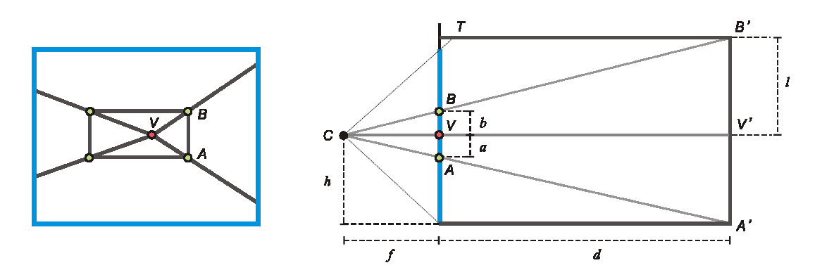
Depth of the box
Can compute by similar triangles (CVA vs. CV’A’)
Need to know focal length f (or FOV)
Note: can compute position on any object on the ground
Simple unprojection
What about things off the ground?

Slide 27
Step 2: map image textures into frontal view
2d coordinates
3d plane coordinates
A
B’
A’
C
D
B
C’
D’

Slide 28
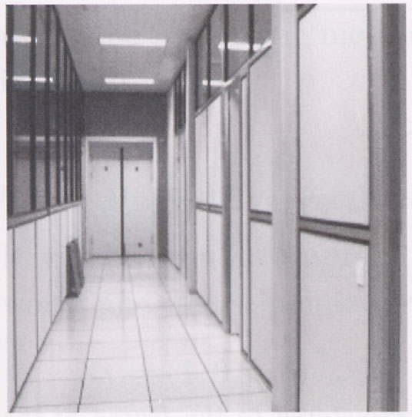
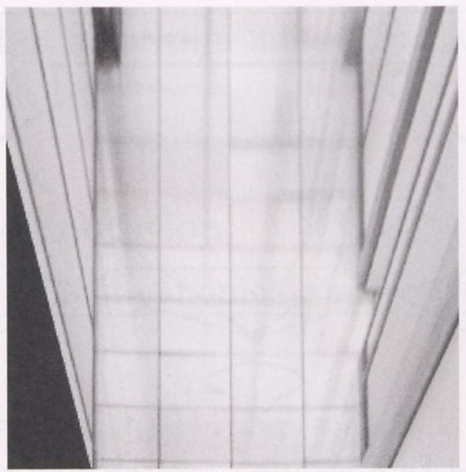
Image rectification
p’
p
To unwarp (rectify) an image solve for homography H given p and p’: wp’=Hp

Slide 29
Computing homography
Assume we have four matched points: How do we compute homography H?
Direct Linear Transformation (DLT)

Slide 30
Computing homography
Direct Linear Transform
Apply SVD: USV^{T} = A
h = V_{smallest} (column of V^{T} corr. to smallest singular value)
Matlab
[U, S, V] = svd(A);
h = V(:, end);
Explanation of SVD, solving systems of linear equations, derivation of solution here
Notes:
SVD gives the homogeneous least squares solution constrained to have a norm of 1

Slide 31
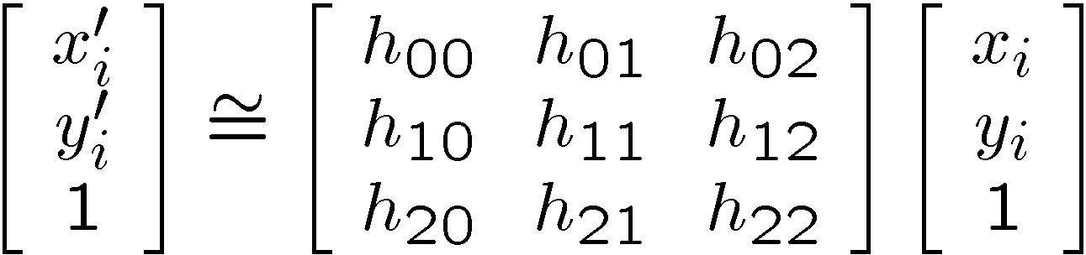
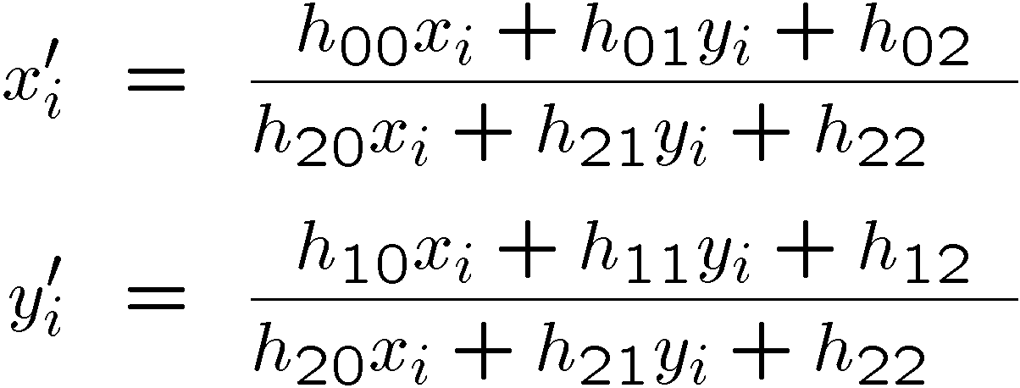
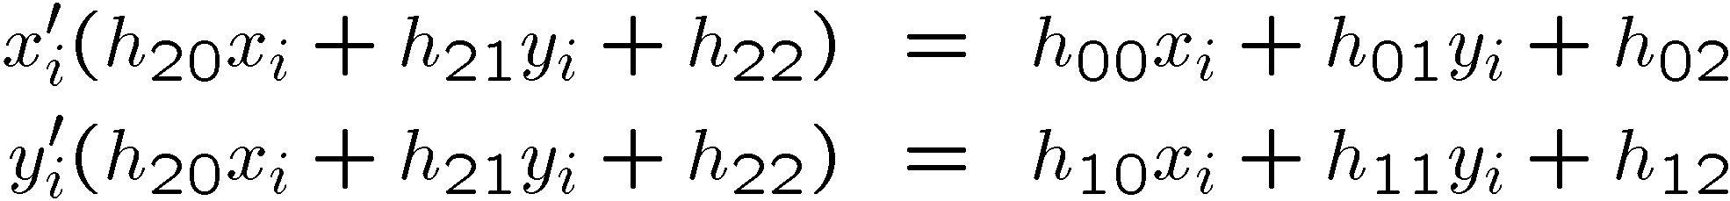
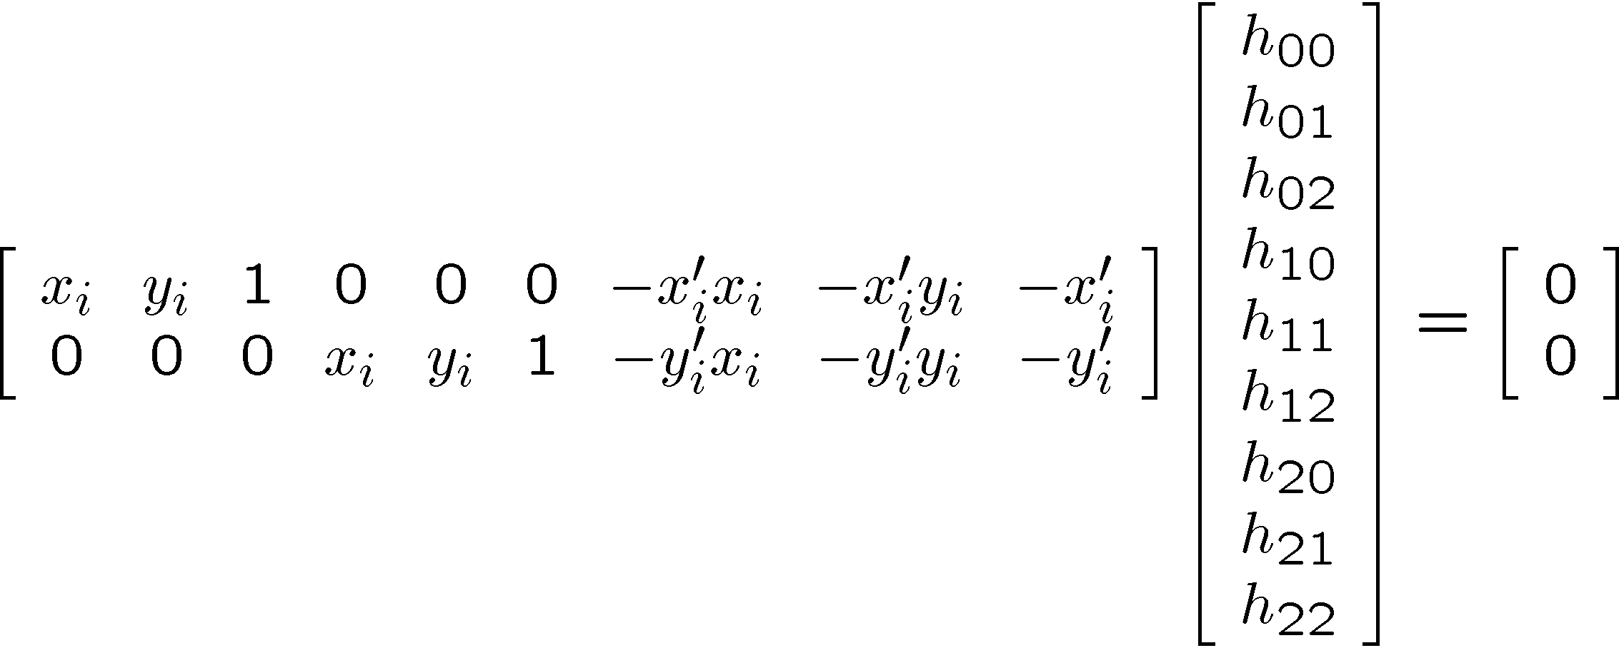
Solving for homographies (more detail)

Slide 32
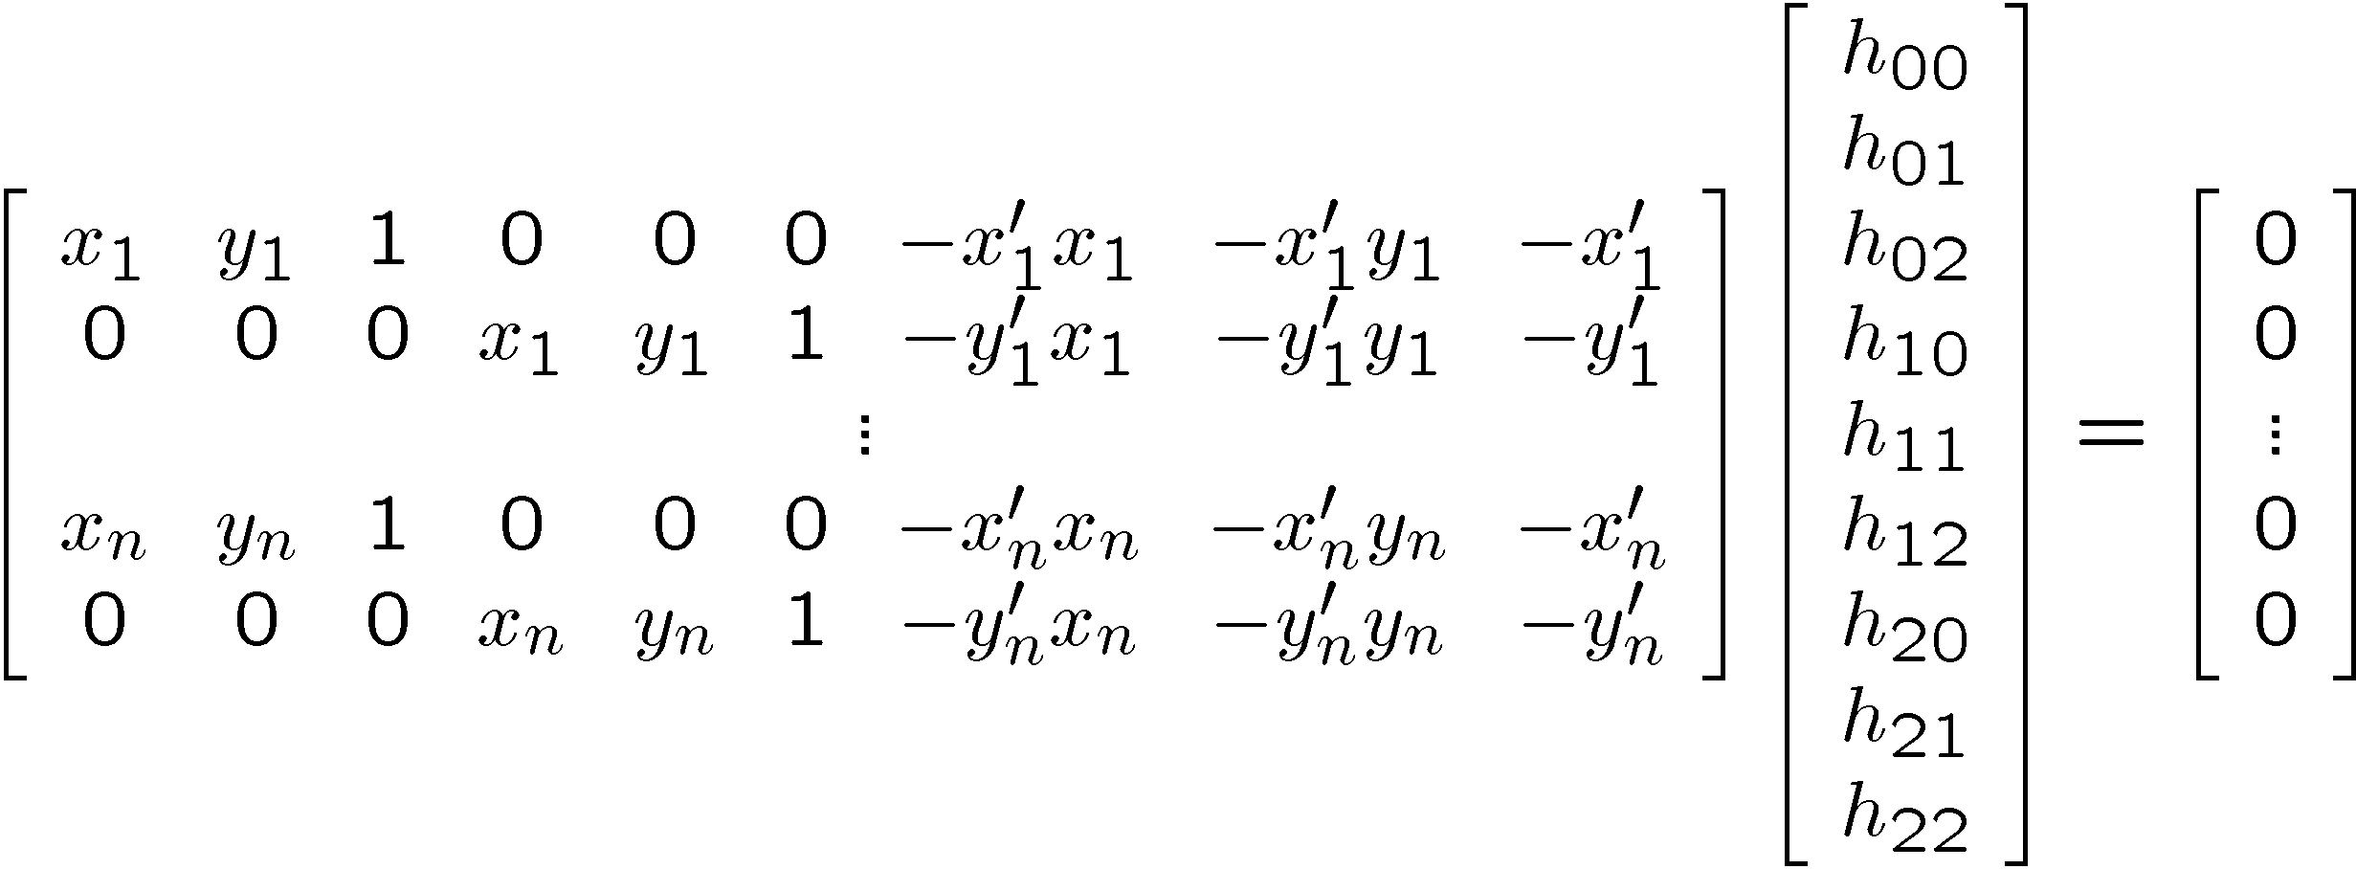

Solving for homographies (more detail)
A
h
0
2n × 9
9
2n
Defines a least squares problem:
Since h is only defined up to scale, solve for unit vector ĥ
Solution: ĥ = eigenvector of A^{T}A with smallest eigenvalue
Works with 4 or more points

Slide 33
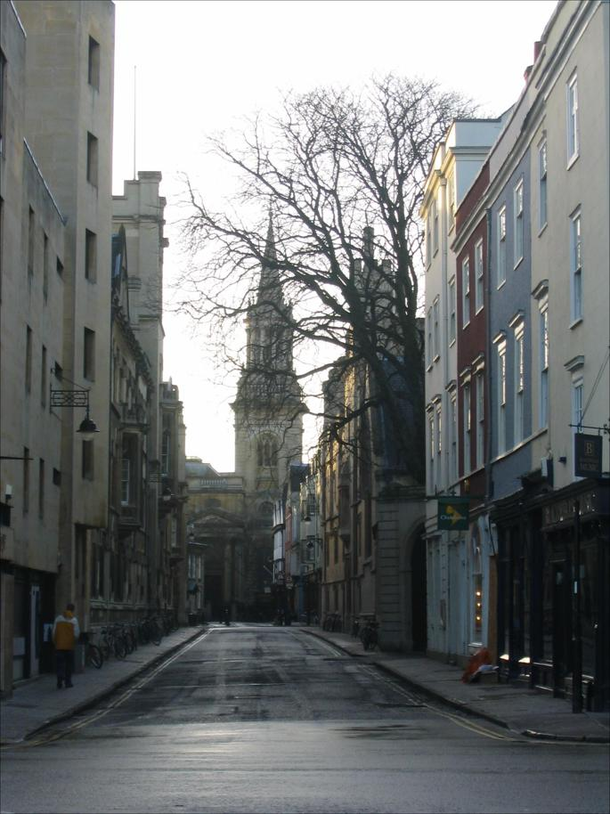
Tour into the picture algorithm
Set the box corners

Slide 34
Tour into the picture algorithm
Set the box corners
Set the VP
Get 3D coordinates
Compute height, width, and depth of box
Get texture maps
homographies for each face
Create file to store plane coordinates and texture maps
x

Slide 35
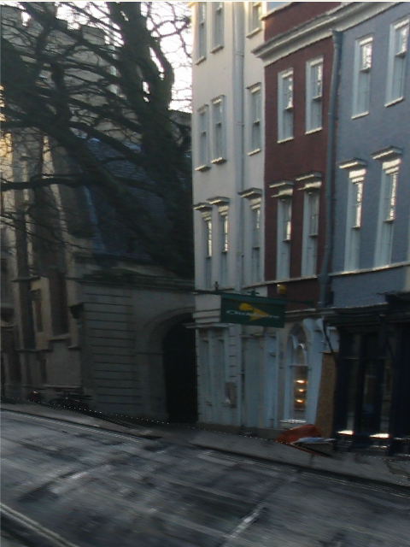
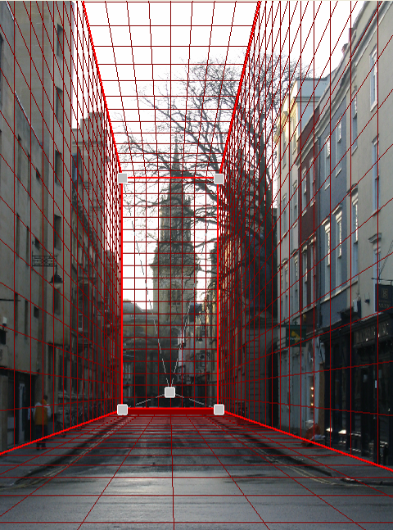
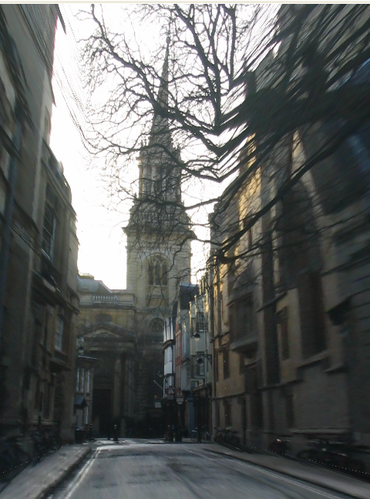
Result
Render from new views
http://www.cs.cmu.edu/afs/cs.cmu.edu/academic/class/15463-f08/www/proj5/www/dmillett/

Slide 36
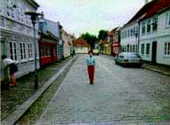

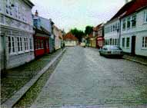
Foreground Objects
Use separate billboard for each
For this to work, three separate images used:
Original image.
Mask to isolate desired foreground images.
Background with objects removed

Slide 37
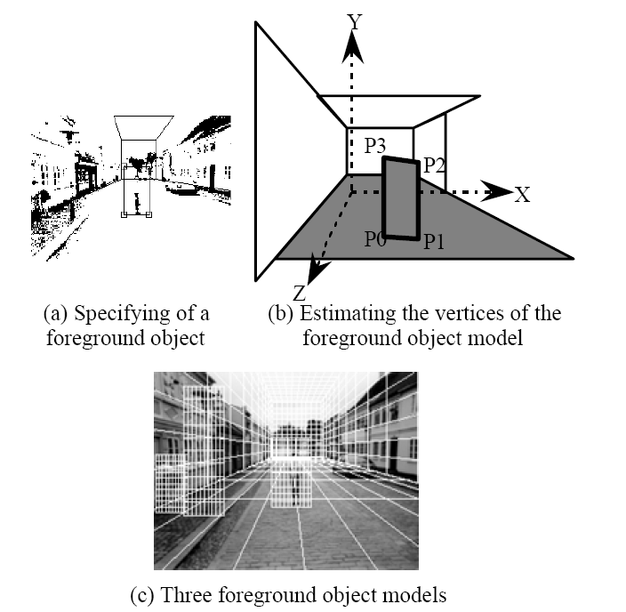
Foreground Objects
Add vertical rectangles for each foreground object
Can compute 3D coordinates P0, P1 since they are on known plane.
P2, P3 can be computed as before (similar triangles)

Slide 38
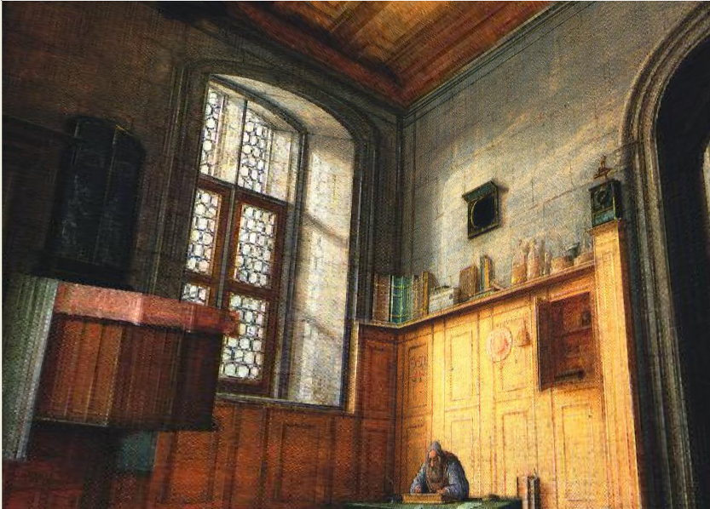
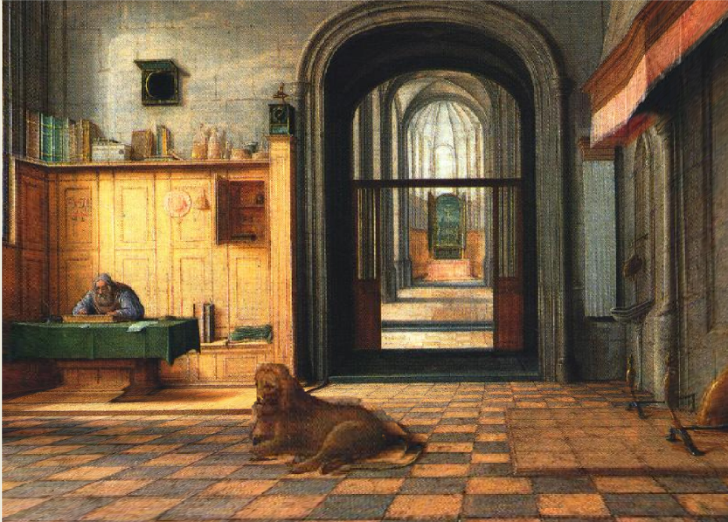
Foreground Result
Video from CMU class: http://www.youtube.com/watch?v=dUAtdmGwcuM

Slide 39
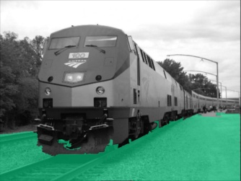
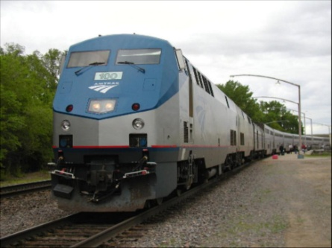
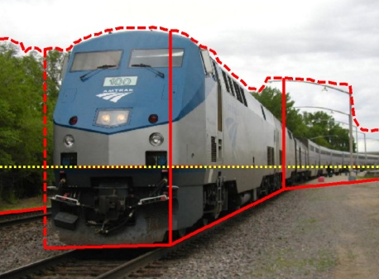
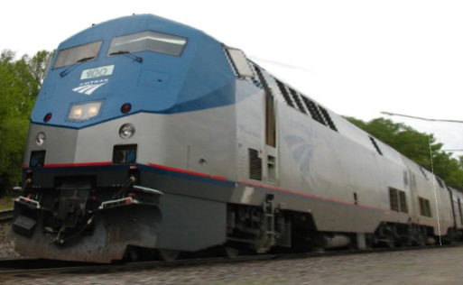
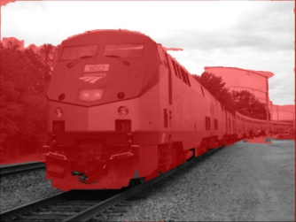












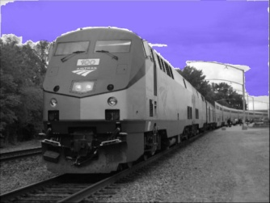
Automatic Photo Pop-up
Input
Geometric Labels
Cut’n’Fold
3D Model
Ground
Image
Vertical
Learned Models
Sky
Hoiem et al. 2005

Slide 40
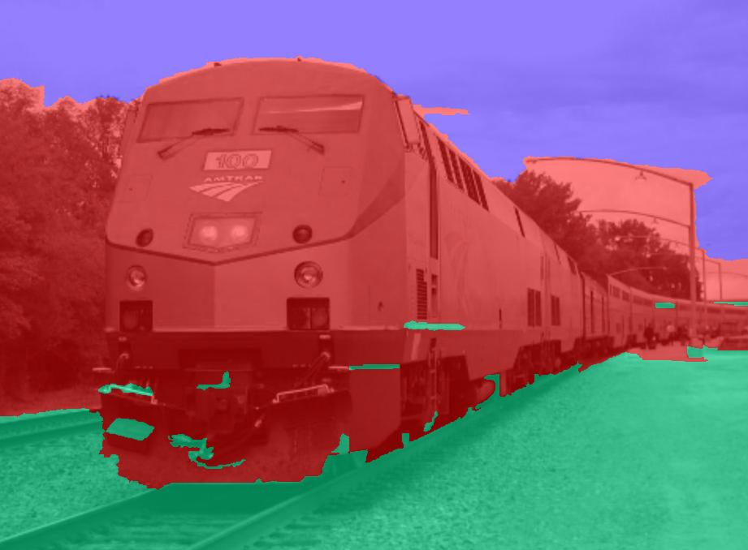
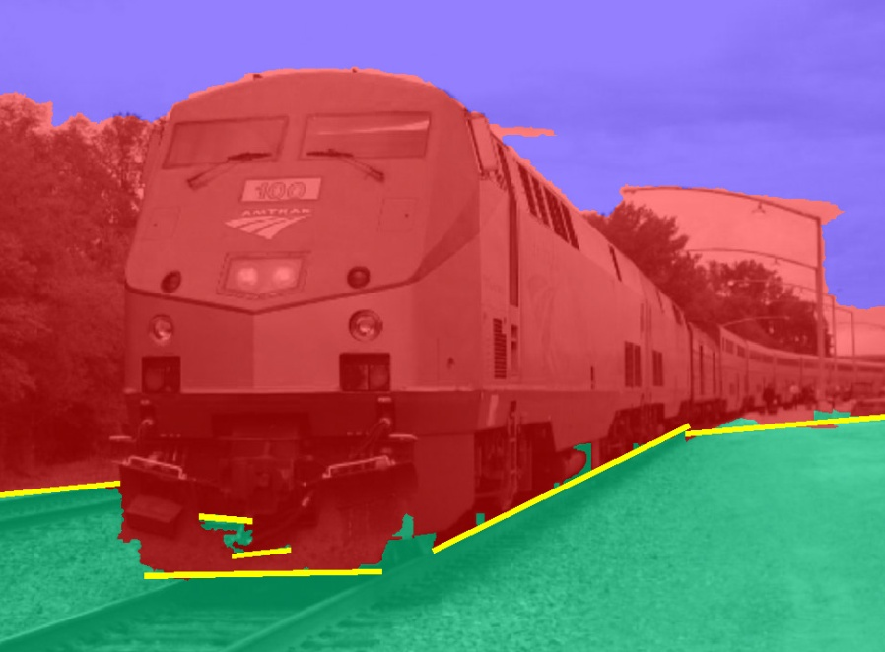
Cutting and Folding
Fit ground-vertical boundary
Iterative Hough transform

Slide 41
Cutting and Folding
Form polylines from boundary segments
Join segments that intersect at slight angles
Remove small overlapping polylines
Estimate horizon position from perspective cues

Slide 42

Cutting and Folding
``Fold’’ along polylines and at corners
``Cut’’ at ends of polylines and along vertical-sky boundary

Slide 43
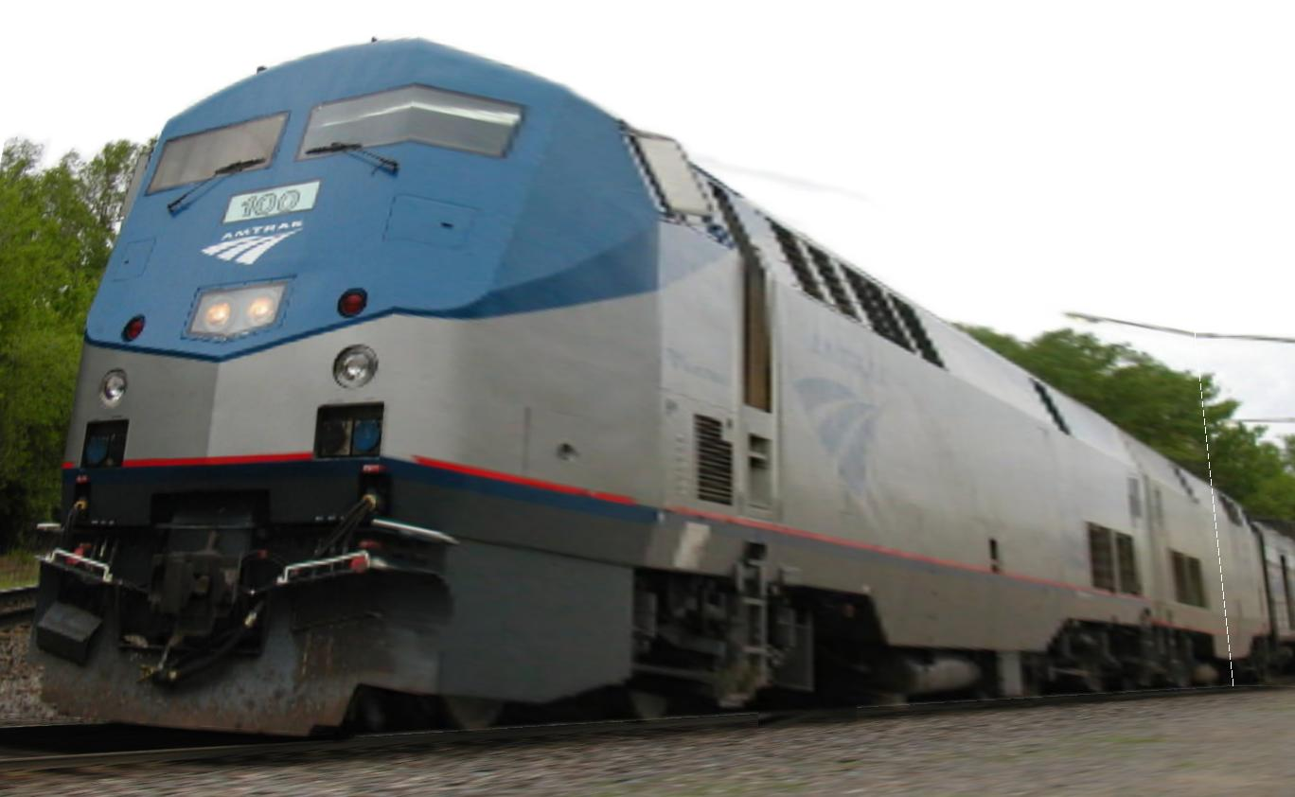
Cutting and Folding
Construct 3D model
Texture map

Slide 44
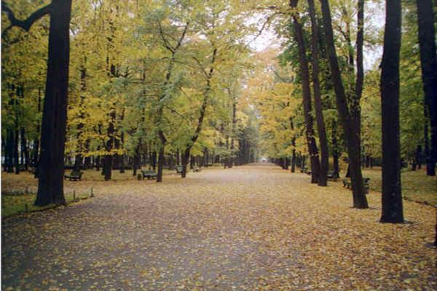
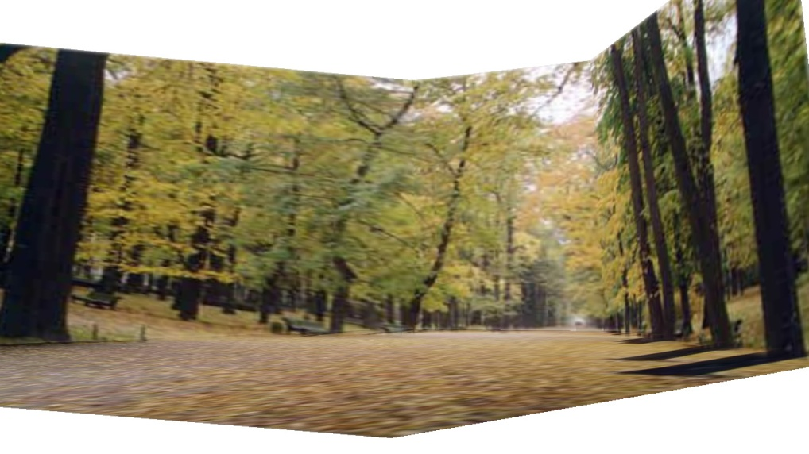
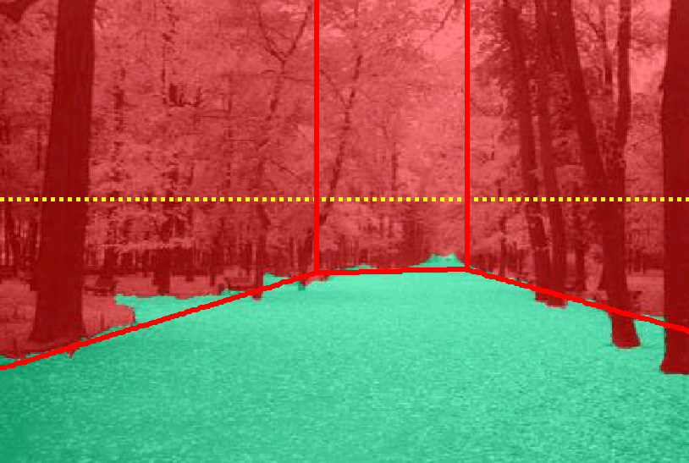
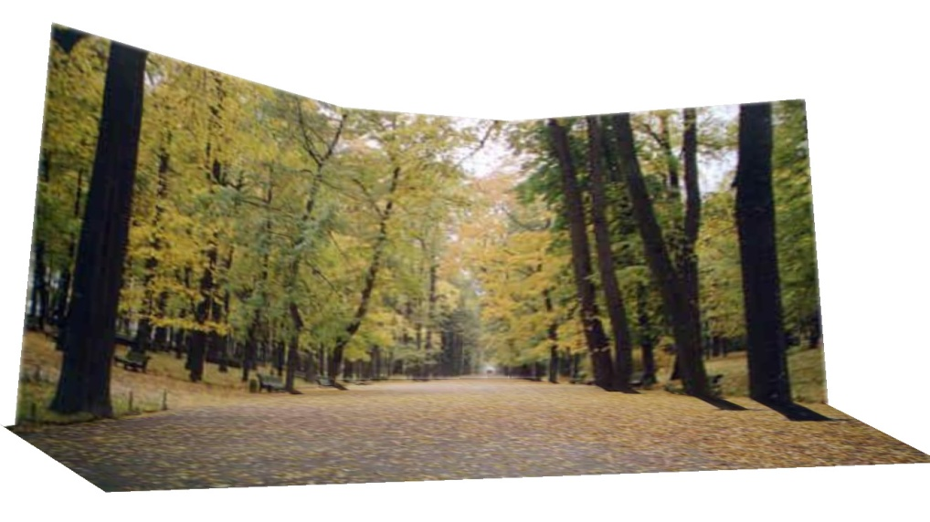
Results
http://www.cs.illinois.edu/homes/dhoiem/projects/popup/
Input Image
Cut and Fold
Automatic Photo Pop-up

Slide 45
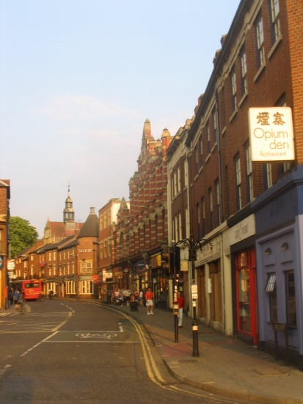
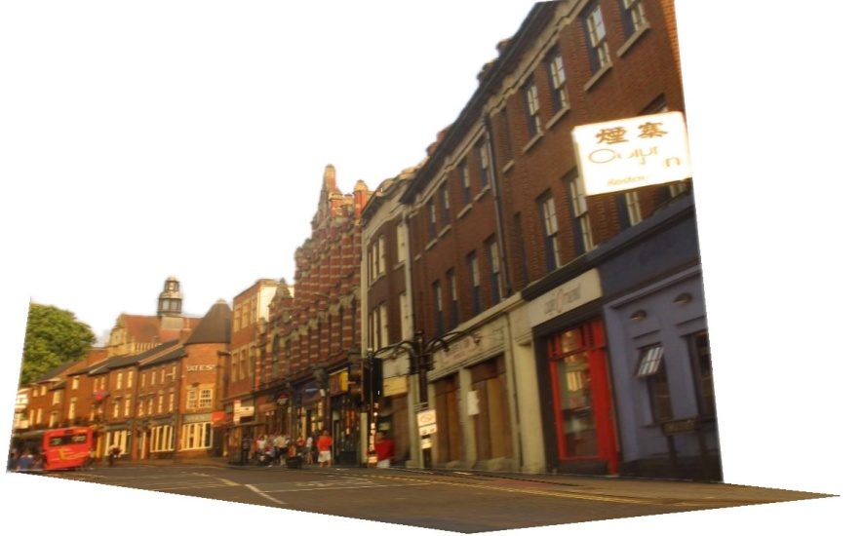
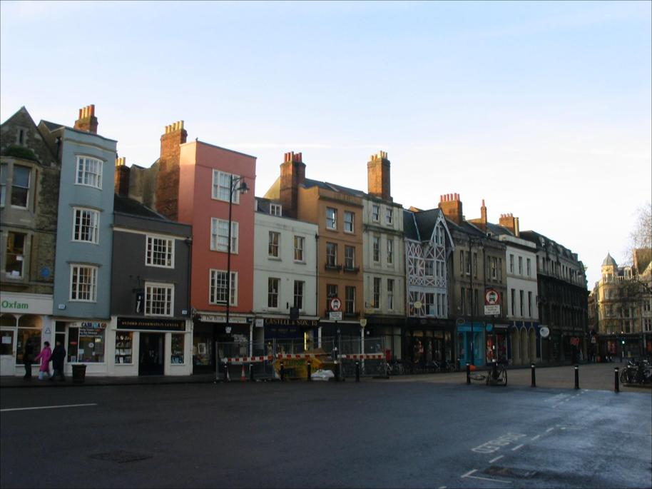

Results
Input Image
Automatic Photo Pop-up

Slide 46


Comparison with Manual Method
[Liebowitz et al. 1999]
Input Image
Automatic Photo Pop-up (15 sec)!
Notes:
From the results of Liebowitz et al. As you can see, their model is slightly better in that the roof is slanted, but our method is fully automatic requiring none of the user’s time, while their method requires extensive manual labeling.

Slide 47



Failures
Labeling Errors

Slide 48




Failures
Foreground Objects

Slide 49

Adding Foreground Labels
Recovered Surface Labels +
Ground-Vertical Boundary Fit
Object Boundaries + Horizon

Slide 50

Notes:
Explain holes

Slide 51

Fitting boxes to indoor scenes
Wall
Sofa
Table
Floor

Slide 52




Box Layout Algorithm
Hedau et al. 2010
Detect edges
Estimate 3 orthogonal vanishing points
Apply region classifier to label pixels with visible surfaces
Boosted decision trees on region based on color, texture, edges, position
Generate box candidates by sampling pairs of rays from VPs
Score each box based on edges and pixel labels
Learn score via structured learning
Jointly refine box layout and pixel labels to get final estimate
+

Slide 53






Experimental results
Detected Edges
Surface Labels
Box Layout
Detected Edges
Surface Labels
Box Layout

Slide 54






Experimental results
Detected Edges
Surface Labels
Box Layout
Detected Edges
Surface Labels
Box Layout

Slide 55



Complete 3D from RGBD
Guo Hoiem, to be submitted

Slide 56













Complete 3D from RGBD
RGB-D Input
Layout Proposals
Composing
Object Proposals
Exemplar Region Retrieval
3D Model Fitting
Annotated Scene
...
Retrieved Region
Source 3D Model
Transferred Model
Retrieved Region
Source 3D Model
Transferred Model
Notes:
3D Layout: Detection. 3D Object: transfer. Composition: integer programming

Slide 57


Complete 3D from RGBD

Slide 58
Final project ideas
If a one-person project:
Interactive program to make 3D model from an image (e.g., output in VRML, or draw path for animation)
If a two-person team, 2nd person:
Add tools for cutting out foreground objects and automatic hole-filling

Slide 59
Summary
2D→3D is mathematically impossible
(but we do it without even thinking)
Need right assumptions about the world geometry
Important tools
Vanishing points
Camera matrix
Homography

Slide 60
Next Week
Project 3 is due Monday
Next three classes: image-based lighting
How to model light
Recover HDR image from multiple LDR images
Recover lighting model from an image
Render object into a scene with correct lighting and geometry

