Slide 1
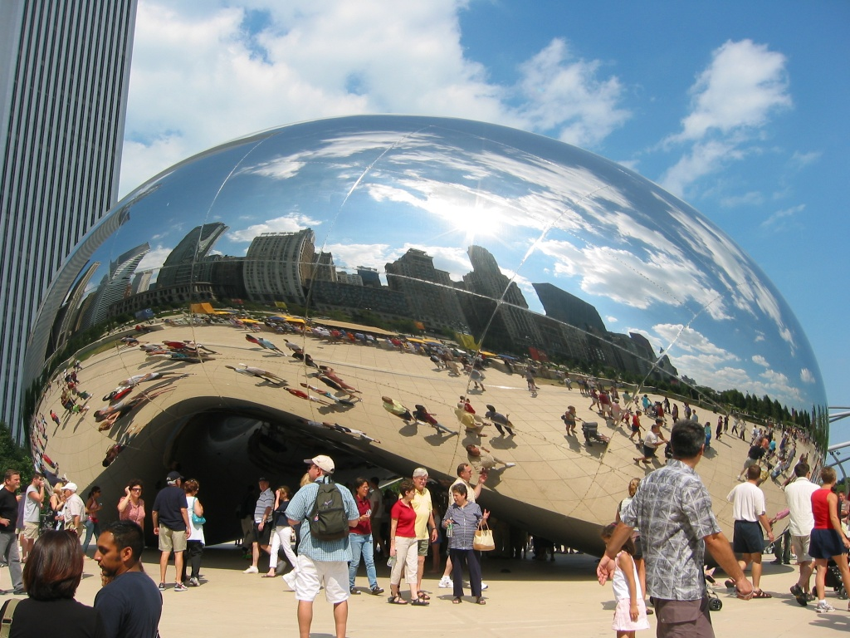
Image Warping
09/25/14
Computational Photography
Derek Hoiem, University of Illinois
Many slides from Alyosha Efros + Steve Seitz
Photo by Sean Carroll
Notes:
Show applications (alignment for hybrid image, face morphing, photo stitching) and example of transformation

Slide 2
Reminder: Proj 2 due monday
Much more difficult than project 1 – get started asap if not already (could take >10 hours)
Must compute SSD cost for every pixel (slow but not horribly slow using filtering method; see tips at end of project page)
Learn how to debug visual algorithms: imshow, plot, dbstop if error, keyboard and break points are your friends
Suggestion: For “quilt_simple”, first set upper-left patch to be upper-left patch in source and iteratively find minimum cost patch and overlay --- should reproduce original source image, at least for part of the output
Remember office hours: Amin on Thurs, Derek on Mon

Slide 3
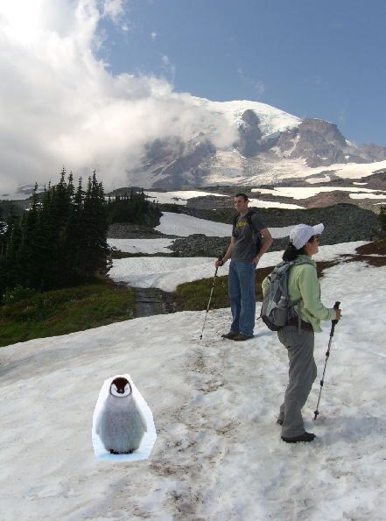
Resuming from last class… Poisson Blending
A good blend should preserve gradients of source region without changing the background
Perez et al. 2003

Slide 4
Method 3: Poisson Blending
A good blend should preserve gradients of source region without changing the background
Treat pixels as variables to be solved
Minimize squared difference between gradients of foreground region and gradients of target region
Keep background pixels constant
Perez et al. 2003
Notes:
Draw on board

Slide 5
Examples
2. Gradient domain processing
source image
background image
target image
1
5
9
13
1
5
9
13
1
5
9
13
20 | 20 | 20 | 20
20 | 80 | 20 | 20
20 | 20 | 80 | 20
20 | 20 | 20 | 20
10 | 10 | 10 | 10
10 | 10 | 10 | 10
10 | 10 | 10 | 10
10 | 10 | 10 | 10
10 | 10 | 10 | 10
10 | v₁ | v₃ | 10
10 | v₂ | v₄ | 10
10 | 10 | 10 | 10
2
6
10
14
2
6
10
14
2
6
10
14
3
7
11
15
3
7
11
15
3
7
11
15
4
8
12
16
4
8
12
16
4
8
12
16

Slide 6
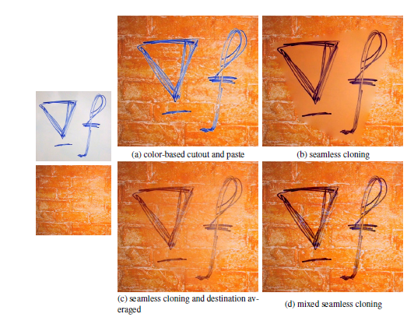
Blending with Mixed Gradients
Use foreground or background gradient with larger magnitude as the guiding gradient
Perez et al. 2003

Slide 7
Gradient-domain editing
Many image processing applications can be thought of as trying to manipulate gradients or intensities:
Contrast enhancement
Denoising
Poisson blending
HDR to RGB
Color to Gray
Recoloring
Texture transfer
See Perez et al. 2003 and GradientShop for many examples

Slide 8
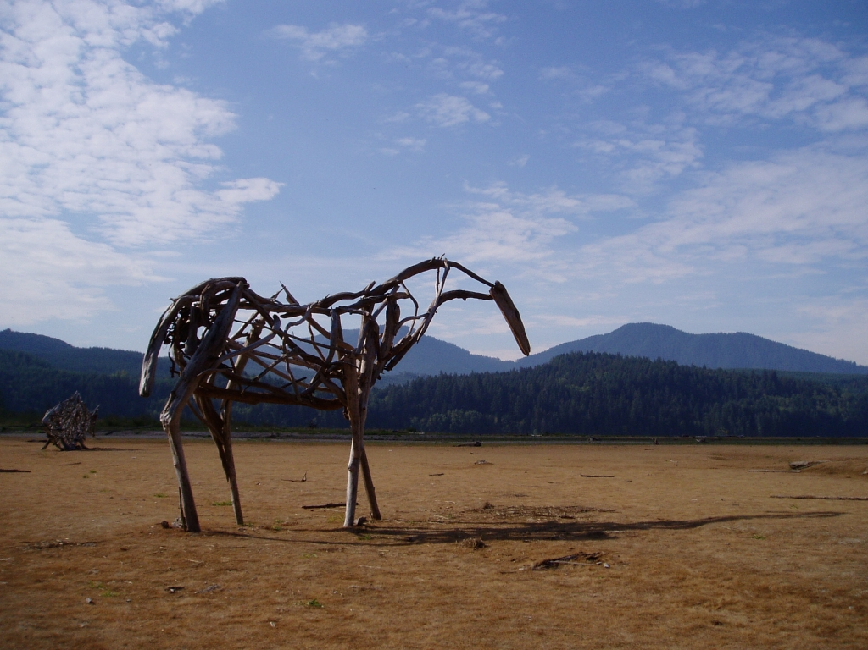
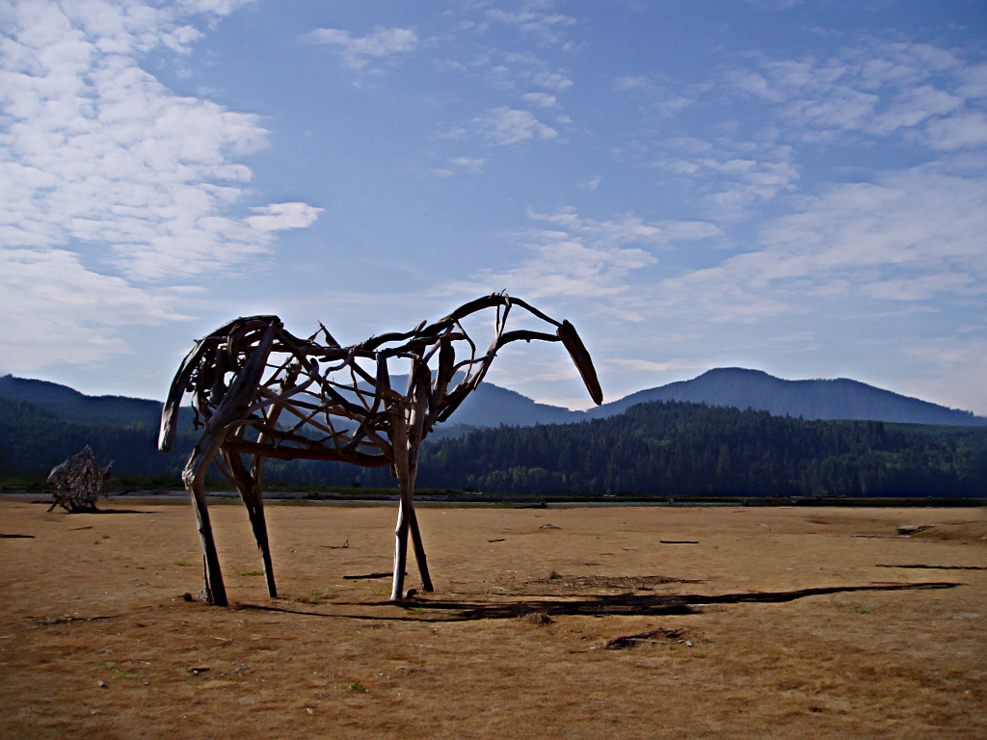
Gradient-domain processing
Saliency-based Sharpening
http://www.gradientshop.com

Slide 9


Gradient-domain processing
Non-photorealistic rendering
http://www.gradientshop.com

Slide 10
Project 3: Gradient Domain Editing
General concept: Solve for pixels of new image that satisfy constraints on the gradient and the intensity
Constraints can be from one image (for filtering) or more (for blending)

Slide 11

Project 3: Reconstruction from Gradients
Preserve x-y gradients
Preserve intensity of one pixel
Source pixels: s
Variable pixels: v
minimize (v(x+1,y)-v(x,y) - (s(x+1,y)-s(x,y))^2
minimize (v(x,y+1)-v(x,y) - (s(x,y+1)-s(x,y))^2
minimize (v(1,1)-s(1,1))^2

Slide 12
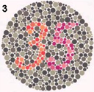
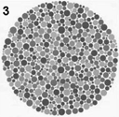
Project 3 (extra): Color2Gray
rgb2gray
Gradient-domain editing
?

Slide 13
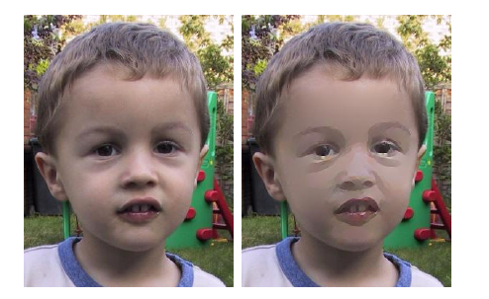
Project 3 (extra): NPR
Preserve gradients on edges
e.g., get canny edges with edge(im, ‘canny’)
Reduce gradients not on edges
Preserve original intensity
Perez et al. 2003

Slide 14
Summary of last class
Three ways to blend/composite
Alpha compositing
Need nice cut (intelligent scissors)
Should feather
Laplacian pyramid blending
Smooth blending at low frequencies, sharp at high frequencies
Usually used for stitching
Gradient domain editing
Also called Poisson Editing
Explicit control over what to preserve
Changes foreground color (for better or worse)
Applicable for many things besides blending

Slide 15



Take-home questions
9/23/2014
1) I am trying to blend this bear into this pool. What problems will I have if I use:
Alpha compositing with feathering
Laplacian pyramid blending
Poisson editing?
Lap. Pyramid
Poisson Editing

Slide 16
Take-home questions
9/23/2014
2) How would you make a sharpening filter using gradient domain processing? What are the constraints on the gradients and the intensities?

Slide 17
Next two classes
Today
Global coordinate transformations
Image alignment
Tuesday
Interpolation and texture mapping
Meshes and triangulation
Shape morphing

Slide 18
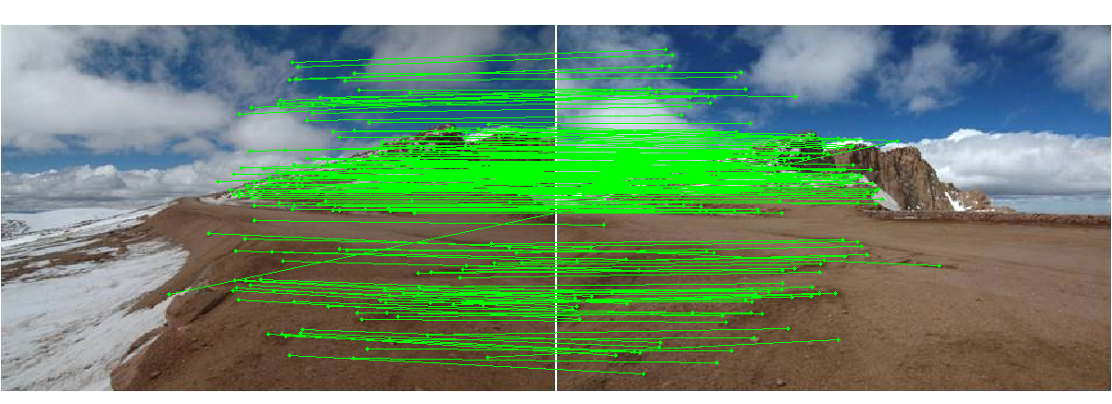
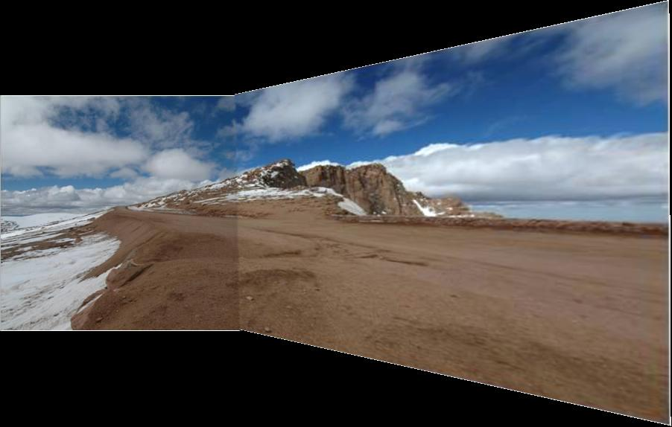
Photo stitching: projective alignment
Find corresponding points in two images
Solve for transformation that aligns the images

Slide 19
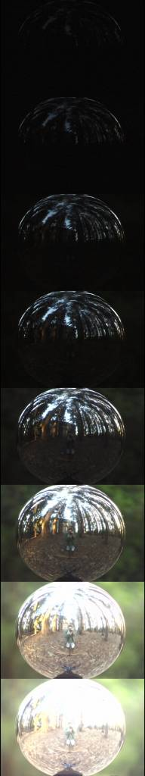
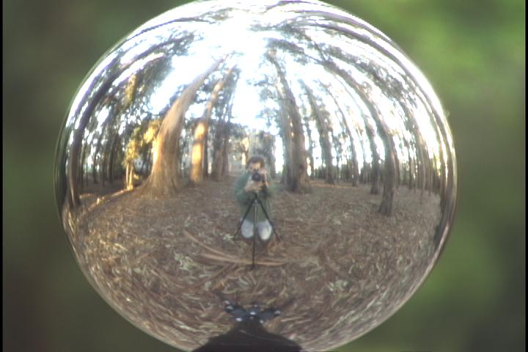
Capturing light fields
Estimate light via projection from spherical surface onto image

Slide 20
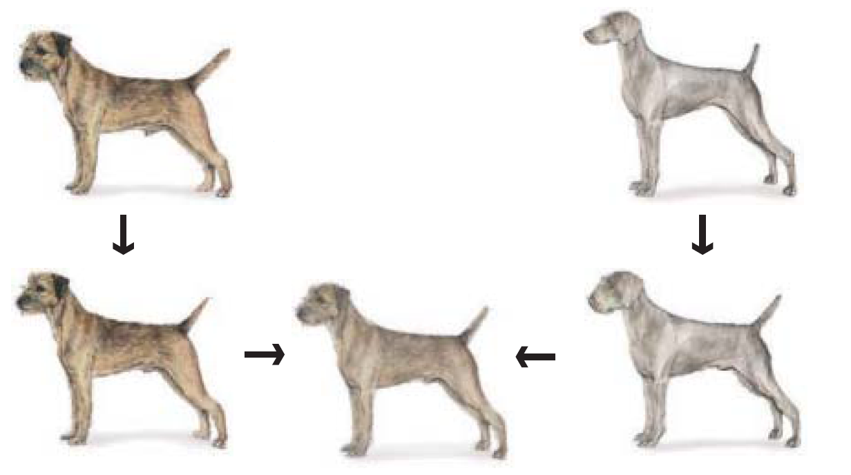
Morphing
Blend from one object to other with a series of local transformations

Slide 21
Image Transformations
image filtering: change range of image
g(x) = T(f(x))
f
f
T
x
x
image warping: change domain of image
g(x) = f(T(x))
f
f
T
x
x

Slide 22
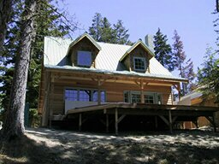
Image Transformations
image filtering: change range of image
g(x) = T(f(x))
f
g
T
image warping: change domain of image
g(x) = f(T(x))
f
g
T

Slide 23
Parametric (global) warping
T
p = (x,y)
p’ = (x’,y’)
Transformation T is a coordinate-changing machine:
p’ = T(p)
What does it mean that T is global?
Is the same for any point p
can be described by just a few numbers (parameters)
For linear transformations, we can represent T as a matrix
p’ = Mp

Slide 24
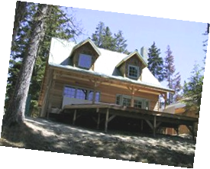
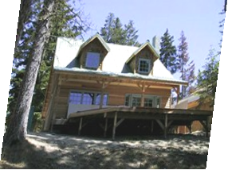
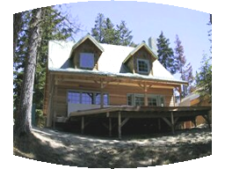
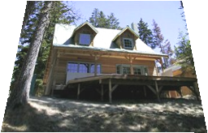
Parametric (global) warping
Examples of parametric warps:
translation
rotation
aspect
perspective
affine
cylindrical

Slide 25
Scaling
Scaling a coordinate means multiplying each of its components by a scalar
Uniform scaling means this scalar is the same for all components:
× 2

Slide 26
Scaling
Non-uniform scaling: different scalars per component:
X × 2, Y × 0.5

Slide 27
Scaling
Scaling operation:
Or, in matrix form:
scaling matrix S
What is the transformation from (x’, y’) to (x, y)?

Slide 28
2-D Rotation
(x’, y’)
(x, y)
x’ = x cos(θ) - y sin(θ)
y’ = x sin(θ) + y cos(θ)
θ

Slide 29
2-D Rotation
Polar coordinates…
x = r cos (φ)
y = r sin (φ)
x’ = r cos (φ + θ)
y’ = r sin (φ + θ)
Trig Identity…
x’ = r cos(φ) cos(θ) – r sin(φ) sin(θ)
y’ = r sin(φ) cos(θ) + r cos(φ) sin(θ)
Substitute…
x’ = x cos(θ) - y sin(θ)
y’ = x sin(θ) + y cos(θ)
(x’, y’)
(x, y)
θ
φ

Slide 30
2-D Rotation
This is easy to capture in matrix form:
Even though sin(θ) and cos(θ) are nonlinear functions of θ,
x’ is a linear combination of x and y
y’ is a linear combination of x and y
What is the inverse transformation?
Rotation by –θ
For rotation matrices
R

Slide 31
2x2 Matrices
What types of transformations can be represented with a 2x2 matrix?
2D Identity?
2D Scale around (0,0)?

Slide 32
2x2 Matrices
What types of transformations can be represented with a 2x2 matrix?
2D Rotate around (0,0)?
2D Shear?

Slide 33
2x2 Matrices
What types of transformations can be represented with a 2x2 matrix?
2D Mirror about Y axis?
2D Mirror over (0,0)?

Slide 34
2x2 Matrices
What types of transformations can be represented with a 2x2 matrix?
2D Translation?
NO!
Only linear 2D transformations
can be represented with a 2x2 matrix

Slide 35
All 2D Linear Transformations
Linear transformations are combinations of …
Scale,
Rotation,
Shear, and
Mirror
Properties of linear transformations:
Origin maps to origin
Lines map to lines
Parallel lines remain parallel
Ratios are preserved
Closed under composition

Slide 36
Homogeneous Coordinates
Q: How can we represent translation in matrix form?

Slide 37
Homogeneous Coordinates
Homogeneous coordinates
represent coordinates in 2 dimensions with a 3-vector

Slide 38
Homogeneous Coordinates
2D Points → Homogeneous Coordinates
Append 1 to every 2D point: (x y) → (x y 1)
Homogeneous coordinates → 2D Points
Divide by third coordinate (x y w) → (x/w y/w)
Special properties
Scale invariant: (x y w) = k * (x y w)
(x, y, 0) represents a point at infinity
(0, 0, 0) is not allowed
y
Scale Invariance
2
(2,1,1)
or (4,2,2)
or (6,3,3)
1
1
2
x

Slide 39
Homogeneous Coordinates
Q: How can we represent translation in matrix form?
A: Using the rightmost column:

Slide 40
Translation Example
Homogeneous Coordinates
t_{x} = 2 t_{y} = 1

Slide 41
Basic 2D transformations as 3x3 matrices
Translate
Scale
Rotate
Shear

Slide 42
Matrix Composition
Transformations can be combined by matrix multiplication
p’ = T(t_{x},t_{y}) R(Θ) S(s_{x},s_{y}) p
Does the order of multiplication matter?

Slide 43
Affine Transformations
Affine transformations are combinations of
Linear transformations, and
Translations
Properties of affine transformations:
Origin does not necessarily map to origin
Lines map to lines
Parallel lines remain parallel
Ratios are preserved
Closed under composition

Slide 44
Projective Transformations
Projective transformations are combos of
Affine transformations, and
Projective warps
Properties of projective transformations:
Origin does not necessarily map to origin
Lines map to lines
Parallel lines do not necessarily remain parallel
Ratios are not preserved
Closed under composition
Models change of basis
Projective matrix is defined up to a scale (8 DOF)

Slide 45
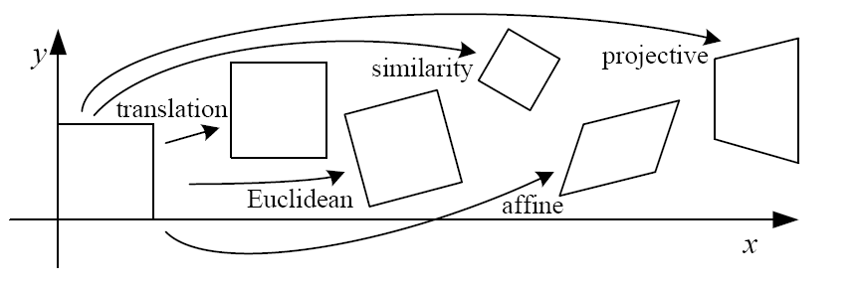
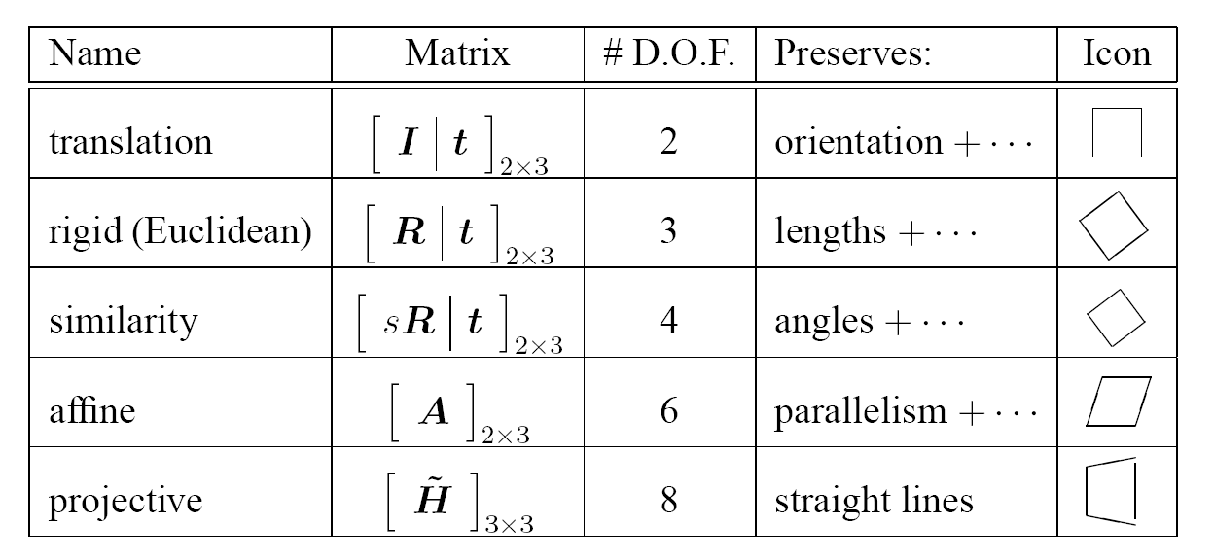
2D image transformations
These transformations are a nested set of groups
Closed under composition and inverse is a member

Slide 46
Recovering Transformations
?
T(x,y)
y
y’
x
x’
f(x,y)
g(x’,y’)
What if we know f and g and want to recover the transform T?
willing to let user provide correspondences
How many do we need?

Slide 47
Translation: # correspondences?
?
T(x,y)
y
y’
x
x’
How many Degrees of Freedom?
How many correspondences needed for translation?
What is the transformation matrix?

Slide 48
Euclidian: # correspondences?
?
T(x,y)
y
y’
x
x’
How many DOF?
How many correspondences needed for translation+rotation?

Slide 49
Affine: # correspondences?
?
T(x,y)
y
y’
x
x’
How many DOF?
How many correspondences needed for affine?

Slide 50
Affine transformation estimation
Math
Matlab demo

Slide 51
Projective: # correspondences?
?
T(x,y)
y
y’
x
x’
How many DOF?
How many correspondences needed for projective?

Slide 52

Take-home Question
9/25/14
1) Suppose we have two triangles: ABC and A’B’C’. What transformation will map A to A’, B to B’, and C to C’? How can we get the parameters?
B
B’
?
T(x,y)
C’
A
C
A’
Source
Destination

Slide 53
Take-home Question
9/25/2014
2) Show that distance ratios along a line are preserved under 2d linear transformations.
o
(x3,y3)
o
(x’3,y’3)
o
o
(x2,y2)
o
p1=(x1,y1)
o
(x’2,y’2)
p‘1=(x’1,y’1)
Hint: Write down x2 in terms of x1 and x3, given that the three points are co-linear

Slide 54
Next class: texture mapping and morphing

