Slide 1
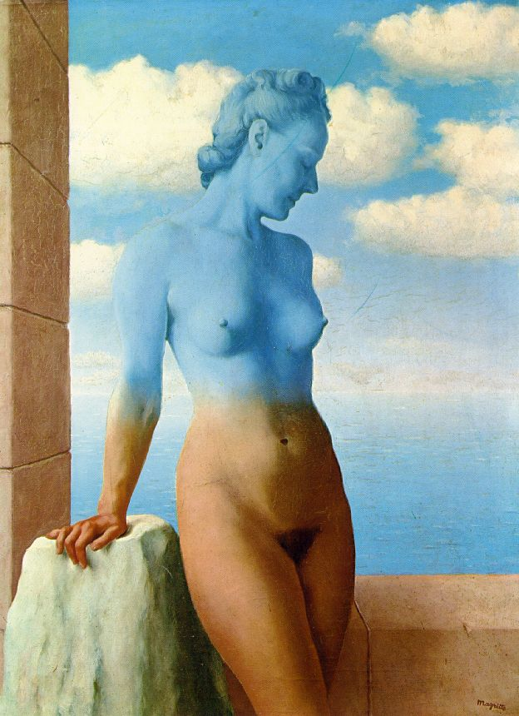
Blending and Compositing
09/23/14
Computational Photography
Derek Hoiem, University of Illinois

Slide 2
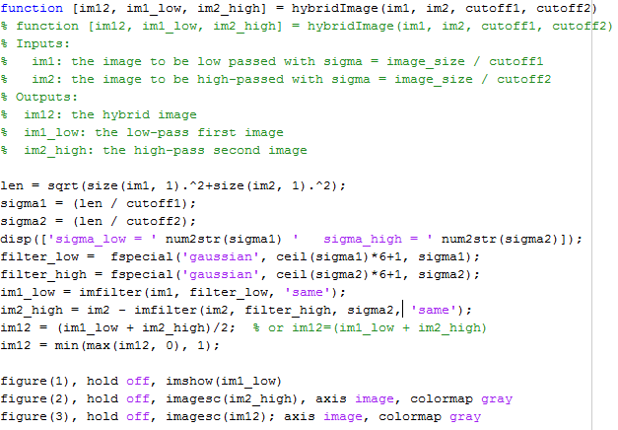
hybridImage.m

Slide 3
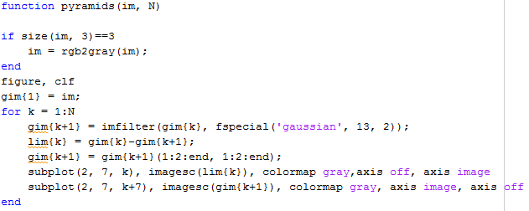
pyramids.m

Slide 4
Project 1: issues
Basic tips
  Display/save Laplacian images using mat2gray or imagesc
  Downsampling: use sigma ~= 2 for factor of 2
Emailing projects: code only (no images)

Slide 5
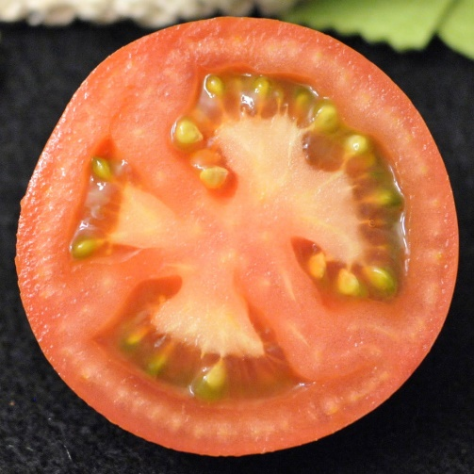
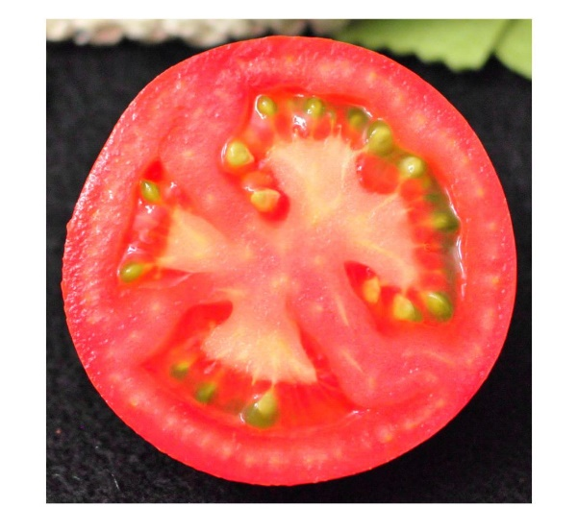
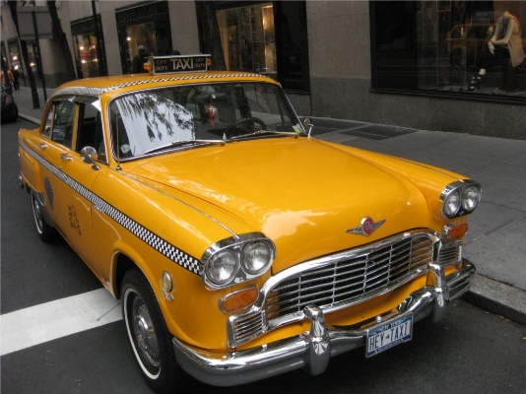
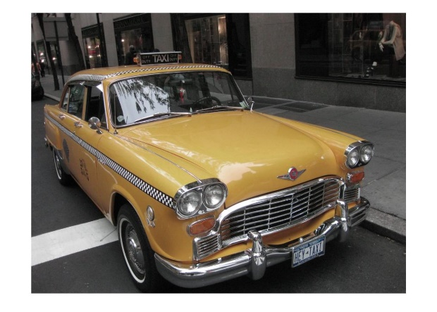
Color shift
Result from Sam Ricker
More red (increase a channel)
L*a*b* space
Less yellow (decrease positive b channel values)

Slide 6
Project 1 Results
Incomplete list of great project pages
  Donald Cha: http://web.engr.illinois.edu/~ddcha3/cs498dwh/proj1/
  Sam Ricker: http://web.engr.illinois.edu/~sricker2/cs498dwh/proj1/
  David Turner: http://web.engr.illinois.edu/~dkturne2/cs498dwh/proj1/
  Elizabeth Weeks: http://web.engr.illinois.edu/~eweeks2/cs498dwh/proj1/
  Jeremy Goodsitt: http://web.engr.illinois.edu/~goodsit2/cs498dwh/proj1/

Slide 7
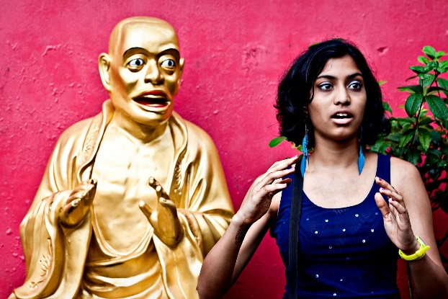
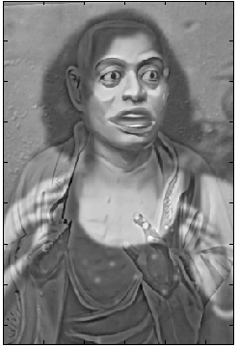
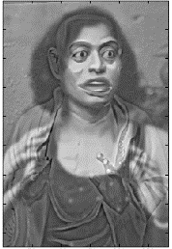
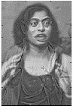
Hybrid results
Pooja Bag

Slide 8
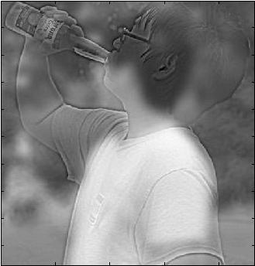

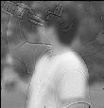
Donald Cha

Slide 9
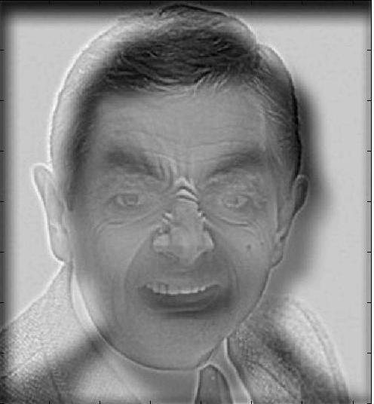


Hao Gao

Slide 10
Last class: finding boundaries
Intelligent scissors
  Good boundary has a low-cost path from seed to cursor
  Low cost = edge, high gradient, right orientation
GrabCut
  Good region is similar to foreground color model and dissimilar from background color
  Good boundaries have a high gradient
  Optimize over both

Slide 11
Take-home questions
1. What would be the result in “Intelligent Scissors” if all of the edge costs were set to 1?
2. Typically, “GrabCut” will not work well on objects with thin structures. How could you change the boundary costs to better segment such objects?

Slide 12
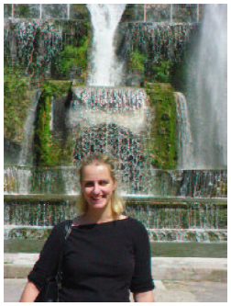
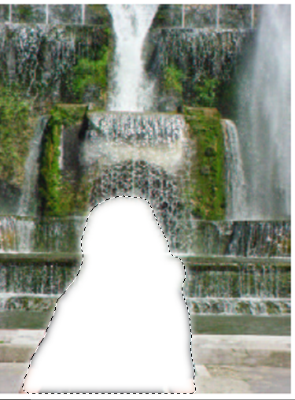
Last Class: cutting out objects

Slide 13
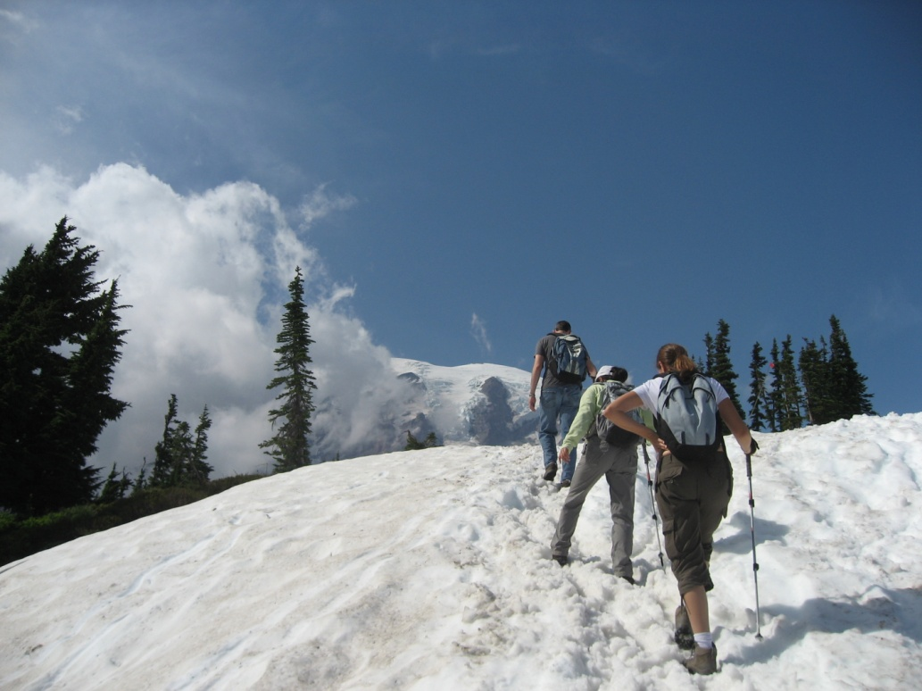
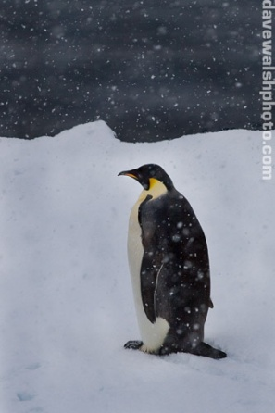
This Class
How do I put an object from one image into another?

Slide 14
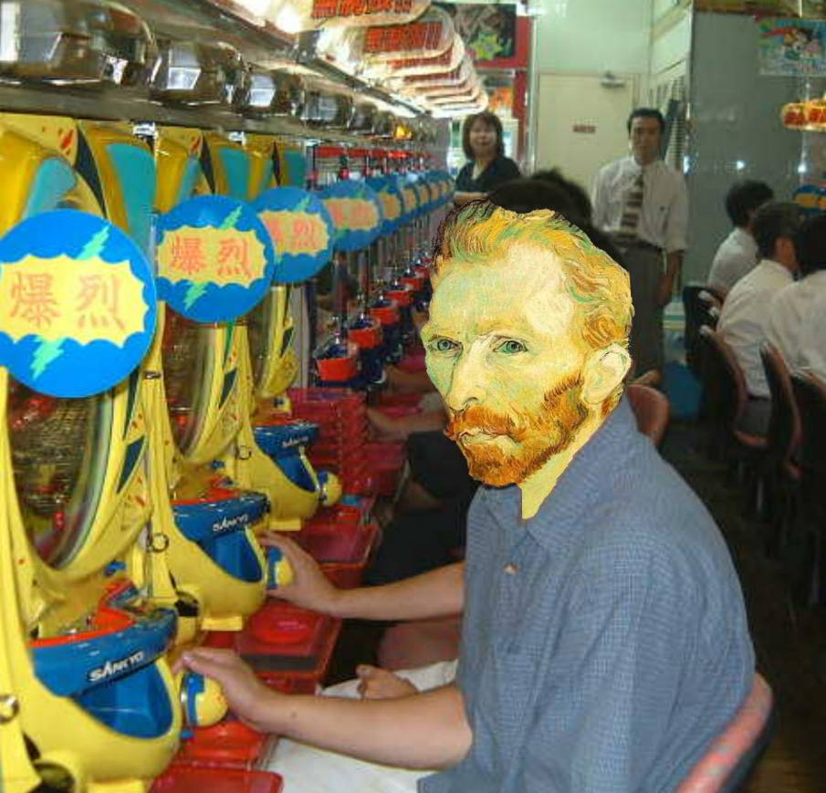
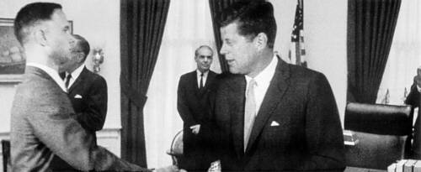
Image Compositing
Some slides from Efros/Seitz

Slide 15
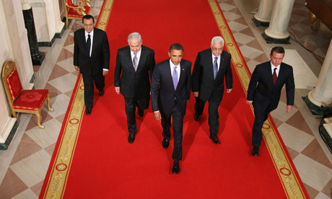
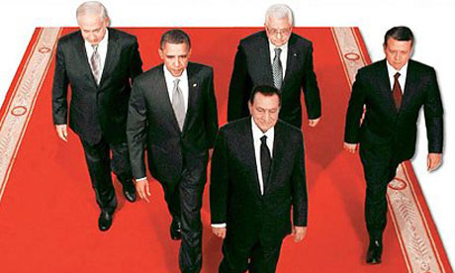
News Composites
http://www.guardian.co.uk/world/2010/sep/16/mubarak-doctored-red-carpet-picture
Original
“Enhanced” Version

Slide 16
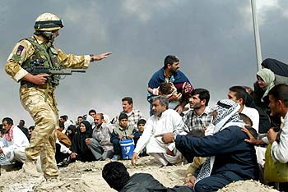
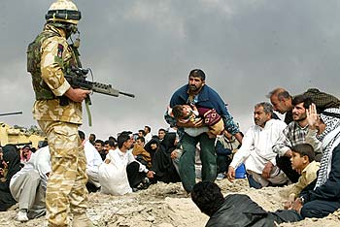
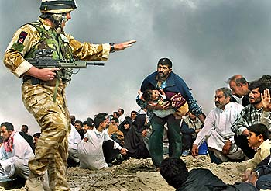
News Composites
Original
“Enhanced” Version
Walski, LA Times, 2003

Slide 17
Three methods
Cut and paste
Laplacian pyramid blending
Poisson blending

Slide 18
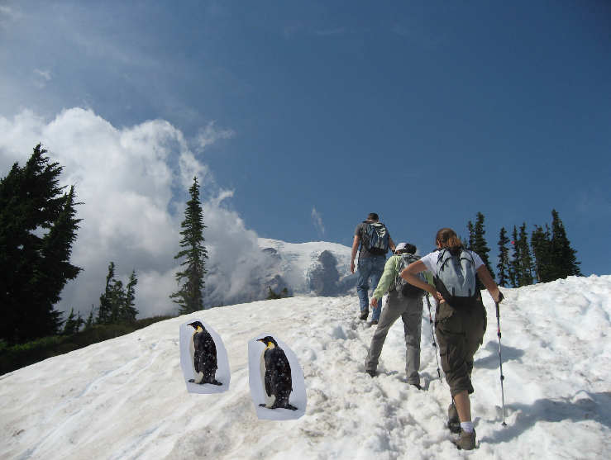
Method 1: Cut and Paste

Slide 19
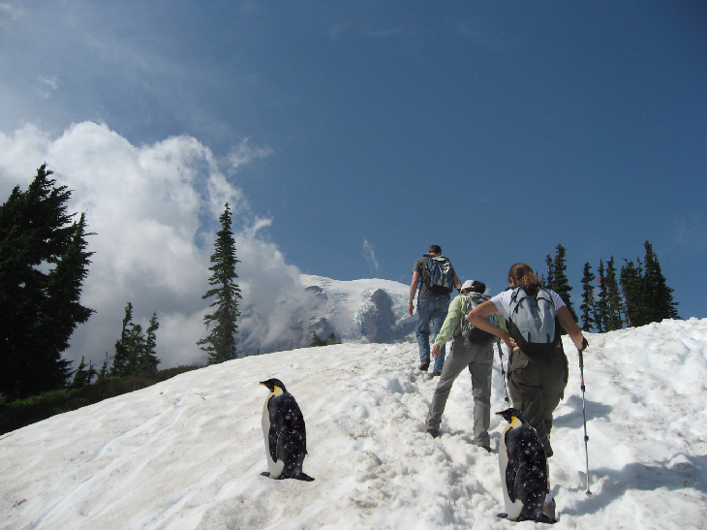
Method 1: Cut and Paste
Method:
Segment using intelligent scissors
Paste foreground pixels onto target region

Slide 20
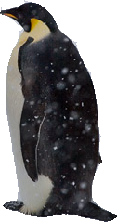
Method 1: Cut and Paste
Problems:
Small segmentation errors noticeable
Pixels are too blocky
Won’t work for semi-transparent materials

Slide 21
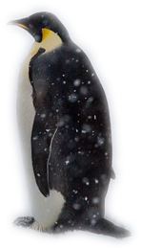
Feathering
Near object boundary pixel values come partly from foreground and partly from background

Slide 22
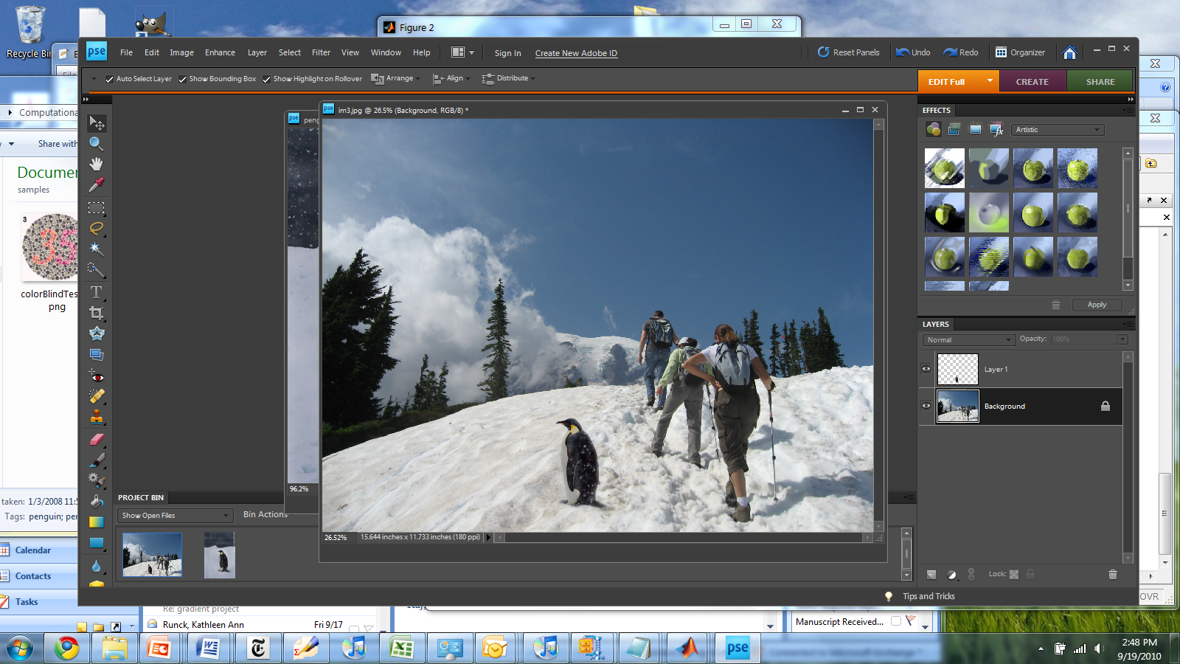
Method 1: Cut and Paste (with feathering)

Slide 23
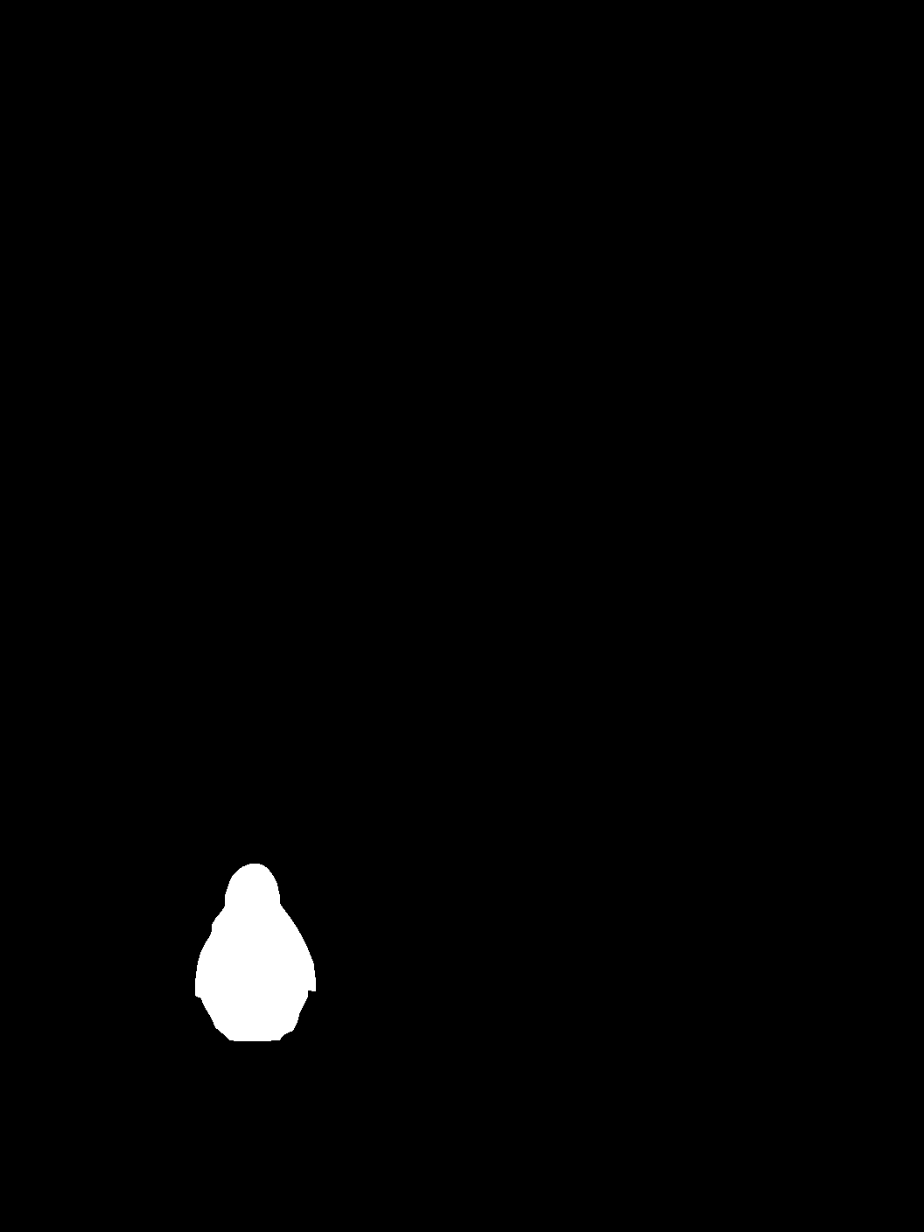
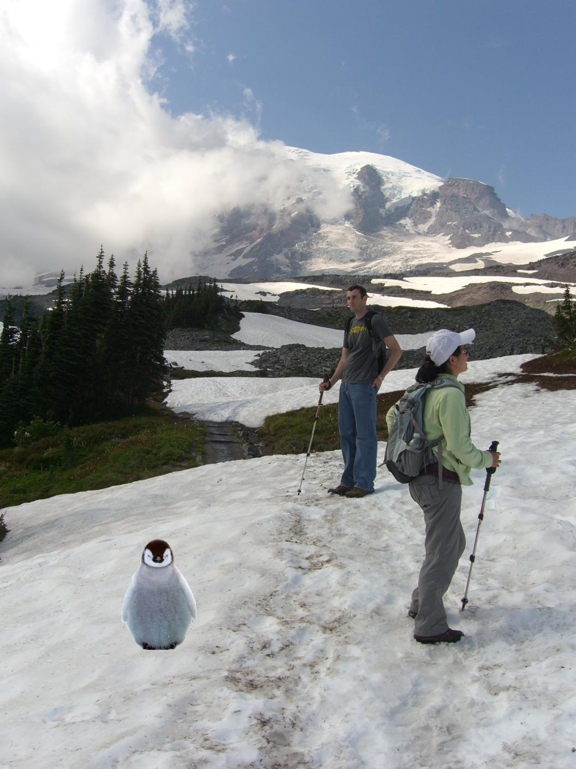
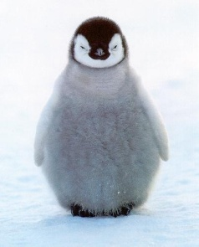
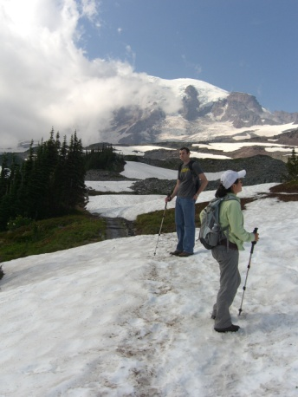
Alpha compositing
+
Output = foreground*mask + background*(1-mask)

Slide 24


Alpha compositing with feathering
Output = foreground*mask + background*(1-mask)

Slide 25
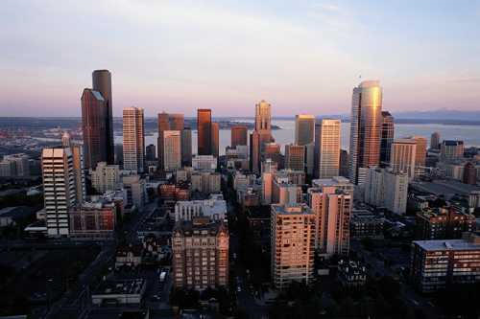

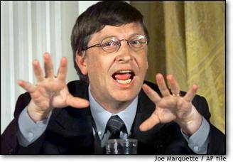

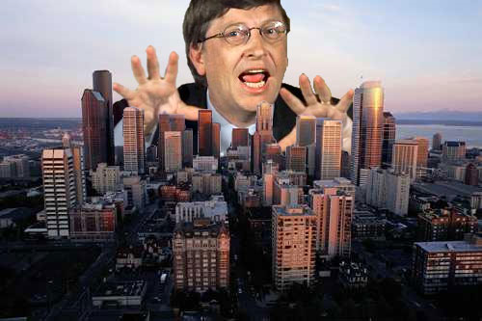
Another example (without feathering)
Mattes
Composite
Composite by
David Dewey

Slide 26
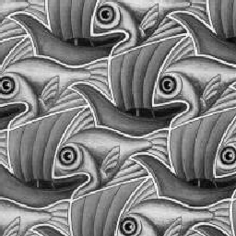
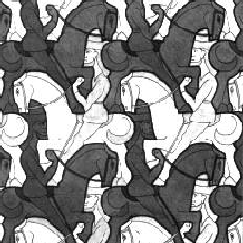
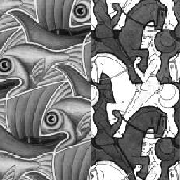
Proper blending is key

Slide 27
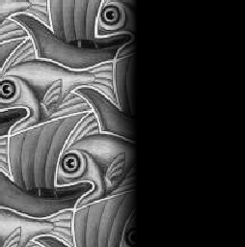
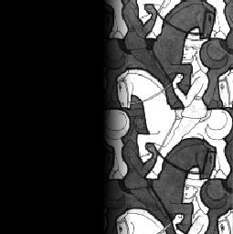

Alpha Blending / Feathering
+
1
1
0
0
I_{blend} = αI_{left} + (1-α)I_{right}
=

Slide 28
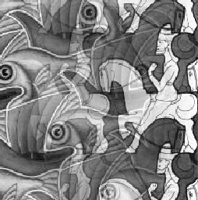
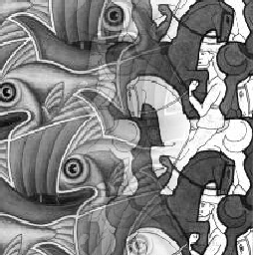
Affect of Window Size
1
left
1
right
0
0

Slide 29


Affect of Window Size
1
1
0
0

Slide 30

Good Window Size
1
0
“Optimal” Window: smooth but not ghosted

Slide 31
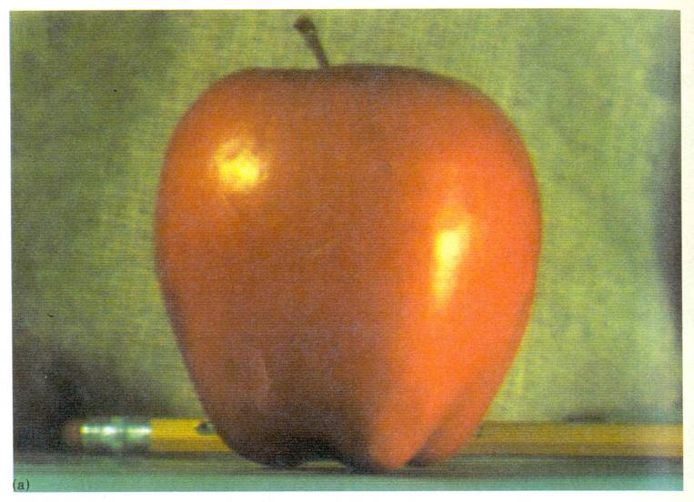
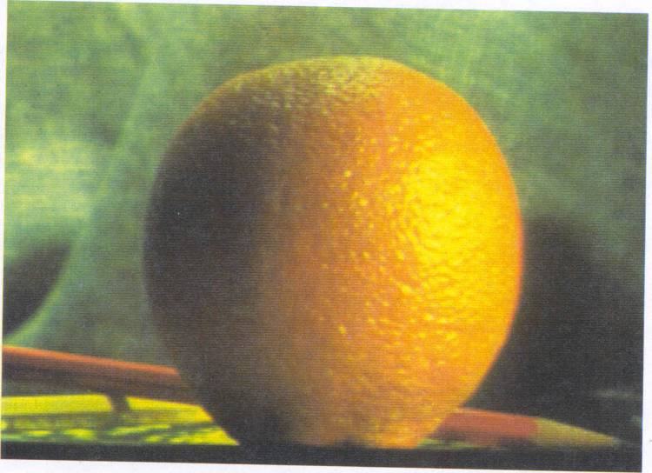
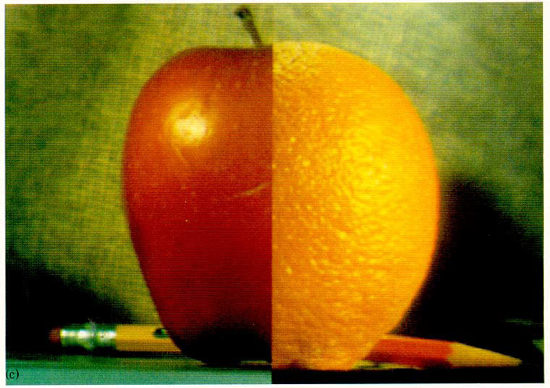
How much should we blend?

Slide 32
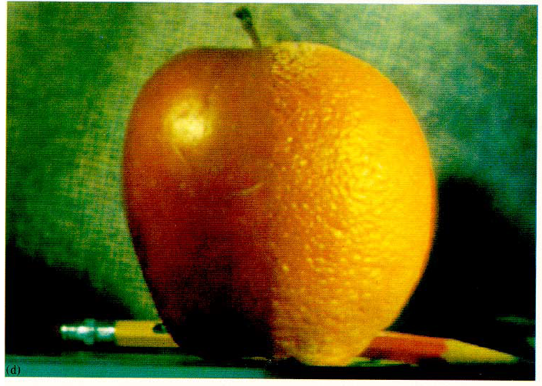
Method 2: Pyramid Blending

Slide 33
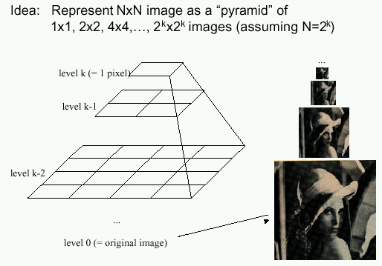
Method 2: Pyramid Blending
At low frequencies, blend slowly
At high frequencies, blend quickly
1
0
1
0
1
0
Left pyramid
blend
Right pyramid

Slide 34
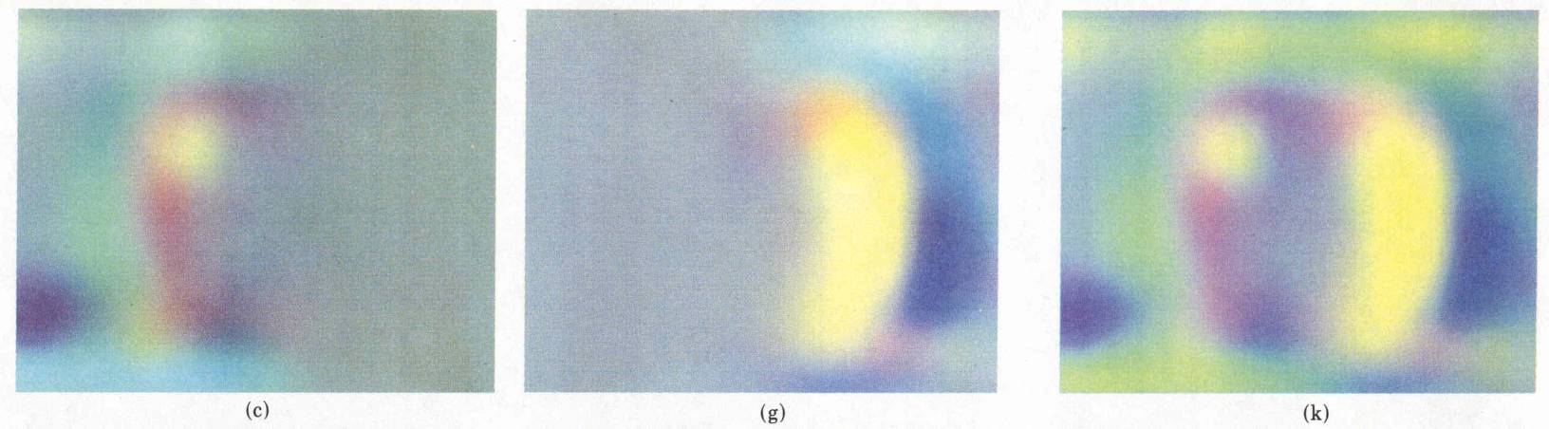


laplacian
level
4
laplacian
level
2
laplacian
level
0
left pyramid
right pyramid
blended pyramid

Slide 35

Method 2: Pyramid Blending
Burt and Adelson 1983

Slide 36
Laplacian Pyramid Blending
Implementation:
Build Laplacian pyramids for each image
Build a Gaussian pyramid of region mask
Blend each level of pyramid using region mask from the same level
Collapse the pyramid to get the final blended image
Image 1 at level i of Laplacian pyramid
Region mask at level i of Gaussian pyramid
Pointwise multiply
Burt and Adelson 1983

Slide 37


Simplification: Two-band Blending
Brown & Lowe, 2003
  Only use two bands: high freq. and low freq.
  Blends low freq. smoothly
  Blend high freq. with no smoothing: use binary alpha

Slide 38


2-band Blending
Low frequency
High frequency

Slide 39

Linear Blending

Slide 40

2-band Blending

Slide 41

Blending Regions

Slide 42

© Chris Cameron

Slide 43

Related idea: Poisson Blending
A good blend should preserve gradients of source region without changing the background
Perez et al. 2003

Slide 44
Related idea: Poisson Blending
A good blend should preserve gradients of source region without changing the background
Project 3!
Perez et al. 2003

Slide 45
Method 3: Poisson Blending
A good blend should preserve gradients of source region without changing the background
Treat pixels as variables to be solved
  Minimize squared difference between gradients of foreground region and gradients of target region
  Keep background pixels constant
Perez et al. 2003
Notes:
Draw on board

Slide 46


Example
Gradient Visualization
Source: Evan Wallace

Slide 47



+
Specify object region
Source: Evan Wallace

Slide 48

Gradient-domain editing
Creation of image = least squares problem in terms of: 1) pixel intensities; 2) differences of pixel intensities
Use Matlab least-squares solvers for numerically stable solution with sparse A
Least Squares Line Fit in 2 Dimensions

Slide 49
Examples
Line-fitting: y=mx+b

Slide 50
Examples
2. Gradient domain processing
source image
background image
target image
1
5
9
13
1
5
9
13
1
5
9
13
20 | 20 | 20 | 20
20 | 80 | 20 | 20
20 | 20 | 80 | 20
20 | 20 | 20 | 20
10 | 10 | 10 | 10
10 | 10 | 10 | 10
10 | 10 | 10 | 10
10 | 10 | 10 | 10
10 | 10 | 10 | 10
10 | v₁ | v₃ | 10
10 | v₂ | v₄ | 10
10 | 10 | 10 | 10
2
6
10
14
2
6
10
14
2
6
10
14
3
7
11
15
3
7
11
15
3
7
11
15
4
8
12
16
4
8
12
16
4
8
12
16

Slide 51


Other results
Perez et al. 2003

Slide 52
What do we lose?
Foreground color changes
Background pixels in target region are replaced
Perez et al. 2003
Notes:
Background pixels completely replaced, color of foreground changed

Slide 53

Blending with Mixed Gradients
Use foreground or background gradient with larger magnitude as the guiding gradient
Perez et al. 2003

Slide 54
Project 3: Gradient Domain Editing
General concept: Solve for pixels of new image that satisfy constraints on the gradient and the intensity
  Constraints can be from one image (for filtering) or more (for blending)

Slide 55

Project 3: Reconstruction from Gradients
Preserve x-y gradients
Preserve intensity of one pixel
Source pixels: s
Variable pixels: v
minimize (v(x+1,y)-v(x,y) - (s(x+1,y)-s(x,y))^2
minimize (v(x,y+1)-v(x,y) - (s(x,y+1)-s(x,y))^2
minimize (v(1,1)-s(1,1))^2

Slide 56


Project 3 (extra): Color2Gray
rgb2gray
Gradient-domain editing
?

Slide 57

Project 3 (extra): NPR
Preserve gradients on edges
  e.g., get canny edges with edge(im, ‘canny’)
Reduce gradients not on edges
Preserve original intensity
Perez et al. 2003

Slide 58
Things to remember
Three ways to blend/composite
  Alpha compositing
    Need nice cut (intelligent scissors)
    Should feather
  Laplacian pyramid blending
    Smooth blending at low frequencies, sharp at high frequencies
    Usually used for stitching
  Gradient domain editing
    Also called Poisson Editing
    Explicit control over what to preserve
    Changes foreground color (for better or worse)
    Applicable for many things besides blending

Slide 59

Take-home questions
9/23/2014
1) I am trying to blend this bear into this pool. What problems will I have if I use:
  Alpha compositing with feathering
  Laplacian pyramid blending
  Poisson editing?

Slide 60
Take-home questions
9/23/2014
2) How would you make a sharpening filter using gradient domain processing? What are the constraints on the gradients and the intensities?

Slide 61
Next class
Image warping: affine, projective, rotation, etc.

