Slide 1
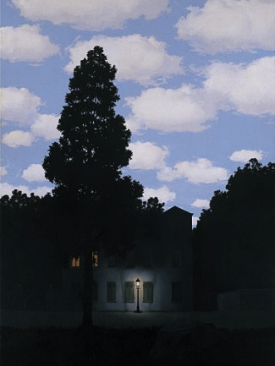
Light and Color
09/10/13
Computational Photography
Derek Hoiem, University of Illinois
“Empire of Light”, Magritte

Slide 2
Outline
Light and wavelengths
The eye
Physiology (rods and cones)
Receptivity, non-linear response
Trichromacity
The camera and display
Bayer filter revisited
RGB display
Physics of light and reflection
Direct light: spectrum of wavelengths
Reflection: influence of albedo, orientation, reflectivity, BRDF
Inter-reflection: light may be influenced by multiple surfaces
Illusions, ambiguity of albedo and illumination color, color constancy
Light sources and shadows
Color spaces
RGB, HSV, YCrCb, XYZ, Lab

Slide 3
Announcements
Project 1 due next Mon (9/15), 11:59pm
Choosing cutoff: sigma > 1
Remember to convert images to double
Don’t use built-in code for pyramids, contrast equalization etc., ask if not sure

Slide 4
Today’s class
How is incoming light measured by the eye or camera?
Incoming Light
Lens
Sensors/Retina

Slide 5
Today’s class
How is incoming light measured by the eye or camera?
How is light reflected from a surface?
Light source
Reflected Light
Incoming Light
Lens
Sensors/Retina
Notes:
Basis for vision, graphics
<number>

Slide 6
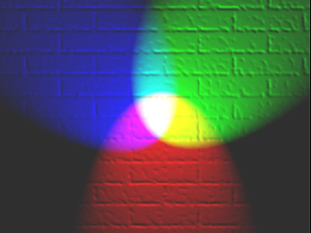
Today’s class
How is incoming light measured by the eye or camera?
How is light reflected from a surface?
How can we represent color?

Slide 7
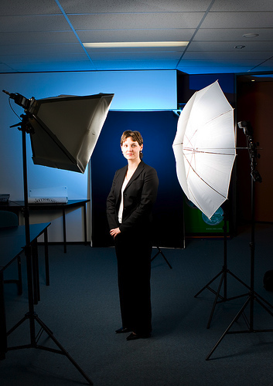
Photo by nickwheeleroz, Flickr
Slide: Forsyth

Slide 8
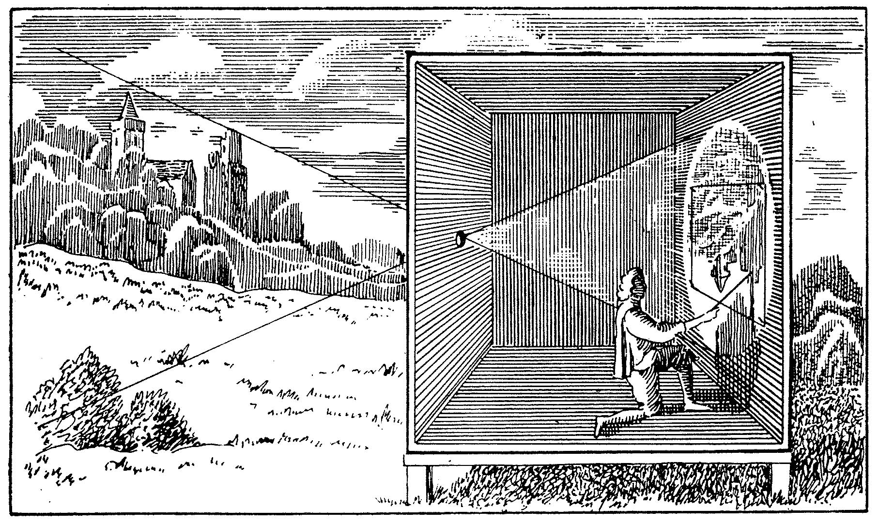
The Eye

Slide 9
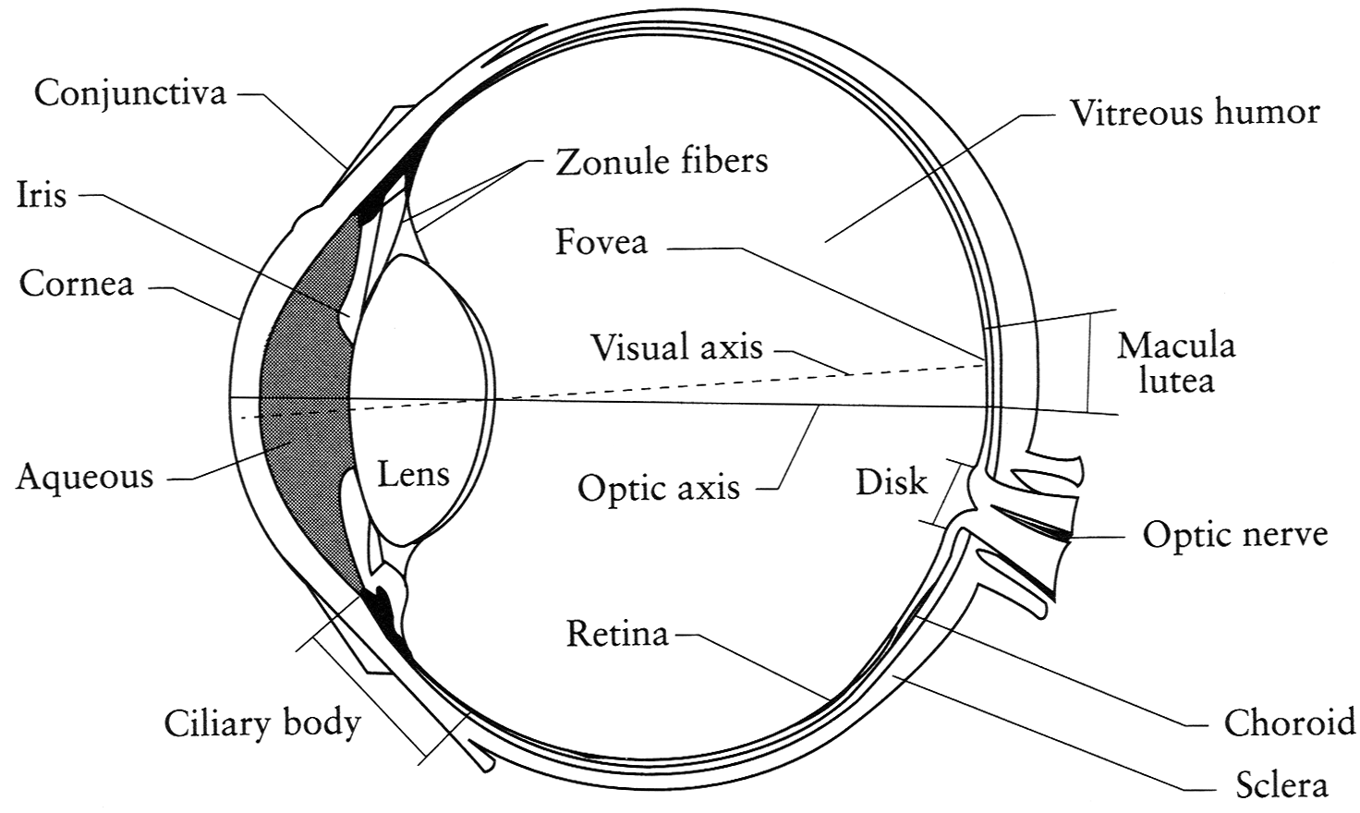
The Eye
The human eye is a camera!
Iris - colored annulus with radial muscles
Pupil - the hole (aperture) whose size is controlled by the iris
What’s the “film”?
photoreceptor cells (rods and cones) in the retina
Slide by Steve Seitz

Slide 10
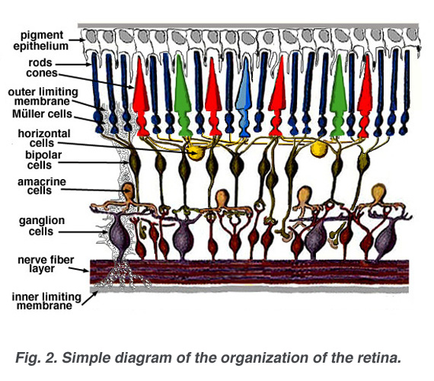
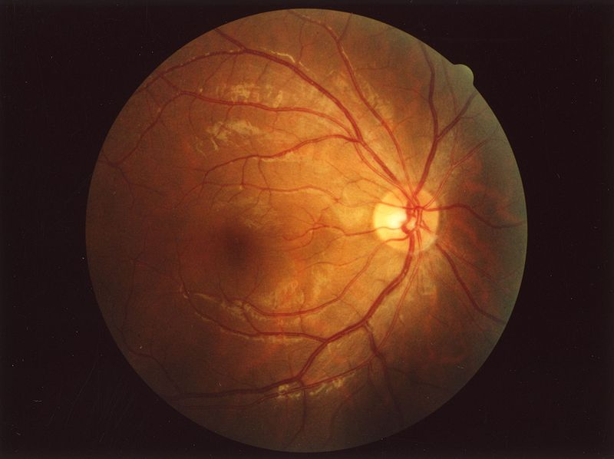
Retina up-close
Light
Notes:
Floaty things in your vision are white blood cells in capillaries. Some animals have two foveas (some birds) and some have none (cats and dogs). 100x sensors than nerve fibers: much processing (e.g., center surround) in retina itself
<number>

Slide 11
Two types of light-sensitive receptors
Cones
cone-shaped
less sensitive
operate in high light
color vision
Rods
rod-shaped
highly sensitive
operate at night
gray-scale vision
slower to respond
© Stephen E. Palmer, 2002
Slide Credit: Efros

Slide 12
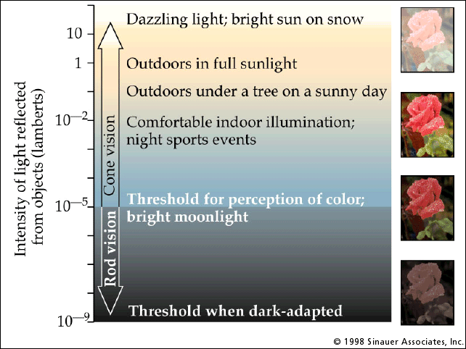
Rod / Cone sensitivity
Slide Credit: Efros
Notes:
Sock matching in dark is difficult
<number>

Slide 13
Distribution of Rods and Cones
Night Sky: why are there more stars off-center?
© Stephen E. Palmer, 2002
Slide Credit: Efros

Slide 14
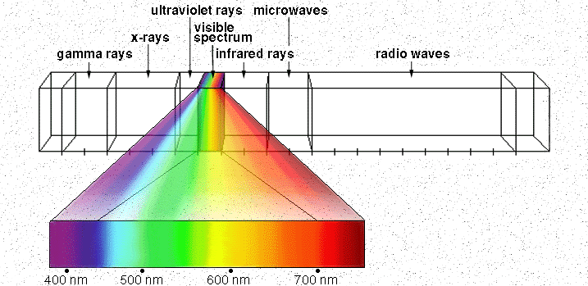
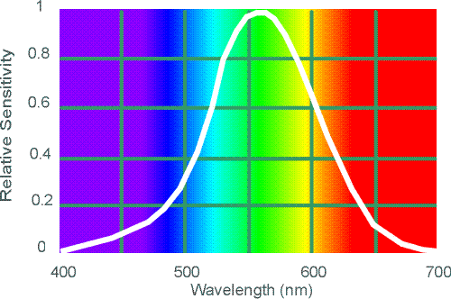
Electromagnetic Spectrum
Human Luminance Sensitivity Function
Slide Credit: Efros
http://www.yorku.ca/eye/photopik.htm
Notes:
<number>
At least 3 spectral bands required (e.g. R,G,B)

Slide 15
Visible Light
Why do we see light of these wavelengths?
…because that’s where the
Sun radiates EM energy
© Stephen E. Palmer, 2002

Slide 16
The Physics of Light
Any patch of light can be completely described
physically by its spectrum: the number of photons
(per time unit) at each wavelength 400 - 700 nm.
© Stephen E. Palmer, 2002

Slide 17
The Physics of Light
Some examples of the spectra of light sources
© Stephen E. Palmer, 2002

Slide 18
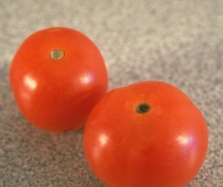
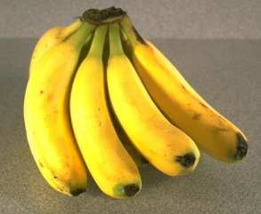
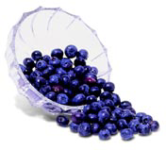
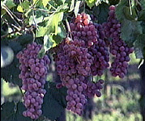
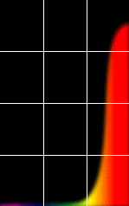
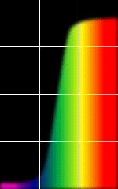
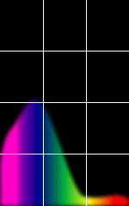
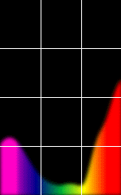
The Physics of Light
Some examples of the reflectance spectra of surfaces
Red
Yellow
Blue
Purple
400 700
400 700
400 700
400 700
% Photons Reflected
Wavelength (nm)
© Stephen E. Palmer, 2002

Slide 19
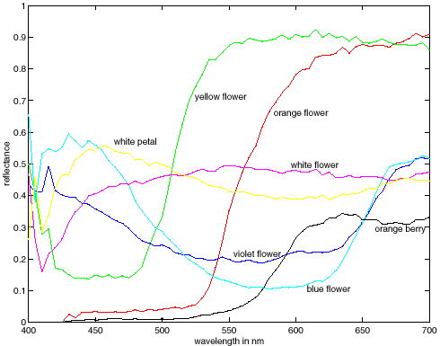
More Spectra
metamers

Slide 20
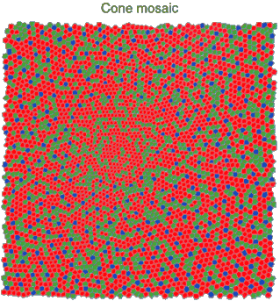
Physiology of Color Vision
Three kinds of cones:
Why are M and L cones so close?
Why are there 3?
© Stephen E. Palmer, 2002
Notes:
Dogs have 2, birds and butterflies have 4
<number>

Slide 21
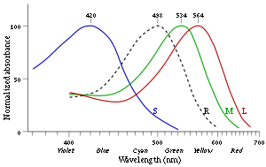
3 is better than 2…
Some animals have 1 (night animals), 2 (e.g., dogs), 4 (fish, birds), 5 (pigeons, some reptiles/amphibians), or even 12 (mantis shrimp)
Most color-blind people see 2 colors (men)
Some women who have a color-blind gene could see 4 colors but it is hard to tell.
http://en.wikipedia.org/wiki/Color_vision

Slide 22
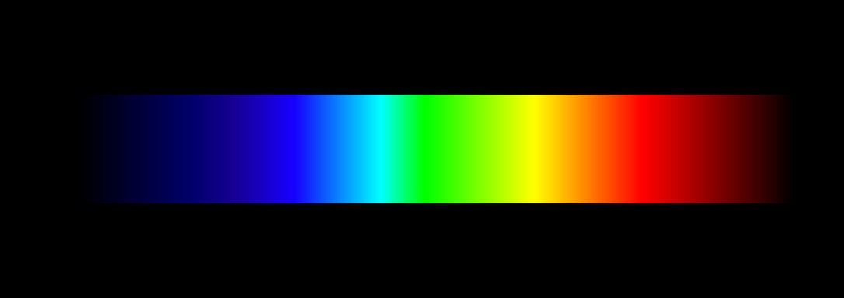
We don’t perceive a spectrum
We perceive
Hue, Saturation, Intensity
Same perceived color can be recreated with combinations of three primary colors (“trichromacy”)

Slide 23
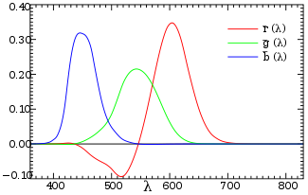
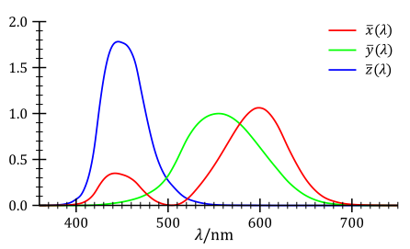
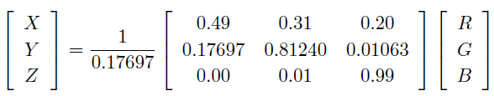
Trichromacy and CIE-XYZ
Perceptual equivalents with RGB
Perceptual equivalents with CIE-XYZ

Slide 24

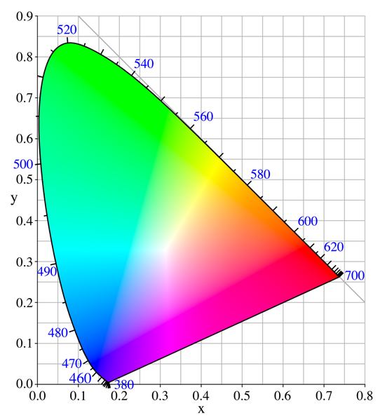

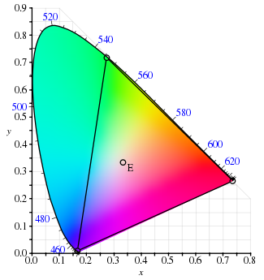
CIE-XYZ
RGB portion is in triangle

Slide 25
The Psychophysical Correspondence
There is no simple functional description for the perceived
color of all lights under all viewing conditions, but …...
A helpful constraint:
Consider only physical spectra with normal distributions
mean
area
variance
© Stephen E. Palmer, 2002

Slide 26
The Psychophysical Correspondence
Mean
Hue
# Photons
Wavelength
© Stephen E. Palmer, 2002

Slide 27
The Psychophysical Correspondence
Variance
Saturation
# Photons
Wavelength
© Stephen E. Palmer, 2002

Slide 28
The Psychophysical Correspondence
Area
Brightness
# Photons
Wavelength
© Stephen E. Palmer, 2002

Slide 29
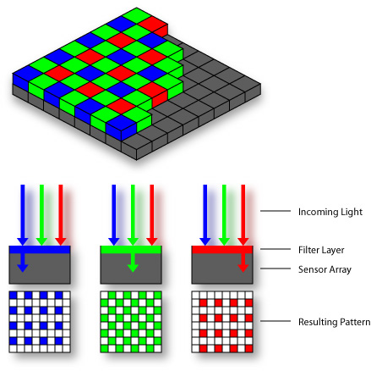

Color Sensing: Bayer Grid
Estimate RGB at each cell from neighboring values
http://en.wikipedia.org/wiki/Bayer_filter
Slide by Steve Seitz

Slide 30

Alternative to Bayer: RGB+W
Kodak 2007

Slide 31
How is light reflected from a surface?
Depends on
Illumination properties: wavelength, orientation, intensity
Surface properties: material, surface orientation, roughness, etc.
light source
λ
?

Slide 32
Lambertian surface
Some light is absorbed (function of albedo)
Remaining light is reflected in all directions (diffuse reflection)
Examples: soft cloth, concrete, matte paints
light source
light source
λ
λ
absorption
diffuse reflection

Slide 33
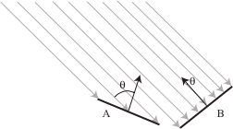
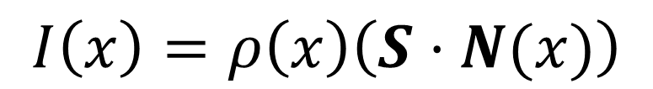
Diffuse reflection
Intensity does depend on illumination angle because less light comes in at oblique angles.
albedo
directional source
surface normal
image intensity
Slide: Forsyth

Slide 34
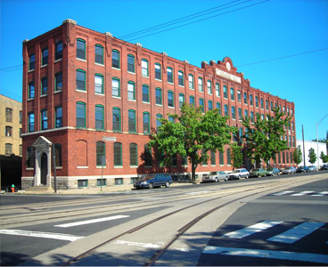
1
2

Slide 35
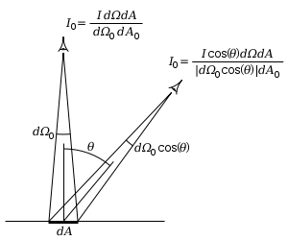
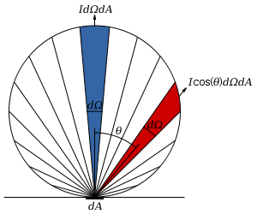
Diffuse reflection
Perceived intensity does not depend on viewer angle.
Amount of reflected light proportional to cos(theta)
Visible solid angle also proportional to cos(theta)
http://en.wikipedia.org/wiki/Lambert%27s_cosine_law

Slide 36

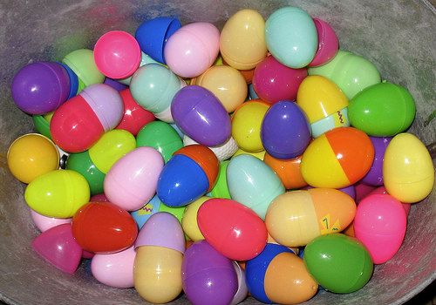


Specular Reflection
Reflected direction depends on light orientation and surface normal
E.g., mirrors are fully specular
Flickr, by suzysputnik
light source
λ
specular reflection
Flickr, by piratejohnny

Slide 37
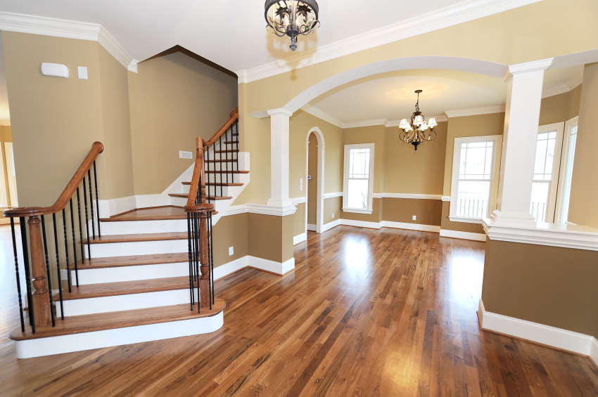
Many surfaces have both specular and diffuse components
Specularity = spot where specular reflection dominates (typically reflects light source)
Photo: northcountryhardwoodfloors.com

Slide 38
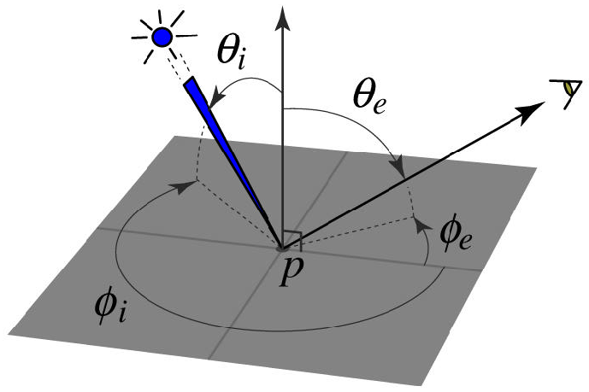
BRDF: Bidirectional Reflectance Distribution Function
Model of local reflection that tells how bright a surface appears when viewed from one direction when light falls on it from another
surface normal
Slide credit: S. Savarese

Slide 39

More complicated effects
transparency
light source
light source
refraction
λ
λ

Slide 40
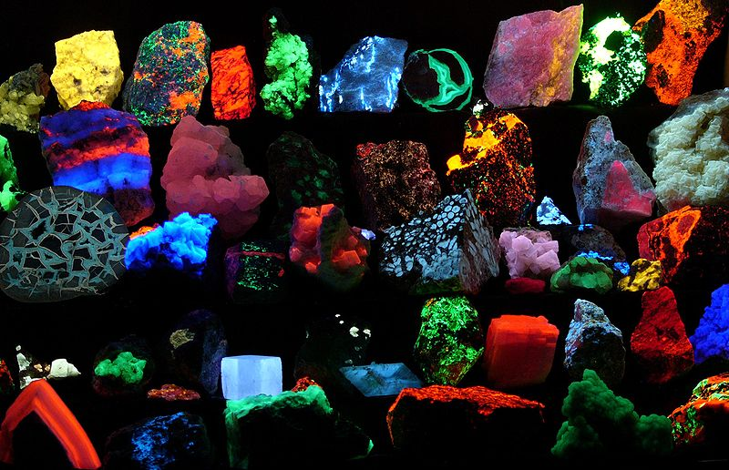
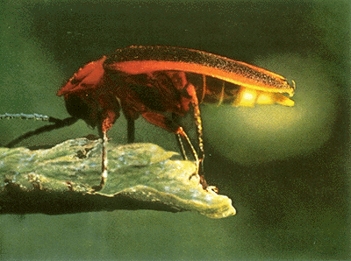
light source
light source
fluorescence
phosphorescence
λ1
t=1
λ2
t>1

Slide 41
light source
light source
subsurface scattering
interreflection
λ
λ

Slide 42
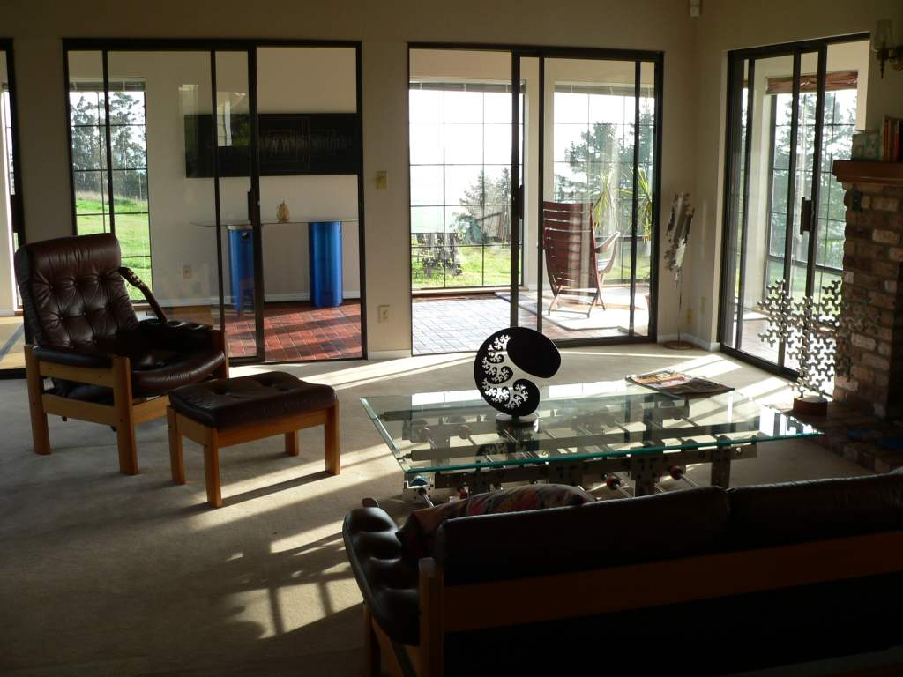
Inter-reflection is a major source of light

Slide 43
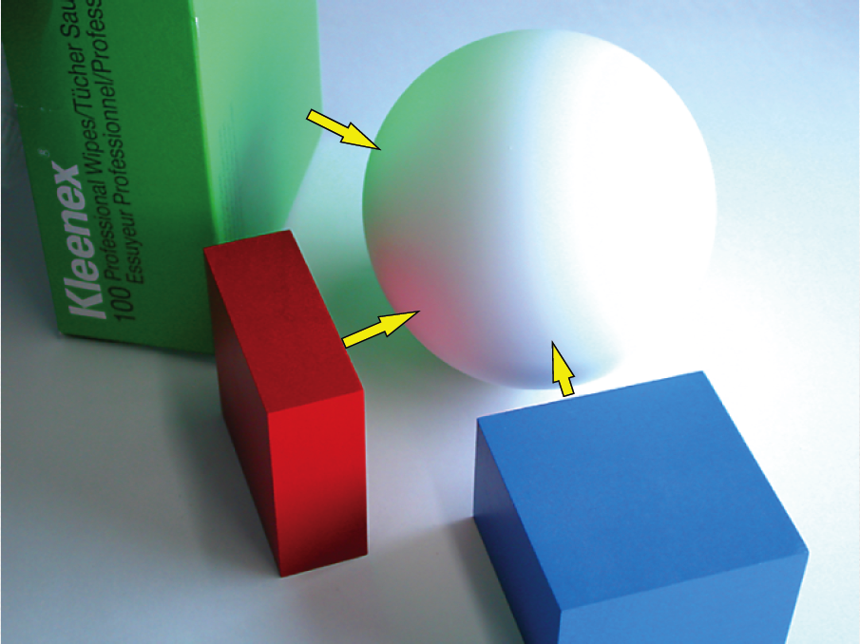
Inter-reflection affects the apparent color of objects
From Koenderink slides on image texture and the flow of light

Slide 44
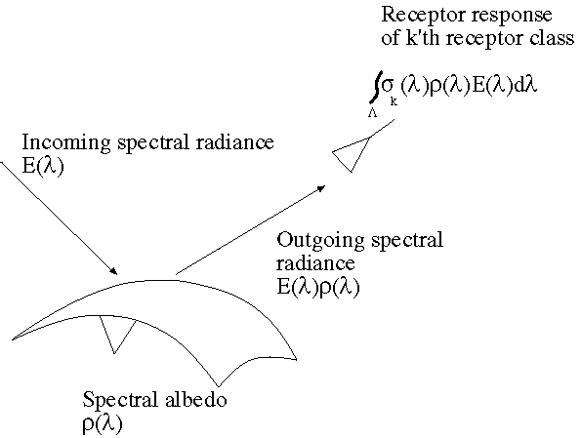
The color of objects
Colored light arriving at the camera involves two effects
The color of the light source (illumination + inter-reflections)
The color of the surface
Slide: Forsyth

Slide 45
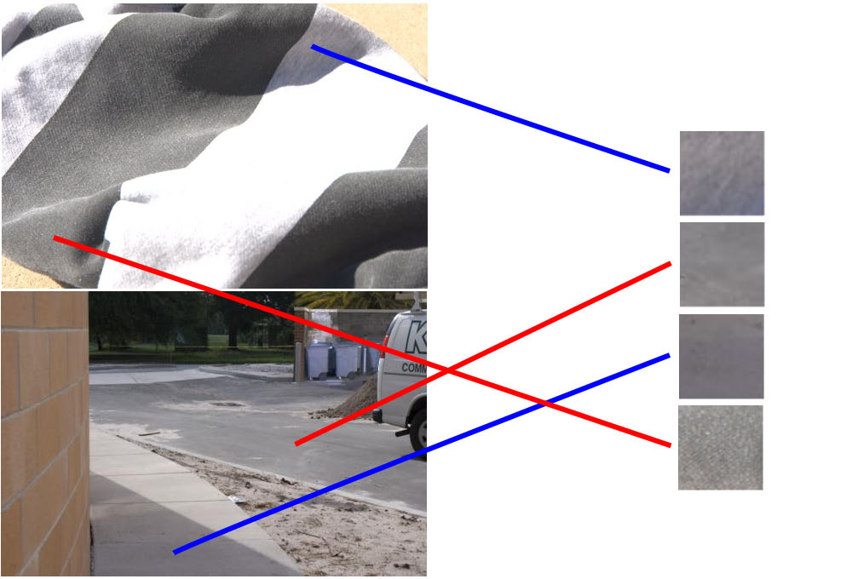
Color constancy
Interpret surface in terms of albedo or “true color”, rather than observed intensity
Humans are good at it
Computers are not nearly as good

Slide 46
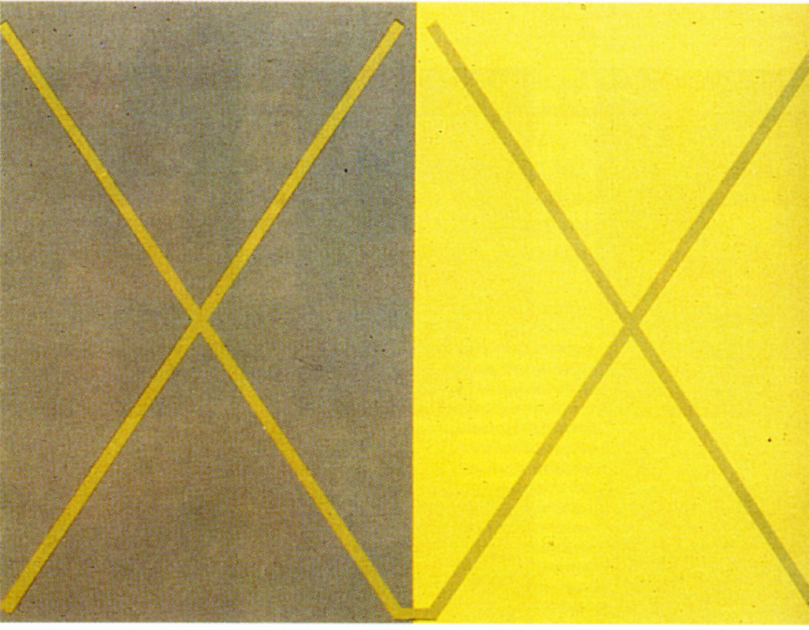
Color illusions

Slide 47
Color illusions

Slide 48
Color illusions

Slide 49

Color illusions

Slide 50
Color illusions

Slide 51
Color illusions
http://www.echalk.co.uk/amusements/OpticalIllusions/colourPerception/colourPerception.html

Slide 52
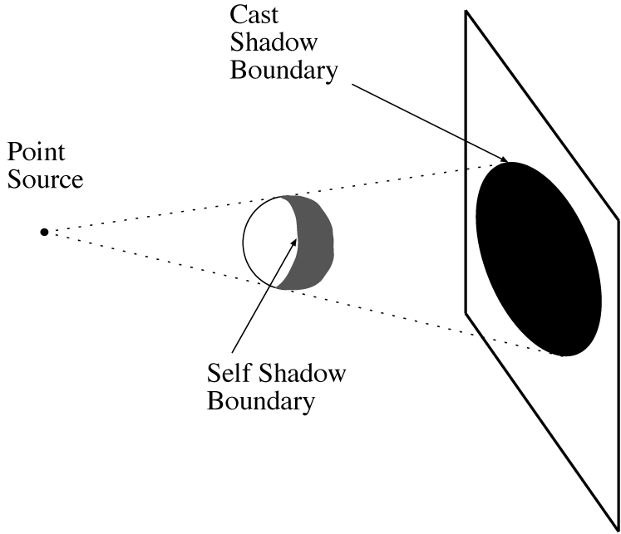
Shadows cast by a point source
A point that can’t see the source is in shadow
For point sources, the geometry is simple
Slide: Forsyth

Slide 53
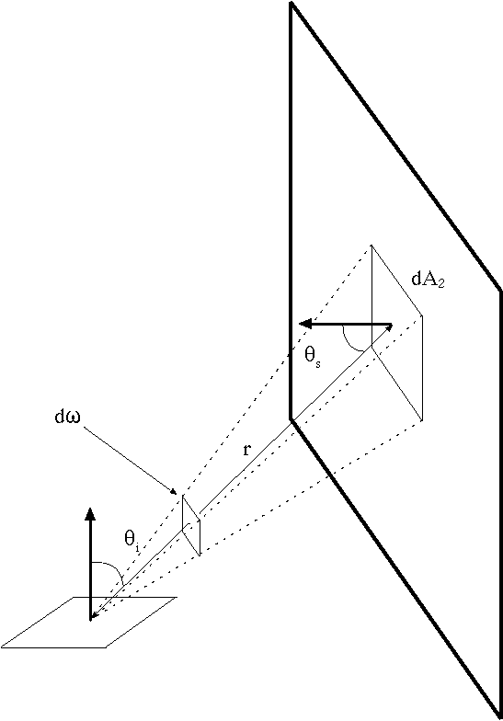
Area sources
Examples: diffuser boxes, white walls
The energy received at a point due to an area source is obtained by adding up the contribution of small elements over the whole source
Slide: Forsyth

Slide 54
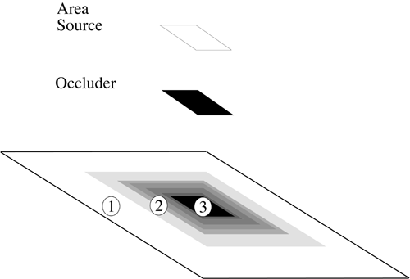
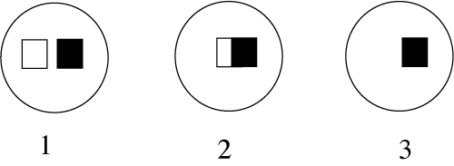
Area Source Shadows
Slide: Forsyth

Slide 55
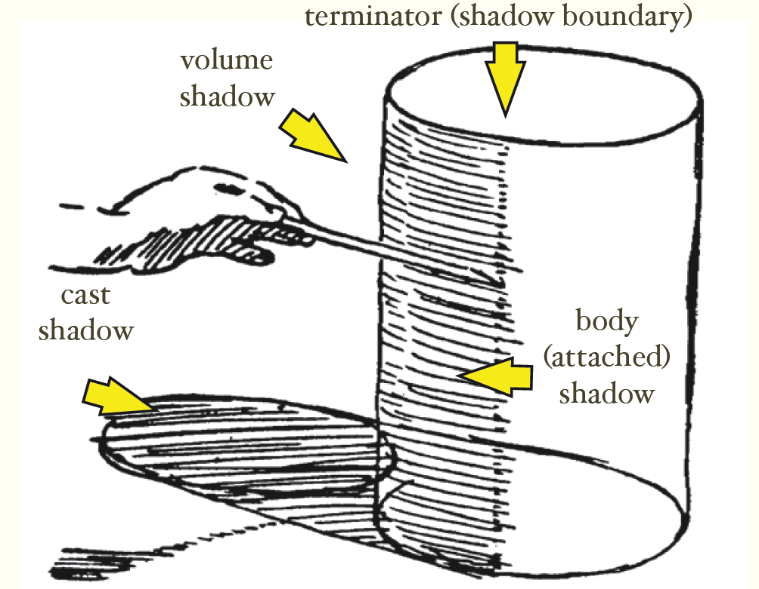
Shading and shadows are major cues to shape and position
From Koenderink slides on image texture and the flow of light
Slide: Forsyth

Slide 56

Recap
6
3
5
4
1
2
1. Why is (2) brighter than (1)? Each points to the asphault.
2. Why is (4) darker than (3)? 4 points to the marking.
3. Why is (5) brighter than (3)? Each points to the side of the wooden block.
4. Why isn’t (6) black, given that there is no direct path from it to the sun?

Slide 57
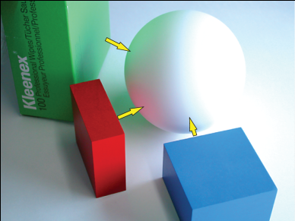
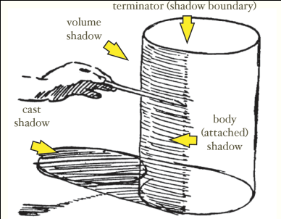
Things to remember
Light has a spectrum of wavelengths
Humans (and RGB cameras) have color sensors sensitive to three ranges
Observed light depends on: illumination intensities, surface orientation, material (albedo, specular component, diffuse component), etc.
Every object is an indirect light source for every other
Shading and shadows are informative about shape and position

Slide 58

Take-home questions
09/10/13
Possible factors: albedo, shadows, texture, specularities, curvature, lighting direction

