Slide 1
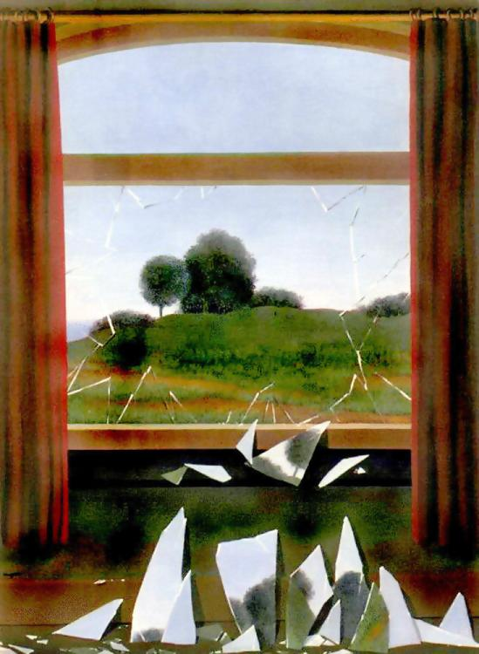
Computational Photography
CS498dh
8/26/14
Derek Hoiem (instructor)
Amin Sadeghi (TA)

Slide 2
Today’s Class
A little about me and Amin
Intro to Computational Photography
Course outline and logistics
A little about you

Slide 3
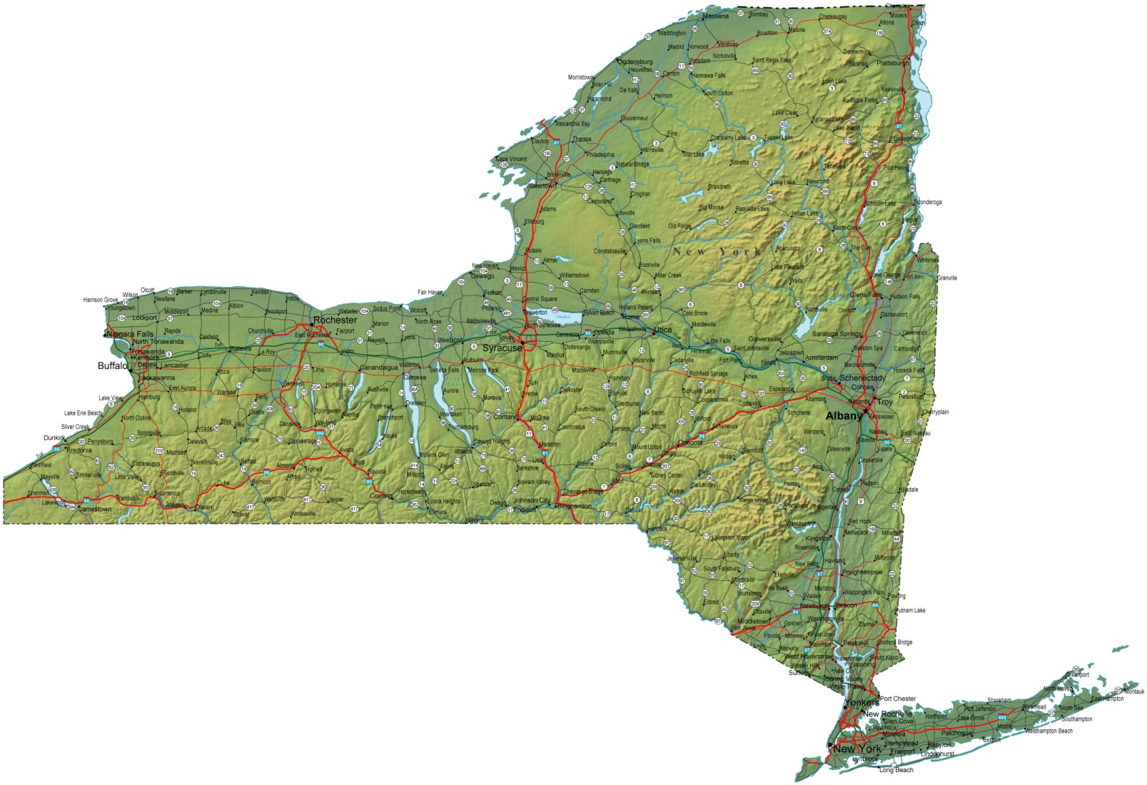
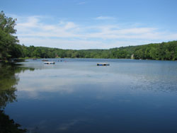
About me
Raised in “upstate” NY

Slide 4
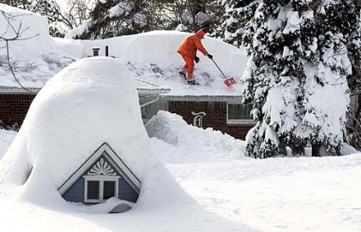
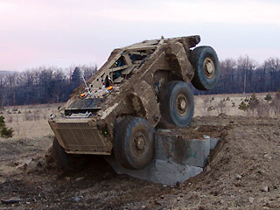
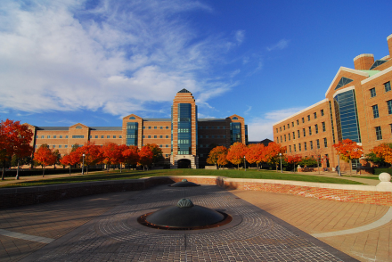
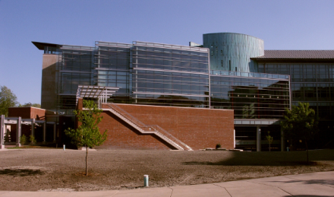
About me
1998-2002
Undergrad at SUNY Buffalo
B.S., EE and CSE
2002-2007
Grad at Carnegie Mellon
Ph.D. in Robotics
2007-2008
Postdoc at Beckman Institute
2009-
Assistant Prof in CS at UIUC

Slide 5
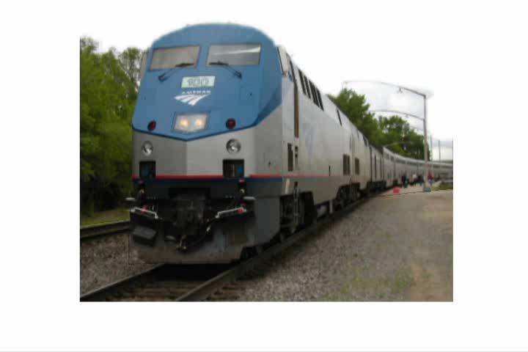
My research

Slide 6
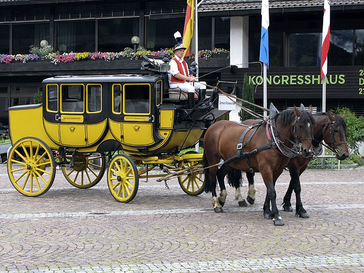
My Research
Animal
Vehicle
head
Four-legged
Mammal
wheel
leg
Can run, jump
Is herbivorous
Facing right
Move on road
Facing right
Farhadi et al. 2010
Notes:
Example of a detection result of our system, which has not seen carriages or horses during training. The red box is a detected location of a vehicle; the green box indicates a detected location of an animal. The shown categories and parts are those that served as evidence for the detections.

Slide 7
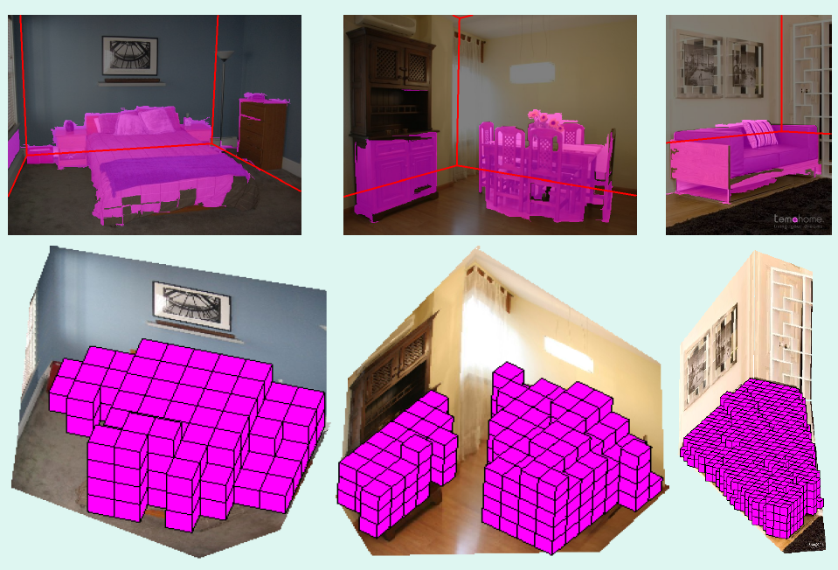
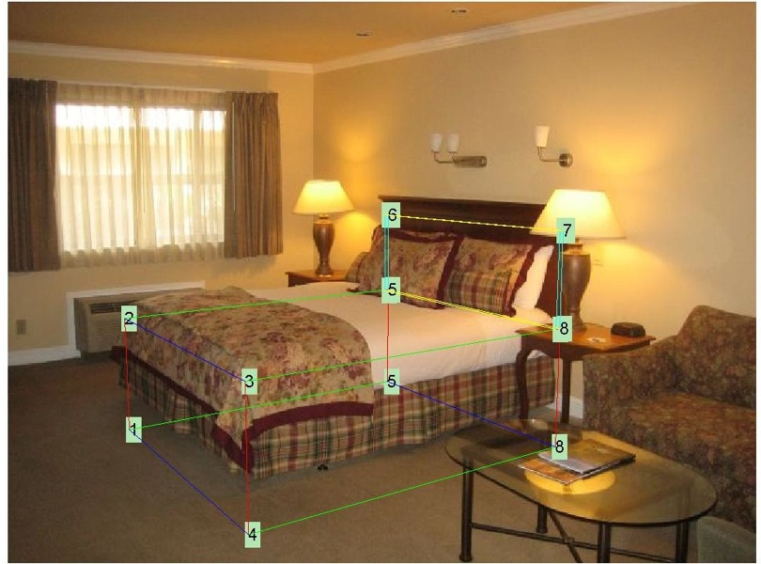
My Research
Recovering 3D layout and context
BED
Hedau et al. 2009, 2010
Notes:
Left: Pink regions are estimated as pixels or 3D voxels that are occupied by objects. Red lines indicate estimated floor-wall boundaries. Right: An example of correct localization and identification of a bed, using spatial layout information.

Slide 8
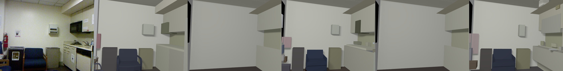
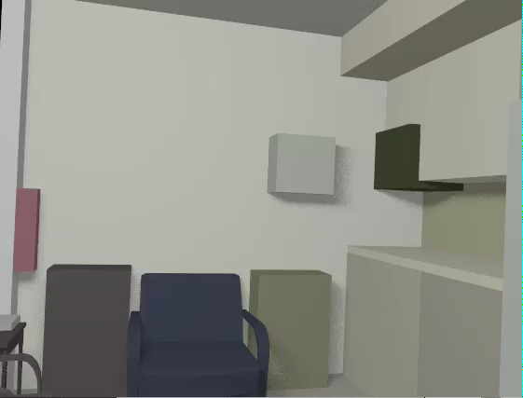
My Research
3D scene model from RGB+D image
RGBD Image
3D Model
Guo and Hoiem, unpublished

Slide 9
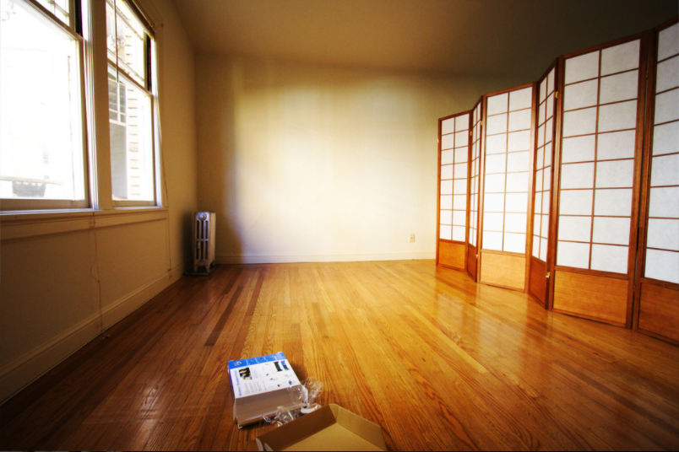
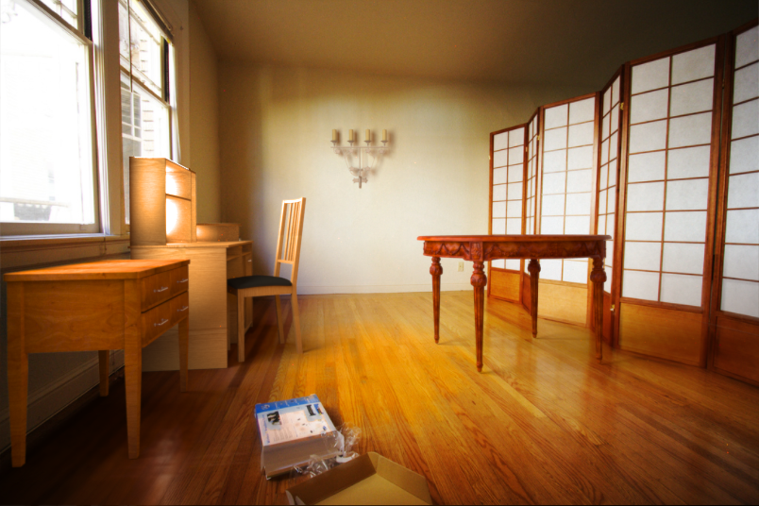
My Research
Editing images as if they were 3D scenes
Karsch et al. 2011

Slide 10
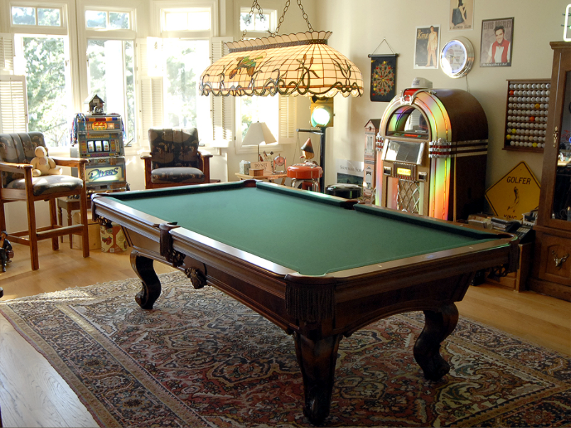

Slide 11
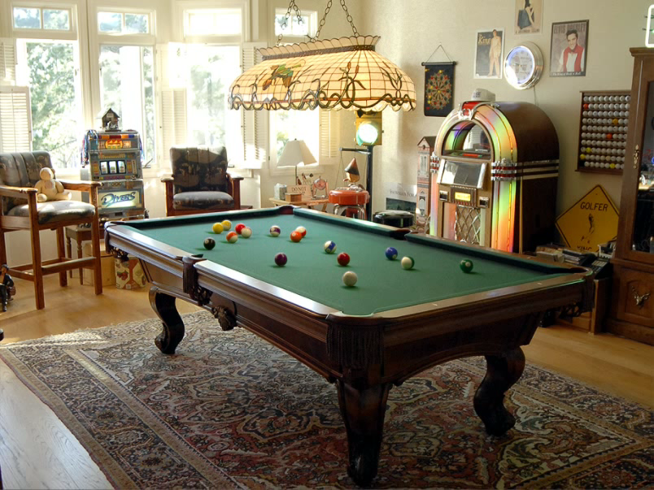

Slide 12
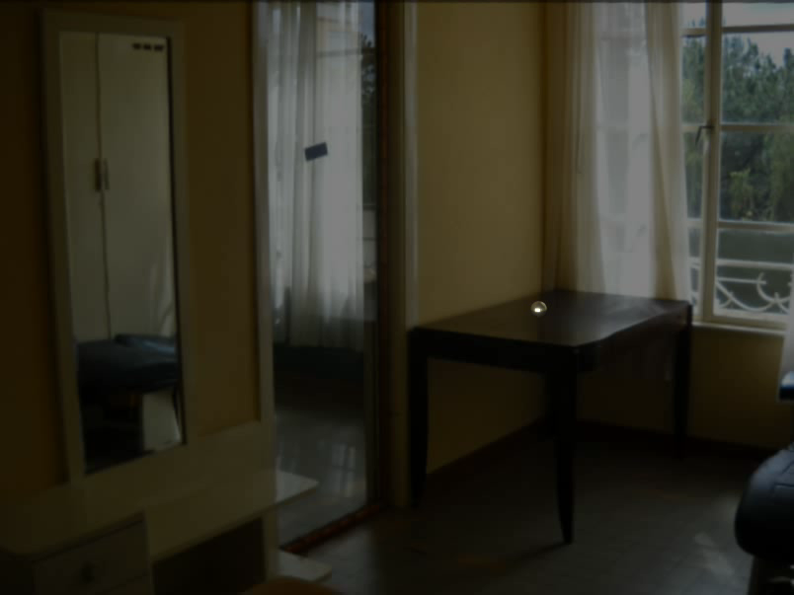

Slide 13
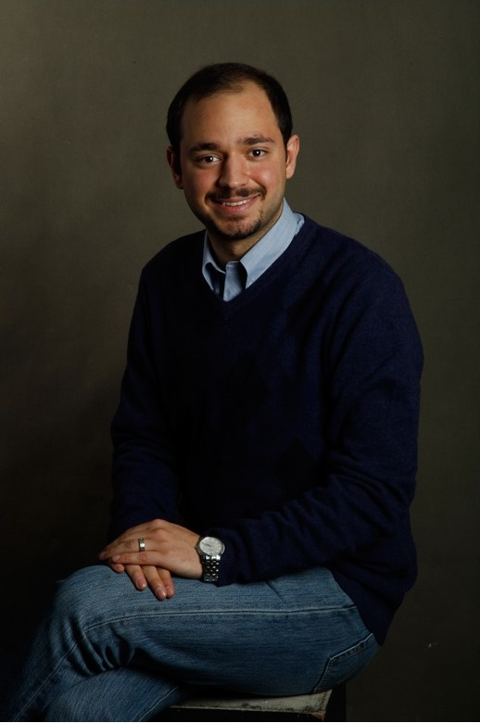
Class TA
Mohammad Amin Sadeghi
Call me Amin
Email: msadegh2@illinois.edu

Slide 14
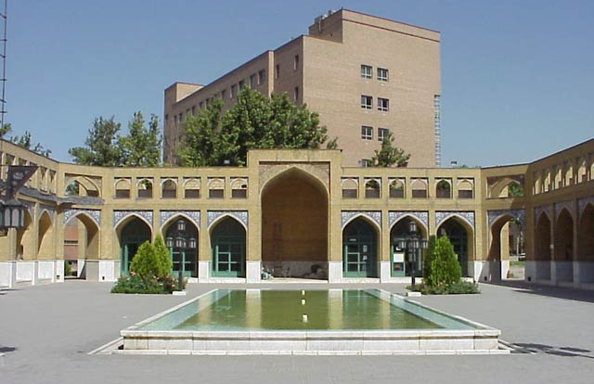
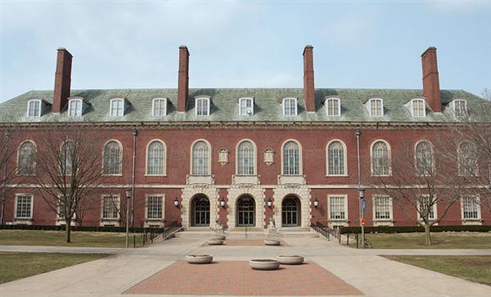
Education
Sharif University
  BSc Computer Engineering
  Iran, 2005 - 2010
University of Illinois
  PhD in Computer Science
  2010 - present

Slide 15


Awards
Bronze Medal at
IOI’2005
Best Student Paper Award at
CVPR’2011

Slide 16
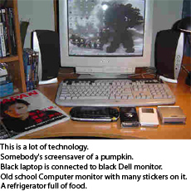
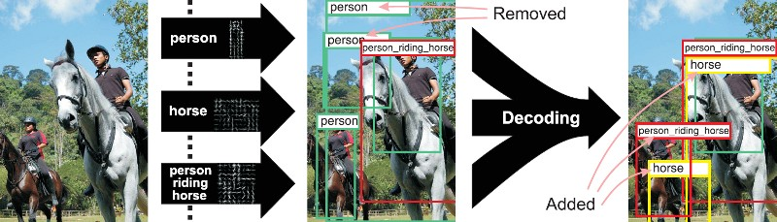
Image Understanding
Automatic Image description
Visual Phrases

Slide 17
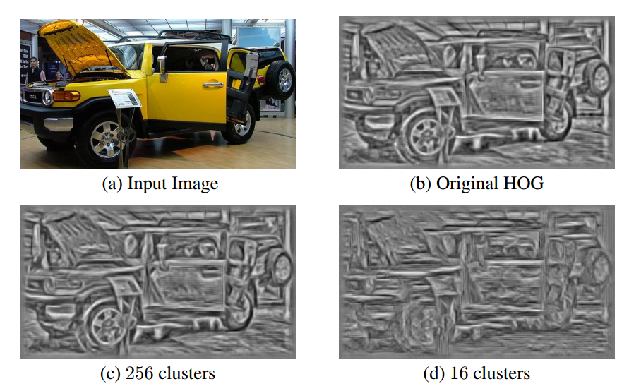
Fast Object Detection

Slide 18
Some background to computational photography and …
The Pursuit of Realism
Several of following slides from Alyosha Efros

Slide 19
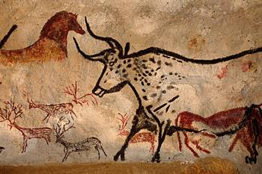
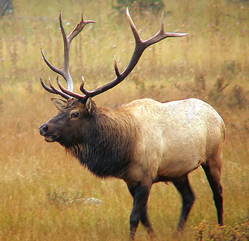
Depicting Our World: The Beginning
Prehistoric Painting, Lascaux Cave, France
~ 15,000 B.C.

Slide 20
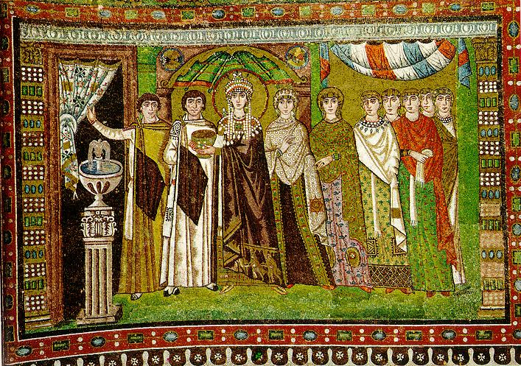
Depicting Our World: Middle Ages
The Empress Theodora with her court.
Ravenna, St. Vitale 6th c.

Slide 21
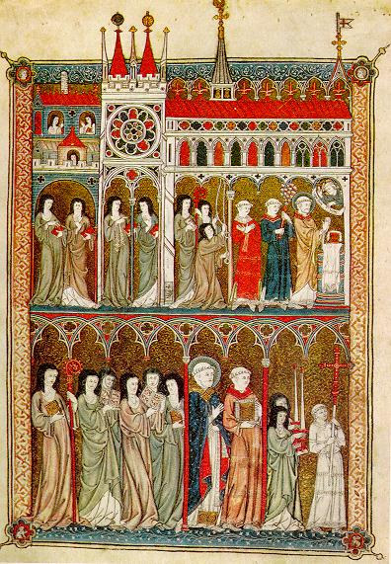
Depicting Our World: Middle Ages
Nuns in Procession. French ms. ca. 1300.

Slide 22
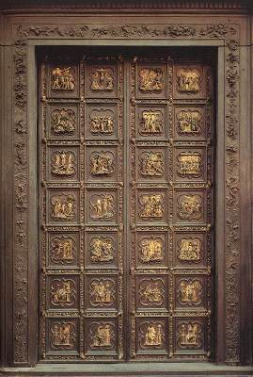
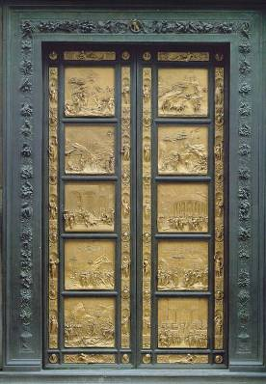
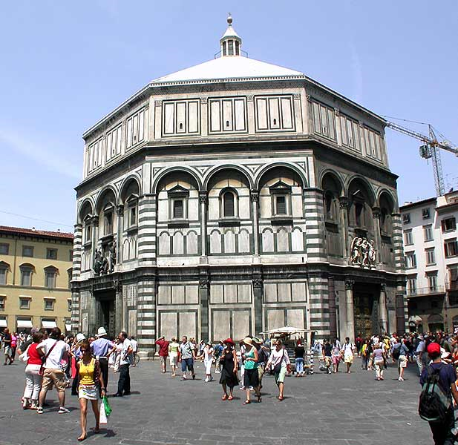
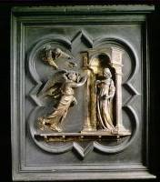
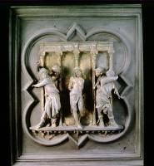
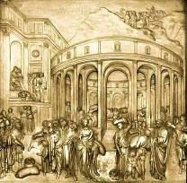
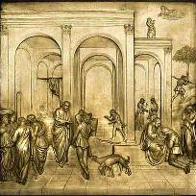
Depicting Our World: Renaissance
North Doors (1424)
East Doors (1452)
Lorenzo
Ghiberti
(1378-1455)
Notes:
Florentine cathedral. Ghiberti influenced by Alazhan’s book of optics, first published around 1000 AD but translated into Italian by 14th century

Slide 23
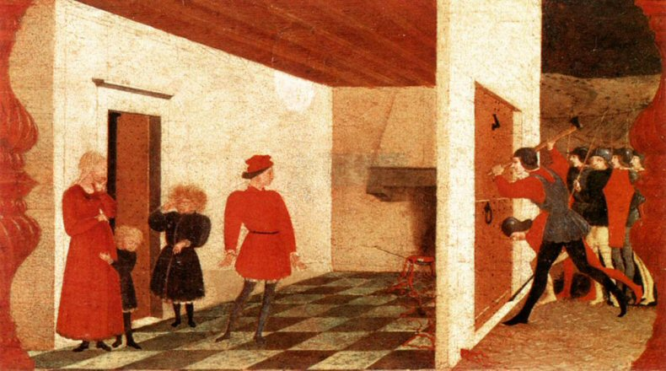
Depicting Our World: Renaissance
Paolo Uccello,
Miracle of the Profaned Host (c.1467-9)
Notes:
Paolo Uccello was one of Ghiberti’s students and a early master of perspective

Slide 24
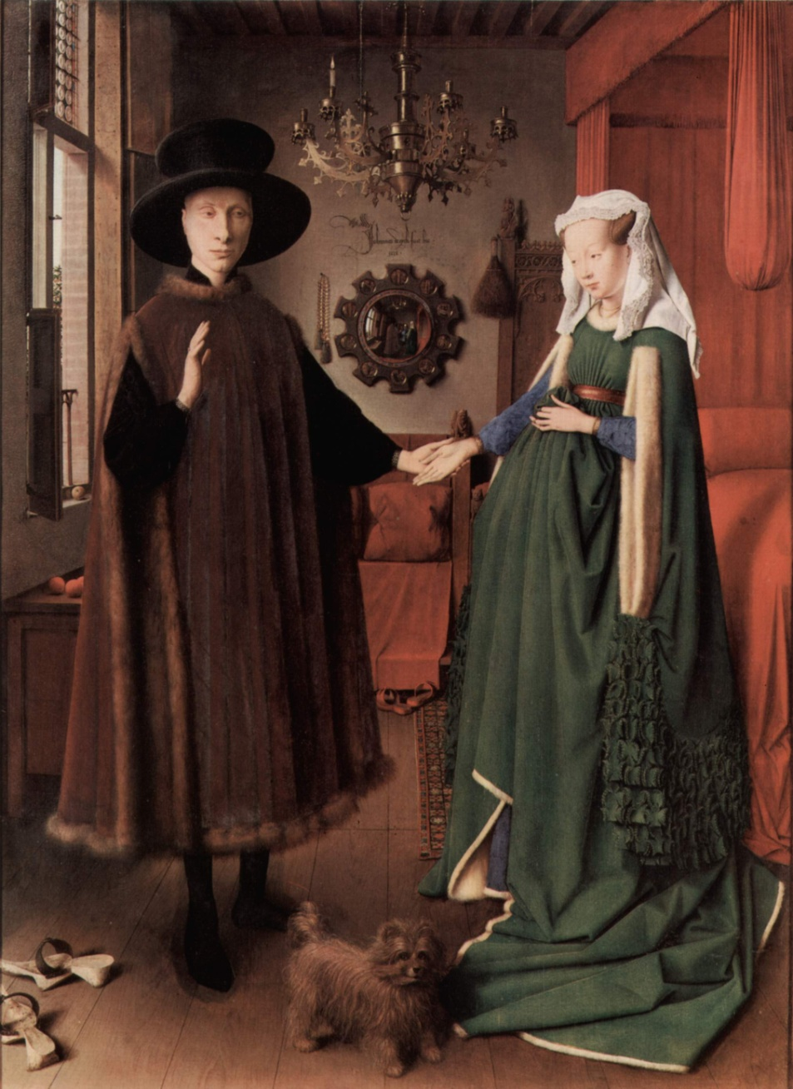
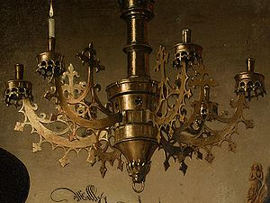
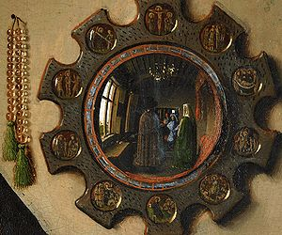
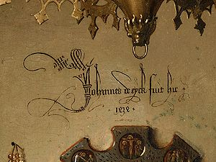
Depicting Our World: Toward Perfection
Jan van Eyck, The Arnolfini Portrait (1426-1434)

Slide 25
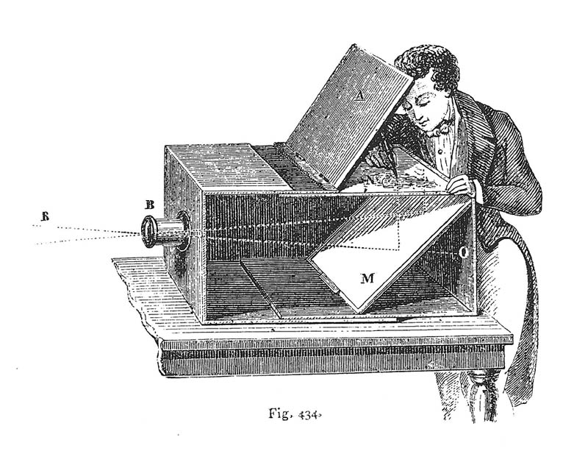
Depicting Our World: Toward Perfection
Lens Based Camera Obscura, 1568

Slide 26
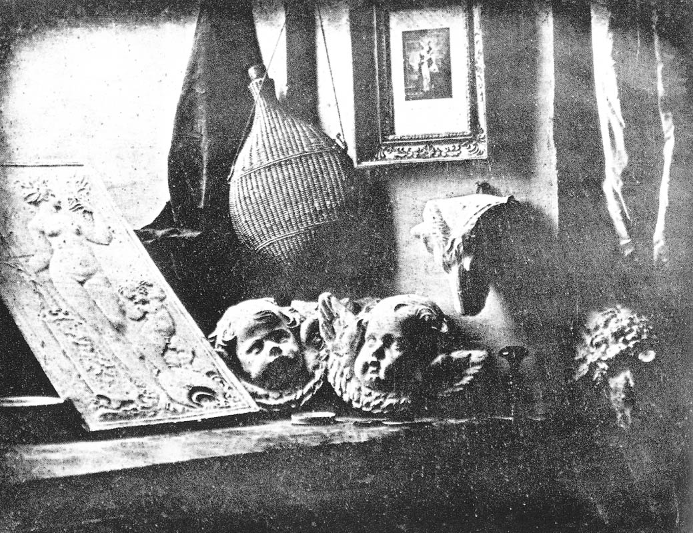
Depicting Our World: Perfection!
Still Life, Louis Jaques Mande Daguerre, 1837

Slide 27
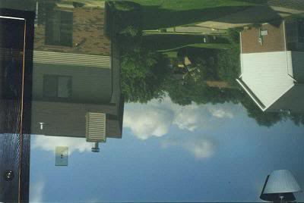
Your own camera obscura?

Slide 28
Depicting Our World: Perfection!
Still Life, Louis Jaques Mande Daguerre, 1837

Slide 29
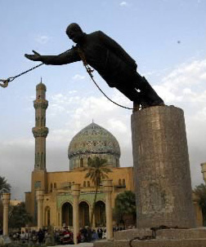
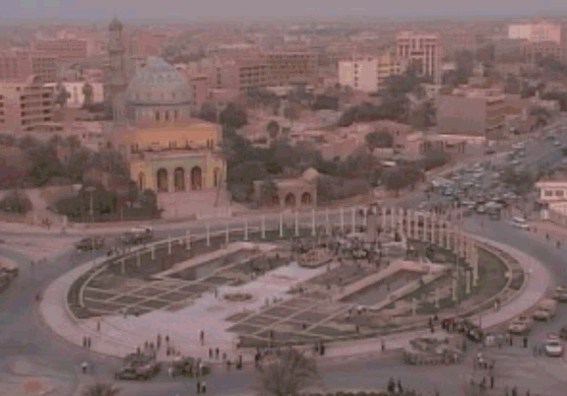
But is a photo really realistic?

Slide 30
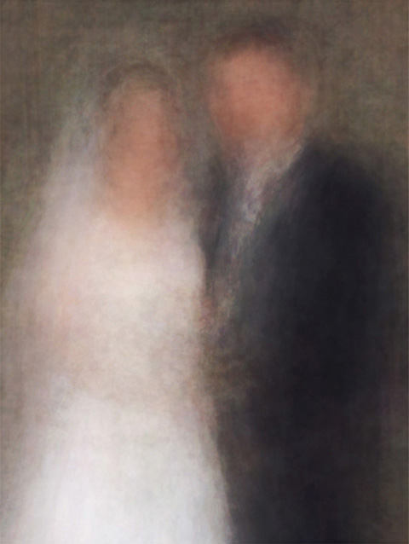
Is reality what we want?
Newlyweds
http://salavon.com

Slide 31
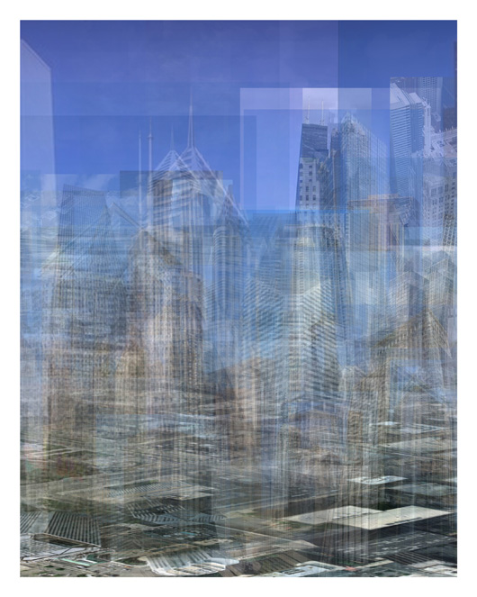
Better than realism?
City (westward)
http://salavon.com

Slide 32
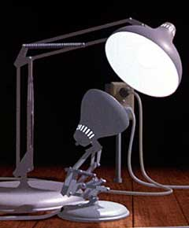
Enter Computer Graphics...

Slide 33
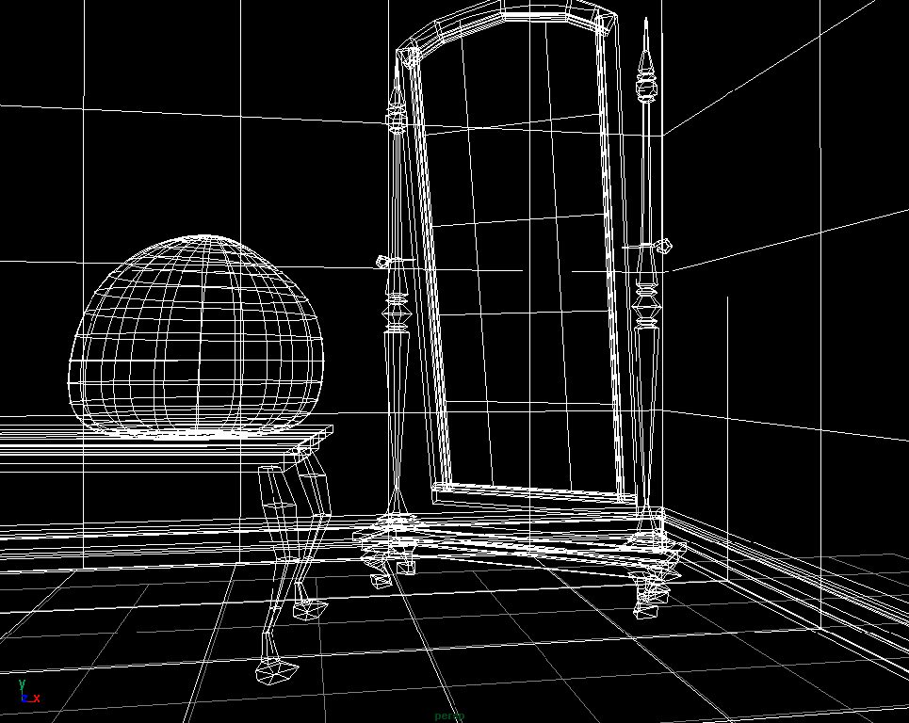
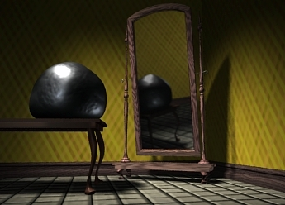

Traditional Computer Graphics
3D geometry
projection
Simulation
physics
GRAPHICS

Slide 34

Computer graphics
What’s wrong?
Notes:
So lifeless and sterile

Slide 35

The richness of our everyday world
Photo by Svetlana Lazebnik

Slide 36

Which parts are hard to model?
Photo by Svetlana Lazebnik

Slide 37


People
Alyosha Efros - On the Tube, London
From “Final Fantasy”

Slide 38


Faces / Hair
From “Final Fantasy”
Photo by Joaquin Rosales Gomez

Slide 39


Urban Scenes
Photo of l LA
Virtual LA (SGI)

Slide 40


Nature
River Cherwell, Oxford

Slide 41
The Realism Spectrum
Computational
Photography
Computer Graphics
Photography
Realism
Manipulation
Ease of capture
+ easy to create new worlds
+ easy to manipulate objects/viewpoint
- very hard to look realistic
+ instantly realistic
+ easy to aquire
- very hard to manipulate objects/viewpoint

Slide 42



Computational Photography
How can I use computational techniques to capture light in new ways?
How can I use computational techniques to breathe new life into the photograph?
How can I use computational techniques to synthesize and organize photo collections?

Slide 43
Virtual Real World
Campanile Movie (1997)
http://www.debevec.org/Campanile/

Slide 44
Going beyond reality…
Benjamin Button (2008)
http://digitaldomain.com/projects/8/

Slide 45
Course outline
Prof: Derek Hoiem (dhoiem@illlinois.edu), SC 3312
TA: Amin Sadeghi (msadegh2@illinois.edu), SC 3307
Web page:
http://courses.engr.illinois.edu/cs498dh3/

Slide 46

Course objectives
You will have new abilities for visual creation.
Graphic by James Hays
Notes:
Visual creation is no longer just pure graphics or pure photography. There is a growing need to blend the two. We want to edit photos, work with photo collections, create cool special effects, etc. After this course, you should have the background and experience that you need to do these things.

Slide 47






Course objectives
2. You will get a foundation in computer vision.
Safety
Health
Security
Comfort
Fun
Access
Notes:
Foundation for computer vision. We want machines to watch for us, do our work, and make us live longer, more healthy, and more entertaining lives. This course will give you a good hands-on background for learning more or developing new computer vision applications.

Slide 48
Got job?
Google, Facebook, Microsoft, Sony, iRobot, Amazon A9, tons of startups, etc.
http://www.cs.ubc.ca/~lowe/vision.html

Slide 49

Course objectives
3. You’ll better appreciate your own visual ability.
Is that a queen or a bishop?
Notes:
You'll gain an appreciation for your own visual ability. We tend to take it for granted, but half of our brain is cranking away on the vision problem. Interestingly, we are usually aware only of the interpretation, not what we actually see. By working with pixels, you'll see how messy images actually are and how incredible it is that we can interpret anything from them.

Slide 50
Course objectives
4. You’ll have fun doing cool stuff!
Notes:
Do cool stuff. You'll get the opportunity to implement a variety of fun projects that work with your own photos. You can be creative. You can also go beyond the minimum and do some "bells and whistles" or additional projects that I offer. You'll get to do a final project on whatever you want. You'll also be able to see the work that everyone else does.

Slide 51
Projects

Slide 52


Project 1: Hybrid Images

Slide 53





Project 2: Image Quilting for Texture Synthesis and Transfer

Slide 54



Project 3: Poisson Editing
Photos from James Hays

Slide 55



Project 3: Poisson Editing
Photos from Evan Wallace

Slide 56


Project 4: Image-Based Lighting

Slide 57




Project 5: Automatic Photo Stitching
(maybe changing for video-based project)

Slide 58
Final Project
Something cool!

Slide 59
Project details
Implement stuff from scratch and apply it to your own photos
Reporting via web page (plus e-mail code)
Afterwards, vote for class favorite(s)!
Software/hardware
  Matlab!
  Machines available in EWS labs

Slide 60
Getting help outside of class
Office hours
TBA: http://doodle.com/49shtvw5haicz498
Matlab + linear algebra tutorial
TBA: http://doodle.com/f4wzcrshumttkxzt
Discussion board:
https://piazza.com/class/hyzzw1vjjb83cf
Readings/textbook

Slide 61
Grades
Written and programming assignments (55%)
  Core projects worth total of 500 points, “bells and whistles” for additional points
  Undergrads graded out of 525, grads out of 600
Exam (25%)
Final Project (20%)
Participation
Late policy
Up to five free days total – use them wisely!
10 points per day after that

Slide 62
Academic Integrity
Can discuss projects, but don’t share code
Don’t look up code (even to get hints) or copy from a friend
If you’re not sure if it’s allowed, ask
Acknowledge any inspirations
If you get stuck, come talk to me

Slide 63
Other comments
Prerequisites
Linear algebra, plus some basic calculus and probability
Experience with graphics, image processing, or Matlab will help but is not necessary
Your own camera
Strongly recommended – can get decent cameras for reasonable $$$
Pro camera apps for smartphones

Slide 64
Feedback is welcome

Slide 65
Introduce yourselves

Slide 66
Final comments
Reasons to not take the course…
To do now
  Please fill out the feed-forward forms
  Any Q’s or concerns, come talk to me!
To do later
  Look over syllabus, etc.
  Sign up for Piazza
  Doodles for office hours and tutorial
Next class: pixels and basic filtering

