Slide 1
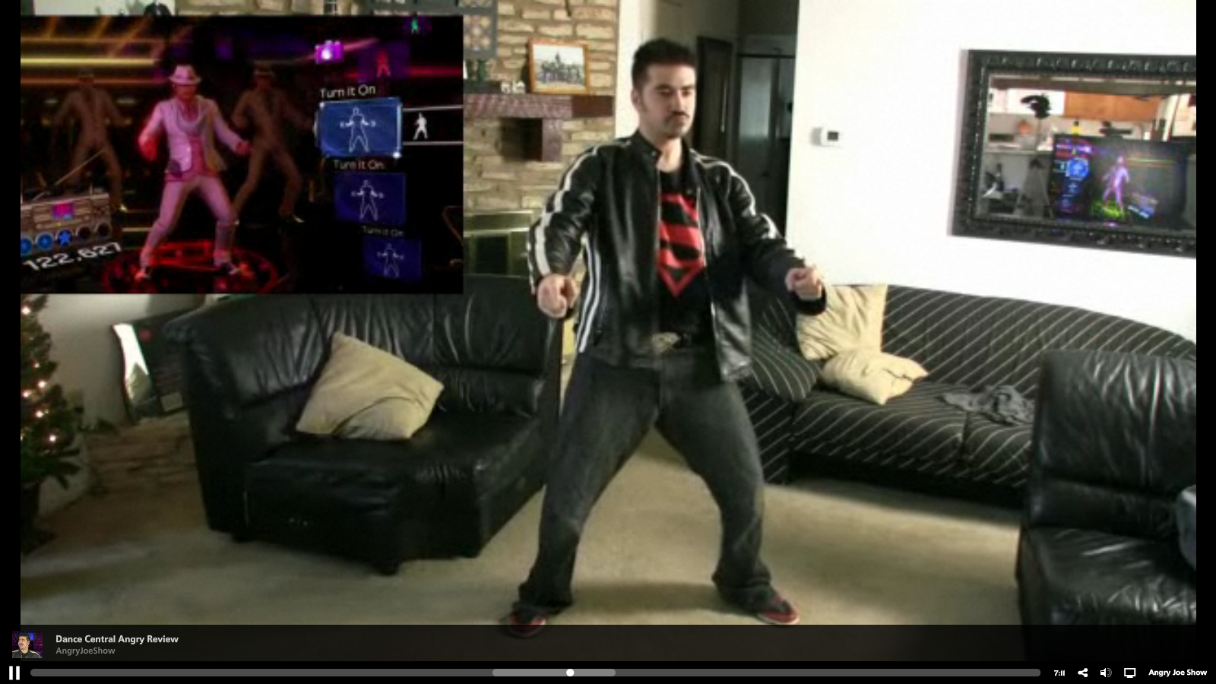
How the Kinect Works
11/07/13
T2
Computational Photography
Derek Hoiem, University of Illinois
Photo frame-grabbed from: http://www.blisteredthumbs.net/2010/11/dance-central-angry-review

Slide 2
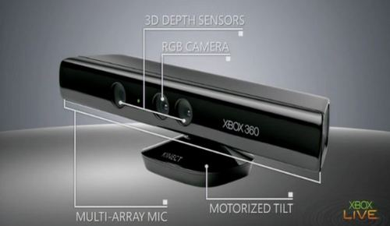
Kinect Device

Slide 3
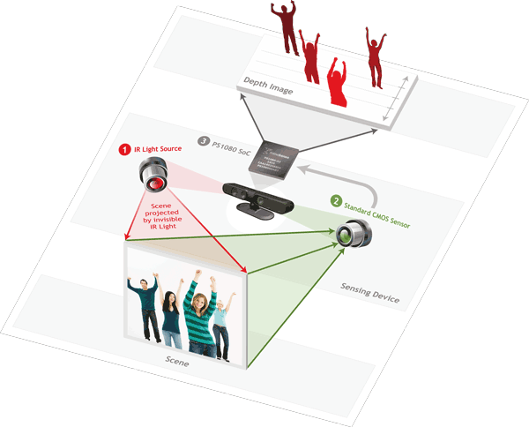
Kinect Device
illustration source: primesense.com

Slide 4
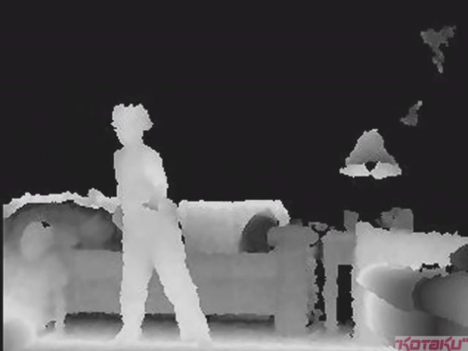
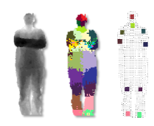
What the Kinect does
Get Depth Image
Application (e.g., game)
Estimate Body Pose

Slide 5
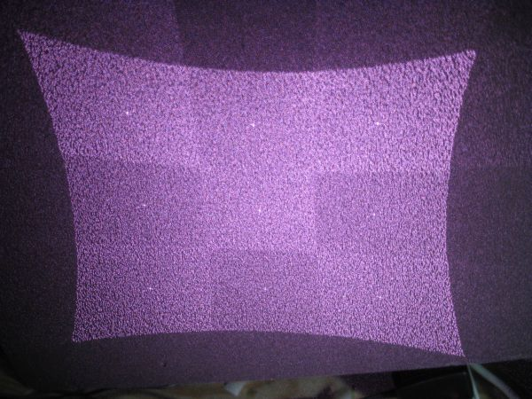
How Kinect Works: Overview
IR Projector
IR Sensor
Projected Light Pattern
Stereo Algorithm
Segmentation,
Part Prediction
Depth Image
Body Pose

Slide 6
Part 1: Stereo from projected dots
IR Projector
IR Sensor
Projected Light Pattern
Stereo Algorithm
Segmentation,
Part Prediction
Depth Image
Body Pose

Slide 7
Part 1: Stereo from projected dots
Overview of depth from stereo
How it works for a projector/sensor pair
Stereo algorithm used by Primesense (Kinect)

Slide 8
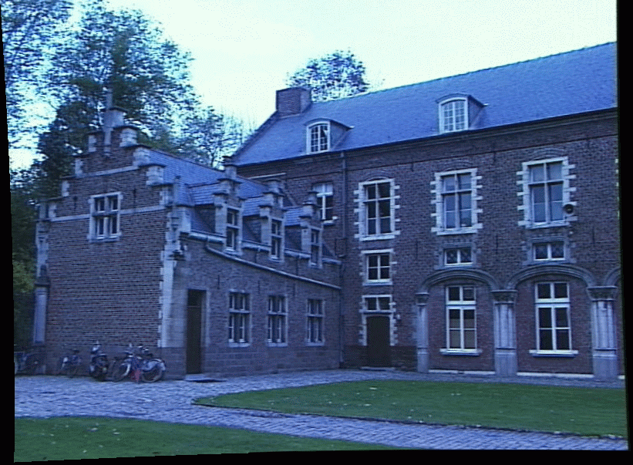
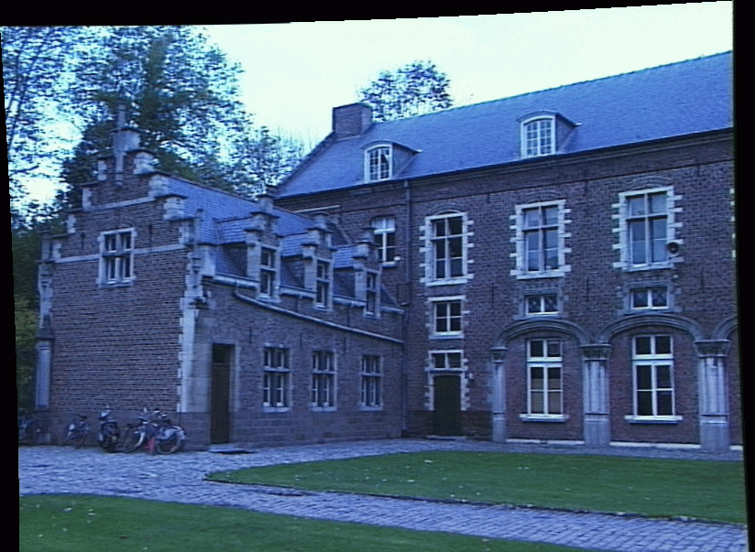
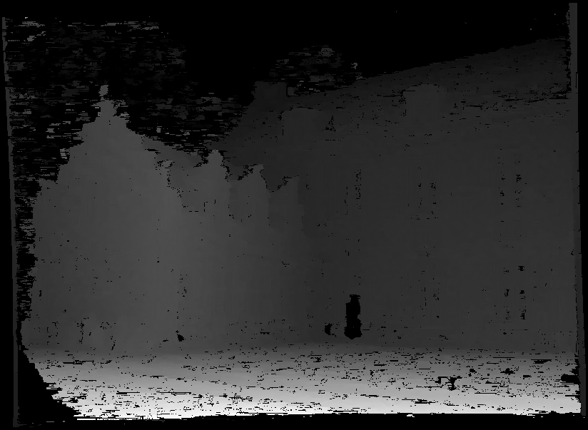
Depth from Stereo Images
image 1
image 2
Dense depth map
Some of following slides adapted from Steve Seitz and Lana Lazebnik

Slide 9
Depth from Stereo Images
Goal: recover depth by finding image coordinate x’ that corresponds to x
X
X
x
z
x
x’
x'
f
f
C
Baseline B
C’

Slide 10
Depth from disparity
X
z
x
x’
f
f
O
Baseline B
O’
Disparity is inversely proportional to depth.

Slide 11
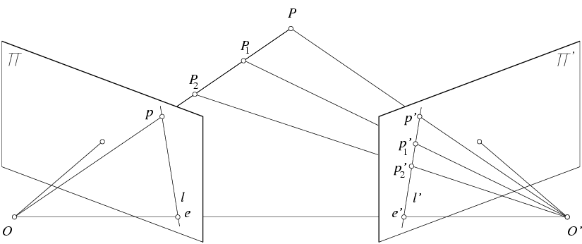
Stereo and the Epipolar constraint
X
X
X
x
x’
x’
x’
Potential matches for x have to lie on the corresponding line l’.
Potential matches for x’ have to lie on the corresponding line l.

Slide 12
Simplest Case: Parallel images
Image planes of cameras are parallel to each other and to the baseline
Camera centers are at same height
Focal lengths are the same
Then, epipolar lines fall along the horizontal scan lines of the images

Slide 13
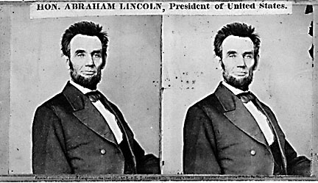
Basic stereo matching algorithm
For each pixel in the first image
Find corresponding epipolar line in the right image
Examine all pixels on the epipolar line and pick the best match
Triangulate the matches to get depth information

Slide 14
Basic stereo matching algorithm
If necessary, rectify the two stereo images to transform epipolar lines into scanlines
For each pixel x in the first image
Find corresponding epipolar scanline in the right image
Examine all pixels on the scanline and pick the best match x’
Compute disparity x-x’ and set depth(x) = fB/(x-x’)

Slide 15
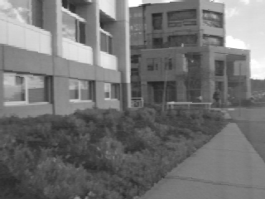
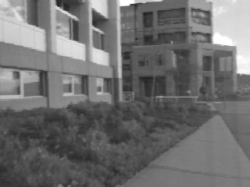
Correspondence search
Left
Right
scanline
Matching cost
disparity
Slide a window along the right scanline and compare contents of that window with the reference window in the left image
Matching cost: SSD or normalized correlation

Slide 16
Correspondence search
Left
Right
scanline
SSD

Slide 17
Correspondence search
Left
Right
scanline
Norm. corr

Slide 18
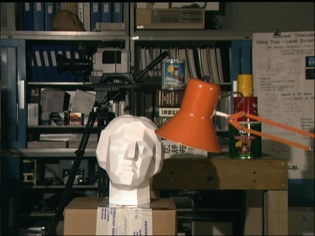
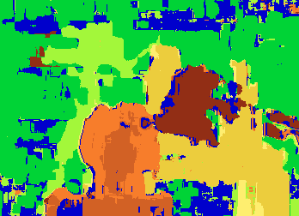

Results with window search
Data
Window-based matching
Ground truth

Slide 19
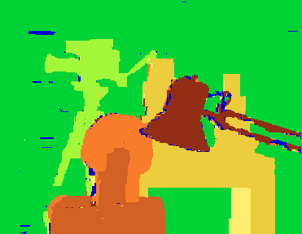
Add constraints and solve with graph cuts
Before
Graph cuts
Ground truth
Y. Boykov, O. Veksler, and R. Zabih, Fast Approximate Energy Minimization via Graph Cuts, PAMI 2001
For the latest and greatest: http://www.middlebury.edu/stereo/

Slide 20

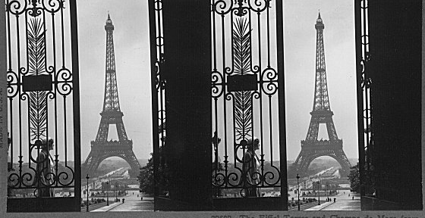
Failures of correspondence search
Textureless surfaces
Occlusions, repetition
Non-Lambertian surfaces, specularities

Slide 21
Dot Projections
http://www.youtube.com/watch?v=28JwgxbQx8w

Slide 22
Depth from Projector-Sensor
Only one image: How is it possible to get depth?
Scene Surface
Projector
Sensor

Slide 23
Same stereo algorithms apply
Projector
Sensor

Slide 24
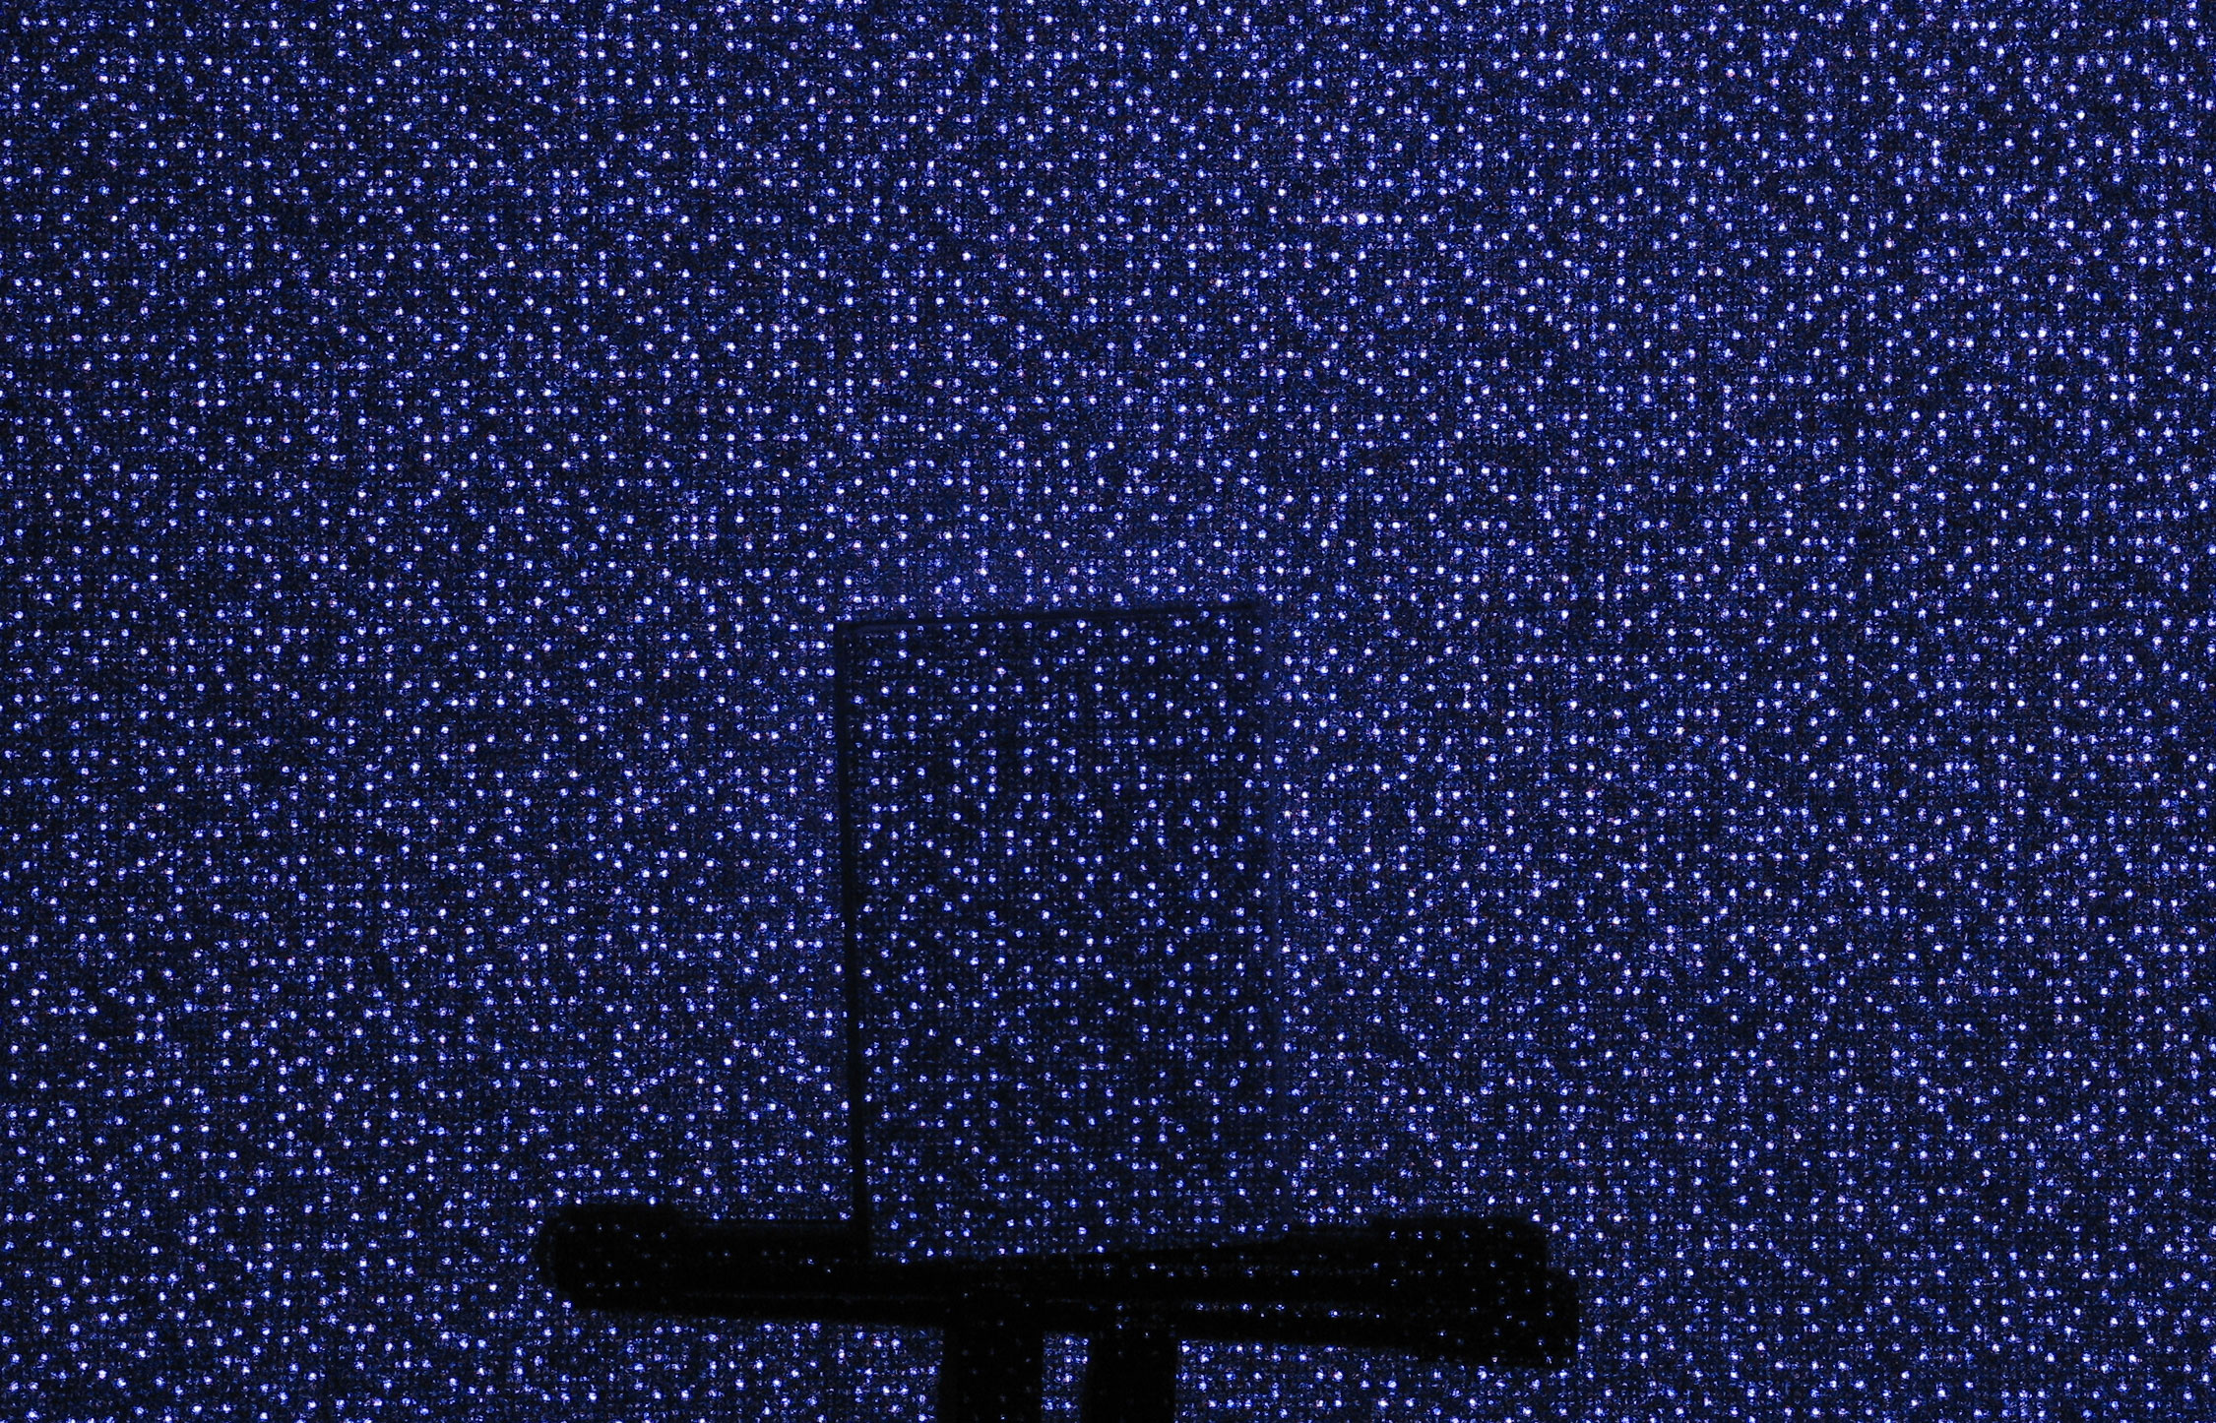
Example: Book vs. No Book
Source: http://www.futurepicture.org/?p=97

Slide 25
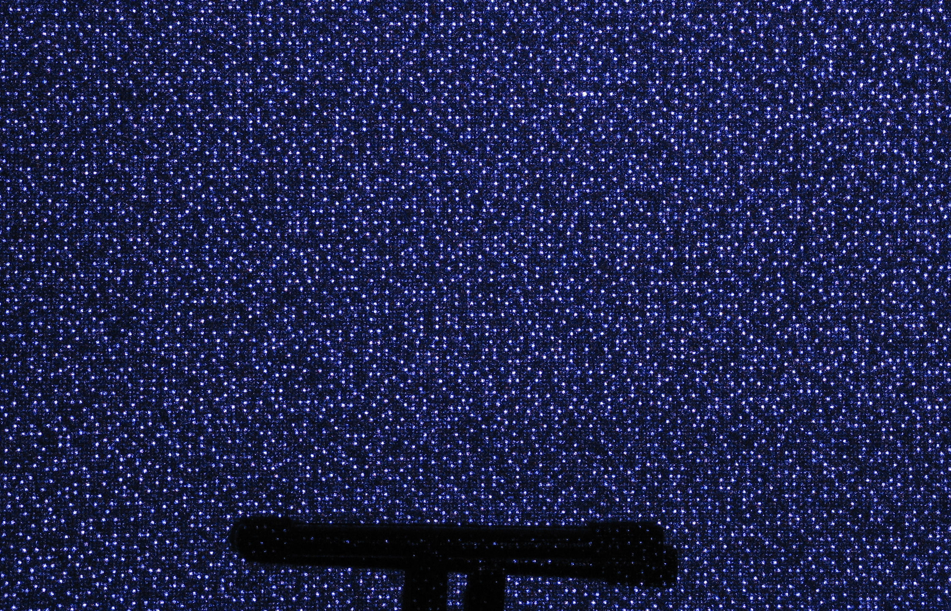
Example: Book vs. No Book
Source: http://www.futurepicture.org/?p=97

Slide 26
Region-growing Random Dot Matching
Detect dots (“speckles”) and label them unknown
Randomly select a region anchor, a dot with unknown depth
Windowed search via normalized cross correlation along scanline
Check that best match score is greater than threshold; if not, mark as “invalid” and go to 2
Region growing
Neighboring pixels are added to a queue
For each pixel in queue, initialize by anchor’s shift; then search small local neighborhood; if matched, add neighbors to queue
Stop when no pixels are left in the queue
Repeat until all dots have known depth or are marked “invalid”
http://www.wipo.int/patentscope/search/en/WO2007043036

Slide 27
Projected IR vs. Natural Light Stereo
What are the advantages of IR?
Works in low light conditions
Does not rely on having textured objects
Not confused by repeated scene textures
Can tailor algorithm to produced pattern
What are advantages of natural light?
Works outside, anywhere with sufficient light
Uses less energy
Resolution limited only by sensors, not projector
Difficulties with both
Very dark surfaces may not reflect enough light
Specular reflection in mirrors or metal causes trouble

Slide 28
Part 2: Pose from depth
IR Projector
IR Sensor
Projected Light Pattern
Stereo Algorithm
Segmentation,
Part Prediction
Depth Image
Body Pose

Slide 29
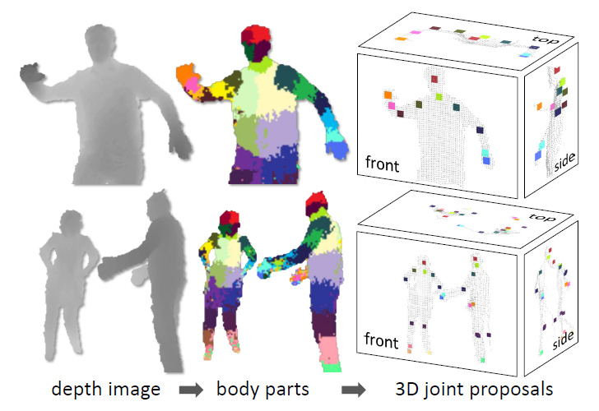
Goal: estimate pose from depth image
Real-Time Human Pose Recognition in Parts from a Single Depth Image
Jamie Shotton, Andrew Fitzgibbon, Mat Cook, Toby Sharp, Mark Finocchio, Richard Moore, Alex Kipman, and Andrew Blake CVPR 2011

Slide 30
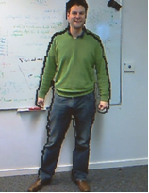
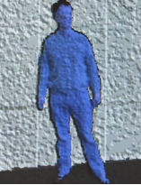
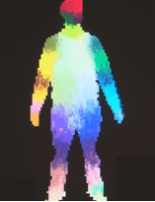
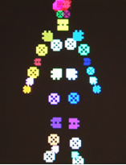
Goal: estimate pose from depth image
RGB
Depth
Part Label Map
Joint Positions
http://research.microsoft.com/apps/video/default.aspx?id=144455

Slide 31
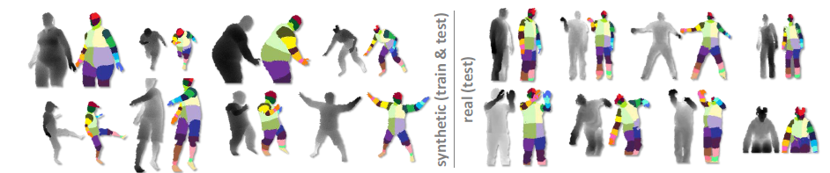
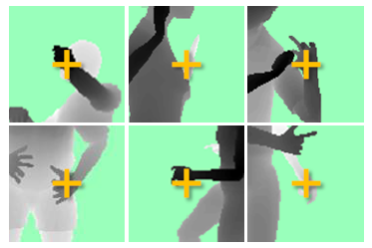
Challenges
Lots of variation in bodies, orientation, poses
Needs to be very fast (their algorithm runs at 200 FPS on the Xbox 360 GPU)
Pose Examples
Examples of one part

Slide 32
Extract body pixels by thresholding depth

Slide 33
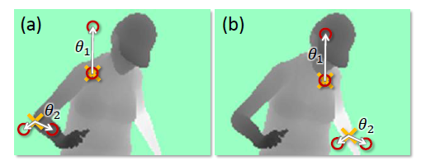
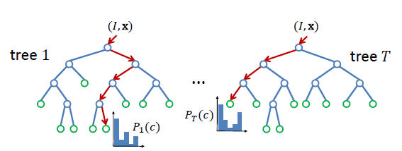
Basic learning approach
Very simple features
Lots of data
Flexible classifier

Slide 34
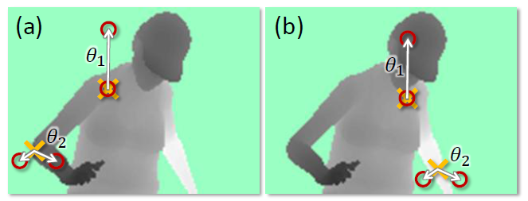
Features
Difference of depth at two offsets
Offset is scaled by depth at center

Slide 35
Get lots of training data
Capture and sample 500K mocap frames of people kicking, driving, dancing, etc.
Get 3D models for 15 bodies with a variety of weight, height, etc.
Synthesize mocap data for all 15 body types

Slide 36
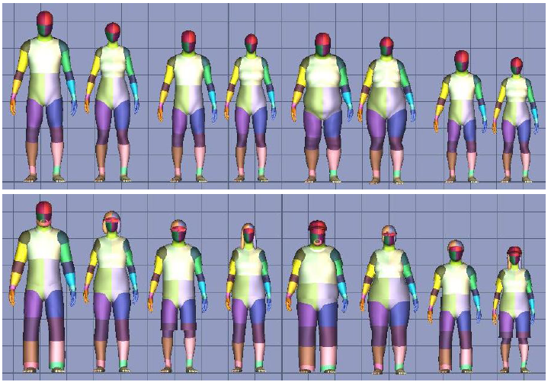
Body models

Slide 37
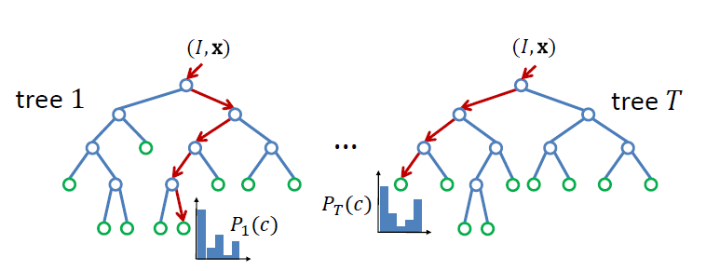
Part prediction with random forests
Randomized decision forests: collection of independently trained trees
Each tree is a classifier that predicts the likelihood of a pixel belonging to each part
Node corresponds to a thresholded feature
The leaf node that an example falls into corresponds to a conjunction of several features
In training, at each node, a subset of features is chosen randomly, and the most discriminative is selected

Slide 38
Joint estimation
Joints are estimated using mean-shift (a fast mode-finding algorithm)
Observed part center is offset by pre-estimated value

Slide 39
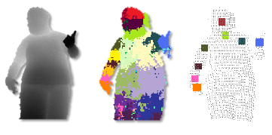
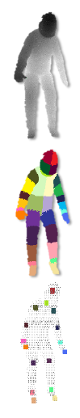
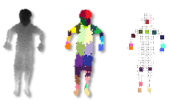
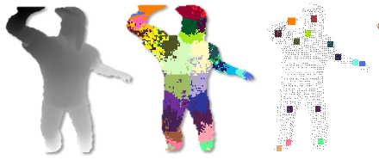
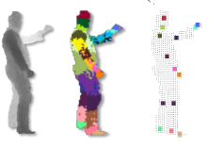
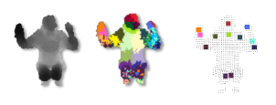
Results
Ground Truth

Slide 40
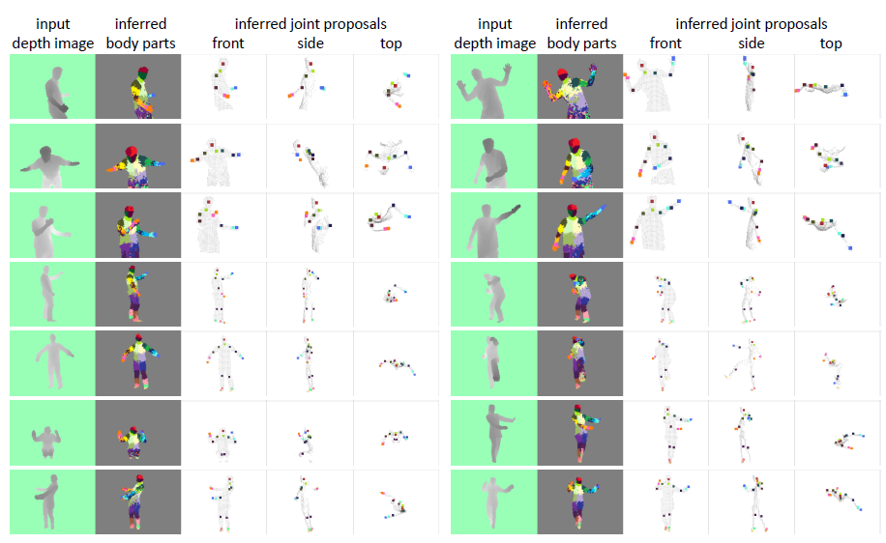
More results

Slide 41
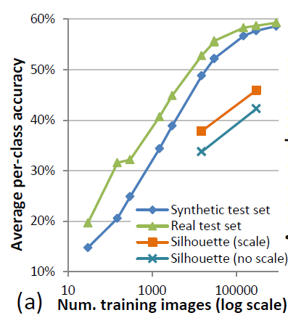
Accuracy vs. Number of Training Examples

Slide 42
Uses of Kinect
Mario: http://www.youtube.com/watch?v=8CTJL5lUjHg
Robot Control: http://www.youtube.com/watch?v=w8BmgtMKFbY
Capture for holography: http://www.youtube.com/watch?v=4LW8wgmfpTE
Virtual dressing room: http://www.youtube.com/watch?v=1jbvnk1T4vQ
Fly wall: http://vimeo.com/user3445108/kiwibankinteractivewall
3D Scanner: http://www.youtube.com/watch?v=V7LthXRoESw
IllumiRoom: http://www.youtube.com/watch?v=V7LthXRoESw

Slide 43
To learn more
Warning: lots of wrong info on web
Great site by Daniel Reetz: http://www.futurepicture.org/?p=97
Kinect patents: http://www.faqs.org/patents/app/20100118123 http://www.faqs.org/patents/app/20100020078 http://www.faqs.org/patents/app/20100007717

Slide 44
Next week
Mon: Image stitching project due
Tues: detecting fake photographs
Thurs: computational approaches to cameras

