Slide 1
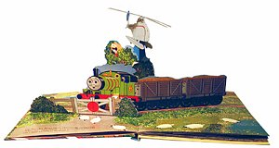
Single-view 3D Reconstruction
10/10/13
Computational Photography
Derek Hoiem, University of Illinois
Some slides from Alyosha Efros, Steve Seitz

Slide 2
Project 3 extension (one day)
EWS down Fri 9pm to Sun 10am
Project 3 now due Tues

Slide 3
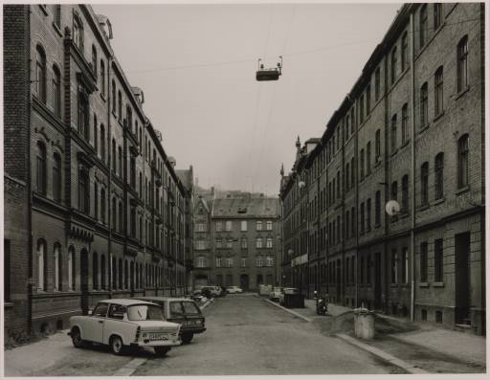
Take-home question
Suppose you have estimated three vanishing points corresponding to orthogonal directions. How can you recover the rotation matrix that is aligned with the 3D axes defined by these points?
  Assume that intrinsic matrix K has three parameters
  Remember, in homogeneous coordinates, we can write a 3d point at infinity as (X, Y, Z, 0)
VP_{y}
.
VP_{x}
VP_{z}
Photo from online Tate collection

Slide 4
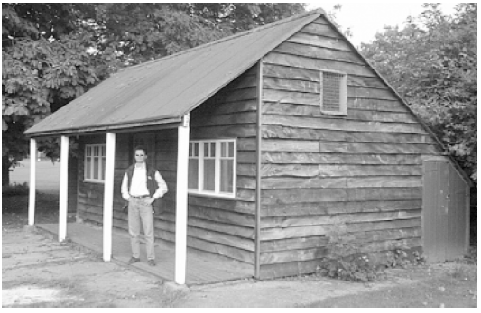
Take-home question
Assume that the camera height is 5 ft.
  What is the height of the man?
  What is the height of the building?

Slide 5
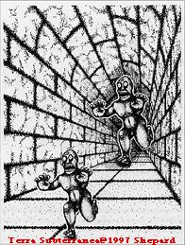

Slide 6
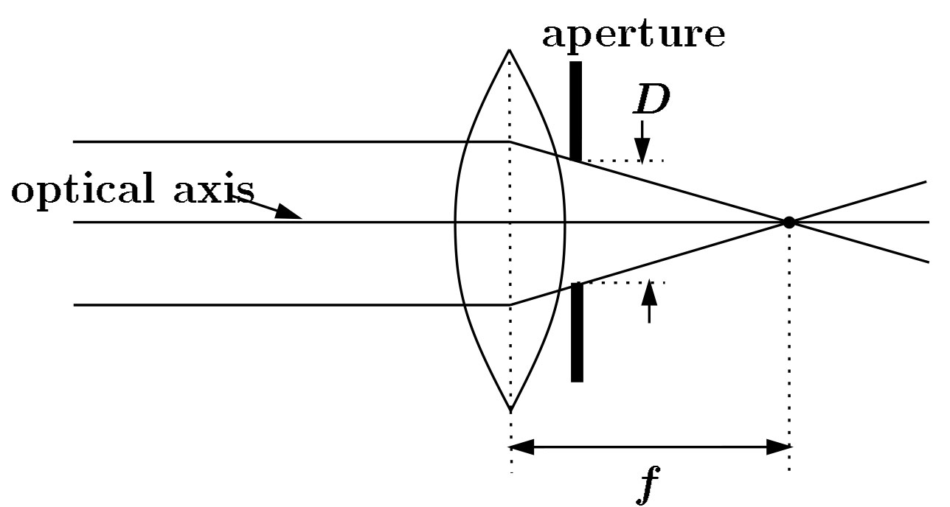
Focal length, aperture, depth of field
F
focal point
optical center
(Center Of Projection)
A lens focuses parallel rays onto a single focal point
  focal point at a distance f beyond the plane of the lens
  Aperture of diameter D restricts the range of rays
Slide source: Seitz

Slide 7
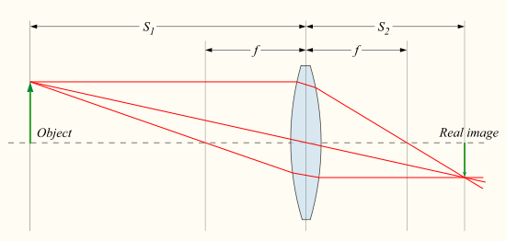

Focus with lenses
Distance to object
Distance to sensor
Lens focal length
Equation for objects in focus
Source: http://en.wikipedia.org/wiki/File:Lens3.svg
Notes:
Which object points are in focus depends on the distance of the image plane from the lense

Slide 8

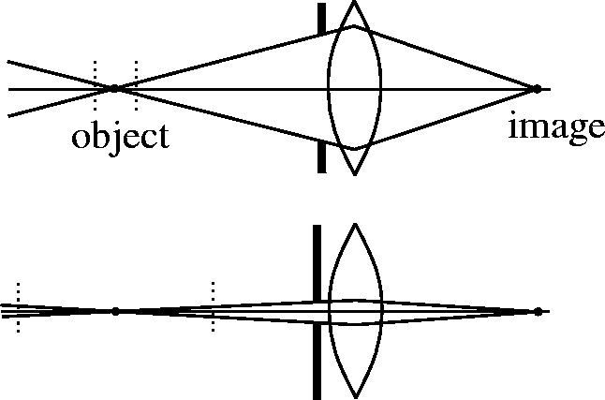

The aperture and depth of field
Slide source: Seitz
f / 5.6
f / 32
Changing the aperture size or focusing distance affects depth of field
  f-number (f/#) =focal_length / aperture_diameter (e.g., f/16 means that the focal length is 16 times the diameter)
  When you change the f-number, you are changing the aperture
Flower images from Wikipedia http://en.wikipedia.org/wiki/Depth_of_field

Slide 9
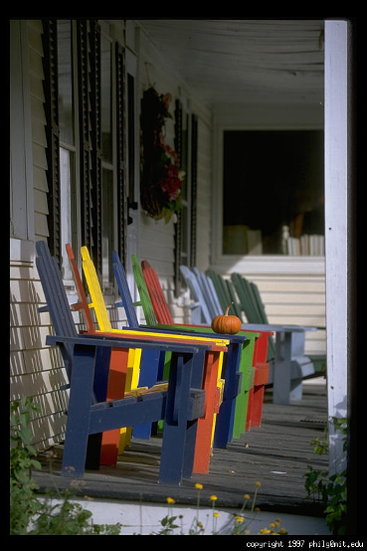
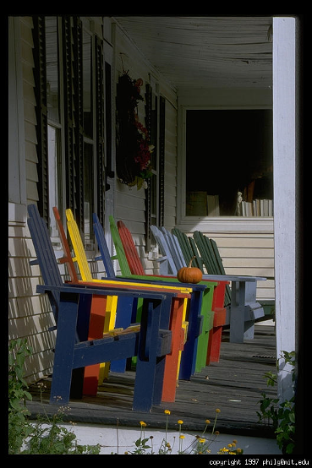
Varying the aperture
Slide from Efros
Large aperture = small DOF
Small aperture = large DOF

Slide 10
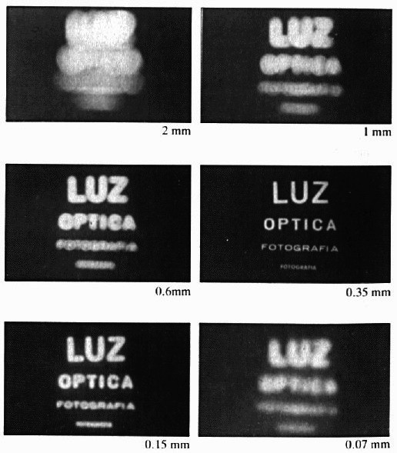
Shrinking the aperture
Why not make the aperture as small as possible?
  Less light gets through
  Diffraction effects
Slide by Steve Seitz

Slide 11
Shrinking the aperture
Slide by Steve Seitz

Slide 12
The Photographer’s Great Compromise
What we want
More spatial resolution
Broader field of view
More depth of field
More temporal resolution
More light
How we get it
Cost
Increase focal length
Light, FOV
Decrease focal length
Resolution,
DOF
Decrease aperture
Light
Increase aperture
DOF
Shorten exposure
Light
Lengthen exposure
Temporal Res

Slide 13
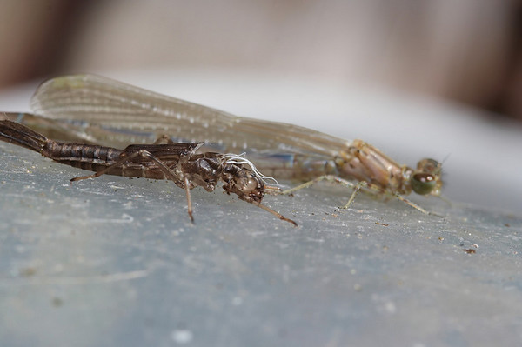
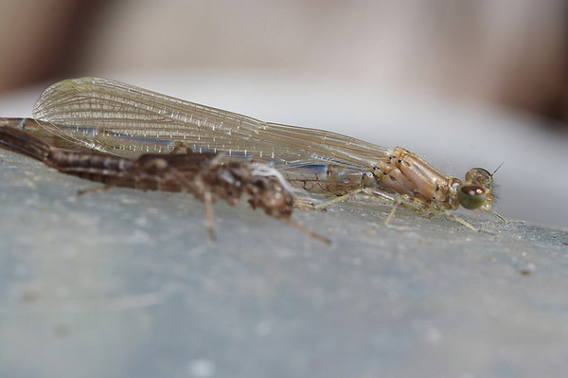
Difficulty in macro (close-up) photography
For close objects, we have a small relative DOF
Can only shrink aperture so far
How to get both bugs in focus?

Slide 14
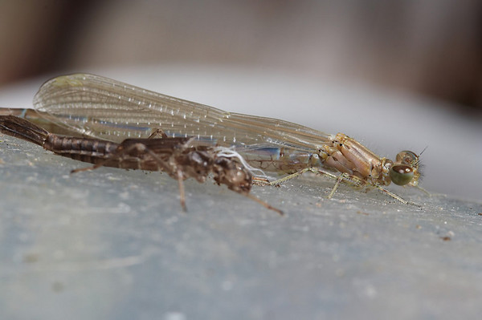
Solution: Focus stacking
Take pictures with varying focal length
Example from
http://www.wonderfulphotos.com/articles/macro/focus_stacking/

Slide 15
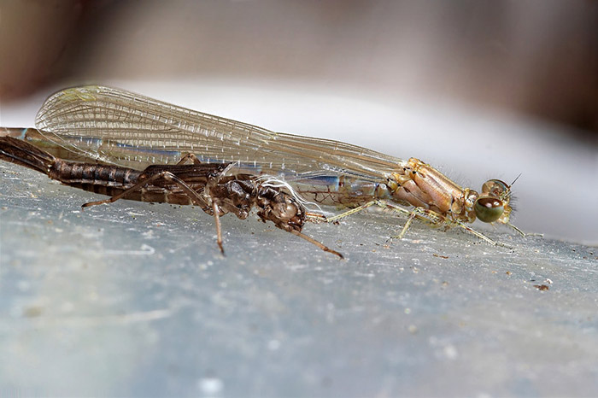
Solution: Focus stacking
Take pictures with varying focal length
Combine

Slide 16

Focus stacking
http://www.wonderfulphotos.com/articles/macro/focus_stacking/

Slide 17
Focus stacking
How to combine?
Web answer: With software (Photoshop, CombineZM)
How to do it automatically?

Slide 18
Focus stacking
How to combine?
Align images (e.g., using corresponding points)
Two ideas
  Mask regions by hand and combine with pyramid blend
  Gradient domain fusion (mixed gradient) without masking
Automatic solution would make a very interesting final project
Recommended Reading:
http://www.digital-photography-school.com/an-introduction-to-focus-stacking
http://www.zen20934.zen.co.uk/photography/Workflow.htm#Focus%20Stacking

Slide 19
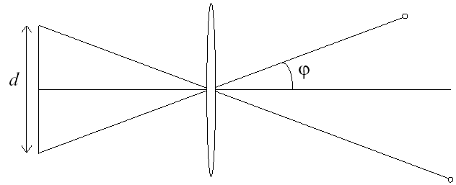
Relation between field of view and focal length
Field of view (angle width)
Film/Sensor Width
Focal length

Slide 20
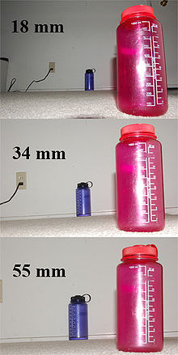
Dolly Zoom or “Vertigo Effect”
http://www.youtube.com/watch?v=NB4bikrNzMk
How is this done?
Zoom in while moving away
http://en.wikipedia.org/wiki/Focal_length

Slide 21
Dolly zoom (or “Vertigo effect”)
Field of view (angle width)
Film/Sensor Width
Focal length
width of object
Distance between object and camera

Slide 22
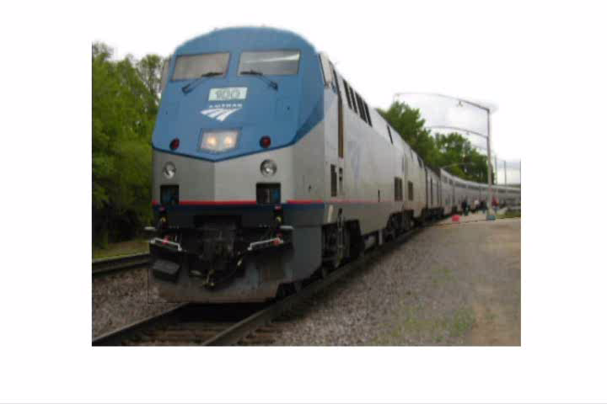
Today’s class: 3D Reconstruction

Slide 23
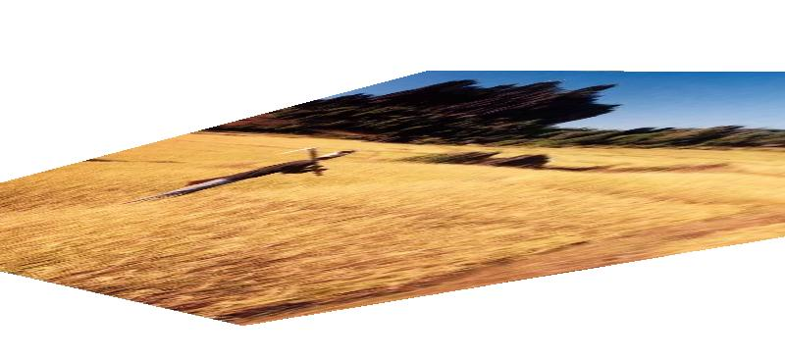
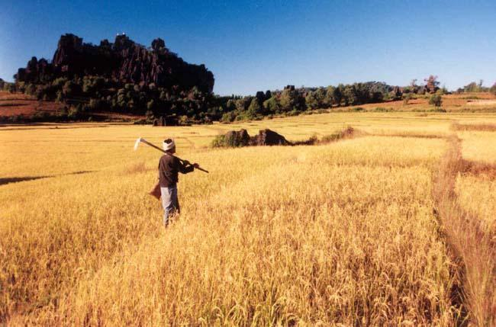
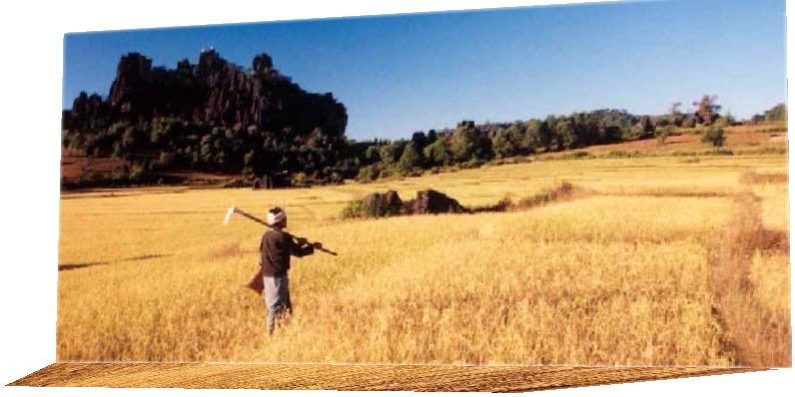
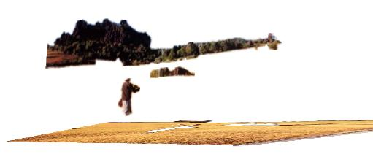
The challenge
One 2D image could be generated by an infinite number of 3D geometries
?
?
?

Slide 24
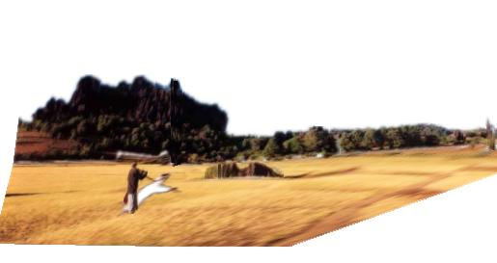
The solution
Make simplifying assumptions about 3D geometry
Unlikely
Likely

Slide 25
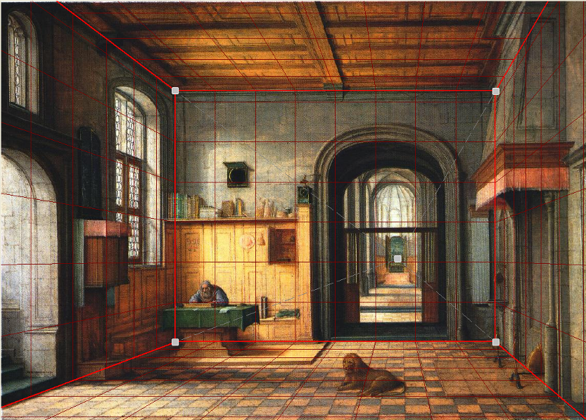
Today’s class: Two Models
Box + frontal billboards
Ground plane + non-frontal billboards

Slide 26
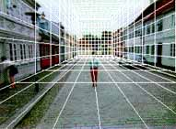
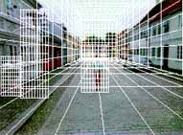
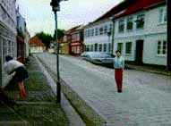
“Tour into the Picture” (Horry et al. SIGGRAPH ’97)
Create a 3D “theatre stage” of five billboards
Specify foreground objects through bounding polygons
Use camera transformations to navigate through the scene
Following slides modified from Efros

Slide 27
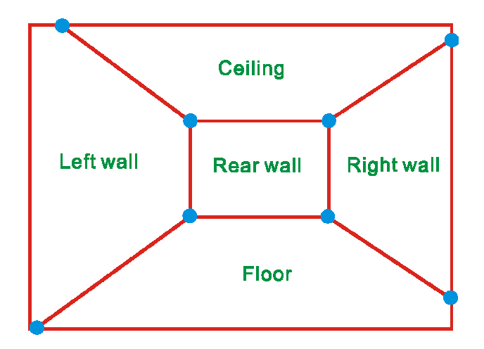
The idea
Many scenes can be represented as an axis-aligned box volume (i.e. a stage)
Key assumptions
All walls are orthogonal
Camera view plane is parallel to back of volume
How many vanishing points does the box have?
Three, but two at infinity
Single-point perspective
Can use the vanishing point
to fit the box to the particular
scene

Slide 28
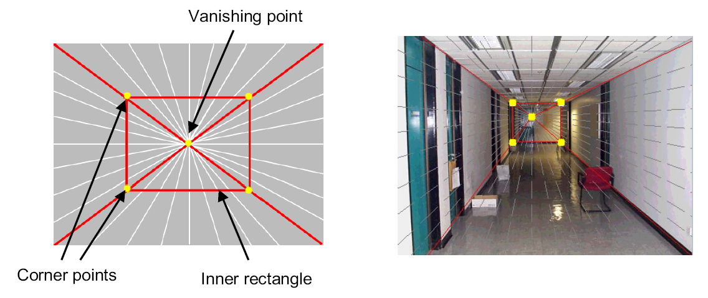
Step 1: specify scene geometry
User controls the inner box and the vanishing point placement (# of DOF?)
Q: What’s the significance of the vanishing point location?
A: It’s at eye (camera) level: ray from center of projection to VP is perpendicular to image plane
  Under single-point perspective assumptions, the VP should be the principal point of the image

Slide 29
Example of user input: vanishing point and back face of view volume are defined
High
Camera

Slide 30
Example of user input: vanishing point and back face of view volume are defined
Low
Camera

Slide 31
Comparison of how image is subdivided based on two different camera positions. You should see how moving the box corresponds to moving the eyepoint in the 3D world.
High Camera
Low Camera

Slide 32
Another example of user input: vanishing point and back face of view volume are defined
Left
Camera

Slide 33
Another example of user input: vanishing point and back face of view volume are defined
Right
Camera

Slide 34
Comparison of two camera placements – left and right. Corresponding subdivisions match view you would see if you looked down a hallway.
Left Camera
Right Camera

Slide 35
Question
Think about the camera center and image plane…
  What happens when we move the box?
  What happens when we move the vanishing point?

Slide 36
2D to 3D conversion
First, we can get ratios
left
right
top
vanishing
point
bottom
back
plane

Slide 37
2D to 3D conversion
Size of user-defined back plane determines width/height throughout box (orthogonal sides)
Use top versus side ratio
to determine relative
height and width
dimensions of box
Left/right and top/bot
ratios determine part of
3D camera placement
left
right
top
camera
pos
bottom

Slide 38
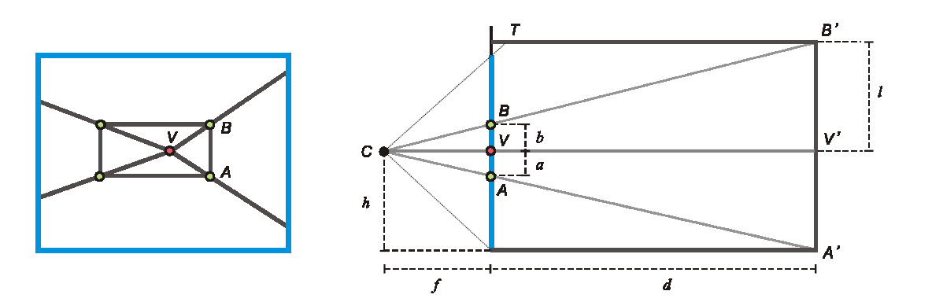
Depth of the box
Can compute by similar triangles (CVA vs. CV’A’)
Need to know focal length f (or FOV)
Note: can compute position on any object on the ground
  Simple unprojection
  What about things off the ground?

Slide 39
Step 2: map image textures into frontal view
2d coordinates
3d plane coordinates
A
B’
A’
C
D
B
C’
D’

Slide 40
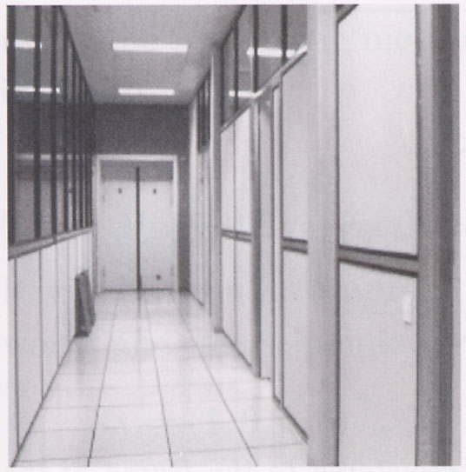
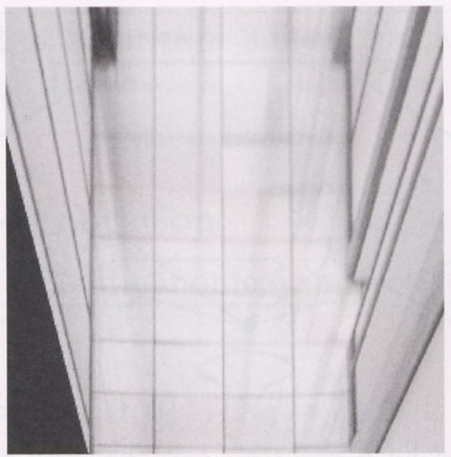
Image rectification
p’
p
To unwarp (rectify) an image solve for homography H given p and p’: wp’=Hp

Slide 41
Computing homography
Assume we have four matched points: How do we compute homography H?
Direct Linear Transformation (DLT)

Slide 42
Computing homography
Direct Linear Transform
Apply SVD: USV^{T} = A
h = V_{smallest} (column of V^{T} corr. to smallest singular value)
Matlab
[U, S, V] = svd(A);
h = V(:, end);
Explanation of SVD (also here) and solving systems of linear equations
Notes:
SVD gives the homogeneous least squares solution constrained to have a norm of 1

Slide 43
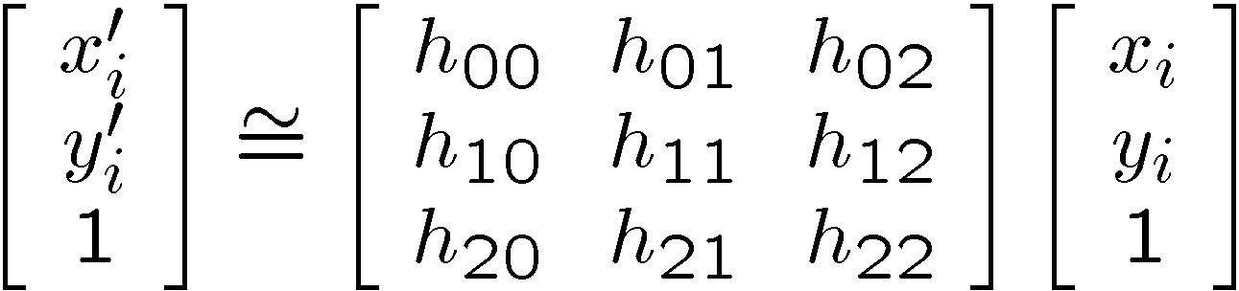
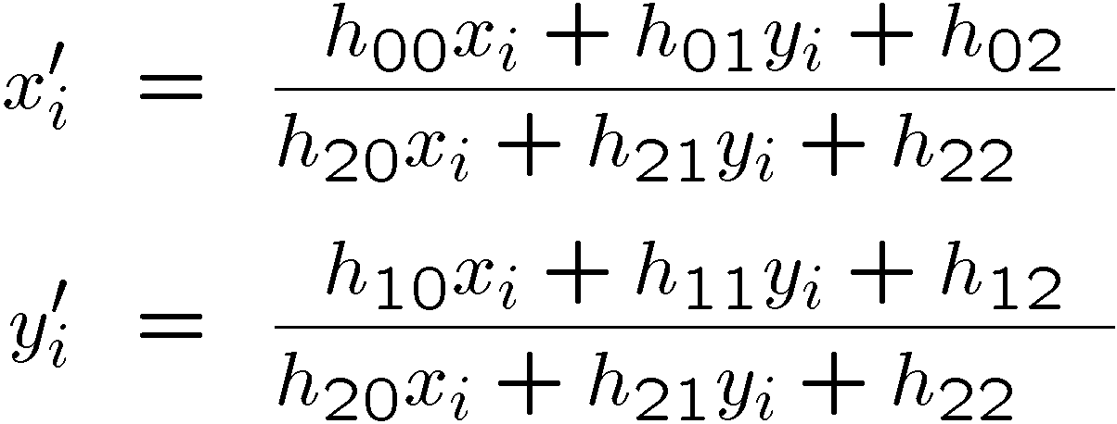
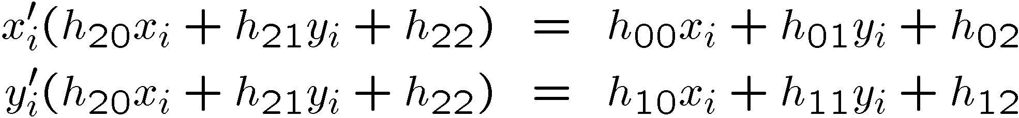
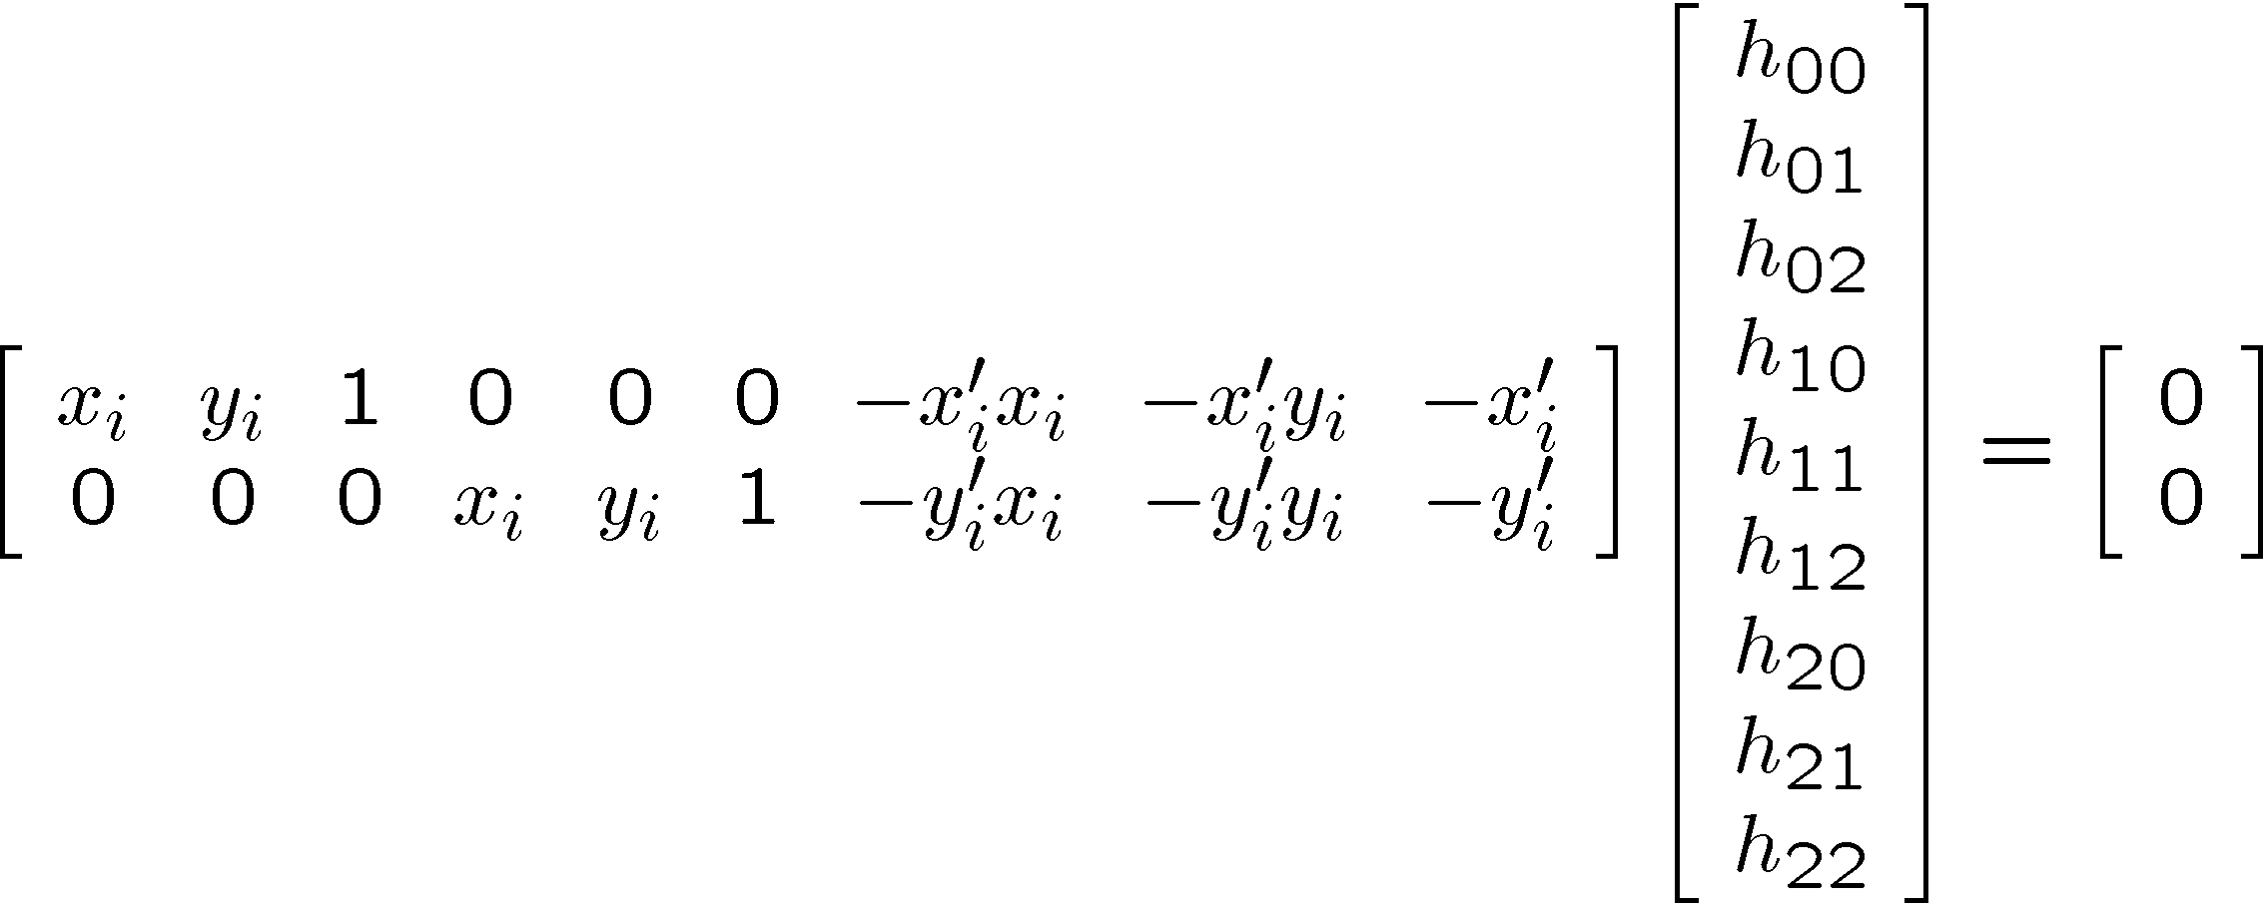
Solving for homographies (more detail)

Slide 44
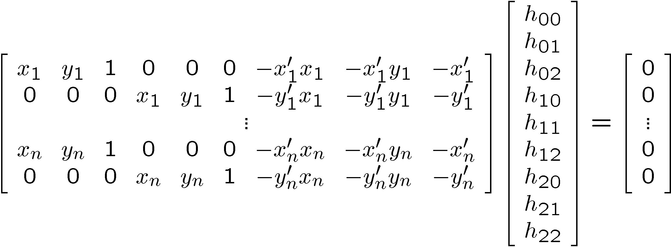

Solving for homographies (more detail)
A
h
0
2n × 9
9
2n
Defines a least squares problem:
  Since h is only defined up to scale, solve for unit vector ĥ
  Solution: ĥ = eigenvector of A^{T}A with smallest eigenvalue
  Works with 4 or more points

Slide 45
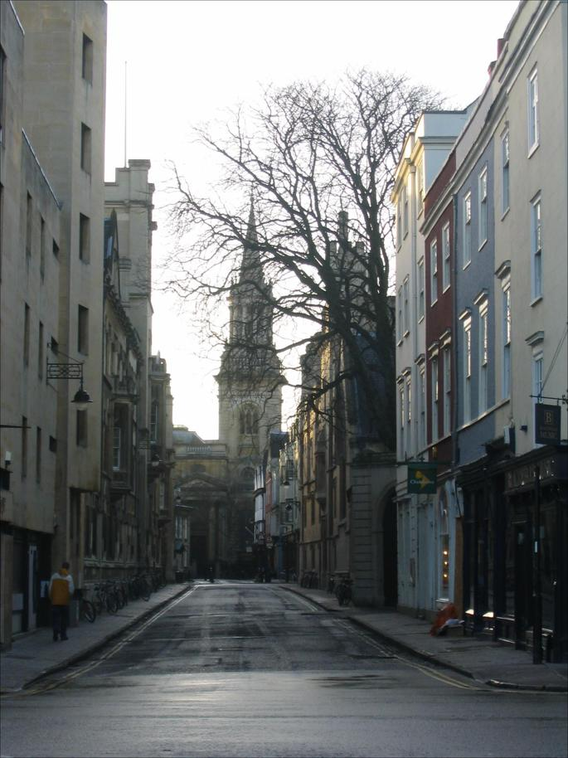
Tour into the picture algorithm
Set the box corners

Slide 46
Tour into the picture algorithm
Set the box corners
Set the VP
Get 3D coordinates
  Compute height, width, and depth of box
Get texture maps
  homographies for each face
Create file to store plane coordinates and texture maps
x

Slide 47
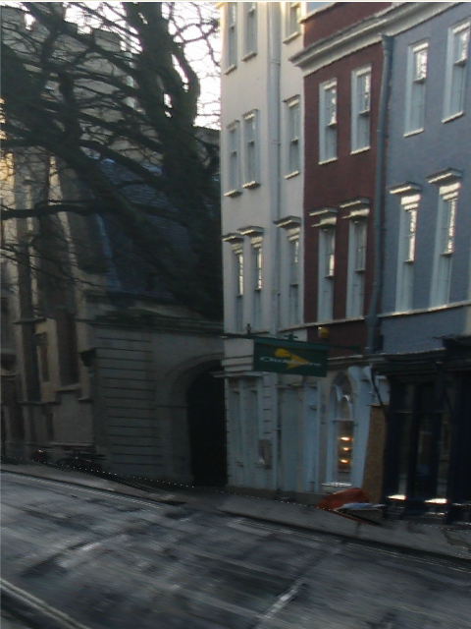
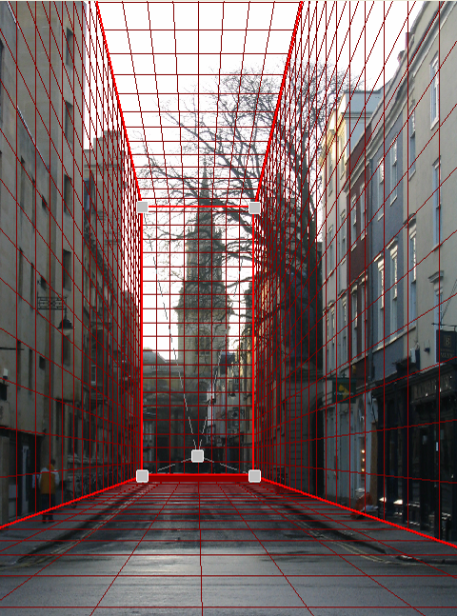
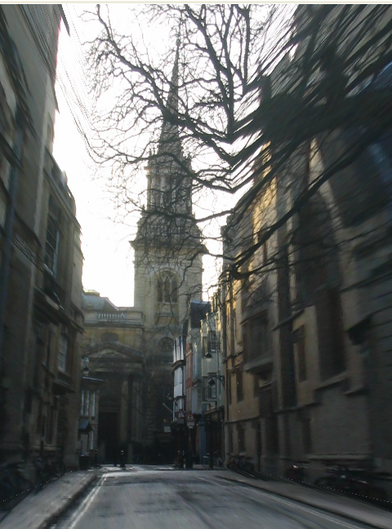
Result
Render from new views
http://www.cs.cmu.edu/afs/cs.cmu.edu/academic/class/15463-f08/www/proj5/www/dmillett/

Slide 48
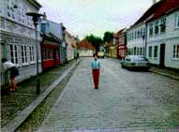

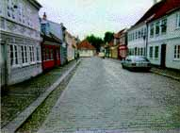
Foreground Objects
Use separate billboard for each
For this to work, three separate images used:
  Original image.
  Mask to isolate desired foreground images.
  Background with objects removed

Slide 49
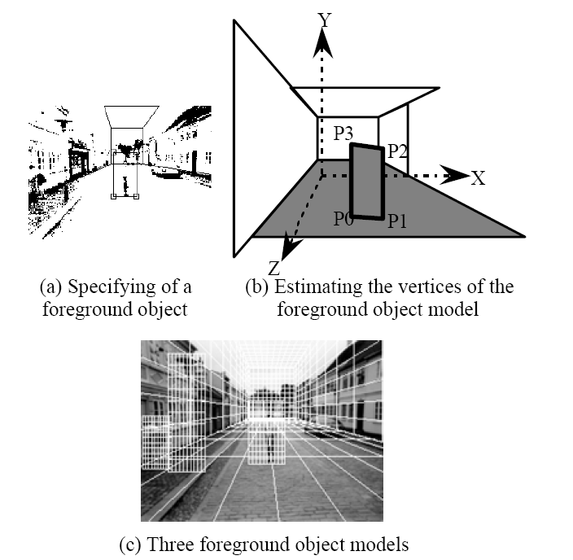
Foreground Objects
Add vertical rectangles for each foreground object
Can compute 3D coordinates P0, P1 since they are on known plane.
P2, P3 can be computed as before (similar triangles)

Slide 50
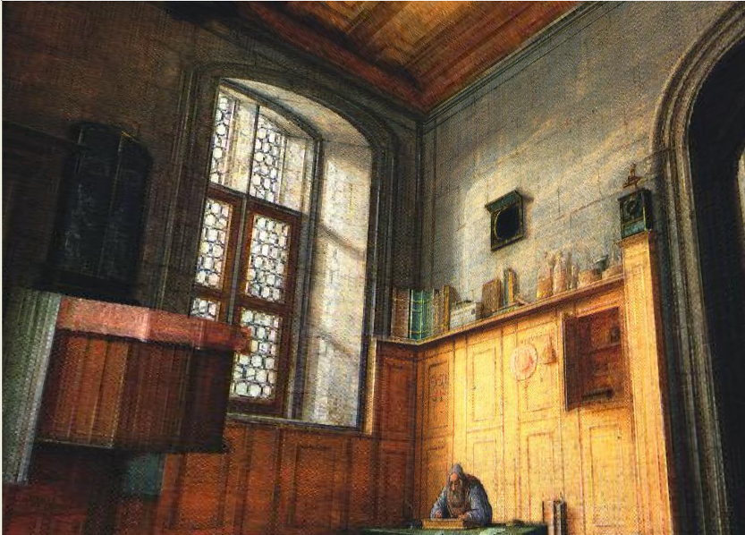
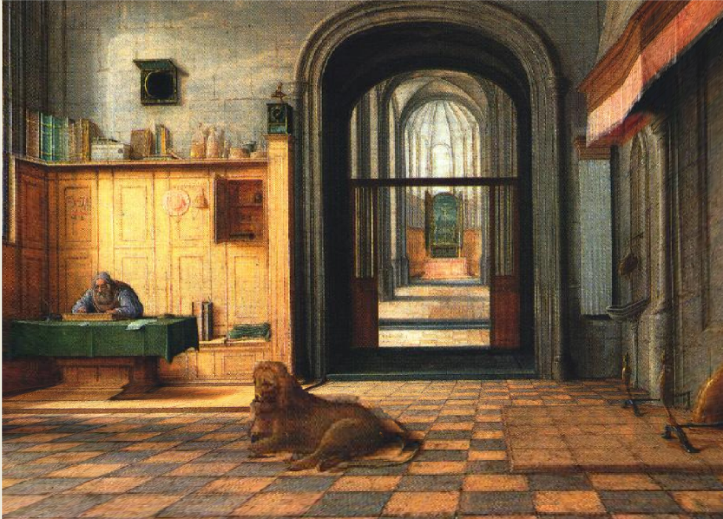
Foreground Result
Video from CMU class: http://www.youtube.com/watch?v=dUAtdmGwcuM

Slide 51
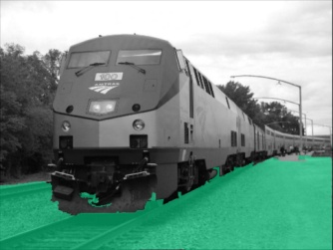
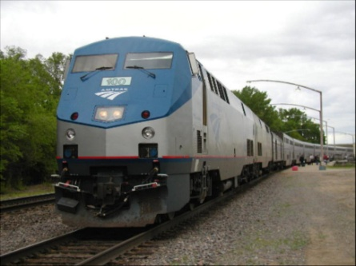
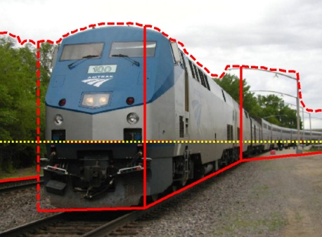
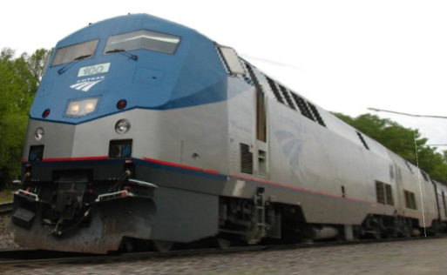
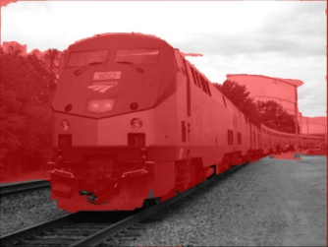













Automatic Photo Pop-up
Input
Geometric Labels
Cut’n’Fold
3D Model
Ground
Image
Vertical
Learned Models
Sky
Hoiem et al. 2005

Slide 52


Cutting and Folding
Fit ground-vertical boundary
  Iterative Hough transform

Slide 53
Cutting and Folding
Form polylines from boundary segments
  Join segments that intersect at slight angles
  Remove small overlapping polylines
Estimate horizon position from perspective cues

Slide 54

Cutting and Folding
``Fold’’ along polylines and at corners
``Cut’’ at ends of polylines and along vertical-sky boundary

Slide 55

Cutting and Folding
Construct 3D model
Texture map

Slide 56




Results
http://www.cs.illinois.edu/homes/dhoiem/projects/popup/
Input Image
Cut and Fold
Automatic Photo Pop-up

Slide 57




Results
Input Image
Automatic Photo Pop-up

Slide 58


Comparison with Manual Method
[Liebowitz et al. 1999]
Input Image
Automatic Photo Pop-up (15 sec)!
Notes:
From the results of Liebowitz et al. As you can see, their model is slightly better in that the roof is slanted, but our method is fully automatic requiring none of the user’s time, while their method requires extensive manual labeling.

Slide 59



Failures
Labeling Errors

Slide 60




Failures
Foreground Objects

Slide 61

Adding Foreground Labels
Recovered Surface Labels +
Ground-Vertical Boundary Fit
Object Boundaries + Horizon

Slide 62

Notes:
Explain holes

Slide 63
Final project ideas
If a one-person project:
  Interactive program to make 3D model from an image (e.g., output in VRML, or draw path for animation)
If a two-person team, 2nd person:
  Add tools for cutting out foreground objects and automatic hole-filling

Slide 64
Summary
2D→3D is mathematically impossible
Need right assumptions about the world geometry
Important tools
  Vanishing points
  Camera matrix
  Homography

Slide 65
Next Week
Project 3 is due Tuesday (extension of 1 day)
Next three classes: image-based lighting
  How to model light
  Recover HDR image from multiple LDR images
  Recover lighting model from an image
  Render object into a scene with correct lighting and geometry

