Slide 1
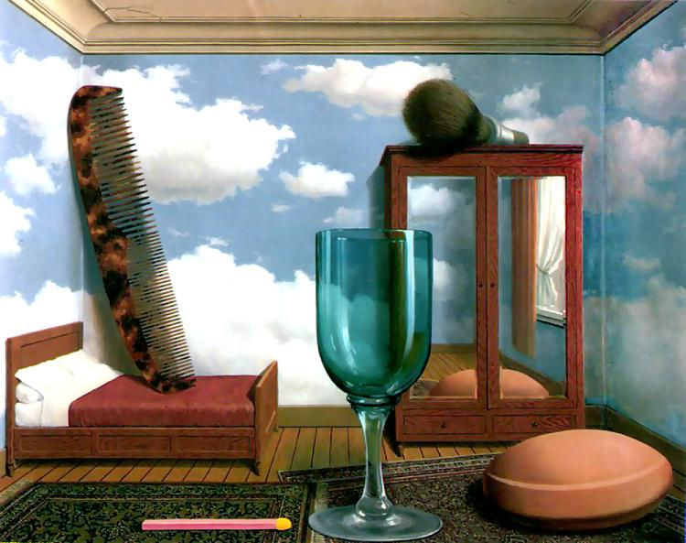
Single-view Metrology and Cameras
10/8/13
Computational Photography
Derek Hoiem, University of Illinois

Slide 2
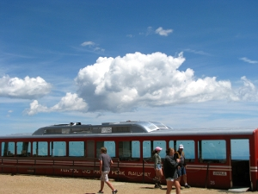
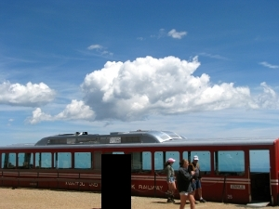
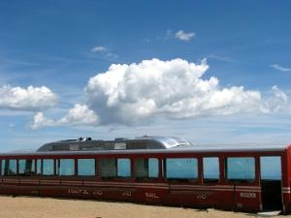

Project 2
Class favorites
Projects: Joe DeGol, Justin Thorsen
Favorite result
Justin Thorsen: synthesis on train

Slide 3
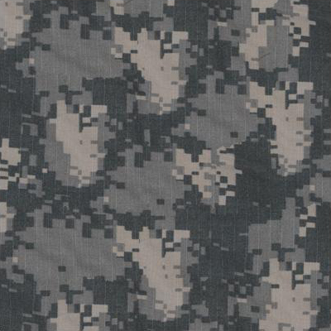
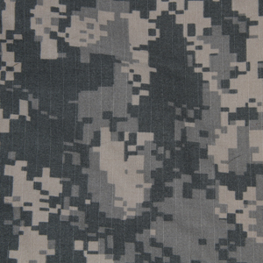
Synthesis
Andrew M

Slide 4


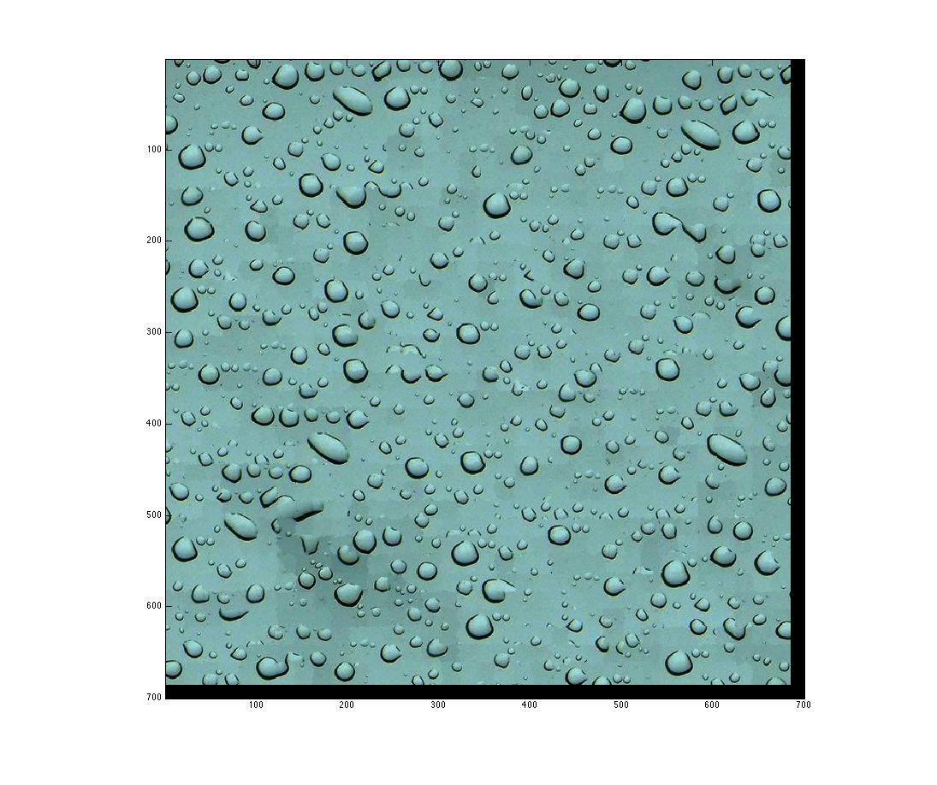

Synthesis
Rui Wang

Slide 5
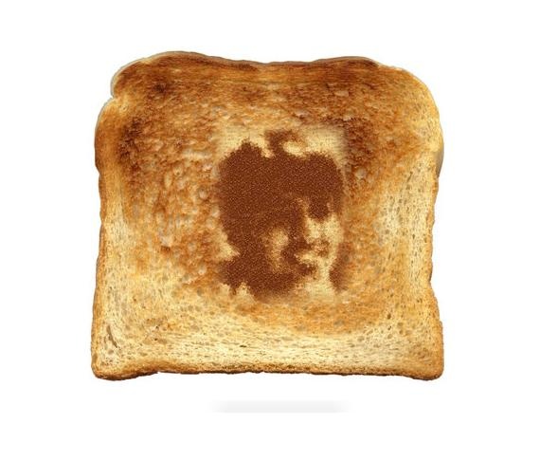
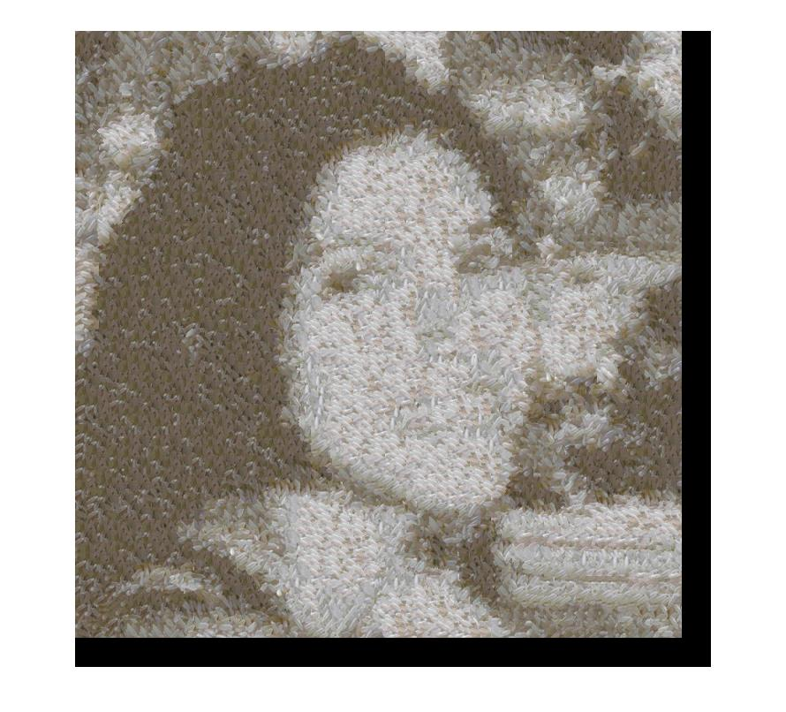

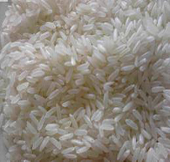
Transfer
Banu M

Slide 6
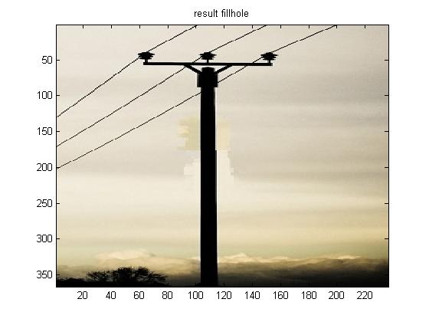
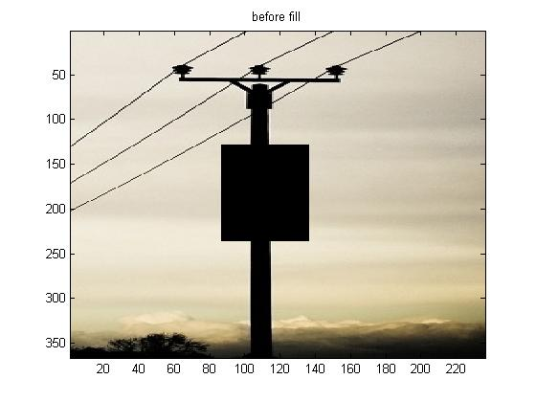
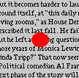

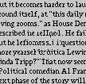
Hole filling
Jiajun Li
http://web.engr.illinois.edu/~jlu23/Course/cs498dh3/hw2/
Michael Sittig
http://web.engr.illinois.edu/~sittig2/cs498dwh/proj2/

Slide 7
Project 3
Due Monday
http://courses.engr.illinois.edu/cs498dh3/projects/gradient/ComputationalPhotography_ProjectGradient.html
Strongly recommend that you get at least toy problem working before Thursday

Slide 8
Review: Pinhole Camera
.
Optical Center (u₀, v₀)
.
.
f
Z
Y
.
v
Camera Center (t_{x}, t_{y}, t_{z})
u

Slide 9
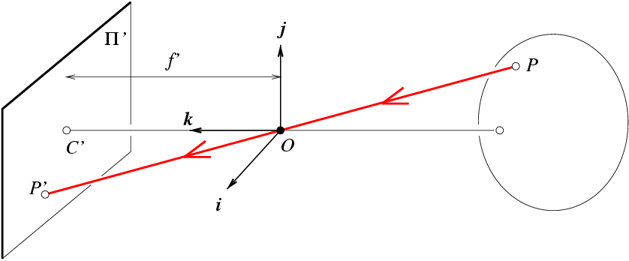
Review: Projection Matrix
R
j_{w}
t
k_{w}
O_{w}
i_{w}

Slide 10
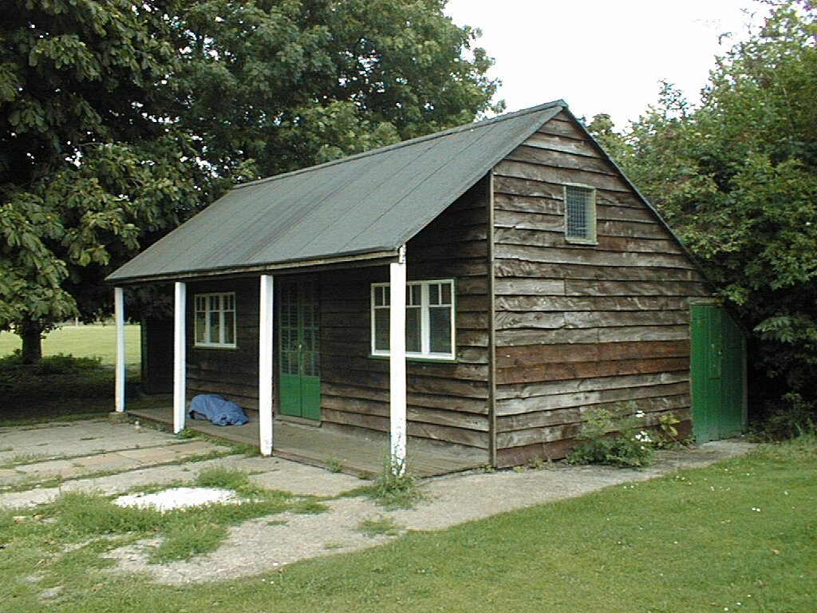
Review: Vanishing Points
Vertical vanishing
point
(at infinity)
Vanishing
line
Vanishing
point
Vanishing
point
Slide from Efros, Photo from Criminisi

Slide 11
This class
How can we calibrate the camera?
How can we measure the size of objects in the world from an image?
What about other camera properties: focal length, field of view, depth of field, aperture, f-number?
How to do “focus stacking” to get a sharp picture of a nearby object
How the “vertigo effect” works

Slide 12
How to calibrate the camera?

Slide 13
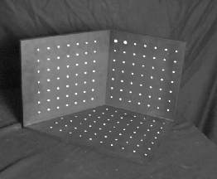
Calibrating the Camera
Method 1: Use an object (calibration grid) with known geometry
Correspond image points to 3d points
Get least squares solution (or non-linear solution)

Slide 14
Calibrating the Camera
Method 2: Use vanishing points
Find vanishing points corresponding to orthogonal directions
Vertical vanishing
point
(at infinity)
Vanishing
line
Vanishing
point
Vanishing
point

Slide 15
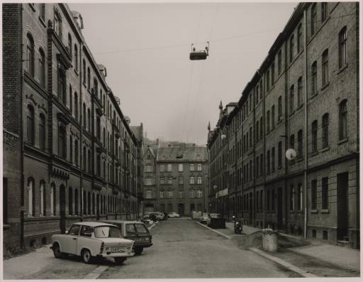
Take-home question
Suppose you have estimated three vanishing points corresponding to orthogonal directions. How can you recover the rotation matrix that is aligned with the 3D axes defined by these points?
Assume that intrinsic matrix K has three parameters
Remember, in homogeneous coordinates, we can write a 3d point at infinity as (X, Y, Z, 0)
VP_{y}
.
VP_{x}
VP_{z}
Photo from online Tate collection

Slide 16
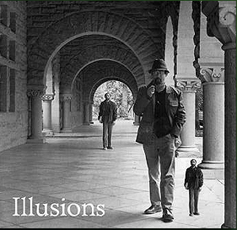
How can we measure the size of 3D objects from an image?
Slide by Steve Seitz

Slide 17
Perspective cues
Slide by Steve Seitz

Slide 18
Perspective cues
Slide by Steve Seitz

Slide 19
Perspective cues
Slide by Steve Seitz

Slide 20
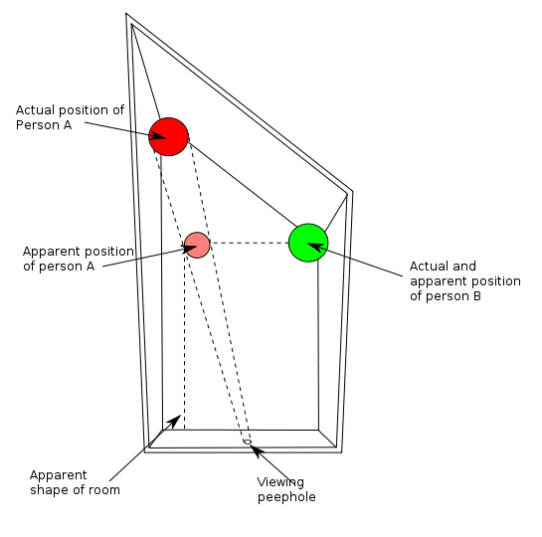
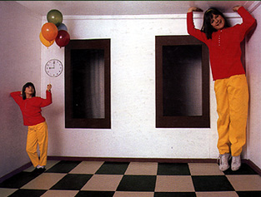
Ames Room

Slide 21
Comparing heights
Slide by Steve Seitz
Vanishing
Point

Slide 22
Measuring height
Slide by Steve Seitz
5.4
5
Camera height
4
3.3
3
2.8
2
1

Slide 23
Two views of a scene
Image
camera center
Parallel to ground
horizon
image plane
ground
camera looks down
slight foreshortening due to camera angle

Slide 24

Which is higher – the camera or the parachute?

Slide 25
Computing vanishing points (from lines)
v
q₂
q₁
p₂
p₁
Intersect p₁q₁ with p₂q₂
Least squares version
Better to use more than two lines and compute the “closest” point of intersection
See notes by Bob Collins for one good way of doing this:
http://www-2.cs.cmu.edu/~ph/869/www/notes/vanishing.txt

Slide 26
Measuring height without a giant ruler
Slide by Steve Seitz
C
Z
ground plane
Compute Z from image measurements
Need a reference object

Slide 27
The cross ratio
Slide by Steve Seitz
A Projective Invariant
Something that does not change under projective transformations (including perspective projection)
The cross-ratio of 4 collinear points
P₄
P₃
P₂
P₁
Can permute the point ordering
4! = 24 different orders (but only 6 distinct values)
This is the fundamental invariant of projective geometry

Slide 28
Measuring height
Slide by Steve Seitz
∞
scene cross ratio
T (top of object)
t
r
R (reference point)
C
H
b
R
image cross ratio
v_{Z}
B (bottom of object)
ground plane
scene points represented as
image points as

Slide 29


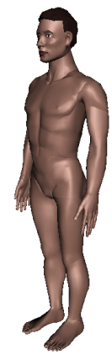
Measuring height
Slide by Steve Seitz
v_{z}
r
vanishing line (horizon)
t₀
t
v_{x}
v
v_{y}
H
R
H
b₀
b
image cross ratio

Slide 30
Measuring height
Slide by Steve Seitz
v_{z}
r
t₀
vanishing line (horizon)
t₀
v_{x}
v
v_{y}
m₀
t₁
b₀
b₁
b
What if the point on the ground plane b₀ is not known?
Here the guy is standing on the box, height of box is known
Use one side of the box to help find b₀ as shown above

Slide 31
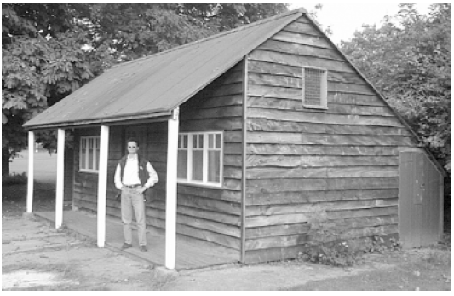
Take-home question
Assume that the camera height is 5 ft.
What is the height of the man?
What is the height of the building?

Slide 32
Beyond the pinhole: What about focus, aperture, DOF, FOV, etc?
.
Optical Center (u₀, v₀)
.
.
f
Z
Y
.
v
Camera Center (t_{x}, t_{y}, t_{z})
u

Slide 33
Adding a lens
“circle of
confusion”
A lens focuses light onto the film
There is a specific distance at which objects are “in focus”
other points project to a “circle of confusion” in the image
Changing the shape of the lens changes this distance

Slide 34
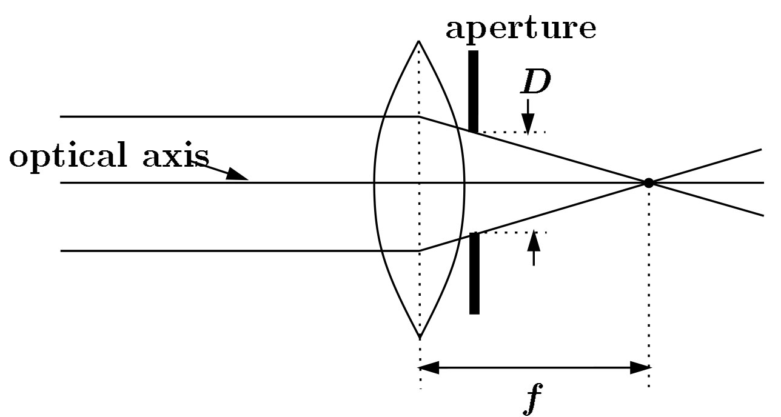
Focal length, aperture, depth of field
F
focal point
optical center
(Center Of Projection)
A lens focuses parallel rays onto a single focal point
focal point at a distance f beyond the plane of the lens
Aperture of diameter D restricts the range of rays
Slide source: Seitz

Slide 35
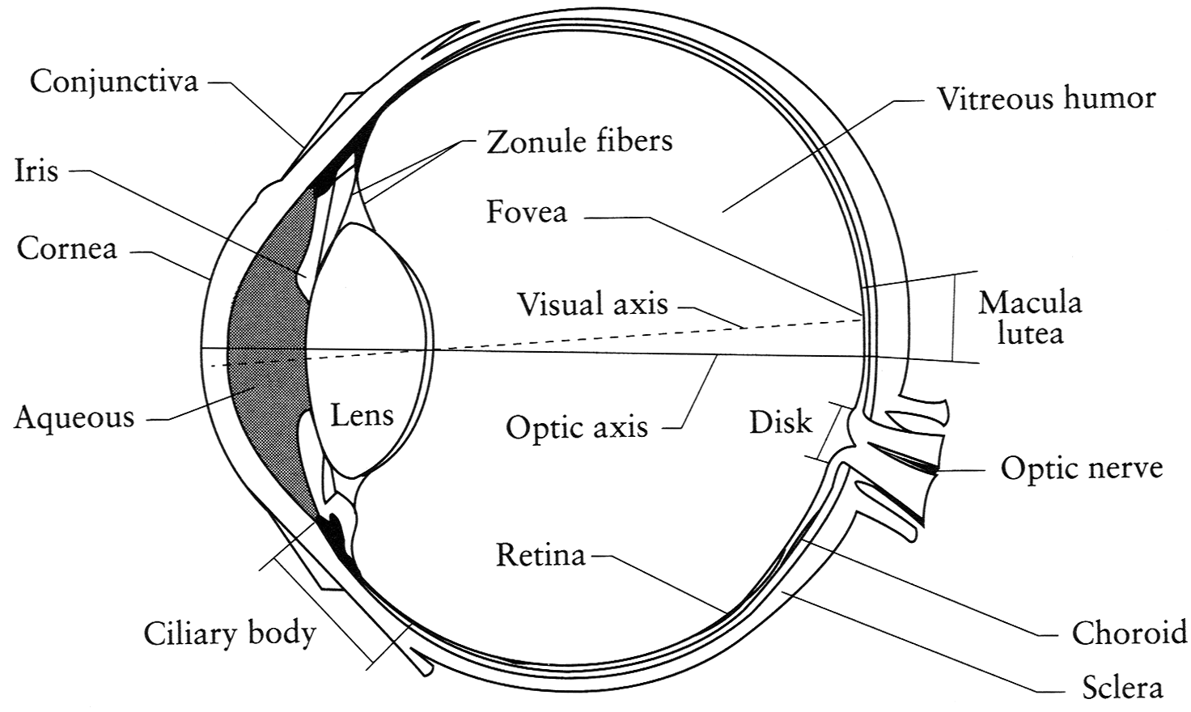
The eye
The human eye is a camera
Iris - colored annulus with radial muscles
Pupil - the hole (aperture) whose size is controlled by the iris
Notes:
Note that the retina is curved

Slide 36
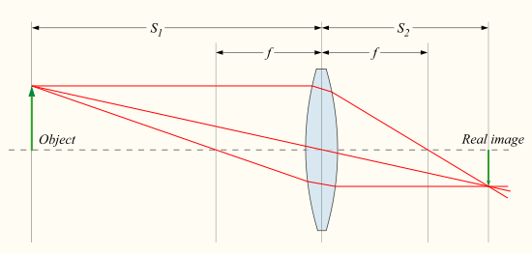

Focus with lenses
Distance to object
Distance to sensor
Lens focal length
Equation for objects in focus
Source: http://en.wikipedia.org/wiki/File:Lens3.svg

Slide 37

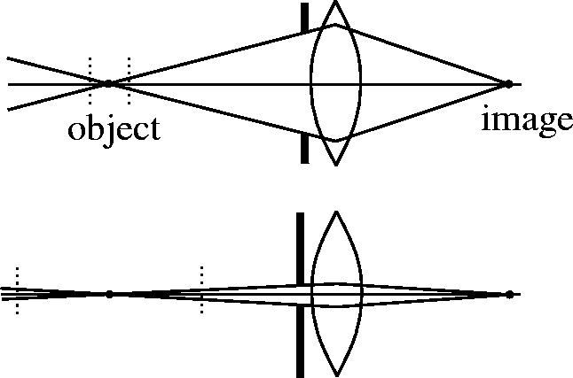

The aperture and depth of field
Slide source: Seitz
f / 5.6
f / 32
Changing the aperture size or focusing distance affects depth of field
f-number (f/#) =focal_length / aperture_diameter (e.g., f/16 means that the focal length is 16 times the diameter)
When you change the f-number, you are changing the aperture
Flower images from Wikipedia http://en.wikipedia.org/wiki/Depth_of_field

Slide 38
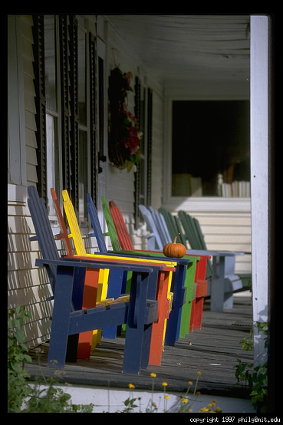
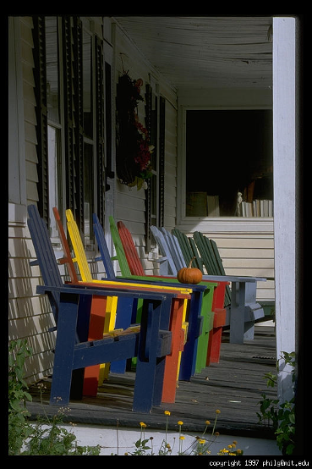
Varying the aperture
Slide from Efros
Large aperture = small DOF
Small aperture = large DOF

Slide 39
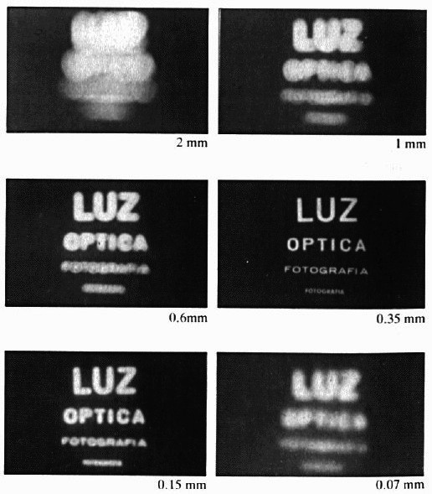
Shrinking the aperture
Why not make the aperture as small as possible?
Less light gets through
Diffraction effects
Slide by Steve Seitz

Slide 40
Shrinking the aperture
Slide by Steve Seitz

Slide 41
The Photographer’s Great Compromise
What we want
More spatial resolution
Broader field of view
More depth of field
More temporal resolution
More light
How we get it
Cost
Increase focal length
Light, FOV
Decrease focal length
DOF
Decrease aperture
Light
Increase aperture
DOF
Shorten exposure
Light
Lengthen exposure
Temporal Res

Slide 42
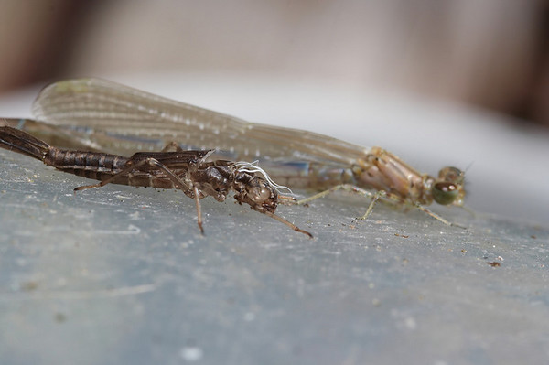
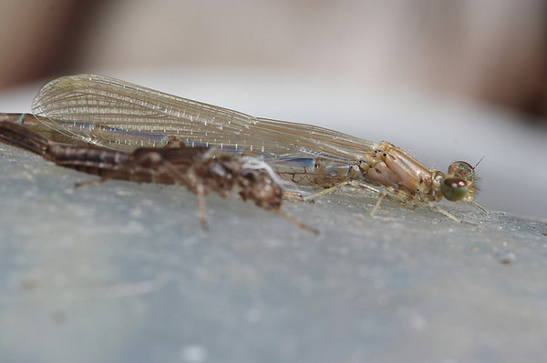
Difficulty in macro (close-up) photography
For close objects, we have a small relative DOF
Can only shrink aperture so far
How to get both bugs in focus?

Slide 43
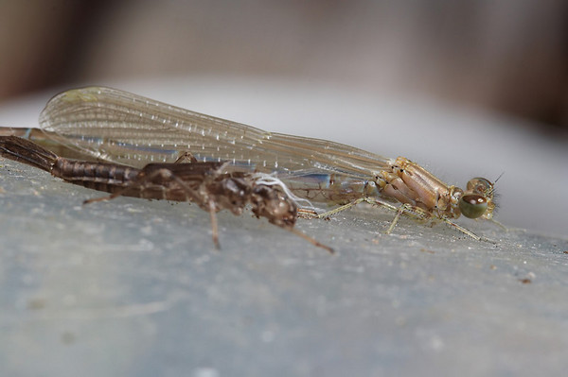
Solution: Focus stacking
Take pictures with varying focal length
Example from
http://www.wonderfulphotos.com/articles/macro/focus_stacking/

Slide 44
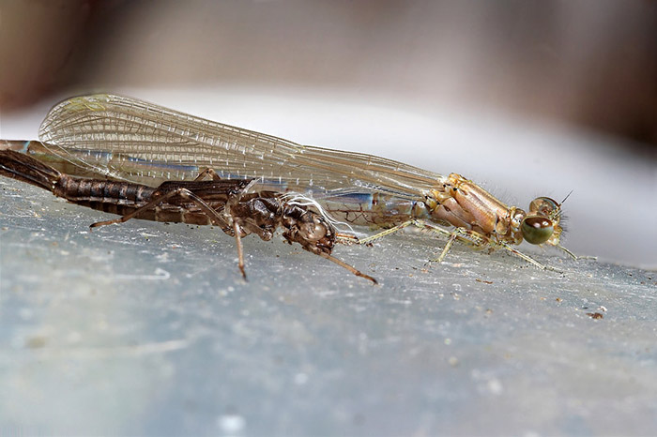
Solution: Focus stacking
Take pictures with varying focal length
Combine

Slide 45

Focus stacking
http://www.wonderfulphotos.com/articles/macro/focus_stacking/

Slide 46
Focus stacking
How to combine?
Web answer: With software (Photoshop, CombineZM)
How to do it automatically?

Slide 47
Focus stacking
How to combine?
Align images (e.g., using corresponding points)
Two ideas
Mask regions by hand and combine with pyramid blend
Gradient domain fusion (mixed gradient) without masking
Automatic solution would make a very interesting final project
Recommended Reading:
http://www.digital-photography-school.com/an-introduction-to-focus-stacking
http://www.zen20934.zen.co.uk/photography/Workflow.htm#Focus%20Stacking

Slide 48
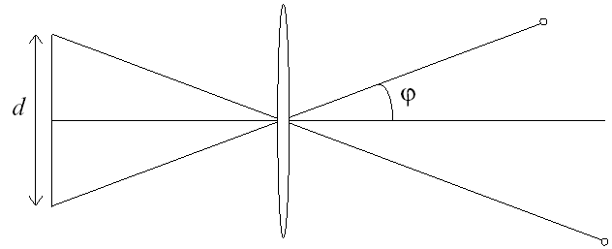
Relation between field of view and focal length
Field of view (angle width)
Film/Sensor Width
Focal length

Slide 49
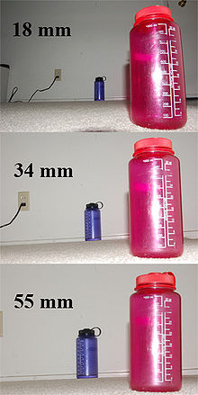
Dolly Zoom or “Vertigo Effect”
http://www.youtube.com/watch?v=NB4bikrNzMk
How is this done?
Zoom in while moving away
http://en.wikipedia.org/wiki/Focal_length

Slide 50
Dolly zoom (or “Vertigo effect”)
Field of view (angle width)
Film/Sensor Width
Focal length
width of object
Distance between object and camera

Slide 51
Things to remember
Can calibrate using grid or VP
Can measure relative sizes using VP
Effects of focal length, aperture + tricks
5
4
3
2
1

Slide 52
Next class
Go over take-home questions from today
Single-view 3D Reconstruction

