Slide 1
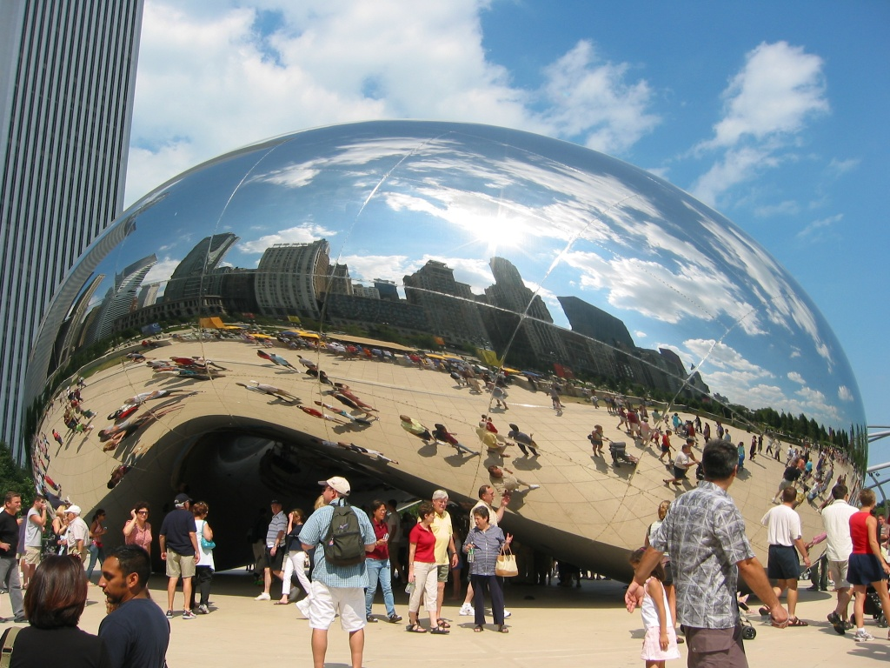
Image Warping
09/26/13
Computational Photography
Derek Hoiem, University of Illinois
Many slides from Alyosha Efros + Steve Seitz
Photo by Sean Carroll
Notes:
Show applications (alignment for hybrid image, face morphing, photo stitching) and example of transformation

Slide 2
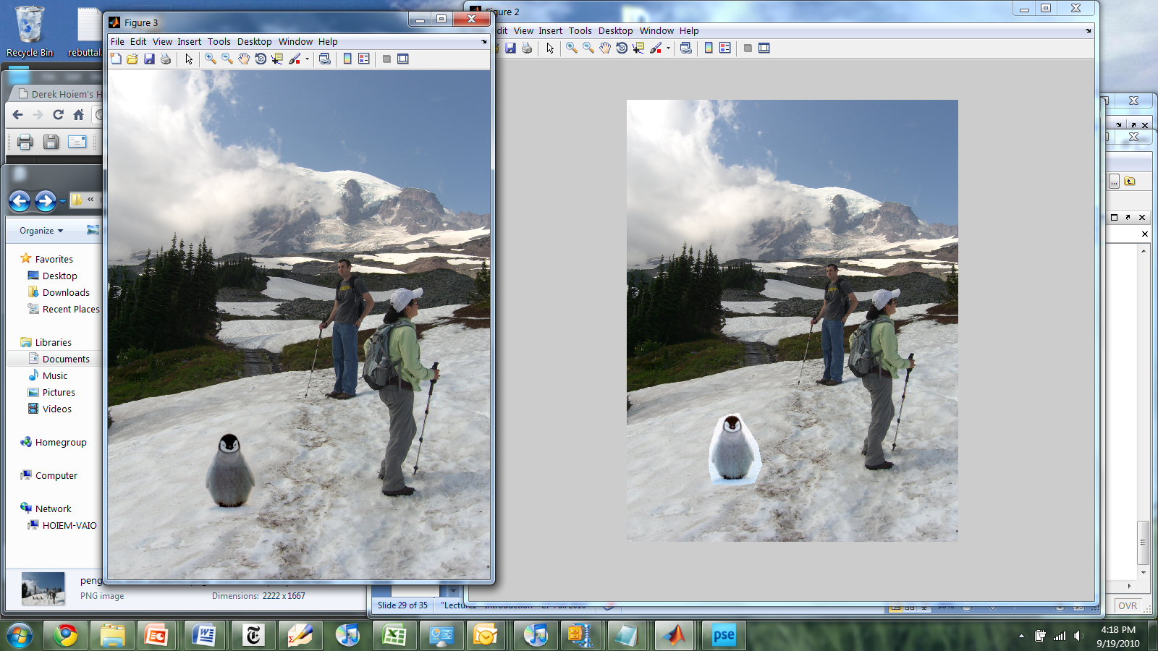
Last class: gradient-domain processing for blending
A good blend should preserve gradients of source region without changing the background

Slide 3
Last class: Gradient-domain editing
Many image processing applications can be thought of as trying to manipulate gradients or intensities:
Contrast enhancement
Denoising
Poisson blending
HDR to RGB
Color to Gray
Recoloring
Texture transfer
See Perez et al. 2003 and GradientShop for many examples

Slide 4
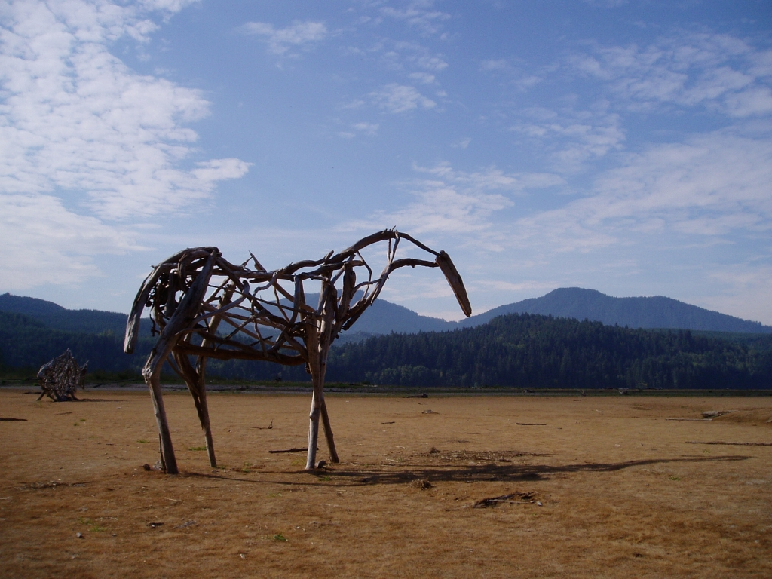
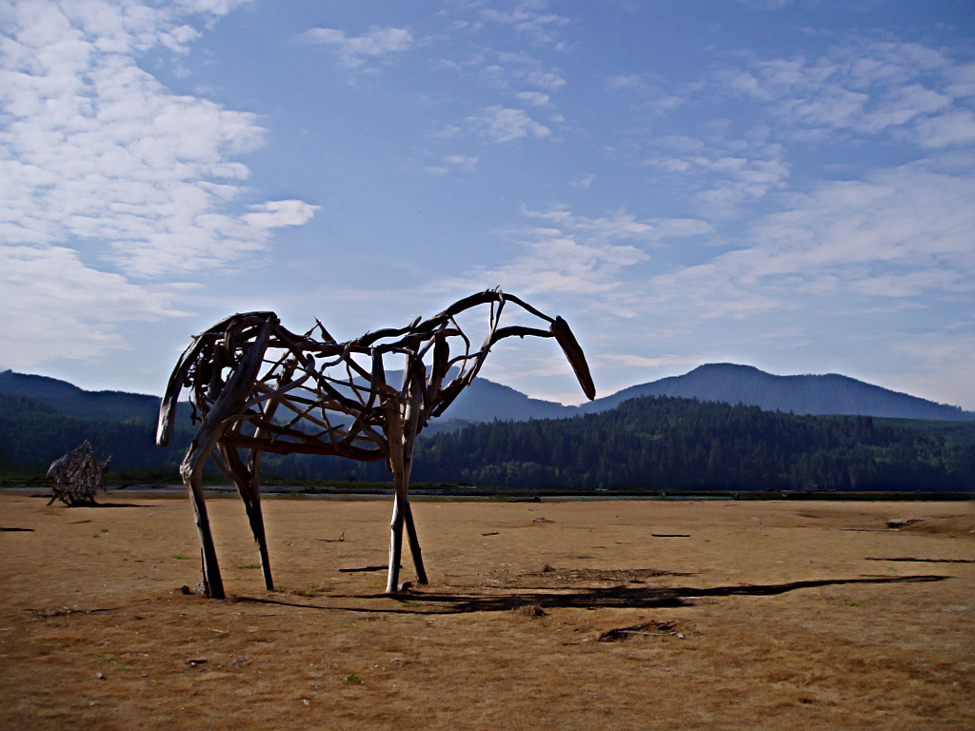
Gradient-domain processing
Saliency-based Sharpening
http://www.gradientshop.com

Slide 5


Gradient-domain processing
Non-photorealistic rendering
http://www.gradientshop.com

Slide 6
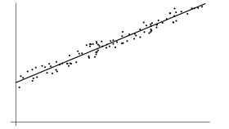
Gradient-domain editing
Creation of image = least squares problem in terms of: 1) pixel intensities; 2) differences of pixel intensities
Use Matlab least-squares solvers for numerically stable solution with sparse A
Least Squares Line Fit in 2 Dimensions

Slide 7
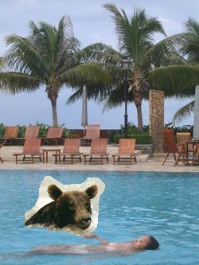


Take-home questions
1) I am trying to blend this bear into this pool. What problems will I have if I use:
Alpha compositing with feathering
Laplacian pyramid blending
Poisson editing?
Lap. Pyramid
Poisson Editing

Slide 8
Take-home questions
2) How would you make a sharpening filter using gradient domain processing? What are the constraints on the gradients and the intensities?

Slide 9
Next two classes
Today
Global coordinate transformations
Image alignment
Tuesday
Interpolation and texture mapping
Meshes and triangulation
Shape morphing

Slide 10
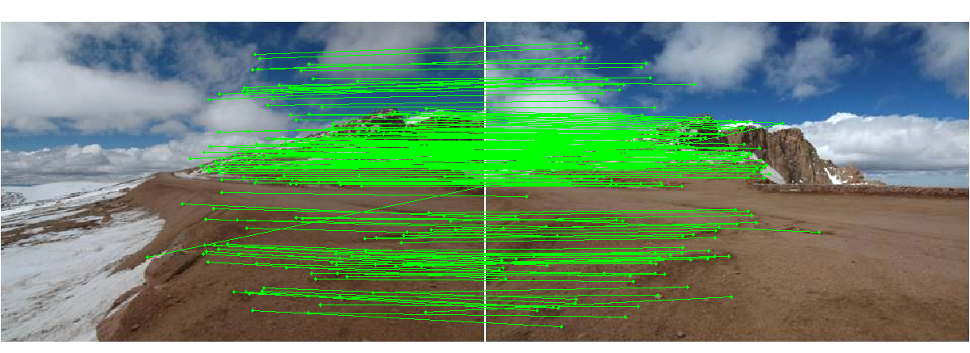
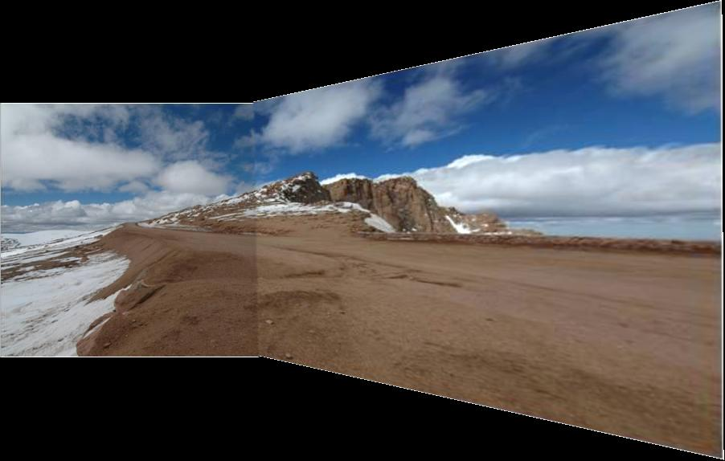
Photo stitching: projective alignment
Find corresponding points in two images
Solve for transformation that aligns the images

Slide 11
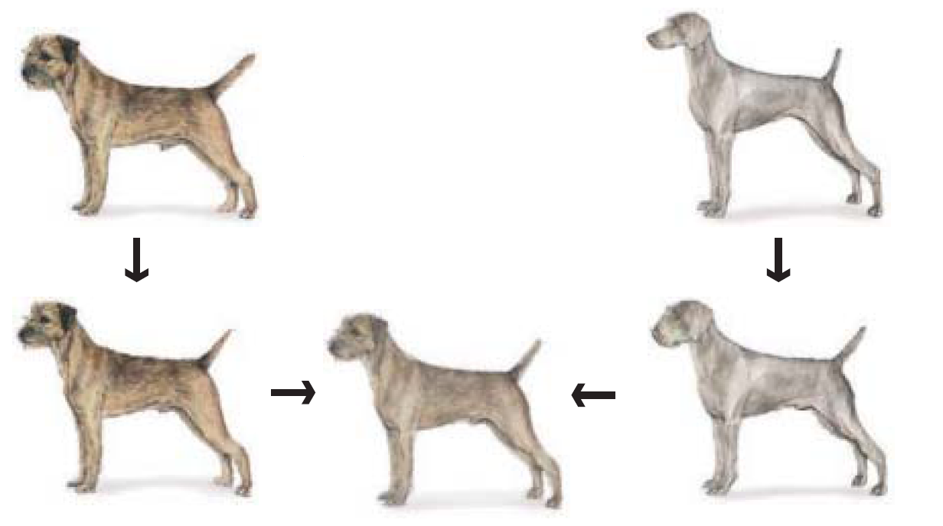
Morphing
Blend from one object to other with a series of local transformations

Slide 12

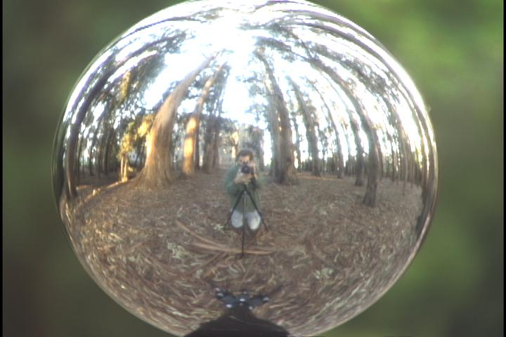
Capturing light fields
Estimate light via projection from spherical surface onto image

Slide 13
Image Transformations
image filtering: change range of image
g(x) = T(f(x))
f
f
T
x
x
image warping: change domain of image
g(x) = f(T(x))
f
f
T
x
x

Slide 14
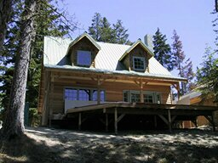
Image Transformations
image filtering: change range of image
g(x) = T(f(x))
f
g
T
image warping: change domain of image
g(x) = f(T(x))
f
g
T

Slide 15
Parametric (global) warping
T
p = (x,y)
p’ = (x’,y’)
Transformation T is a coordinate-changing machine:
p’ = T(p)
What does it mean that T is global?
Is the same for any point p
can be described by just a few numbers (parameters)
For linear transformations, we can represent T as a matrix
p’ = Mp

Slide 16
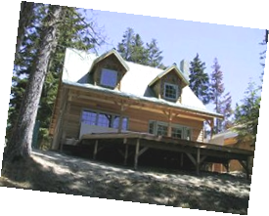
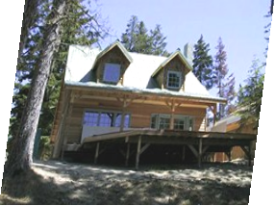
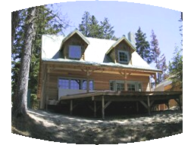
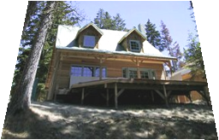
Parametric (global) warping
Examples of parametric warps:
translation
rotation
aspect
perspective
affine
cylindrical

Slide 17
Scaling
Scaling a coordinate means multiplying each of its components by a scalar
Uniform scaling means this scalar is the same for all components:
× 2

Slide 18
Scaling
Non-uniform scaling: different scalars per component:
X × 2, Y × 0.5

Slide 19
Scaling
Scaling operation:
Or, in matrix form:
scaling matrix S
What is the transformation from (x’, y’) to (x, y)?

Slide 20
2-D Rotation
(x’, y’)
(x, y)
x’ = x cos(θ) - y sin(θ)
y’ = x sin(θ) + y cos(θ)
θ

Slide 21
2-D Rotation
Polar coordinates…
x = r cos (φ)
y = r sin (φ)
x’ = r cos (φ + θ)
y’ = r sin (φ + θ)
Trig Identity…
x’ = r cos(φ) cos(θ) – r sin(φ) sin(θ)
y’ = r sin(φ) cos(θ) + r cos(φ) sin(θ)
Substitute…
x’ = x cos(θ) - y sin(θ)
y’ = x sin(θ) + y cos(θ)
(x’, y’)
(x, y)
θ
φ

Slide 22
2-D Rotation
This is easy to capture in matrix form:
Even though sin(θ) and cos(θ) are nonlinear functions of θ,
x’ is a linear combination of x and y
y’ is a linear combination of x and y
What is the inverse transformation?
Rotation by –θ
For rotation matrices
R

Slide 23
2x2 Matrices
What types of transformations can be represented with a 2x2 matrix?
2D Identity?
2D Scale around (0,0)?

Slide 24
2x2 Matrices
What types of transformations can be represented with a 2x2 matrix?
2D Rotate around (0,0)?
2D Shear?

Slide 25
2x2 Matrices
What types of transformations can be represented with a 2x2 matrix?
2D Mirror about Y axis?
2D Mirror over (0,0)?

Slide 26
2x2 Matrices
What types of transformations can be represented with a 2x2 matrix?
2D Translation?
NO!
Only linear 2D transformations
can be represented with a 2x2 matrix

Slide 27
All 2D Linear Transformations
Linear transformations are combinations of …
Scale,
Rotation,
Shear, and
Mirror
Properties of linear transformations:
Origin maps to origin
Lines map to lines
Parallel lines remain parallel
Ratios are preserved
Closed under composition

Slide 28
Homogeneous Coordinates
Q: How can we represent translation in matrix form?

Slide 29
Homogeneous Coordinates
Homogeneous coordinates
represent coordinates in 2 dimensions with a 3-vector

Slide 30
Homogeneous Coordinates
2D Points → Homogeneous Coordinates
Append 1 to every 2D point: (x y) → (x y 1)
Homogeneous coordinates → 2D Points
Divide by third coordinate (x y w) → (x/w y/w)
Special properties
Scale invariant: (x y w) = k * (x y w)
(x, y, 0) represents a point at infinity
(0, 0, 0) is not allowed
y
Scale Invariance
2
(2,1,1)
or (4,2,2)
or (6,3,3)
1
1
2
x

Slide 31
Homogeneous Coordinates
Q: How can we represent translation in matrix form?
A: Using the rightmost column:

Slide 32
Translation Example
Homogeneous Coordinates
t_{x} = 2 t_{y} = 1

Slide 33
Basic 2D transformations as 3x3 matrices
Translate
Scale
Rotate
Shear

Slide 34
Matrix Composition
Transformations can be combined by matrix multiplication
p’ = T(t_{x},t_{y}) R(Θ) S(s_{x},s_{y}) p
Does the order of multiplication matter?

Slide 35
Affine Transformations
Affine transformations are combinations of
Linear transformations, and
Translations
Properties of affine transformations:
Origin does not necessarily map to origin
Lines map to lines
Parallel lines remain parallel
Ratios are preserved
Closed under composition

Slide 36
Projective Transformations
Projective transformations are combos of
Affine transformations, and
Projective warps
Properties of projective transformations:
Origin does not necessarily map to origin
Lines map to lines
Parallel lines do not necessarily remain parallel
Ratios are not preserved
Closed under composition
Models change of basis
Projective matrix is defined up to a scale (8 DOF)

Slide 37
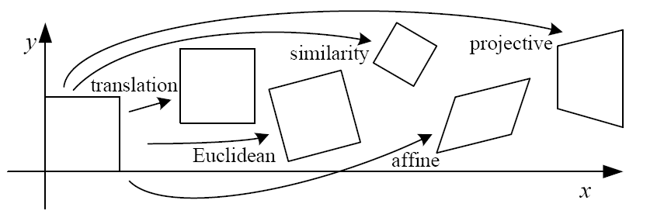
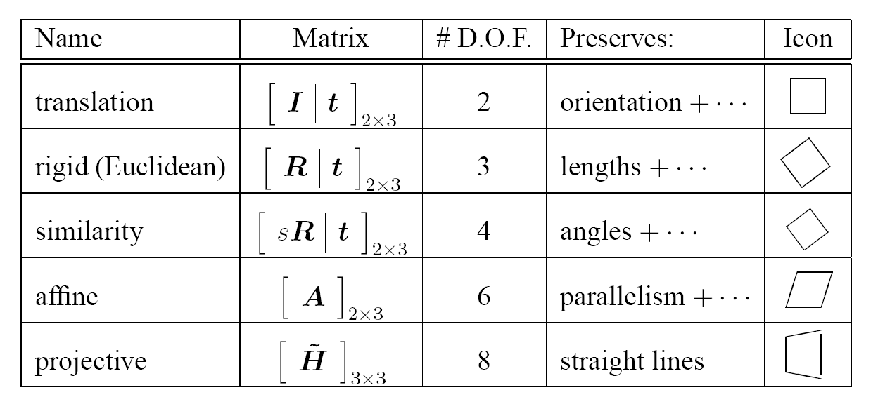
2D image transformations
These transformations are a nested set of groups
Closed under composition and inverse is a member

Slide 38
Recovering Transformations
?
T(x,y)
y
y’
x
x’
f(x,y)
g(x’,y’)
What if we know f and g and want to recover the transform T?
willing to let user provide correspondences
How many do we need?

Slide 39
Translation: # correspondences?
?
T(x,y)
y
y’
x
x’
How many Degrees of Freedom?
How many correspondences needed for translation?
What is the transformation matrix?

Slide 40
Euclidian: # correspondences?
?
T(x,y)
y
y’
x
x’
How many DOF?
How many correspondences needed for translation+rotation?

Slide 41
Affine: # correspondences?
?
T(x,y)
y
y’
x
x’
How many DOF?
How many correspondences needed for affine?

Slide 42
Affine transformation estimation
Math
Matlab demo

Slide 43
Projective: # correspondences?
?
T(x,y)
y
y’
x
x’
How many DOF?
How many correspondences needed for projective?

Slide 44

Take-home Question
9/26/13
1) Suppose we have two triangles: ABC and A’B’C’. What transformation will map A to A’, B to B’, and C to C’? How can we get the parameters?
B
B’
?
T(x,y)
C’
A
C
A’
Source
Destination

Slide 45
Take-home Question
9/26/2013
2) Show that distance ratios along a line are preserved under 2d linear transformations.
o
(x3,y3)
o
(x’3,y’3)
o
o
(x2,y2)
o
p1=(x1,y1)
o
(x’2,y’2)
p‘1=(x’1,y’1)
Hint: Write down x2 in terms of x1 and x3, given that the three points are co-linear

Slide 46
Next class: texture mapping and morphing

