Slide 1
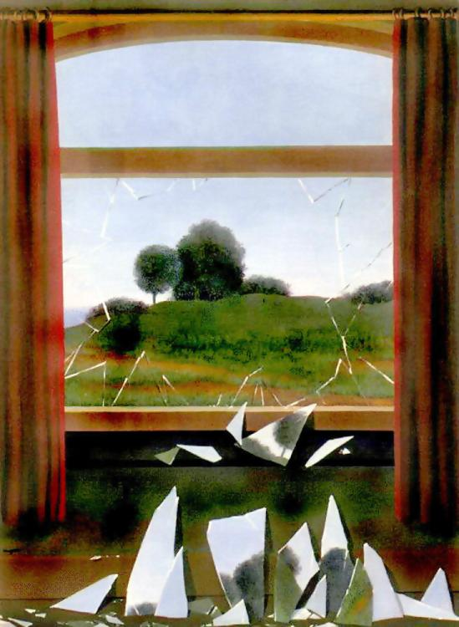
Computational Photography
CS498dh
8/27/13
Derek Hoiem
Kevin Karsch (TA)

Slide 2
Today’s Class
A little about me
Intro to Computational Photography
Course outline and logistics
A little about you

Slide 3
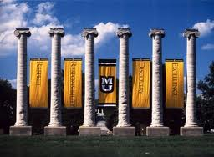
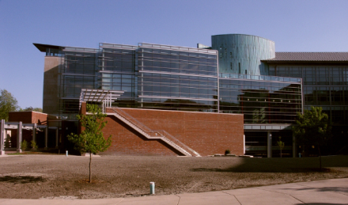

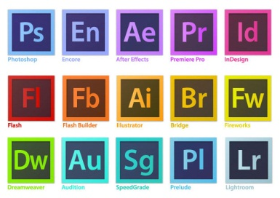

About me
2005-2009
Undergrad at the University of Missouri
B.S., Math and CS
2009-
Grad at UIUC
Ph.D. in computer vision/graphics
2010-2012
MSR, Adobe Research
Intern
2012 Lemelson-MIT Student Prize Winner

Slide 4
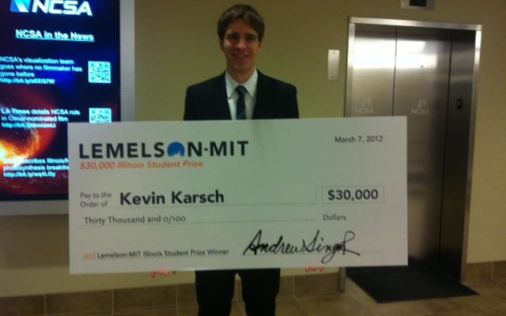
Lemelson-MIT UIUC Student Prize
http://www.tec.illinois.edu/30kprize

Slide 5
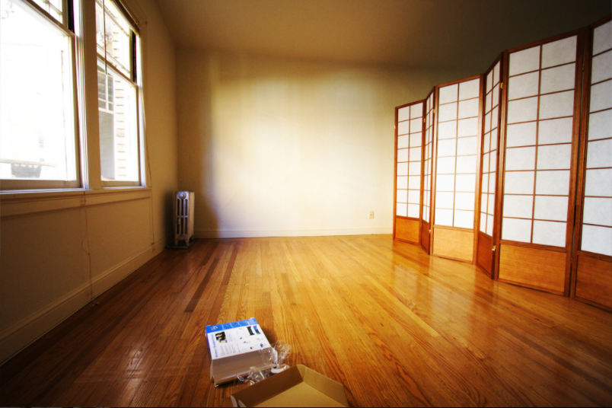
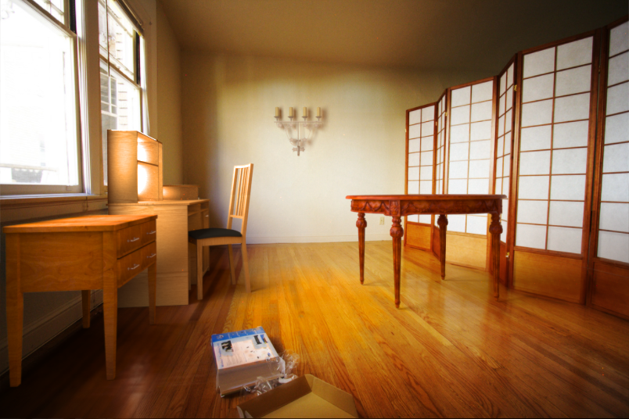
My Research
Editing images as if they were 3D scenes

Slide 6
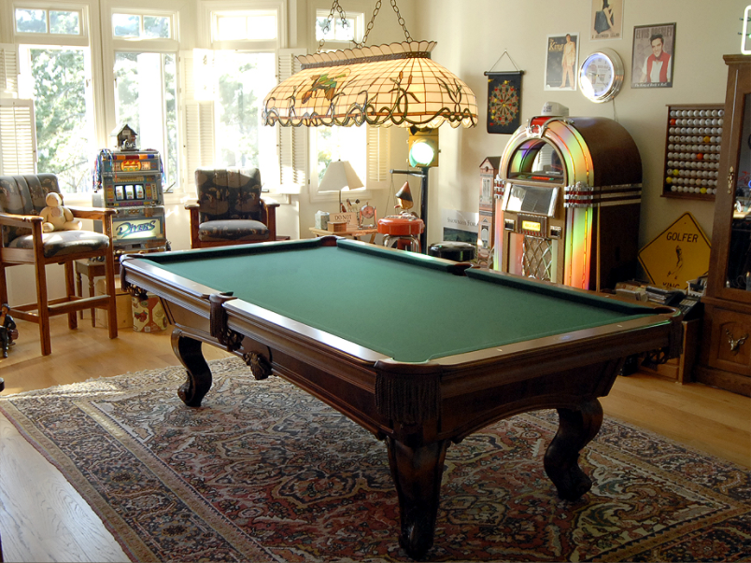

Slide 7
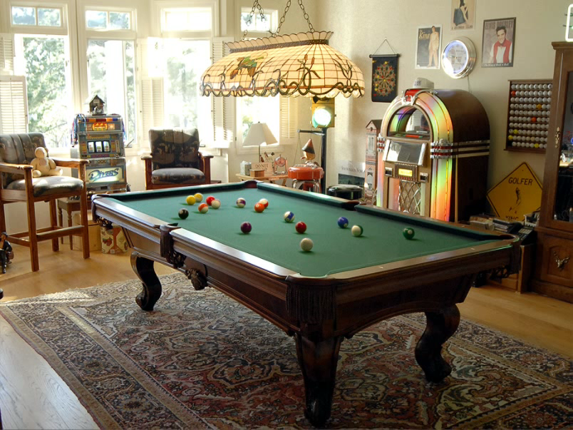

Slide 8
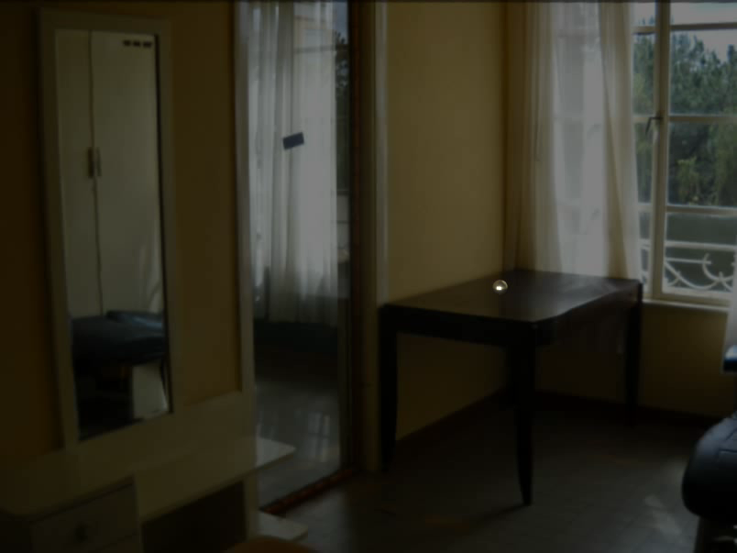

Slide 9
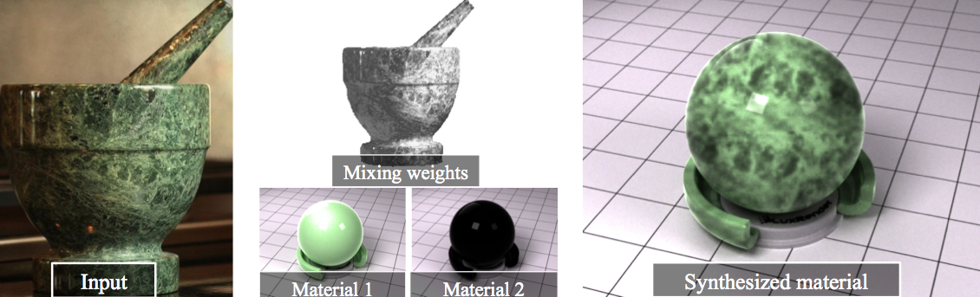
My Research
Material estimation
Depth/geometry

Slide 10
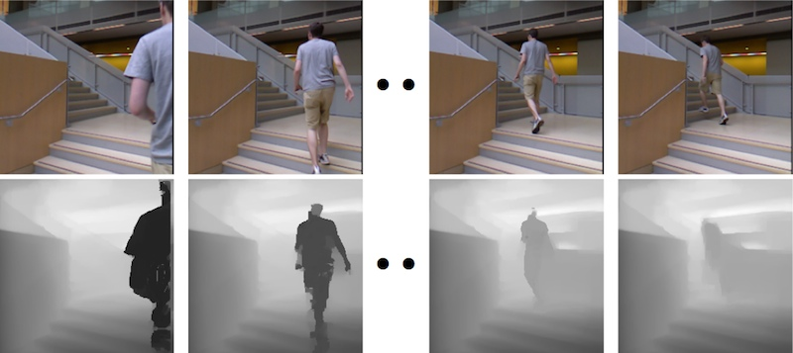
My Research
Depth / geometry estimation

Slide 11
Some background to computational photography and …
The Pursuit of Realism
Several of following slides from Alyosha Efros

Slide 12
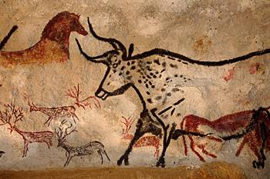
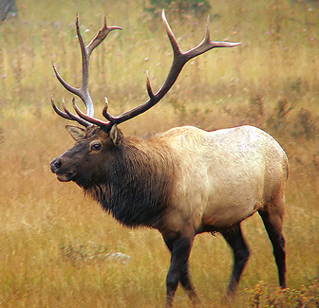
Depicting Our World: The Beginning
Prehistoric Painting, Lascaux Cave, France
~ 15,000 B.C.

Slide 13
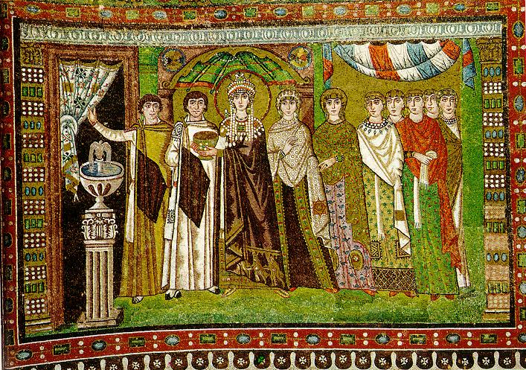
Depicting Our World: Middle Ages
The Empress Theodora with her court.
Ravenna, St. Vitale 6th c.

Slide 14
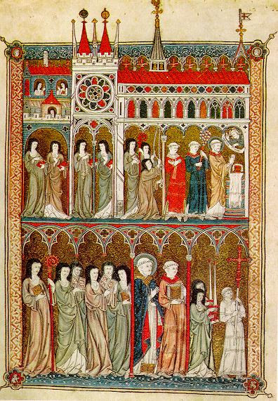
Depicting Our World: Middle Ages
Nuns in Procession. French ms. ca. 1300.

Slide 15
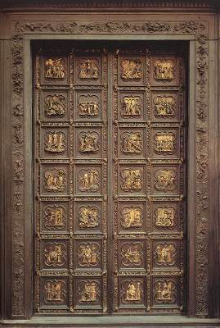
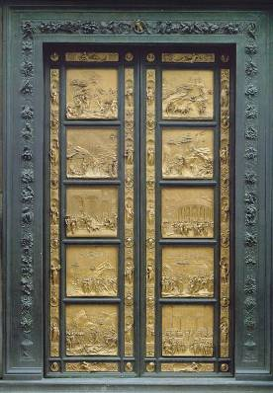
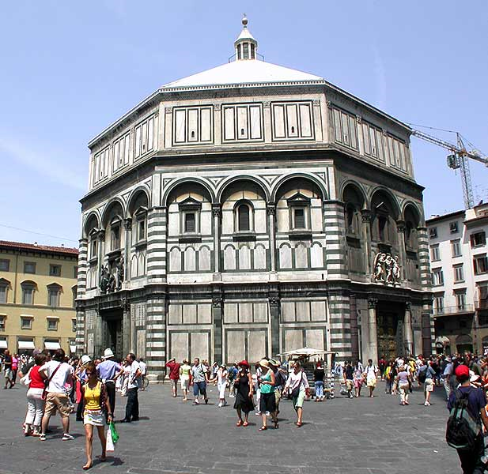
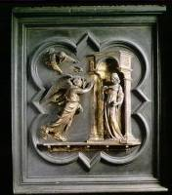
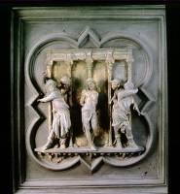
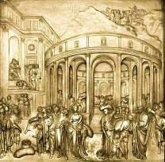
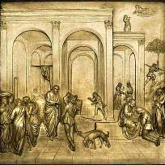
Depicting Our World: Renaissance
North Doors (1424)
East Doors (1452)
Lorenzo
Ghiberti
(1378-1455)
Notes:
Florentine cathedral. Ghiberti influenced by Alazhan’s book of optics, first published around 1000 AD but translated into Italian by 14th century

Slide 16
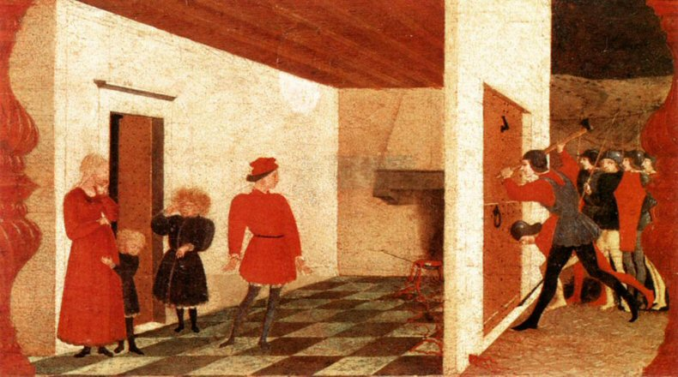
Depicting Our World: Renaissance
Paolo Uccello,
Miracle of the Profaned Host (c.1467-9)
Notes:
Paolo Uccello was one of Ghiberti’s students and a early master of perspective

Slide 17
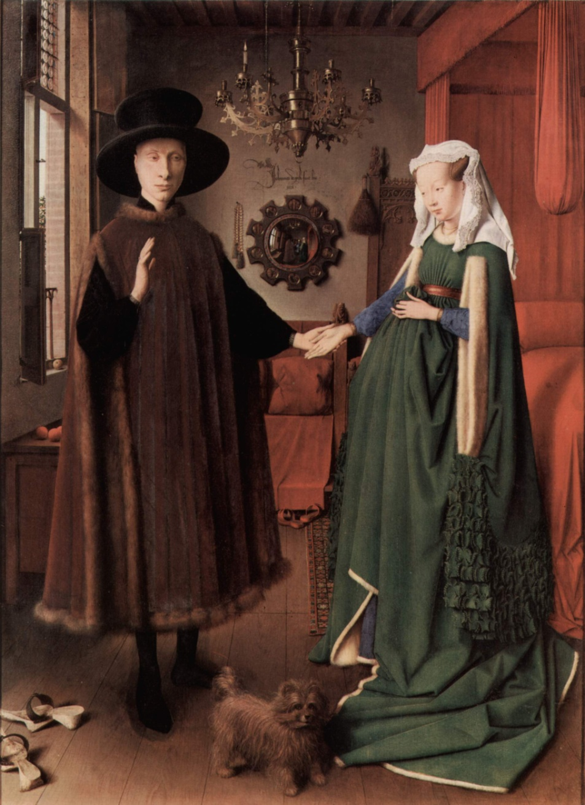
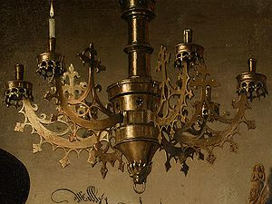
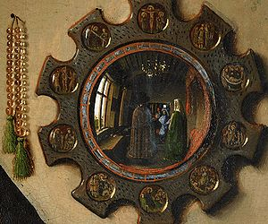
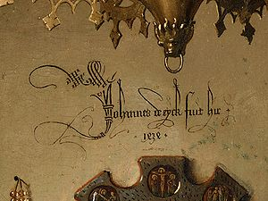
Depicting Our World: Toward Perfection
Jan van Eyck, The Arnolfini Portrait (1426-1434)

Slide 18
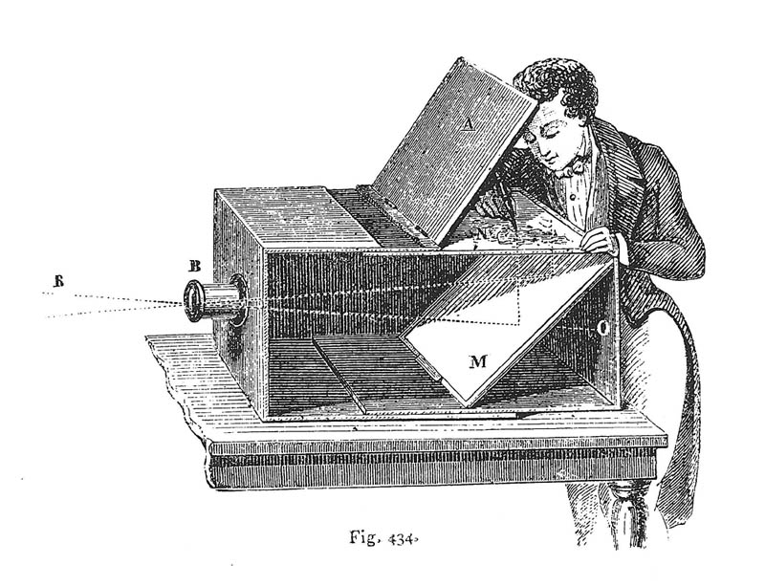
Depicting Our World: Toward Perfection
Lens Based Camera Obscura, 1568

Slide 19
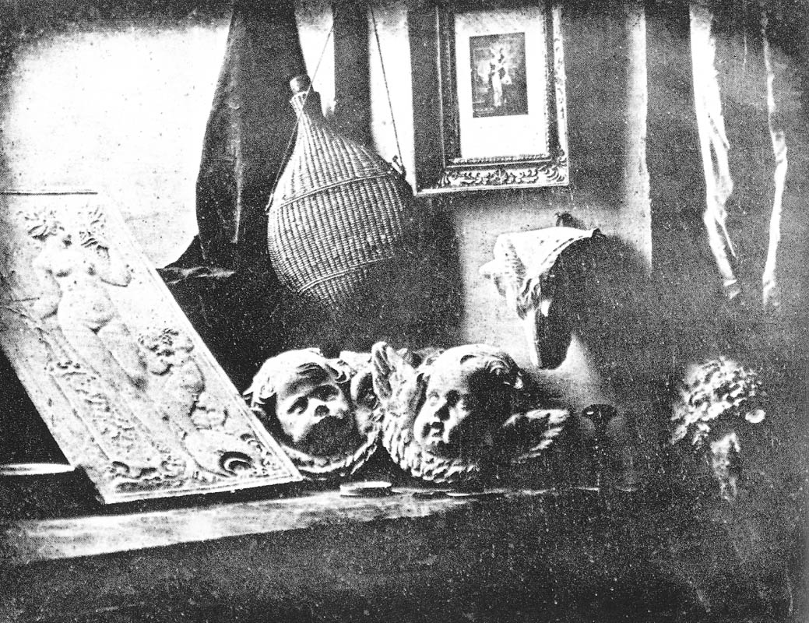
Depicting Our World: Perfection!
Still Life, Louis Jaques Mande Daguerre, 1837

Slide 20
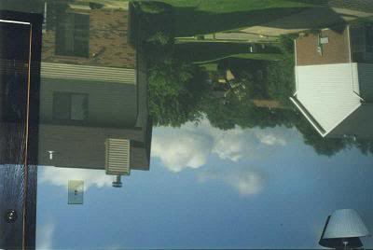
Your own camera obscura?

Slide 21
Depicting Our World: Perfection!
Still Life, Louis Jaques Mande Daguerre, 1837

Slide 22
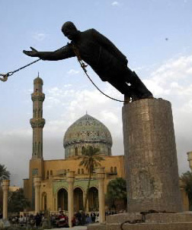
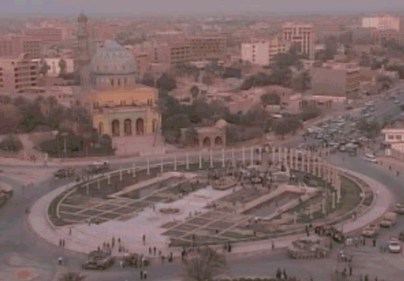
But is a photo really realistic?

Slide 23
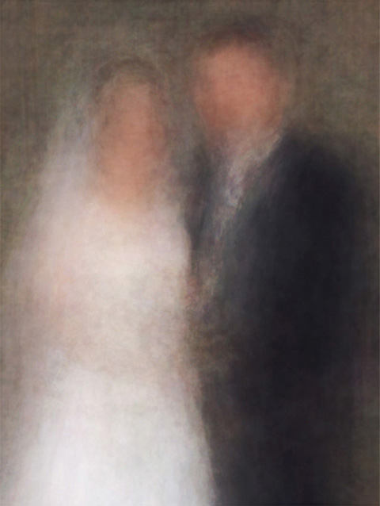
Is reality what we want?
Newlyweds
http://salavon.com

Slide 24
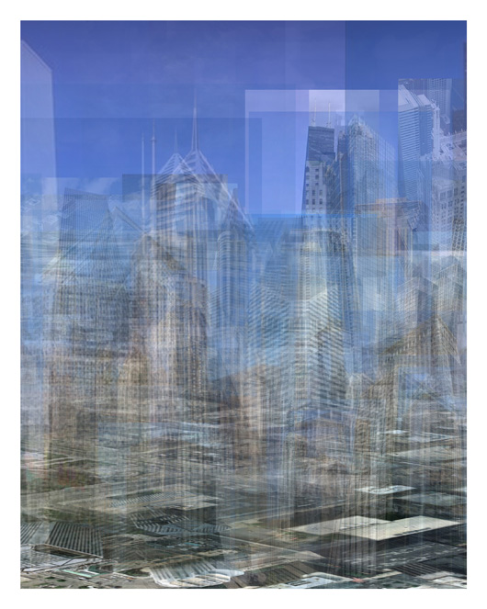
Better than realism?
City (westward)
http://salavon.com

Slide 25
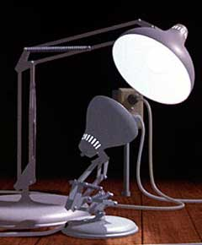
Enter Computer Graphics...

Slide 26
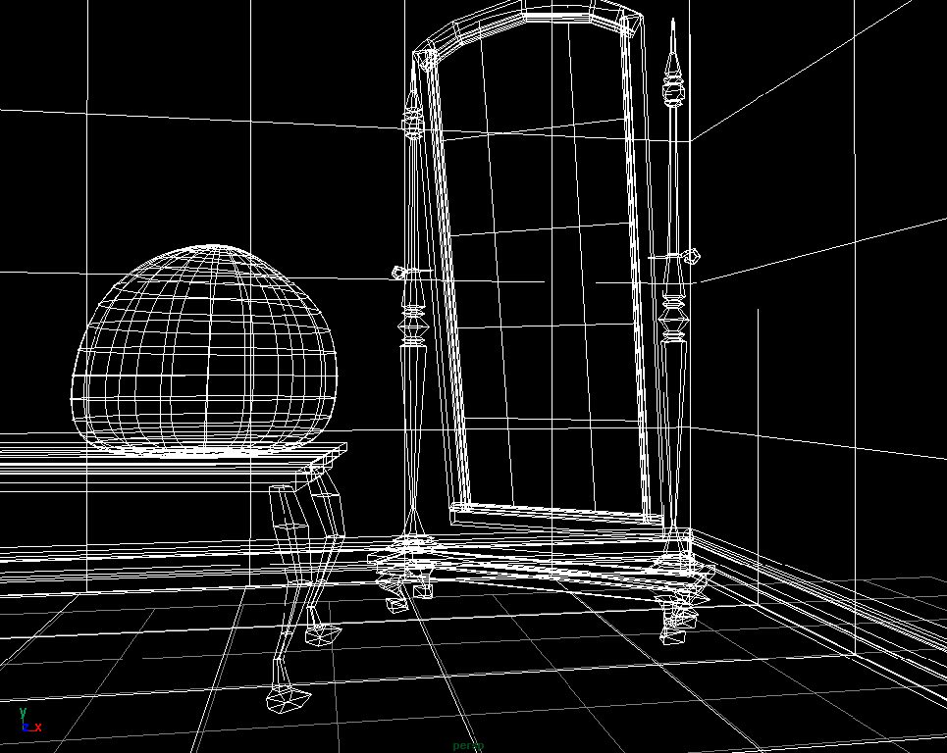
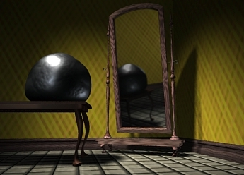
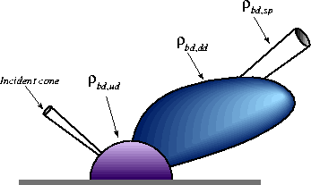
Traditional Computer Graphics
3D geometry
projection
Simulation
physics
GRAPHICS

Slide 27

Computer graphics
What’s wrong?
Notes:
So lifeless and sterile

Slide 28
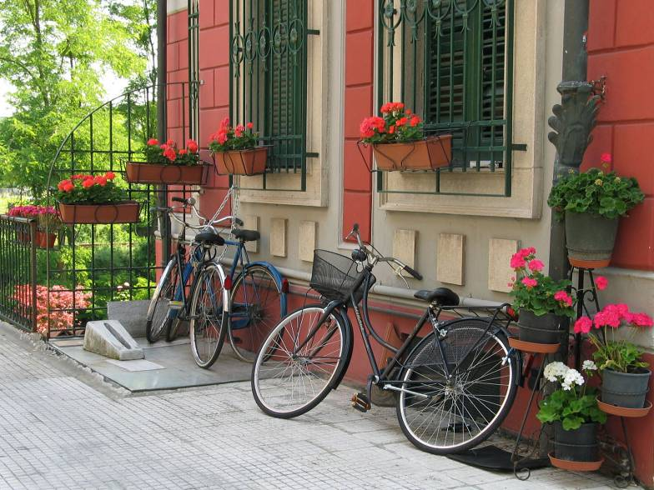
The richness of our everyday world
Photo by Svetlana Lazebnik

Slide 29
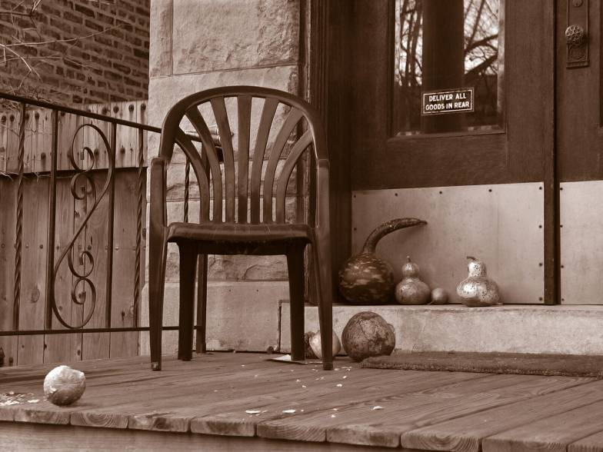
Which parts are hard to model?
Photo by Svetlana Lazebnik

Slide 30
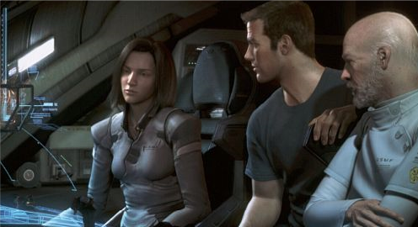
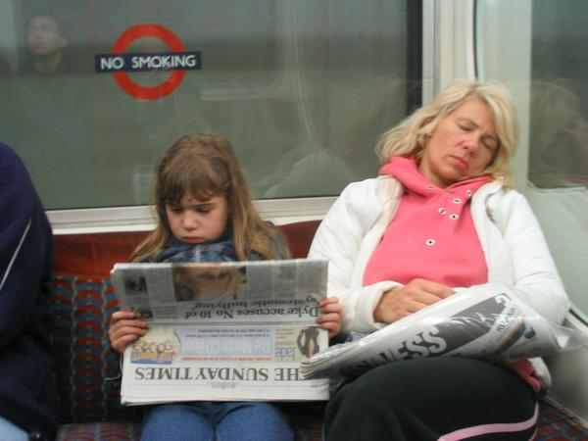
People
Alyosha Efros - On the Tube, London
From “Final Fantasy”

Slide 31
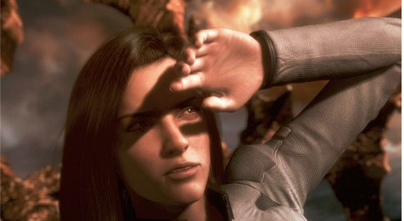
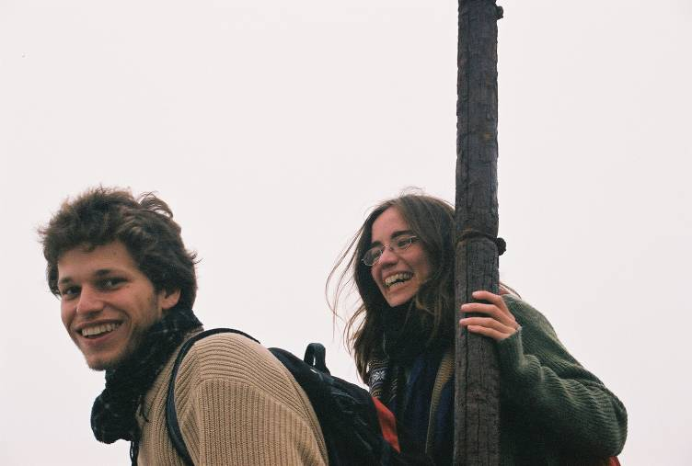
Faces / Hair
From “Final Fantasy”
Photo by Joaquin Rosales Gomez

Slide 32
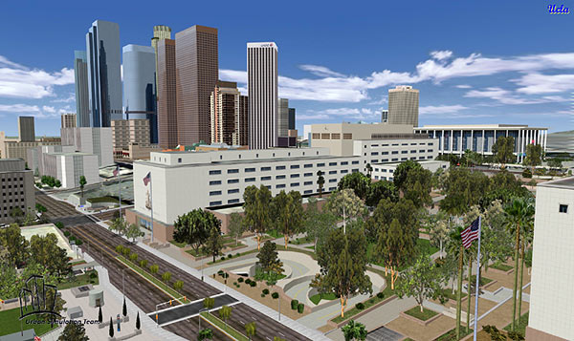
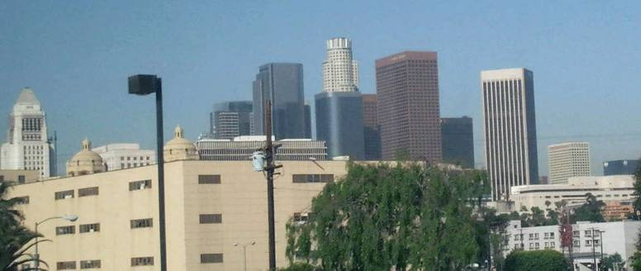
Urban Scenes
Photo of l LA
Virtual LA (SGI)

Slide 33
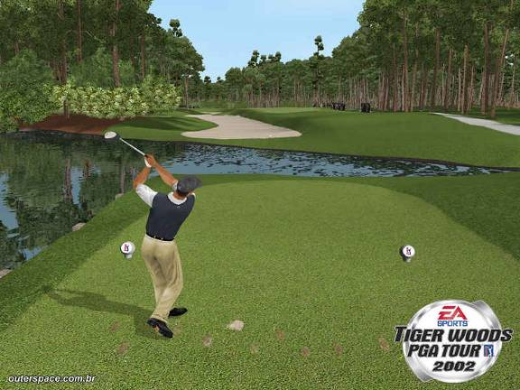
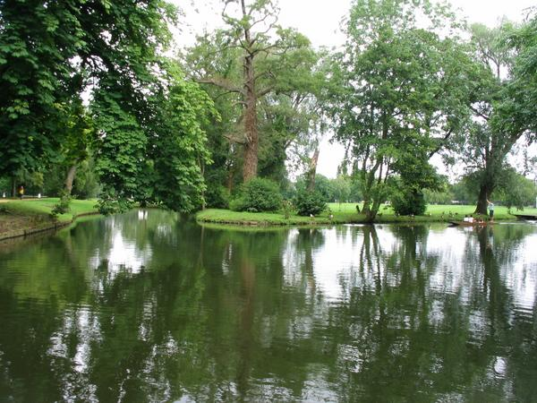
Nature
River Cherwell, Oxford

Slide 34
The Realism Spectrum
Computational
Photography
Computer Graphics
Photography
Realism
Manipulation
Ease of capture
+ easy to create new worlds
+ easy to manipulate objects/viewpoint
- very hard to look realistic
+ instantly realistic
+ easy to aquire
- very hard to manipulate objects/viewpoint

Slide 35
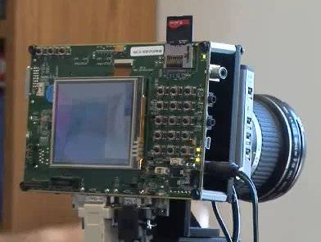


Computational Photography
How can I use computational techniques to capture light in new ways?
How can I use computational techniques to breathe new life into the photograph?
How can I use computational techniques to synthesize and organize photo collections?

Slide 36
Virtual Real World
Campanile Movie (1997)
http://www.debevec.org/Campanile/

Slide 37
Going beyond reality…
Benjamin Button (2008)
http://digitaldomain.com/projects/8/

Slide 38
Course outline
Prof: Derek Hoiem (dhoiem@illlinois.edu), SC 3312
TA: Kevin Karsch (karsch1@illinois.edu), SC 3238A
Web page:
http://courses.engr.illinois.edu/cs498dh3/

Slide 39

Course objectives
You will have new abilities for visual creation.
Graphic by James Hays
Notes:
Visual creation is no longer just pure graphics or pure photography. There is a growing need to blend the two. We want to edit photos, work with photo collections, create cool special effects, etc. After this course, you should have the background and experience that you need to do these things.

Slide 40






Course objectives
2. You will get a foundation in computer vision.
Safety
Health
Security
Comfort
Fun
Access
Notes:
Foundation for computer vision. We want machines to watch for us, do our work, and make us live longer, more healthy, and more entertaining lives. This course will give you a good hands-on background for learning more or developing new computer vision applications.

Slide 41
Got job?
Google, Facebook, Microsoft, Sony, iRobot, Amazon A9, tons of startups, etc.
http://www.cs.ubc.ca/~lowe/vision.html

Slide 42

Course objectives
3. You’ll better appreciate your own visual ability.
Is that a queen or a bishop?
Notes:
You'll gain an appreciation for your own visual ability. We tend to take it for granted, but half of our brain is cranking away on the vision problem. Interestingly, we are usually aware only of the interpretation, not what we actually see. By working with pixels, you'll see how messy images actually are and how incredible it is that we can interpret anything from them.

Slide 43
Course objectives
4. You’ll have fun doing cool stuff!
Notes:
Do cool stuff. You'll get the opportunity to implement a variety of fun projects that work with your own photos. You can be creative. You can also go beyond the minimum and do some "bells and whistles" or additional projects that I offer. You'll get to do a final project on whatever you want. You'll also be able to see the work that everyone else does.

Slide 44
Projects

Slide 45


Project 1: Hybrid Images

Slide 46





Project 2: Image Quilting for Texture Synthesis and Transfer

Slide 47



Project 3: Poisson Editing
Photos from James Hays

Slide 48



Project 3: Poisson Editing
Photos from Evan Wallace

Slide 49


Project 4: Image-Based Lighting

Slide 50




Project 5: Automatic Photo Stitching

Slide 51
Final Project
Something cool!

Slide 52
Project details
Implement stuff from scratch and apply it to your own photos
Reporting via web page (plus e-mail code)
Afterwards, vote for class favorite(s)!
Software/hardware
  Matlab!
  Machines available in EWS labs

Slide 53
Getting help outside of class
Office hours
TBA: http://www.doodle.com/e9hzmy65k2icdi64
Matlab + linear algebra tutorial
TBA: http://www.doodle.com/f7bien4sadwfvz64
Discussion board:
http://groups.google.com/group/cs498-cp-uiuc
Readings/textbook

Slide 54
Grades
Written and programming assignments (60%)
  Core projects worth total of 500 points, “bells and whistles” for additional points
  Undergrads graded out of 525, grads out of 600
Exam (20%)
Final Project (20%)
Participation
Late policy
Up to five free days total – use them wisely!
10 points per day after that

Slide 55
Academic Integrity
Can discuss projects, but don’t share code
Don’t look up code (even to get hints) or copy from a friend
If you’re not sure if it’s allowed, ask
Acknowledge any inspirations
If you get stuck, come talk to me

Slide 56
Other comments
Prerequisites
Linear algebra, plus some basic calculus and probability
Experience with graphics, image processing, or Matlab will help but is not necessary
Your own camera
Strongly recommended – can get decent cameras for reasonable $$$, e.g., Canon A1300 ($100)
Pro camera apps for smartphones

Slide 57
Feedback is welcome

Slide 58
Introduce yourselves

Slide 59
Final comments
Reasons to not take the course…
To do now
  Please fill out the feed-forward forms
  Any Q’s or concerns, come talk to me!
To do later
  Look over syllabus, etc.
  Sign up for discussion group
Next class: pixels and basic filtering

