Slide 1
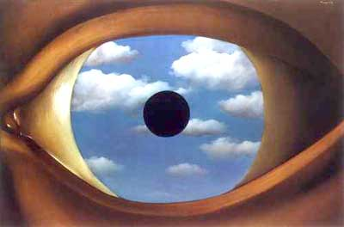
Computational Approaches to Cameras
12/04/12
Magritte , The False Mirror (1935)
Computational Photography
Derek Hoiem, University of Illinois

Slide 2
Announcements
Vote for Project 5 favorites by Sun night
Only three classes left
  Today: computational cameras
  Thurs: Kinect Sensor and applications
  Tues: wrap-up, feedback/ICES

Slide 3
Final projects
Image Editing and Synthesis
Image Analogies: Grace, Sidd, Suraj
Interactive Photo Montage: Jiqin and Zhongbo
Animating Pictures with Stochastic Motion Textures: Shengjie and Brian
LazySnapping segmentation: Roeland
Image Crystalization: Micheal W.
Seam Carving for Content-aware Image Resizing: Nan
Seam Carving or Miniature Faking: Abdel
Seam Carving: Joanne and Mike
Seam Carving: Brian Goerlitz
Geometry
Interface for zooming into panoramic stitches: Nemo
3D Reconstruction from Image(s): Ramy
Other Topics
FocusTest: JunYoung
Light fields: Xinqi, Siying
Tracking of Cells in Microscopic Video: Xing

Slide 4
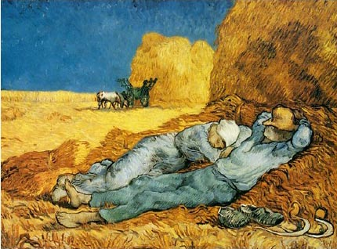
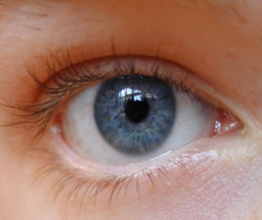
Conventional cameras
Conventional cameras are designed to capture light in a medium that is directly viewable
Scene
Eye
Sensor
Lens
Light
Display

Slide 5
Computational cameras
With a computational approach, we can capture light and then figure out what to do with it
Captured Light
Computation
Scene
Eyes
Light
Displays

Slide 6
Questions for today
How can we represent all of the information contained in light?
What are the fundamental limitations of cameras?
What sacrifices have we made in conventional cameras? For what benefits?
How else can we design cameras for better focus, deblurring, multiple views, depth, etc.?

Slide 7
How can we represent all of the information contained in light?

Slide 8
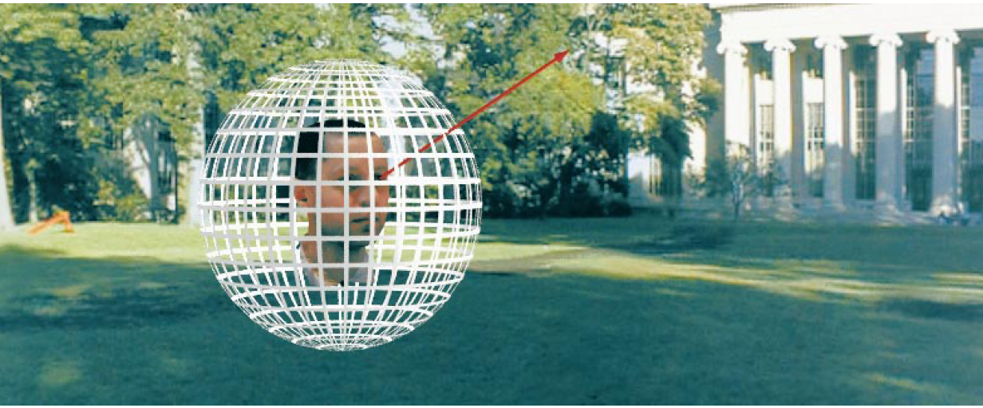
Representing Light: The Plenoptic Function
Figure by Leonard McMillan
Q: What is the set of all things that we can ever see?
A: The Plenoptic Function (Adelson & Bergen)
Let’s start with a stationary person and try to parameterize everything that he can see…
Slides from Efros

Slide 9
Grayscale snapshot
P(θ,φ)
is intensity of light
  Seen from a single view point
  At a single time
  Averaged over the wavelengths of the visible spectrum
(can also do P(x,y), but spherical coordinate are nicer)

Slide 10
Color snapshot
P(θ,φ,λ)
is intensity of light
  Seen from a single view point
  At a single time
  As a function of wavelength

Slide 11
A movie
P(θ,φ,λ,t)
is intensity of light
  Seen from a single view point
  Over time
  As a function of wavelength

Slide 12
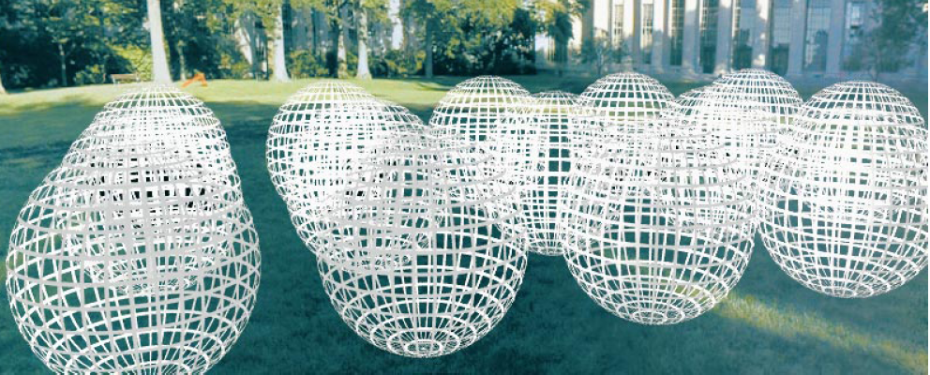
Holographic movie
P(θ,φ,λ,t,V_{X},V_{Y},V_{Z})
is intensity of light
  Seen from ANY viewpoint
  Over time
  As a function of wavelength

Slide 13
The Plenoptic Function
P(θ,φ,λ,t,V_{X},V_{Y},V_{Z})
  Can reconstruct every possible view, at every moment, from every position, at every wavelength
  Contains every photograph, every movie, everything that anyone has ever seen!

Slide 14
Full Plenoptic Camera
Records position and orientation of each ray at each time and wavelength
P(V_{X},V_{Y},V_{Z},θ,φ,t,λ)

Slide 15
What fundamentally limits cameras?

Slide 16
Representing light
  The atomic element of light: a pixel a ray

Slide 17
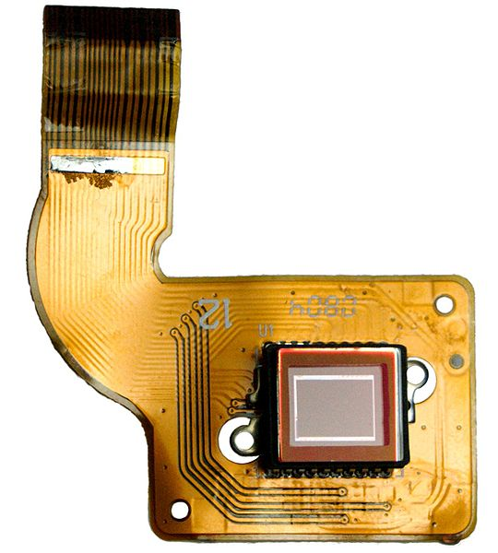
Fundamental limitations and trade-offs
Only so much light in a given area to capture
Basic sensor accumulates light at a set of positions from all orientations, over all time
We want intensity of light at a given time at one position for a set of orientations
Solutions:
  funnel, constrain, redirect light
  change the sensor
CCD inside camera

Slide 18
What sacrifices does the conventional camera make? For what gains?

Slide 19


Trade-offs of conventional camera
Add a pinhole
  Pixels correspond to small range of orientations at the camera center, instead of all gathered light at one position
  Much less light hits sensor
Add a lens
  More light hits sensor
  Limited depth of field
  Chromatic aberration
Add a shutter
  Capture average intensity at a particular range of times
Increase sensor resolution
  Each pixel represents a smaller range of orientations
  Less light per pixel
Controls: aperture size, focal length, shutter time

Slide 20
How else can we design cameras?
What do they sacrifice/gain?

Slide 21
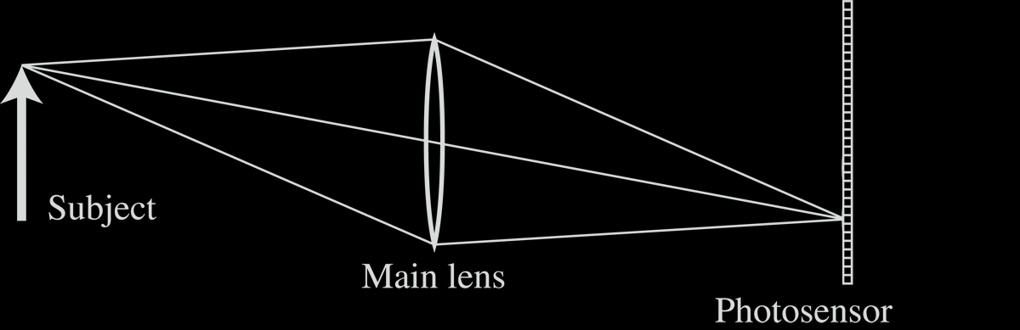
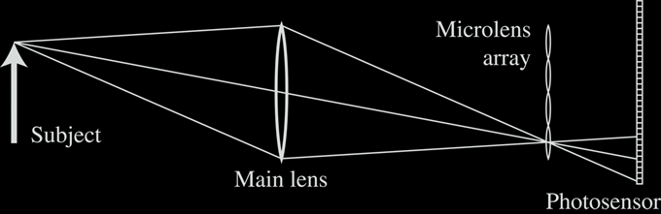
1. Light Field Photography with “Plenoptic Camera”
Conventional Camera
“Plenoptic Camera”
Adelson and Wang 1992
Ng et al. Stanford TR, 2005

Slide 22
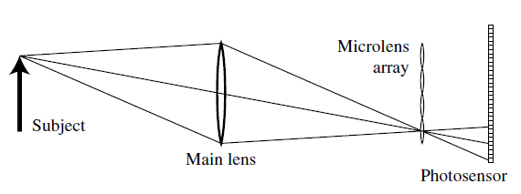
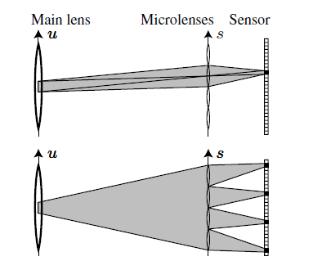
Light field photography
Like replacing the human retina with an insect compound eye
Records where light ray hits the lens

Slide 23
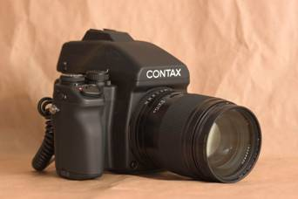
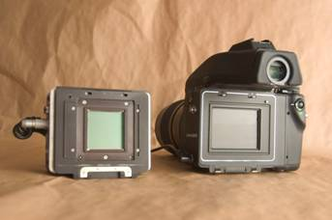
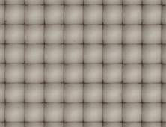
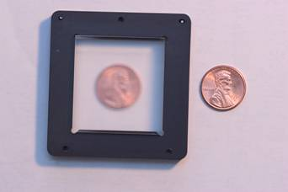
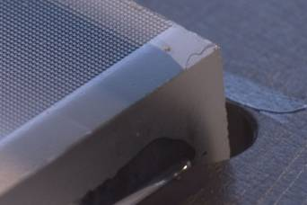
Stanford Plenoptic Camera [Ng et al 2005]
Contax medium format camera
Kodak 16-megapixel sensor
Adaptive Optics microlens array
125μ square-sided microlenses
4000 × 4000 pixels ÷ 292 × 292 lenses = 14 × 14 pixels per lens

Slide 24
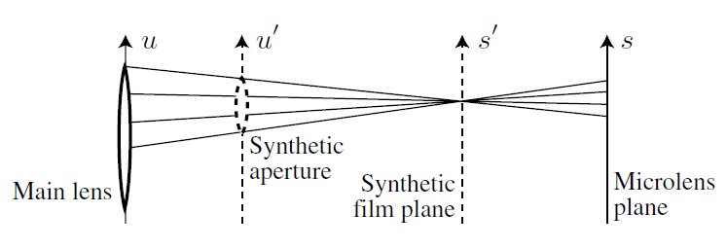
Light field photography: applications

Slide 25
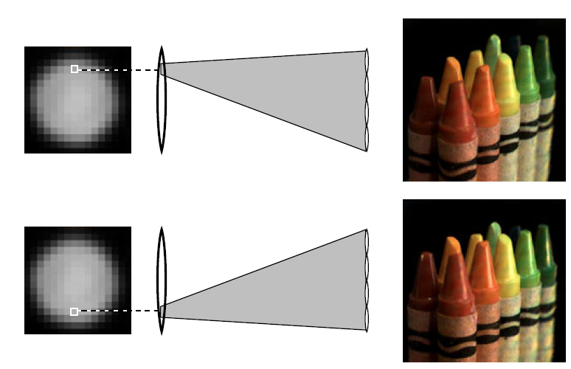
Light field photography: applications
Change in viewpoint

Slide 26
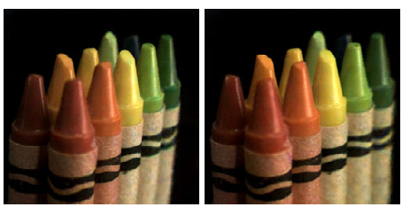
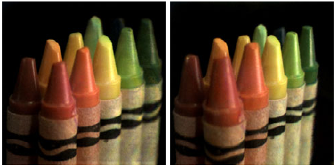
Light field photography: applications
Change in viewpoint
Lateral
Along Optical Axis

Slide 27
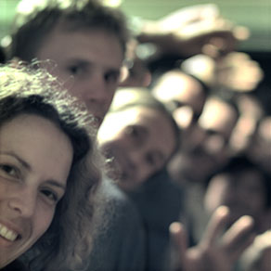
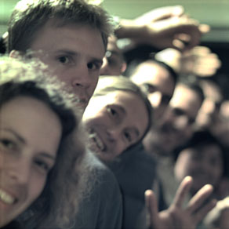
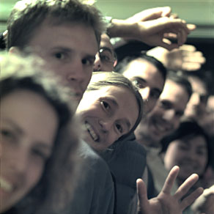
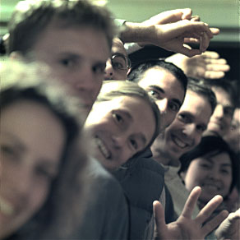
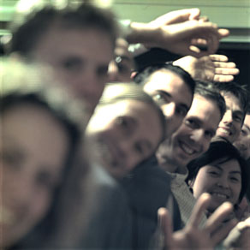
Digital Refocusing

Slide 28
Light field photography w/ microlenses
We gain
  Ability to refocus or increase depth of field
  Ability for small viewpoint shifts
What do we lose (vs. conventional camera)?
Notes:
Lose resolution and/or light

Slide 29
2. Coded apertures

Slide 30
Image and Depth from a Conventional Camera with a Coded Aperture
Anat Levin, Rob Fergus, Frédo Durand, William Freeman
MIT CSAIL
Sliides from SIGGRAPH Presentation

Slide 31
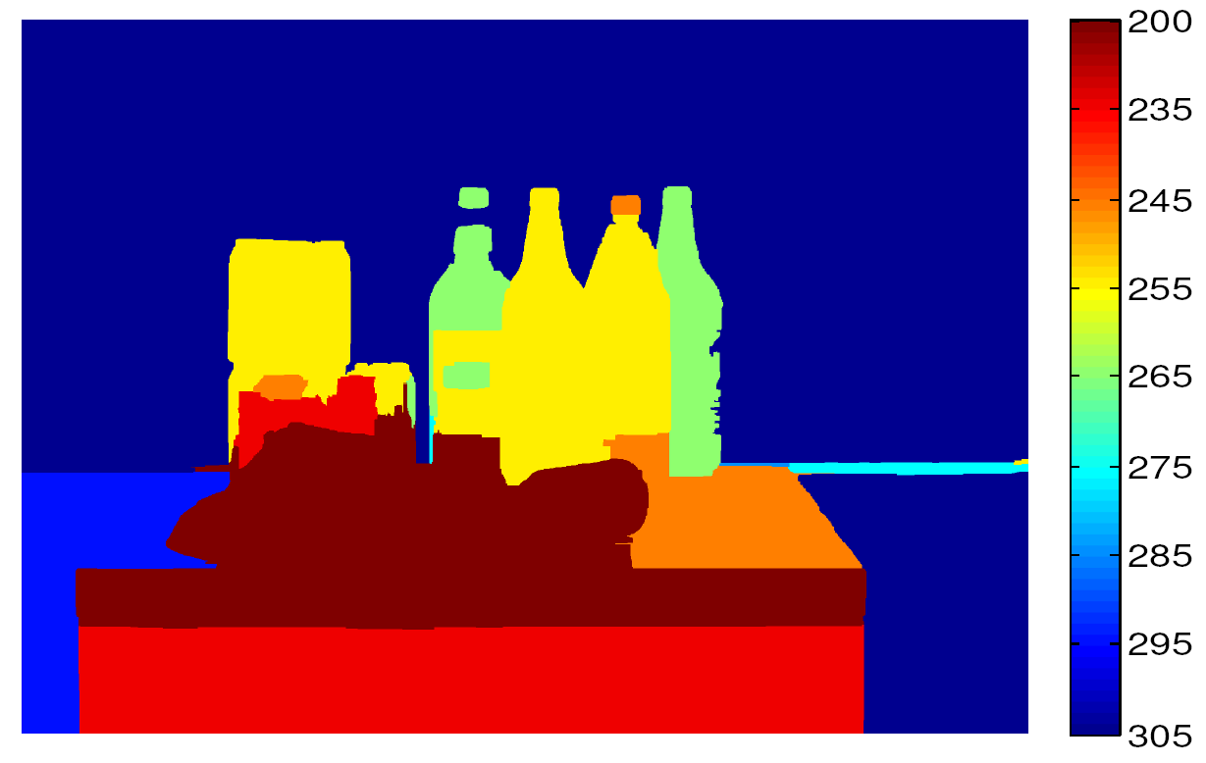
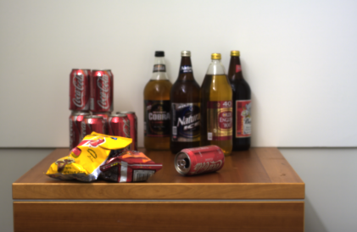
Output #1: Depth map
Single input image:
Notes:
In this work we infer depth from a single image by analyzing the local defocus patterns.

Slide 32
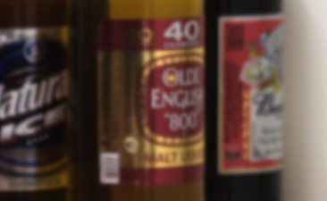

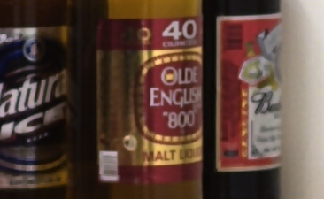
Output #1: Depth map
Single input image:
Output #2: All-focused image
Notes:
We also undo the defocus blur and recover an all focused image.

Slide 33
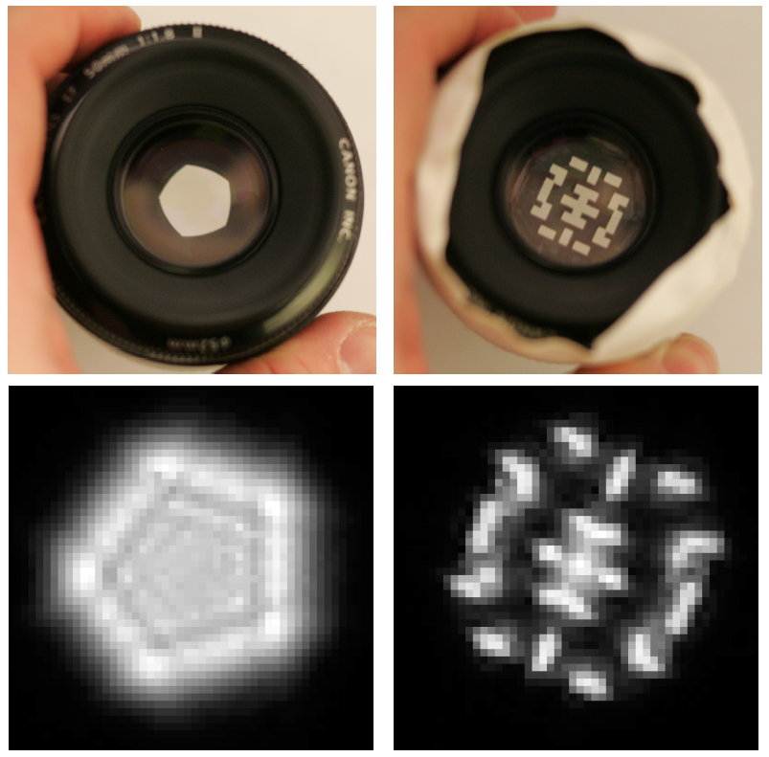
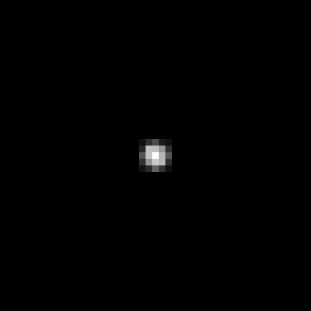
Lens and defocus
Lens’ aperture
Image of a point light source
Lens
Camera sensor
Point spread function
Focal plane
Notes:
before we modify lenses, let’s start with a brief review of conventional lenses.
When we capture an object at the focus distance of a lens all light rays which emerge from an object point will be mapped by the lens onto a single point on the sensor plane.

Slide 34
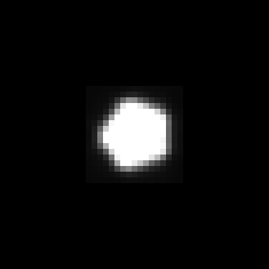
Lens and defocus
Lens’ aperture
Image of a defocused point light source
Object
Lens
Camera sensor
Point spread function
Focal plane
Notes:
when the object is moved from the focus distance, the rays will spread over multiple sensor points and the captured image will be blurry.

Slide 35
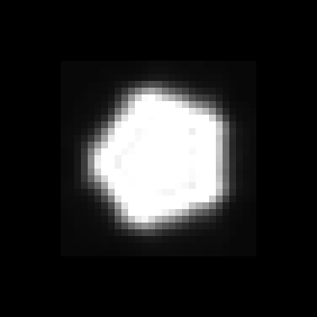
Lens and defocus
Lens’ aperture
Image of a defocused point light source
Object
Lens
Camera sensor
Point spread function
Focal plane
Notes:
If the object is moved further away the blur will be even larger

Slide 36
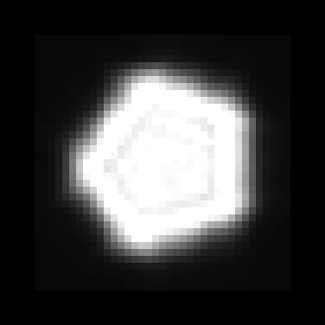
Lens and defocus
Lens’ aperture
Image of a defocused point light source
Object
Lens
Camera sensor
Point spread function
Focal plane

Slide 37
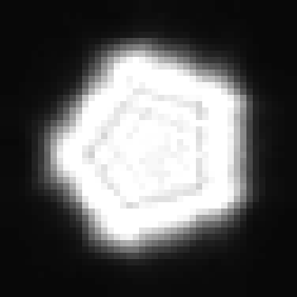
Lens and defocus
Lens’ aperture
Image of a defocused point light source
Object
Lens
Camera sensor
Point spread function
Focal plane

Slide 38
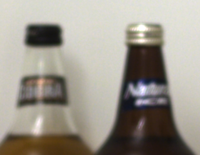
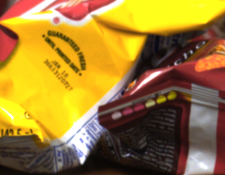
Depth and defocus
Out of focus
Depth from defocus:
Infer depth by analyzing local scale of defocus blur
ill posed
In focus
Notes:
Therefore, if we could measure the exact amount of defocus blur at every image location, we could infer the depth of the scene.
Unfortunately, despite many years of research there is no good way to measure defocus from a single input image.

Slide 39
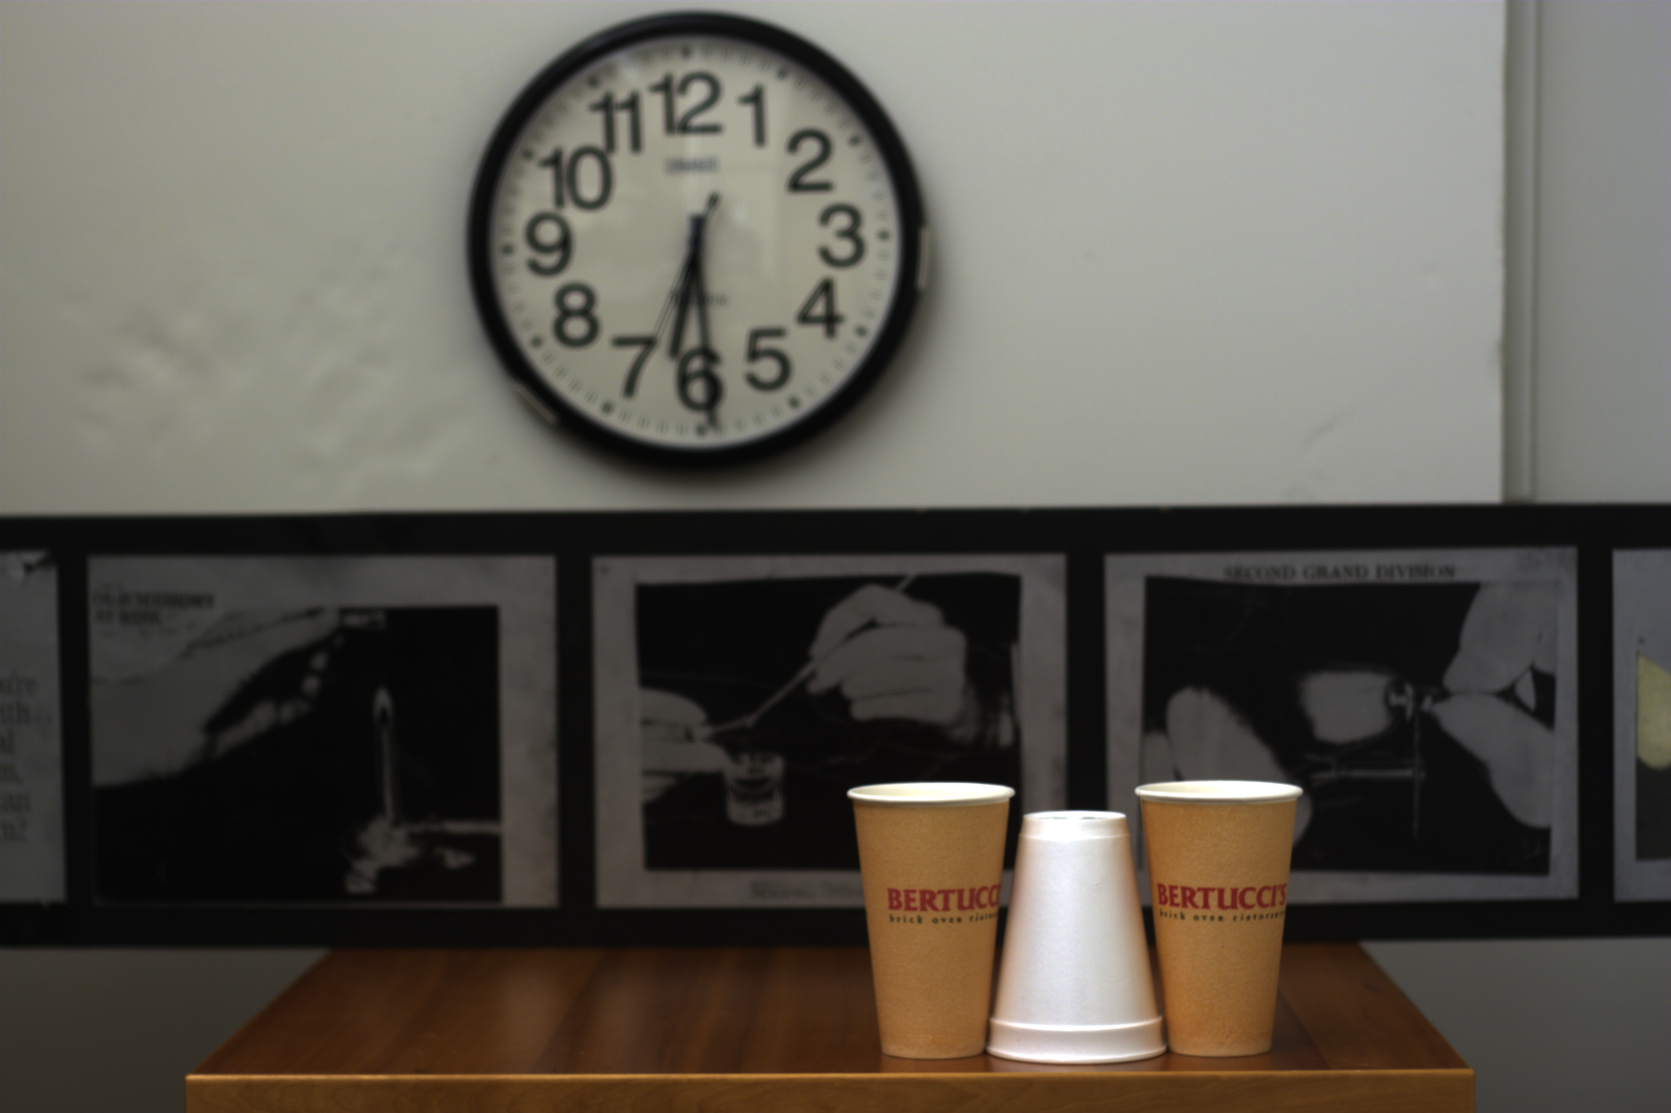
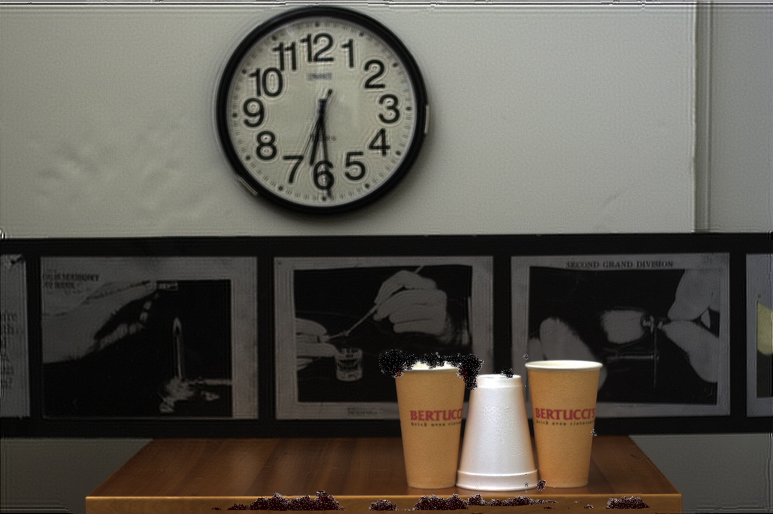
Challenges
Hard to discriminate a smooth scene from defocus blur
Hard to undo defocus blur
?
Out of focus
Input
Ringing with conventional deblurring algorithm
Notes:
The reason the problem is hard is that when observing a blurry image window it’s very hard to know: do we observe the blurry image of a sharp object or the sharp image of a blurry scene.
The second challenge involved with the project is that even if we could infer the depth, undoing the defocus blur is not strait forward.

Slide 40
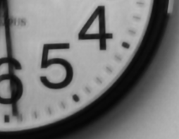
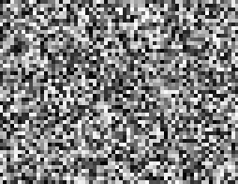
Key ideas
Exploit prior on natural images
- Improve deconvolution
- Improve depth discrimination
Coded aperture (mask inside lens)
- make defocus patterns different from natural images and easier to discriminate
Natural
Unnatural
Notes:
To address these challenges we use two main ideas. The first is the fact that typical images we observe around us are not just white noise and we can place strong image priors which will guide our search.
The second idea is to replace the conventional lens with a coded one. This allows us to change the defocus pattern and make it more discriminative to depth variations.

Slide 41
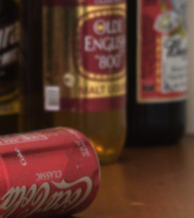
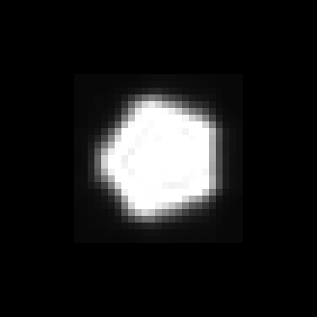
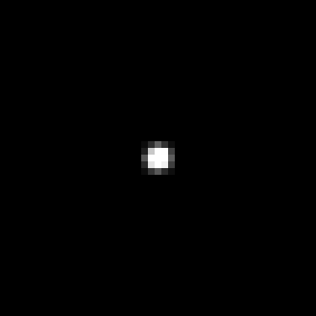
Defocus as local convolution
Calibrated blur kernels at different depths
Input defocused image
Notes:
Now let’s define the problem mathematically. Our input is a single defocused image. In addition, we can calibrate and pre-store the lens blur at different depths.

Slide 42





Defocus as local convolution
Input defocused image
Local
sub-window
Calibrated blur kernels at depth
Sharp
sub-window
Depth k=1:
Depth k=2:
Depth k=3:
Notes:
If we consider local windows whose depth is constant, the observed image y can be modeled as a convolution of a sharp image x with one of the defocus filters. The exact scale of the defocus filter is a function of depth.
There are 2 elements in this equation that we don’t know- first we don’t know the sharp image x, and second we don’t know the scale of the filter with which it was blurred since we don’t know the depth.

Slide 43




Overview
Try deconvolving local input windows with different scaled filters:
?
Larger scale
?
Correct scale
?
Smaller scale
Somehow: select best scale.
Notes:
So here is the high level strategy that we use in our work.
We try to deconvolve the image with all scales of defocus kernels, and we somehow choose the best explanation. And if we manage to identify the correct scale of defocus we will have the depth.
However, the two steps of this strategy are quite challenging.

Slide 44

Challenges
Hard to deconvolve even when kernel is known
Hard to deconvolve even when kernel is known
Input
Ringing with the traditional Richardson-Lucy deconvolution algorithm
Hard to identify correct scale:
?
Larger scale
?
Correct scale
?
Smaller scale
Notes:
First, deconvolution is known to be difficult, and existing algorithms result in significant ringing artifacts.
The second challenge is that if there was a simple good criterion to identify the correct defocus scale, we could probably solve depth from defocus 20 years ago.
If we check this example we can see that the larger scale indeed looks very wrong. The correct scale is ok, but the smallest scale explanation is also not that bad, so it’s not easy to decide which of these two explanations to keep.
In fact this is the same ambiguity we mentioned in the beginning: do we observe the blurry image of a sharp object or the sharp image of a blurry scene.

Slide 45
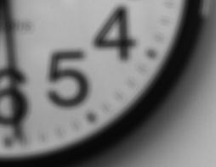
Deconvolution is ill posed
?
=
Notes:
The deconvolution problem can be defined as finding an image x, such that convolved with a filter f, will be equal to the input y.
Convolution is a linear operation and therefore we have here linear constraints on x.
However, in many cases the blur filter kills some of the image information and we don’t have a full rank system, which means that there may not be a unique solution.

Slide 46
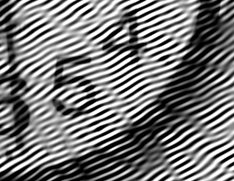

Deconvolution is ill posed
Solution 1:
=
?
Solution 2:
=
?
Notes:
For example, here are 2 possible solutions, and believe it or not, but convolving these to image with the filter f, gives *exactly* the same image.
Yet, when you look at these two solutions it’s very clear to you which of them is good and which of them isn’t, and this is because you know that the original signal was an image and you have in mind a very strong prior on what an image should look like.

Slide 47
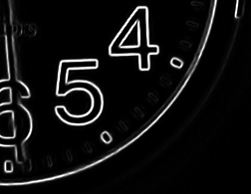
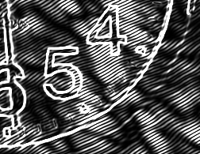
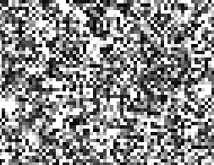
Idea 1: Natural images prior
What makes images special?
Natural
Unnatural
Image
gradient
Natural images have sparse gradients
put a penalty on gradients
Notes:
If we could computationally characterize typical images, we can bias algorithms to output 2D arrays that are more likely to look natural. This is a very powerful idea that is becoming popular for a number of problems in computer vision and image processing.
One way to characterize images is to observe that the gradients are rare, and the normal image on this slide has much fewer gradients comparing to the bad ones.
We can exploit this fact by penalizing potential outputs that have high gradients.

Slide 48
Deconvolution with prior
Convolution error
Derivatives prior
2
_
+
?
Low
Equal convolution error
2
_
+
?
High
Notes:
Therefore we say that we want to find an image x that will minimize the convolution error, but also add the request that it will have fewer gradients.
Or in other words, we try to minimize the sum of a gradient measure over all image pixels.
Therefore despite the fact that the 2 solutions have equal convolution error, we can prefer the good one because it has fewer gradients.

Slide 49
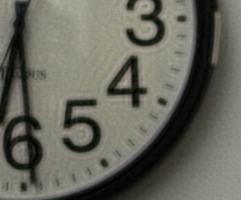

Comparing deconvolution algorithms
(Non blind) deconvolution code available online: http://groups.csail.mit.edu/graphics/CodedAperture/
Input
“spread” gradients
“localizes” gradients
Richardson-Lucy
Gaussian prior
Sparse prior
Notes:
Here is an input blurry image.
A traditional 30 years old way to do deconvolution, is the Richardson Lucy algorithm, which usually produces an image full of ringing.
Instead we can minimize the energy in the previous slide.
The simplest way to penalize the gradients is with the squared norm, which is equivalent to a Gaussian prior. The squared norm is smaller when many small gradients are distributed evenly over many pixels- so this strategy generates some ringing.
A better thing to do is to use a robust norm, or a sparse prior. This prior prefers that only a small number of pixels will suffer- so it generates a small number of sharp transitions and keep the rest of the image clean and smooth.

Slide 50
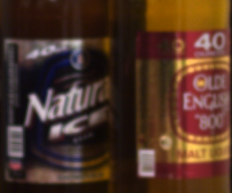



Comparing deconvolution algorithms
(Non blind) deconvolution code available online: http://groups.csail.mit.edu/graphics/CodedAperture/
Input
“spread” gradients
“localizes” gradients
Richardson-Lucy
Gaussian prior
Sparse prior

Slide 51
Recall: Overview
Try deconvolving local input windows with different scaled filters:
Larger scale
?
Correct scale
?
?
Smaller scale
Somehow: select best scale.
Challenge: smaller scale not so different than correct
Notes:
This was about deconvolution, and we now that we know how to deconvolve, we return to our main algorithm.
Recall that we said we would like to try to deblur local input windows with different defocus scales and somehow keep the best explanation.
But the challenge is that the smaller scale is not so different from the correct one.

Slide 52
Idea 2: Coded Aperture
Mask (code) in aperture plane
- make defocus patterns different from natural images and easier to discriminate
Conventional
aperture
Our coded aperture
Notes:
To reduce this uncertainty we reach our main idea- the coded aperture. The coded aperture is a simple change to conventional lenses- inserting into the aperture an occluding pattern.

Slide 53
Solution: lens with occluder
Object
Lens
Camera sensor
Point spread function
Focal plane
Notes:
To understand what happens let’s return to the rays diagram.

Slide 54

Solution: lens with occluder
Aperture pattern
Image of a defocused point light source
Object
Lens with coded aperture
Camera sensor
Point spread function
Focal plane
Notes:
Since the occluder blocks part of the light rays the scene point isn’t spread uniformly, but in a way proportional to the aperture pattern.

Slide 55

Solution: lens with occluder
Aperture pattern
Image of a defocused point light source
Object
Lens with coded aperture
Camera sensor
Point spread function
Focal plane
Notes:
And like the conventional aperture-
If we move the point light source closer to the focus plane, we get a smaller scale of the same pattern, and the exact scale is a function of depth.

Slide 56

Solution: lens with occluder
Aperture pattern
Image of a defocused point light source
Object
Lens with coded aperture
Camera sensor
Point spread function
Focal plane

Slide 57

Solution: lens with occluder
Aperture pattern
Image of a defocused point light source
Object
Lens with coded aperture
Camera sensor
Point spread function
Focal plane

Slide 58
Solution: lens with occluder
Aperture pattern
Image of a defocused point light source
Object
Lens with coded aperture
Camera sensor
Point spread function
Focal plane

Slide 59



Coded aperture reduces uncertainty in scale identification
Conventional
Coded
Larger scale
Correct scale
Smaller scale
Notes:
So why a coded aperture does actually helps us to estimate depth?
We captured the same image with both a conventional and a coded lens.
And let’s try again to deconvolve our local image window with different scales of the defocus filter. With a conventional aperture we have uncertainty between the correct scale and the smaller one, but with the coded aperture, both the smaller and the larger scales are making mess, so the uncertainty is reduced.
This uncertainty demonstrates the major idea behind the coded aperture, and for those of you who want to understand better what happens, we make a short transition into the frequency domain.

Slide 60





Convolution- frequency domain representation
Sharp Image
spectrum
=
1st observed image
Frequency
spectrum
Filter, 1st scale
spectrum
Frequency
Frequency
Sharp Image
spectrum
=
2nd observed image
Frequency
spectrum
Filter, 2nd scale
spectrum
Frequency
Frequency
Output spectrum has zeros
where filter spectrum has zeros
Spatial convolution frequency multiplication
Notes:
Here we have a Fourier transform of a 1D filter at 2 different scales.
We can apply the 2 filters on an image signal. In the frequency domain convolution is just multiplication, and we obtain output signals.
The outputs maintain some of the filters structure and in particular they will be zeros at the same frequencies in which the filters are zeros.

Slide 61

Coded aperture: Scale estimation and division by zero
Estimated image
?
spectrum
Frequency
=
Observed image
Filter, correct scale
spectrum
spectrum
Frequency
Frequency
Large magnitude in image to compensate for tiny magnitude in filter
Estimated image
?
spectrum
Frequency
=
Filter, wrong scale
spectrum
spatial ringing
Frequency
Notes:
Now let’s do the opposite thing- suppose we are given an input signal and we would like to determine by which scale of the filter it was generated.
So we can try to explain it with the first scale, and in this case there is a simple solution- the original image signal.
Now we also try to explain the observed signal with the second scale.
Since convolution is multiplication in the frequency domain, theoretically we just need to divide.
However, at the frequency omega we end up dividing by zero. Since the value of the observed signal is bigger than zero while the value of the filter is zero, no meter which value we place in the recovered image we can never get a non-zero value at the output.
Even for the frequencies in which the filter response is close to zero but not exactly zero we need very high spectrum values in order to explain the observation, and such high values are uncommon in natural images, and they are translated into ringing in the spatial domain.

Slide 62




Division by zero with a conventional aperture?
Estimated image
?
spectrum
Frequency
=
Observed image
Filter, correct scale
spectrum
spectrum
Frequency
Frequency
Estimated image
?
spectrum
no spatial ringing
Frequency
=
Filter, wrong scale
spectrum
Frequency
Notes:
So we see that the division by zero prevents us from explaining the observation with the wrong scale. But why does the zeros trick *not* work with a conventional aperture?
To explain this we got here two scales of the conventional aperture.
And at a first glance we can find a zero value in the wrong scale. However, the corresponding value in the true scale is close enough to zero, and as a result the observed signal value is tiny as well. This means that we now need to divide only a tiny number by zero, and this is not as bad anymore. In fact, any reasonable deconvolution algorithm will explain this tiny value as just noise in the observed signal.
Therefore, we don’t get huge spectrum values in the estimated signal and we don’t get spatial ringing.
As a result, with a conventional aperture the wrong scale explanation is not significantly different than the correct one.

Slide 63




Filter Design
Analytically search for a pattern maximizing discrimination between images at different defocus scales (KL-divergence)
Account for image prior and physical constraints
Score
More discrimination between scales
Less discrimination between scales
Sampled aperture patterns
Conventional aperture
Notes:
In order to design a good aperture filter in a principled way, we propose in the paper an analytical measure for the statistical distance between different scales of a filter.
Using this measure we can search over aperture filters, and evaluate their discrimination score, and we select a filter with a high score.
On the other hand, our measure indeed predicts that a conventional aperture Gaussian filter will have a poor discrimination.
And for further details about this, please see the paper..

Slide 64
Depth results

Slide 65


Regularizing depth estimation
Try deblurring with 10 different aperture scales
Convolution error
Derivatives prior
2
_
+
Keep minimal error scale in each local window
+ regularization
Input
Local depth estimation
Regularized depth
Notes:
To obtain depth for the full image, we consider each sub-window independently, trying a range of defocus scales and picking the one which minimizes the deconvolution error. However, this can be noisy.
Also, like most passive depth estimation methods, our approach requires texture, so has trouble with uniform areas of the image.
Therefore, we use a markov random field to regularize the local depth map. This prefers the depth to be piece-wise constant and that depth discontinuities should align with image discontinuities. This gives the improved depth map on the right.
The colors correspond to depth from the camera, red being closer and blue being further away.

Slide 66

Regularizing depth estimation
Local depth estimation
Input
Regularized depth

Slide 67
All focused results

Slide 68

Input

Slide 69

All-focused (deconvolved)
Notes:
Unlike conventional plenoptic cameras, our approach produces images at full resolution, which in this case
exceeds that of the projector, so we need to zoom in to see better.

Slide 70
Close-up
Original image
All-focus image

Slide 71

Comparison- conventional aperture result
Ringing due to wrong scale estimation
Notes:
To show the power of the coded aperture, we used exactly the same
calibration and depth estimation pipelines with a conventional
aperture. The resulting all-focused image contains ringing due to
incorrect estimation of the depth.

Slide 72
Comparison- coded aperture result
Notes:
By contrast, if we use a coded aperture we get a clean result.

Slide 73

Input

Slide 74

All-focused (deconvolved)

Slide 75


Close-up
Original image
All-focus image
Naïve sharpening
Notes:
Zooming in, we can see the original and deblurred output. For comparison, we also try a naive edge sharpening operation in Photoshop, but it simply increases the artifacts in the image.

Slide 76

Application: Digital refocusing from a single image
Notes:
Using the all-focused image and the layered depth map, one application
is post-exposure refocusing.

Slide 77

Application: Digital refocusing from a single image
Notes:
and we can refocus on different individuals.

Slide 78

Application: Digital refocusing from a single image

Slide 79

Application: Digital refocusing from a single image

Slide 80

Application: Digital refocusing from a single image

Slide 81

Application: Digital refocusing from a single image

Slide 82

Application: Digital refocusing from a single image

Slide 83


Coded aperture: pros and cons
+
Image AND depth at a single shot
No loss of image resolution
Simple modification to lens
Depth is coarse
But depth is a pure bonus
Lose some light
But deconvolution increases depth of field
+
+
-
unable to get depth at untextured areas, might need manual corrections.
+
-
+
Notes:
Let's summarize the pros and cons of the method.
We obtain a high-resolution image and depth
information from a single shot. This requires a simple modification to
a conventional lens.
Like most passive depth acquisition methods our technique relies on the fact that the scene will include texture.
Our depth estimation is not perfect and for some images we need user
help to correct the depth map.
However, since users can continue to use a conventional camera and capture high resolution images the depth information is a pure bonus.
Another limitation is that by blocking parts of the aperture we loose about 50% of the incoming light and we will require longer exposure time. But on the other hand the deconvolution allows us to increase depth of field.

Slide 84


50mm f/1.8:
$79.95
Cardboard:
$1
Tape:
$1
Depth acquisition:
priceless
Notes:
In summary, our coded aperture is a very simple modification of a
conventional lens. It's a low budget project: the lens is $80, the
cardboard is cheap and the tape is virtually free and for this you get
get back depth.

Slide 85
Some more quick examples

Slide 86

Quickly move camera in a parabola when taking a picture
A motion at any speed in the direction of the parabola will give the same blur kernel

Slide 87


Results
Static Camera
Parabolic Camera

Slide 88

Results
Static Camera
Parabolic Camera
Motion in wrong direction

Slide 89



Slide 90


RGBW Sensors
2007: Kodak ‘Panchromatic’ Pixels
Outperforms Bayer Grid
  2X-4X sensitivity (W: no filter loss)
  May improve dynamic range (W >> RGB sensitivity)
http://www.dpreview.com/news/2007/6/14/kodakhighsens

Slide 91

Computational Approaches to Display
3D TV without glasses
  20”, $2900, available in Japan (2010)
  You see different images from different angles
http://news.cnet.com/8301-13506_3-20018421-17.html
Newer version: http://www.pcmag.com/article2/0,2817,2392380,00.asp
Toshiba

Slide 92
Recap of questions
How can we represent all of the information contained in light?
What are the fundamental limitations of cameras?
What sacrifices have we made in conventional cameras? For what benefits?
How else can we design cameras for better focus, deblurring, multiple views, depth, etc.?
Notes:
Answers:
1) Plenoptic function
2) Amount of light
3) Limit light and get depth of field effects; sharp images that are easy to display
4) Lots of ways

Slide 93

Next class
Kinect sensor

