Slide 1
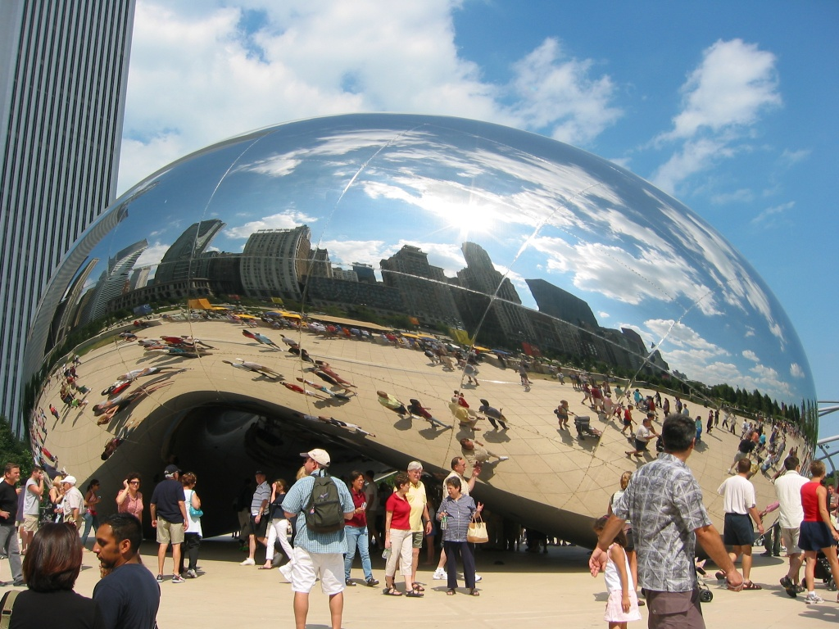
Image Warping
09/27/12
Computational Photography
Derek Hoiem, University of Illinois
Many slides from Alyosha Efros + Steve Seitz
Photo by Sean Carroll

Slide 2
Last class: Gradient-domain editing
Many image processing applications can be thought of as trying to manipulate gradients or intensities:
  Contrast enhancement
  Denoising
  Poisson blending
  HDR to RGB
  Color to Gray
  Recoloring
  Texture transfer
See Perez et al. 2003 and GradientShop for many examples

Slide 3
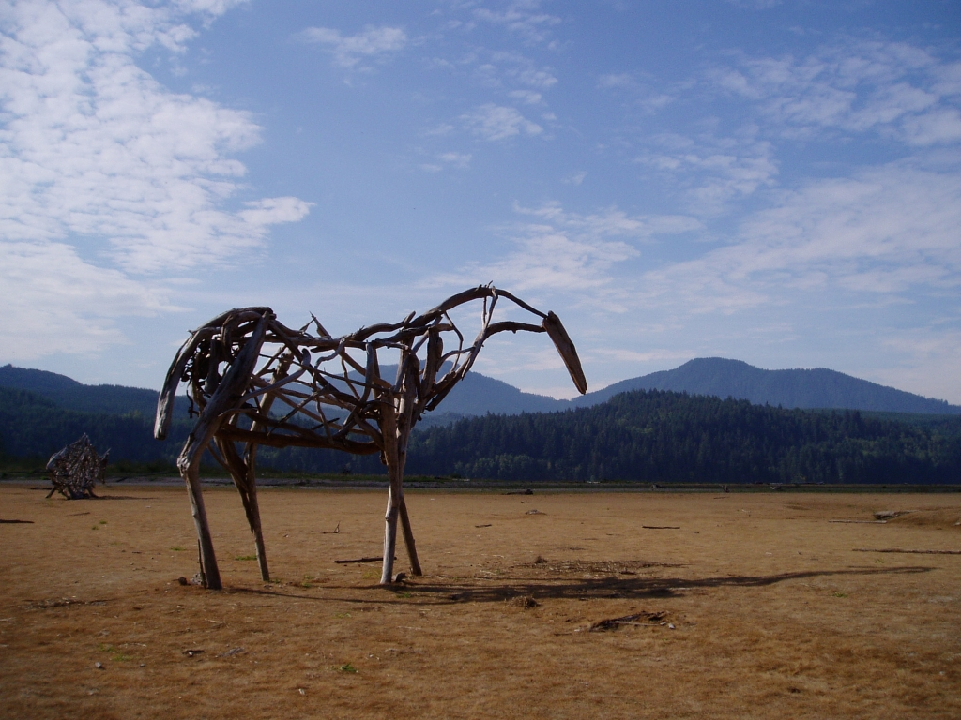
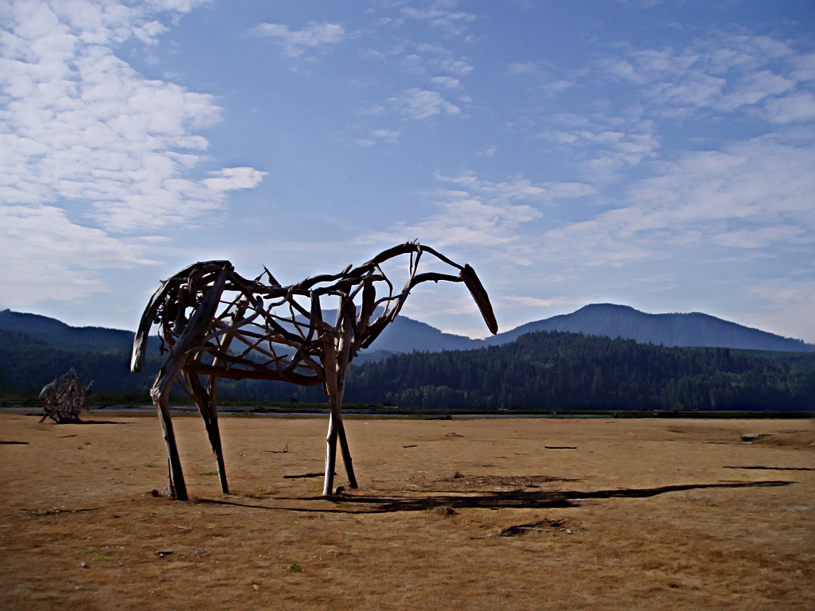
Gradient-domain processing
Saliency-based Sharpening
http://www.gradientshop.com

Slide 4


Gradient-domain processing
Non-photorealistic rendering
http://www.gradientshop.com

Slide 5
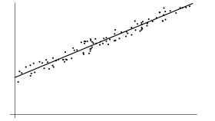
Gradient-domain editing
Creation of image = least squares problem in terms of: 1) pixel intensities; 2) differences of pixel intensities
Use Matlab least-squares solvers for numerically stable solution with sparse A
Least Squares Line Fit in 2 Dimensions

Slide 6
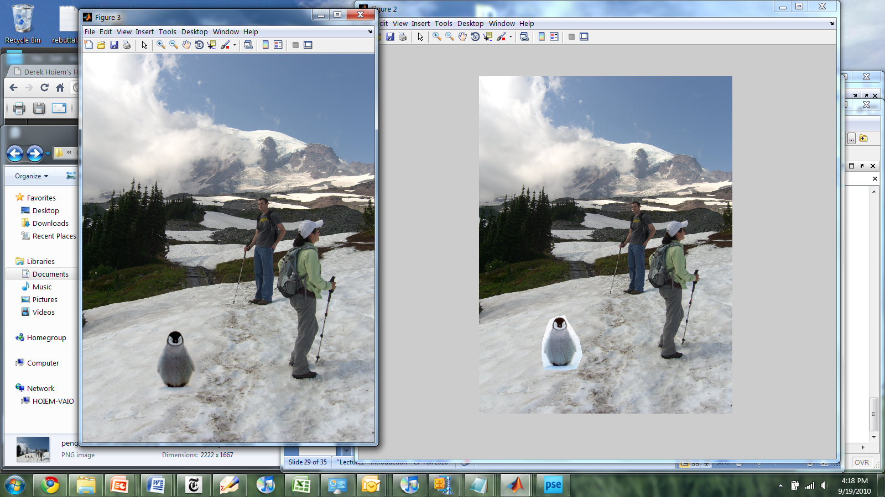
Poisson blending example
A good blend should preserve gradients of source region without changing the background

Slide 7



Take-home questions
1) I am trying to blend this bear into this pool. What problems will I have if I use:
  Alpha compositing with feathering
  Laplacian pyramid blending
  Poisson editing?
Lap. Pyramid
Poisson Editing

Slide 8
Take-home questions
2) How would you make a sharpening filter using gradient domain processing? What are the constraints on the gradients and the intensities?

Slide 9
Next two classes
Image warping and morphing
  Global coordinate transformations
  Meshes and triangulation
  Texture mapping
  Interpolation
Applications
  Morphing and transitions (project 4)
  Panoramic stitching (project 5)
  Many more

Slide 10
Image Transformations
image filtering: change range of image
g(x) = T(f(x))
f
f
T
x
x
image warping: change domain of image
g(x) = f(T(x))
f
f
T
x
x

Slide 11
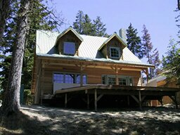
Image Transformations
image filtering: change range of image
g(x) = T(f(x))
f
g
T
image warping: change domain of image
g(x) = f(T(x))
f
g
T

Slide 12
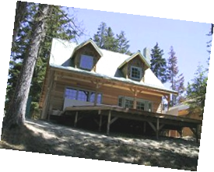
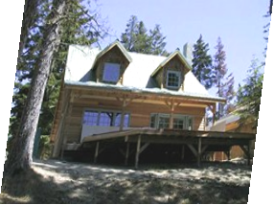
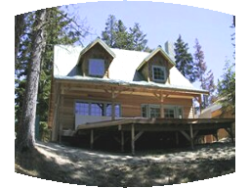
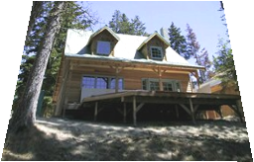
Parametric (global) warping
Examples of parametric warps:
translation
rotation
aspect
perspective
affine
cylindrical

Slide 13
Parametric (global) warping
T
p = (x,y)
p’ = (x’,y’)
Transformation T is a coordinate-changing machine:
p’ = T(p)
What does it mean that T is global?
  Is the same for any point p
  can be described by just a few numbers (parameters)
For linear transformations, we can represent T as a matrix
p’ = Mp

Slide 14
Scaling
Scaling a coordinate means multiplying each of its components by a scalar
Uniform scaling means this scalar is the same for all components:
× 2

Slide 15
Scaling
Non-uniform scaling: different scalars per component:
X × 2,
Y × 0.5

Slide 16
Scaling
Scaling operation:
Or, in matrix form:
scaling matrix S
What’s inverse of S?

Slide 17
2-D Rotation
(x’, y’)
(x, y)
x’ = x cos(θ) - y sin(θ)
y’ = x sin(θ) + y cos(θ)
θ

Slide 18
2-D Rotation
Polar coordinates…
x = r cos (φ)
y = r sin (φ)
x’ = r cos (φ + θ)
y’ = r sin (φ + θ)
Trig Identity…
x’ = r cos(φ) cos(θ) – r sin(φ) sin(θ)
y’ = r sin(φ) cos(θ) + r cos(φ) sin(θ)
Substitute…
x’ = x cos(θ) - y sin(θ)
y’ = x sin(θ) + y cos(θ)
(x’, y’)
(x, y)
θ
φ

Slide 19
2-D Rotation
This is easy to capture in matrix form:
Even though sin(θ) and cos(θ) are nonlinear functions of θ,
  x’ is a linear combination of x and y
  y’ is a linear combination of x and y
What is the inverse transformation?
  Rotation by –θ
  For rotation matrices
R

Slide 20
2x2 Matrices
What types of transformations can be
represented with a 2x2 matrix?
2D Identity?
2D Scale around (0,0)?

Slide 21
2x2 Matrices
What types of transformations can be
represented with a 2x2 matrix?
2D Rotate around (0,0)?
2D Shear?

Slide 22
2x2 Matrices
What types of transformations can be
represented with a 2x2 matrix?
2D Mirror about Y axis?
2D Mirror over (0,0)?

Slide 23
2x2 Matrices
What types of transformations can be
represented with a 2x2 matrix?
2D Translation?
NO!
Only linear 2D transformations
can be represented with a 2x2 matrix

Slide 24
All 2D Linear Transformations
Linear transformations are combinations of …
  Scale,
  Rotation,
  Shear, and
  Mirror
Properties of linear transformations:
  Origin maps to origin
  Lines map to lines
  Parallel lines remain parallel
  Ratios are preserved
  Closed under composition

Slide 25
Homogeneous Coordinates
Q: How can we represent translation in matrix form?

Slide 26
Homogeneous Coordinates
Homogeneous coordinates
represent coordinates in 2 dimensions with a 3-vector

Slide 27
Homogeneous Coordinates
2D Points → Homogeneous Coordinates
Append 1 to every 2D point: (x y) → (x y 1)
Homogeneous coordinates → 2D Points
Divide by third coordinate (x y w) → (x/w y/w)
Special properties
Scale invariant: (x y w) = k * (x y w)
(x, y, 0) represents a point at infinity
(0, 0, 0) is not allowed
y
Scale Invariance
2
(2,1,1)
or (4,2,2)
or (6,3,3)
1
1
2
x

Slide 28
Homogeneous Coordinates
Q: How can we represent translation in matrix form?
A: Using the rightmost column:

Slide 29
Translation Example
Homogeneous Coordinates
t_{x} = 2
t_{y} = 1

Slide 30
Basic 2D transformations as 3x3 matrices
Translate
Scale
Rotate
Shear

Slide 31
Matrix Composition
Transformations can be combined by
matrix multiplication
p’ = T(t_{x},t_{y}) R(Θ) S(s_{x},s_{y}) p
Does the order of multiplication matter?

Slide 32
Affine Transformations
Affine transformations are combinations of
  Linear transformations, and
  Translations
Properties of affine transformations:
  Origin does not necessarily map to origin
  Lines map to lines
  Parallel lines remain parallel
  Ratios are preserved
  Closed under composition
Will the last coordinate w ever change?

Slide 33
Projective Transformations
Projective transformations are combos of
  Affine transformations, and
  Projective warps
Properties of projective transformations:
  Origin does not necessarily map to origin
  Lines map to lines
  Parallel lines do not necessarily remain parallel
  Ratios are not preserved
  Closed under composition
  Models change of basis
  Projective matrix is defined up to a scale (8 DOF)

Slide 34
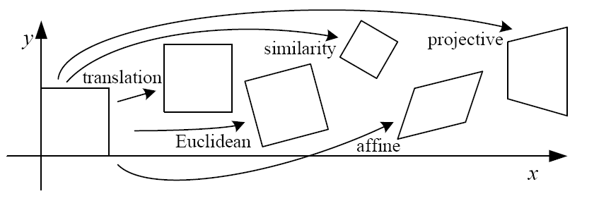
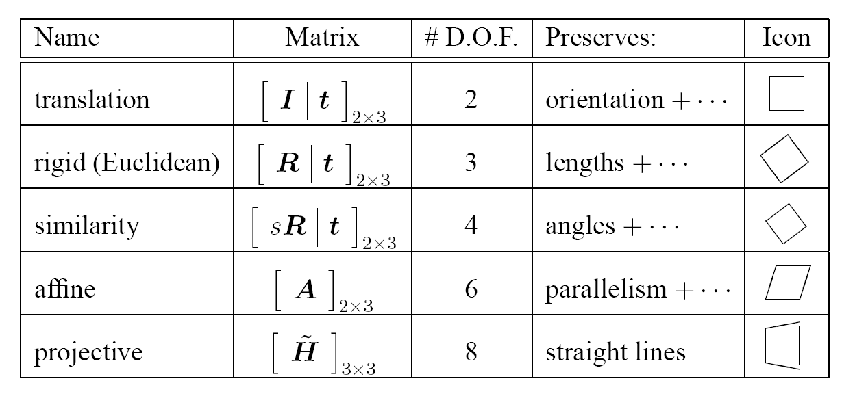
2D image transformations
These transformations are a nested set of groups
  Closed under composition and inverse is a member

Slide 35
Recovering Transformations
?
T(x,y)
y
y’
x
x’
f(x,y)
g(x’,y’)
What if we know f and g and want to recover the transform T?
  willing to let user provide correspondences
    How many do we need?

Slide 36
Translation: # correspondences?
?
T(x,y)
y
y’
x
x’
How many Degrees of Freedom?
How many correspondences needed for translation?
What is the transformation matrix?

Slide 37
Euclidian: # correspondences?
?
T(x,y)
y
y’
x
x’
How many DOF?
How many correspondences needed for translation+rotation?

Slide 38
Affine: # correspondences?
?
T(x,y)
y
y’
x
x’
How many DOF?
How many correspondences needed for affine?

Slide 39
Projective: # correspondences?
?
T(x,y)
y
y’
x
x’
How many DOF?
How many correspondences needed for projective?

Slide 40

Take-home Question
9/27/12
1) Suppose we have two triangles: ABC and A’B’C’. What transformation will map A to A’, B to B’, and C to C’? How can we get the parameters?
B
B’
?
T(x,y)
C’
A
C
A’
Source
Destination

Slide 41
Take-home Question
9/27/2012
2) Show that distance ratios along a line are preserved under 2d linear transformations.
o
(x3,y3)
o
(x’3,y’3)
o
o
(x2,y2)
o
p1=(x1,y1)
o
(x’2,y’2)
p‘1=(x’1,y’1)
Hint: Write down x2 in terms of x1 and x3, given that the three points are co-linear

Slide 42
Next class: texture mapping and morphing

