Slide 1
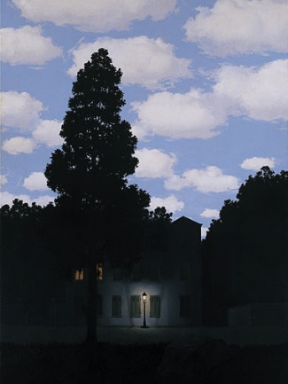
Light and Color
09/11/12
Computational Photography
Derek Hoiem, University of Illinois
“Empire of Light”, Magritte

Slide 2
Outline
Light and wavelengths
The eye
  Physiology (rods and cones)
  Receptivity, non-linear response
  Trichromacity
The camera and display
  Bayer filter revisited
  RGB display
Physics of light and reflection
  Direct light: spectrum of wavelengths
  Reflection: influence of albedo, orientation, reflectivity, BRDF
  Inter-reflection: light may be influenced by multiple surfaces
  Illusions, ambiguity of albedo and illumination color, color constancy
  Light sources and shadows
Color spaces
  RGB, HSV, YCrCb, XYZ, Lab

Slide 3
Announcements
Tutorial: today 5pm SC3403
Project 1 due next Mon (9/17), 11:59pm
  Choosing cutoff: sigma > 1

Slide 4
Today’s class
How is incoming light measured by the eye or camera?
Incoming Light
Lens
Sensors/Retina

Slide 5
Today’s class
How is incoming light measured by the eye or camera?
How is light reflected from a surface?
Light source
Reflected Light
Incoming Light
Lens
Sensors/Retina
Notes:
Basis for vision, graphics

Slide 6
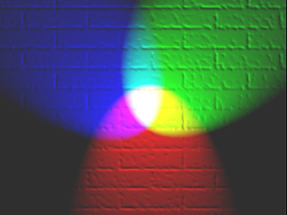
Today’s class
How is incoming light measured by the eye or camera?
How is light reflected from a surface?
How can we represent color?

Slide 7
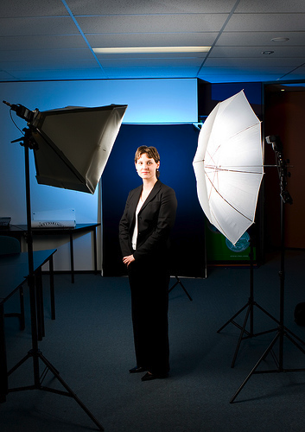
Photo by nickwheeleroz, Flickr
Slide: Forsyth

Slide 8
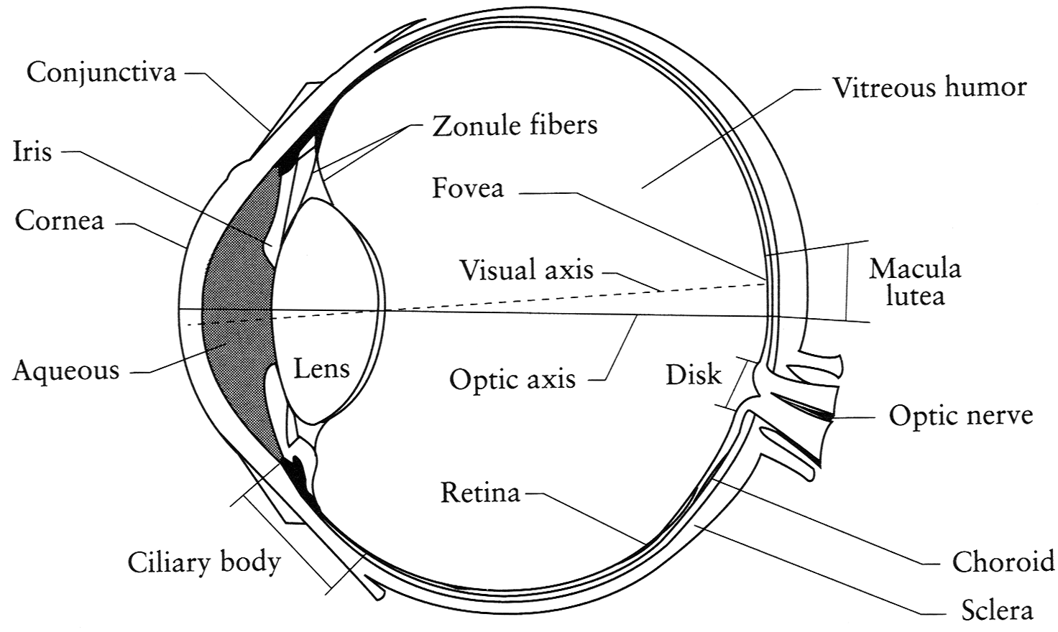
The Eye
The human eye is a camera!
  Iris - colored annulus with radial muscles
  Pupil - the hole (aperture) whose size is controlled by the iris
  What’s the “film”?
    photoreceptor cells (rods and cones) in the retina
Slide by Steve Seitz

Slide 9
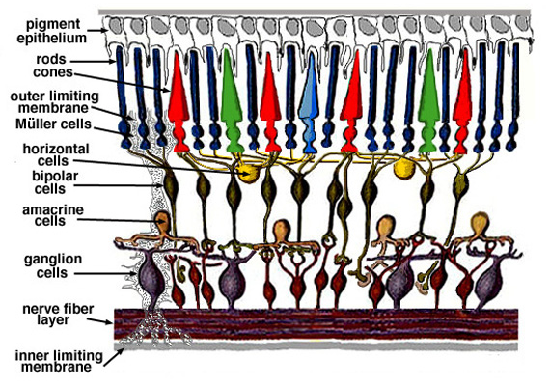
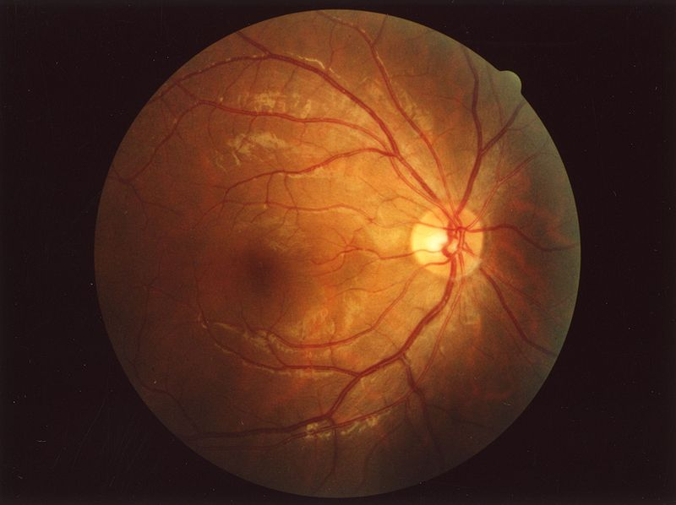
Retina up-close
Light

Slide 10
Two types of light-sensitive receptors
Cones
cone-shaped
less sensitive
operate in high light
color vision
Rods
rod-shaped
highly sensitive
operate at night
gray-scale vision
slower to respond
© Stephen E. Palmer, 2002
Slide Credit: Efros

Slide 11
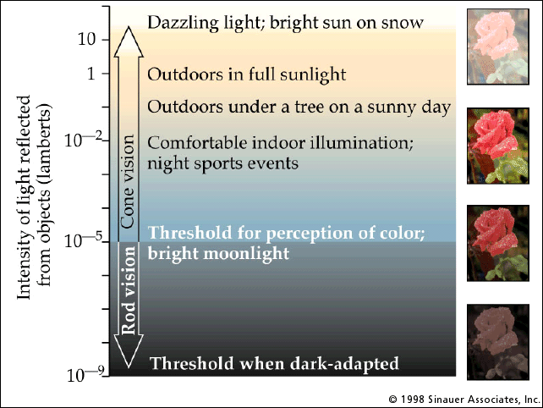
Rod / Cone sensitivity
Slide Credit: Efros
Notes:
Sock matching in dark is difficult

Slide 12
Distribution of Rods and Cones
Night Sky: why are there more stars off-center?
© Stephen E. Palmer, 2002
Slide Credit: Efros

Slide 13
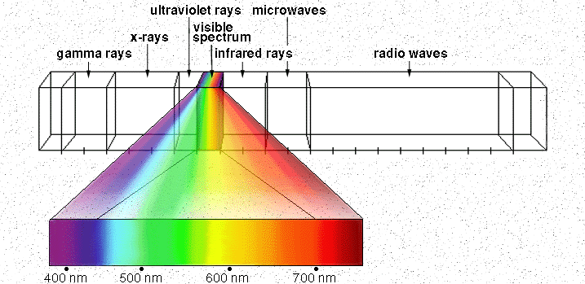

Electromagnetic Spectrum
Human Luminance Sensitivity Function
Slide Credit: Efros
http://www.yorku.ca/eye/photopik.htm
Notes:
At least 3 spectral bands required (e.g. R,G,B)

Slide 14
Visible Light
Why do we see light of these wavelengths?
…because that’s where the
Sun radiates EM energy
© Stephen E. Palmer, 2002

Slide 15
The Physics of Light
Any patch of light can be completely described
physically by its spectrum: the number of photons
(per time unit) at each wavelength 400 - 700 nm.
© Stephen E. Palmer, 2002

Slide 16
The Physics of Light
Some examples of the spectra of light sources
© Stephen E. Palmer, 2002

Slide 17
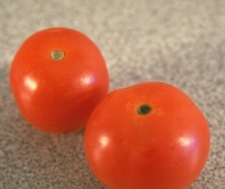
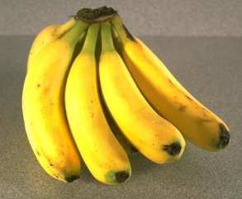
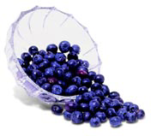
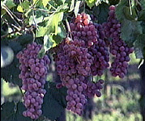
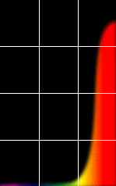
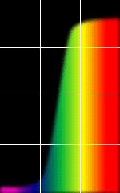
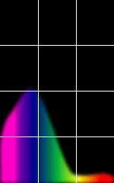
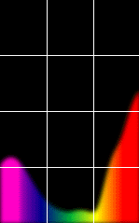
The Physics of Light
Some examples of the reflectance spectra of surfaces
Red
Yellow
Blue
Purple
% Photons Reflected
400 700
400 700
400 700
400 700
Wavelength (nm)
© Stephen E. Palmer, 2002

Slide 18
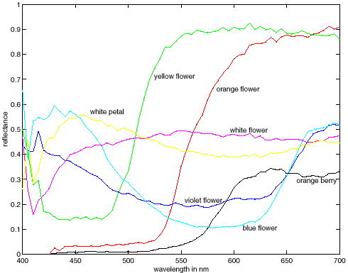
More Spectra
metamers

Slide 19
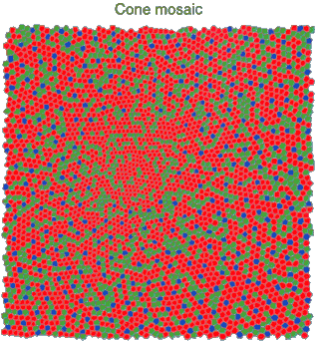
Physiology of Color Vision
Three kinds of cones:
Why are M and L cones so close?
Why are there 3?
© Stephen E. Palmer, 2002
Notes:
Dogs have 2, birds and butterflies have 4

Slide 20
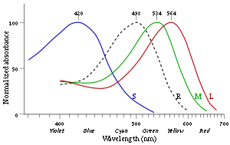
3 is better than 2…
“M” and “L” on the X-chromosome
  Why men are more likely to be color blind (see what it’s like: http://www.vischeck.com/vischeck/vischeckURL.php)
“L” has high variation, so some women are tetrachromatic
Some animals have 1 (night animals), 2 (e.g., dogs), 4 (fish, birds), 5 (pigeons, some reptiles/amphibians), or even 12 (mantis shrimp)
http://en.wikipedia.org/wiki/Color_vision

Slide 21
We don’t perceive a spectrum
We perceive
  Hue: mean wavelength, color
  Saturation: variance, vividness
  Intensity: total amount of light
Same perceived color can be recreated with combinations of three primary colors (“trichromacy”)

Slide 22
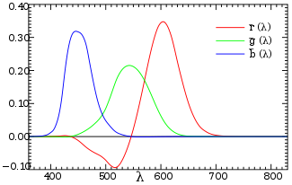
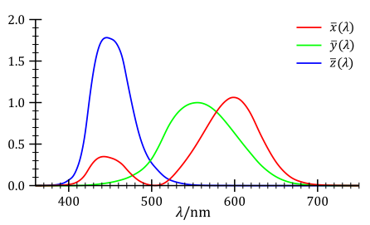
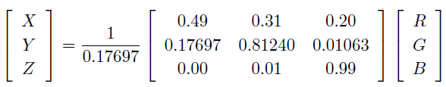
Trichromacy and CIE-XYZ
Perceptual equivalents with RGB
Perceptual equivalents with CIE-XYZ

Slide 23

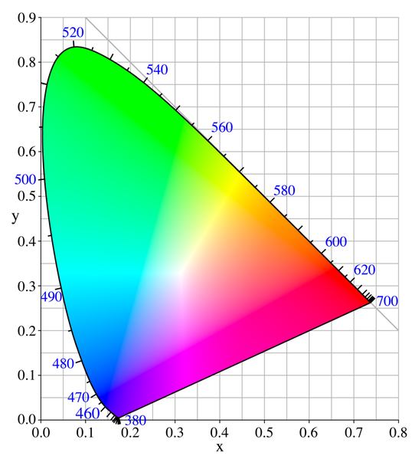

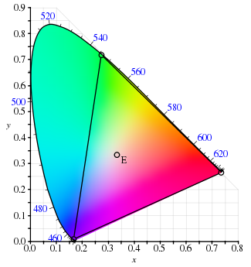
CIE-XYZ
RGB portion is in triangle

Slide 24
The Psychophysical Correspondence
There is no simple functional description for the perceived
color of all lights under all viewing conditions, but …...
A helpful constraint:
Consider only physical spectra with normal distributions
mean
area
variance
© Stephen E. Palmer, 2002

Slide 25
The Psychophysical Correspondence
Mean
Hue
# Photons
Wavelength
© Stephen E. Palmer, 2002

Slide 26
The Psychophysical Correspondence
Variance
Saturation
# Photons
Wavelength
© Stephen E. Palmer, 2002

Slide 27
The Psychophysical Correspondence
Area
Brightness
# Photons
Wavelength
© Stephen E. Palmer, 2002

Slide 28


Color Sensing: Bayer Grid
Estimate RGB at each cell from neighboring values
http://en.wikipedia.org/wiki/Bayer_filter
Slide by Steve Seitz

Slide 29

Alternative to Bayer: RGB+W
Kodak 2007

Slide 30
How is light reflected from a surface?
Depends on
Illumination properties: wavelength, orientation, intensity
Surface properties: material, surface orientation, roughness, etc.
light source
λ
?

Slide 31
Lambertian surface
Some light is absorbed (function of albedo)
Remaining light is reflected in all directions (diffuse reflection)
Examples: soft cloth, concrete, matte paints
light source
light source
λ
λ
absorption
diffuse reflection

Slide 32
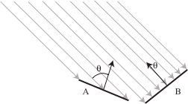
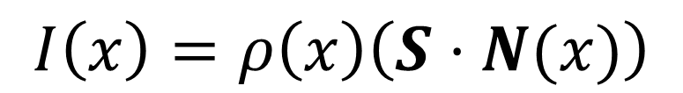

Diffuse reflection
Intensity does depend on illumination angle because less light comes in at oblique angles.
$ρ=$albedo
$S=$ directional source
$N=$ surface normal
$I=$ image intensity
$$I\left(x\right)=ρ\left(x\right)\left(S⋅N(x)\right)$$
Slide: Forsyth

Slide 33
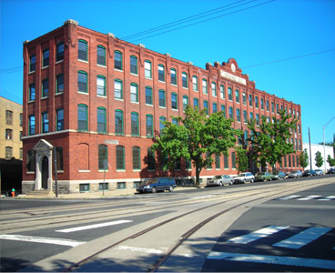
1
2

Slide 34
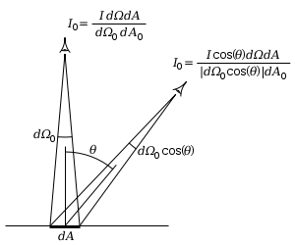
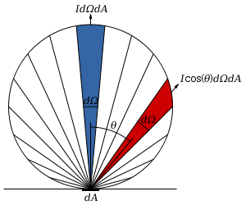
Diffuse reflection
Perceived intensity does not depend on viewer angle.
  Amount of reflected light proportional to cos(theta)
  Visible solid angle also proportional to cos(theta)
http://en.wikipedia.org/wiki/Lambert%27s_cosine_law

Slide 35

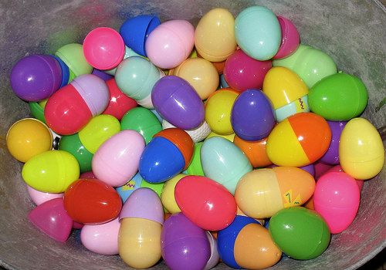


Specular Reflection
Reflected direction depends on light orientation and surface normal
E.g., mirrors are fully specular
Flickr, by suzysputnik
light source
λ
specular reflection
$$Θ$$
$$Θ$$
Flickr, by piratejohnny

Slide 36
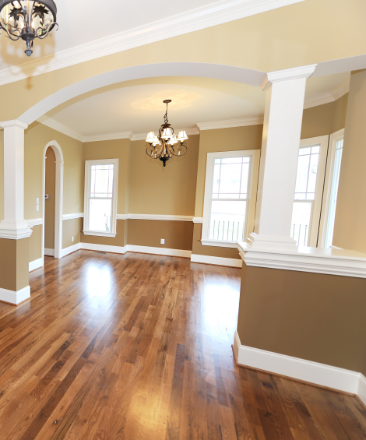
Many surfaces have both specular and diffuse components
Specularity = spot where specular reflection dominates (typically reflects light source)
Photo: northcountryhardwoodfloors.com

Slide 37
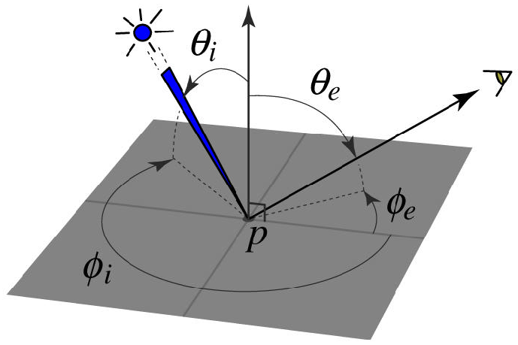
BRDF: Bidirectional Reflectance Distribution Function
Model of local reflection that tells how bright a surface appears when viewed from one direction when light falls on it from another
surface normal
Slide credit: S. Savarese

Slide 38

More complicated effects
transparency
light source
light source
refraction
λ
λ

Slide 39
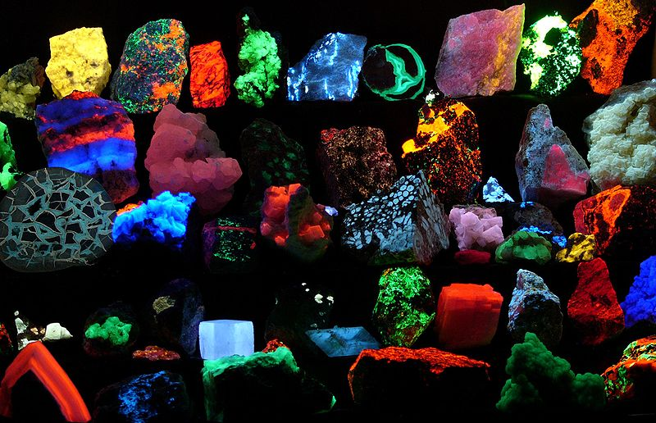
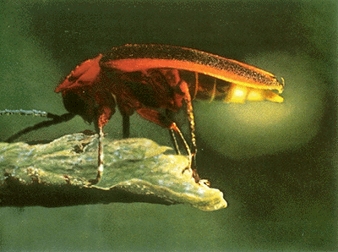
light source
light source
fluorescence
phosphorescence
λ₁
t=1
λ₂
t>1

Slide 40
light source
light source
subsurface scattering
interreflection
λ
λ

Slide 41
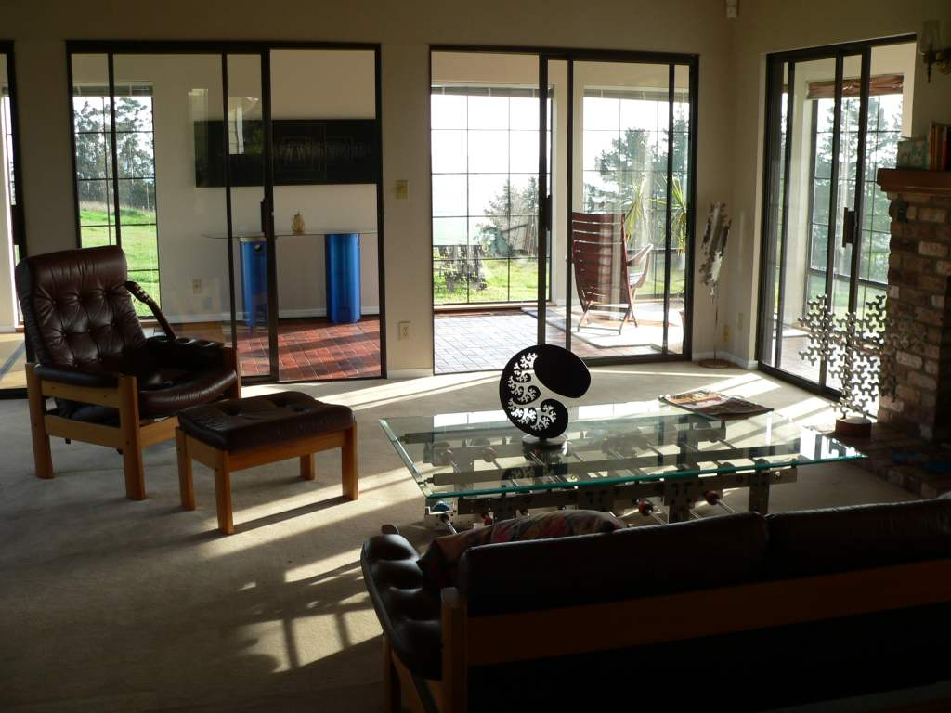
Inter-reflection is a major source of light

Slide 42
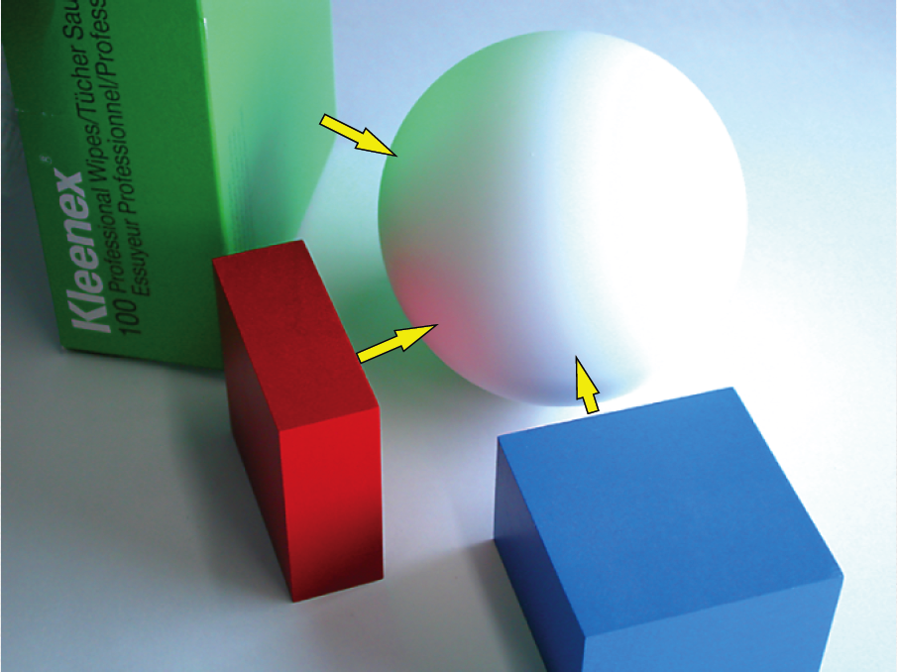
Inter-reflection affects the apparent color of objects
From Koenderink slides on image texture and the flow of light

Slide 43
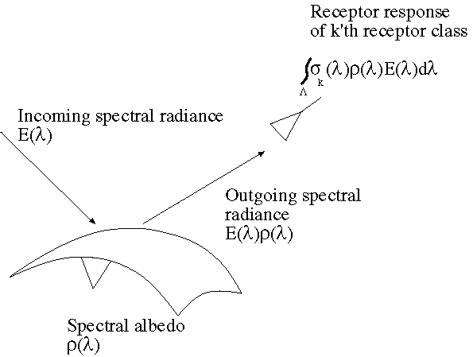
The color of objects
Colored light arriving at the camera involves two effects
  The color of the light source (illumination + inter-reflections)
  The color of the surface
Slide: Forsyth

Slide 44
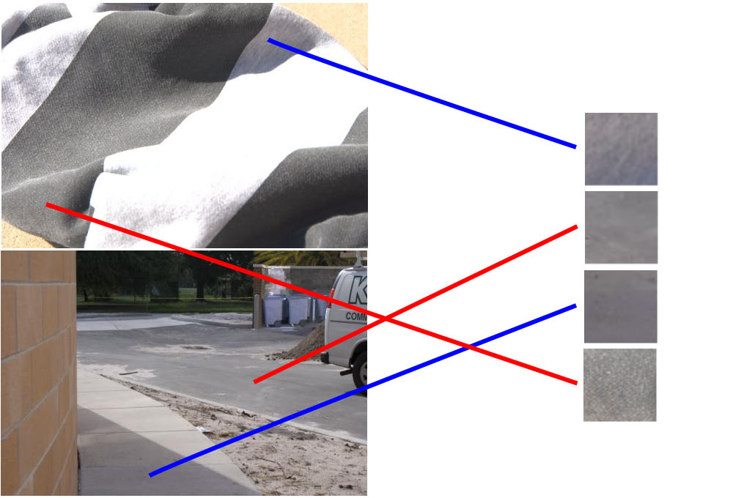
Color constancy
Interpret surface in terms of albedo or “true color”, rather than observed intensity
  Humans are good at it
  Computers are not nearly as good

Slide 45
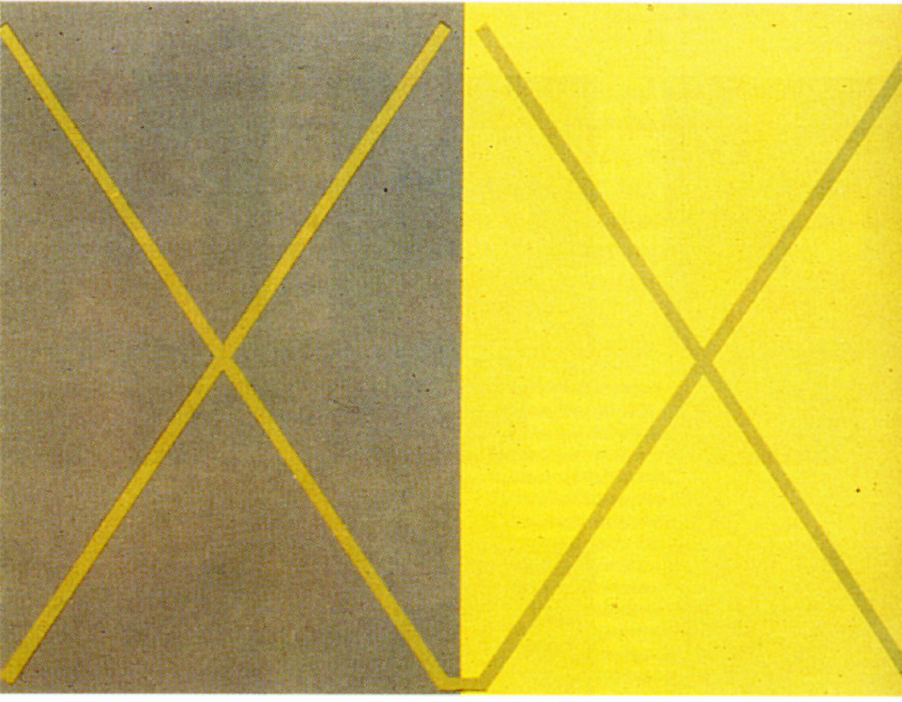
Color illusions

Slide 46
Color illusions

Slide 47
Color illusions

Slide 48

Color illusions

Slide 49
Color illusions

Slide 50
Color illusions
http://www.echalk.co.uk/amusements/OpticalIllusions/colourPerception/colourPerception.html

Slide 51
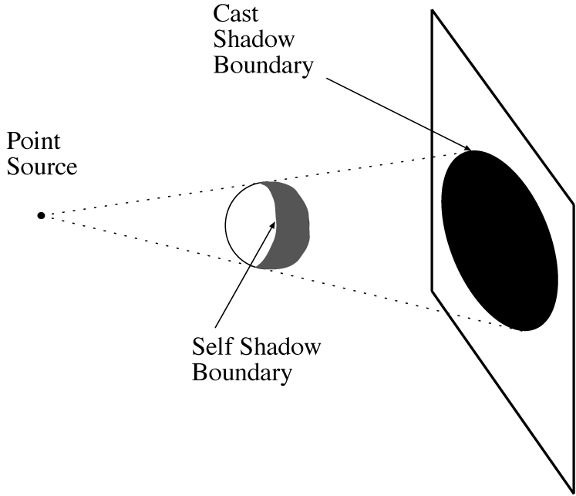
Shadows cast by a point source
A point that can’t see the source is in shadow
For point sources, the geometry is simple
Slide: Forsyth

Slide 52
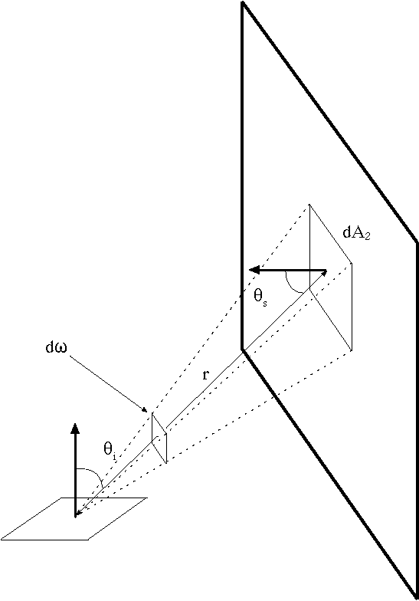
Area sources
Examples: diffuser boxes, white walls
The energy received at a point due to an area source is obtained by adding up the contribution of small elements over the whole source
Slide: Forsyth

Slide 53
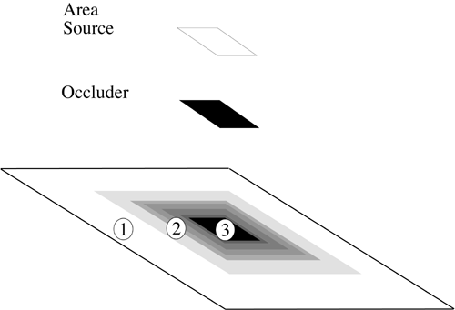
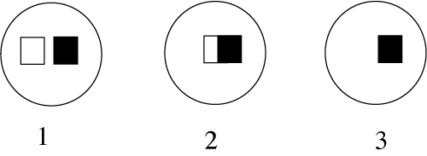
Area Source Shadows
Slide: Forsyth

Slide 54
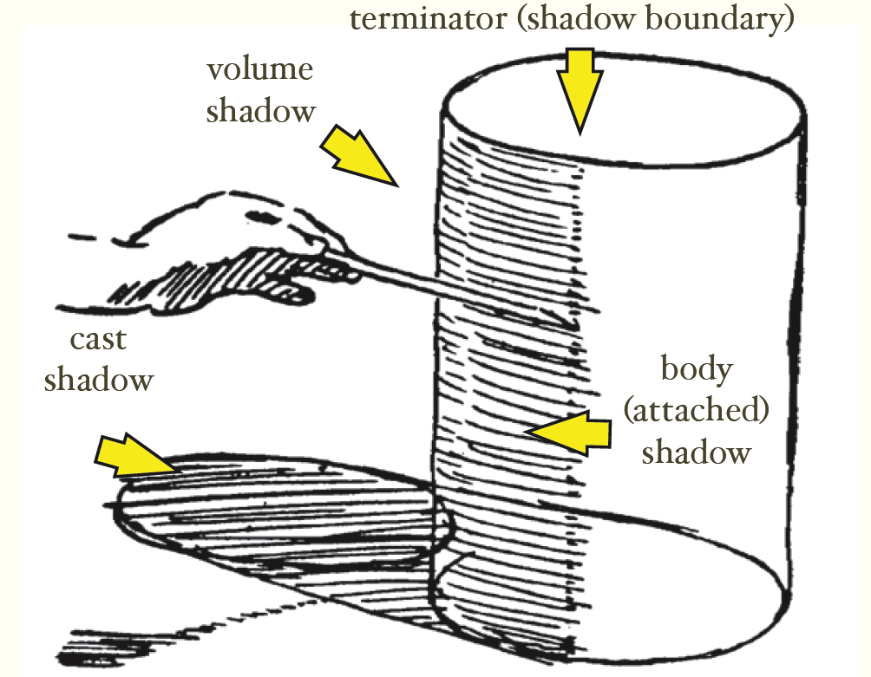
Shading and shadows are major cues to shape and position
From Koenderink slides on image texture and the flow of light
Slide: Forsyth

Slide 55

Recap
6
3
5
4
1
2
1. Why is (2) brighter than (1)? Each points to the asphault.
2. Why is (4) darker than (3)? 4 points to the marking.
3. Why is (5) brighter than (3)? Each points to the side of the wooden block.
4. Why isn’t (6) black, given that there is no direct path from it to the sun?

Slide 56
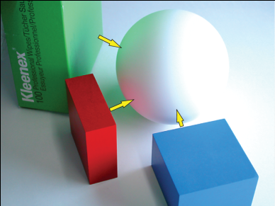
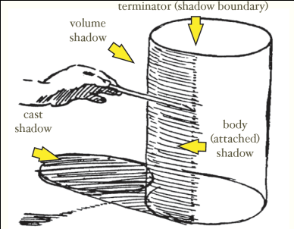
Things to remember
Light has a spectrum of wavelengths
  Humans (and RGB cameras) have color sensors sensitive to three ranges
Observed light depends on: illumination intensities, surface orientation, material (albedo, specular component, diffuse component), etc.
Every object is an indirect light source for every other
Shading and shadows are informative about shape and position

Slide 57
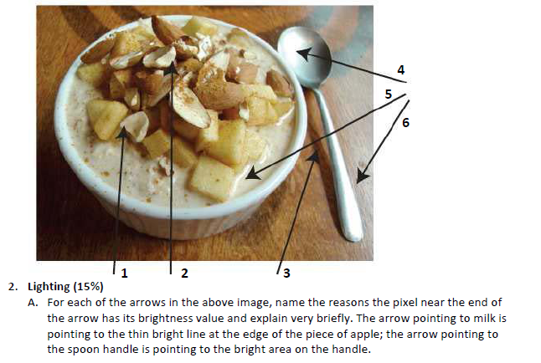
Take-home questions
09/11/12
Possible factors: albedo, shadows, texture, specularities, curvature, lighting direction

