Slide 1

Pixels and Image Filtering
08/30/12
Computational Photography
Derek Hoiem
Graphic: http://www.notcot.org/post/4068/

Slide 2
Administrative stuff
Any questions?
Matlab tutorial
  Thursday (9/6): 3-4pm
Linear algebra tutorial
  Monday (9/10): 3-4pm

Slide 3
Today’s Class: Pixels and Linear Filters
What is a pixel? How is an image represented?
What is image filtering and how do we do it?
Introduce Project 1: Hybrid Images

Slide 4
Next three classes
Image filters in spatial domain
  Smoothing, sharpening, measuring texture
Image filters in the frequency domain
  Denoising, sampling, image compression
Templates and Image Pyramids
  Detection, coarse-to-fine registration

Slide 5

Image Formation

Slide 6

Digital camera
A digital camera replaces film with a sensor array
Each cell in the array is light-sensitive diode that converts photons to electrons
Two common types: Charge Coupled Device (CCD) and CMOS
http://electronics.howstuffworks.com/digital-camera.htm
Slide by Steve Seitz

Slide 7
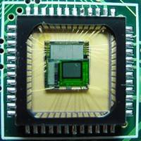

Sensor Array
CMOS sensor

Slide 8
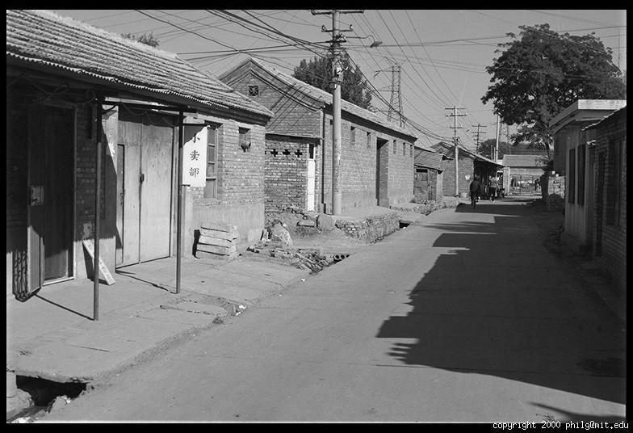
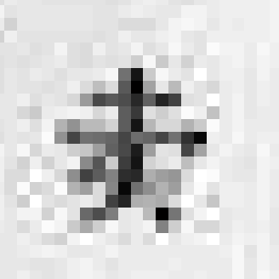
The raster image (pixel matrix)

Slide 9
The raster image (pixel matrix)
0.92 | 0.93 | 0.94 | 0.97 | 0.62 | 0.37 | 0.85 | 0.97 | 0.93 | 0.92 | 0.99
0.95 | 0.89 | 0.82 | 0.89 | 0.56 | 0.31 | 0.75 | 0.92 | 0.81 | 0.95 | 0.91
0.89 | 0.72 | 0.51 | 0.55 | 0.51 | 0.42 | 0.57 | 0.41 | 0.49 | 0.91 | 0.92
0.96 | 0.95 | 0.88 | 0.94 | 0.56 | 0.46 | 0.91 | 0.87 | 0.90 | 0.97 | 0.95
0.71 | 0.81 | 0.81 | 0.87 | 0.57 | 0.37 | 0.80 | 0.88 | 0.89 | 0.79 | 0.85
0.49 | 0.62 | 0.60 | 0.58 | 0.50 | 0.60 | 0.58 | 0.50 | 0.61 | 0.45 | 0.33
0.86 | 0.84 | 0.74 | 0.58 | 0.51 | 0.39 | 0.73 | 0.92 | 0.91 | 0.49 | 0.74
0.96 | 0.67 | 0.54 | 0.85 | 0.48 | 0.37 | 0.88 | 0.90 | 0.94 | 0.82 | 0.93
0.69 | 0.49 | 0.56 | 0.66 | 0.43 | 0.42 | 0.77 | 0.73 | 0.71 | 0.90 | 0.99
0.79 | 0.73 | 0.90 | 0.67 | 0.33 | 0.61 | 0.69 | 0.79 | 0.73 | 0.93 | 0.97
0.91 | 0.94 | 0.89 | 0.49 | 0.41 | 0.78 | 0.78 | 0.77 | 0.89 | 0.99 | 0.93

Slide 10
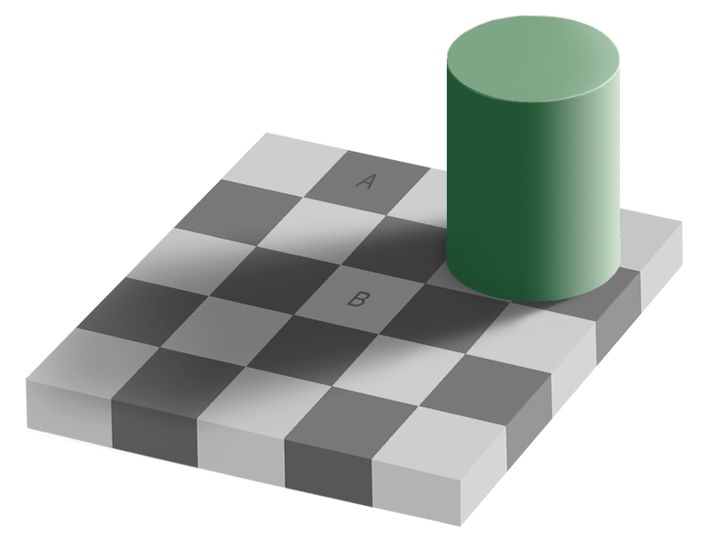
Perception of Intensity
from Ted Adelson

Slide 11
Perception of Intensity
from Ted Adelson

Slide 12
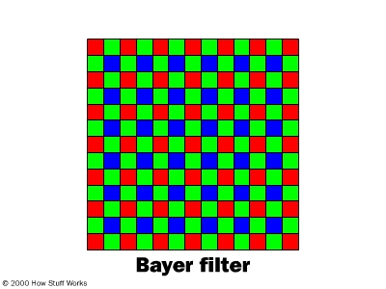
Digital Color Images

Slide 13
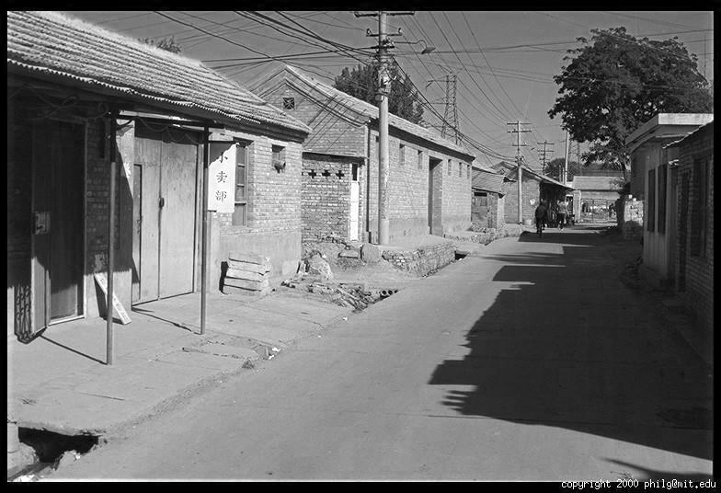
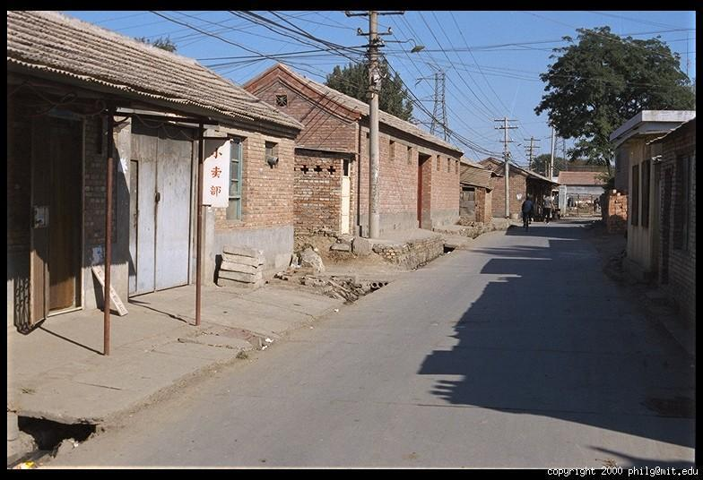
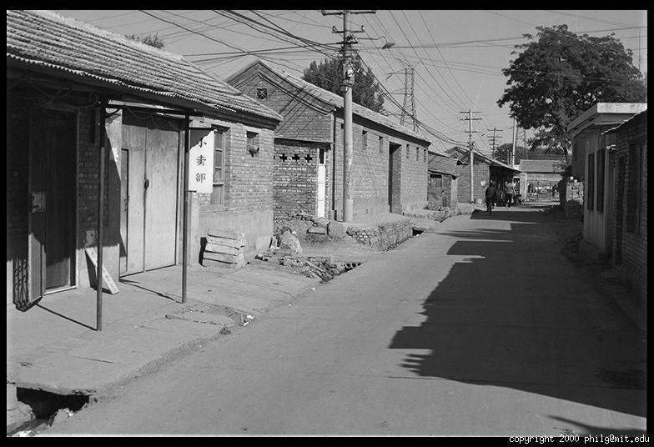
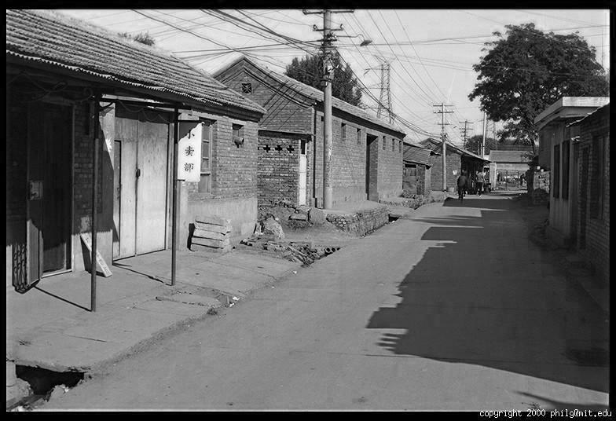
Color Image
R
G
B

Slide 14
Images in Matlab
Images represented as a matrix
Suppose we have a NxM RGB image called “im”
  im(1,1,1) = top-left pixel value in R-channel
  im(y, x, b) = y pixels down, x pixels to right in the b^{th} channel
  im(N, M, 3) = bottom-right pixel in B-channel
imread(filename) returns a uint8 image (values 0 to 255)
  Convert to double format (values 0 to 1) with im2double
column
row
R
0.92 | 0.93 | 0.94 | 0.97 | 0.62 | 0.37 | 0.85 | 0.97 | 0.93 | 0.92 | 0.99
0.95 | 0.89 | 0.82 | 0.89 | 0.56 | 0.31 | 0.75 | 0.92 | 0.81 | 0.95 | 0.91
0.89 | 0.72 | 0.51 | 0.55 | 0.51 | 0.42 | 0.57 | 0.41 | 0.49 | 0.91 | 0.92
0.96 | 0.95 | 0.88 | 0.94 | 0.56 | 0.46 | 0.91 | 0.87 | 0.90 | 0.97 | 0.95
0.71 | 0.81 | 0.81 | 0.87 | 0.57 | 0.37 | 0.80 | 0.88 | 0.89 | 0.79 | 0.85
0.49 | 0.62 | 0.60 | 0.58 | 0.50 | 0.60 | 0.58 | 0.50 | 0.61 | 0.45 | 0.33
0.86 | 0.84 | 0.74 | 0.58 | 0.51 | 0.39 | 0.73 | 0.92 | 0.91 | 0.49 | 0.74
0.96 | 0.67 | 0.54 | 0.85 | 0.48 | 0.37 | 0.88 | 0.90 | 0.94 | 0.82 | 0.93
0.69 | 0.49 | 0.56 | 0.66 | 0.43 | 0.42 | 0.77 | 0.73 | 0.71 | 0.90 | 0.99
0.79 | 0.73 | 0.90 | 0.67 | 0.33 | 0.61 | 0.69 | 0.79 | 0.73 | 0.93 | 0.97
0.91 | 0.94 | 0.89 | 0.49 | 0.41 | 0.78 | 0.78 | 0.77 | 0.89 | 0.99 | 0.93
G
0.92 | 0.93 | 0.94 | 0.97 | 0.62 | 0.37 | 0.85 | 0.97 | 0.93 | 0.92 | 0.99
0.95 | 0.89 | 0.82 | 0.89 | 0.56 | 0.31 | 0.75 | 0.92 | 0.81 | 0.95 | 0.91
0.89 | 0.72 | 0.51 | 0.55 | 0.51 | 0.42 | 0.57 | 0.41 | 0.49 | 0.91 | 0.92
0.96 | 0.95 | 0.88 | 0.94 | 0.56 | 0.46 | 0.91 | 0.87 | 0.90 | 0.97 | 0.95
0.71 | 0.81 | 0.81 | 0.87 | 0.57 | 0.37 | 0.80 | 0.88 | 0.89 | 0.79 | 0.85
0.49 | 0.62 | 0.60 | 0.58 | 0.50 | 0.60 | 0.58 | 0.50 | 0.61 | 0.45 | 0.33
0.86 | 0.84 | 0.74 | 0.58 | 0.51 | 0.39 | 0.73 | 0.92 | 0.91 | 0.49 | 0.74
0.96 | 0.67 | 0.54 | 0.85 | 0.48 | 0.37 | 0.88 | 0.90 | 0.94 | 0.82 | 0.93
0.69 | 0.49 | 0.56 | 0.66 | 0.43 | 0.42 | 0.77 | 0.73 | 0.71 | 0.90 | 0.99
0.79 | 0.73 | 0.90 | 0.67 | 0.33 | 0.61 | 0.69 | 0.79 | 0.73 | 0.93 | 0.97
0.91 | 0.94 | 0.89 | 0.49 | 0.41 | 0.78 | 0.78 | 0.77 | 0.89 | 0.99 | 0.93
B
0.92 | 0.93 | 0.94 | 0.97 | 0.62 | 0.37 | 0.85 | 0.97 | 0.93 | 0.92 | 0.99
0.95 | 0.89 | 0.82 | 0.89 | 0.56 | 0.31 | 0.75 | 0.92 | 0.81 | 0.95 | 0.91
0.89 | 0.72 | 0.51 | 0.55 | 0.51 | 0.42 | 0.57 | 0.41 | 0.49 | 0.91 | 0.92
0.96 | 0.95 | 0.88 | 0.94 | 0.56 | 0.46 | 0.91 | 0.87 | 0.90 | 0.97 | 0.95
0.71 | 0.81 | 0.81 | 0.87 | 0.57 | 0.37 | 0.80 | 0.88 | 0.89 | 0.79 | 0.85
0.49 | 0.62 | 0.60 | 0.58 | 0.50 | 0.60 | 0.58 | 0.50 | 0.61 | 0.45 | 0.33
0.86 | 0.84 | 0.74 | 0.58 | 0.51 | 0.39 | 0.73 | 0.92 | 0.91 | 0.49 | 0.74
0.96 | 0.67 | 0.54 | 0.85 | 0.48 | 0.37 | 0.88 | 0.90 | 0.94 | 0.82 | 0.93
0.69 | 0.49 | 0.56 | 0.66 | 0.43 | 0.42 | 0.77 | 0.73 | 0.71 | 0.90 | 0.99
0.79 | 0.73 | 0.90 | 0.67 | 0.33 | 0.61 | 0.69 | 0.79 | 0.73 | 0.93 | 0.97
0.91 | 0.94 | 0.89 | 0.49 | 0.41 | 0.78 | 0.78 | 0.77 | 0.89 | 0.99 | 0.93

Slide 15
Image filtering
Image filtering: compute function of local neighborhood at each position
Really important!
  Enhance images
    Denoise, resize, increase contrast, etc.
  Extract information from images
    Texture, edges, distinctive points, etc.
  Detect patterns
    Template matching

Slide 16

Example: box filter
1
1
1
1
1
1
1
1
1
Slide credit: David Lowe (UBC)

Slide 17
Image filtering
1
1
1
1
1
1
1
1
1
0 | 0 | 0 | 0 | 0 | 0 | 0 | 0 | 0 | 0
0 | 0 | 0 | 0 | 0 | 0 | 0 | 0 | 0 | 0
0 | 0 | 0 | 90 | 90 | 90 | 90 | 90 | 0 | 0
0 | 0 | 0 | 90 | 90 | 90 | 90 | 90 | 0 | 0
0 | 0 | 0 | 90 | 90 | 90 | 90 | 90 | 0 | 0
0 | 0 | 0 | 90 | 0 | 90 | 90 | 90 | 0 | 0
0 | 0 | 0 | 90 | 90 | 90 | 90 | 90 | 0 | 0
0 | 0 | 0 | 0 | 0 | 0 | 0 | 0 | 0 | 0
0 | 0 | 90 | 0 | 0 | 0 | 0 | 0 | 0 | 0
0 | 0 | 0 | 0 | 0 | 0 | 0 | 0 | 0 | 0
 | 0
0 | 0 | 0 | 0 | 0 | 0 | 0 | 0 | 0 | 0
0 | 0 | 0 | 0 | 0 | 0 | 0 | 0 | 0 | 0
0 | 0 | 0 | 90 | 90 | 90 | 90 | 90 | 0 | 0
0 | 0 | 0 | 90 | 90 | 90 | 90 | 90 | 0 | 0
0 | 0 | 0 | 90 | 90 | 90 | 90 | 90 | 0 | 0
0 | 0 | 0 | 90 | 0 | 90 | 90 | 90 | 0 | 0
0 | 0 | 0 | 90 | 90 | 90 | 90 | 90 | 0 | 0
0 | 0 | 0 | 0 | 0 | 0 | 0 | 0 | 0 | 0
0 | 0 | 90 | 0 | 0 | 0 | 0 | 0 | 0 | 0
0 | 0 | 0 | 0 | 0 | 0 | 0 | 0 | 0 | 0
Credit: S. Seitz
Notes:
ones, divide by 9

Slide 18
Image filtering
1
1
1
1
1
1
1
1
1
0 | 0 | 0 | 0 | 0 | 0 | 0 | 0 | 0 | 0
0 | 0 | 0 | 0 | 0 | 0 | 0 | 0 | 0 | 0
0 | 0 | 0 | 90 | 90 | 90 | 90 | 90 | 0 | 0
0 | 0 | 0 | 90 | 90 | 90 | 90 | 90 | 0 | 0
0 | 0 | 0 | 90 | 90 | 90 | 90 | 90 | 0 | 0
0 | 0 | 0 | 90 | 0 | 90 | 90 | 90 | 0 | 0
0 | 0 | 0 | 90 | 90 | 90 | 90 | 90 | 0 | 0
0 | 0 | 0 | 0 | 0 | 0 | 0 | 0 | 0 | 0
0 | 0 | 90 | 0 | 0 | 0 | 0 | 0 | 0 | 0
0 | 0 | 0 | 0 | 0 | 0 | 0 | 0 | 0 | 0
 | 0 | 10
0 | 0 | 0 | 0 | 0 | 0 | 0 | 0 | 0 | 0
0 | 0 | 0 | 0 | 0 | 0 | 0 | 0 | 0 | 0
0 | 0 | 0 | 90 | 90 | 90 | 90 | 90 | 0 | 0
0 | 0 | 0 | 90 | 90 | 90 | 90 | 90 | 0 | 0
0 | 0 | 0 | 90 | 90 | 90 | 90 | 90 | 0 | 0
0 | 0 | 0 | 90 | 0 | 90 | 90 | 90 | 0 | 0
0 | 0 | 0 | 90 | 90 | 90 | 90 | 90 | 0 | 0
0 | 0 | 0 | 0 | 0 | 0 | 0 | 0 | 0 | 0
0 | 0 | 90 | 0 | 0 | 0 | 0 | 0 | 0 | 0
0 | 0 | 0 | 0 | 0 | 0 | 0 | 0 | 0 | 0
Credit: S. Seitz
Notes:
ones, divide by 9

Slide 19
Image filtering
1
1
1
1
1
1
1
1
1
0 | 0 | 0 | 0 | 0 | 0 | 0 | 0 | 0 | 0
0 | 0 | 0 | 0 | 0 | 0 | 0 | 0 | 0 | 0
0 | 0 | 0 | 90 | 90 | 90 | 90 | 90 | 0 | 0
0 | 0 | 0 | 90 | 90 | 90 | 90 | 90 | 0 | 0
0 | 0 | 0 | 90 | 90 | 90 | 90 | 90 | 0 | 0
0 | 0 | 0 | 90 | 0 | 90 | 90 | 90 | 0 | 0
0 | 0 | 0 | 90 | 90 | 90 | 90 | 90 | 0 | 0
0 | 0 | 0 | 0 | 0 | 0 | 0 | 0 | 0 | 0
0 | 0 | 90 | 0 | 0 | 0 | 0 | 0 | 0 | 0
0 | 0 | 0 | 0 | 0 | 0 | 0 | 0 | 0 | 0
 | 0 | 10 | 20
0 | 0 | 0 | 0 | 0 | 0 | 0 | 0 | 0 | 0
0 | 0 | 0 | 0 | 0 | 0 | 0 | 0 | 0 | 0
0 | 0 | 0 | 90 | 90 | 90 | 90 | 90 | 0 | 0
0 | 0 | 0 | 90 | 90 | 90 | 90 | 90 | 0 | 0
0 | 0 | 0 | 90 | 90 | 90 | 90 | 90 | 0 | 0
0 | 0 | 0 | 90 | 0 | 90 | 90 | 90 | 0 | 0
0 | 0 | 0 | 90 | 90 | 90 | 90 | 90 | 0 | 0
0 | 0 | 0 | 0 | 0 | 0 | 0 | 0 | 0 | 0
0 | 0 | 90 | 0 | 0 | 0 | 0 | 0 | 0 | 0
0 | 0 | 0 | 0 | 0 | 0 | 0 | 0 | 0 | 0
Credit: S. Seitz
Notes:
ones, divide by 9

Slide 20
Image filtering
1
1
1
1
1
1
1
1
1
0 | 0 | 0 | 0 | 0 | 0 | 0 | 0 | 0 | 0
0 | 0 | 0 | 0 | 0 | 0 | 0 | 0 | 0 | 0
0 | 0 | 0 | 90 | 90 | 90 | 90 | 90 | 0 | 0
0 | 0 | 0 | 90 | 90 | 90 | 90 | 90 | 0 | 0
0 | 0 | 0 | 90 | 90 | 90 | 90 | 90 | 0 | 0
0 | 0 | 0 | 90 | 0 | 90 | 90 | 90 | 0 | 0
0 | 0 | 0 | 90 | 90 | 90 | 90 | 90 | 0 | 0
0 | 0 | 0 | 0 | 0 | 0 | 0 | 0 | 0 | 0
0 | 0 | 90 | 0 | 0 | 0 | 0 | 0 | 0 | 0
0 | 0 | 0 | 0 | 0 | 0 | 0 | 0 | 0 | 0
 | 0 | 10 | 20 | 30
0 | 0 | 0 | 0 | 0 | 0 | 0 | 0 | 0 | 0
0 | 0 | 0 | 0 | 0 | 0 | 0 | 0 | 0 | 0
0 | 0 | 0 | 90 | 90 | 90 | 90 | 90 | 0 | 0
0 | 0 | 0 | 90 | 90 | 90 | 90 | 90 | 0 | 0
0 | 0 | 0 | 90 | 90 | 90 | 90 | 90 | 0 | 0
0 | 0 | 0 | 90 | 0 | 90 | 90 | 90 | 0 | 0
0 | 0 | 0 | 90 | 90 | 90 | 90 | 90 | 0 | 0
0 | 0 | 0 | 0 | 0 | 0 | 0 | 0 | 0 | 0
0 | 0 | 90 | 0 | 0 | 0 | 0 | 0 | 0 | 0
0 | 0 | 0 | 0 | 0 | 0 | 0 | 0 | 0 | 0
Credit: S. Seitz
Notes:
ones, divide by 9

Slide 21
Image filtering
1
1
1
1
1
1
1
1
1
0 | 0 | 0 | 0 | 0 | 0 | 0 | 0 | 0 | 0
0 | 0 | 0 | 0 | 0 | 0 | 0 | 0 | 0 | 0
0 | 0 | 0 | 90 | 90 | 90 | 90 | 90 | 0 | 0
0 | 0 | 0 | 90 | 90 | 90 | 90 | 90 | 0 | 0
0 | 0 | 0 | 90 | 90 | 90 | 90 | 90 | 0 | 0
0 | 0 | 0 | 90 | 0 | 90 | 90 | 90 | 0 | 0
0 | 0 | 0 | 90 | 90 | 90 | 90 | 90 | 0 | 0
0 | 0 | 0 | 0 | 0 | 0 | 0 | 0 | 0 | 0
0 | 0 | 90 | 0 | 0 | 0 | 0 | 0 | 0 | 0
0 | 0 | 0 | 0 | 0 | 0 | 0 | 0 | 0 | 0
 | 0 | 10 | 20 | 30 | 30
Credit: S. Seitz
Notes:
ones, divide by 9

Slide 22
Image filtering
1
1
1
1
1
1
1
1
1
0 | 0 | 0 | 0 | 0 | 0 | 0 | 0 | 0 | 0
0 | 0 | 0 | 0 | 0 | 0 | 0 | 0 | 0 | 0
0 | 0 | 0 | 90 | 90 | 90 | 90 | 90 | 0 | 0
0 | 0 | 0 | 90 | 90 | 90 | 90 | 90 | 0 | 0
0 | 0 | 0 | 90 | 90 | 90 | 90 | 90 | 0 | 0
0 | 0 | 0 | 90 | 0 | 90 | 90 | 90 | 0 | 0
0 | 0 | 0 | 90 | 90 | 90 | 90 | 90 | 0 | 0
0 | 0 | 0 | 0 | 0 | 0 | 0 | 0 | 0 | 0
0 | 0 | 90 | 0 | 0 | 0 | 0 | 0 | 0 | 0
0 | 0 | 0 | 0 | 0 | 0 | 0 | 0 | 0 | 0
 | 0 | 10 | 20 | 30 | 30
?
Credit: S. Seitz
Notes:
ones, divide by 9

Slide 23
Image filtering
1
1
1
1
1
1
1
1
1
0 | 0 | 0 | 0 | 0 | 0 | 0 | 0 | 0 | 0
0 | 0 | 0 | 0 | 0 | 0 | 0 | 0 | 0 | 0
0 | 0 | 0 | 90 | 90 | 90 | 90 | 90 | 0 | 0
0 | 0 | 0 | 90 | 90 | 90 | 90 | 90 | 0 | 0
0 | 0 | 0 | 90 | 90 | 90 | 90 | 90 | 0 | 0
0 | 0 | 0 | 90 | 0 | 90 | 90 | 90 | 0 | 0
0 | 0 | 0 | 90 | 90 | 90 | 90 | 90 | 0 | 0
0 | 0 | 0 | 0 | 0 | 0 | 0 | 0 | 0 | 0
0 | 0 | 90 | 0 | 0 | 0 | 0 | 0 | 0 | 0
0 | 0 | 0 | 0 | 0 | 0 | 0 | 0 | 0 | 0
 | 0 | 10 | 20 | 30 | 30
 |  |  |  | 50
?
Credit: S. Seitz
Notes:
ones, divide by 9

Slide 24
Image filtering
1
1
1
1
1
1
1
1
1
0 | 0 | 0 | 0 | 0 | 0 | 0 | 0 | 0 | 0
0 | 0 | 0 | 0 | 0 | 0 | 0 | 0 | 0 | 0
0 | 0 | 0 | 90 | 90 | 90 | 90 | 90 | 0 | 0
0 | 0 | 0 | 90 | 90 | 90 | 90 | 90 | 0 | 0
0 | 0 | 0 | 90 | 90 | 90 | 90 | 90 | 0 | 0
0 | 0 | 0 | 90 | 0 | 90 | 90 | 90 | 0 | 0
0 | 0 | 0 | 90 | 90 | 90 | 90 | 90 | 0 | 0
0 | 0 | 0 | 0 | 0 | 0 | 0 | 0 | 0 | 0
0 | 0 | 90 | 0 | 0 | 0 | 0 | 0 | 0 | 0
0 | 0 | 0 | 0 | 0 | 0 | 0 | 0 | 0 | 0
 | 0 | 10 | 20 | 30 | 30 | 30 | 20 | 10
 | 0 | 20 | 40 | 60 | 60 | 60 | 40 | 20
 | 0 | 30 | 60 | 90 | 90 | 90 | 60 | 30
 | 0 | 30 | 50 | 80 | 80 | 90 | 60 | 30
 | 0 | 30 | 50 | 80 | 80 | 90 | 60 | 30
 | 0 | 20 | 30 | 50 | 50 | 60 | 40 | 20
 | 10 | 20 | 30 | 30 | 30 | 30 | 20 | 10
 | 10 | 10 | 10 | 0 | 0 | 0 | 0 | 0
Credit: S. Seitz

Slide 25
Box Filter
What does it do?
Replaces each pixel with an average of its neighborhood
Achieve smoothing effect (remove sharp features)
1
1
1
1
1
1
1
1
1
Slide credit: David Lowe (UBC)

Slide 26


Smoothing with box filter

Slide 27
One more on board…

Slide 28

Practice with linear filters
0
0
0
?
0
1
0
0
0
0
Original
Source: D. Lowe

Slide 29
Practice with linear filters
0
0
0
0
1
0
0
0
0
Original
Filtered
(no change)
Source: D. Lowe

Slide 30
Practice with linear filters
0
0
0
?
0
0
1
0
0
0
Original
Source: D. Lowe

Slide 31
Practice with linear filters
0
0
0
0
0
1
0
0
0
Original
Shifted left
By 1 pixel
Source: D. Lowe

Slide 32
Practice with linear filters
0
0
0
-
1
1
1
?
0
2
0
1
1
1
0
0
0
1
1
1
(Note that filter sums to 1)
Original
Source: D. Lowe

Slide 33

Practice with linear filters
0
0
0
-
1
1
1
0
2
0
1
1
1
0
0
0
1
1
1
Original
Sharpening filter
  Accentuates differences with local average
Source: D. Lowe

Slide 34

Sharpening
Source: D. Lowe

Slide 35


Other filters
1
0
-1
2
0
-2
1
0
-1
Sobel
Vertical Edge
(absolute value)

Slide 36

Other filters
Q?
1
2
1
0
0
0
-1
-2
-1
Sobel
Horizontal Edge
(absolute value)
Notes:
Questions at this point?

Slide 37
How could we synthesize motion blur?
theta = 30; len = 20;
fil = imrotate(ones(1, len), theta, 'bilinear');
fil = fil / sum(fil(:));
figure(2), imshow(imfilter(im, fil));

Slide 38
Filtering vs. Convolution
g=filter
f=image
2d filtering
  h=filter2(g,f); or h=imfilter(f,g);
2d convolution
  h=conv2(g,f);

Slide 39
Key properties of linear filters
Linearity:
filter(f₁ + f₂) = filter(f₁) + filter(f₂)
Shift invariance: same behavior regardless of pixel location
filter(shift(f)) = shift(filter(f))
Any linear, shift-invariant operator can be represented as a convolution
Source: S. Lazebnik

Slide 40
More properties
Commutative: a * b = b * a
  Conceptually no difference between filter and signal
Associative: a * (b * c) = (a * b) * c
  Often apply several filters one after another: (((a * b₁) * b₂) * b₃)
  This is equivalent to applying one filter: a * (b₁ * b₂ * b₃)
Distributes over addition: a * (b + c) = (a * b) + (a * c)
Scalars factor out: ka * b = a * kb = k (a * b)
Identity: unit impulse e = [0, 0, 1, 0, 0],
a * e = a
Source: S. Lazebnik

Slide 41

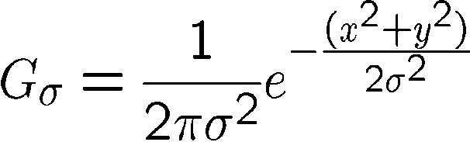
Important filter: Gaussian
Weight contributions of neighboring pixels by nearness
0.003 0.013 0.022 0.013 0.003
0.013 0.059 0.097 0.059 0.013
0.022 0.097 0.159 0.097 0.022
0.013 0.059 0.097 0.059 0.013
0.003 0.013 0.022 0.013 0.003
5 x 5, σ = 1
Slide credit: Christopher Rasmussen

Slide 42

Smoothing with Gaussian filter

Slide 43
Smoothing with box filter

Slide 44
Gaussian filters
Remove “high-frequency” components from the image (low-pass filter)
  Images become more smooth
Convolution with self is another Gaussian
  So can smooth with small-width kernel, repeat, and get same result as larger-width kernel would have
  Convolving two times with Gaussian kernel of width σ is same as convolving once with kernel of width σ√2
Separable kernel
  Factors into product of two 1D Gaussians
Source: K. Grauman
Notes:
Linear vs. quadratic in mask size

Slide 45
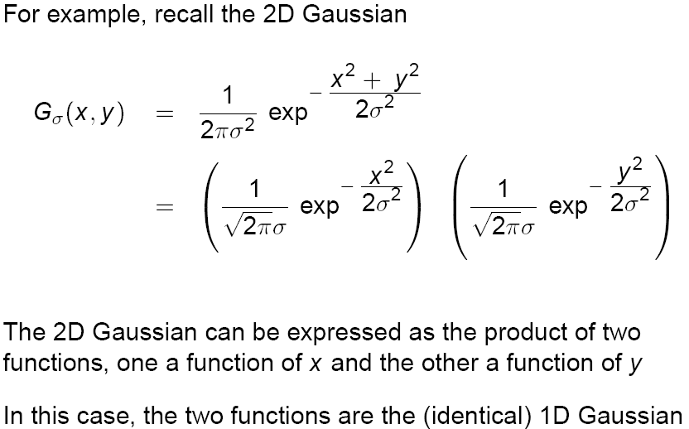
Separability of the Gaussian filter
Source: D. Lowe

Slide 46
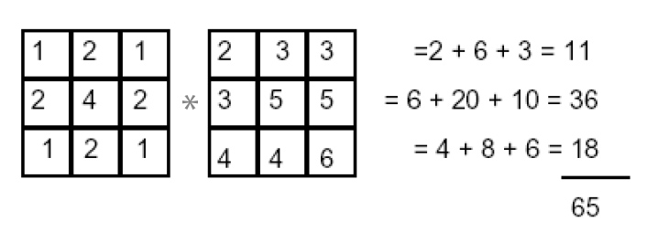
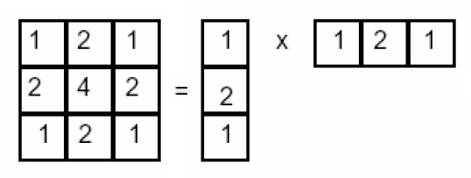
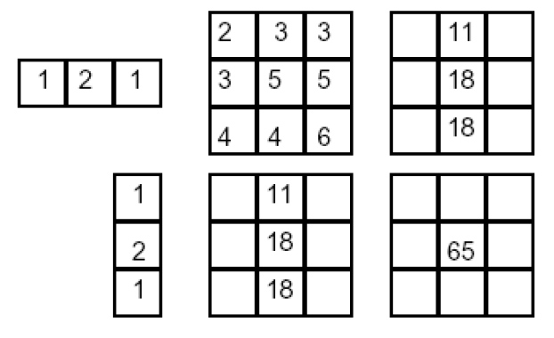
Separability example
2D filtering
(center location only)
The filter factors
into a product of 1D
filters:
Perform filtering
along rows:
*
=
Followed by filtering
along the remaining column:
*
=
Source: K. Grauman

Slide 47
Separability
Why is separability useful in practice?

Slide 48
Some practical matters

Slide 49
Practical matters
How big should the filter be?
Values at edges should be near zero
Rule of thumb for Gaussian: set filter half-width to about 3 σ

Slide 50
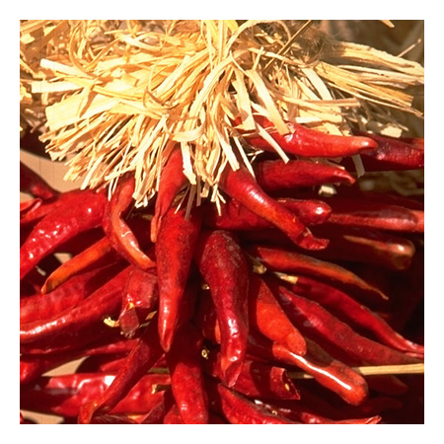
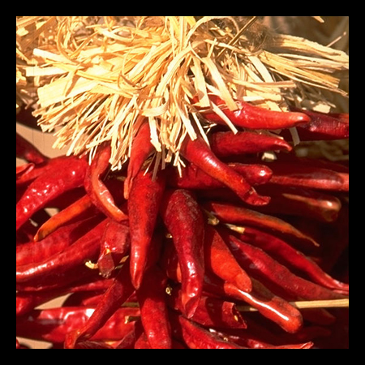

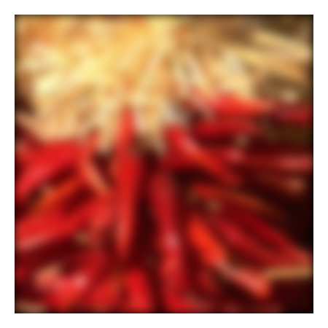
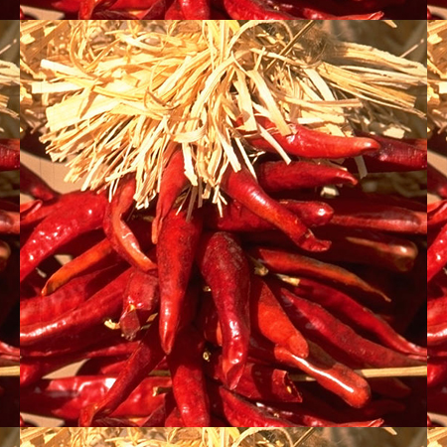

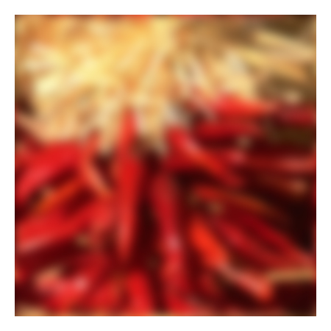



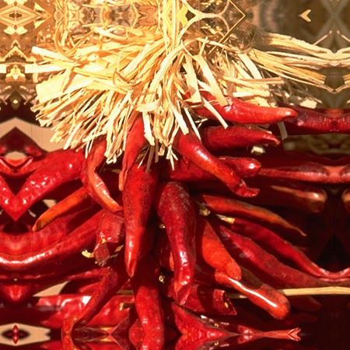


Practical matters
What about near the edge?
  the filter window falls off the edge of the image
  need to extrapolate
  methods:
    clip filter (black)
    wrap around
    copy edge
    reflect across edge
Source: S. Marschner

Slide 51
Practical matters
  methods (MATLAB):
    clip filter (black): imfilter(f, g, 0)
    wrap around: imfilter(f, g, ‘circular’)
    copy edge: imfilter(f, g, ‘replicate’)
    reflect across edge: imfilter(f, g, ‘symmetric’)
Source: S. Marschner

Slide 52
Practical matters
Q?
What is the size of the output?
MATLAB: filter2(g, f, shape)
  shape = ‘full’: output size is sum of sizes of f and g
  shape = ‘same’: output size is same as f
  shape = ‘valid’: output size is difference of sizes of f and g
full
same
valid
g
g
g
g
f
f
f
g
g
g
g
g
g
g
g
Source: S. Lazebnik

Slide 53
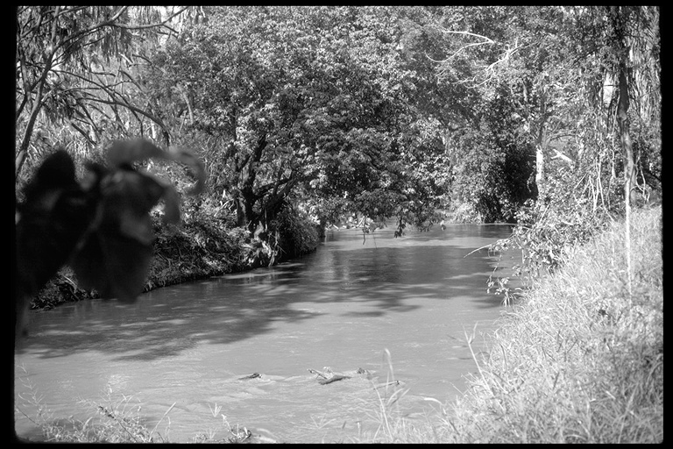
Application: Representing Texture
Source: Forsyth

Slide 54
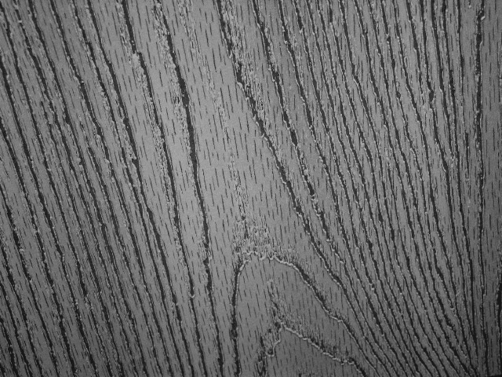
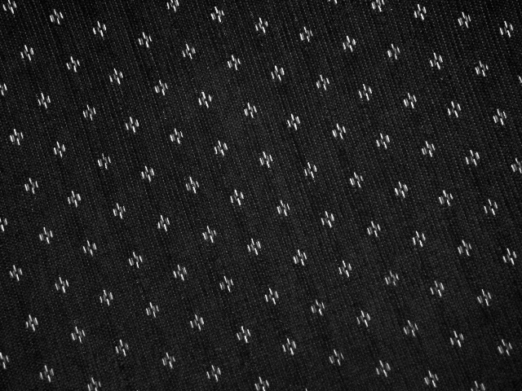
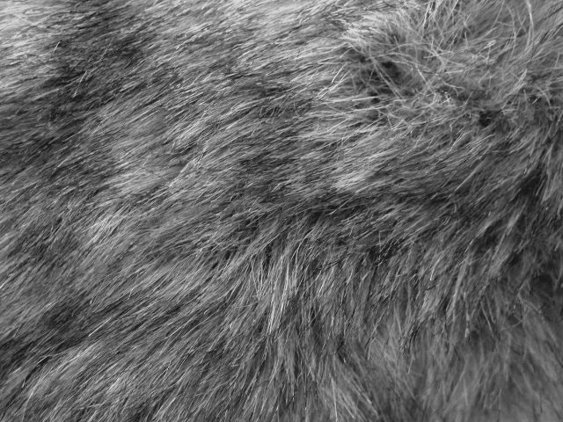
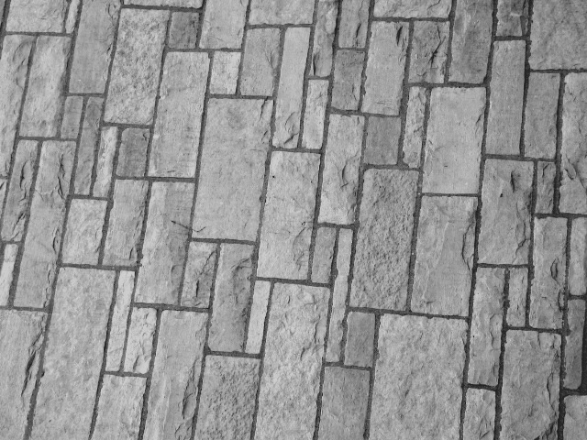
Texture and Material
http://www-cvr.ai.uiuc.edu/ponce_grp/data/texture_database/samples/

Slide 55
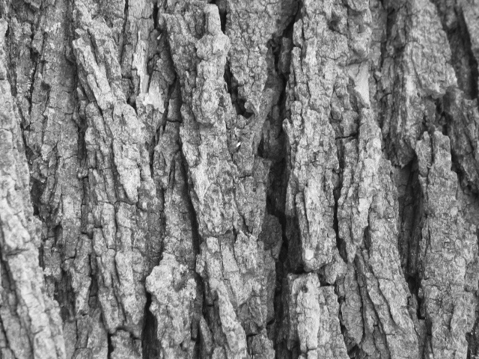
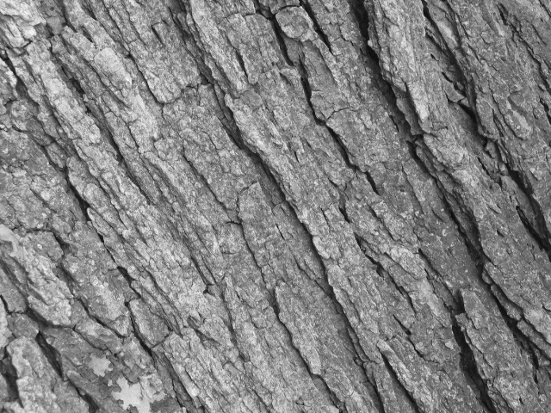
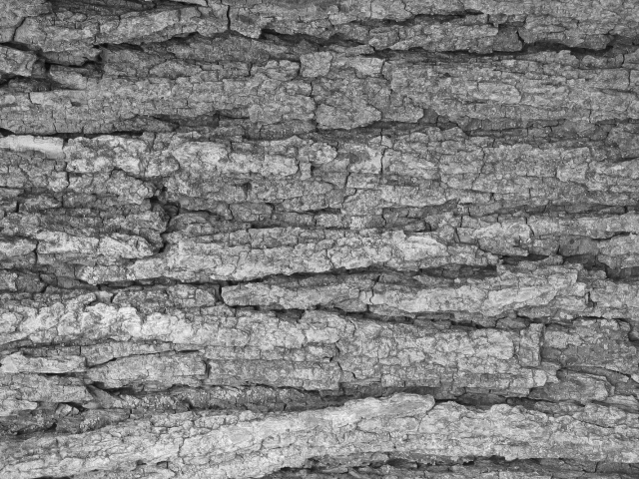
Texture and Orientation
http://www-cvr.ai.uiuc.edu/ponce_grp/data/texture_database/samples/

Slide 56
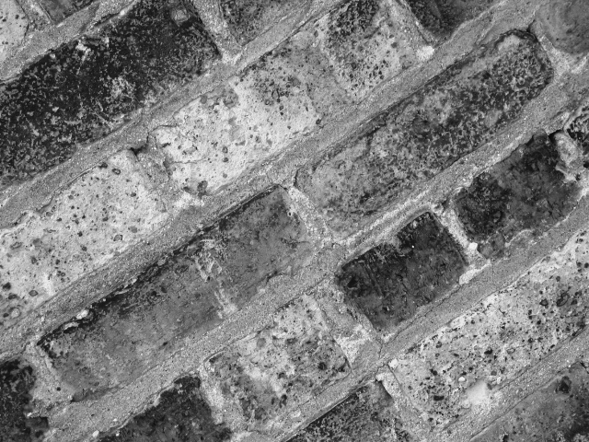
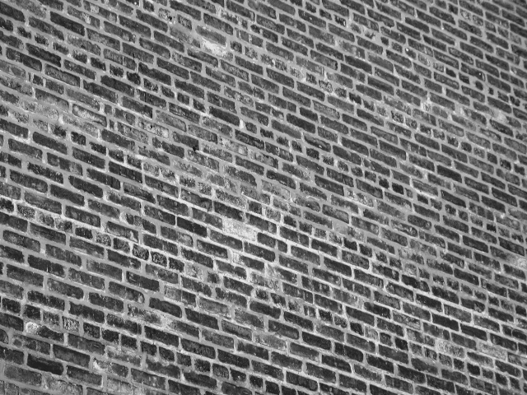
Texture and Scale
http://www-cvr.ai.uiuc.edu/ponce_grp/data/texture_database/samples/

Slide 57
What is texture?
Regular or stochastic patterns caused by bumps, grooves, and/or markings

Slide 58
How can we represent texture?
Compute responses of blobs and edges at various orientations and scales

Slide 59
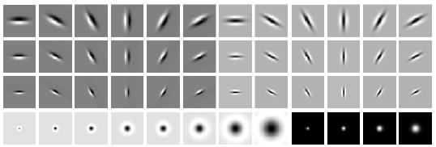
Overcomplete representation: filter banks
LM Filter Bank
Code for filter banks: www.robots.ox.ac.uk/~vgg/research/texclass/filters.html

Slide 60
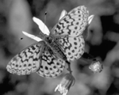
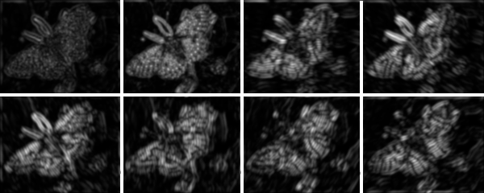
Filter banks
Process image with each filter and keep responses (or squared/abs responses)

Slide 61
How can we represent texture?
Measure responses of blobs and edges at various orientations and scales
Record simple statistics (e.g., mean, std.) of absolute filter responses

Slide 62
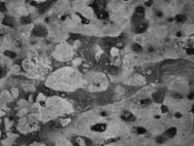
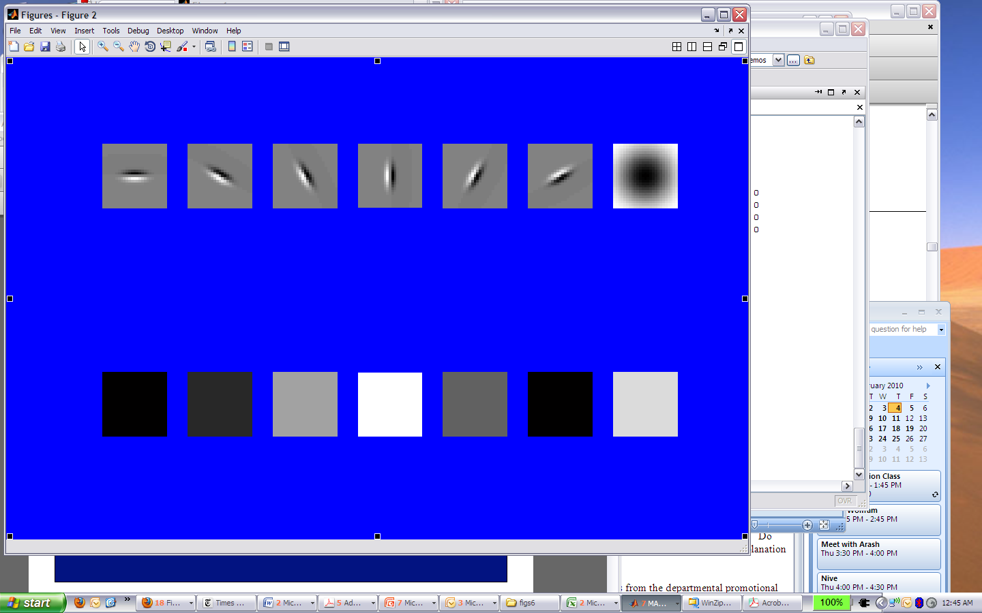
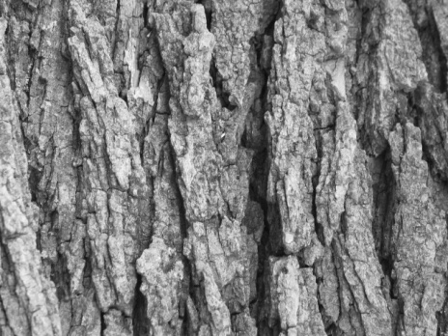
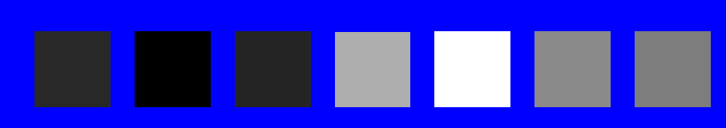
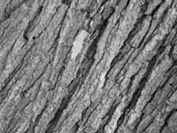
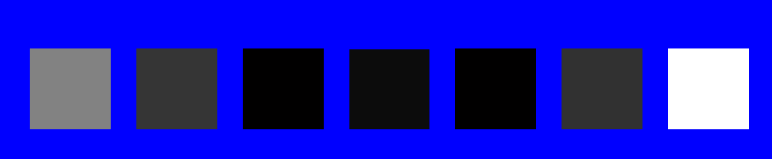
Can you match the texture to the response?
Filters
A
B
1
2
C
3
Mean abs responses

Slide 63

Representing texture by mean abs response
Filters
Mean abs responses

Slide 64




Project 1: Hybrid Images
A. Oliva, A. Torralba, P.G. Schyns,
“Hybrid Images,” SIGGRAPH 2006
Gaussian Filter!
Laplacian Filter!
unit impulse
Gaussian
Laplacian of Gaussian
Project Instructions:
http://courses.engr.illinois.edu/cs498dh3/projects/hybrid/ComputationalPhotography_ProjectHybrid.html

Slide 65

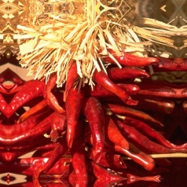
Take-home messages
Image is a matrix of numbers
Linear filtering is a dot product at each position
  Can smooth, sharpen, translate (among many other uses)
Be aware of details for filter size, extrapolation, cropping
Start thinking about project (read the paper, create a test project page)
=
0.92 | 0.93 | 0.94 | 0.97 | 0.62 | 0.37 | 0.85 | 0.97 | 0.93 | 0.92 | 0.99
0.95 | 0.89 | 0.82 | 0.89 | 0.56 | 0.31 | 0.75 | 0.92 | 0.81 | 0.95 | 0.91
0.89 | 0.72 | 0.51 | 0.55 | 0.51 | 0.42 | 0.57 | 0.41 | 0.49 | 0.91 | 0.92
0.96 | 0.95 | 0.88 | 0.94 | 0.56 | 0.46 | 0.91 | 0.87 | 0.90 | 0.97 | 0.95
0.71 | 0.81 | 0.81 | 0.87 | 0.57 | 0.37 | 0.80 | 0.88 | 0.89 | 0.79 | 0.85
0.49 | 0.62 | 0.60 | 0.58 | 0.50 | 0.60 | 0.58 | 0.50 | 0.61 | 0.45 | 0.33
0.86 | 0.84 | 0.74 | 0.58 | 0.51 | 0.39 | 0.73 | 0.92 | 0.91 | 0.49 | 0.74
0.96 | 0.67 | 0.54 | 0.85 | 0.48 | 0.37 | 0.88 | 0.90 | 0.94 | 0.82 | 0.93
0.69 | 0.49 | 0.56 | 0.66 | 0.43 | 0.42 | 0.77 | 0.73 | 0.71 | 0.90 | 0.99
0.79 | 0.73 | 0.90 | 0.67 | 0.33 | 0.61 | 0.69 | 0.79 | 0.73 | 0.93 | 0.97
0.91 | 0.94 | 0.89 | 0.49 | 0.41 | 0.78 | 0.78 | 0.77 | 0.89 | 0.99 | 0.93
1
1
1
1
1
1
1
1
1

Slide 66
Take-home questions
8/30/12
Write down a 3x3 filter that returns a positive value if the average value of the 4-adjacent neighbors is less than the center and a negative value otherwise
Write down a filter that will compute the gradient in the x-direction:
gradx(y,x) = im(y,x+1)-im(y,x) for each x, y

Slide 67
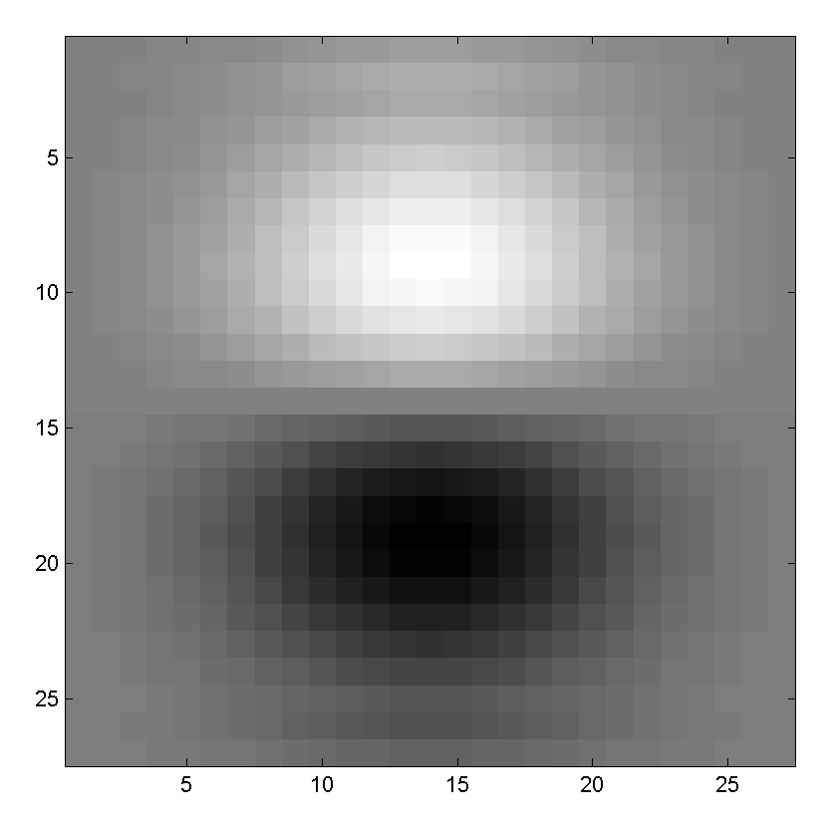
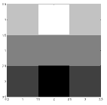
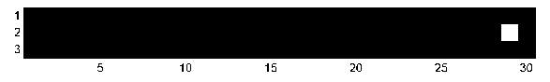
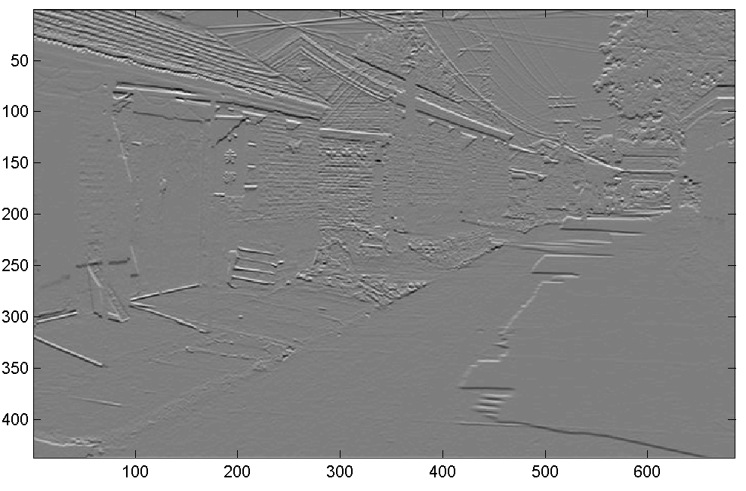
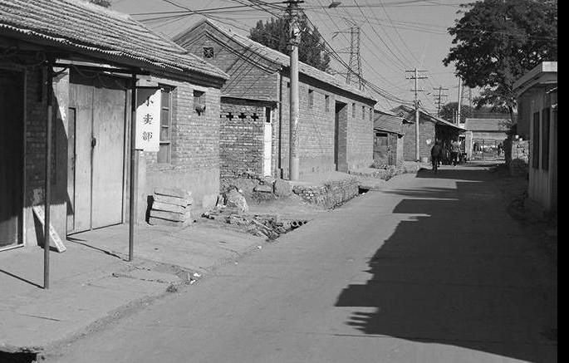
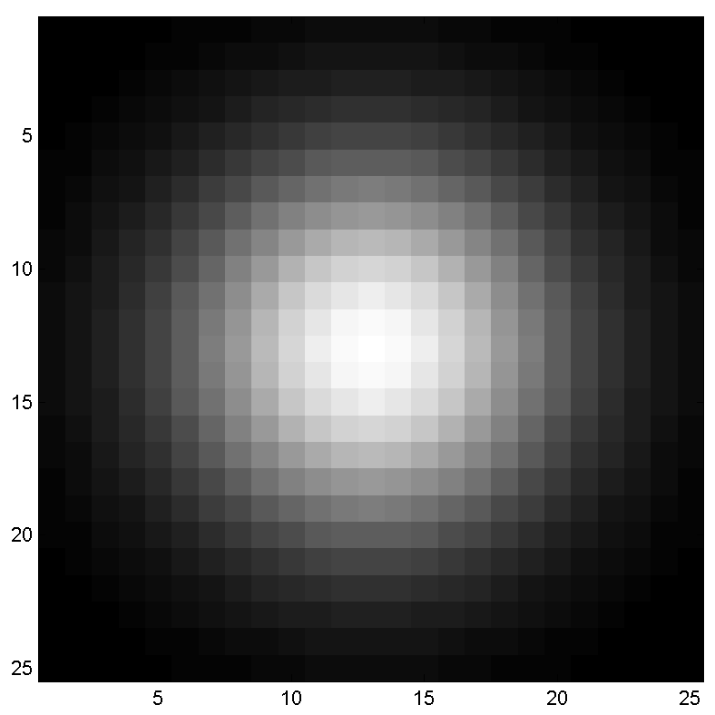
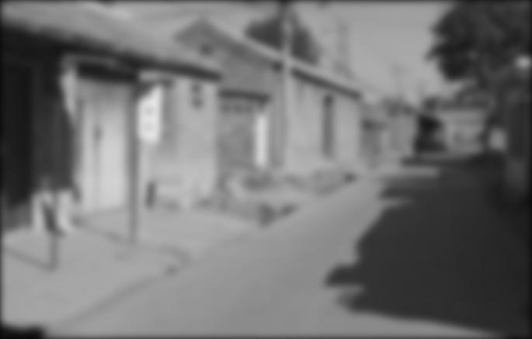
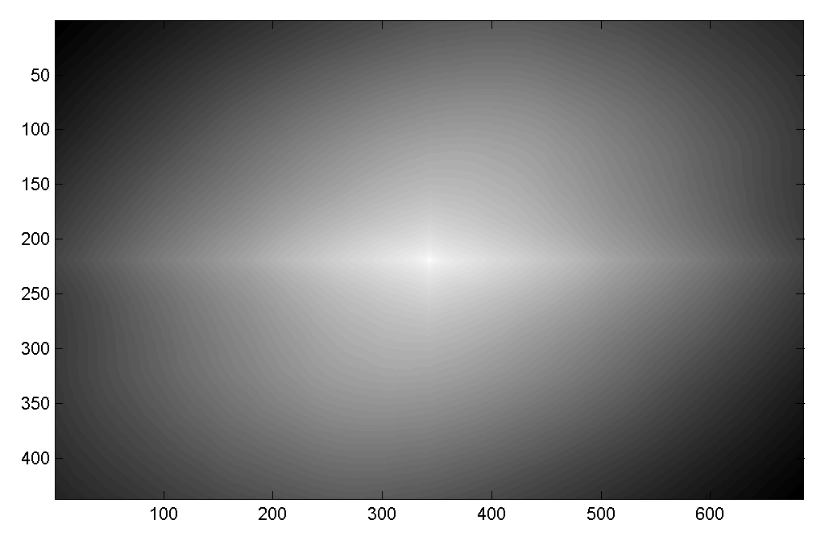

Take-home questions
8/30/12
Filtering Operator
a) _ = D * B
b) A = _ * _
c) F = D * _
d) _ = D * D
3. Fill in the blanks:
A
B
E
G
F
C
H
I
D

Slide 68
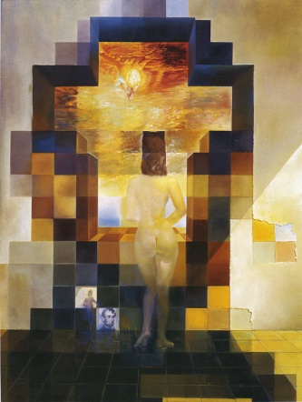
Next class: Thinking in Frequency

