Slide 1
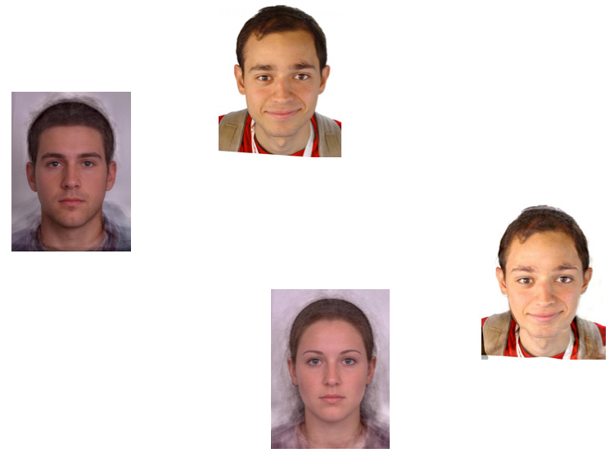
Fun with Faces
Computational Photography
Derek Hoiem, University of Illinois
Many slides from Alyosha Efros
Photos From faceresearch.org
Notes:
----- Meeting Notes (10/4/11 17:24) -----
add a contents slide in the beginning.
and some conclusion.

Slide 2
I will talk about
Averaging Faces
Aligning Faces
Morphing Faces
Principal Component Analysis
Face Attractiveness
Further Applications

Slide 3
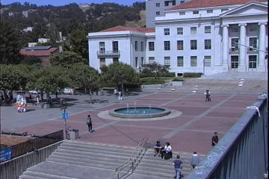
The Power of Averaging

Slide 4

The Power of Averaging
Notes:
Add

Slide 5
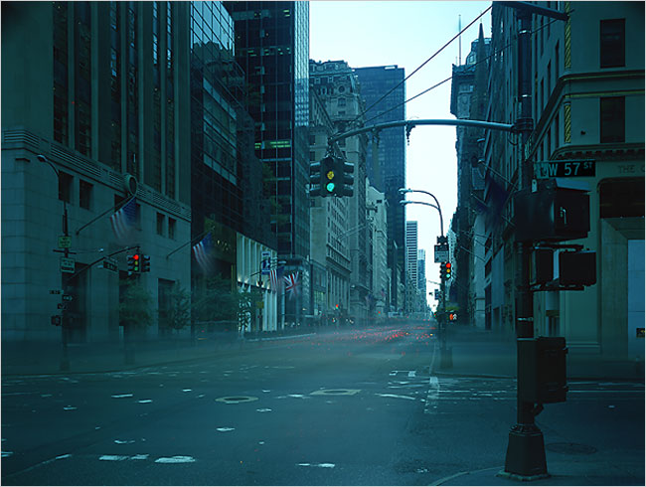
8-hour exposure
© Atta Kim

Slide 6
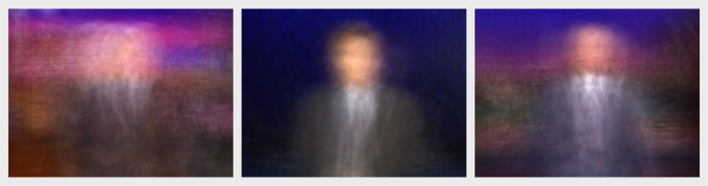
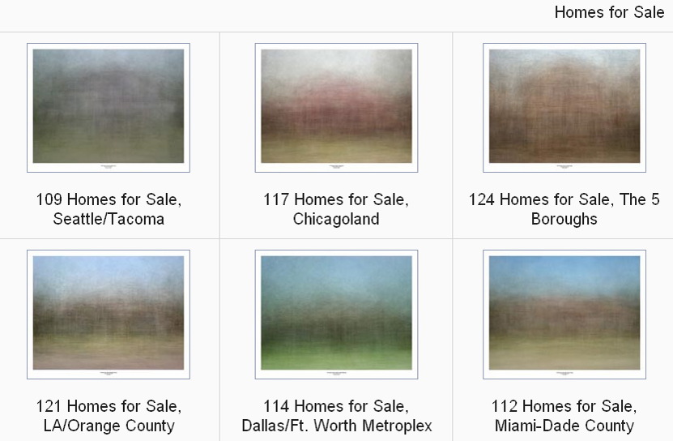
More by Jason Salavon
More at: http://www.salavon.com/
Notes:
Jay Leno, Conan O’Brien, David Letterman

Slide 7
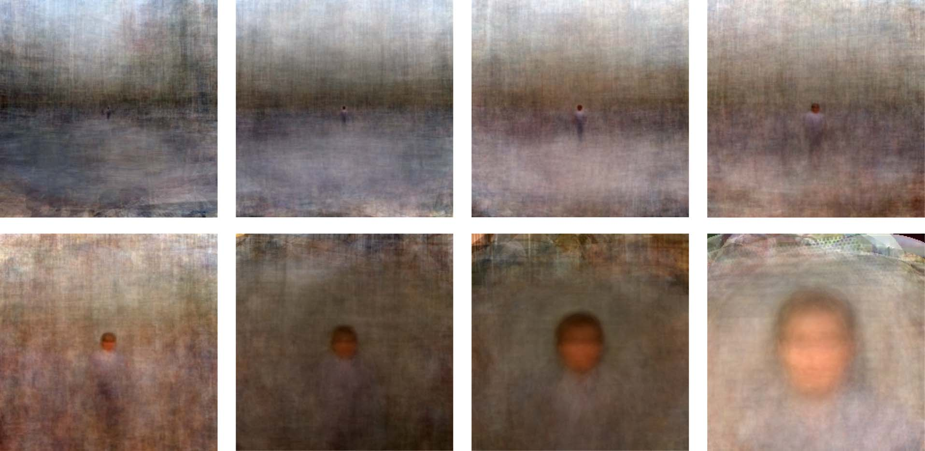
Figure-centric averages
Need to Align
  Position
  Scale
  Orientation
Antonio Torralba & Aude Oliva (2002)
Averages: Hundreds of images containing a person are averaged to reveal regularities
in the intensity patterns across all the images.
Notes:
Another usage is to show a significant trend.
----- Meeting Notes (10/4/11 17:12) -----
Aligned through translation and scale
average
7

Slide 8
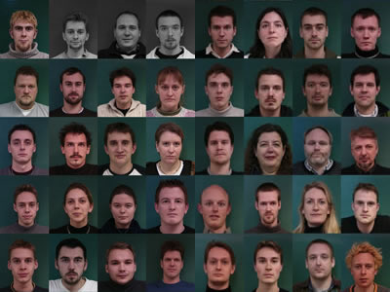
How do we average faces?
http://www2.imm.dtu.dk/~aam/datasets/datasets.html

Slide 9
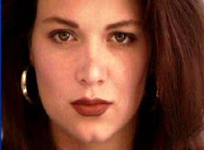

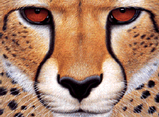
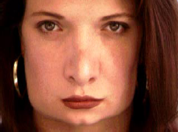
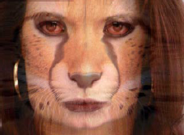
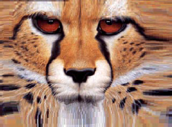
Review: Morphing
image #1
image #2
warp
morphing
warp

Slide 10
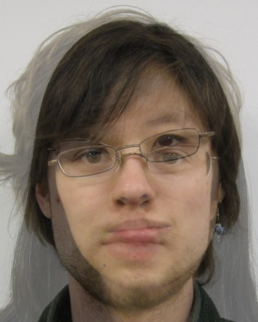
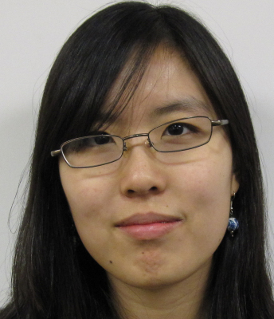
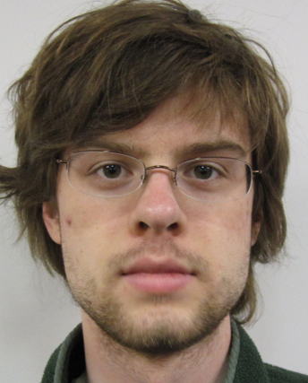
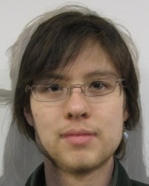
Cross-Dissolve vs. Morphing
Average of
Appearance Vectors
http://www.faceresearch.org/demos/vector
Average of
Shape Vectors
Images from James Hays
Notes:
----- Meeting Notes (10/4/11 17:12) -----
the demo

Slide 11
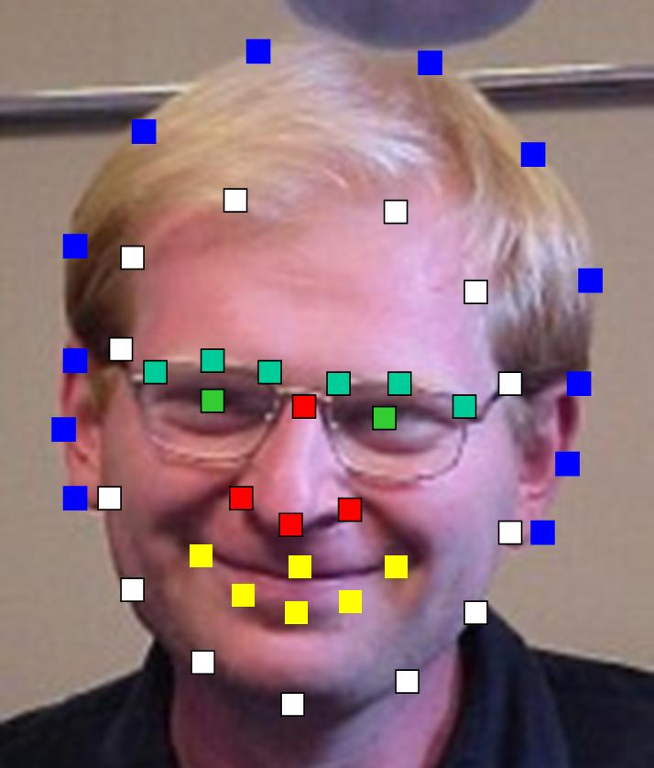
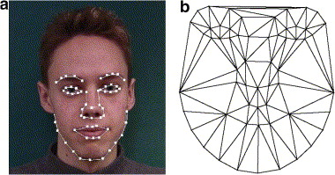
Aligning Faces
Need to Align
  Position
  Scale
  Orientation
  Key-points
The more key-points
the finer alignment
Images from Alyosha Efros

Slide 12
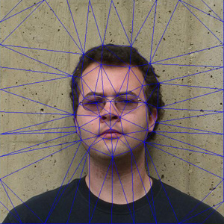
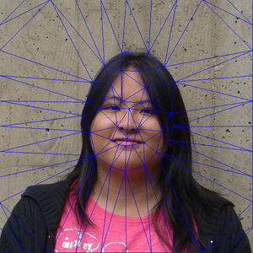
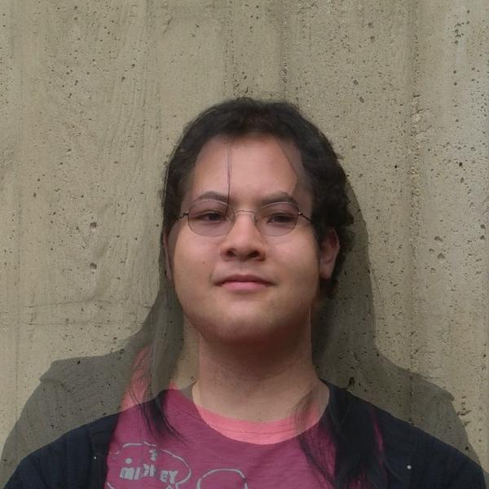
Average of two Faces
Input face key-points
Pairwise Average key-point co-ordinates
Triangulate the faces
Warp: Transform every face triangle
Average The pixels

Slide 13
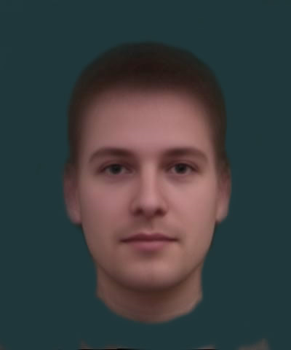
Average of multiple Face
1. Warp to mean shape
2. Average pixels
http://www.faceresearch.org/demos/average
http://graphics.cs.cmu.edu/courses/15-463/2004_fall/www/handins/brh/final/

Slide 14
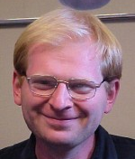
Appearance Vectors vs. Shape Vectors
Appearance
Vector
Vector of
200*150*3
Dimensions
Requires Annotation
Provides alignment!
Complements
200*150 pixels (RGB)
Shape
Vector
Vector of
43*2
Dimensions
43 coordinates (x,y)
Notes:
You can think about faces in different ways. You can represent this way or that way. These are complements.

Slide 15
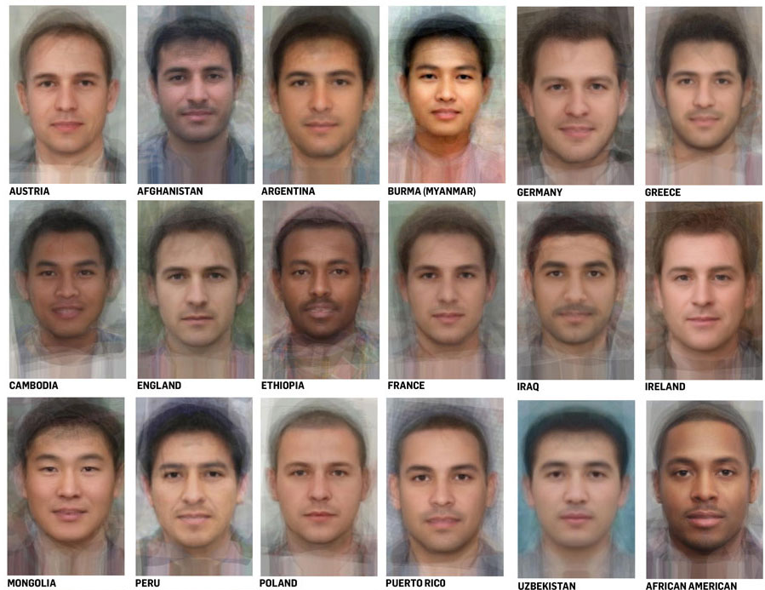
Average Men of the world

Slide 16
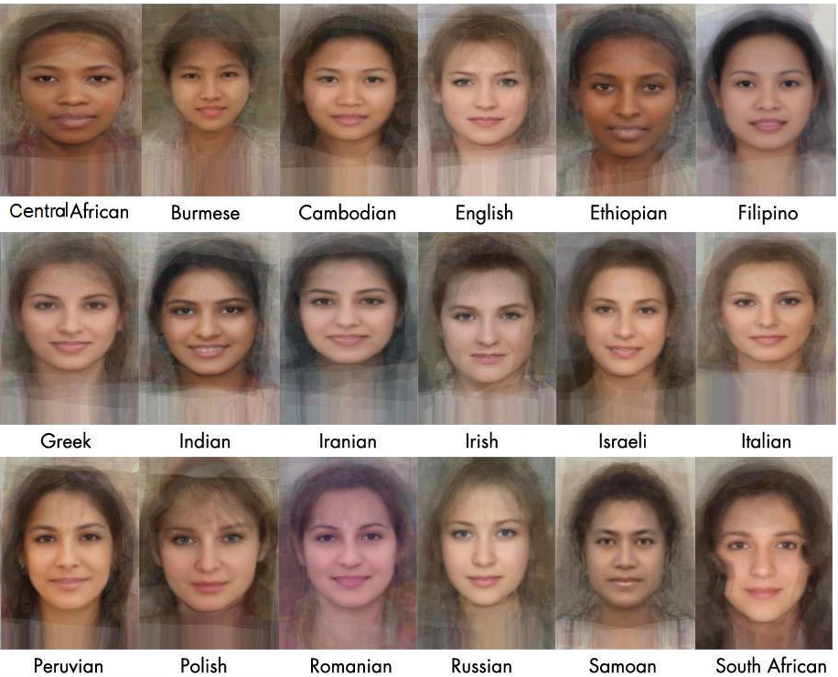
Average Women of the world
Notes:
You will notice that women from every place is very attractive because the …..

Slide 17
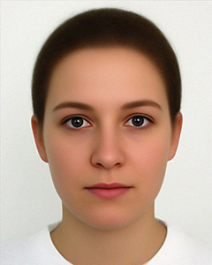
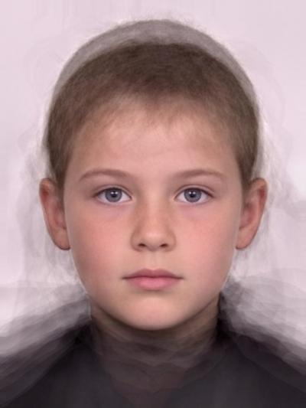
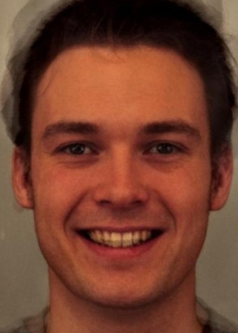
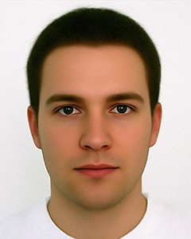
Subpopulation means
Other Examples:
  Average Kids
  Happy Males
  Etc.
  http://www.faceresearch.org
Average female
Average kid
Average happy male
Average male
Notes:
We might be curious what different populations of faces look like.

Slide 18
Manipulating faces
How can we make a face look more female/male, young/old, happy/sad, etc.?
http://www.faceresearch.org/demos/transform
Current face
Prototype 1
Prototype 2
Notes:
----- Meeting Notes (10/4/11 17:24) -----
Add a matlab thing to show the differences. show how to use PCA in matlab.

Slide 19
Manipulating faces
We can imagine various meaningful directions.
Sad
Masculine
Current face
Feminine
Happy

Slide 20
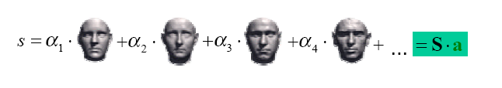
Face Space
How to find a set of directions to cover all space?
We call these directions Basis
If number of basis faces is large enough to span the face subspace:
Any new face can be represented as a linear combination of basis vectors.

Slide 21
Issues:
How many basis faces is enough?
Which ones should they be?
What if some variations are more important than others?
  E.g. corners of mouth carry much more information than haircut
Need a way to obtain basis images automatically, in order of importance!
But what’s important?

Slide 22
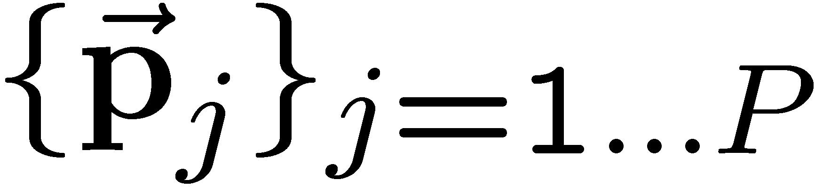
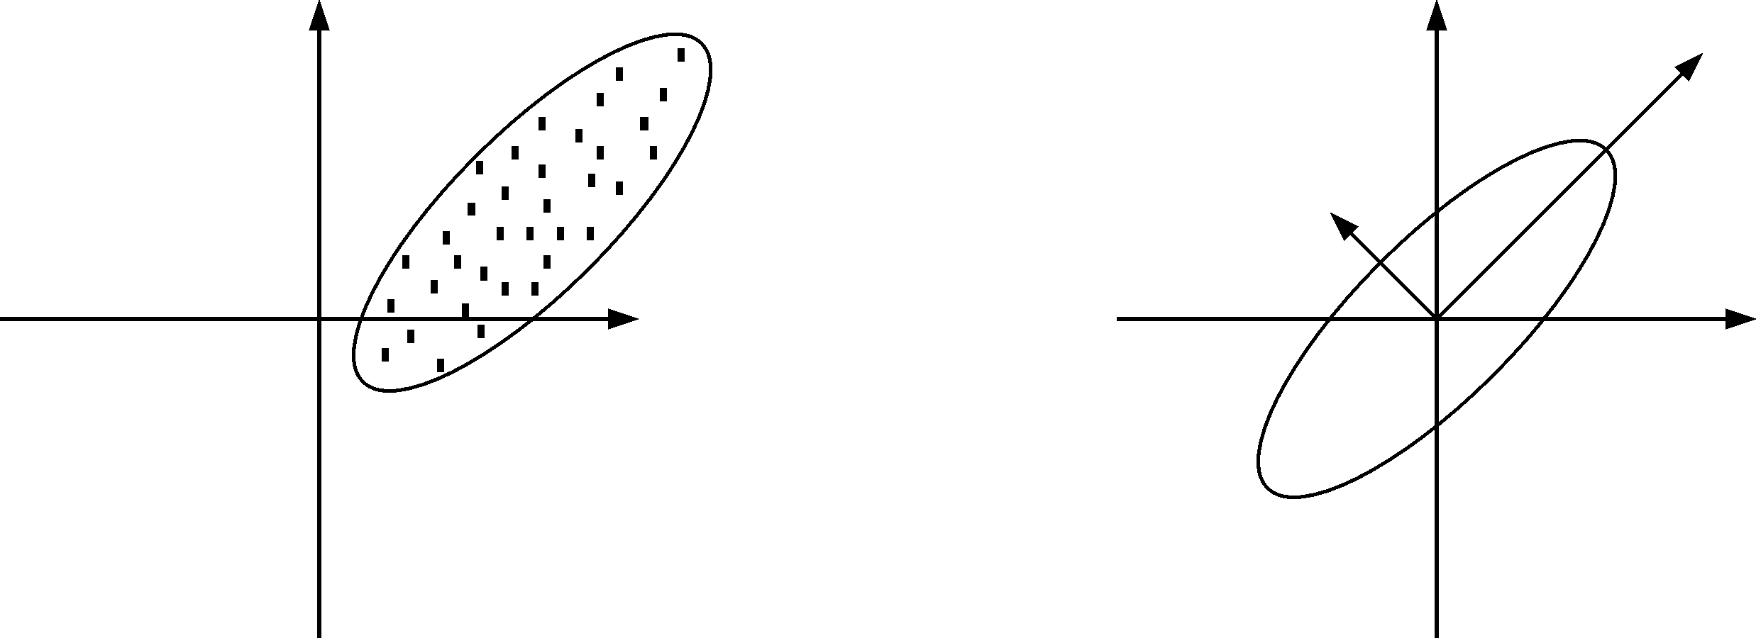
Principal Component Analysis
Given a point set , in an M-dim space, PCA finds a basis such that
  coefficients of the point set in that basis are uncorrelated
  The most variation is in the first basis vector, then second, …
x₁
x₁
1st principal component
2nd principal component
x₀
x₀
Notes:
The goal of PCA is to find orthogonal vectors that the first r vectors have the highest variance of all.
----- Meeting Notes (10/4/11 17:12) -----
Write it more mathematically
say what PCA is solving

Slide 23
PCA in MATLAB
x=rand(3,10);%10 3D examples
M=mean(x,2);
x2=x-repmat(M,[1 n]);
covariance=x2*x2';
[U E] = eig(covariance)
U =
0.74 0.07 -0.66
0.65 0.10 0.74
-0.12 0.99 -0.02
E =
0.27 0 0
0 0.63 0
0 0 0.94

Slide 24
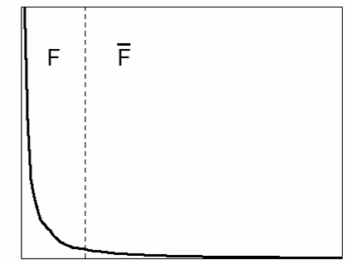
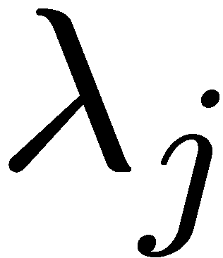
Principal Component Analysis
Continued…
  first r < M basis vectors provide an approximate basis that minimizes the mean-squared-error (MSE) in the approximation (over all bases with dimension r)
Choosing subspace dimension r:
  look at decay of the eigenvalues as a function of r
  Larger r means lower expected error in the subspace data approximation
eigenvalues
1
r
M

Slide 25
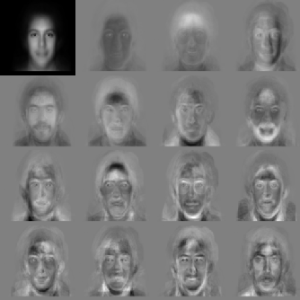
EigenFaces
First popular use of PCA on images was for modeling and recognition of faces [Kirby and Sirovich, 1990, Turk and Pentland, 1991]
Collect a face ensemble
Normalize for contrast, scale, & orientation.
Remove backgrounds
Apply PCA & choose the first N eigen-images that account for most of the variance of the data.
mean face
lighting variation
Notes:
10,000 to 30

Slide 26
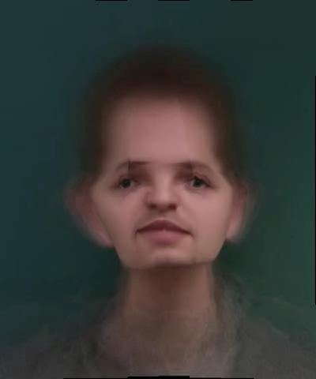
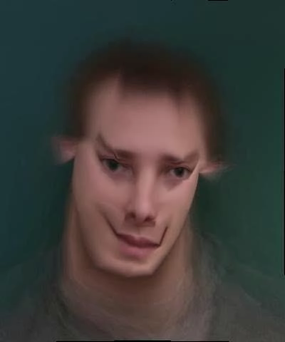
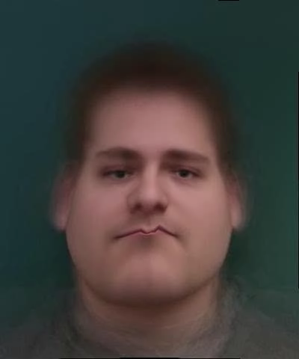
First 3 Shape Basis
Mean appearance
http://graphics.cs.cmu.edu/courses/15-463/2004_fall/www/handins/brh/final/
Notes:
----- Meeting Notes (10/4/11 17:12) -----
show both extremes

Slide 27
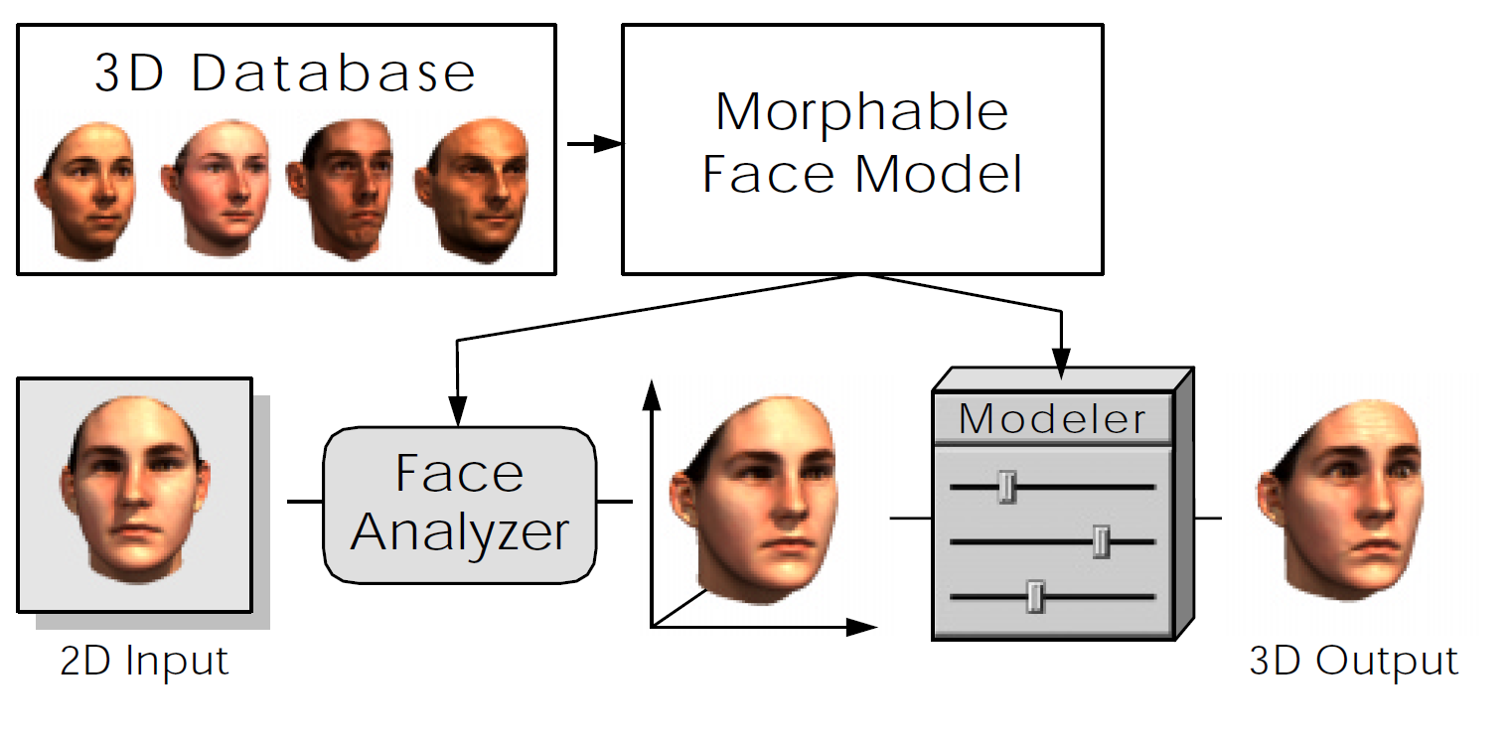
Morphable Face Model
http://www.youtube.com/watch?v=wHg3a9z0aIg&feature=related

Slide 28
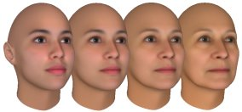
Morphing Applications
The basis concept is useful in many domains
  3D-face
  Human pose
  Any Object
facegen.com

Slide 29
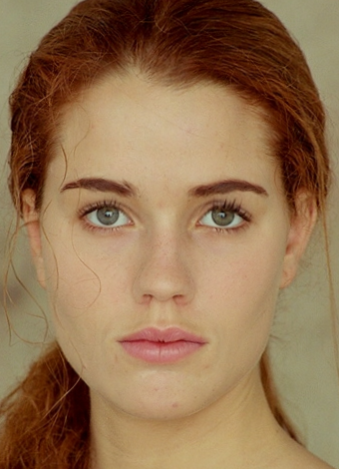
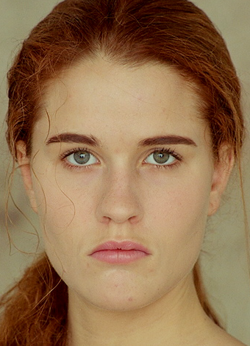
Which face is more attractive?
beautified
original
Notes:
----- Meeting Notes (10/4/11 17:12) -----
The goal is to keep the same person but more attractice.

Slide 30
Data-Driven Enhancement of Facial Attractiveness
T. Leyvand, D. Cohen-Or, G. Dror, and D. Lischinski
SIGGRAPH 2008

Slide 31
System Overview

Slide 32
How to achieve Training Data:
http://www.faceresearch.org/exp/experiment?id=486
Demo:
http://www.youtube.com/watch?v=lVbrUuwK-8g

Slide 33
Face Swapping: Automatically Replacing Faces in Photographs
D. Bitouk, N. Kumar, S. Dhillon, P. Belhumeur, S. K. Nayar
SIGGRAPH 2008

Slide 34
More fun with faces
A Conditional Random Field for Automatic Photo Editing
M. Brand, P. Pletscher
CVPR 2008
Notes:
----- Meeting Notes (10/4/11 17:12) -----
They detect facial features automatically

Slide 35
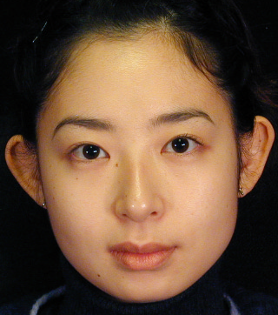


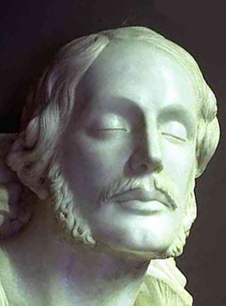
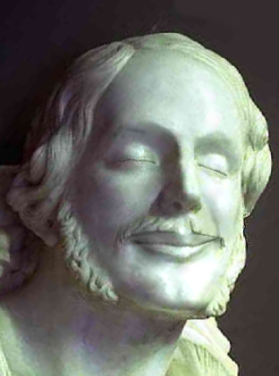
More fun with faces
Original image
Expression transfer by warping
Proposed method
Expressive Expression Mapping with Ratio Images
Z. Liu, Y. Shan, Z. Zhang
SIGGRAPH 2001

Slide 36
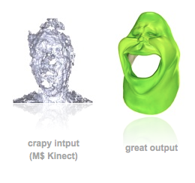
Realtime Performance-Based Facial Animation
http://www.youtube.com/watch?v=8kbPhG3y8ts

Slide 37
Things to remember
Appearance Vector
Shape Vector
Face Transformation
Principal Component Analysis
Notes:
A good way to represent faces is not just the intesities of images, we can also use shape and ….
To show the variation, we can use exemplars, or we can use various directions to be able to represent faces with a few vectors

Slide 38
Questions…

