Slide 1
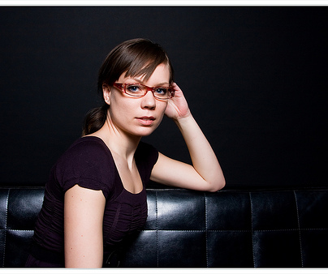
Detecting Fakes
11/10/11
http://www.flickr.com/photos/kjmeow/2320759046/
Bernadette by Stephen Molyneaux
Computational Photography
Derek Hoiem, University of Illinois

Slide 2
Will grade midterm by next Tues
Remember to complete your project 5 by Mon night

Slide 3
Detecting Fakes
Detecting photorealistic graphics
Detecting manipulated images

Slide 4
CG vs. Real: Can you do it?
http://area.autodesk.com/fakeorfoto/challenge
I got 2 out of 12 right
Last year, I got 3/12
Chance = 6 out of 12

Slide 5
CG vs. Real -- Why It Matters: Crime
1996 Child Pornography Prevent Act made certain types of “virtual porn” illegal
Supreme court over-ruled in 2002
To prosecute, state needs to prove that child porn is not computer-generated images
Real Photo
CG

Slide 6
Automatically Detecting CG
Sketch of approach
Intuition: natural images have predictable statistics (e.g., power law for frequency); CG images may have different statistics due to difficulty in creating detail
Decompose the image into wavelet coefficients and compute statistics of these coefficients
Lyu and Farid 2005: “How Realistic is Photorealistic?”

Slide 7
2D Wavelets
Kind of like the Laplacian pyramid, except broken down into horizontal, vertical, and diagonal frequency
Laplacian Pyramid
Wavelet Pyramid

Slide 8
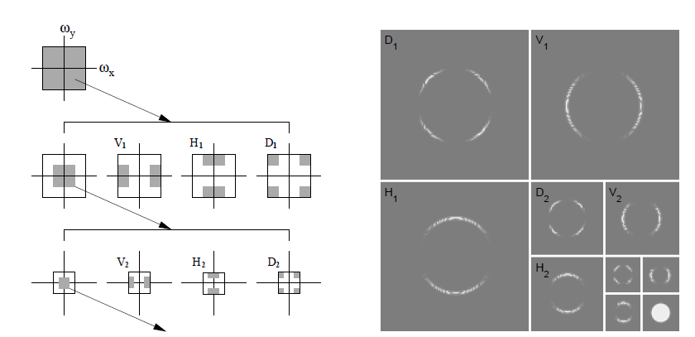
2D Wavelet Transform
Illustration of procedure
Wavelet decomposition of disc image
Figure from Lyu and Farid 2005: “How Realistic is Photorealistic?”

Slide 9
Automatically Detecting CG
Sketch of approach
Intuition: natural images have predictable statistics (e.g., power law for frequency); CG images may have different statistics due to difficulty in creating detail
Decompose the image into wavelet coefficients and compute statistics of these coefficients
Train a classifier to distinguish between CG and Real based on these features
Train RBF SVM with 32,000 real images and 4,800 fake images
Real images from http://www.freefoto.com
Fake images from http://www.raph.com and http://www.irtc.org/irtc/
Lyu and Farid 2005: “How Realistic is Photorealistic?”

Slide 10
Results
98.8% test accuracy on real images
66.8% test accuracy on fake images
10/14 on fakeorfoto.com
Lyu and Farid 2005: “How Realistic is Photorealistic?”

Slide 11
Results
Fake-or-photo.com: Correct
Photos
CG
Lyu and Farid 2005: “How Realistic is Photorealistic?”

Slide 12
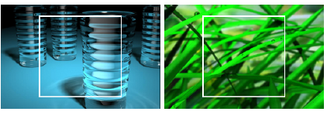
Results
Fake-or-photo.com: Wrong
Photos misclassified as CG
CG misclassified as photos
Lyu and Farid 2005: “How Realistic is Photorealistic?”

Slide 13
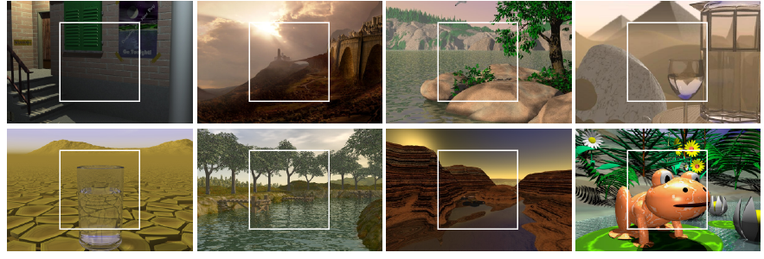
Results
Fakes, confidently labeled as fake
Lyu and Farid 2005: “How Realistic is Photorealistic?”

Slide 14
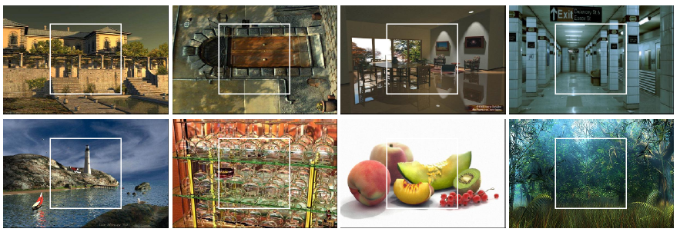
Results
Fake images thought to be real
Lyu and Farid 2005: “How Realistic is Photorealistic?”

Slide 15
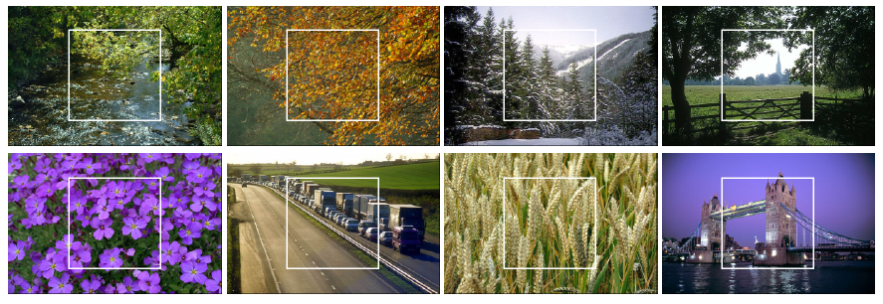
Results
Real photographs, confidently labeled as real
Lyu and Farid 2005: “How Realistic is Photorealistic?”

Slide 16
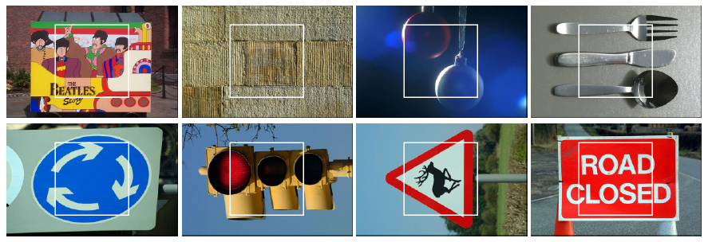
Results
Real photos, incorrectly thought to be fake
Lyu and Farid 2005: “How Realistic is Photorealistic?”

Slide 17
Detecting Forgery: Can You Do It?
http://www.life.com/archive/realfake
I got 5/10 (6/10 last year)
Chance = 5/10

Slide 18
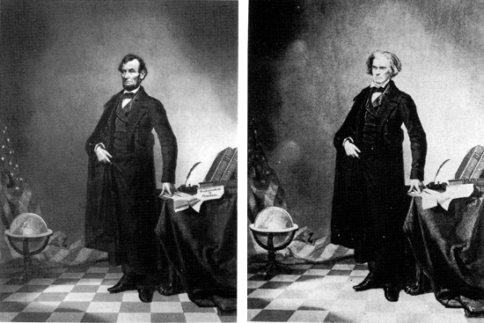
Detecting Forgery -- Why It Matters: Trust
Examples collected by Hany Farid: http://www.fourandsix.com/photo-tampering-history/
Iconic Portrait of Lincoln (1860)

Slide 19
“While photographs may not lie, liars may photograph.”
Lewis Hine (1909)

Slide 20
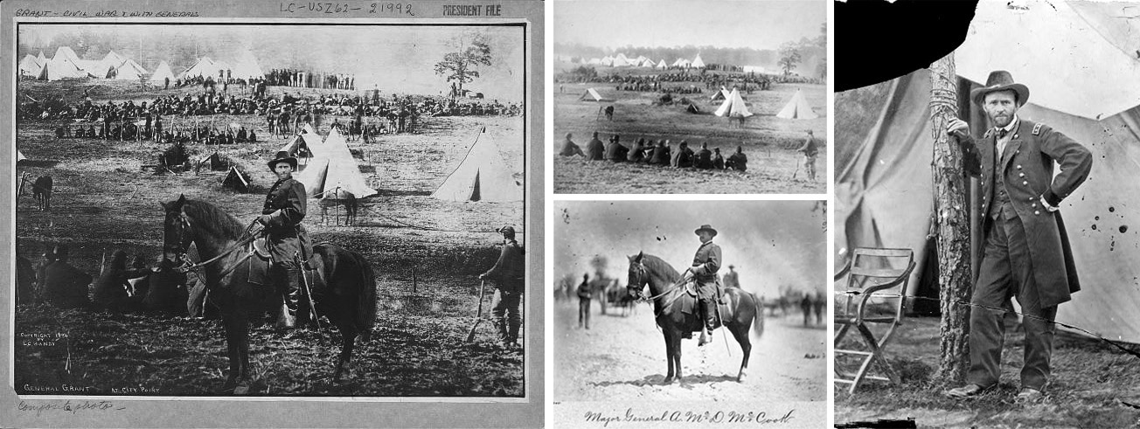
General Grant in front of Troops (1864)

Slide 21
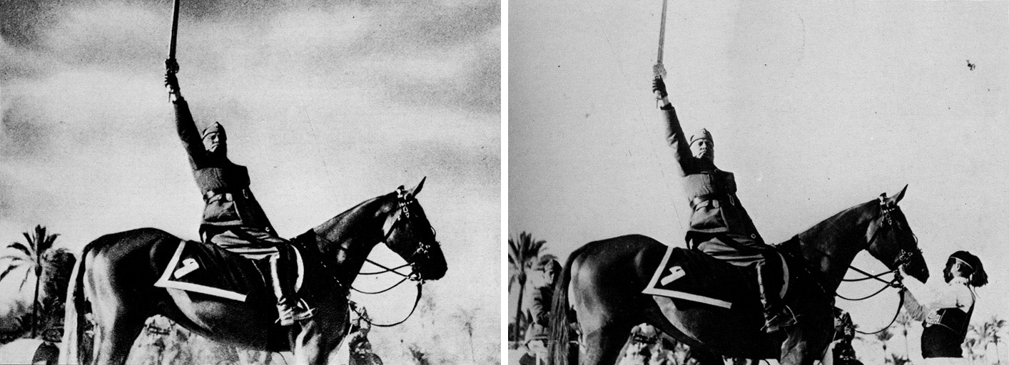
Mussolini in a Heroic Pose (1942)

Slide 22
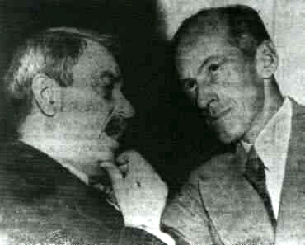
1950: Doctored photo of Senator Tydings talking with Browder, the leader of the communist party, contributed to Tydings’ electoral defeat

Slide 23
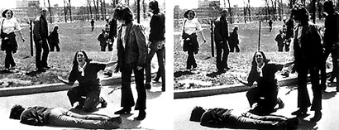
Pulitzer Prize winning photograph of Kent State killing (1970)

Slide 24
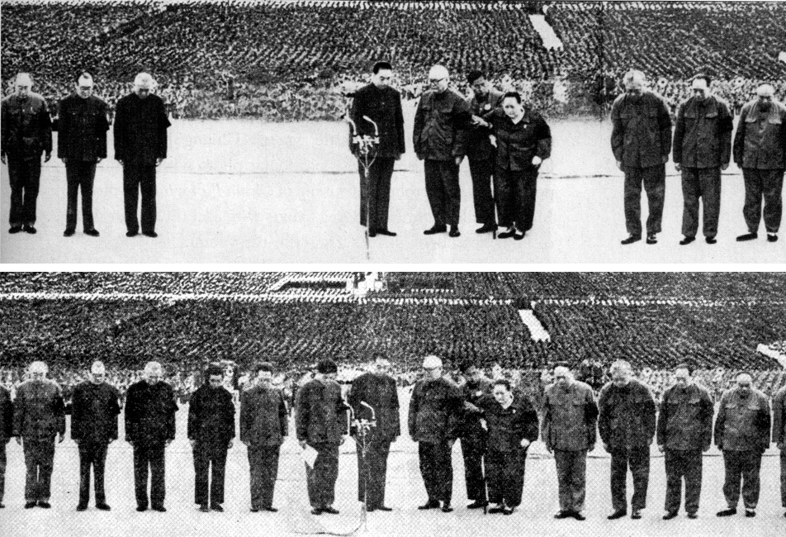
Gang of Four are removed (1976)

Slide 25
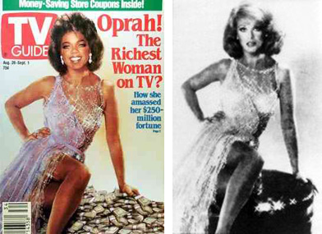
1989 composite of Oprah and Ann-Margret (without either’s permission)

Slide 26
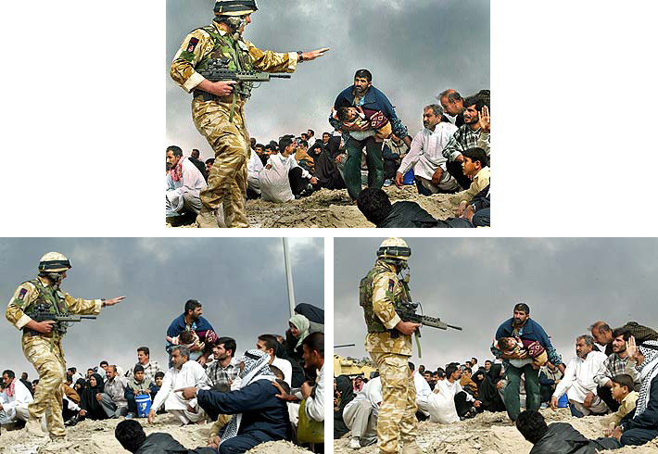
Published photo
2003: Long-time staff photographer for LA Times was fired for this one

Slide 27
Photo from terrorist attack in 1997 in Hatshepsut, Egypt

Slide 28
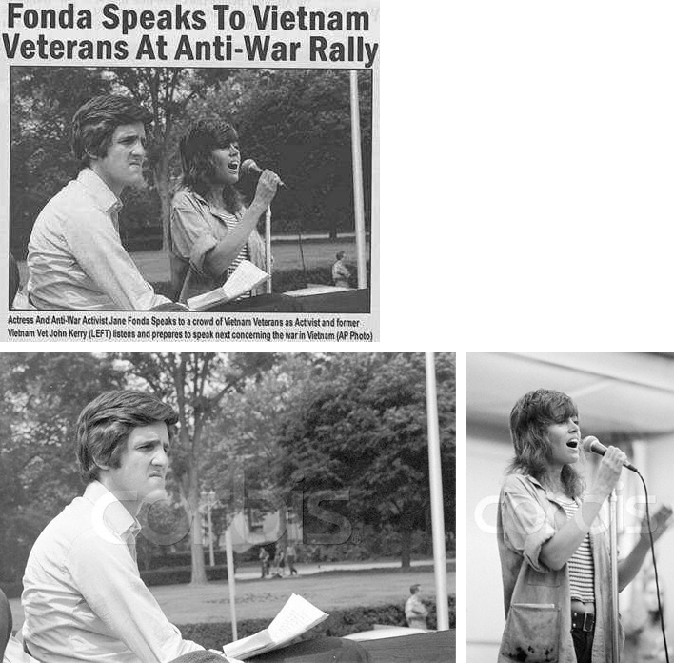
Caption: “Actress and Anti-war activist Jane Fonda speaks to a crowd of Vietnam veterans, as activist and former Vietnam vet John Kerry listens and prepares to speak next concerning the war in Vietnam.” (AP Photo)
Kerry at Rally for Peace 1971
Fonda at rally in 1972

Slide 29
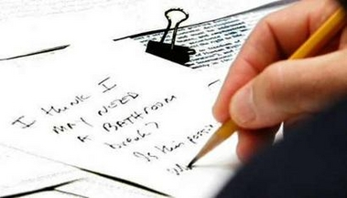
2005: Pres Bush scribbles a note to C. Rice during UN Security Council Meeting

Slide 30
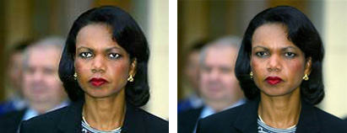
2005: USA Today SNAFU

Slide 31
2006: “Women you will never see in Maxim” – movie star Khushboo’s head on a model’s body; Maxim got sued.

Slide 32
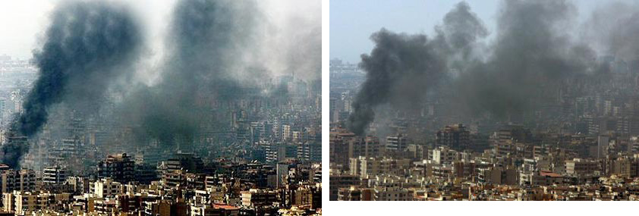
2006: Photo by Adnan Hajj of strikes on Lebanon (original on right)
Later, all of Hajj’s photos were removed from AP and a photo editor was fired.

Slide 33
2007 Retouching is “completely in line with industry standards”

Slide 34
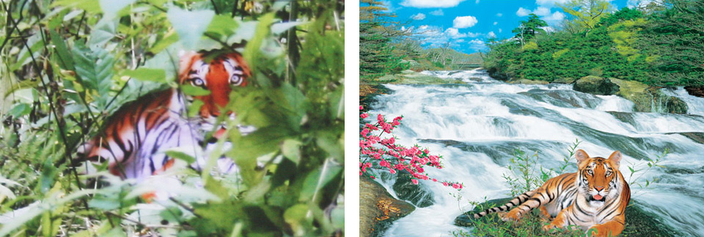
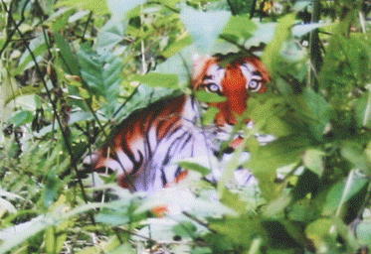
Claimed Photo
Poster
Overlay
2007: Zhou Zhenglong claimed to take 71 photos of the nearly extinct South China tiger

Slide 35
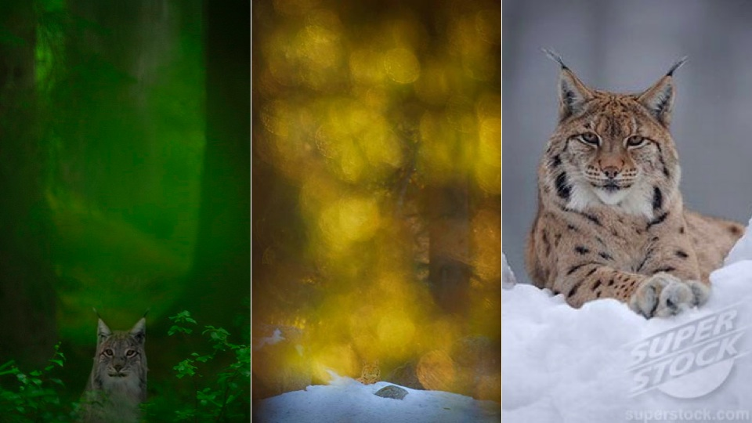
Similar scandal in 2011 from Terje Helleso who won Swedish Env. Prot. award

Slide 36
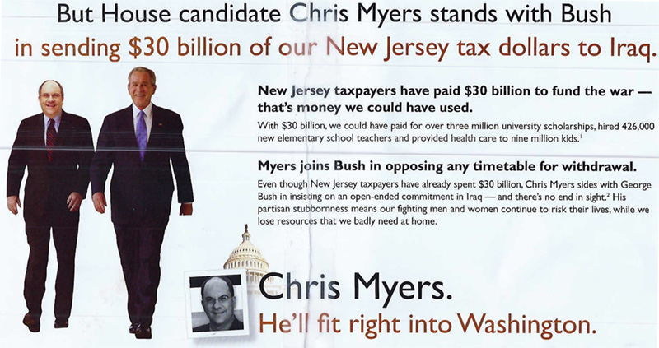
2008 Ad against Myers. Myers says he’s never met Bush.

Slide 37
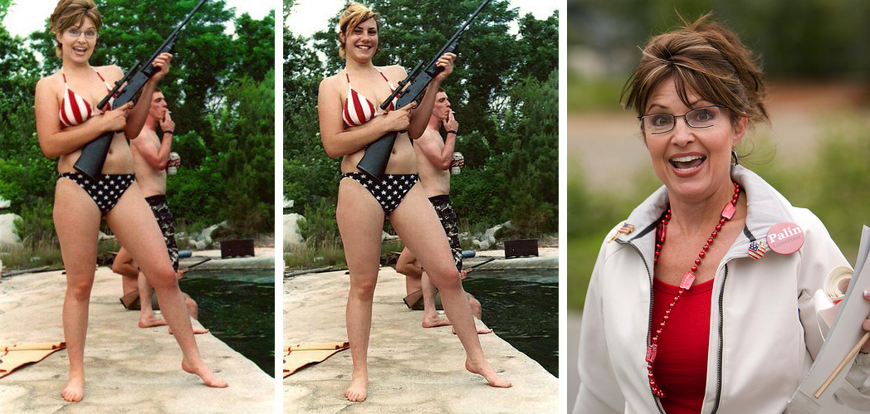
2008

Slide 38
2009: Digital diversity

Slide 39
“Evidence” that Malaysian politician Jeffrey Wong Su En was knighted by the Queen (2010)

Slide 40
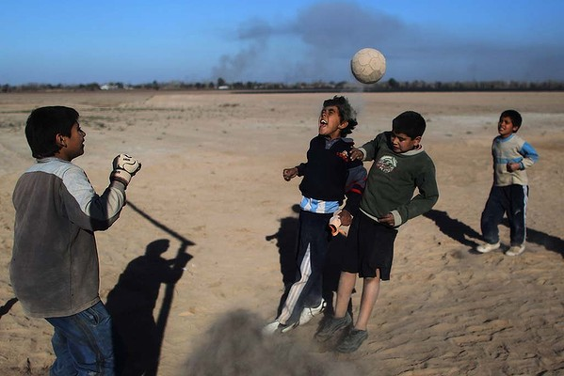
Cloning sand to remove shadow. Miguel Tovar – banned from AP, all his photos removed (2011)

Slide 41
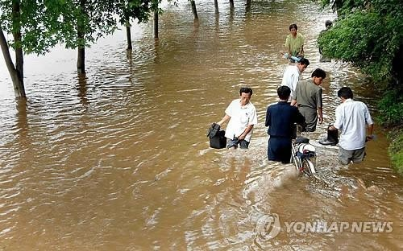
Photo from Korean Central News Agency, determined to be composite (people don’t appear wet) – was attempt to get sympathy for North Korea to get more international aid

Slide 42
Other recent examples
Feb 2011: A spanish newspaper published a doctored photo as evidence of an offside violation in a soccer match
May 2011: Photo of killed Osama bin Laden was composite of alive bin Laden and another guy

Slide 43
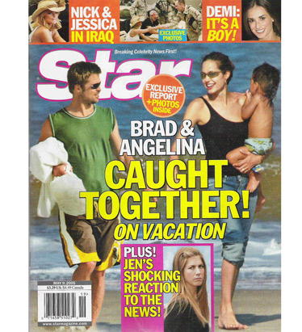
Detecting forgeries
Work by Hany Farid and colleagues
Method 1: 2D light from occluding contours

Slide 44
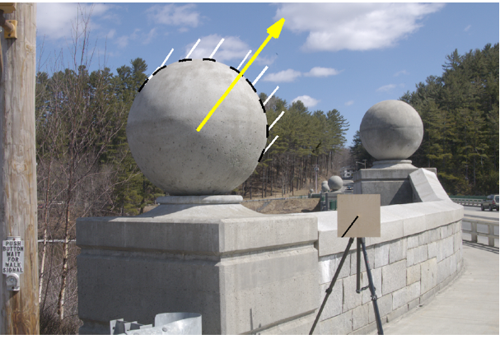
Estimating lighting direction
Method 1: 2D direction from occluding contour
Provide at least 3 points on occluding contour (surface has 0 angle in Z direction)
Estimate light direction from brightness
Estimate
Ground Truth

Slide 45
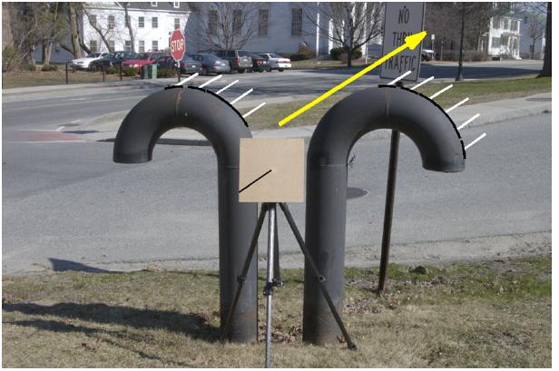
Estimating lighting direction

Slide 46
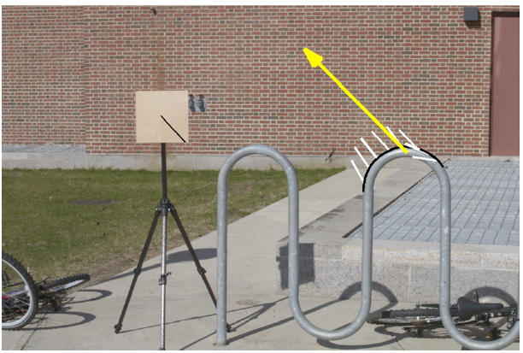
Estimating lighting direction
Average error: 4.8 degrees

Slide 47
Method 2: Light from Eyes
Farid – “Seeing is not believing”, IEEE Spectrum 2009

Slide 48
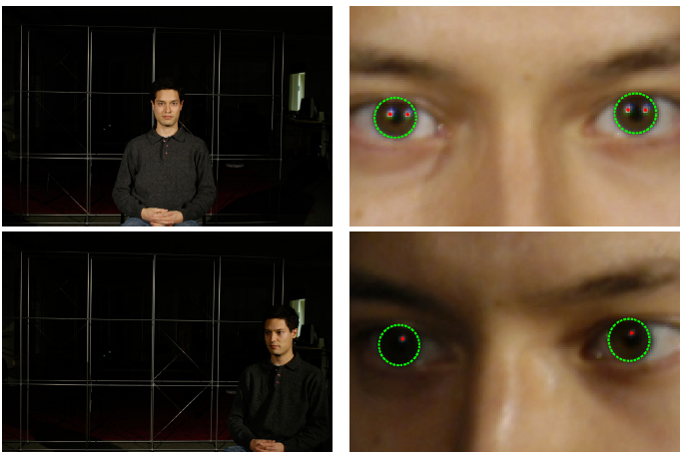
Estimating Lighting from Eyes

Slide 49
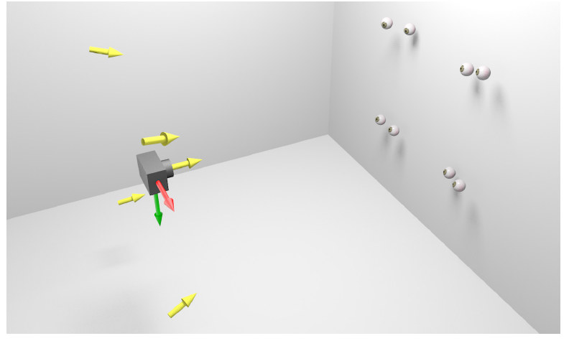
Method 2: Light from Eyes

Slide 50
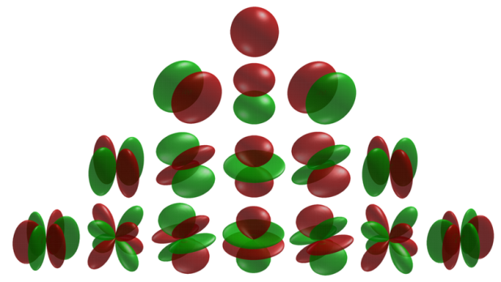
Method 3: Complex light with spherical harmonics
Spherical harmonics parameterize complex lighting environment
Same method as occluding contours, but need 9 points

Slide 51
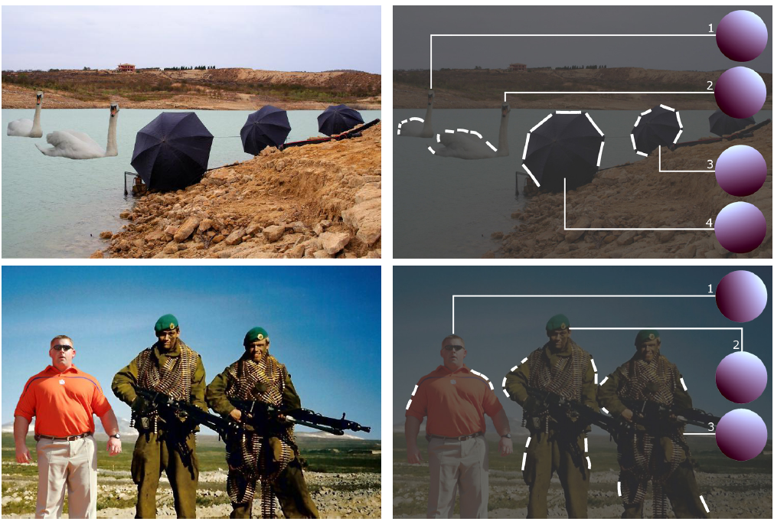
Method 3: Complex light with spherical harmonics

Slide 52
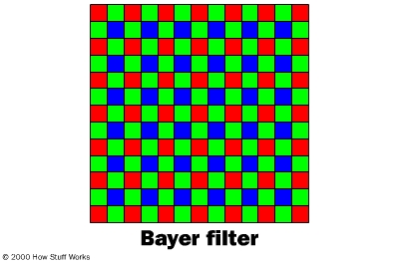
Method 4: Demosaicking Prediction
In demosaicking, RGB values are filled in based on surrounding measured values
Filled in values will be correlated in a particular way for each camera
Local tampering will destroy these correlations
Farid: “Photo Fakery and Forensics” 2009

Slide 53
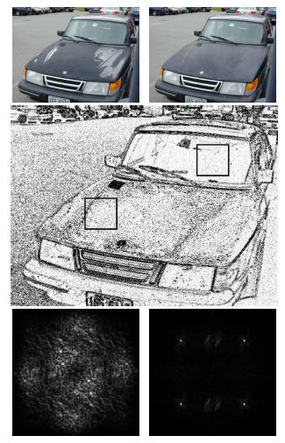
Demosaicking prediction
Upside: can detect many kinds of forgery
Downside: need original resolution, uncompressed image
Original Tampered
Error in pixel prediction from a linear interpolation
FFT of error in each window (periodic for untampered case)

Slide 54
Method 5: JPEG Ghosts
JPEG compresses 8x8 blocks by quantizing DCT coefficients to some level
E.g., coefficient value is 23, quantization = 7, quantized value = 3, error = 23-21=2
Resaving a JPEG at the same quantization will not cause error, but resaving at a lower or higher quantization generally will
Value = 21; quantization = 13; error = 5
Value = 21; quantization = 4; error = 1
Farid: “Photo Fakery and Forensics” 2009

Slide 55
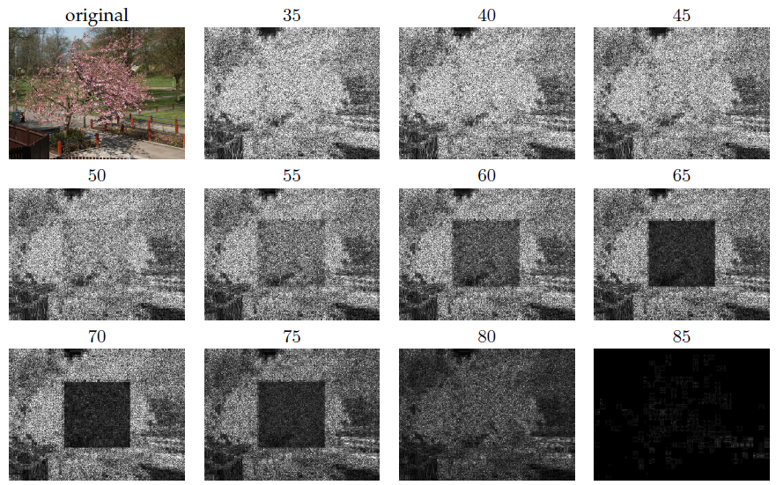
JPEG Ghosts
Original is saved at 85 quality, center square is cut out and compressed at 65 quality; then image is resaved at given qualities
Pixel error for image saved at various JPEG qualities

Slide 56
JPEG Ghosts
If there is enough difference between the quality of the pasted region and the final saved quality, the pasted region can be detected with high accuracy

Slide 57
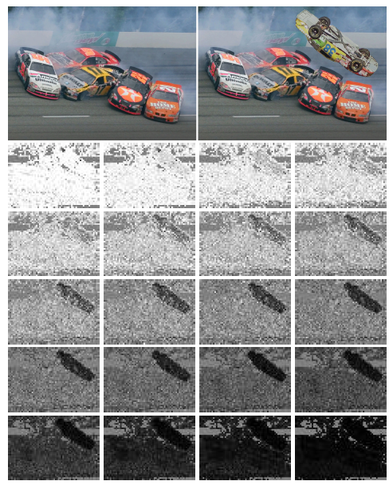
JPEG Ghosts
original
manipulated
Pixel error for manipulated image saved at various JPEG qualities

Slide 58
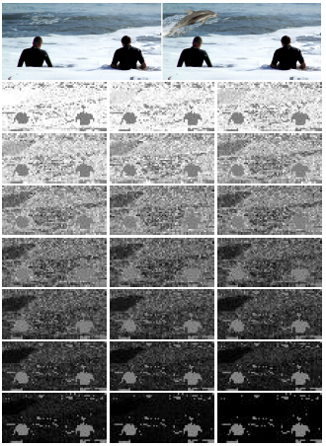
JPEG Ghosts
original
manipulated
Pixel error for manipulated image saved at various JPEG qualities

Slide 59
Summary
Digital forgeries are an increasingly major problem as it becomes easier to fake images
A variety of automatic and semi-automatic methods are available for detection of well-done forgeries
Checking lighting consistency
Checking demosaicking consistency (for high quality images)
Checking JPEG compression level consistency (for low quality images)

Slide 60
Next week
Image-based lighting

