Slide 1
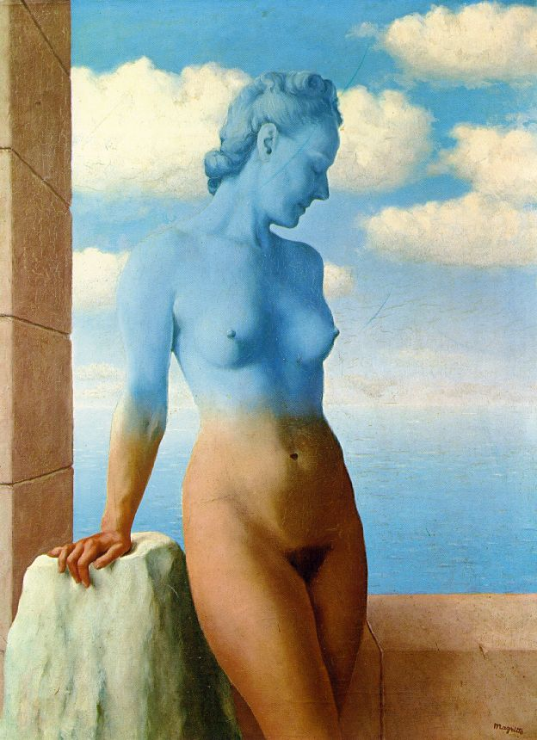
Blending and Compositing
09/22/11
Computational Photography
Derek Hoiem, University of Illinois

Slide 2
Project 2: due Monday

Slide 3
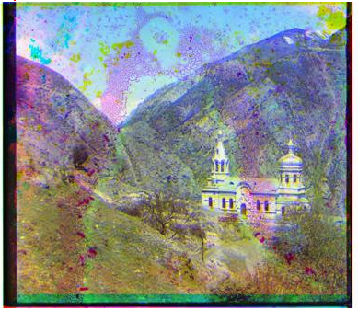
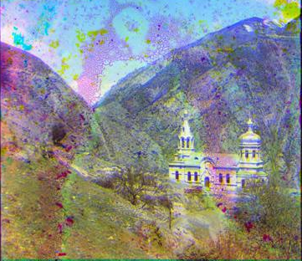
Project 2
Borders and cropping

Slide 4
Last class: texture synthesis

Slide 5
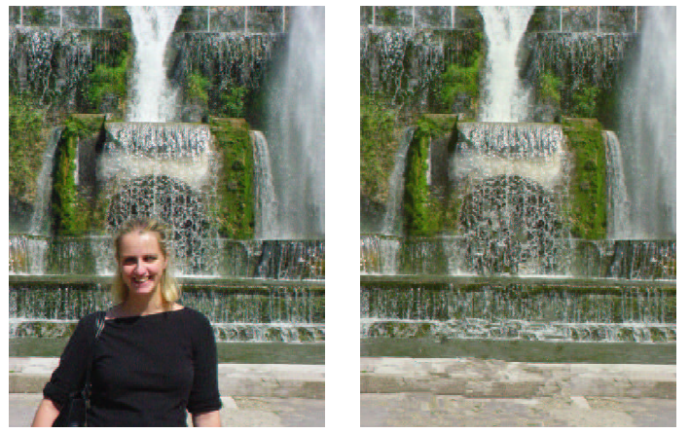
Last class: in-painting

Slide 6
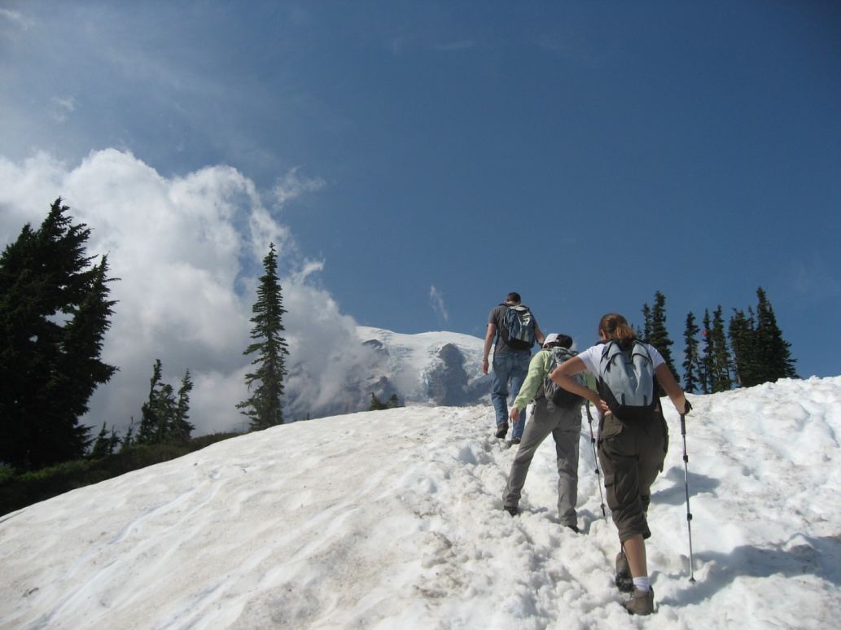
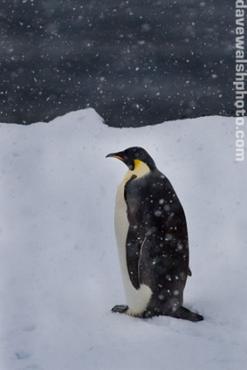
This Class
How do I put an object from one image into another?

Slide 7
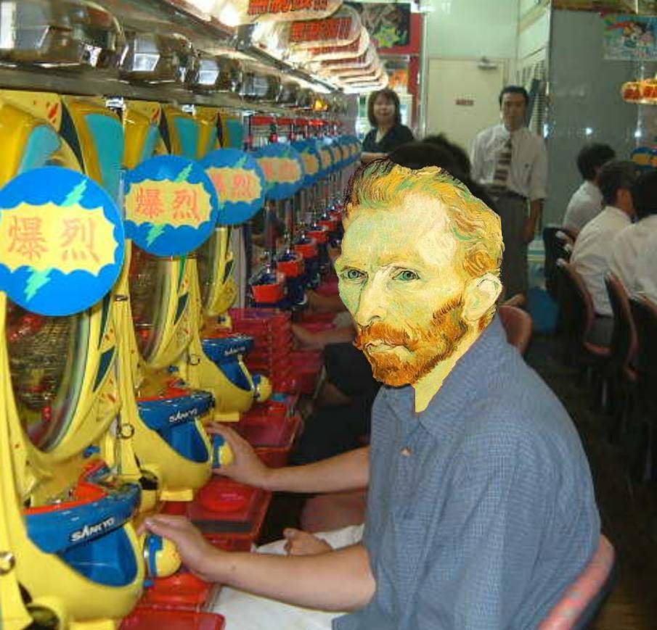
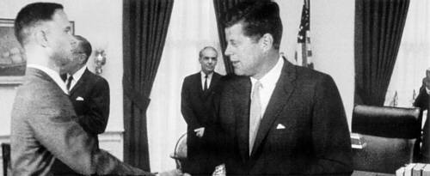
Image Compositing
Some slides from Efros/Seitz

Slide 8
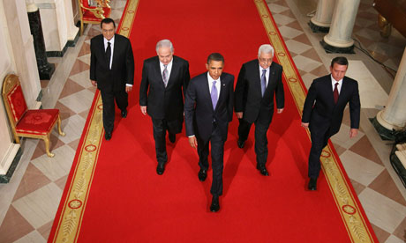
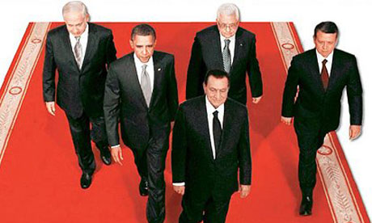
News Composites
http://www.guardian.co.uk/world/2010/sep/16/mubarak-doctored-red-carpet-picture
Original
“Enhanced” Version

Slide 9
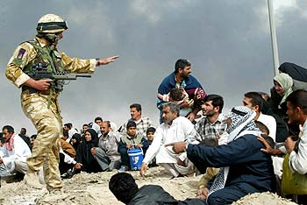
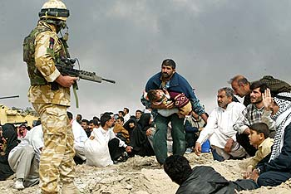
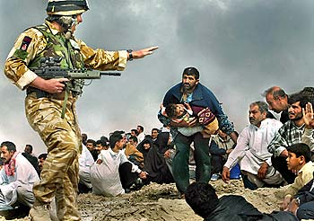
News Composites
Original
“Enhanced” Version
Walski, LA Times, 2003

Slide 10
Three methods
Cut and paste
Laplacian pyramid blending
Poisson blending

Slide 11
Method 1: Cut and Paste

Slide 12
Method 1: Cut and Paste
Method:
Segment using intelligent scissors
Paste foreground pixels onto target region

Slide 13
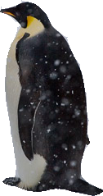
Method 1: Cut and Paste
Problems:
Small segmentation errors noticeable
Pixels are too blocky
Won’t work for semi-transparent materials

Slide 14
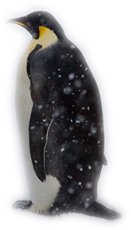
Feathering
Near object boundary pixel values come partly from foreground and partly from background

Slide 15
Method 1: Cut and Paste (with feathering)

Slide 16
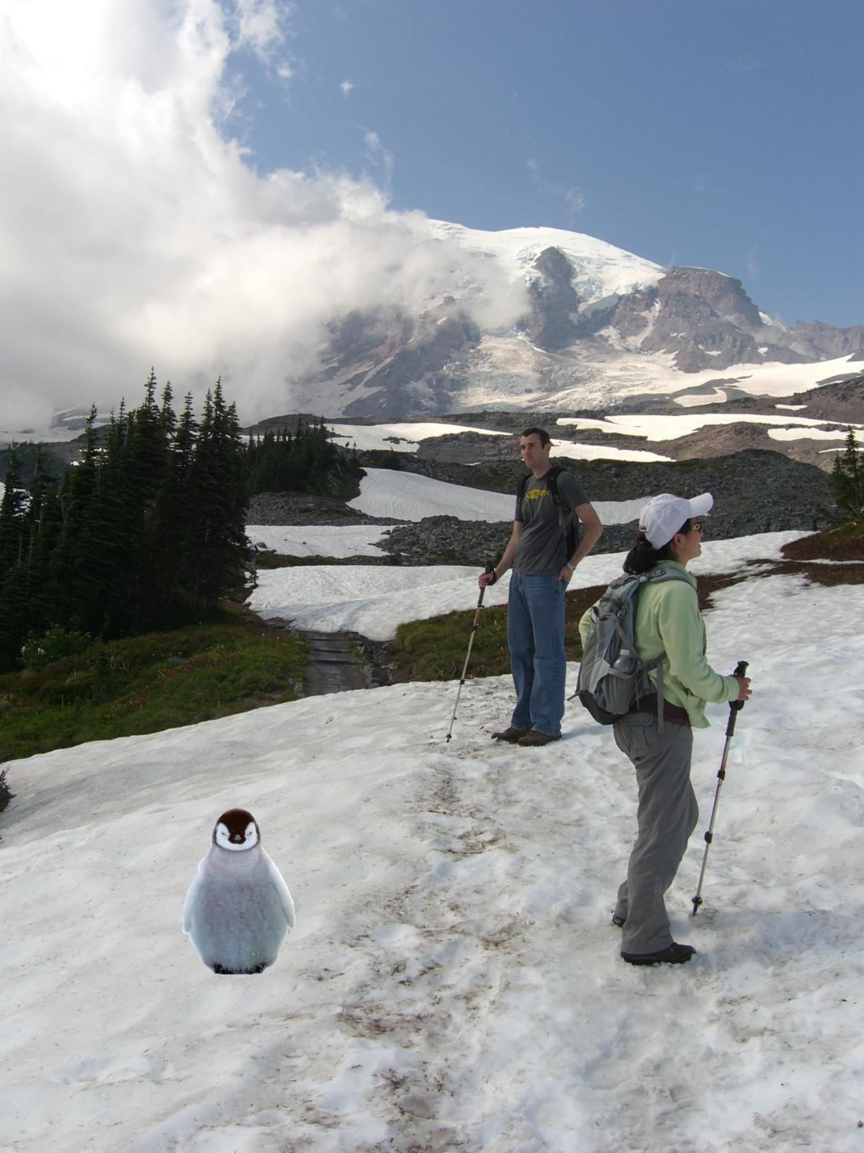
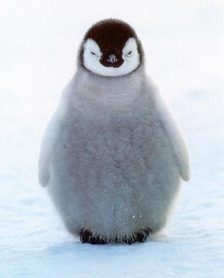
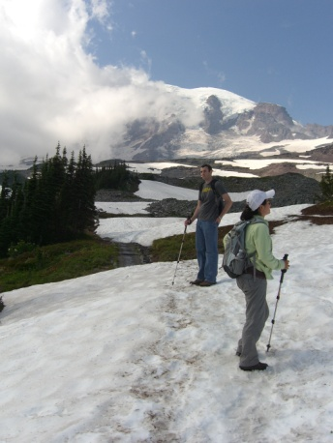
Alpha compositing
+
Output = foreground*mask + background*(1-mask)

Slide 17
Alpha compositing with feathering
Output = foreground*mask + background*(1-mask)

Slide 18
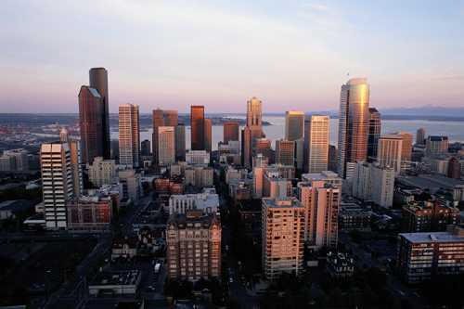
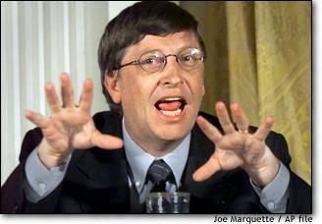
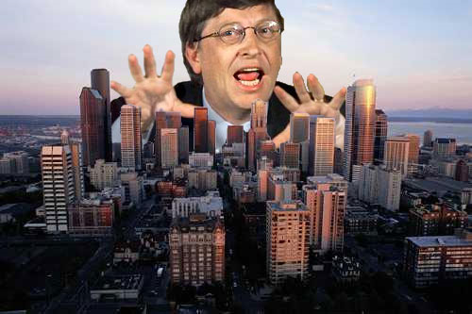
Another example (without feathering)
Mattes
Composite
Composite by
David Dewey

Slide 19
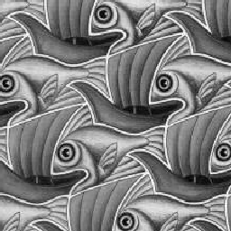
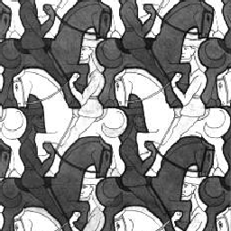
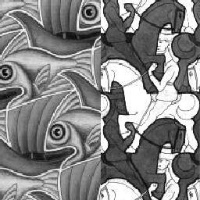
Proper blending is key

Slide 20
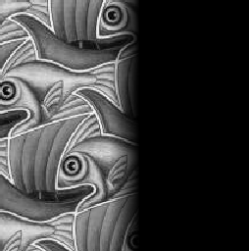
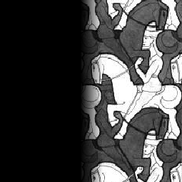
Alpha Blending / Feathering
+
1
1
0
0
I_{blend} = αI_{left} + (1-α)I_{right}
=

Slide 21
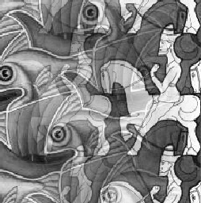
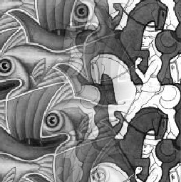
Affect of Window Size
1
left
1
right
0
0

Slide 22
Affect of Window Size
1
1
0
0

Slide 23
Good Window Size
1
0
“Optimal” Window: smooth but not ghosted

Slide 24
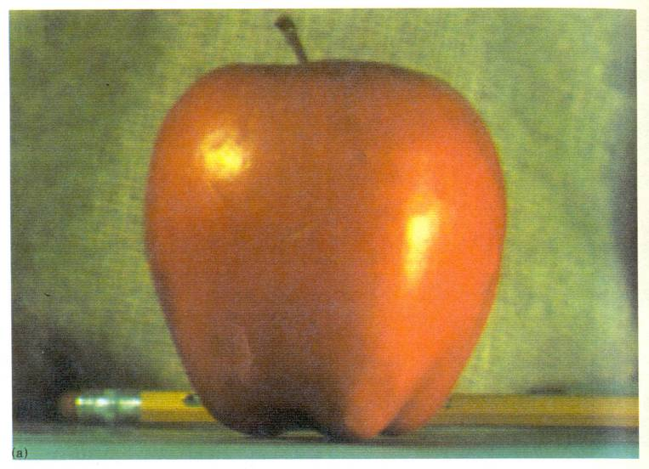
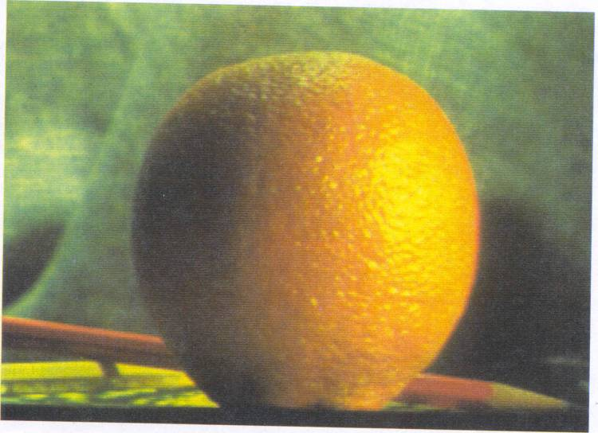
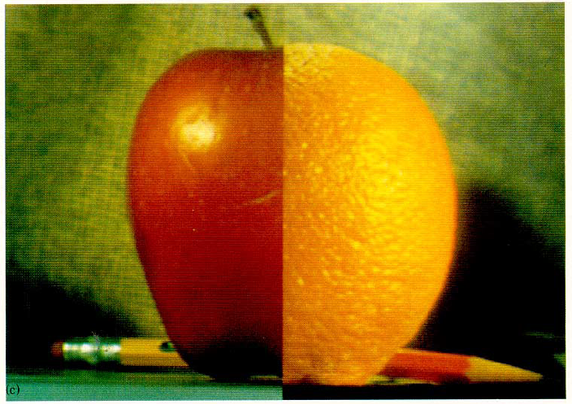
How much should we blend?

Slide 25
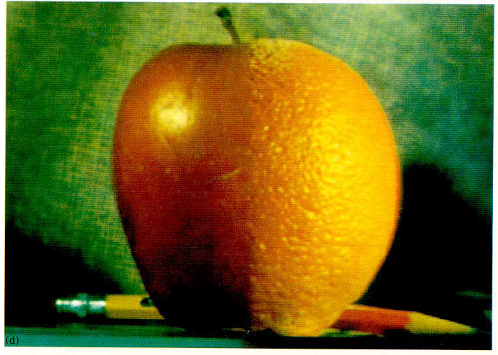
Method 2: Pyramid Blending

Slide 26
Method 2: Pyramid Blending
At low frequencies, blend slowly
At high frequencies, blend quickly
1
0
1
0
1
0
Left pyramid
blend
Right pyramid

Slide 27
laplacian
level
4
laplacian
level
2
laplacian
level
0
left pyramid
right pyramid
blended pyramid

Slide 28
Method 2: Pyramid Blending
Burt and Adelson 1983

Slide 29
Laplacian Pyramid Blending
Implementation:
Build Laplacian pyramids for each image
Build a Gaussian pyramid of region mask
Blend each level of pyramid using region mask from the same level
Collapse the pyramid to get the final blended image
Image 1 at level i of Laplacian pyramid
Region mask at level i of Gaussian pyramid
Burt and Adelson 1983

Slide 30
Simplification: Two-band Blending
Brown & Lowe, 2003
Only use two bands: high freq. and low freq.
Blends low freq. smoothly
Blend high freq. with no smoothing: use binary alpha

Slide 31
2-band Blending
Low frequency
High frequency

Slide 32
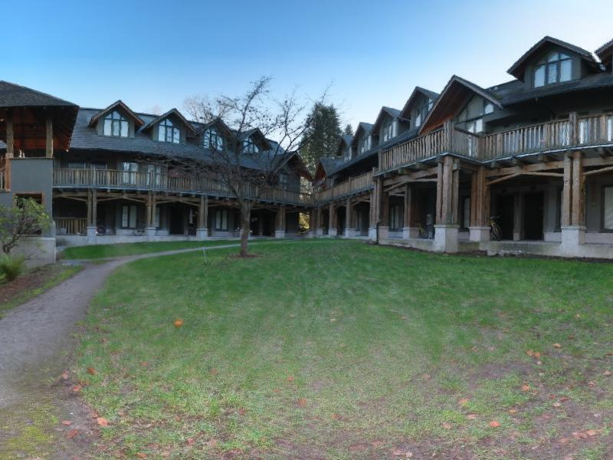
Linear Blending

Slide 33
2-band Blending

Slide 34
Blending Regions

Slide 35
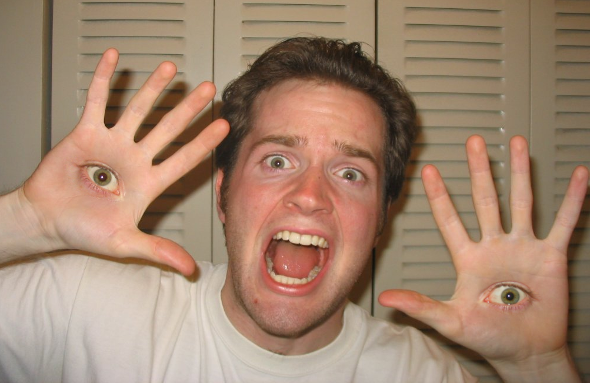
© Chris Cameron

Slide 36
Related idea: Poisson Blending
A good blend should preserve gradients of source region without changing the background
Perez et al. 2003

Slide 37
Related idea: Poisson Blending
A good blend should preserve gradients of source region without changing the background
Project 3!
Perez et al. 2003

Slide 38
Method 3: Poisson Blending
A good blend should preserve gradients of source region without changing the background
Treat pixels as variables to be solved
Minimize squared difference between gradients of foreground region and gradients of target region
Keep background pixels constant
Perez et al. 2003
Notes:
Draw on board

Slide 39
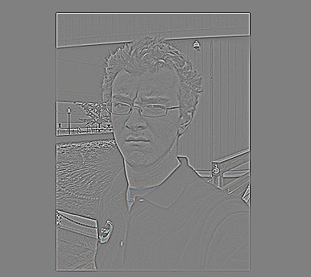
Example
Gradient Visualization
Source: Evan Wallace

Slide 40
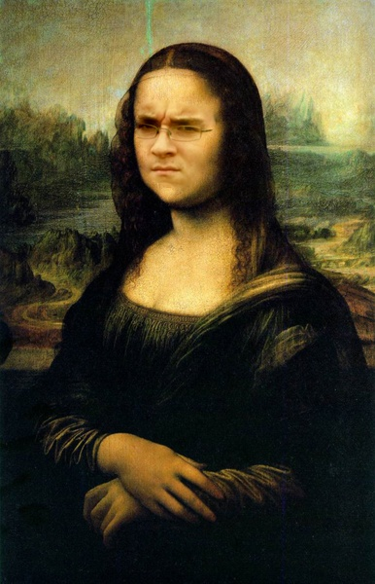
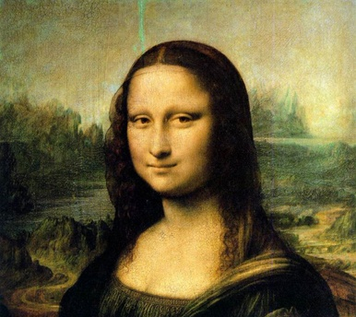
+
Specify object region
Source: Evan Wallace

Slide 41
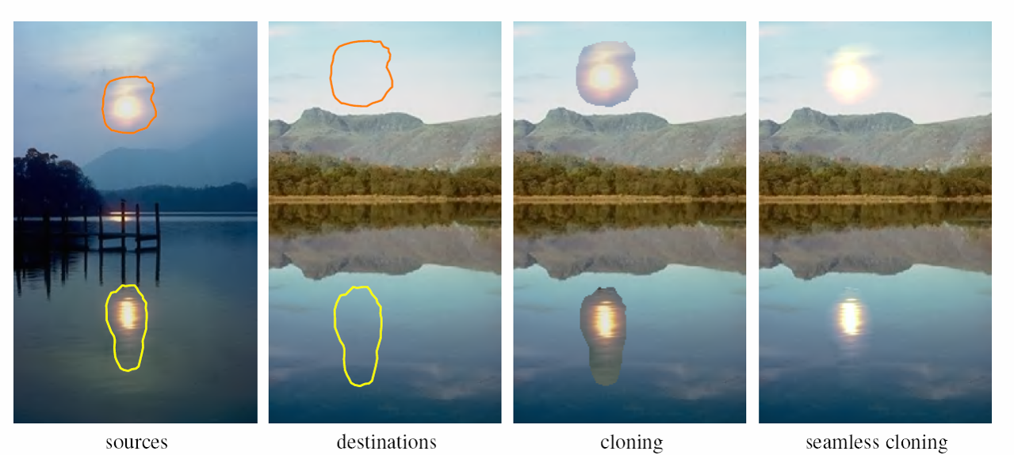
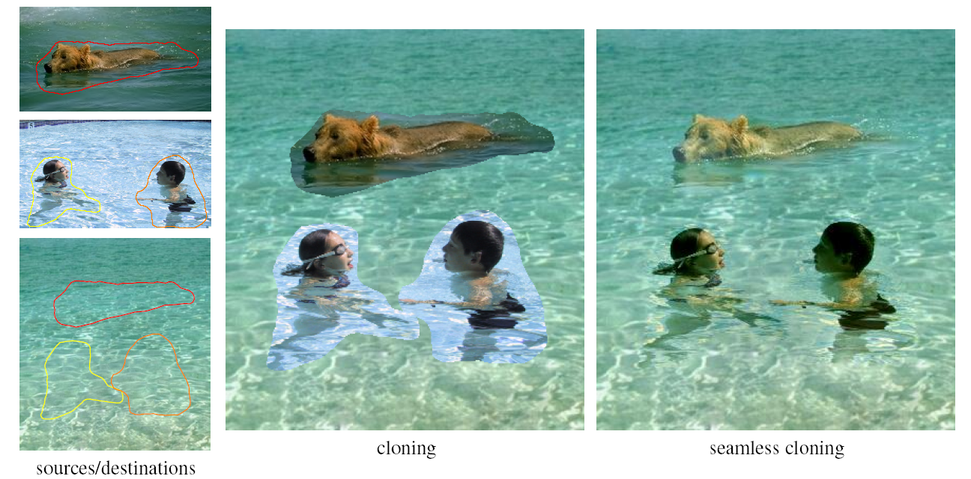
Other results
Perez et al. 2003

Slide 42
What do we lose?
Foreground color changes
Background pixels in target region are replaced
Perez et al. 2003
Notes:
Background pixels completely replaced, color of foreground changed

Slide 43
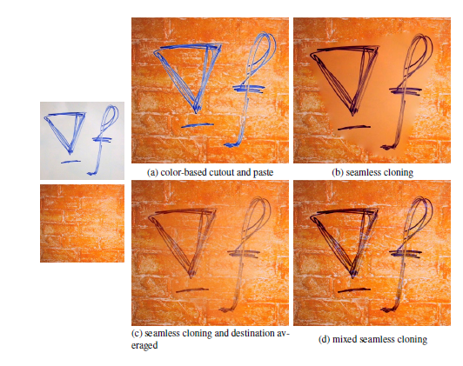
Blending with Mixed Gradients
Use foreground or background gradient with larger magnitude as the guiding gradient
Perez et al. 2003

Slide 44
Project 3: Gradient Domain Editing
General concept: Solve for pixels of new image that satisfy constraints on the gradient and the intensity
Constraints can be from one image (for filtering) or more (for blending)

Slide 45
Project 3: Reconstruction from Gradients
Preserve x-y gradients
Preserve intensity of one pixel
Source pixels: s
Variable pixels: v
minimize (v(x+1,y)-v(x,y) - (s(x+1,y)-s(x,y))^2
minimize (v(x,y+1)-v(x,y) - (s(x,y+1)-s(x,y))^2
minimize (v(1,1)-s(1,1))^2

Slide 46
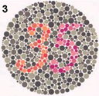
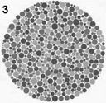
Project 3 (extra): Color2Gray
rgb2gray
Gradient-domain editing
?

Slide 47
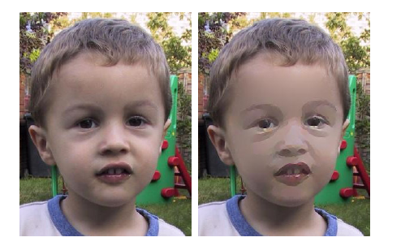
Project 3 (extra): NPR
Preserve gradients on edges
e.g., get canny edges with edge(im, ‘canny’)
Reduce gradients not on edges
Preserve original intensity
Perez et al. 2003

Slide 48
Things to remember
Three ways to blend/composite
Alpha compositing
Need nice cut (intelligent scissors)
Should feather
Laplacian pyramid blending
Smooth blending at low frequencies, sharp at high frequencies
Usually used for stitching
Gradient domain editing
Also called Poisson Editing
Explicit control over what to preserve
Changes foreground color (for better or worse)
Applicable for many things besides blending

Slide 49
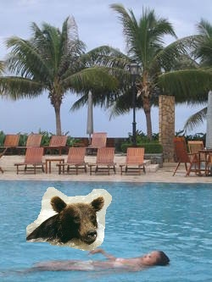
Take-home questions
9/21/2011
1) I am trying to blend this bear into this pool. What problems will I have if I use:
Alpha compositing with feathering
Laplacian pyramid blending
Poisson editing?

Slide 50
Take-home questions
9/21/2011
2) How would you make a sharpening filter using gradient domain processing? What are the constraints on the gradients and the intensities?

Slide 51
Next class
Image warping: affine, projective, rotation, etc.

