Slide 1
Texture Synthesis and Hole-Filling
09/20/11
Computational Photography
Derek Hoiem, University of Illinois

Slide 2
Project 1
Class favorite projects
Hanna Tarsunova
Jihua Huang

Slide 3
Project 1
Class favorite results
“Hybrid Image with 3 Sources” by Greg Meyer

Slide 4
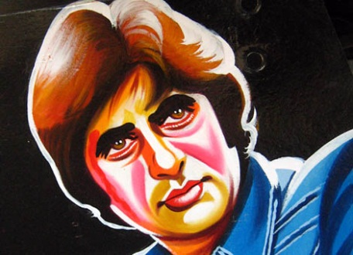
Project 1
Class favorite results
“Amitabh Bachman / Caricature” by Sahil Handa

Slide 5
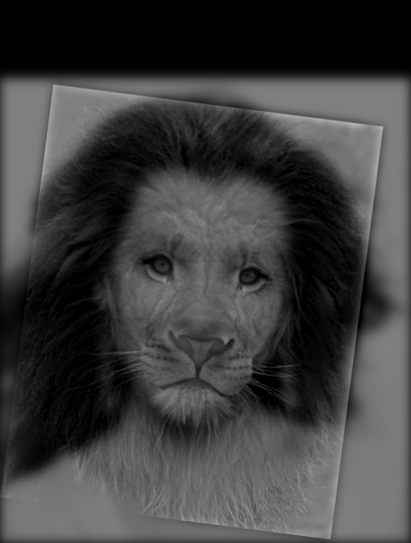
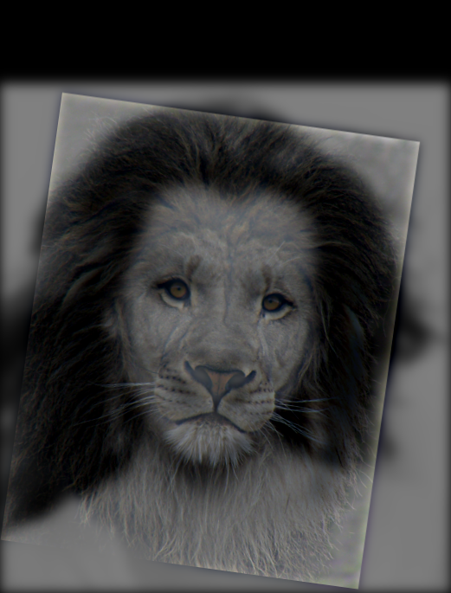
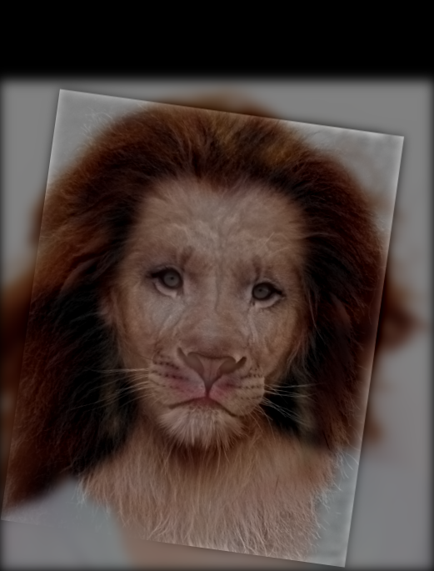
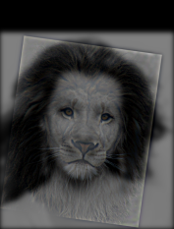
Project 1 issues
Result from Sukolsak Shakshuwong
Effect of color
None
HF Color
LF Color

Slide 6
Project 1 issues
Filter size
Should be big enough not to cut off values
Displaying imagery with arbitrary ranges
imagesc or mat2gray

Slide 7
Project 2
Single-scale alignment
Multi-scale coarse-to-fine alignment
Contrast enhancement
Color enhancement
Make sure you’re signed up for bulletin board
See “final advice”

Slide 8
Last class: finding boundaries
Intelligent scissors
Good boundary has a low-cost path from seed to cursor
Low cost = edge, high gradient, right orientation
GrabCut
Good region is similar to foreground color model and dissimilar from background color
Good boundaries have a high gradient
Optimize over both

Slide 9
Take-home questions
1. What would be the result in “Intelligent Scissors” if all of the edge costs were set to 1?
2. Typically, “GrabCut” will not work well on objects with thin structures. How could you change the boundary costs to better segment such objects?

Slide 10
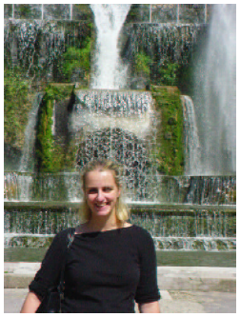
Last class: Cut someone out to make more of them

Slide 11
But what if we want less of somebody?

Slide 12
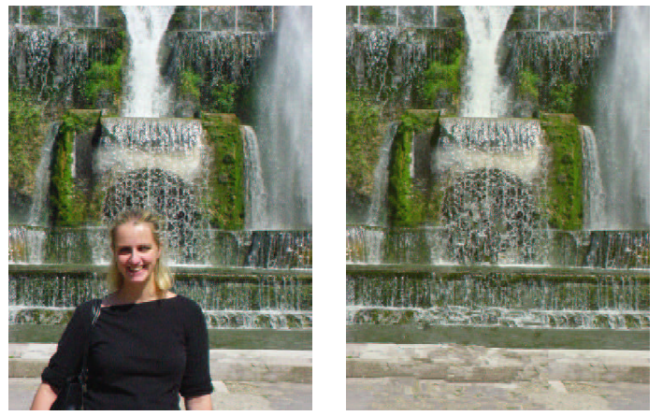
Today’s Class
Texture synthesis and hole-filling

Slide 13
Texture
Texture depicts spatially repeating patterns
Textures appear naturally and frequently
radishes
rocks
yogurt
Many slides from James Hays

Slide 14
Texture Synthesis
Goal of Texture Synthesis: create new samples of a given texture
Many applications: virtual environments, hole-filling, texturing surfaces

Slide 15
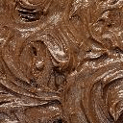
Trivial solutions
Input
1. Tiling
2. Mirrored Tiling
3. Randomly Generate Pixels of Same Color

Slide 16
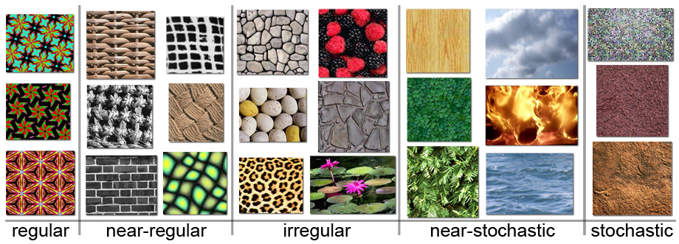
The Challenge
Need to model the whole spectrum: from repeated to stochastic texture

Slide 17
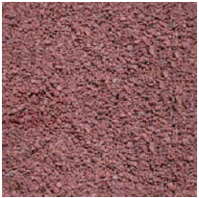
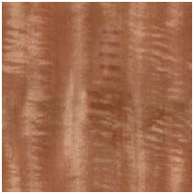
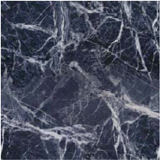
One idea: Build Probability Distributions
Basic idea
Compute statistics of input texture (e.g., histogram of edge filter responses)
Generate a new texture that keeps those same statistics
D. J. Heeger and J. R. Bergen. Pyramid-based texture analysis/synthesis. In SIGGRAPH ’95.
E. P. Simoncelli and J. Portilla. Texture characterization via joint statistics of wavelet coefficient magnitudes. In ICIP 1998.

Slide 18
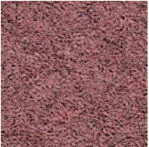
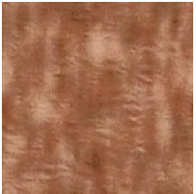
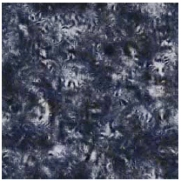
One idea: Build Probability Distributions
But it (usually) doesn’t work
Probability distributions are hard to model well
Input
Synthesized

Slide 19
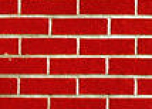
Another idea: Sample from the image
non-parametric
sampling
p
Input image
Synthesizing a pixel
Assuming Markov property, compute P(p|N(p))
Building explicit probability tables infeasible
Instead, we search the input image for all similar neighborhoods — that’s our pdf for p
To sample from this pdf, just pick one match at random
Efros and Leung 1999 SIGGRAPH

Slide 20
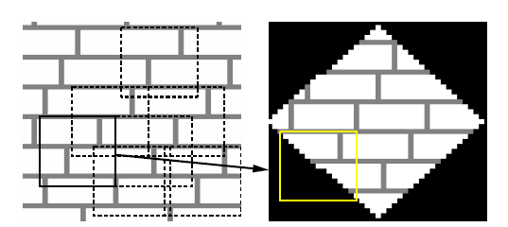
Another idea: Sample from the image
The input image itself provides its truest probability distribution
For each pixel to be synthesized, find matching regions in source image
Fill pixel with center pixel of randomly selected matching region
Efros and Leung 1999 SIGGRAPH

Slide 21
Details
How to match patches?
Gaussian-weighted SSD (more emphasis on nearby pixels)
What order to fill in new pixels?
“Onion skin” order: pixels with most neighbors are synthesized first
To synthesize from scratch, start with a randomly selected small patch from the source texture
How big should the patches be?

Slide 22
Idea from Shannon (Information Theory)
Generate English-sounding sentences by modeling the probability of each word given the previous words (n-grams)
Large “n” will give more structured sentences
“I spent an interesting evening recently with a grain of salt.”

Slide 23
Size of Neighborhood Window
input

Slide 24
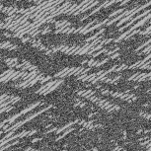
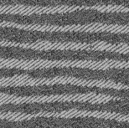
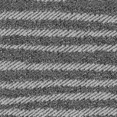
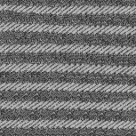
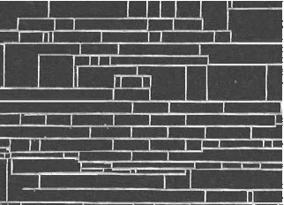
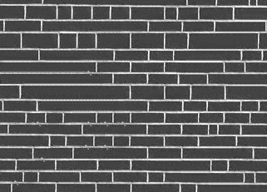
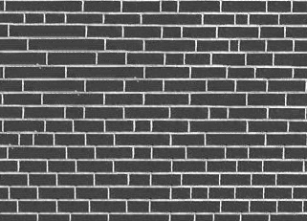
Varying Window Size
Increasing window size

Slide 25
Texture synthesis algorithm
While image not filled
Get unfilled pixels with filled neighbors, sorted by number of filled neighbors
For each pixel, get top N matches based on visible neighbors
- Patch Distance: Gaussian-weighted SSD
Randomly select one of the matches and copy pixel from it

Slide 26
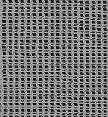
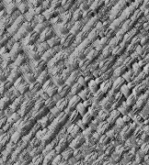
Synthesis Results
french canvas
rafia weave

Slide 27
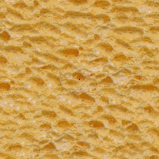
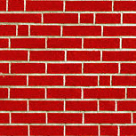
More Results
white bread
brick wall

Slide 28
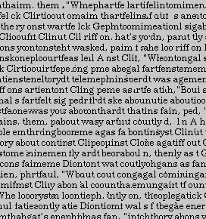
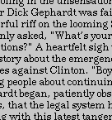
Homage to Shannon

Slide 29
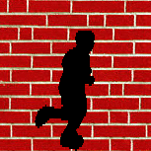
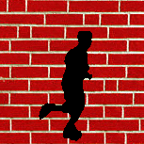
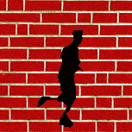
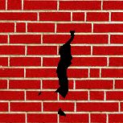
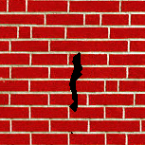
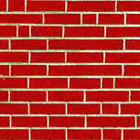
Hole Filling

Slide 30
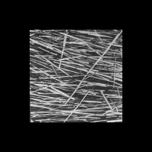
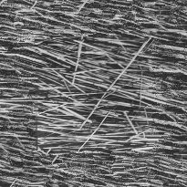
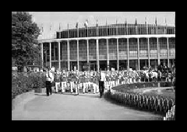
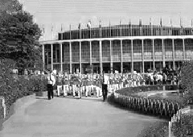
Extrapolation

Slide 31
Summary
The Efros & Leung texture synthesis algorithm
Very simple
Surprisingly good results
Synthesis is easier than analysis!
…but very slow

Slide 32
Image Quilting [Efros & Freeman 2001]
non-parametric
sampling
p
B
Input image
Synthesizing a block
Observation: neighbor pixels are highly correlated
Idea: unit of synthesis = block
Exactly the same but now we want P(B|N(B))
Much faster: synthesize all pixels in a block at once

Slide 33
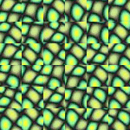
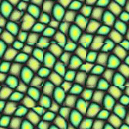
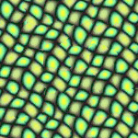
block
Input texture
B1
B2
B1
B2
B1
B2
Random placement
of blocks
Neighboring blocks
constrained by overlap
Minimal error
boundary cut

Slide 34
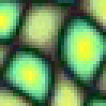
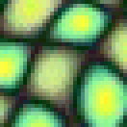
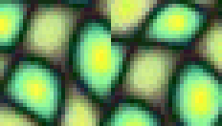
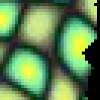
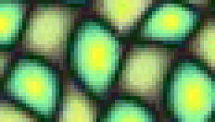
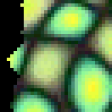
Minimal error boundary
overlapping blocks
vertical boundary
2
_
=
overlap error
min. error boundary

Slide 35
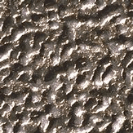

Slide 41
Failures

Slide 42
Portilla & Simoncelli
Xu, Guo & Shum
input image
Wei & Levoy
Quilting

Slide 43
Portilla & Simoncelli
Xu, Guo & Shum
input image
Wei & Levoy
Quilting

Slide 44
Political Texture Synthesis!

Slide 45
In-painting natural scenes
Criminisi, Perez, and Toyama. “Object Removal by Exemplar-based Inpainting,” Proc. CVPR, 2003.

Slide 46
Key idea: Filling order matters
In-painting Result
Image with Hole
Raster-Scan Order
Onion-Peel (Concentric Layers)
Gradient-Sensitive Order
Criminisi, Perez, and Toyama. “Object Removal by Exemplar-based Inpainting,” Proc. CVPR, 2003.

Slide 47
Filling order
Fill a pixel that:
Is surrounded by other known pixels
Is a continuation of a strong gradient or edge
Criminisi, Perez, and Toyama. “Object Removal by Exemplar-based Inpainting,” Proc. CVPR, 2003.

Slide 48
Comparison
Original With Hole Onion-Ring Fill Criminisi
Criminisi, Perez, and Toyama. “Object Removal by Exemplar-based Inpainting,” Proc. CVPR, 2003.

Slide 49
Comparison
Concentric Layers
Gradient Sensitive

Slide 50
Texture Transfer
Try to explain one object with bits and pieces of another object:
+
=

Slide 51
Texture Transfer
Constraint
Texture sample

Slide 52
Texture Transfer
Take the texture from one image and “paint” it onto another object
Same as texture synthesis, except an additional constraint:
Consistency of texture
Patches from texture should correspond to patches from constraint in some way

Slide 54
+
=

Slide 56
Make your own sacred toast
+
?

Slide 57
Related idea: Image Analogies
: :
A
A’
: :
B
B’
Image Analogies, Hertzmann et al. SG 2001

Slide 59
Image analogies
: :
Define a similarity between A and B
For each patch in B:
Find a matching patch in A, whose corresponding A’ also fits in well with existing patches in B’
Copy the patch in A’ to B’
Algorithm is done iteratively, coarse-to-fine
A
A’
: :
B
B’

Slide 60
Blur Filter

Slide 61
Edge Filter

Slide 62
Artistic Filters
A
A’
B
B’

Slide 63
Colorization

Slide 64
Texture-by-numbers
A
A’
B
B’

Slide 65
Super-resolution
A
A’

Slide 66
Super-resolution (result!)
B
B’

Slide 67
Things to remember
Texture synthesis and hole-filling can be thought of as a form of probabilistic hallucination
Simple, similarity-based matching is a powerful tool
Synthesis
Hole-filling
Transfer
Artistic filtering
Super-resolution
Recognition, etc.
Key is usually how to define similarity

Slide 68
Next class
Blending and gradient-domain methods

