Slide 1
Enterprise Risk Management & IT Compliance March 30, 2010 Presented by: Ken Rowe, Director Enterprise Systems Assurance & Chief Security Officer University Office of Administrative Information Technology Services

Slide 2
Why Traditional Practices Fail
Traditional Security Perspective
Enclave-based
Technology-focus
Enterprise Risk Management (ERM)
Security as an IT Enabler
Compliance Requirements
Risk Assessment
Data-Centric Security
Limitation of Enclaves
Insufficiency of Malware Protection
Data approach

Slide 3
Beyond Enclaves
Necessity of the Enclave
Strong Security Architecture of the Data Center
Multiple Levels / Control Points
Changing Landscape
Internet-facing Services
Clouds
PDAs
Data Migration
Notes:
http://www.informationweek.com/news/security/management/showArticle.jhtml?articleID=223000100&queryText=michael%20davis

Slide 4
Does Security Benefit the Business
Do you understand the Business Strategic Plan?
Enterprise Risk Management (ERM)
Functional Business Risk
Compliance Risk
PCI DSS, HIPAA, SOX, GLBA, FFIEC, FTC Red Flag, FCRA, FOIA
Include Lost Opportunity Cost
Assessing Risk
Vulnerability Scanning Leads to Technical Risk Statements
Always evaluate risk in terms of the Business
Threat / Vulnerability / Impact => Risk
Notes:
From http://www.coso.org/documents/COSO_ERM_ExecutiveSummary.pdf

Slide 5
Enterprise Risk Management
COSO Definition
Enterprise risk management is a process, effected by an entity’s board of directors, management and other personnel, applied in strategy setting and across the enterprise, designed to identify potential events that may affect the entity, and manage risk to be within its risk appetite, to provide reasonable assurance regarding the achievement of entity objectives.
Enterprise Risk Management (ERM)
Aligning Risk Appetite and Strategy
Enhancing Risk Response Decisions
Reducing Operational Surprises and Losses
Identifying and Managing Multiple and Cross-Enterprise Risks
Seizing Opportunities
Improving Deployment of Capital
Notes:
From http://www.coso.org/documents/COSO_ERM_ExecutiveSummary.pdf
Value is maximized when management sets strategy and objectives to strike an optimal balance between growth and return goals and related risks, and efficiently and effectively deploys resources in pursuit of the entity’s objectives. Enterprise risk management encompasses:
•Aligning risk appetite and strategy – Management considers the entity’s risk appetite in evaluating strategic alternatives, setting related objectives, and developing mechanisms to manage related risks.
•Enhancing risk response decisions – Enterprise risk management provides the rigor to identify and select among alternative risk responses – risk avoidance, reduction, sharing, and acceptance.
•Reducing operational surprises and losses – Entities gain enhanced capability to identify potential events and establish responses, reducing surprises and associated costs or losses.
•Identifying and managing multiple and cross-enterprise risks – Every enterprise faces a myriad of risks affecting different parts of the organization, and enterprise risk management facilitates effective response to the interrelated impacts, and integrated responses to multiple risks.
•Seizing opportunities – By considering a full range of potential events, management is positioned to identify and proactively realize opportunities.
•Improving deployment of capital – Obtaining robust risk information allows management to effectively assess overall capital needs and enhance capital allocation.

Slide 6
Compliance Example - GLBA
Designate one or more employees to coordinate its information security program
Identify and assess the risks to customer information in each relevant area of the company’s operation, and evaluate the effectiveness of the current safeguards for controlling these risks
Design and implement a safeguards program, and regularly monitor and test it
Employee Management and Training.
Information Systems.
Detecting and Managing System Failures.
Select service providers that can maintain appropriate safeguards
Evaluate and adjust the program in light of relevant circumstances

Slide 7
Taking a Data-Centric Approach
Data at Rest / in Motion / in Use
Encompass full range of data
Address Compliance
Who / What / Where / Why
Least Privilege
Segregation of Duty
Responsive Controls
Data Classification
Establishing Business Owners / Delegation
Acceptable Risk Levels
Enforcement

Slide 8
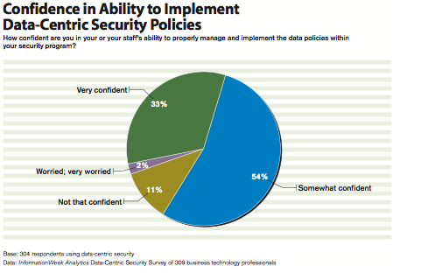
Notes:
http://analytics.informationweek.com/abstract/21/2154/Security/research-data-centric-security.html

Slide 9
Summary
Business Oriented
ERM Perspective
Address Compliance
Vision for Data-centric
Prioritize Technologies

Slide 10
Summary
Business-Oriented
ERM Perspective
Address Compliance Needs
Vision for Data-centric
Prioritize Technologies

Slide 11
Questions?
Email kenrowe@uillinois.edu

