Slide 1
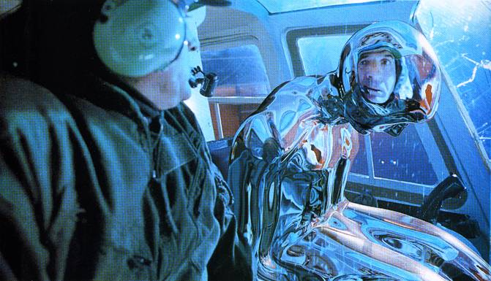
Image-based Lighting
T2
Computational Photography
Derek Hoiem, University of Illinois
Many slides from Debevec, some from Efros

Slide 2
Next two classes
Today
Start on ray tracing, environment maps, and relighting 3D objects (project 4 topics)
Next class
More HDR, light probes, etc.

Slide 3
Image-based Lighting Project

Slide 4
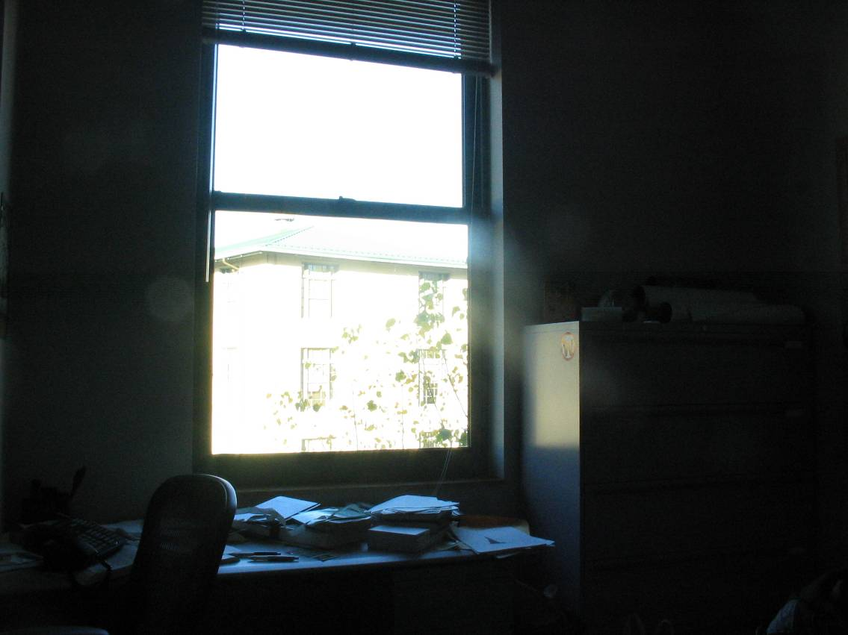
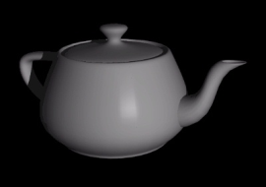
How to render an object inserted into an image?
What’s wrong with the teapot?
Notes:
Lighting, no shadows, blending, etc.

Slide 5
Relighting is important!
http://smashinghub.com/8-of-the-most-epic-government-photoshop-fails-ever.htm
http://petapixel.com/2013/10/13/another-north-korean-photoshop-fail/

Slide 6
How to render an object inserted into an image?
Traditional graphics way
Manually model BRDFs of all room surfaces
Manually model radiance of lights
Do ray tracing to relight object, shadows, etc.
Notes:
Lighting, no shadows, blending, etc.

Slide 7
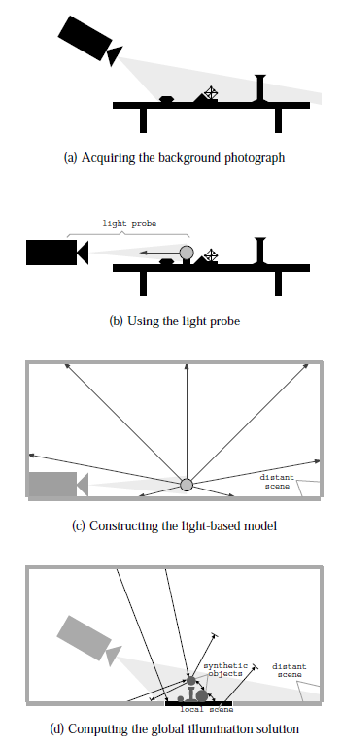
How to render an object inserted into an image?
Image-based lighting
Capture incoming light with a “light probe”
Model local scene
Ray trace, but replace distant scene with info from light probe
Debevec SIGGRAPH 1998

Slide 8
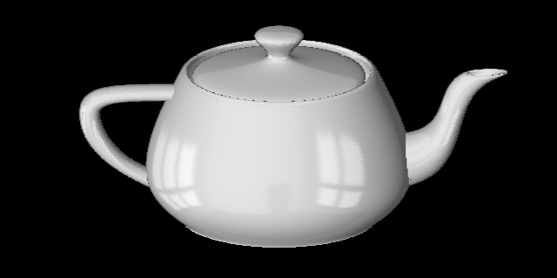
Key ideas for Image-based Lighting
Environment maps: tell what light is entering at each angle within some shell
+

Slide 9
Key ideas for Image-based Lighting
Light probes: a way of capturing environment maps in real scenes

Slide 10
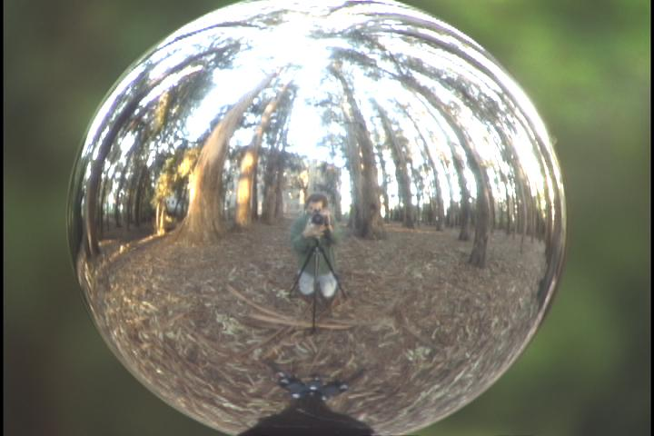
Key ideas for Image-based Lighting
Capturing HDR images: needed so that light probes capture full range of radiance

Slide 11
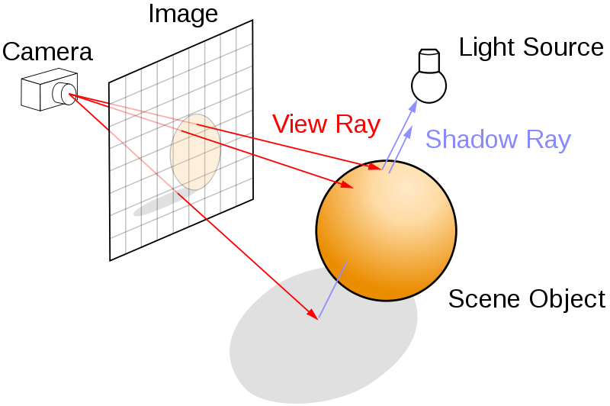
Key ideas for Image-based Lighting
Ray tracing: synthesize light paths between camera and light sources

Slide 12
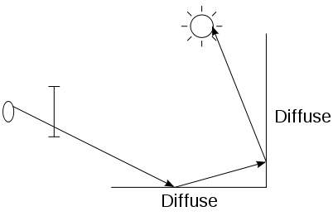
Key ideas for Image-based Lighting
Ray tracing: determining pixel intensity by shooting out rays from the camera

Slide 13
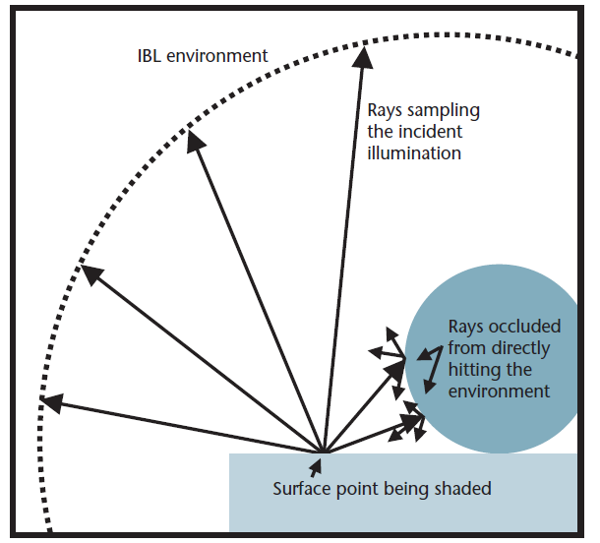
Key ideas for Image-based Lighting
Relighting: environment map acts as light source, substituting for distant scene

Slide 14
Today
Ray tracing
Capturing environment maps

Slide 15
A photon’s life choices
Absorption
Diffusion
Reflection
Transparency
Refraction
Fluorescence
Subsurface scattering
Phosphorescence
Interreflection
light source
λ
?

Slide 16
A photon’s life choices
Absorption
Diffusion
Reflection
Transparency
Refraction
Fluorescence
Subsurface scattering
Phosphorescence
Interreflection
light source
λ

Slide 17
A photon’s life choices
Absorption
Diffuse Reflection
Reflection
Transparency
Refraction
Fluorescence
Subsurface scattering
Phosphorescence
Interreflection
light source
λ

Slide 18
A photon’s life choices
Absorption
Diffusion
Specular Reflection
Transparency
Refraction
Fluorescence
Subsurface scattering
Phosphorescence
Interreflection
light source
λ

Slide 19
A photon’s life choices
Absorption
Diffusion
Reflection
Transparency
Refraction
Fluorescence
Subsurface scattering
Phosphorescence
Interreflection
light source
λ

Slide 20
A photon’s life choices
Absorption
Diffusion
Reflection
Transparency
Refraction
Fluorescence
Subsurface scattering
Phosphorescence
Interreflection
light source
λ

Slide 21
A photon’s life choices
Absorption
Diffusion
Reflection
Transparency
Refraction
Fluorescence
Subsurface scattering
Phosphorescence
Interreflection
light source
λ₁
λ₂

Slide 22
A photon’s life choices
Absorption
Diffusion
Reflection
Transparency
Refraction
Fluorescence
Subsurface scattering
Phosphorescence
Interreflection
light source
λ

Slide 23
A photon’s life choices
Absorption
Diffusion
Reflection
Transparency
Refraction
Fluorescence
Subsurface scattering
Phosphorescence
Interreflection
light source
t=1
t=n

Slide 24
A photon’s life choices
Absorption
Diffusion
Reflection
Transparency
Refraction
Fluorescence
Subsurface scattering
Phosphorescence
Interreflection
light source
λ
(Specular Interreflection)

Slide 25
A photon’s life choices
Absorption
Diffusion
Reflection
Transparency
Fluorescence
Interreflection
Subsurface scattering
Phosphoresence
image plane
light source
camera center
λ
?

Slide 26
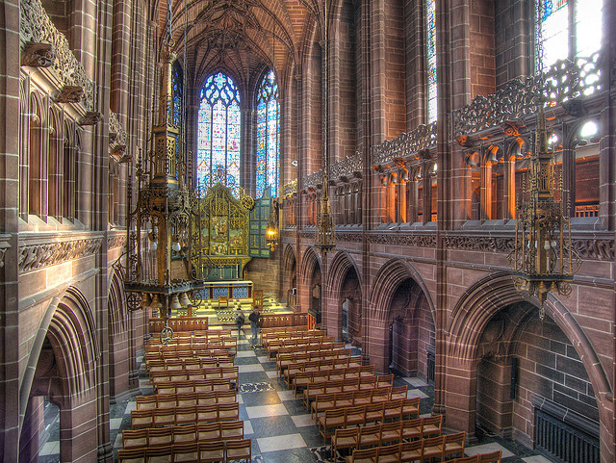
Where are the light sources are in this room?
http://www.flickr.com/photos/chrisdonbavand/493707413/sizes/z/in/photostream/

Slide 27
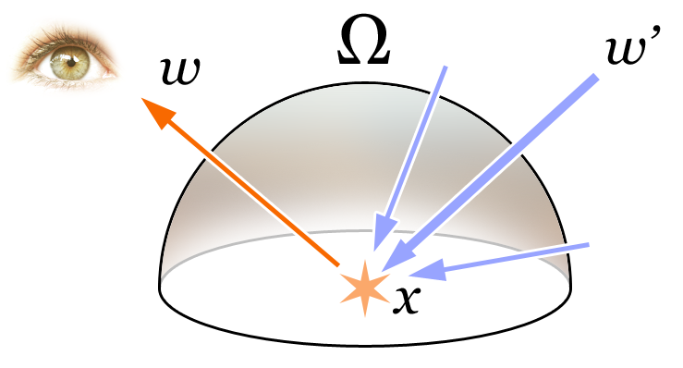
Rendering Equation
Total reflected light
Outgoing light
Generated light
BRDF
Incoming Light
Incident angle

Slide 28
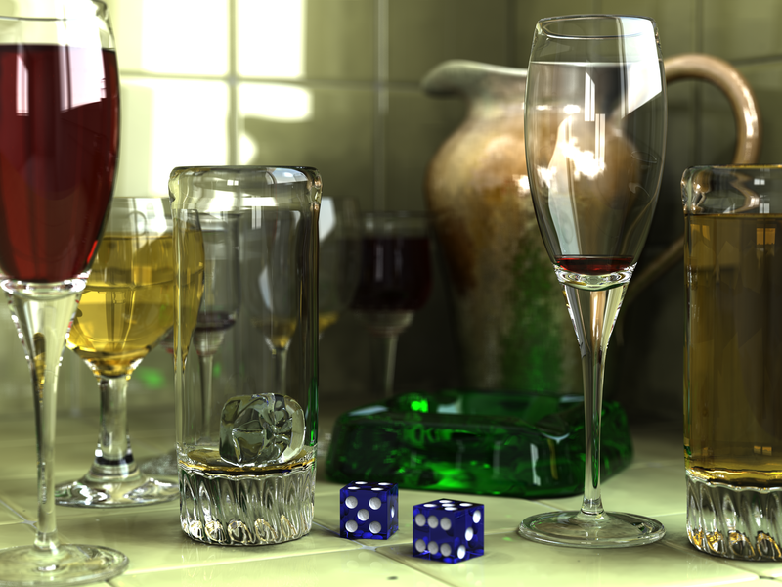
Rendering a scene with ray tracing
http://en.wikipedia.org/wiki/File:Glasses_800_edit.png

Slide 29
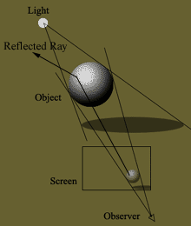
Ray tracing: basics
image plane
light source
camera center
λ

Slide 30
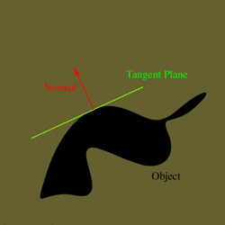
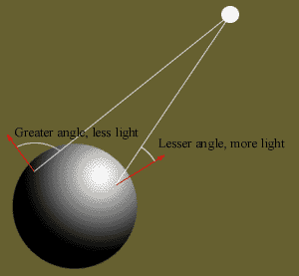
Diffuse shading
http://www.groovyvis.com/other/raytracing/basic.html

Slide 31
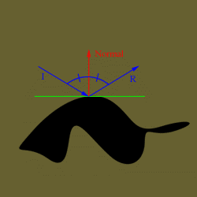
Reflections

Slide 32
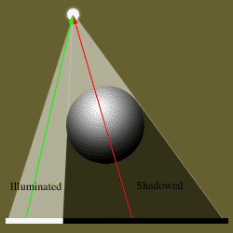
Shadows

Slide 33
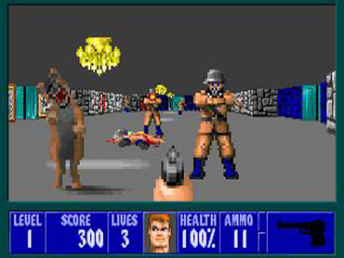
Ray casting
Store colors of surfaces, cast out rays, see what colors each ray hits
Wolfenstein 3D (1992)

Slide 34
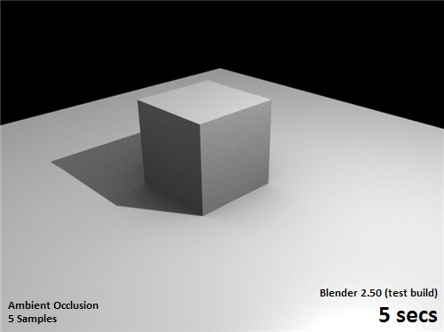
Ray tracing: fast approximation
Upon hitting a surface
Cast reflection/refraction ray to determine reflected or refracted surface
Cast shadow ray: go towards light and see if an object is in the way
http://en.wikipedia.org/wiki/File:Ray_trace_diagram.svg

Slide 35
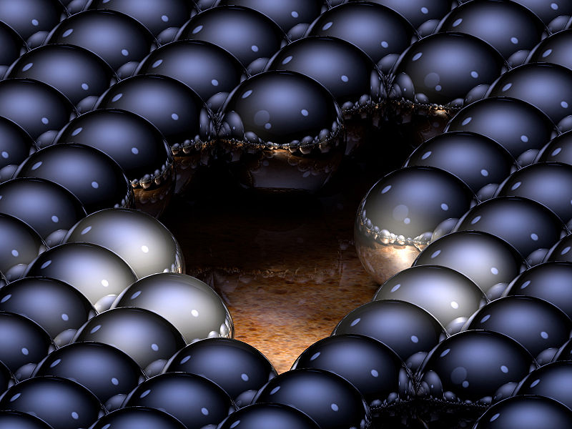
Ray tracing: interreflections
Reflect light N times before heading to light source
N=2
N=16
http://en.wikipedia.org/wiki/Ray_tracing_(graphics)#mediaviewer/File:Ray-traced_steel_balls.jpg

Slide 36
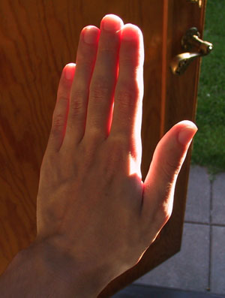
Ray tracing
Conceptually simple but hard to do fast
Full solution requires tracing millions of rays for many inter-reflections
Design choices
Ray paths: Light to camera vs. camera to light?
How many samples per pixel (avoid aliasing)?
How to sample diffuse reflections?
How many inter-reflections to allow?
Deal with subsurface scattering, etc?

Slide 37
Environment Maps
The environment map may take various forms:
Cubic mapping
Spherical mapping
other
Describes the shape of the surface on which the map “resides”
Determines how the map is generated and how it is indexed

Slide 38
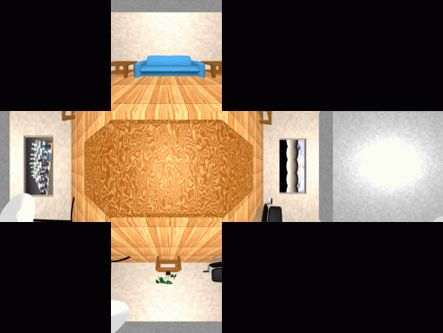
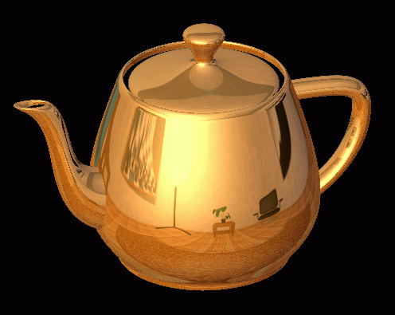
Cubic Map Example

Slide 39
Cubic Mapping
The map resides on the surfaces of a cube around the object
Typically, align the faces of the cube with the coordinate axes
To generate the map:
For each face of the cube, render the world from the center of the object with the cube face as the image plane
Rendering can be arbitrarily complex (it’s off-line)
To use the map:
Index the R ray into the correct cube face
Compute texture coordinates

Slide 40
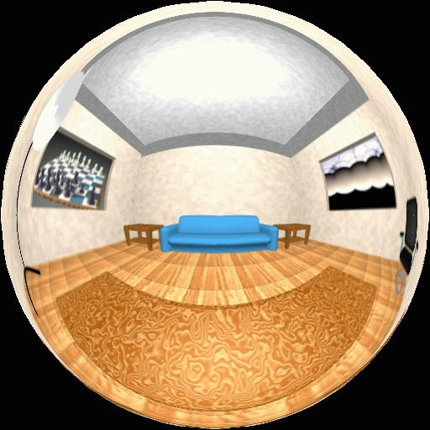
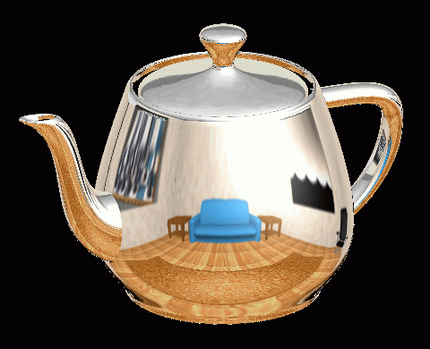
Spherical Map Example

Slide 41
Sphere mapping
Map lives on a sphere
To generate the map:
Render a spherical panorama from the designed center point
“Render” means obtain pixel intensities by casting rays from the camera center through the pixel positions
Rendering with environment map:
Use the orientation of the R ray to index directly into the sphere

Slide 42
What approximations are made?
The map should contain a view of the world with the point of interest on the object as the Center of Projection (CoP)
We can’t store a separate map for each point, so one map is used with the CoP at the center of the object
Introduces distortions in the reflection, but we usually don’t notice
Distortions are minimized for a small object in a large room
The object will not reflect itself (based on the environment map)

Slide 43
Rendering with environment maps and local models
image plane
camera center

Slide 44
Storing environment maps

Slide 45
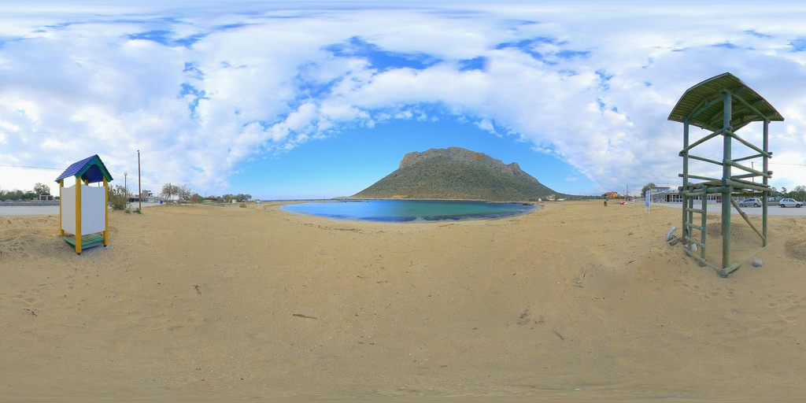
Equirectangular (latitude-longitude) projection

Slide 46
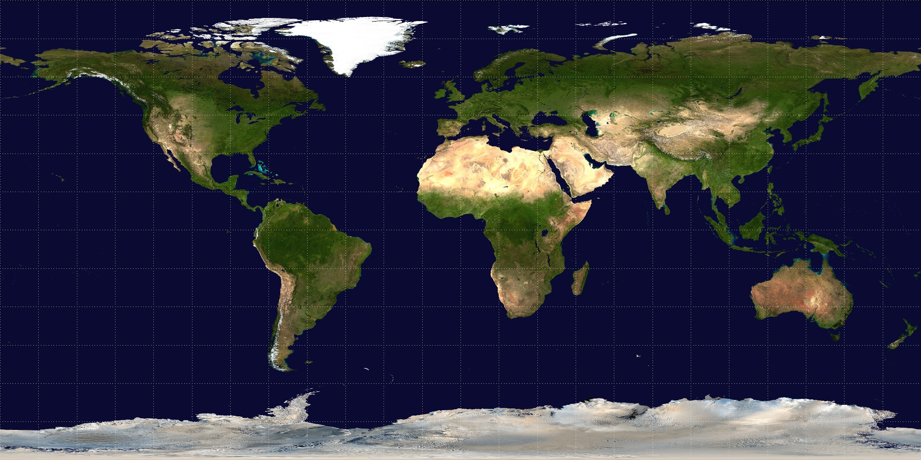
Equirectangular (latitude-longitude) projection

Slide 47
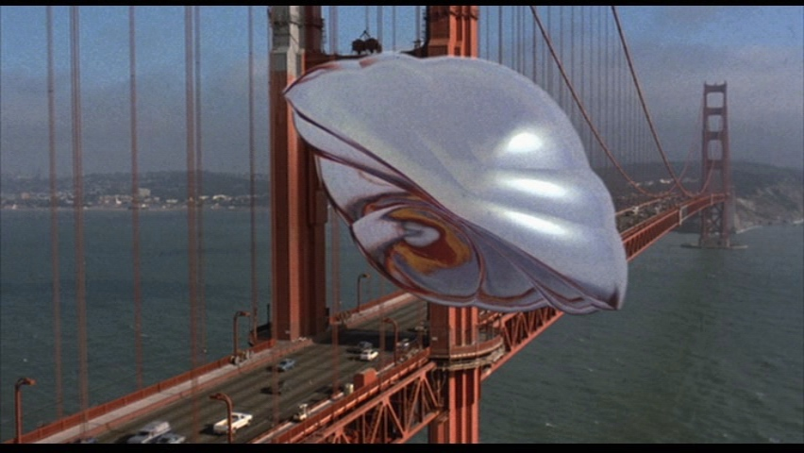
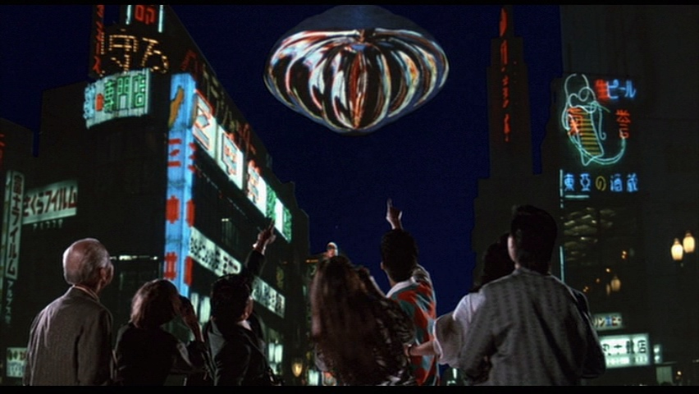
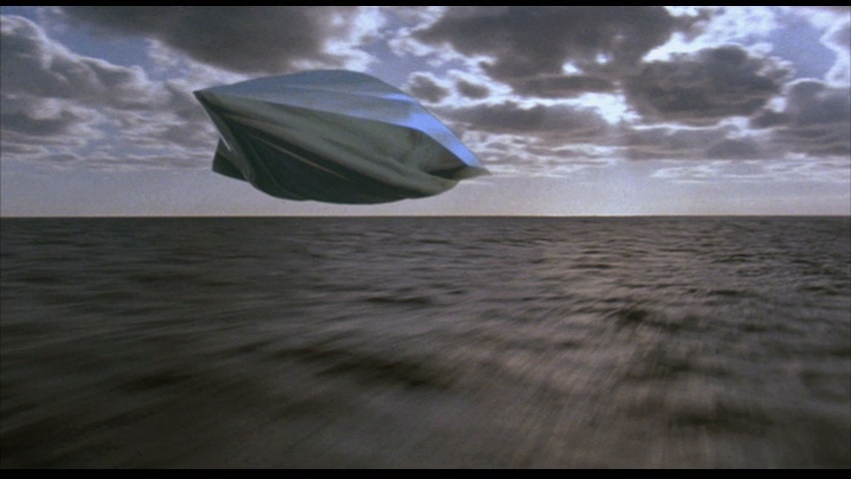
How to capture light in real scenes?
From Flight of the Navigator

Slide 48
How to capture light in real scenes?
from Terminator 2

Slide 49
Real environment maps
We can use photographs to capture environment maps
The first use of panoramic mosaics
Fisheye lens
360 camera
Mirrored balls (light probes)

Slide 50
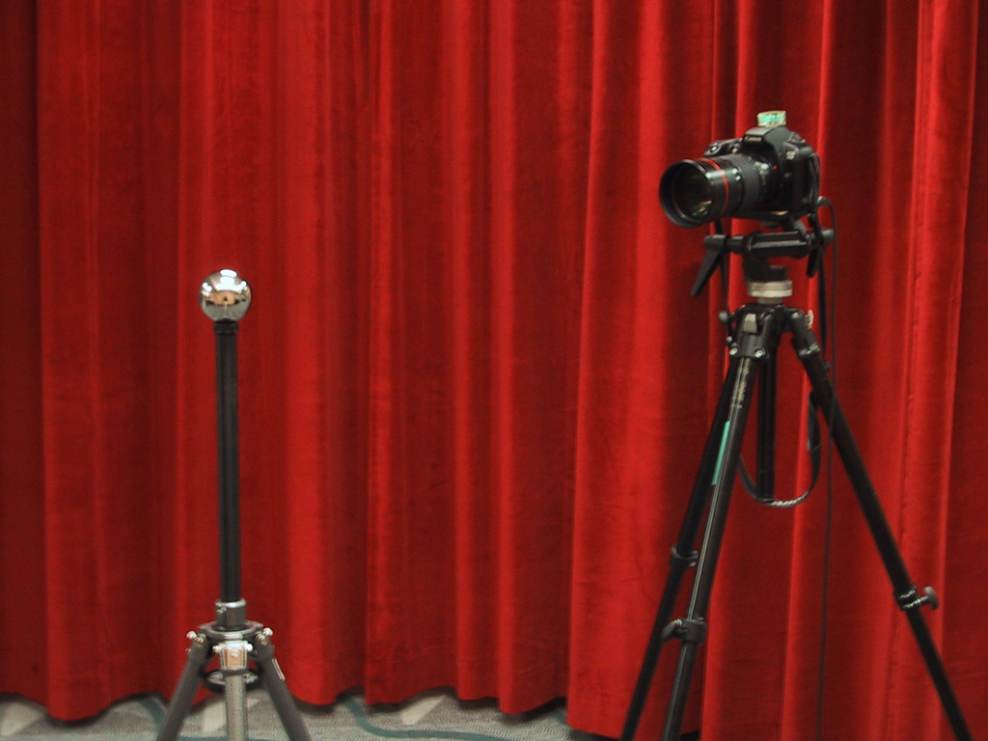
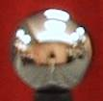
Mirrored Sphere

Slide 51
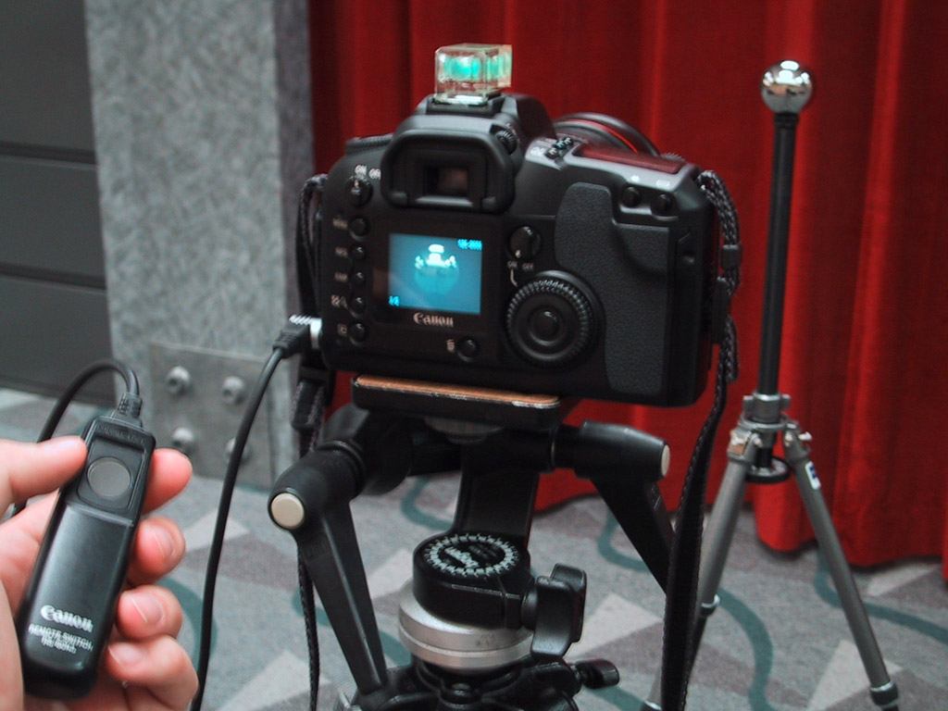

Slide 52
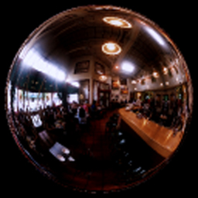
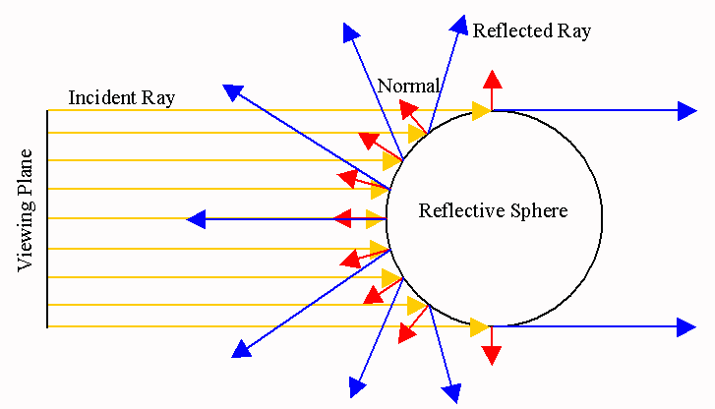
One picture of a mirrored ball received light coming into the ball from nearly all angles (including behind)

Slide 53
Mirror balls for image-based lighting

Slide 54
Mirror balls for image-based lighting

Slide 55
Mirror balls for image-based lighting

Slide 56
0.34
=> 59% Reflective
Calibrating Mirrored Sphere Reflectivity
0.58

Slide 57
Spherical map domain transformations
Many rendering programs only accept one format (mirror ball, equirectangular, cube map, etc)
E.g. Blender only accepts equirectangular maps
How to convert mirror ball to equirectangular?

Slide 58
Mirror ball -> equirectangular

Slide 59
Mirror ball -> equirectangular
Spherical coordinates
Convert the light directions incident to the ball into spherical coordinates (phi, theta)
Map from mirror ball phi, theta to equirectangular phi, theta

Slide 60
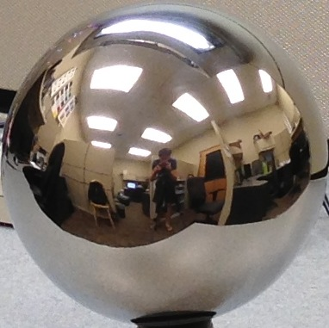
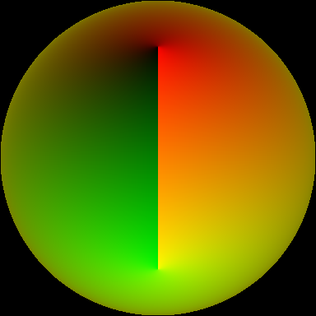
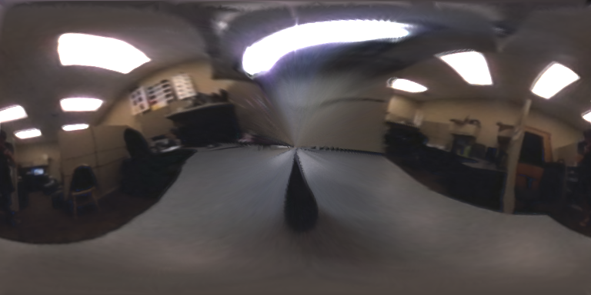
Mirror ball -> equirectangular
Mirror ball
Normals
Reflection
vectors
Phi/theta of reflection vecs
Equirectangular
Phi/theta equirectangular domain

Slide 61
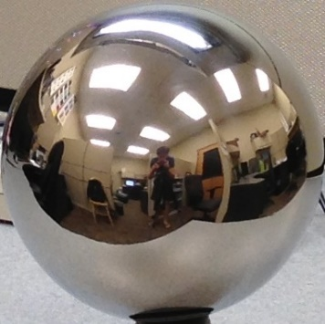
Mirror ball -> equirectangular
latlon(:, :, c) = griddata( (phi_ball, theta_ball),
mirrorball(:, :, c),
(phi_latlon, theta_latlon),
method=‘linear’,
fill_value=‘0’)

Slide 62
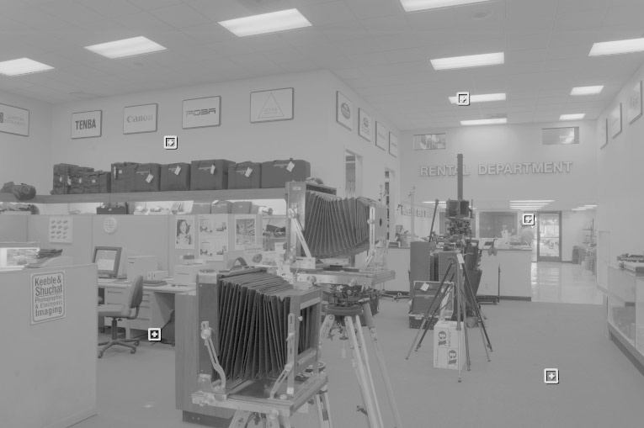
One small snag
How do we deal with light sources? Sun, lights, etc?
They are much, much brighter than the rest of the environment
1907
.
46
.
.
15116
1
.
.
18

Slide 63
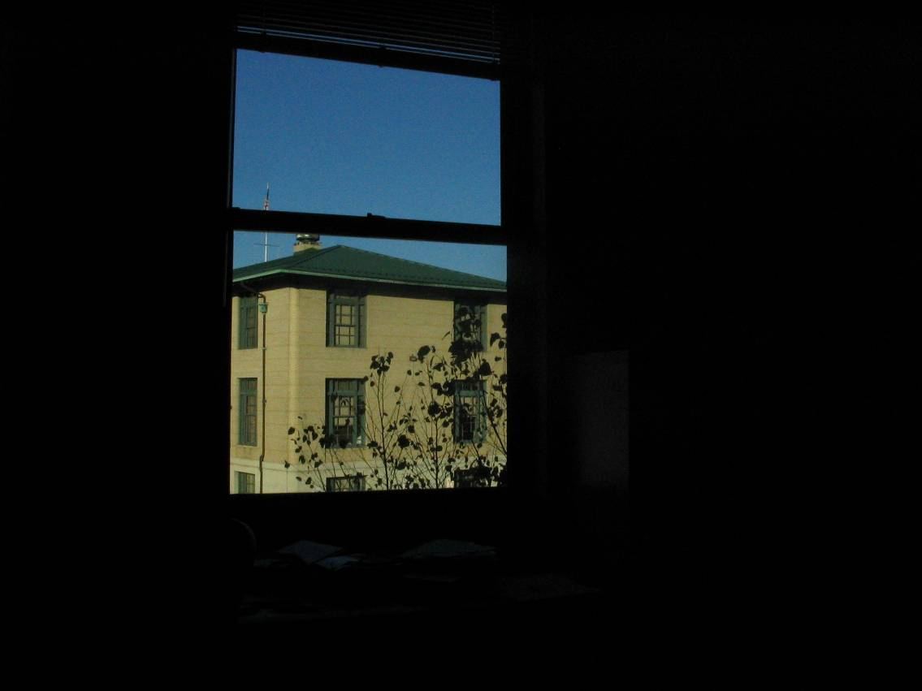
Problem: Dynamic Range

Slide 64
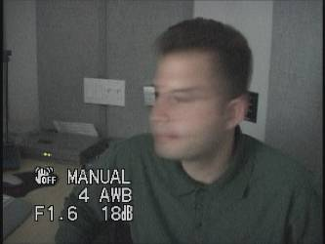
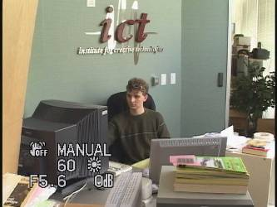
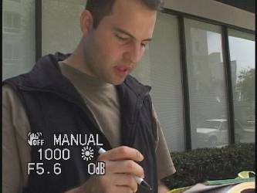
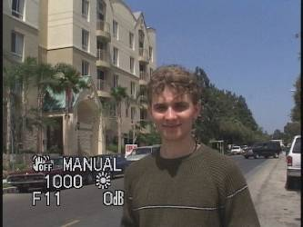
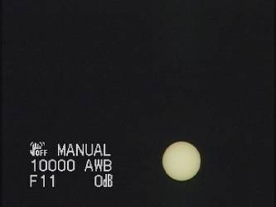
Problem: Dynamic Range
The real world is high dynamic range
1
1500
25,000
400,000
2,000,000,000

Slide 65
Long Exposure
10⁻⁶
High dynamic range
10⁶
Real world
10⁻⁶
10⁶
Picture
^{0 to 255}

Slide 66
Short Exposure
10⁻⁶
High dynamic range
10⁶
Real world
10⁻⁶
10⁶
Picture
^{0 to 255}

Slide 67
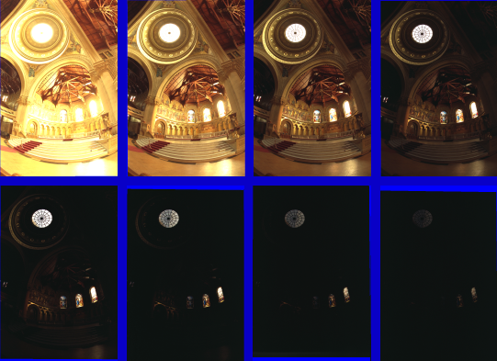
Varying Exposure

Slide 68
Camera is not a photometer
Dynamic range is limited
Can use multiple exposures to capture fuller range
Responds non-linearly to photon intensity
Solution: Recover response curve from multiple exposures and reconstruct the radiance map

Slide 69
Next class
How to capture HDR image using “bracketing”
How to relight an object from an environment map

