Slide 1
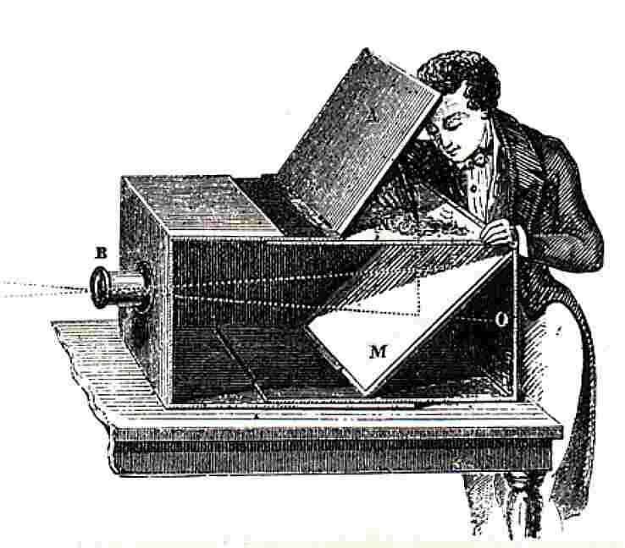
Pinhole Camera Model
Computational Photography
Derek Hoiem, University of Illinois

Slide 2
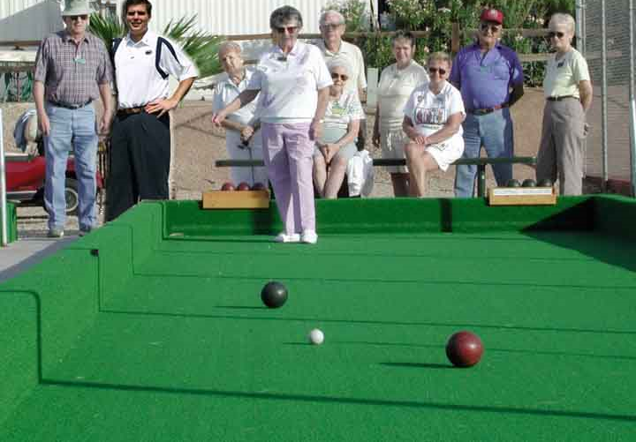
How tall is this woman?
How high is the camera?
What is the camera rotation?
What is the focal length of the camera?
Which ball is closer?

Slide 3
Today’s lecture
Mapping between image and world coordinates
  Pinhole camera model
  Projective geometry
    Vanishing points and lines
  Projection matrix

Slide 4
Image formation
Object
Film
Let’s design a camera
  Idea 1: put a piece of film in front of an object
  What will the image look like?

Slide 5
Pinhole camera
Object
Barrier
Film
Idea 2: add a barrier to block off most of the rays
  Few rays from a point reach the film (small blur)
  The opening is called the aperture

Slide 6

Pinhole camera
f
c
f = focal length
c = center of the camera
Figure from Forsyth

Slide 7
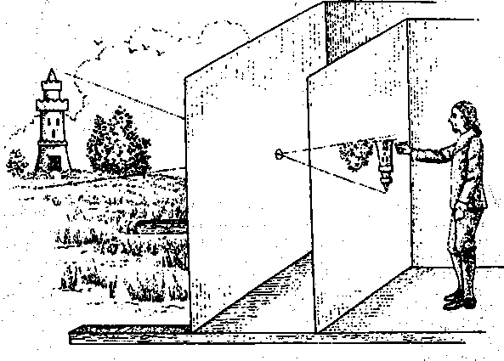
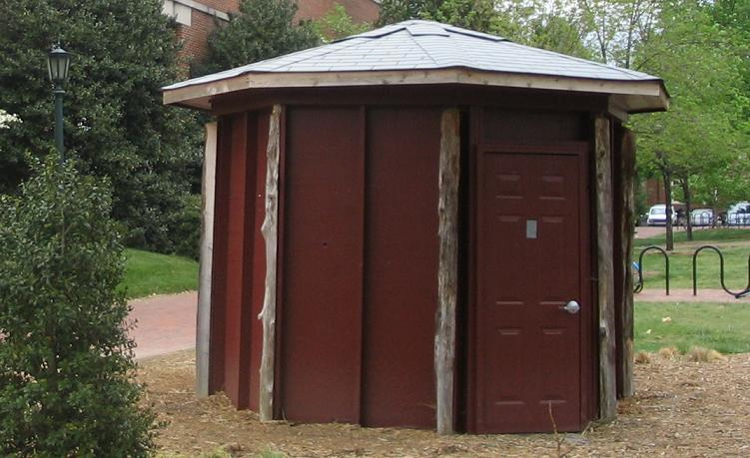
Camera obscura: the pre-camera
First idea: Mozi, China (470BC to 390BC)
First built: Alhacen, Iraq/Egypt (965 to 1039AD)
Illustration of Camera Obscura
Freestanding camera obscura at UNC Chapel Hill
Photo by Seth Ilys

Slide 8
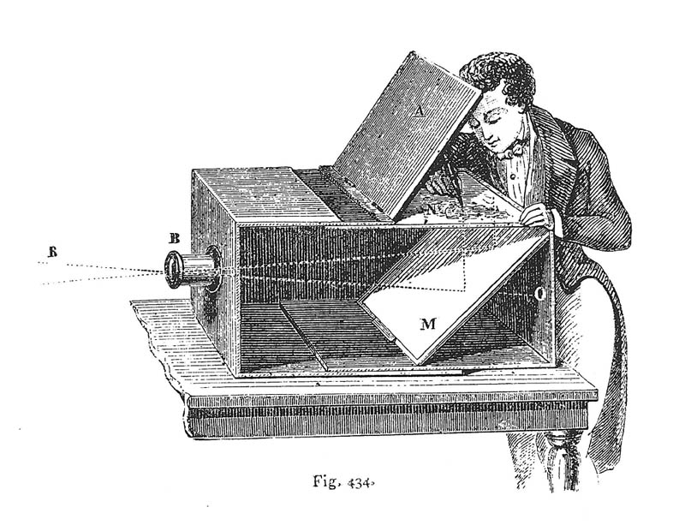
Camera Obscura used for Tracing
Lens Based Camera Obscura, 1568

Slide 9
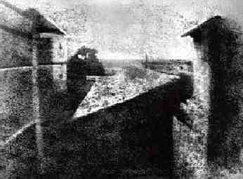
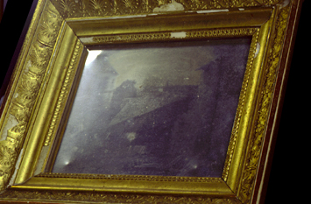
First Photograph
Oldest surviving photograph
  Took 8 hours on pewter plate
Photograph of the first photograph
Joseph Niepce, 1826
Stored at UT Austin
Niepce later teamed up with Daguerre, who eventually created Daguerrotypes

Slide 10
Pinhole camera
“circle of
confusion”
A lens focuses light onto the film
Slide source: Seitz

Slide 11
Dimensionality Reduction Machine (3D to 2D)
3D world
2D image
Figures © Stephen E. Palmer, 2002

Slide 12
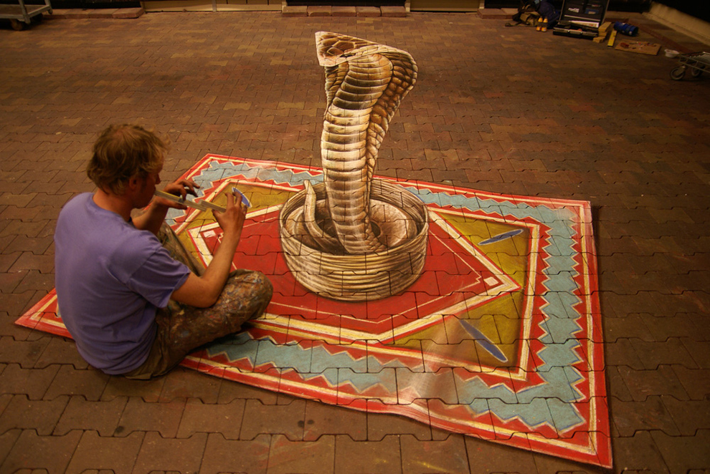
Projection can be tricky…
Leon Keer – streetpainting3d.com
Notes:
Shape is lost

Slide 13
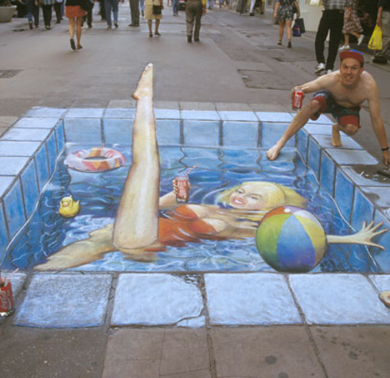
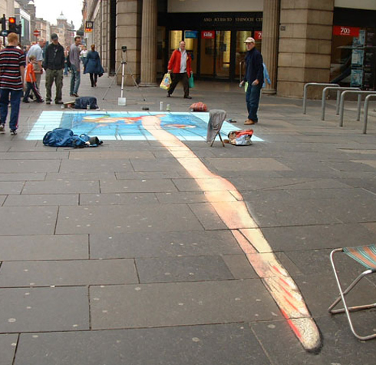
Julian Beever – julianbeever.net

Slide 14
Projective Geometry
What is lost?
Length
Who is taller?
Which is closer?

Slide 15
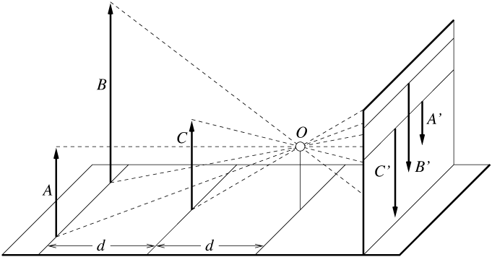
Length is not preserved
A’
C’
B’
Figure by David Forsyth

Slide 16
Projective Geometry
What is lost?
Length
Angles
Parallel?
Perpendicular?

Slide 17
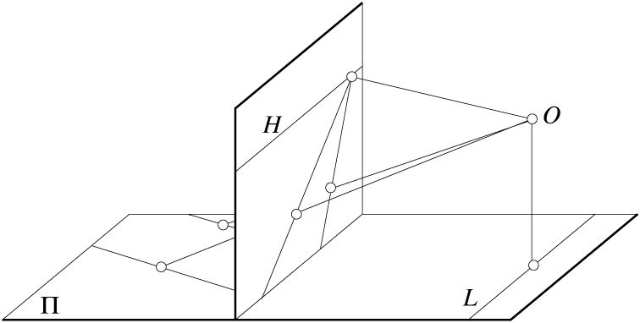
Parallel lines are not parallel in the image
Figure by David Forsyth

Slide 18
Projective Geometry
What is preserved?
Straight lines are still straight

Slide 19

Vanishing points and lines
Parallel lines in the world intersect in the image at a “vanishing point”
Notes:
Go to board, sketch out various properties of vanishing points/lines

Slide 20
Vanishing points and lines
Vanishing Point
Vanishing Point
o
o
Vanishing Line
The projections of parallel 3D lines intersect at a vanishing point
The projection of parallel 3D planes intersect at a vanishing line
If a set of parallel 3D lines are also parallel to a particular plane, their vanishing point will lie on the vanishing line of the plane
Not all lines that intersect are parallel
Vanishing point <-> 3D direction of a line
Vanishing line <-> 3D orientation of a surface
Notes:
Go to board, sketch out various properties of vanishing points/lines
Parallel lines intersect at a point
The intersection of red lines and blue lines form a parallelogram
Sets of parallel lines on the same plane form a vanishing line
Sets of parallel planes form a vanishing line
Not all lines that intersect are parallel

Slide 21

Vanishing points and lines
Vertical vanishing
point
(at infinity)
Vanishing
line
Vanishing
point
Vanishing
point
Credit: Criminisi

Slide 22

Vanishing points and lines
Photo from Garry Knight
Notes:
Where are the vanishing points? Do buildings on left and buildings on right have the same vanishing line? Which way is the camera tilted?

Slide 23

Vanishing objects
Notes:
This image doesn’t require attribution and has a license for reuse

Slide 24
Projection: world coordinates→image coordinates
.
Optical Center (u₀, v₀)
.
.
f
Z
Y
.
v
Camera Center
(X_{c}, Y_{c}, Z_{c})
u

Slide 25




Homogeneous coordinates
Conversion
Converting to homogeneous coordinates
homogeneous image
coordinates
homogeneous scene
coordinates
Converting from homogeneous coordinates
Notes:
Append coordinate with value 1; proportional coordinate system

Slide 26
Homogeneous coordinates
Invariant to scaling
Point in Cartesian is ray in Homogeneous
Homogeneous Coordinates
Cartesian Coordinates
Notes:
Q: Suppose we have a point in Cartesian coordinates. What is that in homogeneous coordinates? A: a ray

Slide 27
Basic geometry in homogeneous coordinates
Line equation: ax + by + c = 0
Append 1 to pixel coordinate to get homogeneous coordinate
Line given by cross product of two points
Intersection of two lines given by cross product of the lines

Slide 28
Another problem solved by homogeneous coordinates
Intersection of parallel lines
  Cartesian: (Inf, Inf)
  Homogeneous: (1, 1, 0)
  Cartesian: (Inf, Inf)
Homogeneous: (1, 2, 0)
Notes:
Parallel lines intersect at different infinities

Slide 29

Pinhole Camera Model
R
j_{w}
t
k_{w}
O_{w}
i_{w}
x: Image Coordinates: (u,v,1)
K: Intrinsic Matrix (3x3)
R: Rotation (3x3)
t: Translation (3x1)
X: World Coordinates: (X,Y,Z,1)

Slide 30
Interlude: when have I used this stuff?

Slide 31
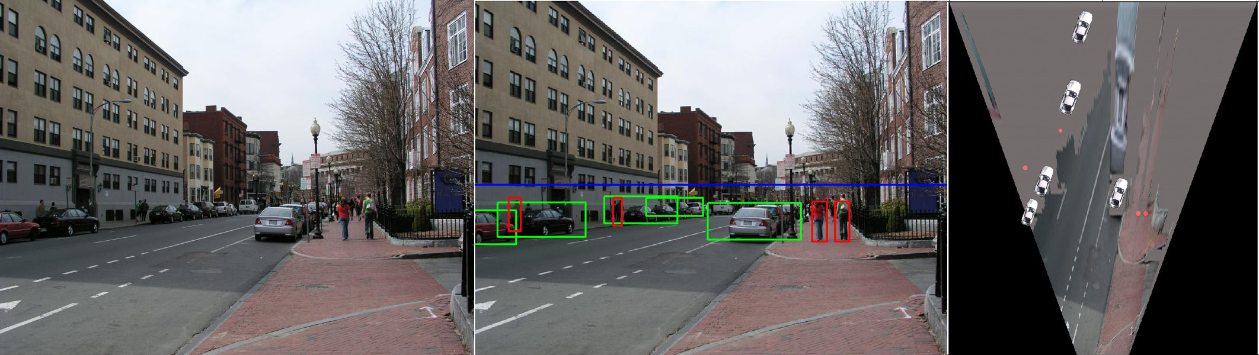
When have I used this stuff?
Object Recognition (CVPR 2006)

Slide 32
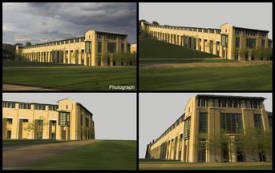
When have I used this stuff?
Single-view reconstruction (SIGGRAPH 2005)

Slide 33
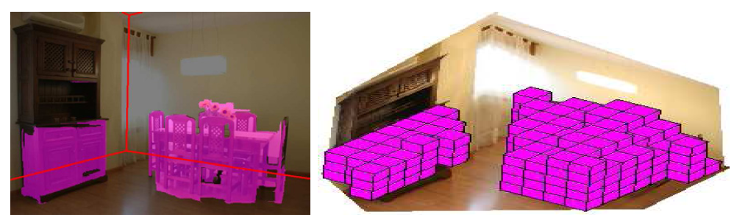
When have I used this stuff?
Getting spatial layout in indoor scenes (ICCV 2009)

Slide 34
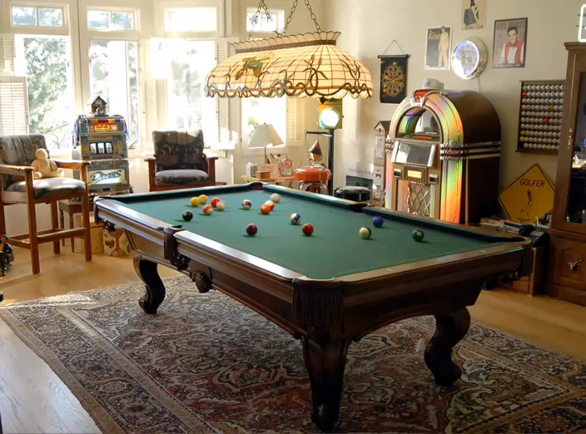
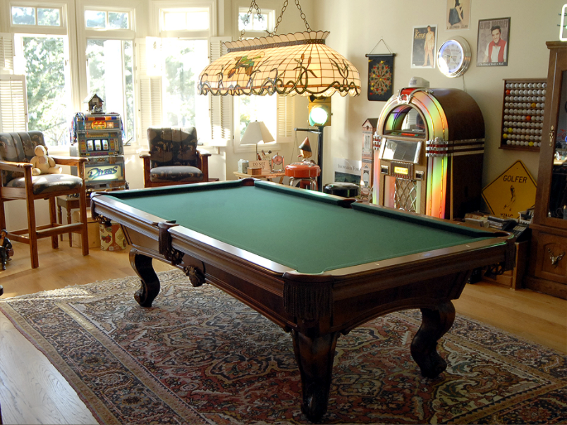
When have I used this stuff?
Inserting synthetic objects into images: http://vimeo.com/28962540

Slide 35
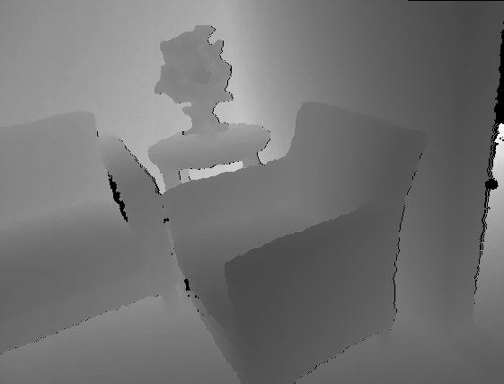

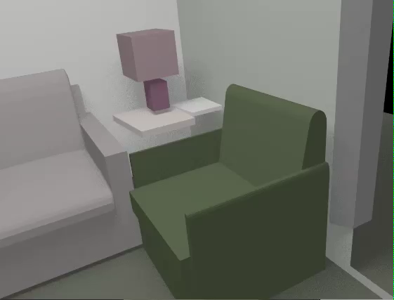
When have I used this stuff?
Creating detailed and complete 3D scene models from a single view

Slide 36
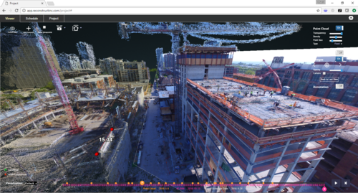
When have I used this stuff?
Multiview 3D reconstruction at Reconstruct

Slide 37
Projection matrix
Intrinsic Assumptions
Unit aspect ratio
Principal point at (0,0)
No skew
Extrinsic Assumptions
No rotation
Camera at (0,0,0)
K
Notes:
Work through equations for u and v on board

Slide 38
Remove assumption about principal point
Intrinsic Assumptions
Unit aspect ratio
No skew
Extrinsic Assumptions
No rotation
Camera at (0,0,0)
This is a very commonly used model

Slide 39
Remove assumption that pixels are square
Intrinsic Assumptions
No skew
Extrinsic Assumptions
No rotation
Camera at (0,0,0)

Slide 40
Remove assumption that pixels are not skewed
Intrinsic Assumptions
Extrinsic Assumptions
No rotation
Camera at (0,0,0)
Note: different books use different notation for parameters

Slide 41
Oriented and Translated Camera
R
j_{w}
t
k_{w}
O_{w}
i_{w}

Slide 42
Allow camera translation
Intrinsic Assumptions
Extrinsic Assumptions
No rotation

Slide 43
3D Rotation of Points
Rotation around the coordinate axes, counter-clockwise:
p’
γ
y
p
z
Slide Credit: Saverese

Slide 44
Allow camera rotation

Slide 45
Degrees of freedom
5
6
Notes:
How many known points are needed to estimate this?

Slide 46
Vanishing Point = Projection from Infinity

Slide 47
Orthographic Projection
Special case of perspective projection
  Distance from the center of projection to the image plane is infinite
  Also called “parallel projection”
  What’s the projection matrix?
Image
World
Slide by Steve Seitz

Slide 48
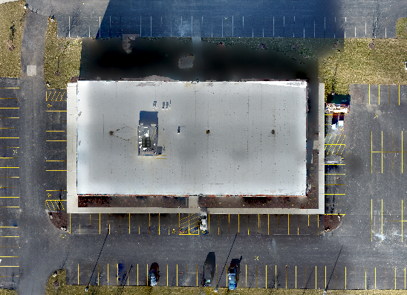
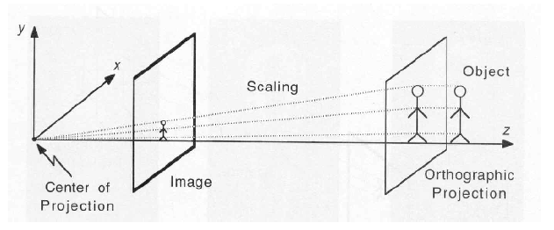
Scaled Orthographic Projection
Special case of perspective projection
  Object dimensions are small compared to distance to camera
  Also called “weak perspective”
  What’s the projection matrix?
Top-down ortho of building in Research Park
Illustration from George Bebis
pixel scale

Slide 49
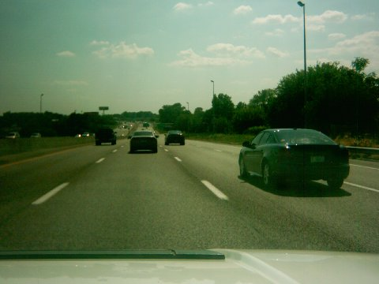
Take-home question
Suppose we have two 3D cubes on the ground facing the viewer, one near, one far.
What would they look like in perspective?
What would they look like in weak perspective?
Photo: Kathy from Flickr

Slide 50
Take-home questions
Suppose the camera axis is in the direction of (x=0, y=0, z=1) in its own coordinate system. What is the camera axis in world coordinates given the extrinsic parameters R, t
Suppose a camera at height y=h (x=0,z=0) observes a point at (u,v) known to be on the ground (y=0). Assume R is identity. What is the 3D position of the point in terms of f, u₀, v₀?

Slide 51
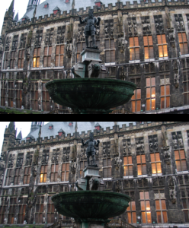
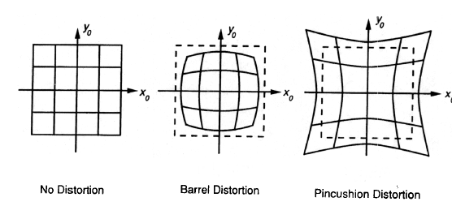
Beyond Pinholes: Radial Distortion
Corrected Barrel Distortion
Image from Martin Habbecke

Slide 52
Things to remember
Vertical vanishing
point
(at infinity)
Vanishing points and vanishing lines
Pinhole camera model and camera projection matrix
Vanishing
line
Vanishing
point
Vanishing
point

Slide 53
Next lectures
Single-view metrology and more camera model
  Measuring 3D distances from the image
  Effects of lens, aperture, focal length, sensor size
Single-view 3D reconstruction

