Slide 1
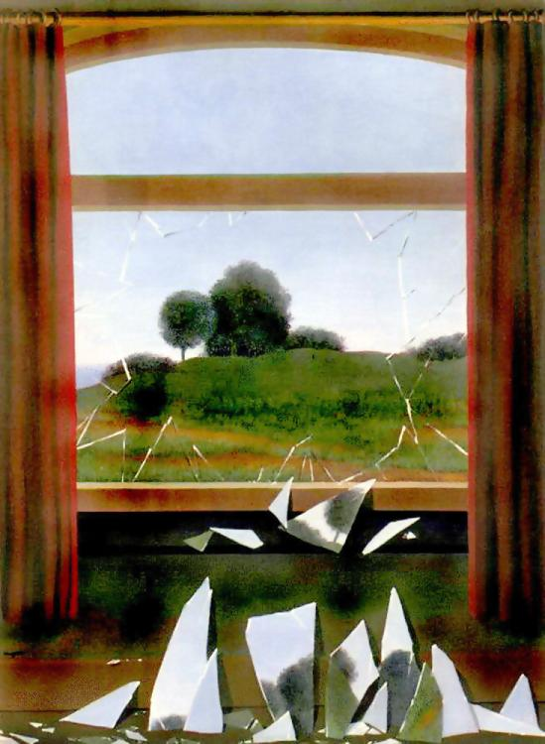
Computational Photography
CS445
Instructor: Derek Hoiem

Slide 2
Today’s Class
A little about me
Intro to Computational Photography
Course outline and logistics

Slide 3
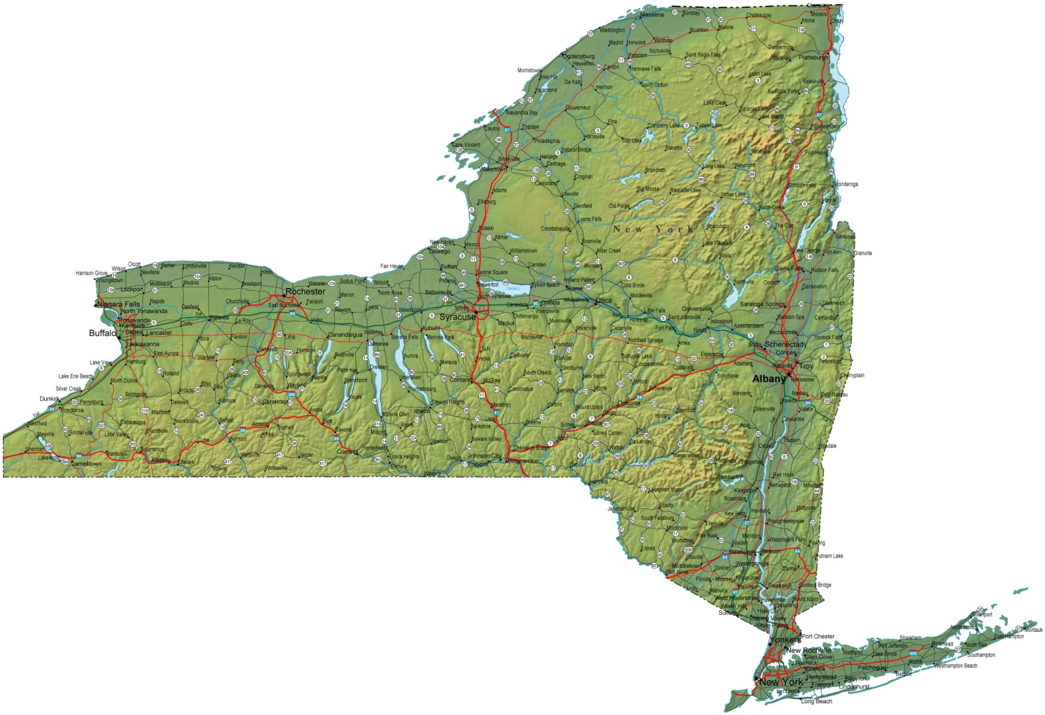
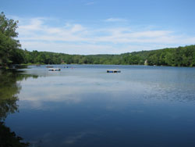
About me
Raised in “upstate” NY

Slide 4
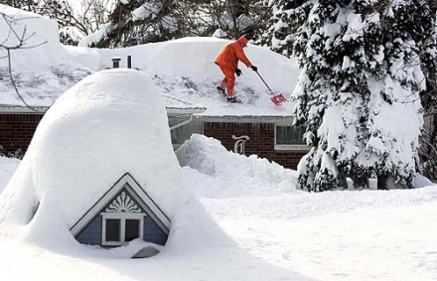
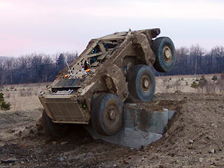
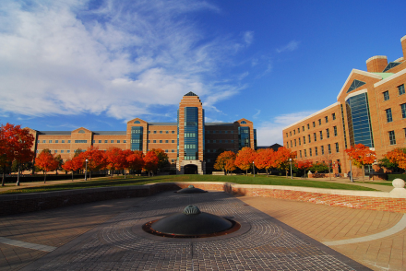
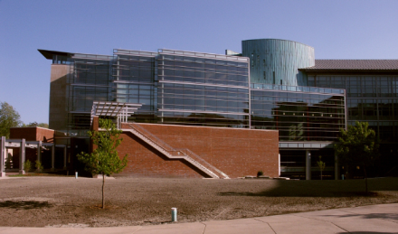
About me
1998-2002
Undergrad at SUNY Buffalo
B.S., EE and CSE
2002-2007
Grad at Carnegie Mellon
Ph.D. in Robotics
2007-2008
Postdoc at Beckman Institute
2009-
Asst/Assoc Prof in CS at UIUC

Slide 5
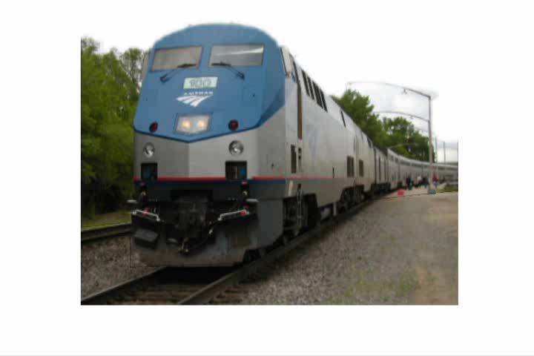
My research

Slide 6
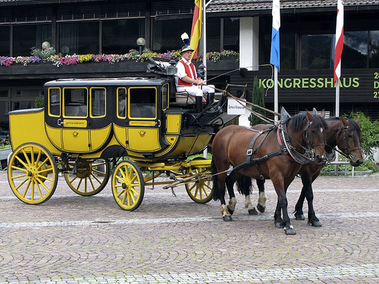
My research
Animal
Vehicle
head
Four-legged
Mammal
wheel
leg
Can run, jump
Is herbivorous
Facing right
Move on road
Facing right
Farhadi et al. 2010
Notes:
Example of a detection result of our system, which has not seen carriages or horses during training. The red box is a detected location of a vehicle; the green box indicates a detected location of an animal. The shown categories and parts are those that served as evidence for the detections.

Slide 7
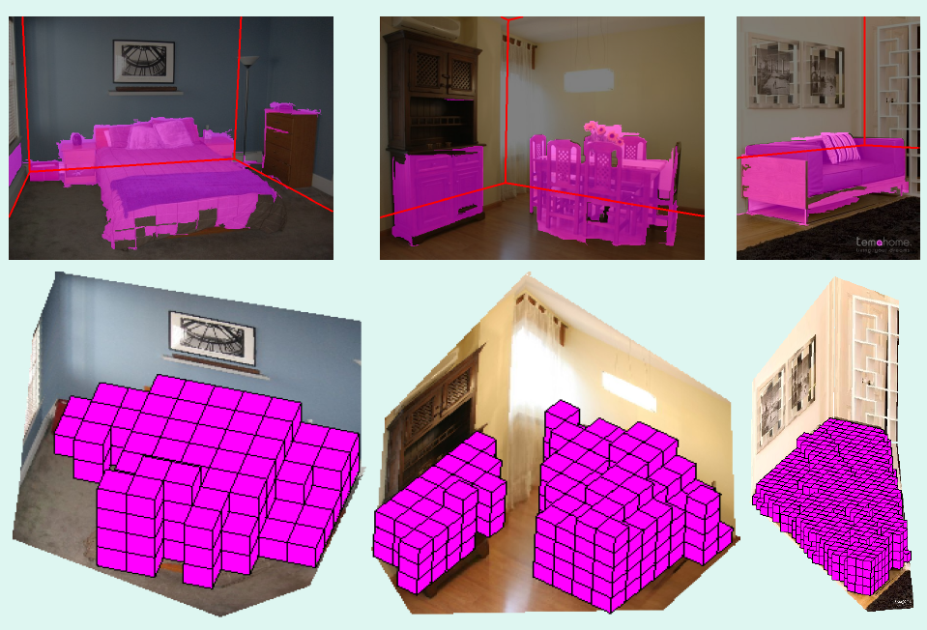
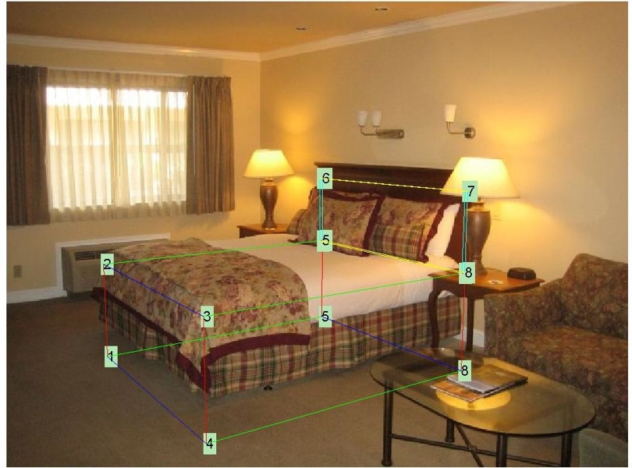
My research
Recovering 3D layout and context
BED
Hedau et al. 2009, 2010
Notes:
Left: Pink regions are estimated as pixels or 3D voxels that are occupied by objects. Red lines indicate estimated floor-wall boundaries. Right: An example of correct localization and identification of a bed, using spatial layout information.

Slide 8
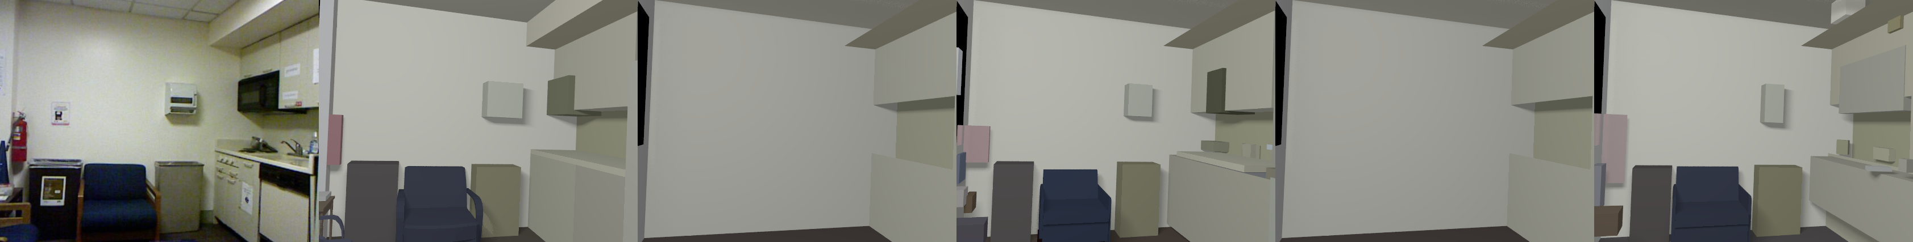
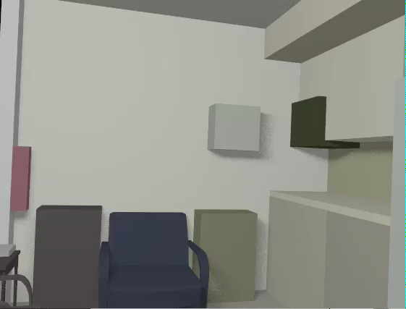
My Research
3D scene model from RGB+D image
RGBD Image
3D Model
Guo, Zou, Hoiem 2018

Slide 9
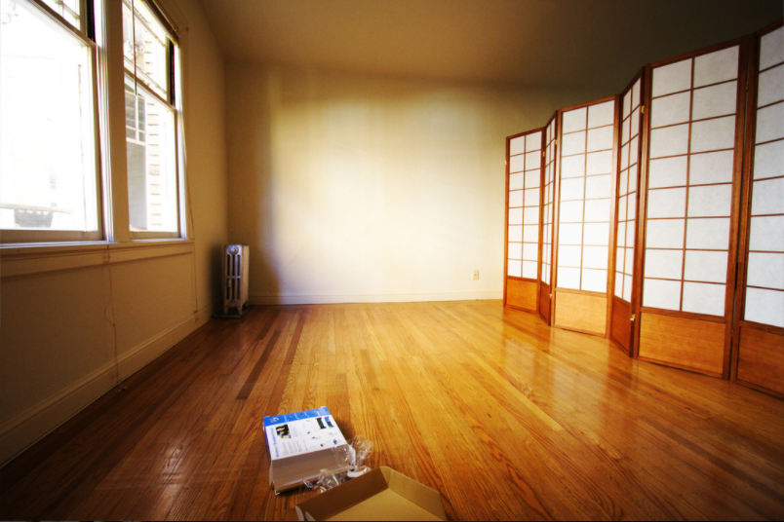
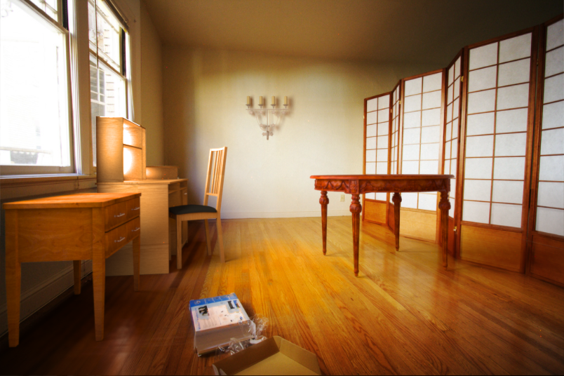
My Research
Editing images as if they were 3D scenes
Karsch et al. 2011

Slide 10
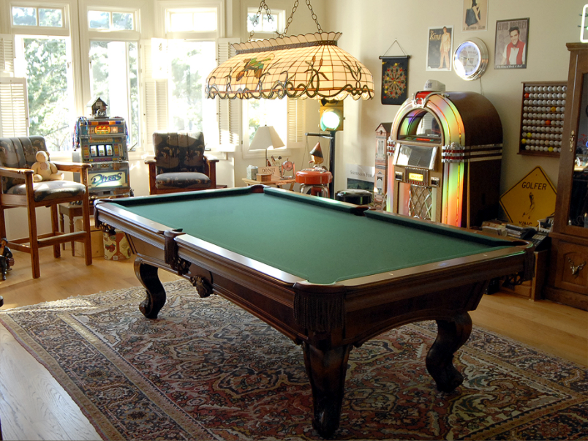

Slide 11
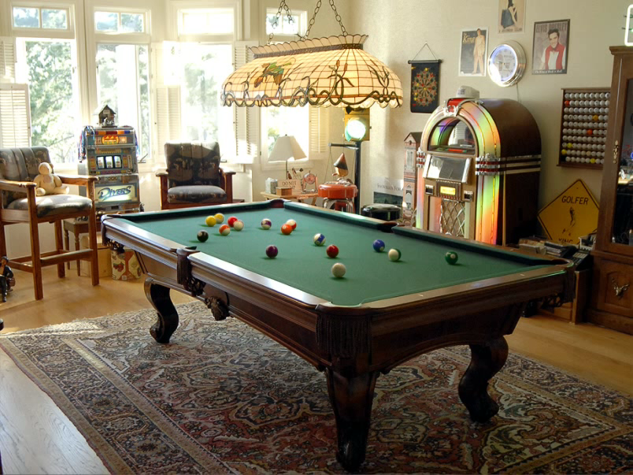

Slide 12
My Research
Gupta et al. 2017

Slide 13
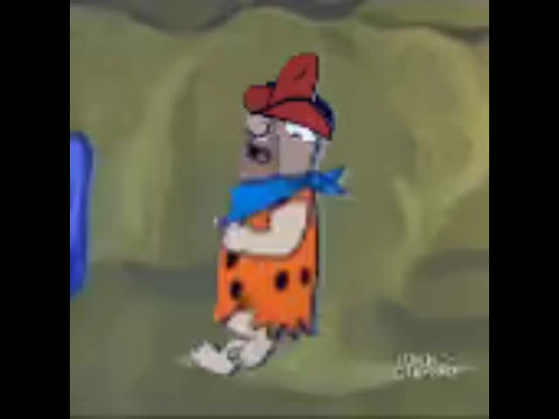
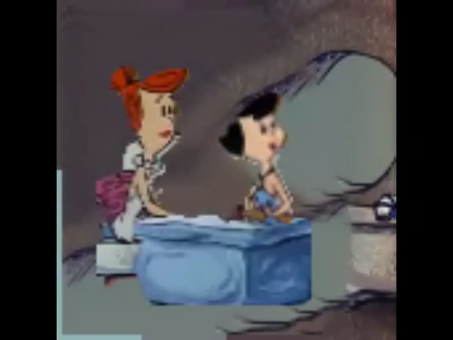
My Research
Generating comic videos
Fred wearing a red hat is walking in the living room.
Wilma and Betty are seated at a table in the kitchen.
Gupta et al. 2018

Slide 14
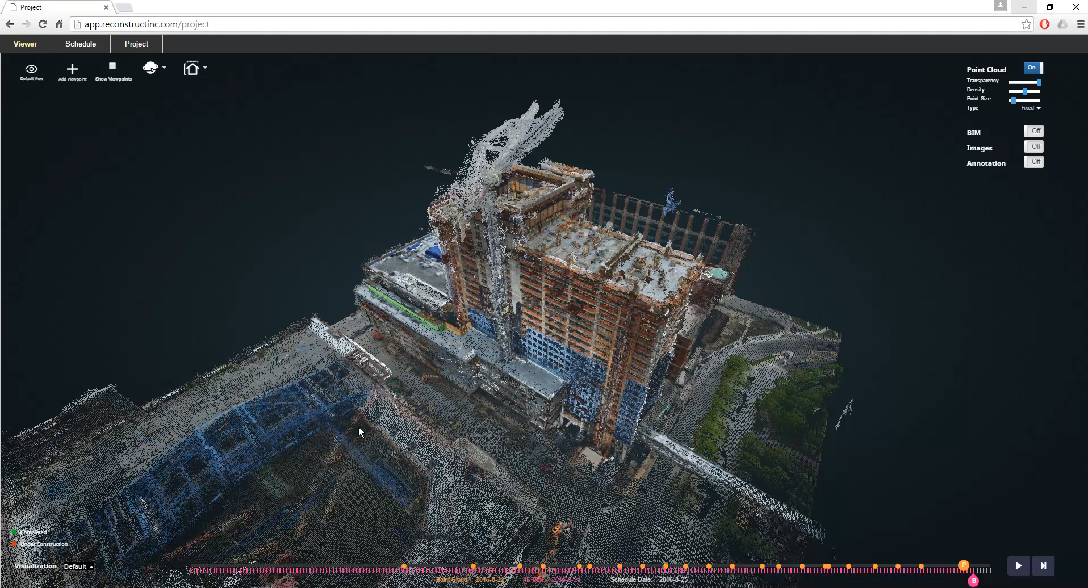
Reconstruct: vision for construction
Crunchbase top 50 global startups
https://vimeo.com/242479887
https://www.reconstructinc.com/

Slide 15
Some background to computational photography and …
The Pursuit of Realism
Several of following slides from Alyosha Efros

Slide 16
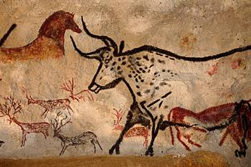
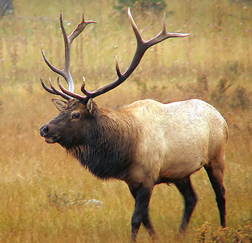
Depicting Our World: The Beginning
Prehistoric Painting, Lascaux Cave, France
~ 15,000 B.C.
Notes:
May be a star chart or correspond to visions from ritualistic trances or be a record of past hunting success

Slide 17
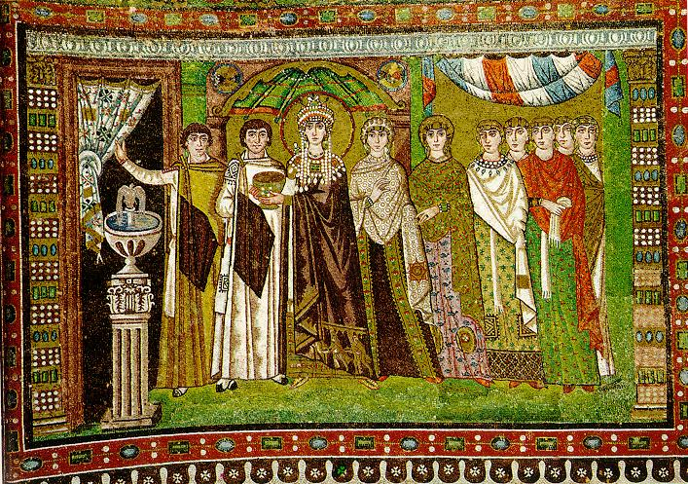
Depicting Our World: Middle Ages
The Empress Theodora with her court.
Ravenna, St. Vitale 6th c.

Slide 18
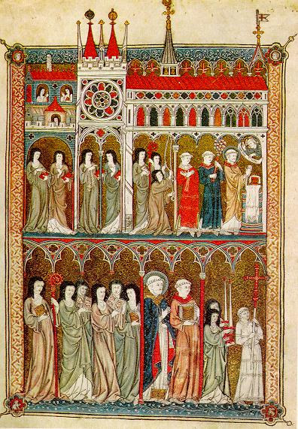
Depicting Our World: Middle Ages
Nuns in Procession. French ms. ca. 1300.

Slide 19
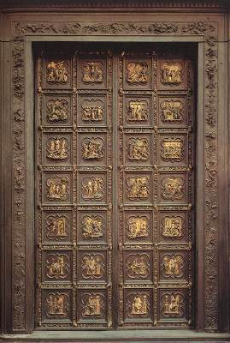
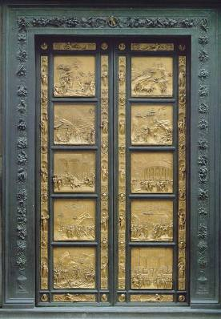
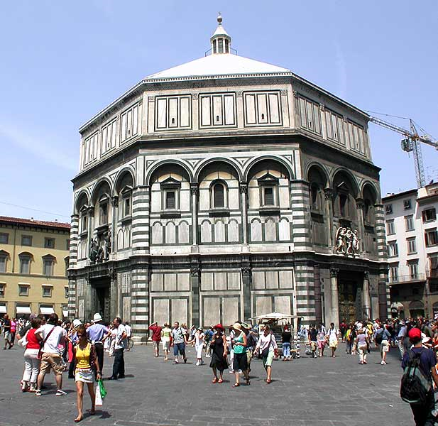
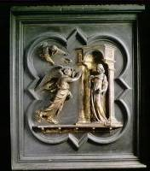
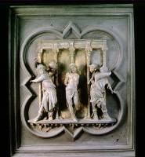
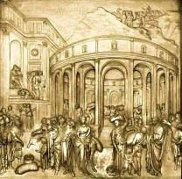
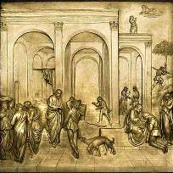
Depicting Our World: Renaissance
North Doors (1424)
East Doors (1452)
Lorenzo
Ghiberti
(1378-1455)
Notes:
Florentine cathedral. Ghiberti influenced by Alazhan’s book of optics, first published around 1000 AD but translated into Italian by 14th century. http://www.nature.com/nature/journal/v518/n7538/full/518164a.html?WT.ec_id=NATURE-20150212

Slide 20
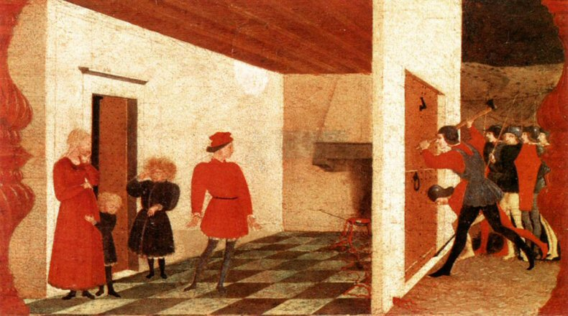
Depicting Our World: Renaissance
Paolo Uccello,
Miracle of the Profaned Host (c.1467-9)
Notes:
Paolo Uccello was one of Ghiberti’s students and a early master of perspective

Slide 21
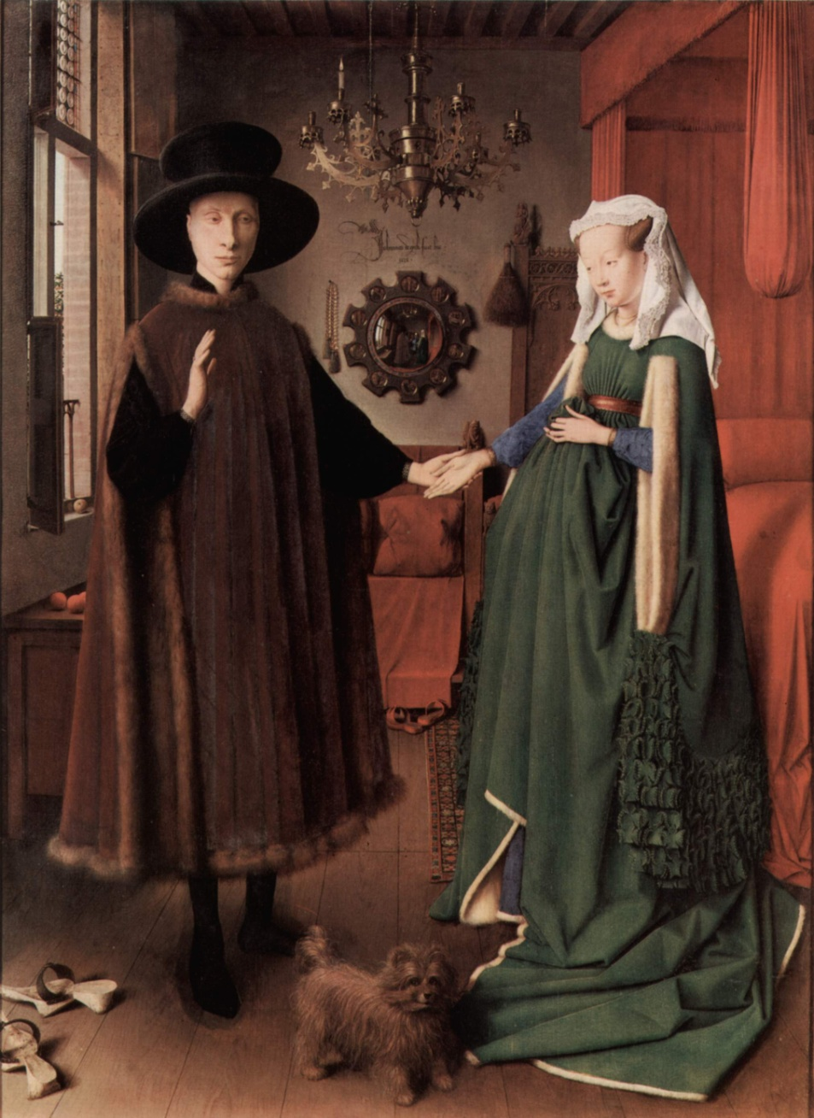
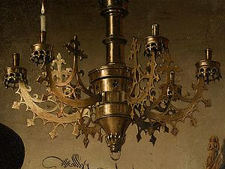
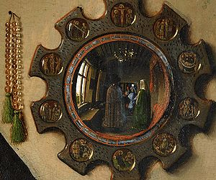
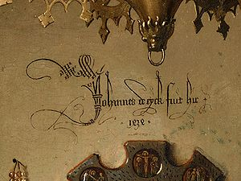
Depicting Our World: Toward Perfection
Jan van Eyck, The Arnolfini Portrait (1426-1434)

Slide 22
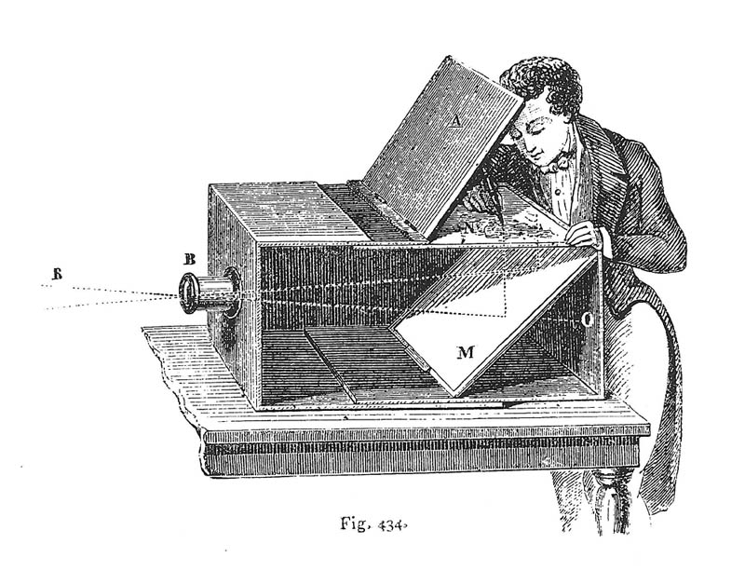
Depicting Our World: Toward Perfection
Lens Based Camera Obscura, 1568

Slide 23
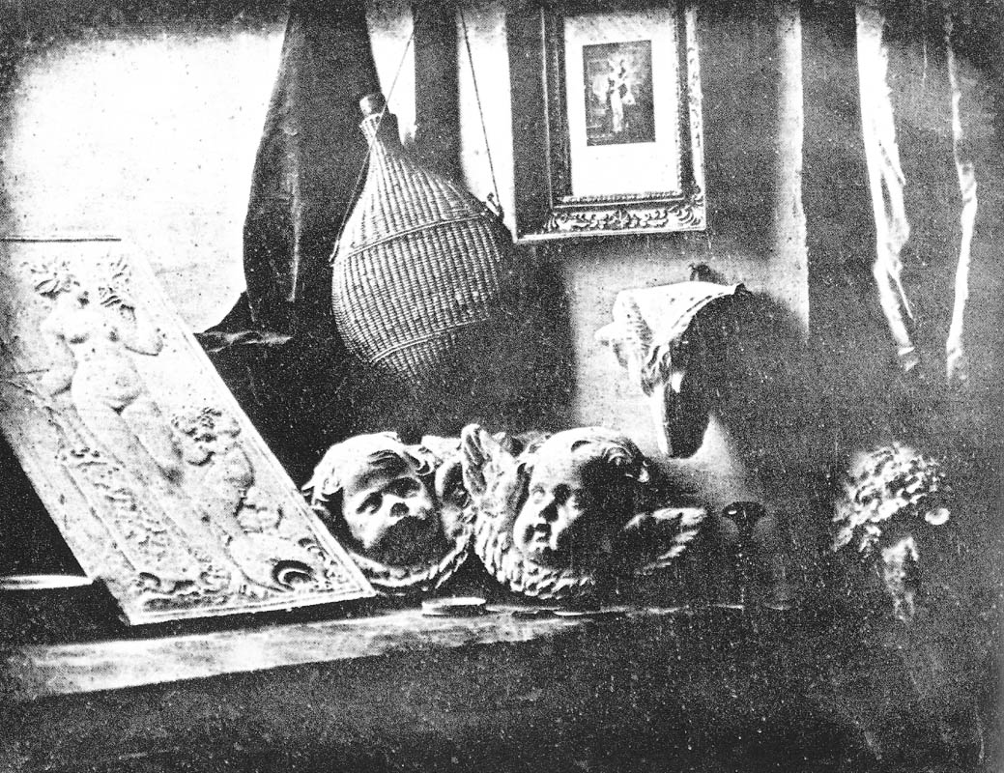
Depicting Our World: Perfection!
Still Life, Louis Jaques Mande Daguerre, 1837

Slide 24
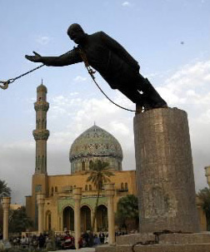
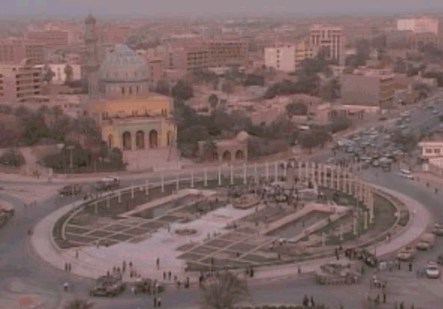
But is a photo really realistic?
Related story: https://www.propublica.org/article/the-toppling-saddam-statue-firdos-square-baghdad

Slide 25
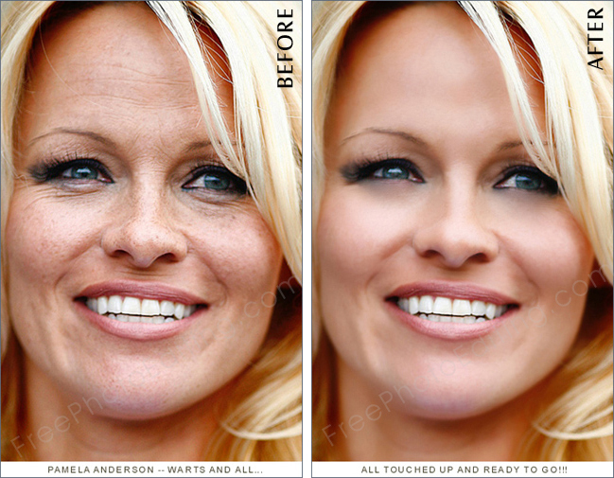
Is reality what we want?
http://www.freephotoediting.com/samples/photo-glamourisation/020_celebrity-skin-retouching.htm

Slide 26
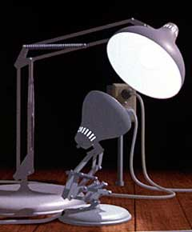
Enter Computer Graphics...

Slide 27
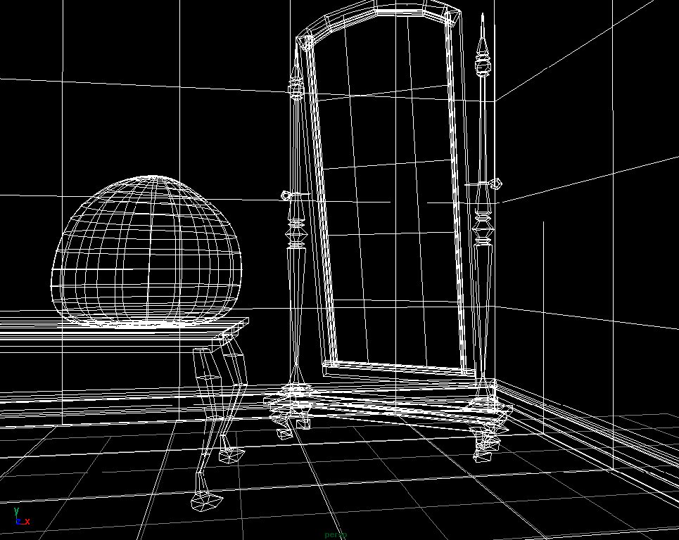
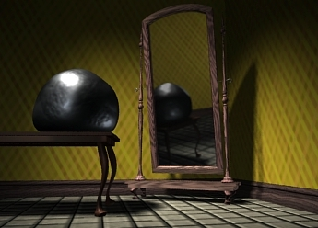
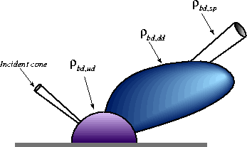
Traditional Computer Graphics
3D geometry
projection
Simulation
physics
GRAPHICS

Slide 28
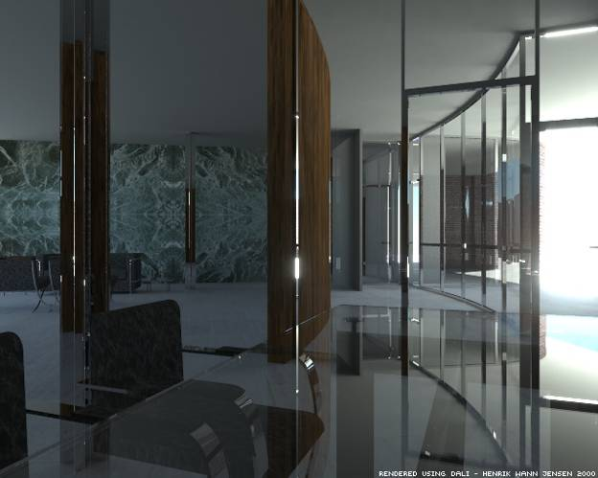
Computer graphics
What’s wrong?
Notes:
So lifeless and sterile

Slide 29
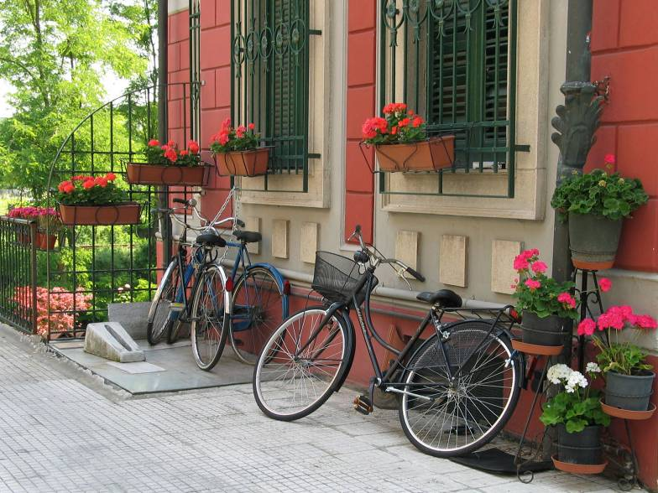
The richness of our everyday world
Photo by Svetlana Lazebnik

Slide 30
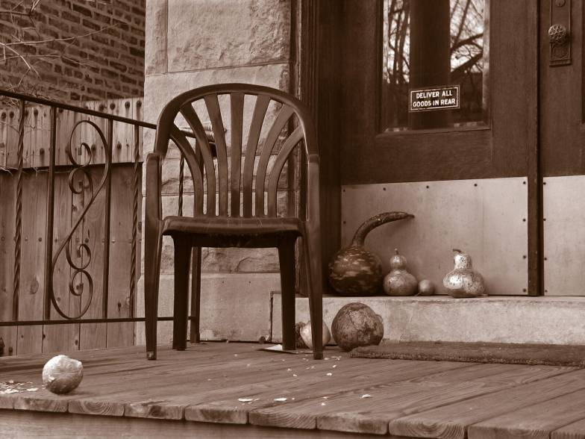
Which parts are hard to model?
Photo by Svetlana Lazebnik

Slide 31
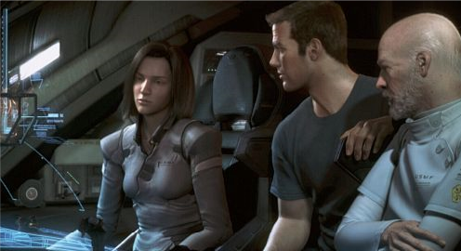
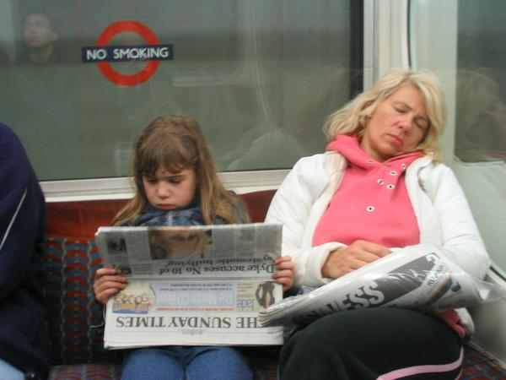
People
Alyosha Efros - On the Tube, London
From “Final Fantasy”

Slide 32


Faces / Hair
From “Final Fantasy”
Photo by Joaquin Rosales Gomez

Slide 33


Urban Scenes
Photo of l LA
Virtual LA (SGI)

Slide 34


Nature
River Cherwell, Oxford

Slide 35
The Realism Spectrum
Computational
Photography
Computer Graphics
Photography
Realism
Manipulation
Ease of capture
+ easy to create new worlds
+ easy to manipulate objects/viewpoint
- very hard to look realistic
+ instantly realistic
+ easy to aquire
- very hard to manipulate objects/viewpoint

Slide 36



Computational Photography
How can I use computational techniques to capture light in new ways?
How can I use computational techniques to breathe new life into the photograph?
How can I use computational techniques to synthesize and organize photo collections?

Slide 37
Virtual Real World
Campanile Movie (1997)
http://www.debevec.org/Campanile/

Slide 38
Going beyond reality…
Benjamin Button (2008)
http://www.digitaldomain.com/work/the-curious-case-of-benjamin-button/

Slide 39


Another example of blending reality with fantasy
Samsung Galaxy S6 regular and “beauty” selfie

Slide 40


FaceApp

Slide 41

Course objectives
You will have new abilities for visual creation.
Graphic by James Hays
Notes:
Visual creation is no longer just pure graphics or pure photography. There is a growing need to blend the two. We want to edit photos, work with photo collections, create cool special effects, etc. After this course, you should have the background and experience that you need to do these things.

Slide 42






Course objectives
2. You will get a foundation in computer vision.
Safety
Health
Security
Comfort
Fun
Access
Notes:
Foundation for computer vision. We want machines to watch for us, do our work, and make us live longer, more healthy, and more entertaining lives. This course will give you a good hands-on background for learning more or developing new computer vision applications.

Slide 43
Got job?
Google, Facebook, Microsoft, Sony, iRobot, Amazon, Snapchat, Ebay, tons of startups, etc.
http://www.cs.ubc.ca/~lowe/vision.html

Slide 44

Course objectives
3. You’ll better appreciate your own visual ability.
Is that a queen or a bishop?
Notes:
You'll gain an appreciation for your own visual ability. We tend to take it for granted, but half of our brain is cranking away on the vision problem. Interestingly, we are usually aware only of the interpretation, not what we actually see. By working with pixels, you'll see how messy images actually are and how incredible it is that we can interpret anything from them.

Slide 45
Course objectives
4. You’ll have fun doing cool stuff!
Notes:
Do cool stuff. You'll get the opportunity to implement a variety of fun projects that work with your own photos. You can be creative. You can also go beyond the minimum and do some "bells and whistles" or additional projects that I offer. You'll get to do a final project on whatever you want. You'll also be able to see the work that everyone else does.

Slide 46
Projects

Slide 47

Project 1: Hybrid Images

Slide 48





Project 2: Image Quilting for Texture Synthesis and Transfer

Slide 49



Project 3: Poisson Editing
Photos from James Hays

Slide 50



Project 3: Poisson Editing
Photos from Evan Wallace

Slide 51


Project 4: Image-Based Lighting

Slide 52

Project 5: video alignment, stitching, and editing

Slide 53
Final Project
Something cool!

Slide 54
Course outline
Prof: Derek Hoiem dhoiem@illlinois.edu
TAs
  Zhi Chen zhic4@illinois.edu
  Shengyu Fen shengyu8@illinois.edu
  Eric Lee kylee5@illinois.edu
  Dominic Roberts djrbrts2@illinois.edu
  Yuan Shen yshen47@illinois.edu

Slide 55
Grades
Projects (55%)
  5 projects: each with 100 core points with more optional “bells and whistles”
  3 credit (ugrad): graded out of 425 points
  4 credit (grad): graded out of 500 points
  Can early 25 additional points for extra credit
Exams (30%)
  Midterm 15%: covers first half
  Final 15%: covers entire semester
Final Project (15%)
  1% for proposal, 14% for final submission
  2 page abstract
Late policy
Up to ten free days total – use them wisely!
5 point penalty per day after that
Project must be submitted within two weeks of due date to receive any points

Slide 56
Project details
Implement stuff from scratch and apply it to your own photos
Submit PDF, Jupyter notebook, and Python code

Slide 57
Learning resources
Lectures
Lecture modules on Coursera
Original full-length recordings: https://ensemble.illinois.edu/Playlist/CS445_Hoiem_FA19
  Search by lecture date, e.g. 9.06 for Sept 6, based on schedule here: https://courses.engr.illinois.edu/cs445/fa2019/
Slides
On Coursera
Office hours
Will be updated on the Coursera page
Discussion board: https://piazza.com/class/kdszesldhqd74g
Readings/textbook: for depth and details not covered in lecture

Slide 58
Academic Integrity
These are OK
Discuss projects with classmates (don’t show each other code)
Use Stack Overflow to learn how to use a Python module
Get images from online (make sure to attribute the source)
Not OK
Copying or looking at project-specific code (i.e. so that you claim credit for part of an assignment based on code that you didn’t write)
Using external resources (code, images) without acknowledging them
Remember
Ask if you’re not sure if it’s ok
You are safe as long as you acknowledge all of your sources of inspiration, images, code, etc. in your write-up

Slide 59
Other comments
Prerequisites
Linear algebra, plus some basic calculus and probability
Experience with graphics, image processing, or Python will help but is not necessary
Equipment
Your own camera, but a smartphone is probably good enough
A mirrored sphere for project 4 (12 cm or bigger) e.g. https://www.amazon.com/Stainless-Mirror-Polished-Sphere-Ornament/dp/B01ING7L4U

Slide 60
Feedback is welcome

