Slide 1
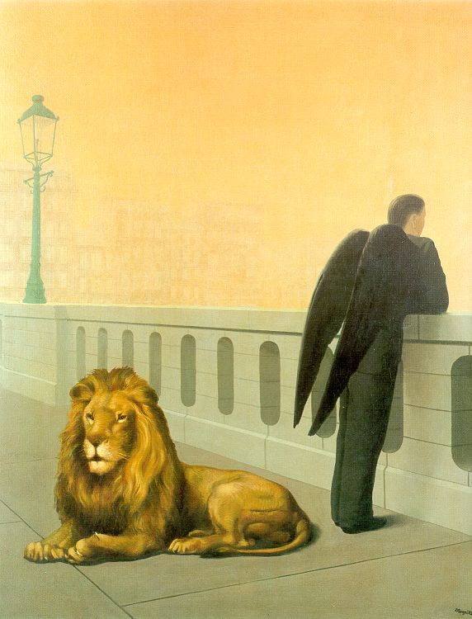
Midterm Review
Computational Photography
Derek Hoiem, University of Illinois
Magritte, Homesickness

Slide 2
Major Topics
Linear Filtering
  How it works
  Template and Frequency interpretations
  Image pyramids and their applications
  Sampling (Nyquist theorem, application of low-pass filtering)
Light and color
  Lambertian shading, shadows, specularities
  Color spaces (RGB, HSV, LAB)
  Image-based lighting
Techniques
  Finding boundaries: intelligent scissors, graph cuts, where to cut and why
  Texture synthesis: idea of sampling patches to synthesize, filling order, PatchMatch optimization
  Compositing and blending: alpha compositing, Laplacian blending, Poisson editing

Slide 3
Major Topics
Warping
  Transformation matrices, homogeneous coordinates, solving for parameters via system of linear equations
Modeling shape
  Averaging and interpolating sets of points
Camera models and Geometry
  Pinhole model: diagram, intrinsic/extrinsic matrices, camera center (or center of projection), image plane
  Focal length, depth of field, field of view, aperture size
  Vanishing points and vanishing lines (what they are, how to find them)
  Measuring relative lengths based on vanishing points and horizon

Slide 4
Preparing for the Exam
Review the slides briefly
Do the practice questions without looking at anything else
Carefully review material related to any that you miss or feel unsure about

Slide 5
Today’s review
Light
Camera capture and geometry
Image filtering
Region selection and compositing
Solving for transformations
Purposes
Remind you of key concepts
Chance for you to ask questions

Slide 6
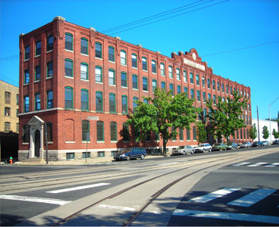
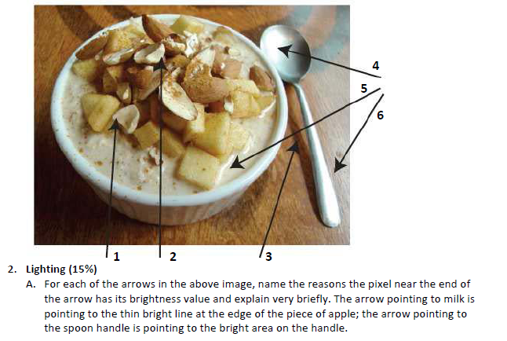
1. Light and color
Lighting
  Lambertian shading, shadows, specularities
  Color spaces (RGB, HSV, LAB)

Slide 7
How is light reflected from a surface?
Depends on
Illumination properties: wavelength, orientation, intensity
Surface properties: material, surface orientation, roughness, etc.
light source
λ
?

Slide 8
Lambertian surface
Some light is absorbed (function of albedo)
Remaining light is reflected equally in all directions (diffuse reflection)
Examples: soft cloth, concrete, matte paints
light source
light source
λ
λ
absorption
diffuse reflection

Slide 9
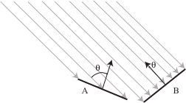

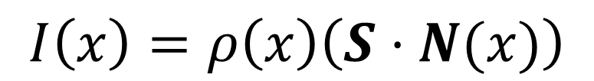
Diffuse reflection
Intensity does depend on illumination angle because less light comes in at oblique angles.
$ρ=$albedo
$S=$ directional source
$N=$ surface normal
$I=$ image intensity
$$I\left(x\right)=ρ\left(x\right)\left(S⋅N(x)\right)$$
Slide: Forsyth

Slide 10
1
2

Slide 11
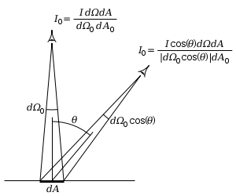
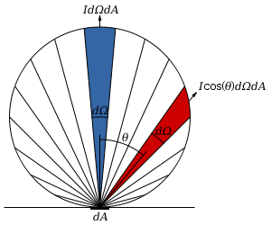
Diffuse reflection
Intensity does not depend on viewer angle.
  Amount of reflected light proportional to cos(theta)
  Visible solid angle also proportional to cos(theta)
http://en.wikipedia.org/wiki/Lambert%27s_cosine_law

Slide 12
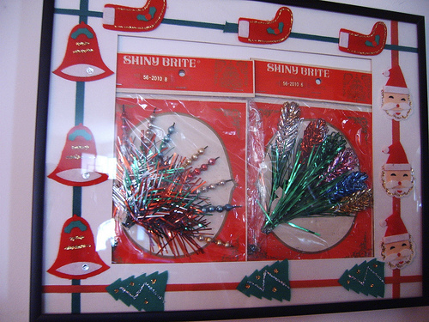
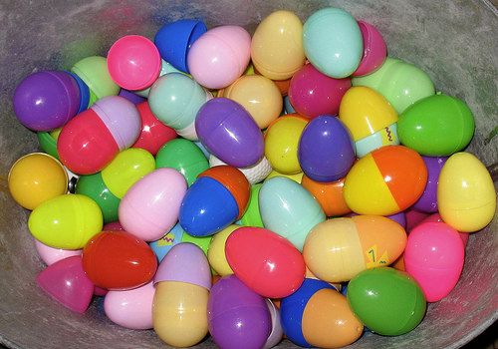


Specular Reflection
Reflected direction depends on light orientation and surface normal
E.g., mirrors are mostly specular
Flickr, by suzysputnik
light source
λ
specular reflection
$$Θ$$
$$Θ$$
Flickr, by piratejohnny

Slide 13
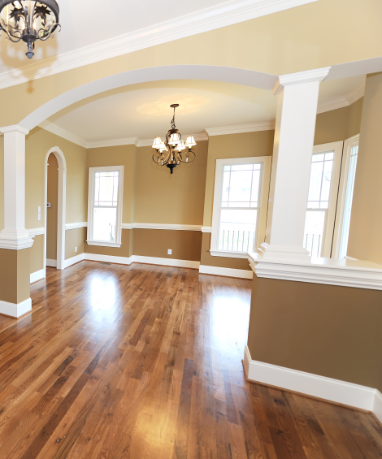
Many surfaces have both specular and diffuse components
Specularity = spot where specular reflection dominates (typically reflects light source)
Photo: northcountryhardwoodfloors.com

Slide 14
Questions
1.
Possible factors: albedo, shadows, texture, specularities, curvature, lighting direction

Slide 15
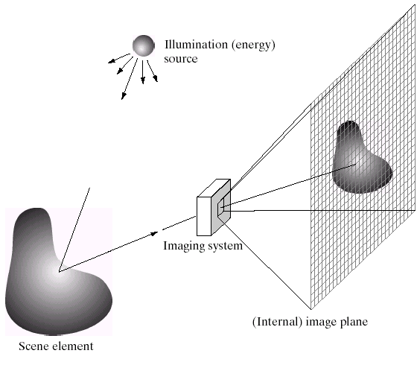
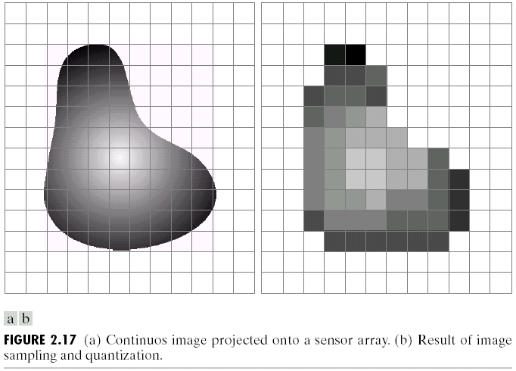
Discretization
Because pixel grid is discrete, pixel intensities are determined by a range of scene points

Slide 16
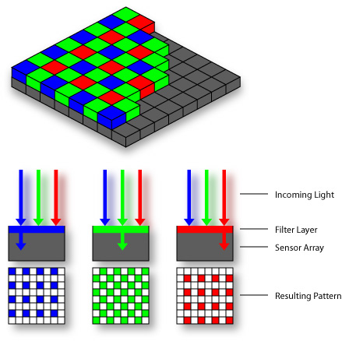

Color Sensing: Bayer Grid
Estimate RGB at each cell from neighboring values
http://en.wikipedia.org/wiki/Bayer_filter

Slide 17
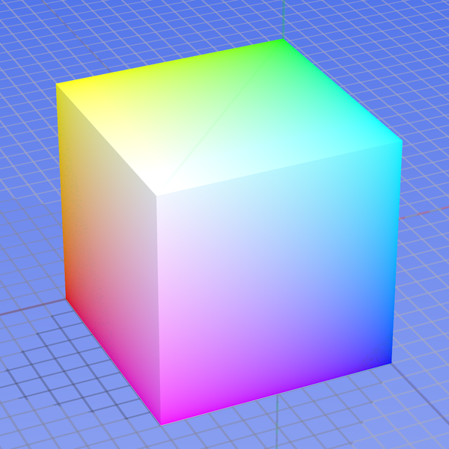
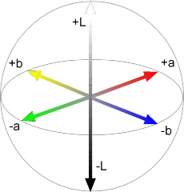
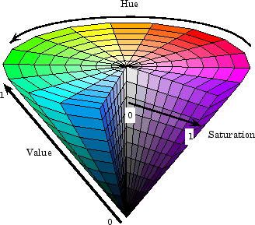



Color spaces
RGB
LAB
0,1,0
1,0,0
0,0,1
HSV
YCbCr
Y=0
Y=0.5
Y=1
Cr
Cb

Slide 18
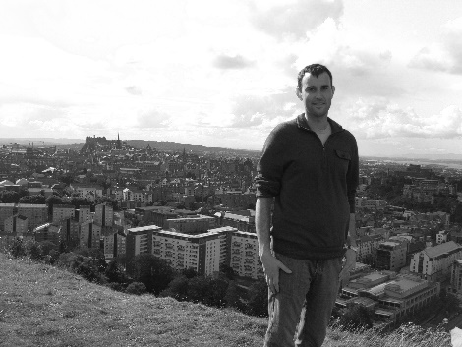
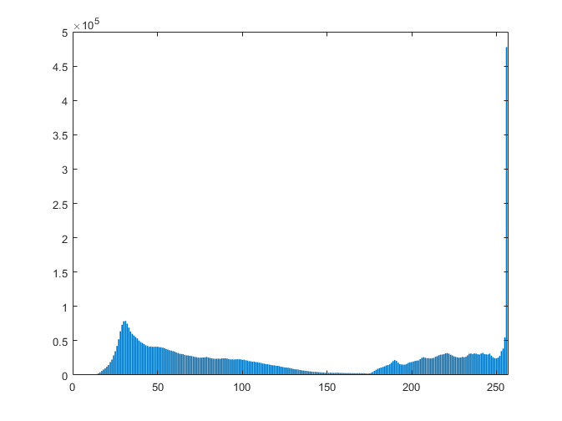
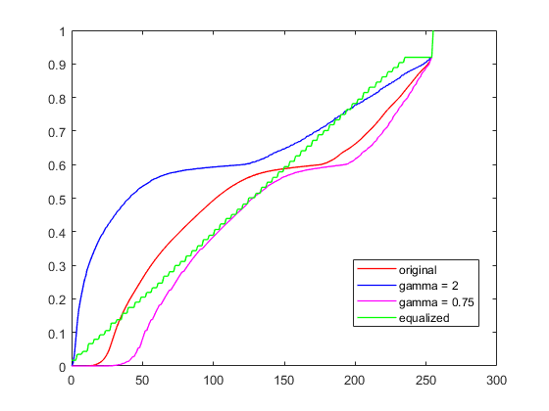
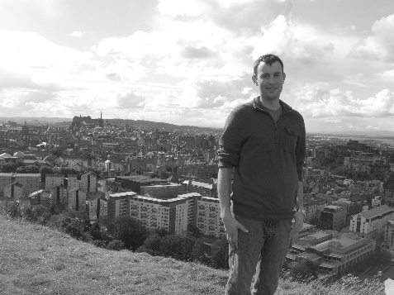
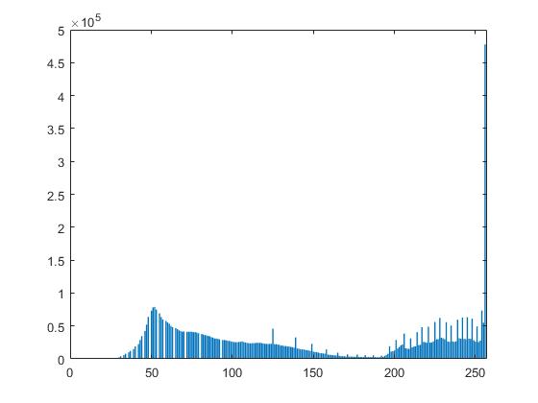
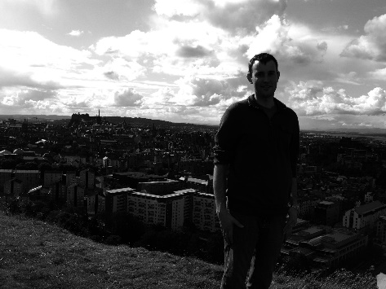
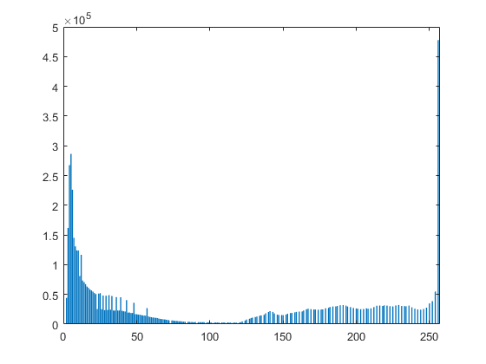
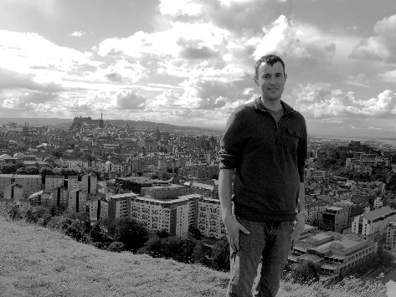
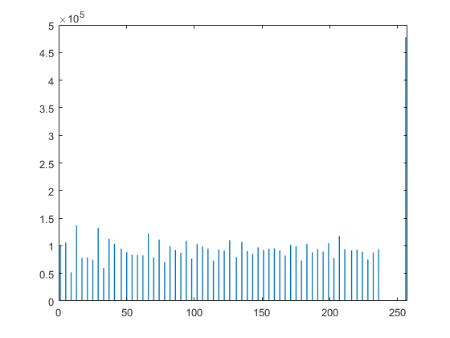
Image Histograms
Cumulative Histograms

Slide 19
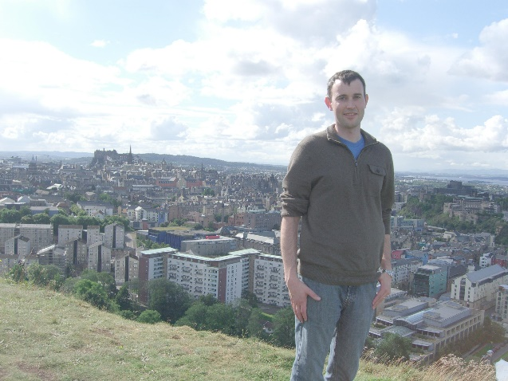
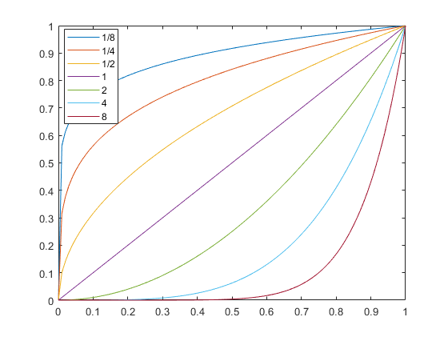
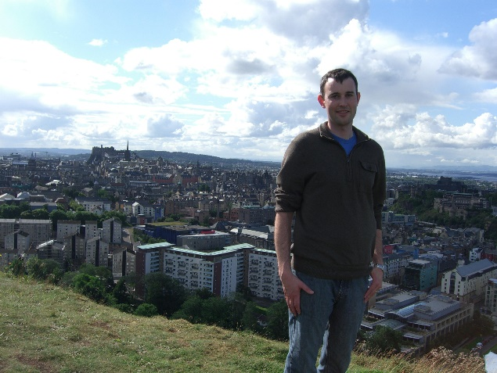
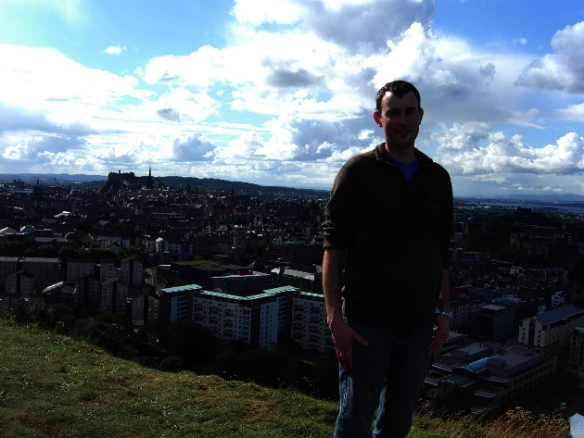




Gamma adjustment
$$iout=iinγ$$
$γ$ = 0.5
Intensity Out
$γ$ = 1
Intensity In
$γ$ = 2

Slide 20
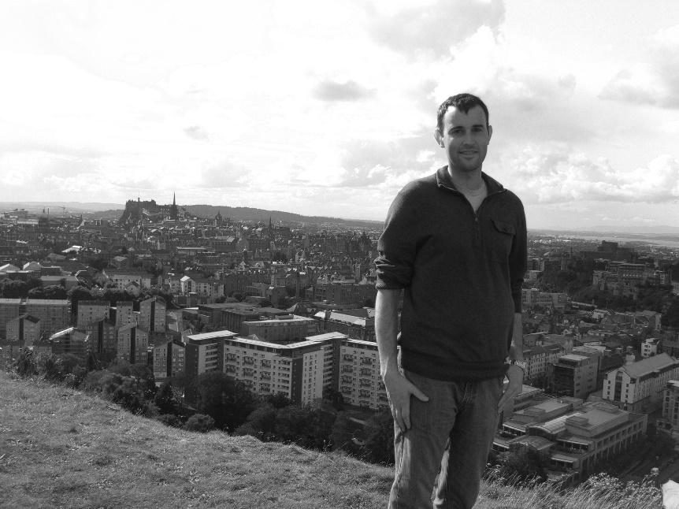
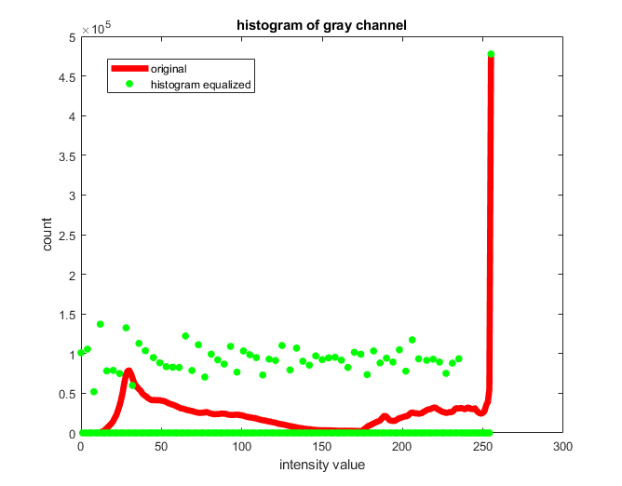

Histogram Equalization

Slide 21
Practice question

Slide 22
2. Camera Capture and Geometry

Slide 23
Pinhole Camera
.
Principal Point (u₀, v₀)
.
.
f
Z
Y
.
v
Camera Center
u
Useful figure to remember

Slide 24
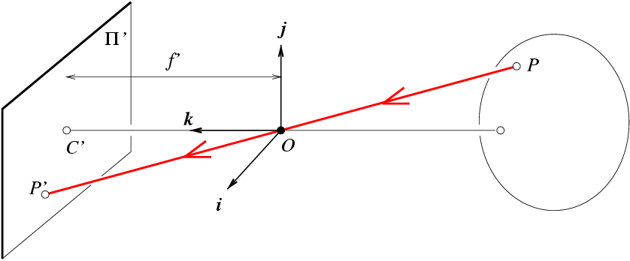
Projection Matrix
R
j_{w}
t
k_{w}
O_{w}
i_{w}

Slide 25
Single-view metrology
5
4
3
2
1

Slide 26
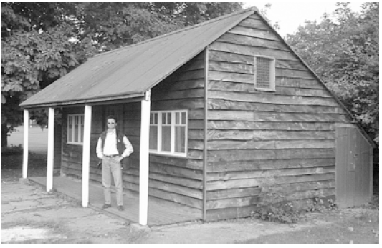
Assume the man is 6 ft tall.
  What is the height of the building?
  How long is the right side of the building compared to the small window on the right side of the building?
cross-ratio
P₄
P₁
P₂
P₃

Slide 27
Adding a lens
“circle of
confusion”
A lens focuses light onto the film
  There is a specific distance at which objects are “in focus”
    other points project to a “circle of confusion” in the image
  Changing the shape of the lens changes this distance

Slide 28
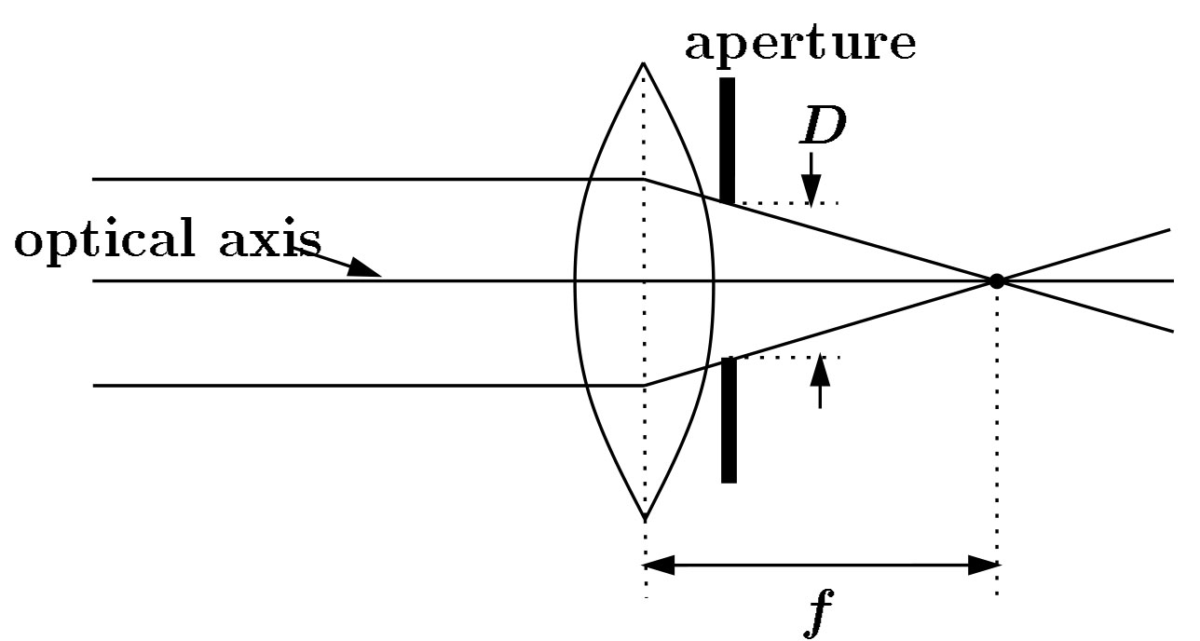
Focal length, aperture, depth of field
F
focal point
optical center
(Center Of Projection)
A lens focuses parallel rays onto a single focal point
  focal point at a distance f beyond the plane of the lens
  Aperture of diameter D restricts the range of rays

Slide 29
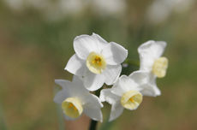
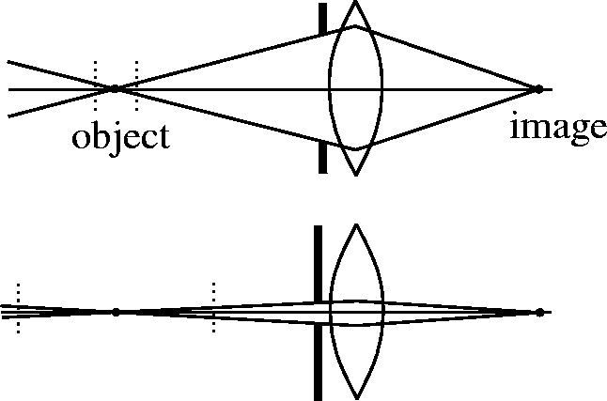
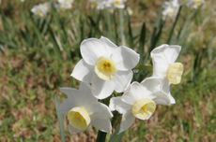
The aperture and depth of field
f / 5.6
f / 32
Main way to increase depth of field: Decrease aperture size
F-number (f/#) =focal_length / aperture_diameter
- E.g., f/16 means that the focal length is 16 times the diameter
- When you set the f-number of a camera, you are setting the aperture
Flower images from Wikipedia http://en.wikipedia.org/wiki/Depth_of_field

Slide 30
The Photographer’s Great Compromise
What we want
More spatial resolution
Broader field of view
More depth of field
More temporal resolution
More light
How we get it
Cost
Increase focal length
Light, FOV
Decrease focal length
DOF
Decrease aperture
Light
Increase aperture
DOF
Shorten exposure
Light
Lengthen exposure
Temporal Res

Slide 31
Practice questions
39, 44, 45

Slide 32
3. Linear filtering
Can think of filtering as
  A function in the spatial domain (e.g., compute average of each 3x3 window)
  Template matching
  Modifying the frequency of the image

Slide 33

Filtering in spatial domain
Slide filter over image and take dot product at each position
1
1
1
1
1
1
1
1
1
0 | 0 | 0 | 0 | 0 | 0 | 0 | 0 | 0 | 0
0 | 0 | 0 | 0 | 0 | 0 | 0 | 0 | 0 | 0
0 | 0 | 0 | 90 | 90 | 90 | 90 | 90 | 0 | 0
0 | 0 | 0 | 90 | 90 | 90 | 90 | 90 | 0 | 0
0 | 0 | 0 | 90 | 90 | 90 | 90 | 90 | 0 | 0
0 | 0 | 0 | 90 | 0 | 90 | 90 | 90 | 0 | 0
0 | 0 | 0 | 90 | 90 | 90 | 90 | 90 | 0 | 0
0 | 0 | 0 | 0 | 0 | 0 | 0 | 0 | 0 | 0
0 | 0 | 90 | 0 | 0 | 0 | 0 | 0 | 0 | 0
0 | 0 | 0 | 0 | 0 | 0 | 0 | 0 | 0 | 0
 | 0 | 10 | 20 | 30 | 30
?

Slide 35
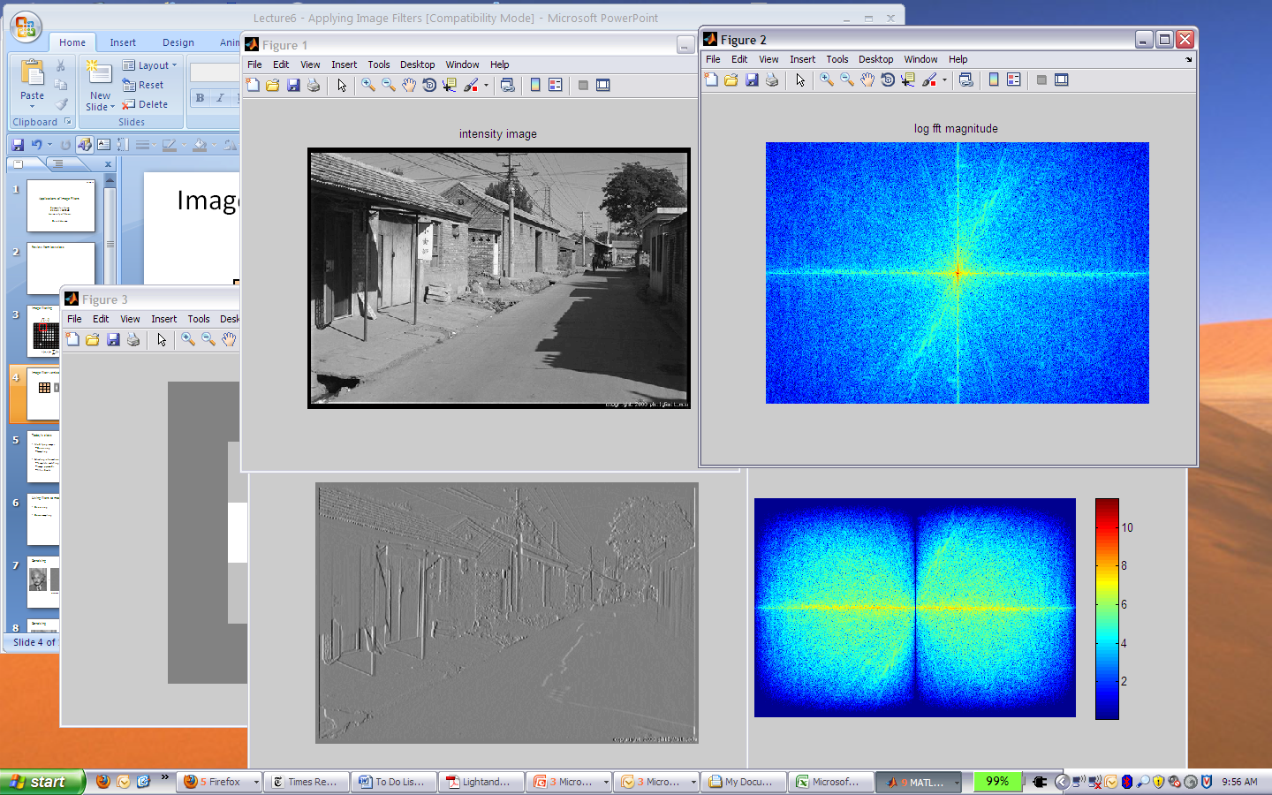
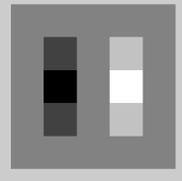
Filtering in spatial domain
1
0
-1
2
0
-2
1
0
-1
*
=

Slide 36
Filtering in frequency domain
Can be faster than filtering in spatial domain (for large filters)
Can help understand effect of filter
Algorithm:
  Convert image and filter to fft (fft2 in matlab)
  Pointwise-multiply ffts
  Convert result to spatial domain with ifft2

Slide 37
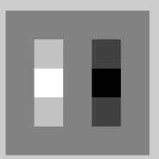

Filtering in frequency domain
FFT
FFT
=
Inverse FFT

Slide 38
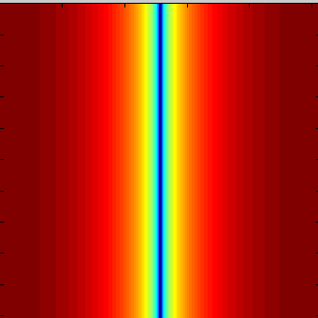
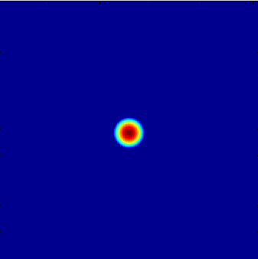

Filtering in frequency domain
Linear filters for basic processing
  Edge filter (high-pass)
  Gaussian filter (low-pass)
[-1 1]
Gaussian
FFT of Gradient Filter
FFT of Gaussian

Slide 39


Filtering
Why does the Gaussian give a nice smooth image, but the square filter give edgy artifacts?
Gaussian
Box filter
Notes:
Things we can’t understand without thinking in frequency

Slide 40
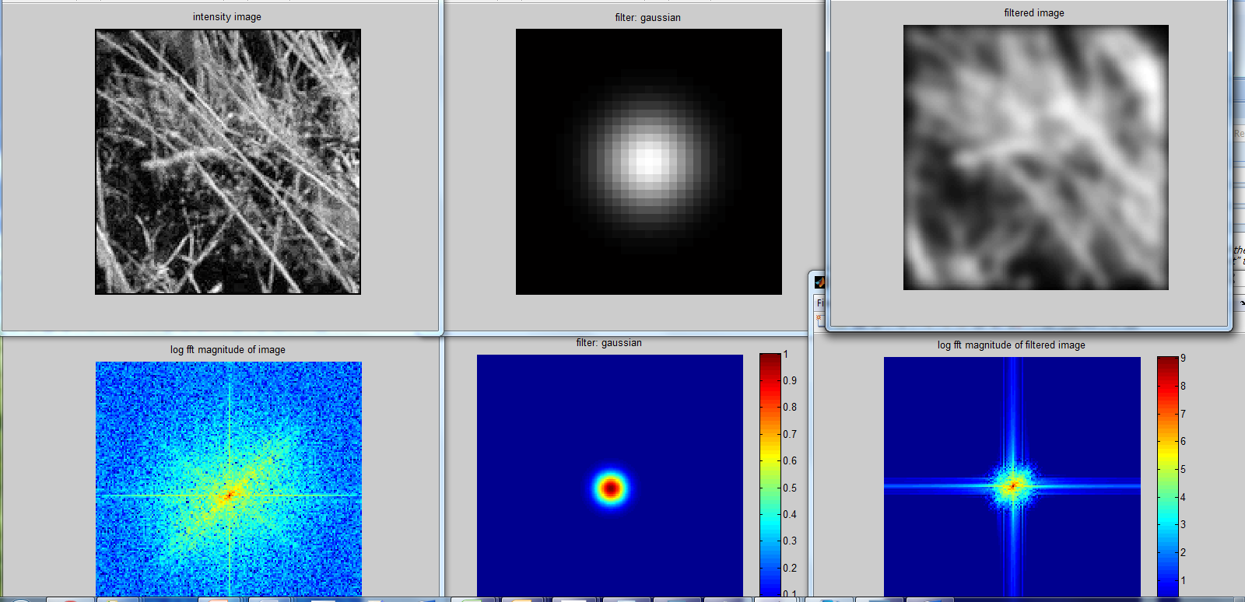
Gaussian

Slide 41
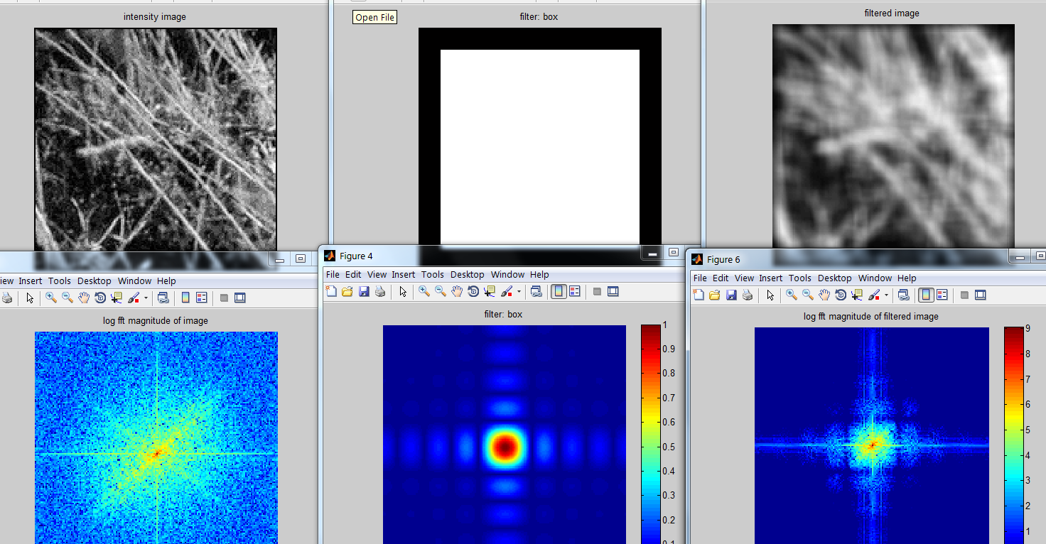
Box Filter

Slide 42
Applications of filters
Template matching (SSD or Normxcorr2)
  SSD can be done with linear filters, is sensitive to overall intensity
  Basis for object detection
Gaussian pyramid
  Coarse-to-fine search, multi-scale detection
Laplacian pyramid
  Can be used for blending
  More compact image representation

Slide 43
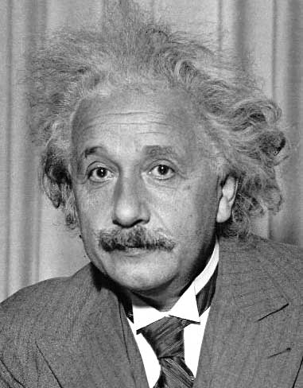
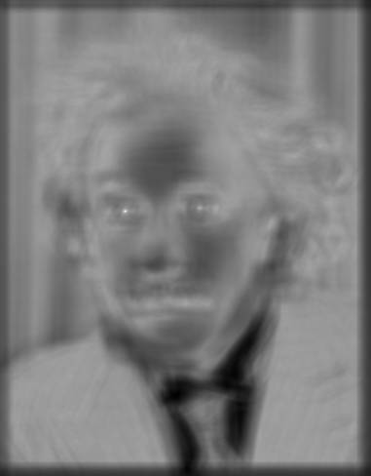

Matching with filters
Goal: find in image
Method 2: SSD
True detections
Input
1- sqrt(SSD)
Thresholded Image
Notes:
Problem: SSD sensitive to average intensity

Slide 44
Matching with filters
Goal: find in image
Method 3: Normalized cross-correlation
mean template
mean image patch
Matlab: normxcorr2(template, im)
Notes:
Invariant to mean and scale of intensity

Slide 45
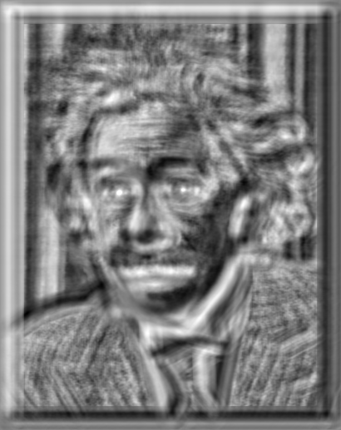

Matching with filters
Goal: find in image
Method 3: Normalized cross-correlation
True detections
Input
Normalized X-Correlation
Thresholded Image

Slide 46
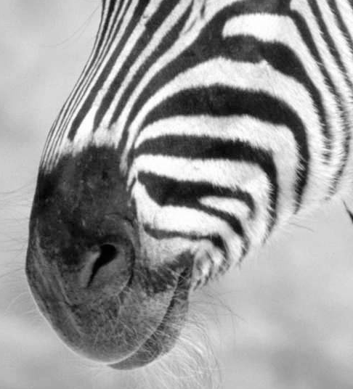
Subsampling by a factor of 2
Problem: This approach causes “aliasing”
Throw away every other row and column to create a 1/2 size image

Slide 47
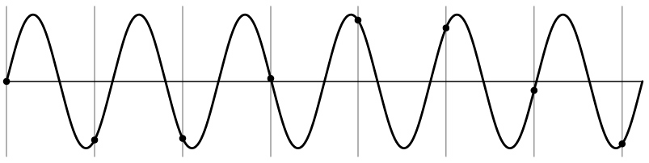

Nyquist-Shannon Sampling Theorem
When sampling a signal at discrete intervals, the sampling frequency must be ≥ 2 × f_{max}
f_{max} = max frequency of the input signal
This will allows to reconstruct the original perfectly from the sampled version
v
v
v
good
bad

Slide 48
Algorithm for downsampling by factor of 2
Start with image(h, w)
Apply low-pass filter
  im_blur = imfilter(image, fspecial(‘gaussian’, 13, 2))
Sample every other pixel
  im_small = im_blur(1:2:end, 1:2:end);

Slide 49



Subsampling without pre-filtering
1/2
1/4 (2x zoom)
1/8 (4x zoom)
Slide by Steve Seitz

Slide 50



Subsampling with Gaussian pre-filtering
Gaussian 1/2
G 1/4
G 1/8
Slide by Steve Seitz

Slide 51


Sampling
Why does a lower resolution image still make sense to us? What do we lose?
Image: http://www.flickr.com/photos/igorms/136916757/

Slide 52

Gaussian pyramid
Useful for coarse-to-fine matching
Applications include multi-scale object detection, image alignment, optical flow, point tracking

Slide 53

Computing Gaussian/Laplacian Pyramid
Gaussian Pyramid
3-level Laplacian Pyramid
Useful figure to remember
http://sepwww.stanford.edu/~morgan/texturematch/paper_html/node3.html

Slide 54

Image reconstruction from Laplacian pyramid

Slide 55
Practice questions
1,2,5,7,9,12

Slide 56
4. Cutting and pasting
Texture synthesis
Selecting image regions
  Intelligent scissors
  Graph cuts
Compositing
  Alpha masks
  Feathering
  Laplacian pyramid blending
  Poisson blending

Slide 57

Texture synthesis and hole-filling
Efros & Leung: To fill in pixels, take the center pixel from a patch that matches known surrounding values
Criminisi et al: Work from the outside in, prioritizing pixels with strong gradients

Slide 58
PatchMatch: Optimization
Goal: Solve for labels that minimize some cost function
Key assumption: a pixel and its neighbor very likely have the same or similar labels
PatchMatch Algorithm basics
Randomly initialize matches
Scan across image (forward and backward)
  Check if neighbor’s offsets or random perturbations around current offset produce better scores
  Keep best found so far
Repeat (2) several times

Slide 59


Intelligent Scissors
You can treat the image as a graph
  Nodes = pixels, edges connect neighboring pixels
Intelligent Scissors: Good boundaries are a short (high gradient) path through the graph

Slide 60

Graph Cuts
You can treat the image as a graph
  Nodes = pixels, edges connect neighboring pixels
Source (Label 0)
Cost to assign to 0
Cost to split nodes
Cost to assign to 1
Sink (Label 1)
Graph cut: Good boundaries are a cheap cut, where some pixels want to be foreground, and some to be background

Slide 61




Compositing and Blending
Feathering: blur mask around its edges
Laplacian blending: blend low-frequency slowly, high frequency quickly
  Blend with alpha mask values ranging from 0 to 1
laplacian
level
4
laplacian
level
2
laplacian
level
0

Slide 62



Question
1) I am trying to blend this bear into this pool. What problems will I have if I use:
  Alpha compositing with feathering
  Laplacian pyramid blending
  Poisson editing?
Lap. Pyramid
Poisson Editing

Slide 63
Transformations
Practice questions

Slide 64
Basic 2D transformations as 3x3 matrices
Translate
Scale
Rotate
Shear

Slide 65


2D image transformations
These transformations are a nested set of groups
  Closed under composition and inverse is a member

Slide 66
Practice questions
32, 34, 36

Slide 67
Good luck!
Exam is Thursday
  Take on your own, in your own private space
  Exam window is 9:30am to 10pm (can start exam by 10pm)
  Let me know by email if you have trouble with access
  Most students have 90 minutes
  DRES students should automatically have additional time. Let me know if not
Do not come to class on Thursday
Questions?

