Slide 1
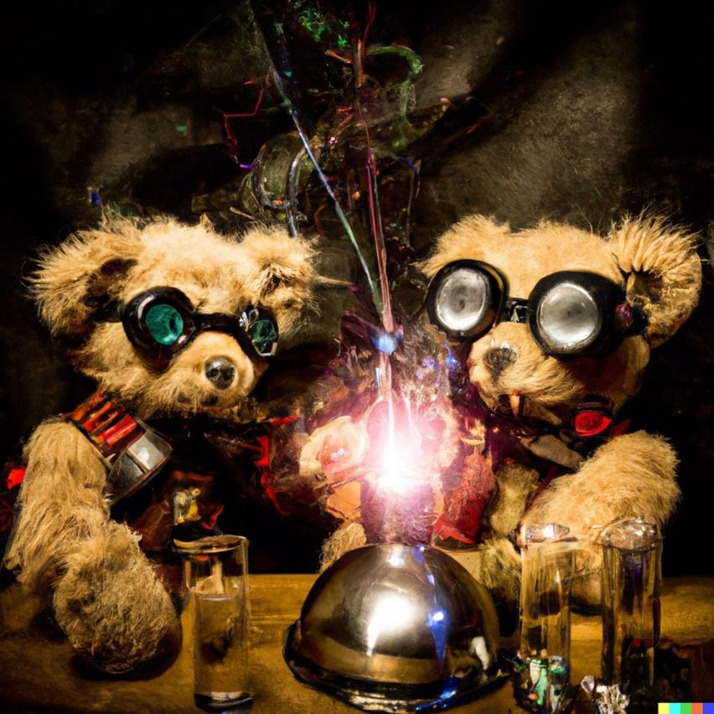
Seeing is Believing: Generating and Detecting Fakes
teddy bears mixing sparkling chemicals as mad scientists in a steampunk style –DALL-E 2
Computational Photography
Derek Hoiem, University of Illinois

Slide 2
Kinds of fakes
Danger Level
Traditional CG
Manipulated images
  Photoshop
  Image-based relighting, etc.
Deep fakes
Yellow: Hard to make, easy to detect automatically
Orange: Easy to make for images, hard for video; harder to detect automatically
Red: Very easy to make for images or video; hard to detect automatically

Slide 3
CG vs. Real: Can you do it?
http://area.autodesk.com/fakeorfoto/
I can’t! (I got 4/12 this time)

Slide 4
Detecting Fakes -- Why It Matters: Trust and Information
Top AI researchers race to detect ‘deepfake’ videos: ‘We are outgunned’
The Impact Of Fake Images
Don't Trust Your Eyes: Image Manipulation in the Age of DeepFakes
“On April 14, 2020, the hashtag #TellTheTruthBelgium caught media attention. A video showed a nearly 5 min speech of Belgian premier Sophie Wilmès, depicting the COVID-19 pandemic as a consequence of environmental destruction. The environmental movement Extinction Rebellion used deepfake technology to alter a past address to the nation that Sophie Wilmès held previously (Extinction Rebellion, 2020; Galindo, 2020).”

Slide 5
Automatically Detecting CG
Sketch of approach
  Intuition: natural images have predictable statistics (e.g., power law for frequency); CG images may have different statistics due to difficulty in creating detail
  Decompose the image into wavelet coefficients and compute statistics of these coefficients
Lyu and Farid 2005: “How Realistic is Photorealistic?”

Slide 6
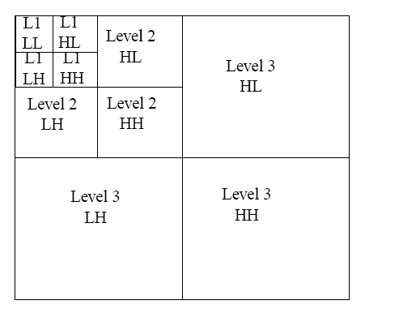
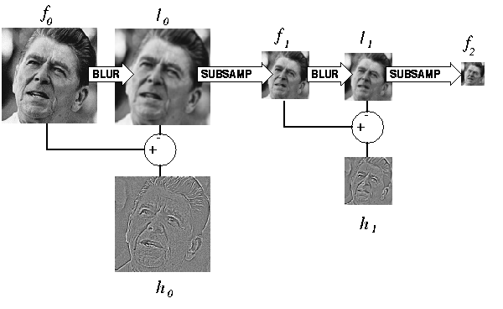
2D Wavelets
Kind of like the Laplacian pyramid, except broken down into horizontal, vertical, and diagonal frequency
Laplacian Pyramid
Wavelet Pyramid

Slide 7
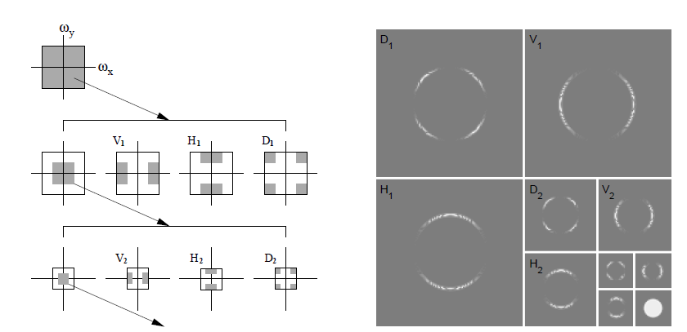
2D Wavelet Transform
Illustration of procedure
Wavelet decomposition of disc image
Figure from Lyu and Farid 2005: “How Realistic is Photorealistic?”

Slide 8
Automatically Detecting CG
Sketch of approach
  Intuition: natural images have predictable statistics (e.g., power law for frequency); CG images may have different statistics due to difficulty in creating detail
  Decompose the image into wavelet coefficients and compute statistics of these coefficients
  Train a classifier to distinguish between CG and Real based on these features
    Train RBF SVM with 32,000 real images and 4,800 fake images
    Real images from http://www.freefoto.com
    Fake images from http://www.raph.com and http://www.irtc.org/irtc/
Lyu and Farid 2005: “How Realistic is Photorealistic?”

Slide 9
Results
98.8% test accuracy on real images
66.8% test accuracy on fake images
10/14 on fakeorfoto.com
Lyu and Farid 2005: “How Realistic is Photorealistic?”

Slide 10
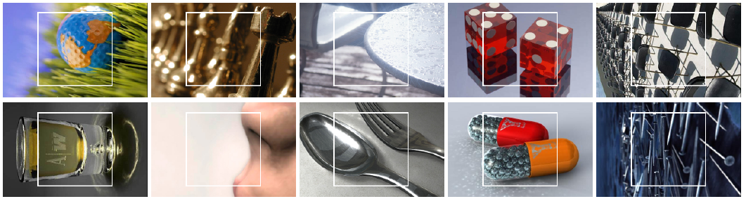
Results
Fake-or-photo.com: Correct
Real Photos
CG
Lyu and Farid 2005: “How Realistic is Photorealistic?”

Slide 11
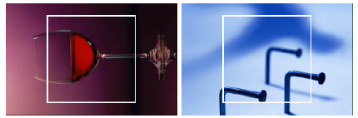
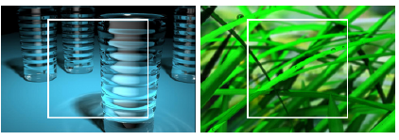
Results
Fake-or-photo.com: Wrong
Real photos misclassified as CG
CG misclassified as real photos
Lyu and Farid 2005: “How Realistic is Photorealistic?”

Slide 12
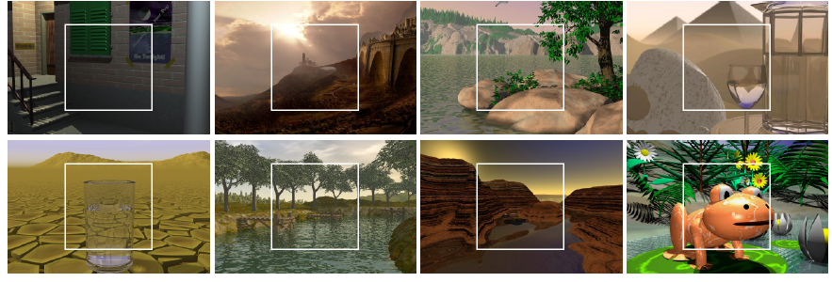
Results
Fakes, confidently labeled as fake
Lyu and Farid 2005: “How Realistic is Photorealistic?”

Slide 13
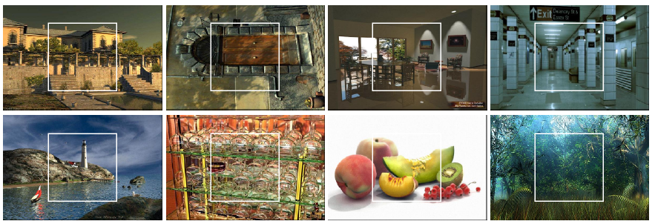
Results
Fake images thought to be real
Lyu and Farid 2005: “How Realistic is Photorealistic?”

Slide 14
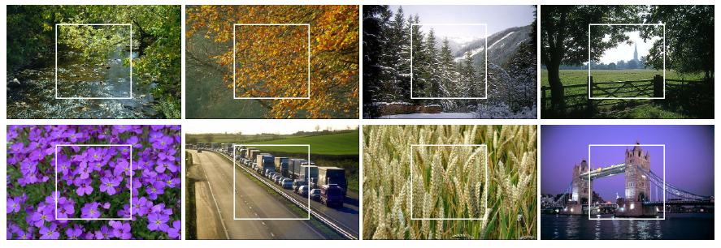
Results
Real photographs, confidently labeled as real
Lyu and Farid 2005: “How Realistic is Photorealistic?”

Slide 15
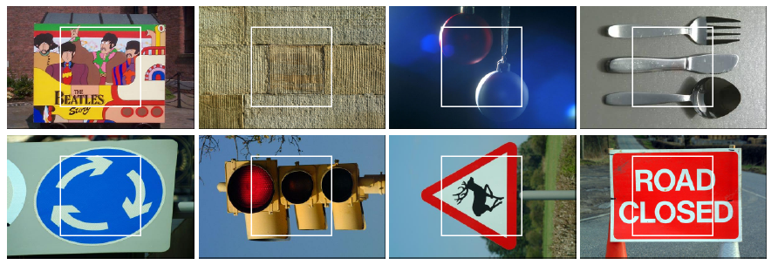
Results
Real photos, incorrectly thought to be fake
Lyu and Farid 2005: “How Realistic is Photorealistic?”

Slide 16
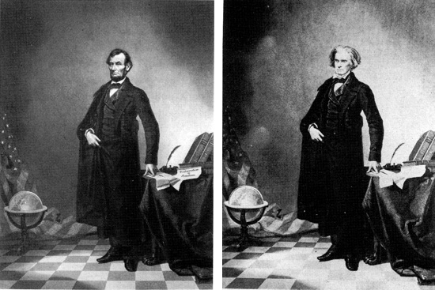
Photographic forgeries are an old problem
Examples collected by Hany Farid: http://www.fourandsix.com/photo-tampering-history/ (site no longer available)
Iconic Portrait of Lincoln (1860)

Slide 17
“While photographs may not lie, liars may photograph.”
Lewis Hine (1909)

Slide 18
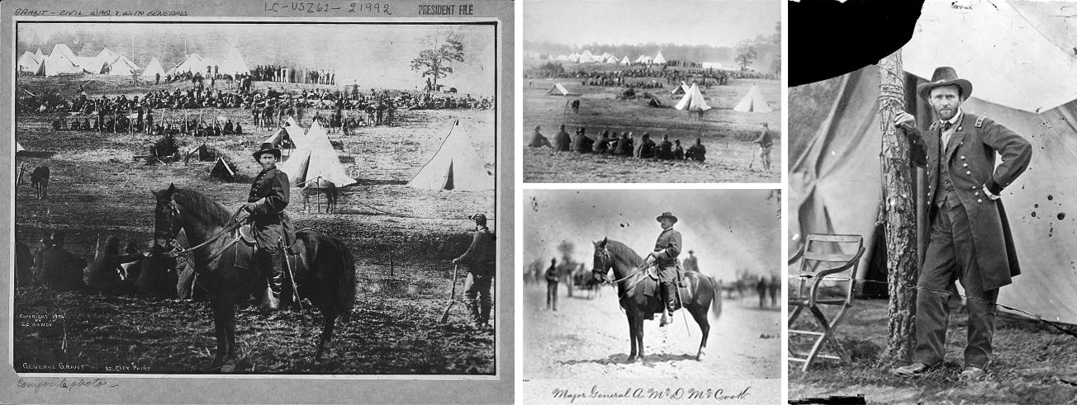
General Grant in front of Troops (1864)

Slide 19
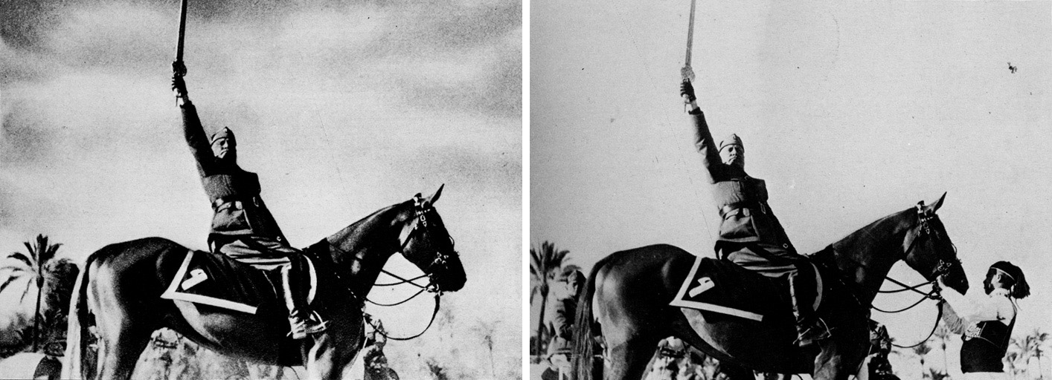
Mussolini in a Heroic Pose (1942)

Slide 20
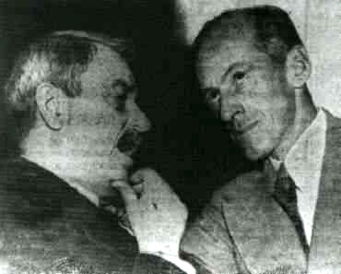
1950: Doctored photo of Senator Tydings talking with Browder, the leader of the communist party, contributed to Tydings’ electoral defeat

Slide 21
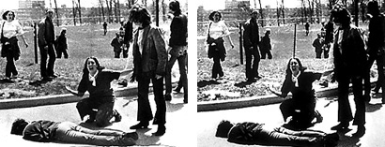
Pulitzer Prize winning photograph of Kent State killing (1970)

Slide 22
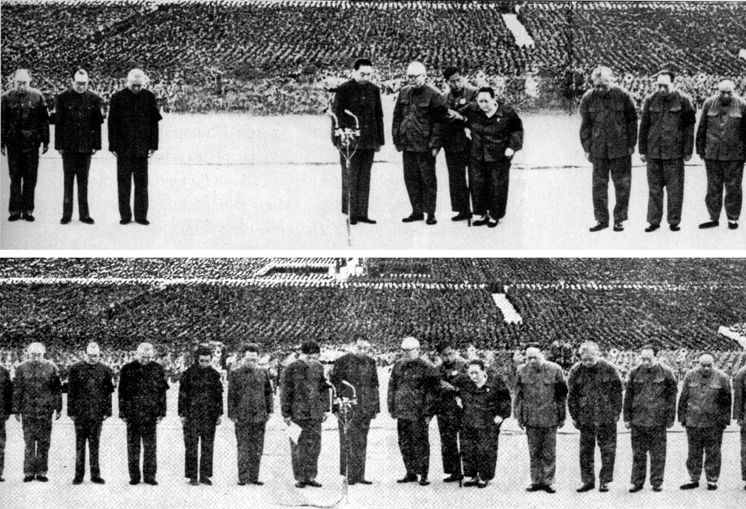
Gang of Four are removed (1976)

Slide 23
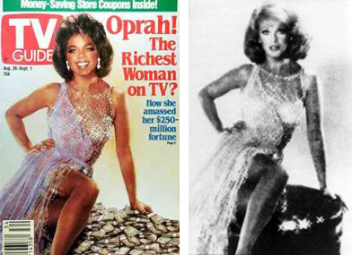
1989 composite of Oprah and Ann-Margret (without either’s permission)

Slide 24
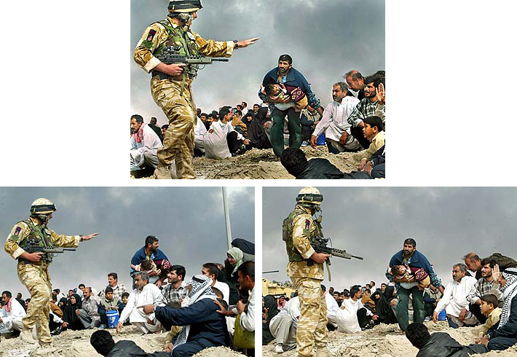
Published photo
2003: Long-time staff photographer for LA Times was fired for this one

Slide 25
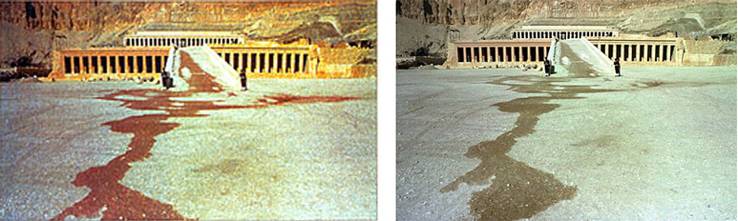
Photo from terrorist attack in 1997 in Hatshepsut, Egypt

Slide 26
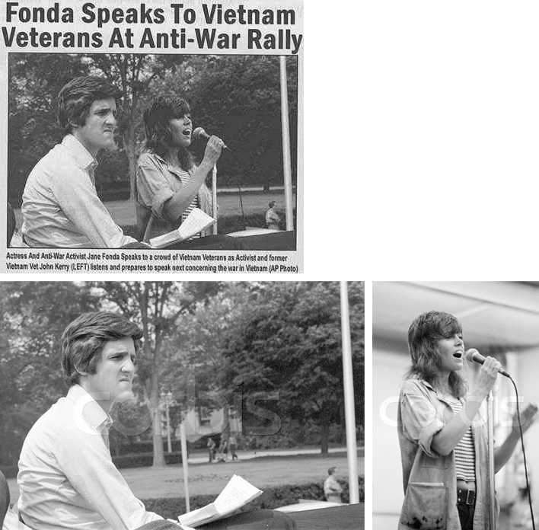
Caption: “Actress and Anti-war activist Jane Fonda speaks to a crowd of Vietnam veterans, as activist and former Vietnam vet John Kerry listens and prepares to speak next concerning the war in Vietnam.” (AP Photo)
Kerry at Rally for Peace 1971
Fonda at rally in 1972

Slide 27
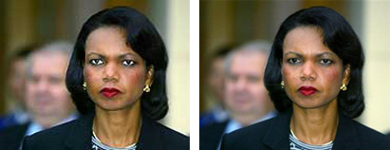
2005: USA Today SNAFU

Slide 28
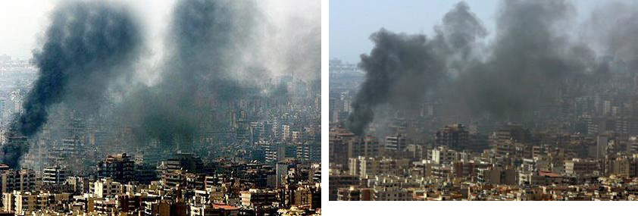
2006: Photo by Adnan Hajj of strikes on Lebanon (original on right)
Later, all of Hajj’s photos were removed from AP and a photo editor was fired.

Slide 29
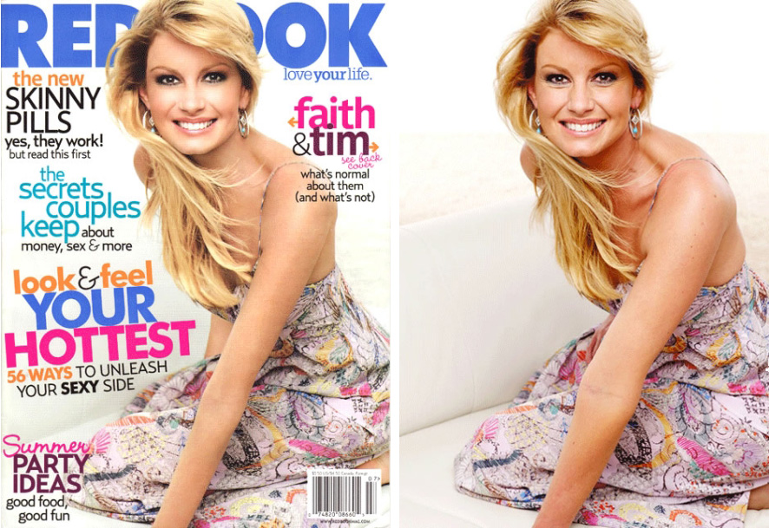
2007 Retouching is “completely in line with industry standards”

Slide 30
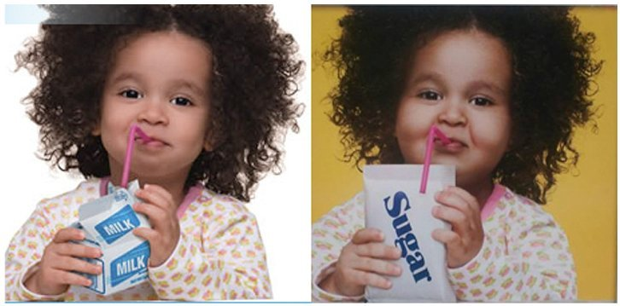
2013: Fake fattening

Slide 31
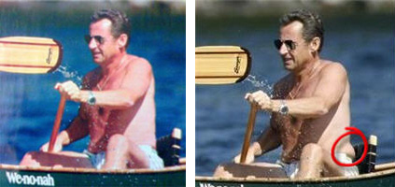
The French Magazine Paris Match altered a photograph of French President Nicolas Sarkozy by removing some body fat. (2007)

Slide 32
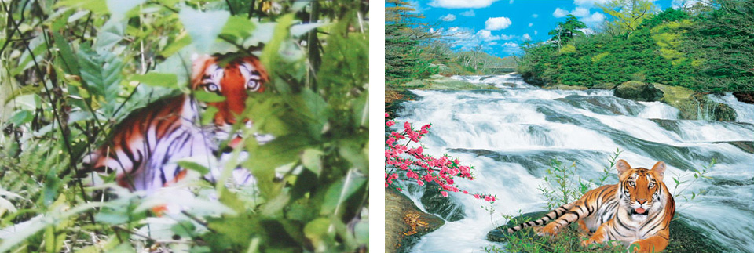
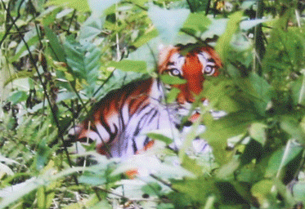
Claimed Photo
Poster
Overlay
2007: Zhou Zhenglong claimed to take 71 photos of the nearly extinct South China tiger

Slide 33
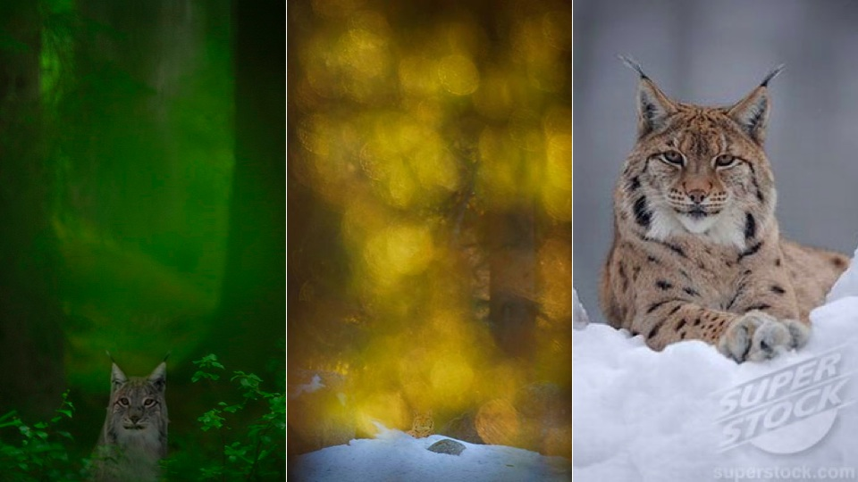
Similar scandal in 2011 from Terje Helleso who won Swedish Env. Prot. award

Slide 34
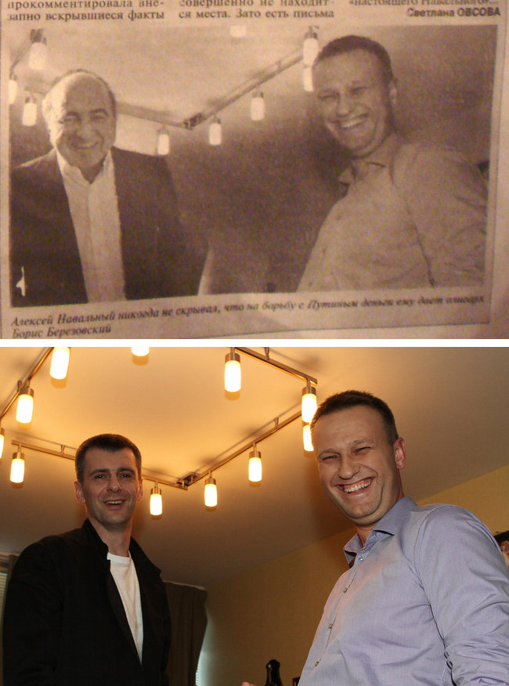
(2012) A Russian newspaper distributed by a pro-Kremlin group printed a photograph showing blogger/activist Aleksei Navalny standing beside Boris A. Berezovsky, an exiled financier being sought by Russian police.

Slide 35
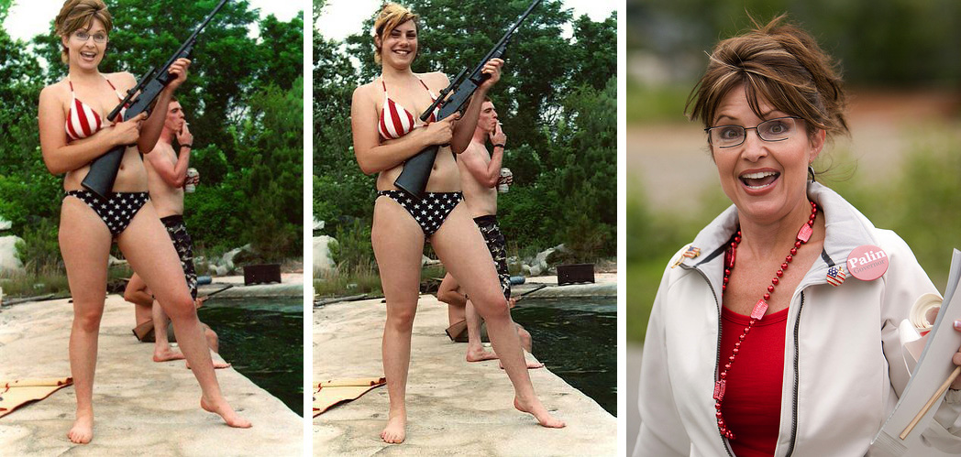
2008

Slide 36
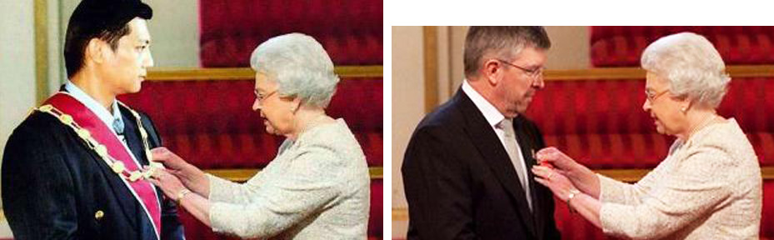
“Evidence” that Malaysian politician Jeffrey Wong Su En was knighted by the Queen (2010)

Slide 37
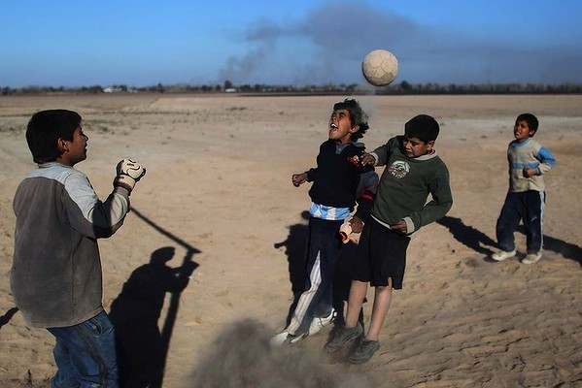
Cloning sand to remove shadow. Miguel Tovar – banned from AP, all his photos removed (2011)

Slide 38
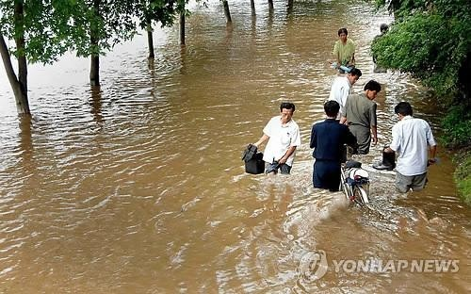
Photo from Korean Central News Agency, determined to be composite (people don’t appear wet) – was attempt to get sympathy for North Korea to get more international aid

Slide 39
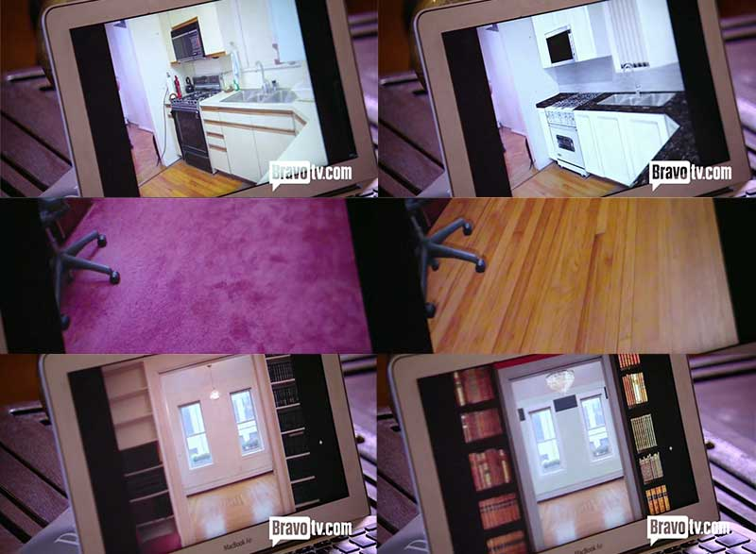
2013: fake floors, counter, appliances digitally added for listing in Luis Ortiz’s show “Million Dollar Listing New York”

Slide 40
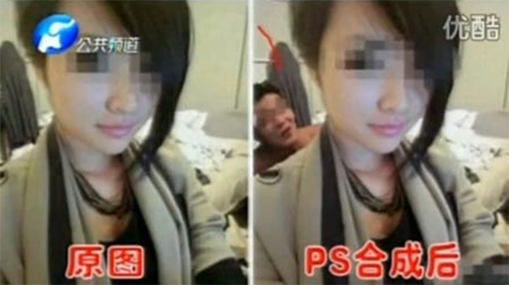
A farmer from Hunan province, China was sentenced to 12 years in prison and fined 500,000 yuan after receiving 453,00 yuan (US$73,000) in blackmail payments out of an attempted 9.47 million yuan. He had mailed to more than 200 officials pornographic photos into which he had inserted them using photo editing software. He threatened to publicize the photos unless he was paid. One of the victims claimed that he made the demanded payment before he “sensed later on that the man inside the photo was actually not me.”

Slide 41
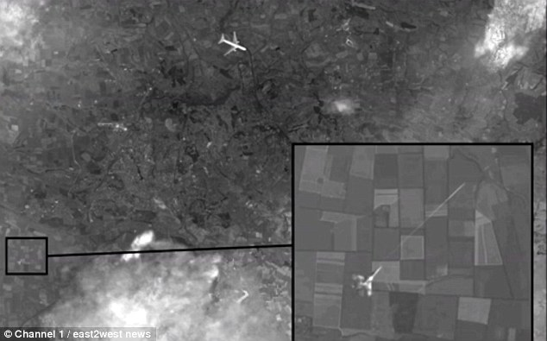
Nov 2014: Russian state media ran a story with “proof” that a Ukranian jet shot down the Malaysian airlines plane. Photo is composed of Google Earth imagery, Yandex maps, and a stock photo of a Boeing jet.
Notes:
After months of denying any responsibility for the downing of Malaysian Air’s flight MH17 over Ukraine, Russian state media ran a story featuring supposedly new satellite imagery it said proved that MH17 had been shot down by a Ukrainian fighter jet. It took very little time, however, for experts and online commentors to debunk the photo. The photo, in fact appears to have been composed of pieces of Google Earth imagery from 2012, a portion from Yandex maps, and a stock photo of a Boeing jet. Furthermore, careful analysis also showed that the location of the plane in the photo does not exactly correspond to the known path that MH17 took.

Slide 42
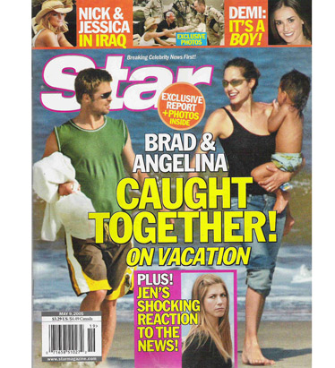
Detecting forgeries
Work by Hany Farid and colleagues
Method 1: 2D light from occluding contours

Slide 43
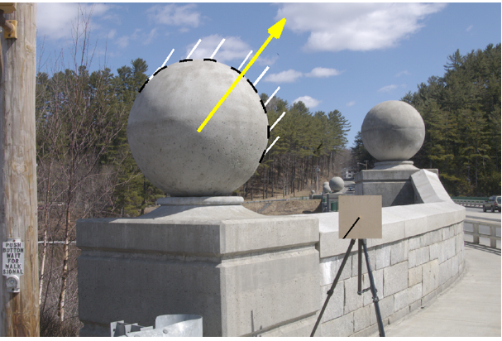
Estimating lighting direction
Method 1: 2D direction from occluding contour
Provide at least 3 points on occluding contour (surface has 0 angle in Z direction)
Estimate light direction from brightness
Estimate
Ground Truth

Slide 44
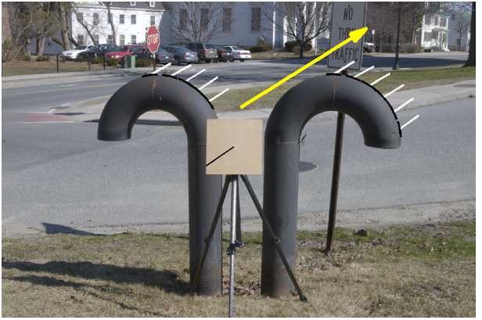
Estimating lighting direction

Slide 45
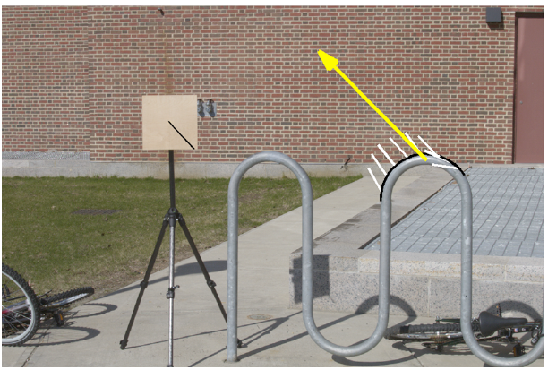
Estimating lighting direction
Average error: 4.8 degrees

Slide 46
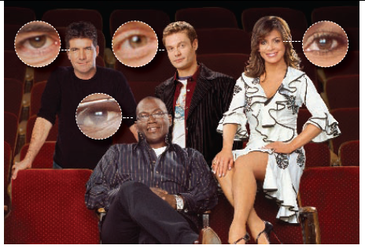
Method 2: Light from Eyes
Farid – “Seeing is not believing”, IEEE Spectrum 2009

Slide 47
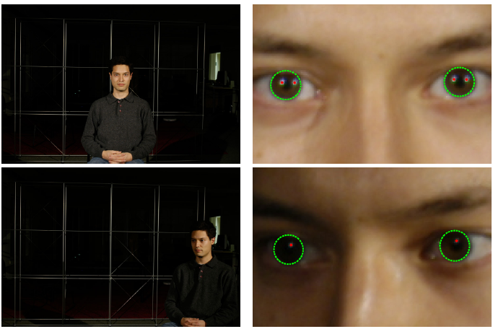
Estimating Lighting from Eyes

Slide 48
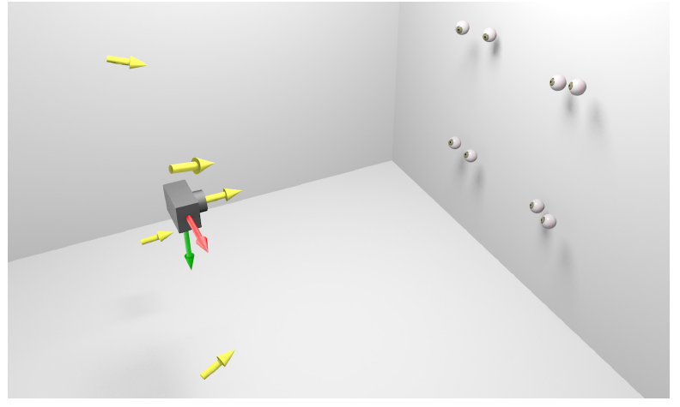
Method 2: Light from Eyes

Slide 49
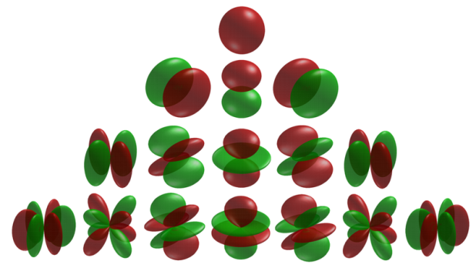
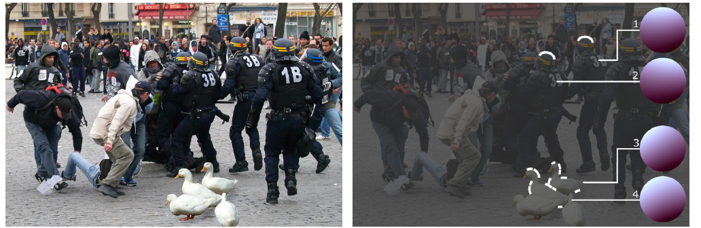
Method 3: Complex light with spherical harmonics
Spherical harmonics parameterize complex lighting environment
Same method as occluding contours, but need 9 points

Slide 50
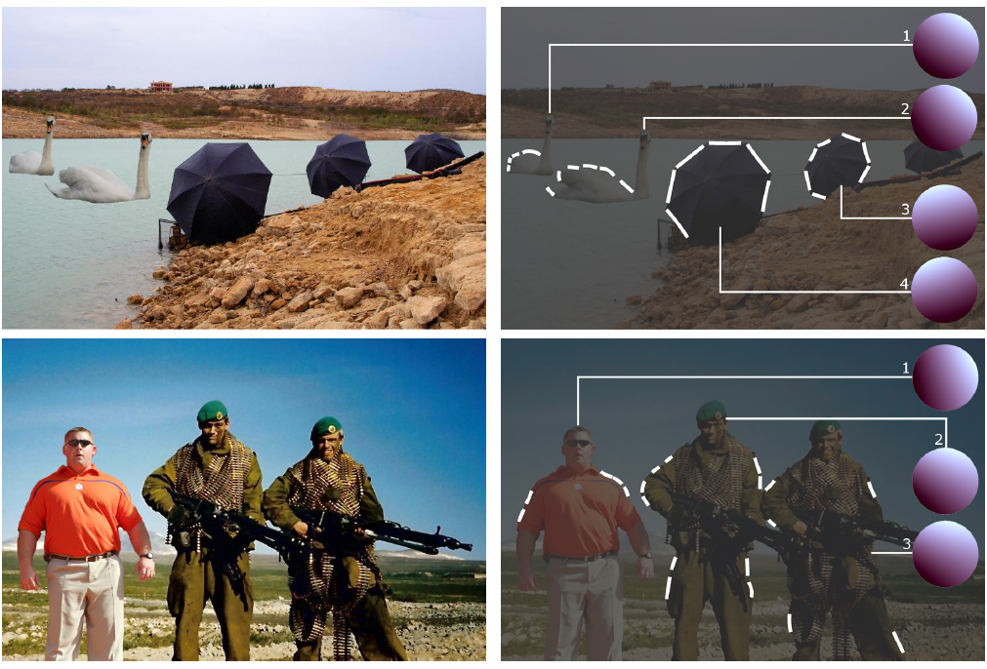
Method 3: Complex light with spherical harmonics

Slide 51
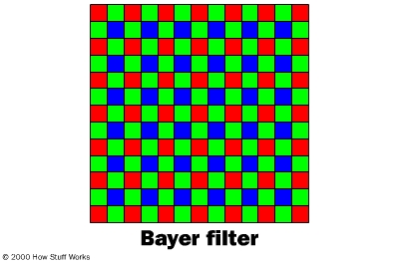
Method 4: Demosaicking Prediction
In demosaicking, RGB values are filled in based on surrounding measured values
Filled in values will be correlated in a particular way for each camera
Local tampering will destroy these correlations
Farid: “Photo Fakery and Forensics” 2009

Slide 52
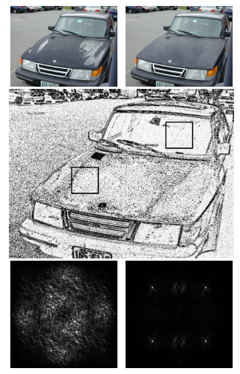
Demosaicking prediction
Upside: can detect many kinds of forgery
Downside: need original resolution, uncompressed image
Original Tampered
Error in pixel prediction from a linear interpolation
FFT of error in each window (periodic for untampered case)

Slide 53
Method 5: JPEG Ghosts
JPEG compresses 8x8 blocks by quantizing DCT coefficients to some level
  E.g., coefficient value is 23, quantization = 7, quantized value = 3, error = 23-21=2
Resaving a JPEG at the same quantization will not cause error, but resaving at a lower or higher quantization generally will
  Value = 21; quantization = 13; error = 5
  Value = 21; quantization = 4; error = 1
Farid: “Photo Fakery and Forensics” 2009

Slide 54
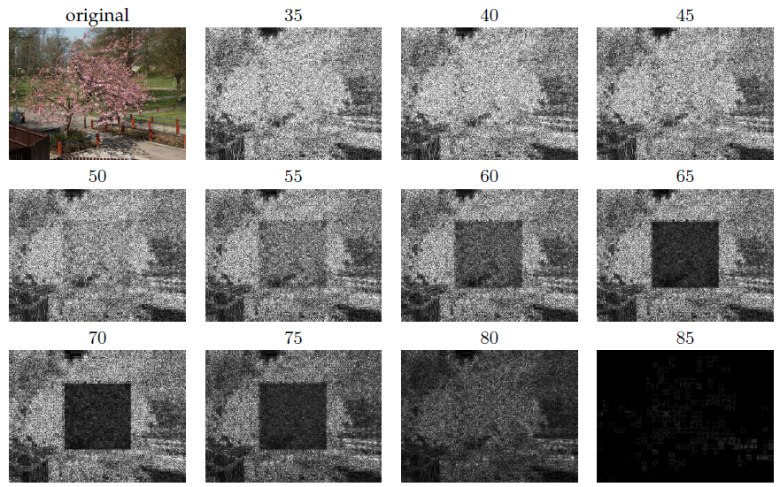
JPEG Ghosts
Original is saved at 85 quality, center square is cut out and compressed at 65 quality; then image is resaved at given qualities
Pixel error for image saved at various JPEG qualities

Slide 55

JPEG Ghosts
If there is enough difference between the quality of the pasted region and the final saved quality, the pasted region can be detected with high accuracy

Slide 56

JPEG Ghosts
original
manipulated
Pixel error for manipulated image saved at various JPEG qualities

Slide 57

JPEG Ghosts
original
manipulated
Pixel error for manipulated image saved at various JPEG qualities

Slide 58
Generating fake images with deep networks
Pix2Pix
CycleGAN
StyleGAN
Diffusion Networks

Slide 59


pix2pix: Image-to-Image Translation
Slides adapted from Isola, Zhu
Image-to-image Translation with Conditional Adversarial Nets
Phillip Isola, Jun-Yan Zhu, Tinghui Zhou, Alexei A. Efros. CVPR 2017

Slide 60


Image to image translation (pix2pix)
Train a conditional generator to translate from one image domain to another

Slide 61





Objective 1: L1 Loss
$$x$$
$$G(x)$$
$$G$$
Sum absolute RGB difference
$$y$$
$$LL1\left(G\right)={𝔼_{x,y}}|\left|y−G\left(x\right)\right||1$$

Slide 62
L1 objective tends to produce slightly blurry results

Slide 63




Objective 2: Paired Adversarial Loss
$$x$$
$$G(x)$$
$$G$$
$$D$$
real or fake pair ?
$$LGAN\left(G,D\right){=𝔼_{x,y}\left[\log{D(x, G\left(x\right))}+\log{(1−D\left(x, y\right))}\right]{}}$$
fake pair
real pair

Slide 64
By itself, cGAN has some high texture artifacts

Slide 65
Combined Objective
$$G$$
$$D$$
real or fake pair ?
$$G∗=\min_{G}{\max_{D}{LGAN\left(G,D\right)+λL1(G)}}$$

Slide 66
Combined objective works best

Slide 67
Design Choices
U-Net Encoder/Decoder helps preserve detail

Slide 68
Design Choices
PatchGAN: Discriminator classifies NxN patches so that it focuses on details/texture that L1 loss doesn’t capture
NxN = 70x70 works well in experiments
Average responses across patches

Slide 69












Sketches → Images
Input
Output
Input
Output
Input
Output
Trained on Edges → Images
Data from [Eitz, Hays, Alexa, 2012]

Slide 70




#edges2cats
[Christopher Hesse]
@gods_tail
@matthematician
Vitaly Vidmirov @vvid
Ivy Tasi @ivymyt
https://affinelayer.com/pixsrv/

Slide 71





Input
Output
Groundtruth
Data from
[maps.google.com]

Slide 72












BW → Color
Input
Output
Input
Output
Input
Output
Data from [Russakovsky et al. 2015]

Slide 73
ICCV 2017

Slide 74
Cycle GAN
Hard to get exact image domain translations for training, but easy to get unmatched sets of images
Key idea: if you translate an image and then translate it back, you should get the original
English
Arabic
أعطيت قطتي حمام دافئ
I gave my cat a warm bath
My cat was given a warm bath

Slide 75








Cycle Consistency Loss
$$x$$
$$G(x)$$
$$F(G\left(x\right))$$
$$D_{Y}(G\left(x\right))$$
Reconstruction
error
$${\left\|F\left(G\left(x\right)\right)−x\right\|}_{1}$$
Slide credit:Jun-Yan Zhu
[Zhu*, Park*, Isola, and Efros, ICCV 2017]

Slide 76




Cycle Consistency Loss
Large cycle loss
Small cycle loss
$$x$$
$$G(x)$$
$$F(G\left(x\right))$$
$$D_{Y}(G\left(x\right))$$
Reconstruction
error
$${\left\|F\left(G\left(x\right)\right)−x\right\|}_{1}$$
Slide credit:Jun-Yan Zhu
[Zhu*, Park*, Isola, and Efros, ICCV 2017]
Notes:
Cycle loss prevents always predicting the same image, because you have to be able to recover the original from the prediction

Slide 77







Cycle Consistency Loss
$$x$$
$$G(x)$$
$$F(G\left(x\right))$$
$$y$$
$$F(y)$$
$$G(F\left(y\right))$$
$$D_{Y}(G\left(x\right))$$
$$D_{G}(F\left(x\right))$$
Reconstruction
error
Reconstruction
error
$${\left\|F\left(G\left(x\right)\right)−x\right\|}_{1}$$
$${\left\|G\left(F\left(y\right)\right)−y\right\|}_{1}$$
Slide credit:Jun-Yan Zhu
[Zhu*, Park*, Isola, and Efros, ICCV 2017]

Slide 78
Cycle GAN: Full Objective
Produce images that look like each domain (according to discriminators) and complete a cycle
For L_{GAN} a squared loss is used instead of log loss

Slide 79





Collection Style Transfer
Photograph
@ Alexei Efros
Ukiyo-e
Cezanne
Van Gogh
Monet
Results slides credit:Jun-Yan Zhu

Slide 80




















Input
Monet
Van Gogh
Cezanne
Ukiyo-e

Slide 81



Monet’s paintings $→$ photos

Slide 82




Monet’s paintings $→$ photos

Slide 83









Slide 84





Slide 85





Slide 86
CycleGAN Horse -> Zebra
https://youtu.be/9reHvktowLY

Slide 89
ICCV 2019

Slide 90
Everybody Dance Now
Open Pose
Conditional GAN

Slide 91
Everybody Dance Now
Optimize a body GAN, face GAN, and temporal smoothness
Discriminator conditions on pose and previous image and uses a perceptual distance for loss

Slide 92
Everybody Dance Now Video
https://www.youtube.com/watch?v=PCBTZh41Ris

Slide 93


StyleGAN (Karras et al. CVPR 2019)
Notes:
While a traditional generator [30] feeds the latent code though the input layer only, we first map the input to an intermediate
latent space W, which then controls the generator through adaptive instance normalization (AdaIN) at each convolution
layer. Gaussian noise is added after each convolution, before evaluating the nonlinearity. Here “A” stands for a learned
affine transform, and “B” applies learned per-channel scaling factors to the noise input. The mapping network f consists of 8 layers
and the synthesis network g consists of 18 layers—two for each resolution (4^2…1024^2). The output of the last layer is converted
to RGB using a separate 1 x1 convolution, similar to Karras et al. [30]. Our generator has a total of 26.2M trainable parameters,
compared to 23.1M in the traditional generator.

Slide 94
Style Mixing
Switch from one latent code to another at a random point in the synthesis network

Slide 96
Language Models and Diffusion Networks – Awesome short vids by Steve Seitz
Text to Image: Parti, Dall-E 2, Imagen
https://www.youtube.com/watch?v=GYyP7Ova8KA&list=PLWfDJ5nla8UpwShx-lzLJqcp575fKpsSO&index=22
Text to Image: Part 2 -- Diffusion
https://www.youtube.com/watch?v=lyodbLwb2lY&list=PLWfDJ5nla8UpwShx-lzLJqcp575fKpsSO&index=23

Slide 97
How to detect deep fakes?
Google is creating DeepFake data for researchers: https://ai.googleblog.com/2019/09/contributing-data-to-deepfake-detection.html
Mazaheri and Roy-Chowdhury (WACV 2022) report 99% accuracy in detection (when able to train on fake samples)
Deep fake detection article: https://nerdist.com/article/deepfake-detector/
https://youtu.be/RoGHVI-w9bE
“Everybody dance now” provides a classifier to identify videos produced by their system
Whose responsibility is it to detect fake images?

Slide 98
Summary
Lots of fun and creative uses for generating images
But digital forgeries are an increasingly major problem as it becomes easier to fake images
A variety of automatic and semi-automatic methods are available for detection of well-done manual forgeries
  Checking lighting consistency
  Checking demosaicking consistency (for high quality images)
  Checking JPEG compression level consistency (for low quality images)
“Deep fakes” have recently become effective, and deep fake detection is a new challenge

Slide 99
Upcoming
Next: How the Kinect Works
After that: Neural Rendering Fields (NeRF)

