Slide 1
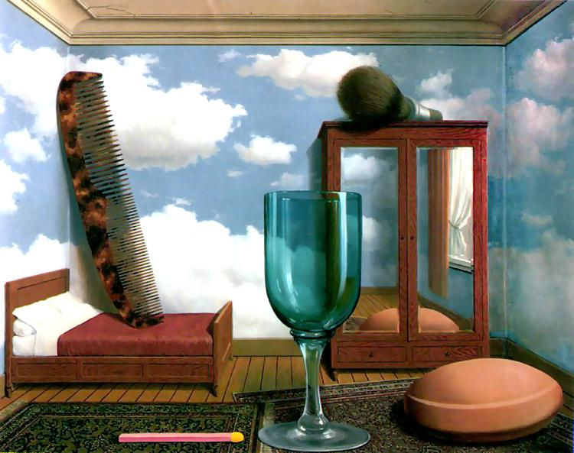
Single-view Metrology and Cameras
Computational Photography
Derek Hoiem, University of Illinois

Slide 2
Review: Pinhole Camera
.
Optical Center (u₀, v₀)
.
.
f
Z
Y
.
v
Camera Center (t_{x}, t_{y}, t_{z})
u

Slide 3
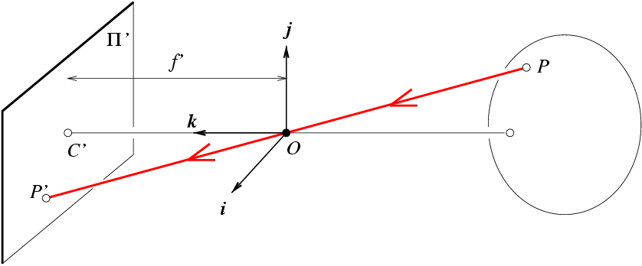
Review: Projection Matrix
R
j_{w}
t
k_{w}
O_{w}
i_{w}

Slide 4
Take-home question review
Suppose the camera axis is in the direction of (x=0, y=0, z=1) in its own coordinate system. What is the camera axis in world coordinates given the extrinsic parameters R, t
Suppose a camera at height y=h (x=0,z=0) observes a point at (u,v) known to be on the ground (y=0). Assume R is identity. What is the 3D position of the point in terms of f, u₀, v₀?

Slide 5
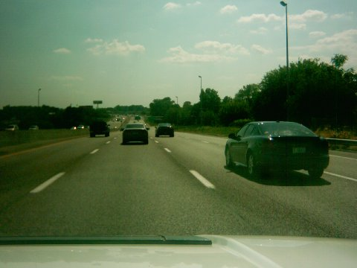
Take-home question review
Suppose we have two 3D cubes on the ground facing the viewer, one near, one far.
What would they look like in perspective?
What would they look like in weak perspective?
Photo: Kathy from Flickr

Slide 6
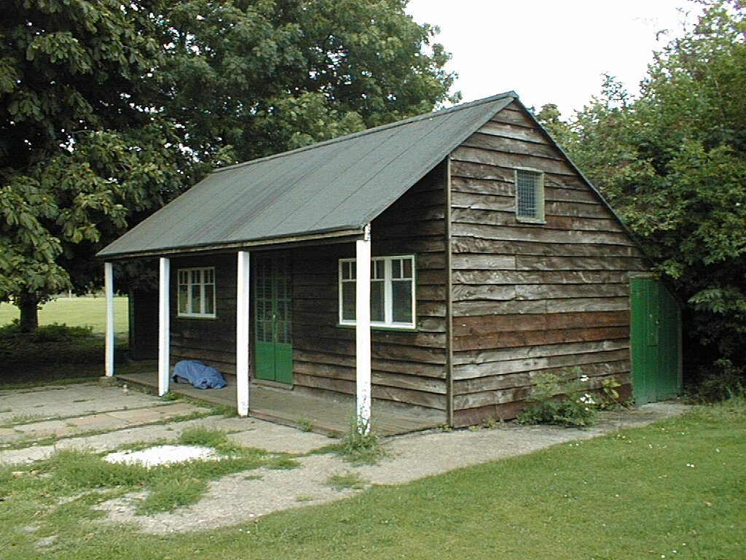
Review: Vanishing Points
Vertical vanishing
point
(at infinity)
Vanishing
line
Vanishing
point
Vanishing
point
Slide from Efros, Photo from Criminisi

Slide 7
This class
How can we calibrate the camera?
How can we measure the size of objects in the world from an image?
What about other camera properties: focal length, field of view, depth of field, aperture, f-number?

Slide 8
How to calibrate the camera?

Slide 9
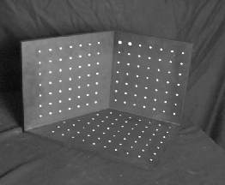
Calibrating the Camera
Method 1: Use an object (calibration grid) with known geometry
  Correspond image points to 3d points
  Get least squares solution (or non-linear solution)

Slide 10
Calibrating the Camera
Method 2: Use vanishing points
  Find vanishing points corresponding to orthogonal directions
Vertical vanishing
point
(at infinity)
Vanishing
line
Vanishing
point
Vanishing
point

Slide 11
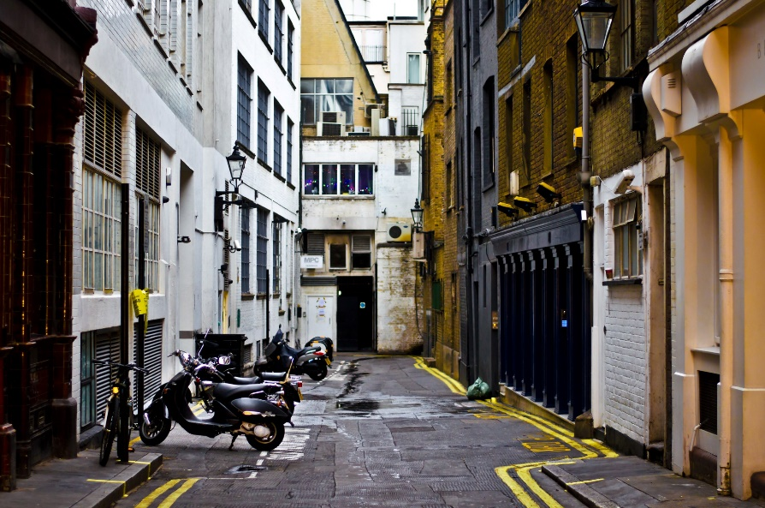
Take-home question (for later)
Suppose you have estimated finite three vanishing points corresponding to orthogonal directions:
  How to solve for intrinsic matrix? (assume K has three parameters)
    The transpose of the rotation matrix is its inverse
    Use the fact that the 3D directions are orthogonal
  How to recover the rotation matrix that is aligned with the 3D axes defined by these points?
    In homogeneous coordinates, 3d point at infinity is (X, Y, Z, 0)
VP_{y}
.
VP_{x}
VP_{z}
Photo from Garry Knight

Slide 12
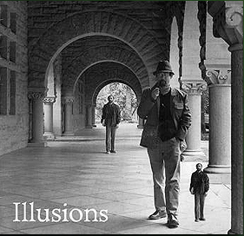
How can we measure the size of 3D objects from an image?

Slide 13
Perspective cues
Slide by Steve Seitz

Slide 14
Perspective cues
Slide by Steve Seitz

Slide 15
Perspective cues
Slide by Steve Seitz

Slide 16
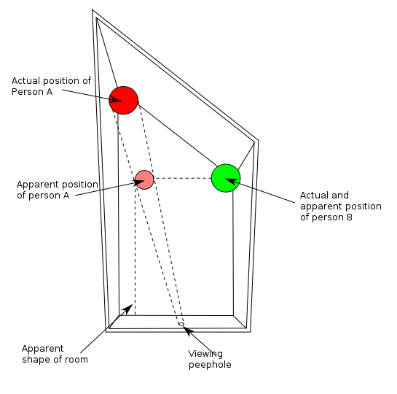
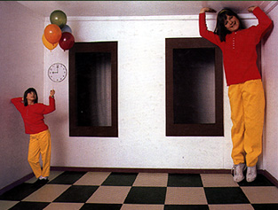
Ames Room

Slide 17
Comparing heights
Slide by Steve Seitz
Vanishing
Point

Slide 18
Measuring height
Slide by Steve Seitz
5.4
5
Camera height
4
3.3
3
2.8
2
1

Slide 19
Two views of a scene
Image
camera center
Parallel to ground
horizon
image plane
ground
camera looks down
slight foreshortening due to camera angle

Slide 20

Which is higher – the camera or the parachute?

Slide 21
Computing vanishing points (from lines)
v
q₂
q₁
p₂
p₁
Intersect p₁q₁ with p₂q₂
Least squares version
  Better to use more than two lines and compute the “closest” point of intersection
  See notes by Bob Collins for one good way of doing this:
    http://www-2.cs.cmu.edu/~ph/869/www/notes/vanishing.txt

Slide 22
Measuring height without a giant ruler
C
Z
ground plane
Compute Z from image measurements
  Need a reference object
Slide by Steve Seitz

Slide 23
The cross ratio
A Projective Invariant
  Something that does not change under projective transformations (including perspective projection)
The cross-ratio of 4 collinear points
P₄
P₃
P₂
P₁
Can permute the point ordering
  4! = 24 different orders (but only 6 distinct values)
This is the fundamental invariant of projective geometry
Slide by Steve Seitz

Slide 24
Measuring height
∞
scene cross ratio
T (top of object)
t
r
R (reference point)
C
H
b
R
image cross ratio
v_{Z}
B (bottom of object)
ground plane
scene points represented as
image points as
Slide by Steve Seitz

Slide 25


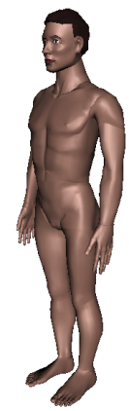
Measuring height
v_{z}
Slide by Steve Seitz
r
vanishing line (horizon)
t₀
t
v_{x}
v
v_{y}
H
R
H
b₀
b
image cross ratio

Slide 26
Measuring height
v_{z}
Slide by Steve Seitz
r
t₀
vanishing line (horizon)
t₀
v_{x}
v
v_{y}
m₀
t₁
b₀
b₁
b
What if the point on the ground plane b₀ is not known?
  Here the guy is standing on the box, height of box is known
  Use one side of the box to help find b₀ as shown above

Slide 27
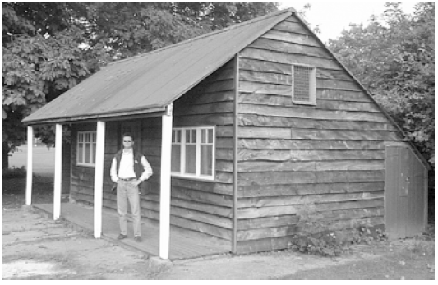
Take-home question
Assume that the man is 6 ft tall
  What is the height of the front of the building?
  What is the height of the camera?

Slide 28
Beyond the pinhole: What about focus, aperture, DOF, FOV, etc?
.
Optical Center (u₀, v₀)
.
.
f
Z
Y
.
v
Camera Center (t_{x}, t_{y}, t_{z})
u

Slide 29
Adding a lens
“circle of
confusion”
A lens focuses light onto the film
  There is a specific distance at which objects are “in focus”
    other points project to a “circle of confusion” in the image
  Changing the shape of the lens changes this distance

Slide 30
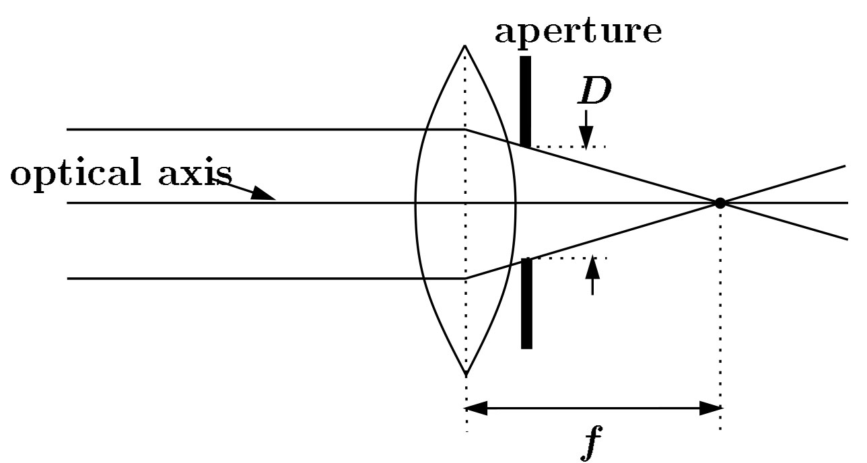
Focal length, aperture, depth of field
F
focal point
optical center
(Center Of Projection)
A lens focuses parallel rays onto a single focal point
focal point at a distance f beyond the plane of the lens
Aperture of diameter D restricts the range of rays
Slide source: Seitz

Slide 31
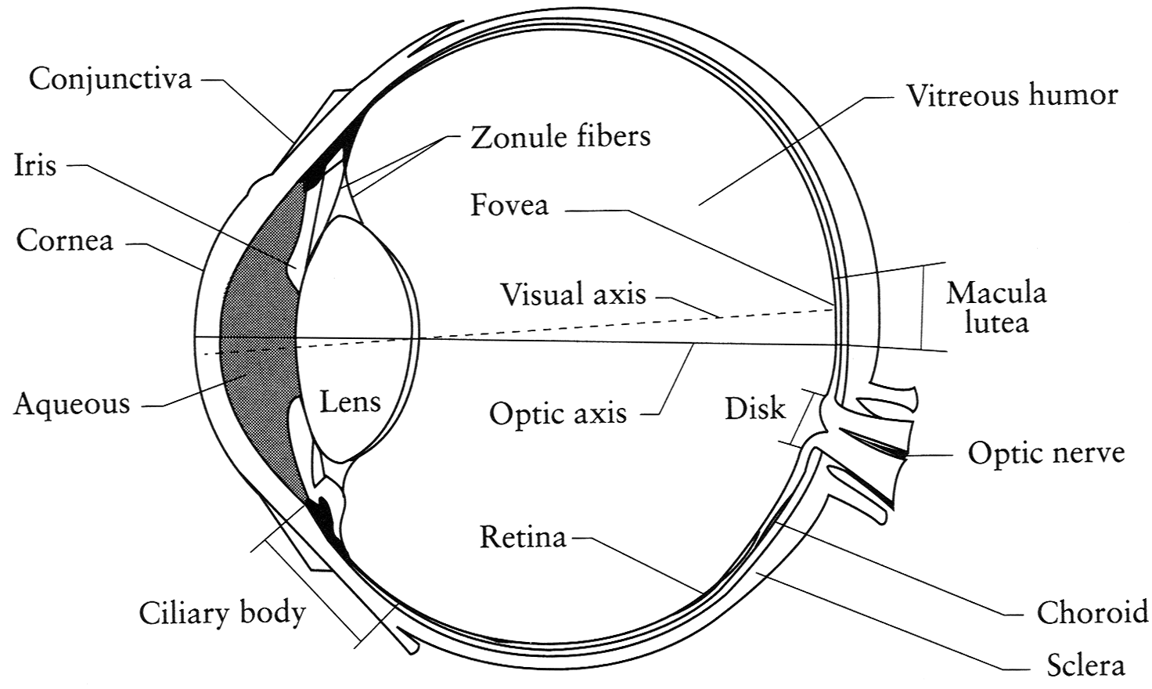
The eye
The human eye is a camera
  Iris - colored annulus with radial muscles
  Pupil - the hole (aperture) whose size is controlled by the iris
Figure: Fig. 1.1, Principles of Digital Image Synthesis, Volume 1. Andrew Glassner
Notes:
Note that the retina is curved

Slide 32
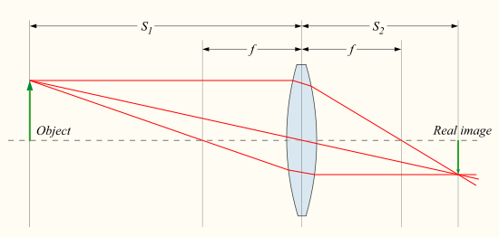

Focus with lenses
Distance to object
Distance to sensor
Lens focal length
Equation for objects in focus
Source: http://en.wikipedia.org/wiki/File:Lens3.svg

Slide 33

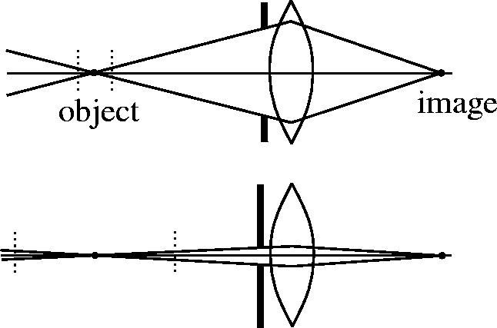

The aperture and depth of field
Slide source: Seitz
Depth of Field
f / 5.6
f / 32
Changing the aperture size or focusing distance affects depth of field
  f-number (f/#) =focal_length / aperture_diameter (e.g., f/16 means that the focal length is 16 times the diameter)
  When you change the f-number, you are changing the aperture
  Depth of Field = range around focused distance that leads to smaller than threshold circle of confusion
Flower images from Wikipedia http://en.wikipedia.org/wiki/Depth_of_field

Slide 34
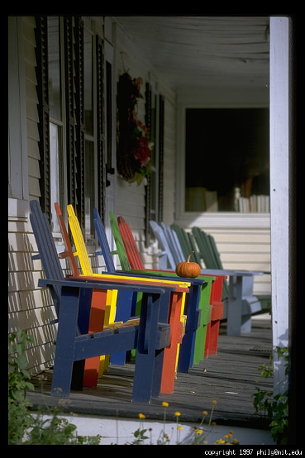
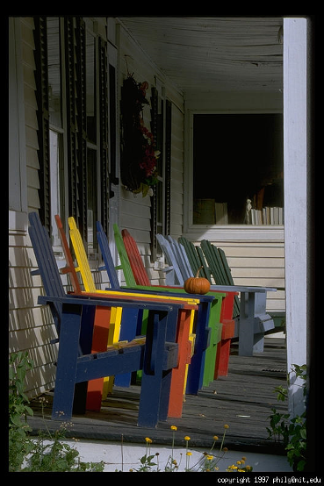
Varying the aperture
Photo credit: Philip Greenspun
Large aperture = small DOF
Small aperture = large DOF

Slide 35
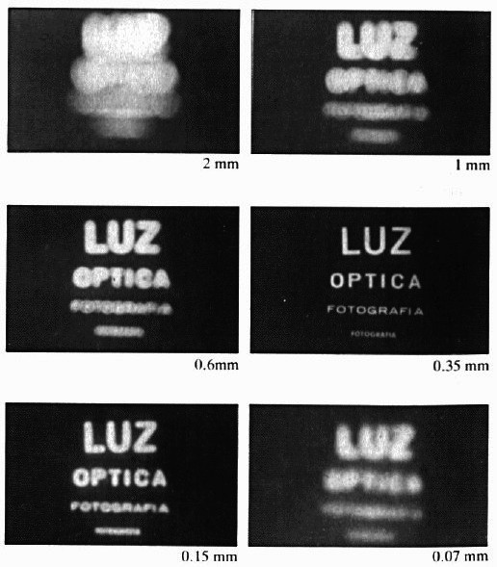
Shrinking the aperture
Why not make the aperture as small as possible?
  Less light gets through
  Diffraction effects
Figure: Optics. Eugene Hecht

Slide 36
Shrinking the aperture
Figure: Optics. Eugene Hecht

Slide 37
The Photographer’s Great Compromise
What we want
More spatial resolution
Broader field of view
More depth of field
More temporal resolution
More light
How we get it
Cost
Increase focal length
Light, FOV
Decrease focal length
DOF
Decrease aperture
Light
Increase aperture
DOF
Shorten exposure
Light
Lengthen exposure
Temporal Res

Slide 38

Things to remember
Can calibrate using grid or VP
Can measure relative sizes using VP
Effects of focal length, aperture
5
4
3
2
1

Slide 39
Next class
Go over take-home questions from today
Tricks with focal length: focus stacking and dolly zoom
Single-view 3D Reconstruction

