Slide 1
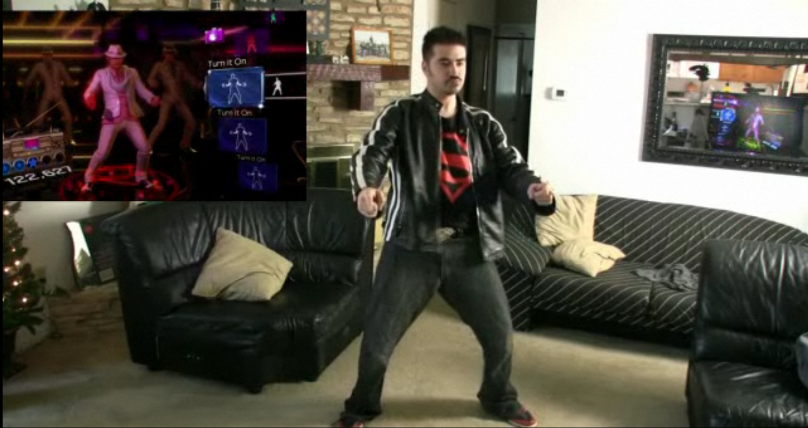
How the Kinect Works
11/13/19
T2
Computational Photography
Derek Hoiem, University of Illinois
Photo frame-grabbed from: http://www.blisteredthumbs.net/2010/11/dance-central-angry-review

Slide 2
Incomplete list of excellent projects
Rendered image looks really good:
https://liwenwu2.web.illinois.edu/cs445/proj4/
Contains GIF rendering:
https://yilinma3.web.illinois.edu/cs445/proj4/
Quality shadow rendering:
https://anbangy2.web.illinois.edu/cs445/proj4/
Pokemon meshes:
https://wyang52.web.illinois.edu/cs445/proj4/

Slide 3
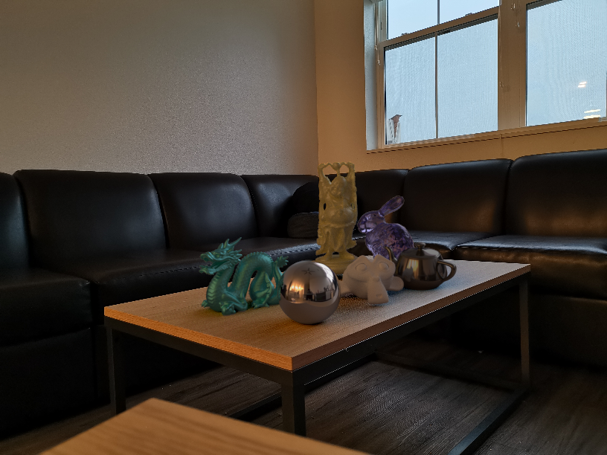
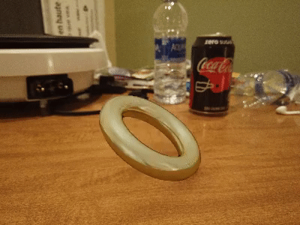
Yilin Ma Kexiang Wang
Liwen Wu

Slide 4
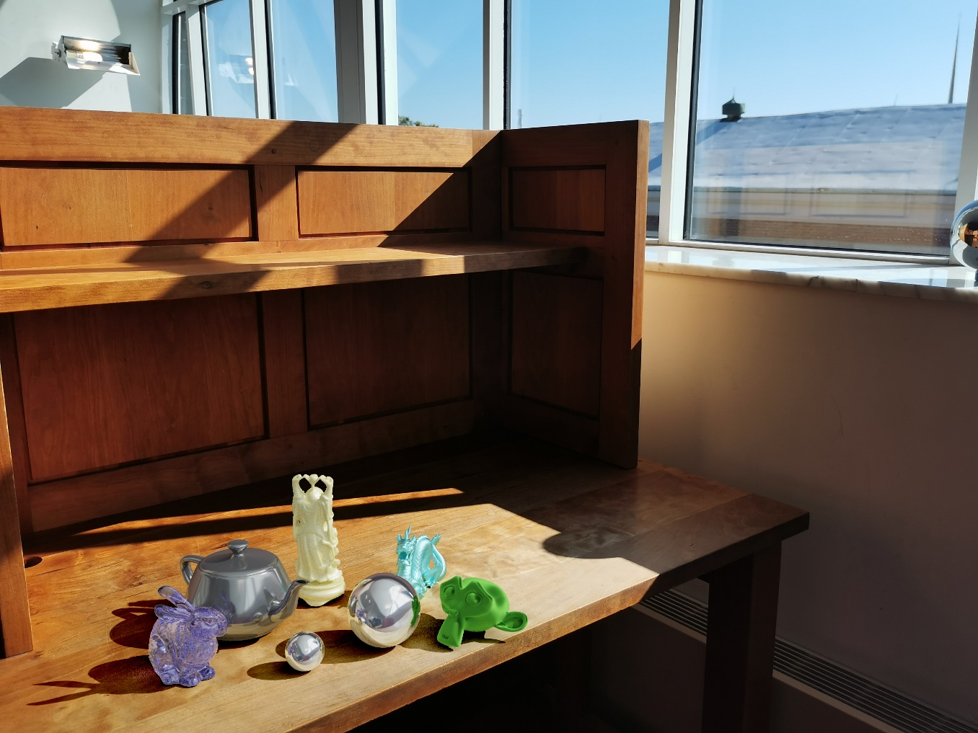
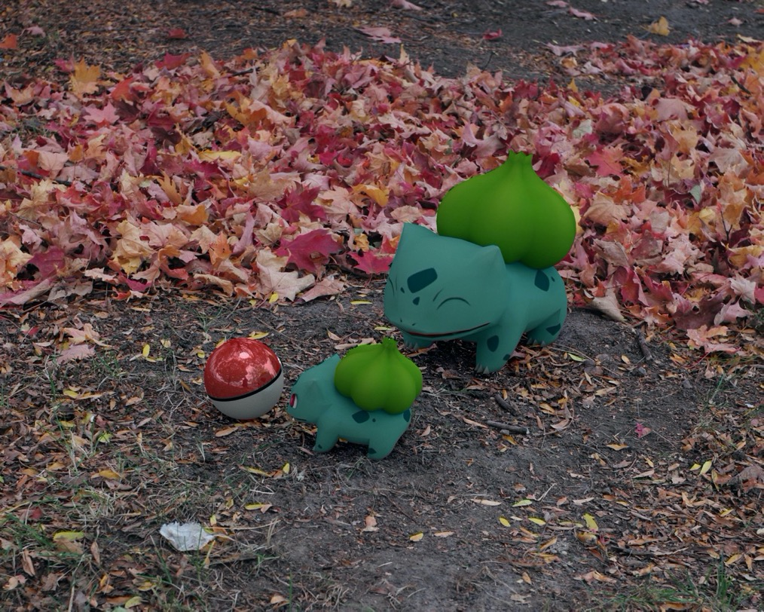
Anbang Ye
Wanxian Yang
Ruicheng Xian

Slide 5
How the Kinect Works
T2
Computational Photography
Derek Hoiem, University of Illinois
Photo frame-grabbed from: http://www.blisteredthumbs.net/2010/11/dance-central-angry-review

Slide 6
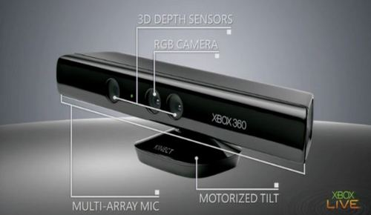
Kinect Device

Slide 7
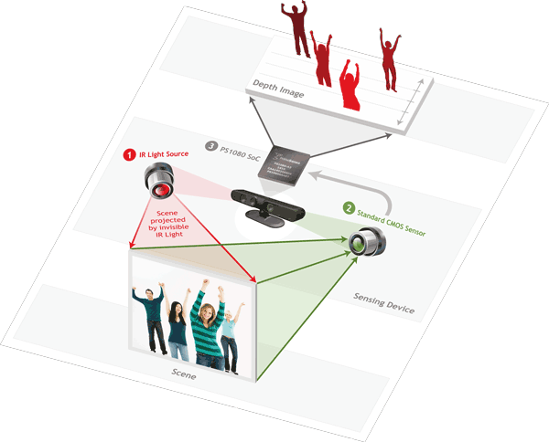
Kinect Device
illustration source: primesense.com

Slide 8
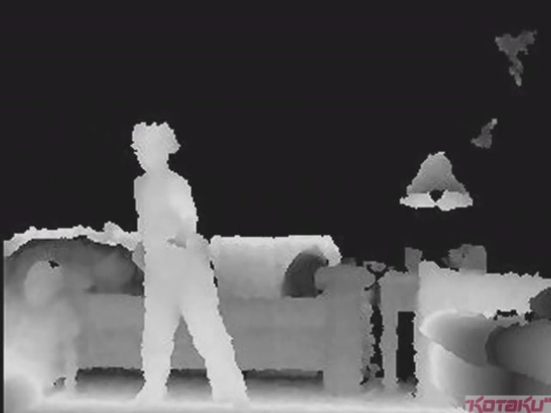

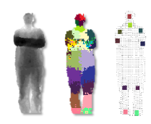
What the Kinect does
Get Depth Image
Application (e.g., game)
Estimate Body Pose

Slide 9
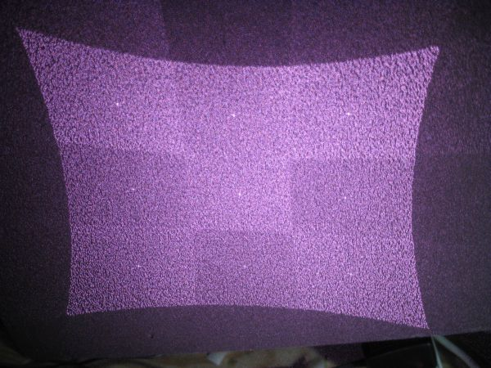
How Kinect Works: Overview
IR Projector
IR Sensor
Projected Light Pattern
Stereo Algorithm
Segmentation,
Part Prediction
Depth Image
Body Pose

Slide 10
Part 1: Stereo from projected dots
IR Projector
IR Sensor
Projected Light Pattern
Stereo Algorithm
Segmentation,
Part Prediction
Depth Image
Body Pose

Slide 11
Part 1: Stereo from projected dots
Overview of depth from stereo
How it works for a projector/sensor pair
Stereo algorithm used by Primesense (Kinect)

Slide 12
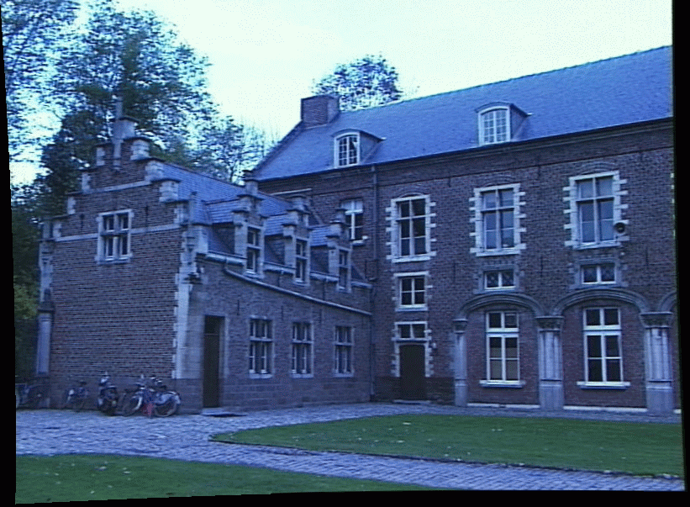
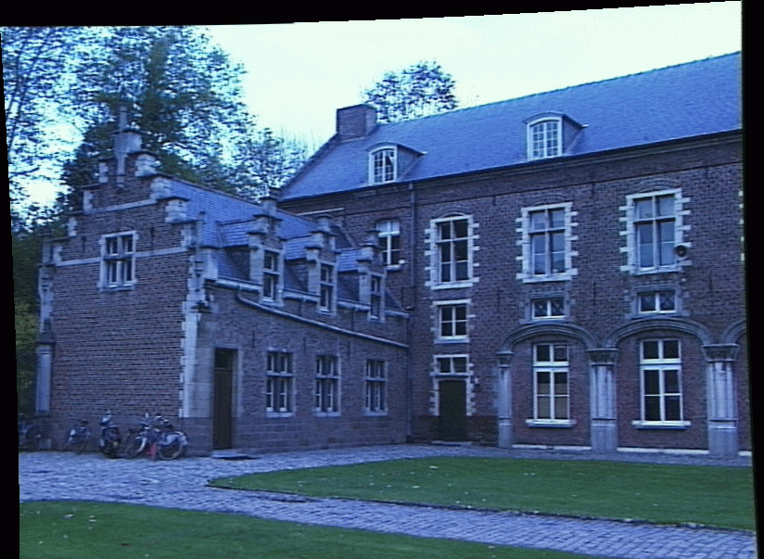
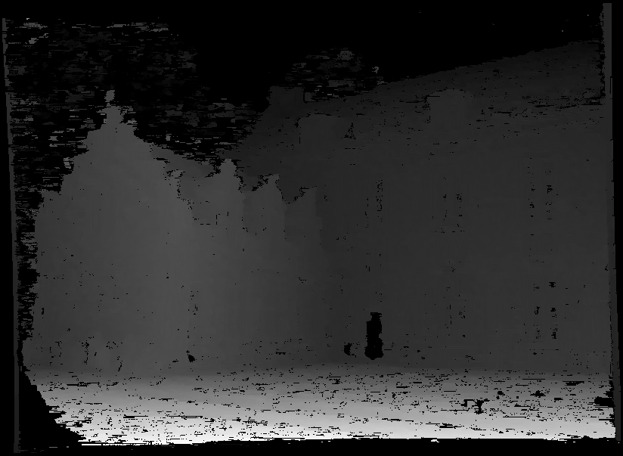
Depth from Stereo Images
image 1
image 2
Dense depth map
Some of following slides adapted from Steve Seitz and Lana Lazebnik

Slide 13
Depth from Stereo Images
Goal: recover depth by finding image coordinate x’ that corresponds to x
X
X
x
z
x
x’
x'
f
f
O
Baseline
B
O’

Slide 14
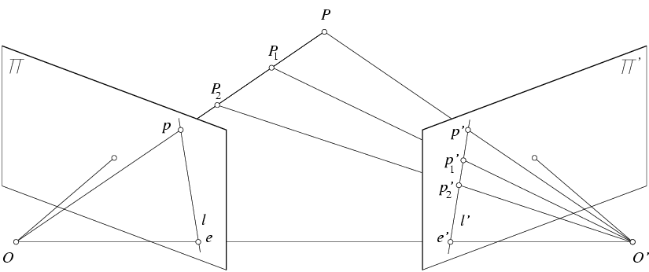
Stereo and the Epipolar constraint
X
X
X
x
x’
x’
x’
Potential matches for x have to lie on the corresponding line l’.
Potential matches for x’ have to lie on the corresponding line l.

Slide 15
Simplest Case: Parallel images
Image planes of cameras are parallel to each other and to the baseline
Camera centers are at same height
Focal lengths are the same
Then, epipolar lines fall along the horizontal scan lines of the images

Slide 16
Depth from disparity
X
z
x
x’
f
f
O
Baseline
B
O’
Disparity is inversely proportional to depth.

Slide 17
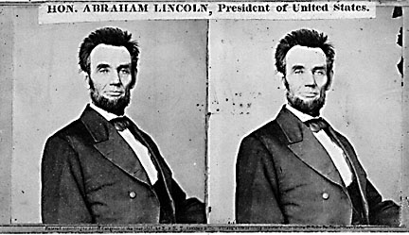
Basic stereo matching algorithm
For each pixel in the first image
  Find corresponding epipolar line in the right image
  Examine all pixels on the epipolar line and pick the best match
  Triangulate the matches to get depth information

Slide 18
Basic stereo matching algorithm
If necessary, rectify the two stereo images to transform epipolar lines into scanlines
For each pixel x in the first image
  Find corresponding epipolar scanline in the right image
  Examine all pixels on the scanline and pick the best match x’
  Compute disparity x-x’ and set depth(x) = fB/(x-x’)

Slide 19
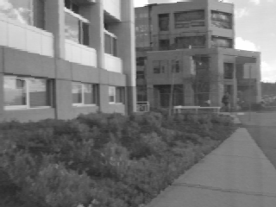
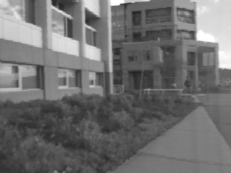
Correspondence search
Left
Right
scanline
Matching cost
disparity
Slide a window along the right scanline and compare contents of that window with the reference window in the left image
Matching cost: SSD or normalized correlation

Slide 20
Correspondence search
Left
Right
scanline
SSD

Slide 21
Correspondence search
Left
Right
scanline
Norm. corr

Slide 22
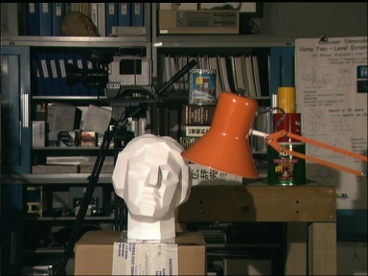
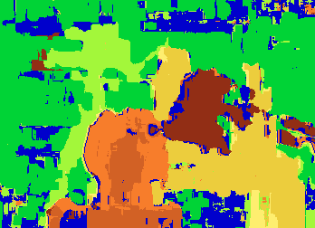

Results with window search
Data
Window-based matching
Ground truth

Slide 23
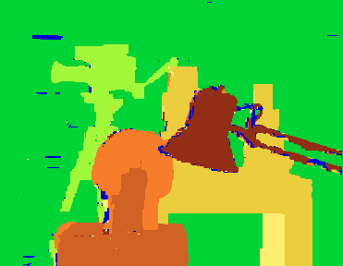
Add constraints and solve with graph cuts
Before
Graph cuts
Ground truth
  Y. Boykov, O. Veksler, and R. Zabih, Fast Approximate Energy Minimization via Graph Cuts, PAMI 2001
    For the latest and greatest: http://www.middlebury.edu/stereo/

Slide 24

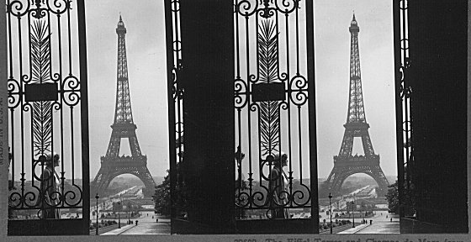
Failures of correspondence search
Textureless surfaces
Occlusions, repetition
Non-Lambertian surfaces, specularities

Slide 25
Dot Projections
http://www.youtube.com/watch?v=28JwgxbQx8w

Slide 26
Depth from Projector-Sensor
Only one image: How is it possible to get depth?
Scene Surface
Projector
Sensor

Slide 27
Same stereo algorithms apply
Projector
Sensor

Slide 28
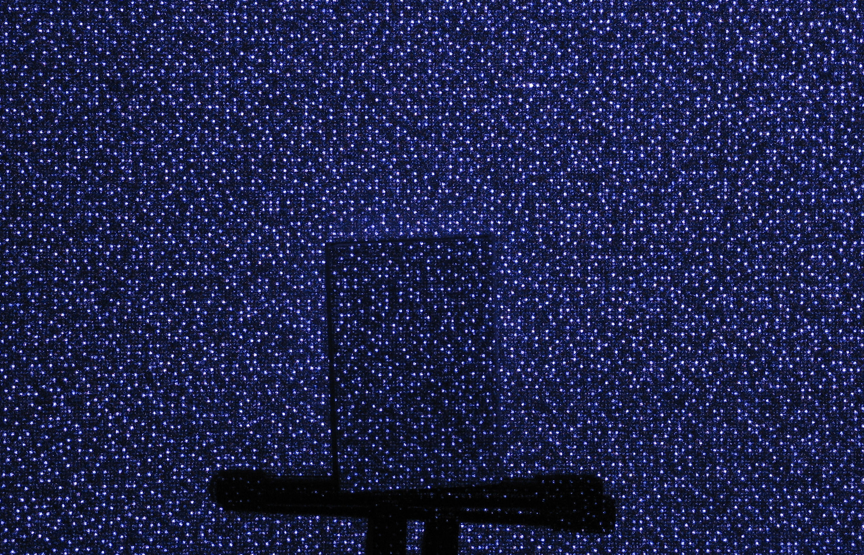
Example: Book vs. No Book
Source: http://www.futurepicture.org/?p=97

Slide 29
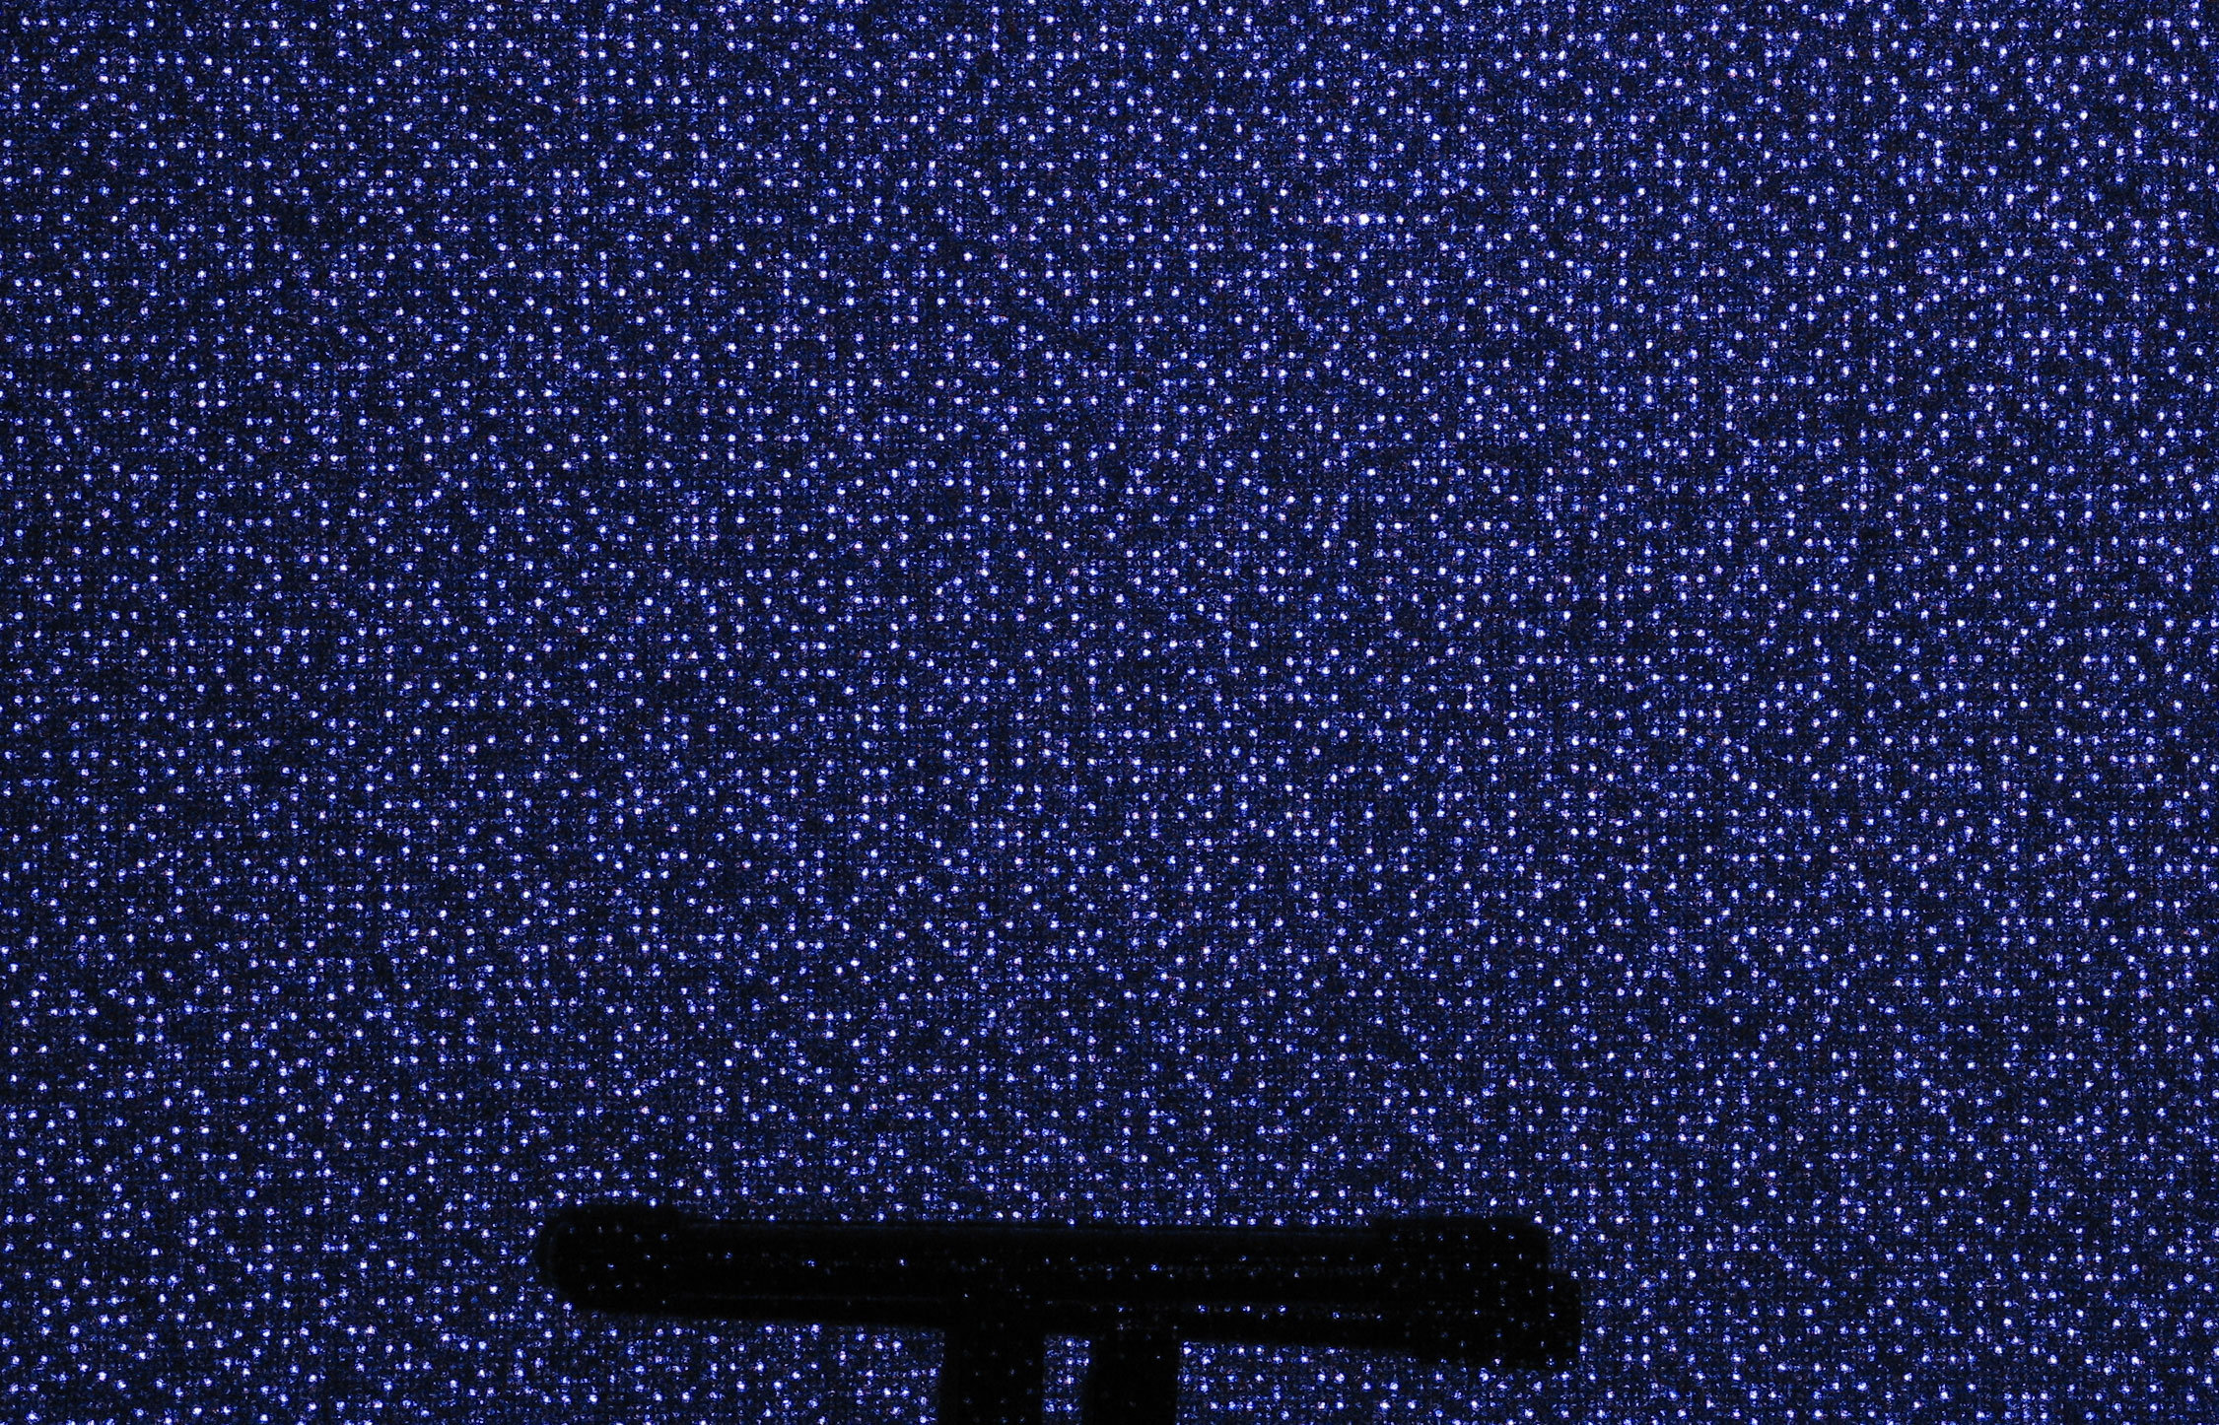
Example: Book vs. No Book
Source: http://www.futurepicture.org/?p=97

Slide 30
Region-growing Random Dot Matching
Detect dots (“speckles”) and label them unknown
Randomly select a region anchor, a dot with unknown depth
  Windowed search via normalized cross correlation along scanline
    Check that best match score is greater than threshold; if not, mark as “invalid” and go to 2
  Region growing
    Neighboring pixels are added to a queue
    For each pixel in queue, initialize by anchor’s shift; then search small local neighborhood; if matched, add neighbors to queue
    Stop when no pixels are left in the queue
Repeat until all dots have known depth or are marked “invalid”
http://www.wipo.int/patentscope/search/en/WO2007043036

Slide 31
Projected IR vs. Natural Light Stereo
What are the advantages of IR?
  Works in low light conditions
  Does not rely on having textured objects
  Not confused by repeated scene textures
  Can tailor algorithm to produced pattern
What are advantages of natural light?
  Works outside, anywhere with sufficient light
  Uses less energy
  Resolution limited only by sensors, not projector
Difficulties with both
  Very dark surfaces may not reflect enough light
  Specular reflection in mirrors or metal causes trouble

Slide 32
Uses of Kinect (part 1)
3D Scanner: http://www.youtube.com/watch?v=V7LthXRoESw
IllumiRoom: http://research.microsoft.com/apps/video/default.aspx?id=191304
https://www.youtube.com/watch?v=nGGMv9RnJIA

Slide 33
To learn more
Warning: lots of wrong info on web
Great site by Daniel Reetz: http://www.futurepicture.org/?p=97
Kinect patents: http://www.faqs.org/patents/app/20100118123
http://www.faqs.org/patents/app/20100020078
http://www.faqs.org/patents/app/20100007717

Slide 34
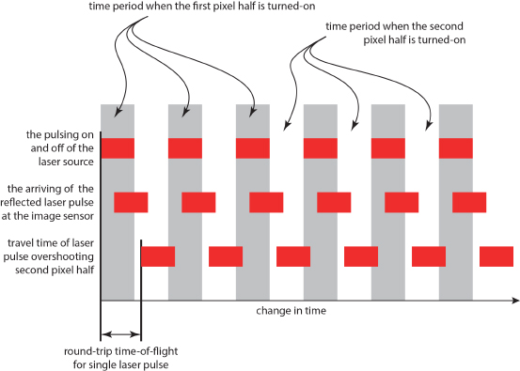
How does the Kinect v2 work?
Time of flight sensor
  Turn on and off two co-located pixels in alternation very quickly (e.g., 10 GHz)
  Pulse laser just as quickly
  Ratio of light achieved by the two pixels tells travel time (i.e., distance) of laser
  By modifying the pulse frequency, you get a low-res and high-res estimate of travel time
http://www.gamasutra.com/blogs/DanielLau/20131127/205820/The_Science_Behind_Kinects_or_Kinect_10_versus_20.php

Slide 35
Part 2: Pose from depth
IR Projector
IR Sensor
Projected Light Pattern
Stereo Algorithm
Segmentation,
Part Prediction
Depth Image
Body Pose

Slide 36
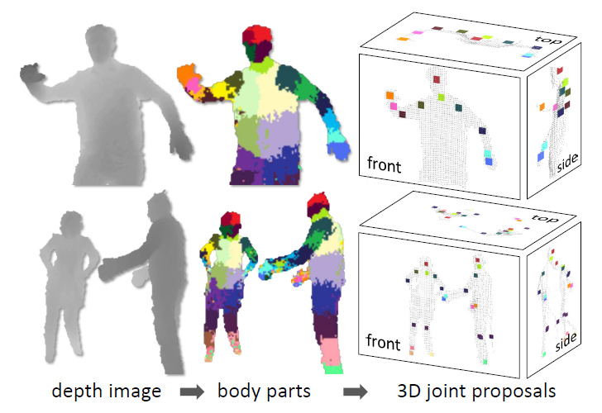
Goal: estimate pose from depth image
Real-Time Human Pose Recognition in Parts from a Single Depth Image
Jamie Shotton, Andrew Fitzgibbon, Mat Cook, Toby Sharp, Mark Finocchio, Richard Moore, Alex Kipman, and Andrew Blake
CVPR 2011

Slide 37
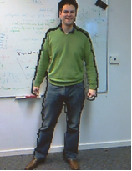
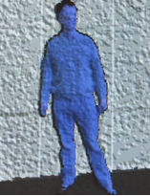
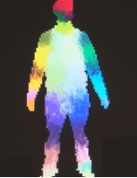
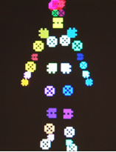
Goal: estimate pose from depth image
RGB
Depth
Part Label Map
Joint Positions
http://research.microsoft.com/apps/video/default.aspx?id=144455

Slide 38
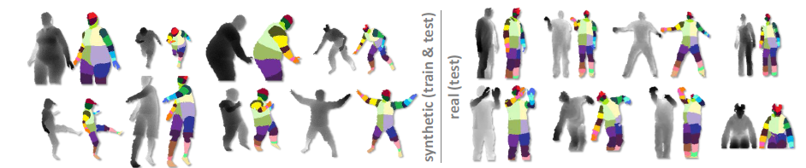
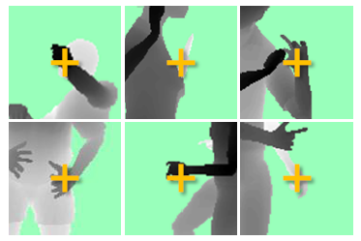
Challenges
Lots of variation in bodies, orientation, poses
Needs to be very fast (their algorithm runs at 200 FPS on the Xbox 360 GPU)
Pose Examples
Examples of one part

Slide 39
Extract body pixels by thresholding depth

Slide 40
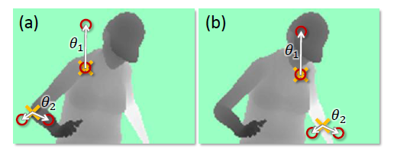
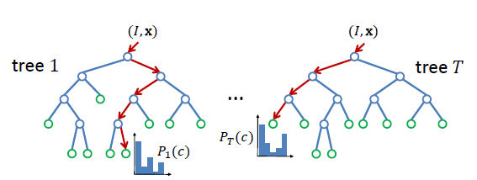
Basic learning approach
Very simple features
Lots of data
Flexible classifier

Slide 41
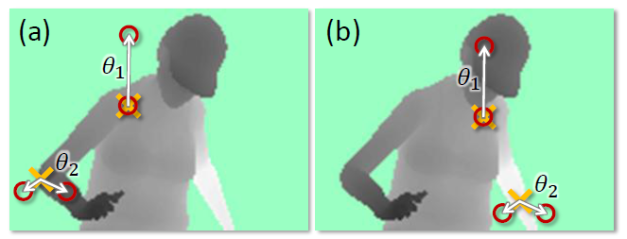
Features
Difference of depth at two offsets
  Offset is scaled by depth at center

Slide 42
Get lots of training data
Capture and sample 500K mocap frames of people kicking, driving, dancing, etc.
Get 3D models for 15 bodies with a variety of weight, height, etc.
Synthesize mocap data for all 15 body types

Slide 43
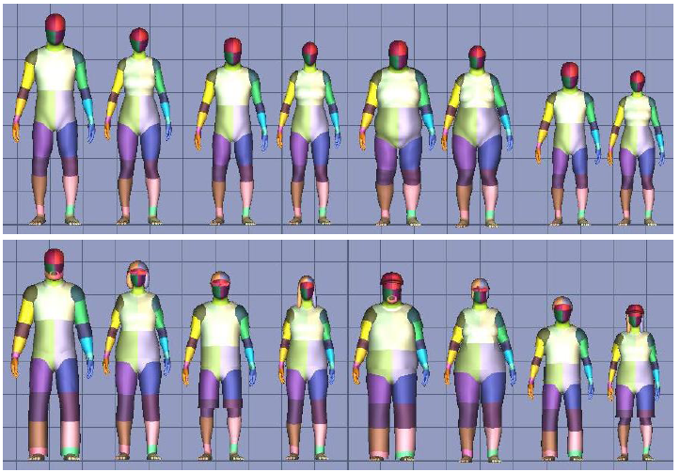
Body models

Slide 44
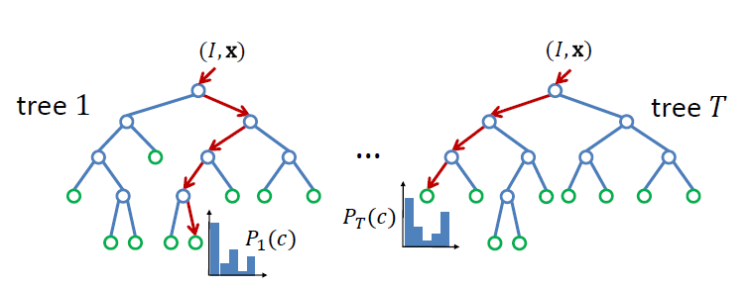
Part prediction with random forests
Randomized decision forests: collection of independently trained trees
Each tree is a classifier that predicts the likelihood of a pixel belonging to each part
  Node corresponds to a thresholded feature
  The leaf node that an example falls into corresponds to a conjunction of several features
  In training, at each node, a subset of features is chosen randomly, and the most discriminative is selected

Slide 45
Joint estimation
Joints are estimated using mean-shift (a fast mode-finding algorithm)
Observed part center is offset by pre-estimated value

Slide 46
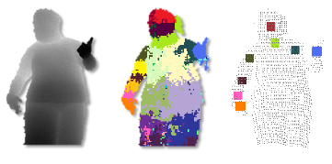
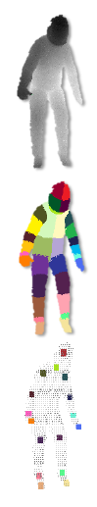
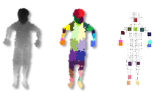
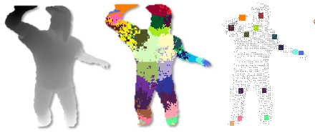
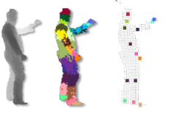
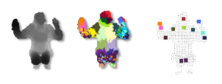
Results
Ground Truth

Slide 47
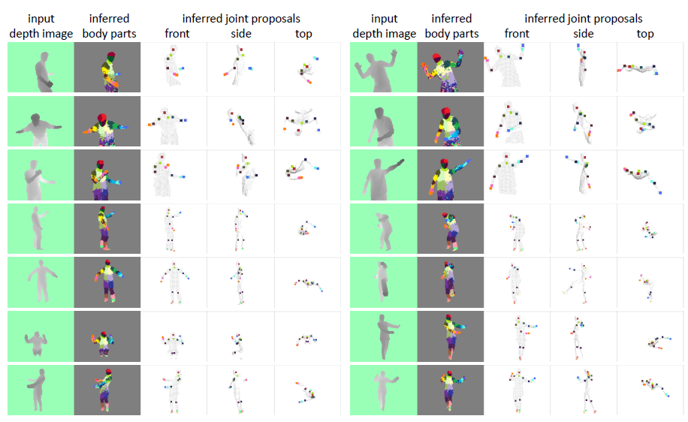
More results

Slide 48
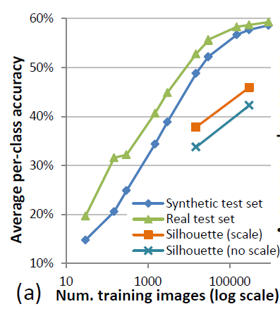
Accuracy vs. Number of Training Examples

Slide 49
Uses of Kinect (part 2)
Mario: http://www.youtube.com/watch?v=8CTJL5lUjHg
Robot Control: https://www.youtube.com/watch?v=7vq-1TiXi3g
Capture for holography: http://www.youtube.com/watch?v=4LW8wgmfpTE
Virtual dressing room: http://www.youtube.com/watch?v=1jbvnk1T4vQ
Fly wall: http://vimeo.com/user3445108/kiwibankinteractivewall

Slide 50
Note: pose from rgb video works amazingly well now
https://www.youtube.com/watch?v=pW6nZXeWlGM&t=77s
OpenPose: https://github.com/CMU-Perceptual-Computing-Lab/openpose

Slide 51
Coming up
Computational approaches to cameras

