Slide 1
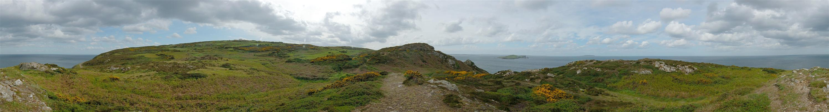
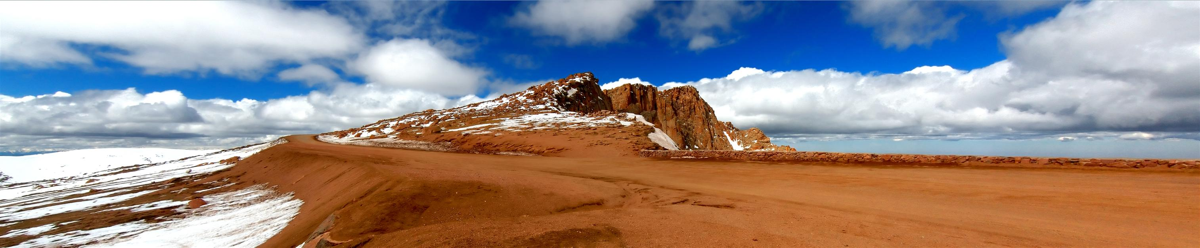
10/30/19
Image Stitching
Computational Photography
Derek Hoiem, University of Illinois
Photos by Russ Hewett

Slide 2
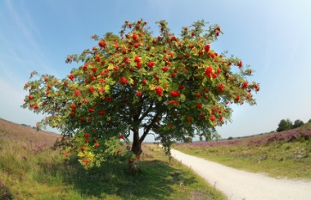
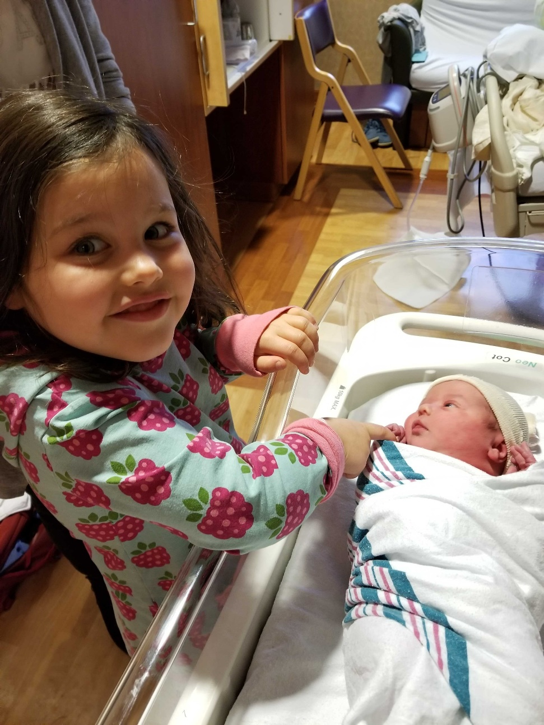
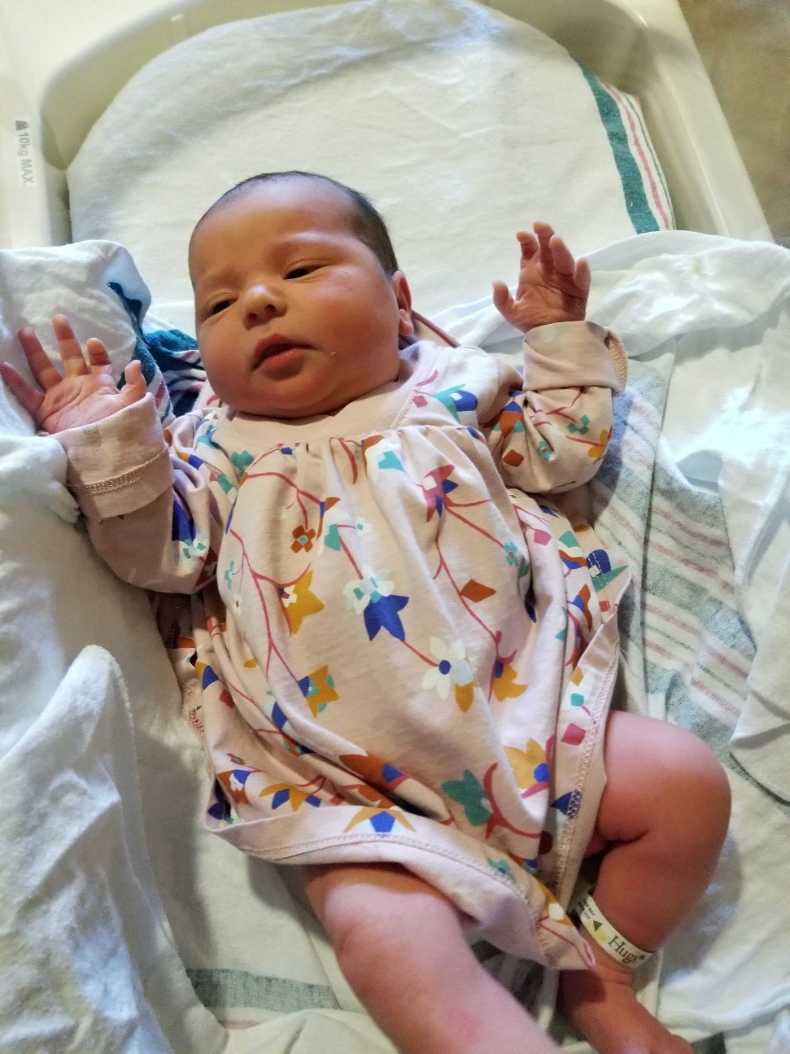
My good excuse for not teaching Friday…
(thank you Wilfredo!)
Rowan Maeve

Slide 3
Project 3 Highlights
https://ksharma.web.illinois.edu/cs445/proj3/ (most likes) good octopus, laplacian image result
https://xz2.web.illinois.edu/cs445/proj3/ great main result
https://ayuship2.web.illinois.edu/cs445/proj3/ many great blends
https://liwenwu2.web.illinois.edu/cs445/proj3/ good blends, colorization
https://aipark2.web.illinois.edu/cs445/proj3/ good comparisons w/ web page design
https://byhsieh2.web.illinois.edu/cs445/proj3/ great blends and npr
https://yicheng9.web.illinois.edu/cs445/proj3/ cat bread and cat magic
https://kl2.web.illinois.edu/cs445/proj3/ mixed gradient
http://lehan2.web.illinois.edu/cs445/proj3/ laplacian pyramid(the last one)
https://rxian2.web.illinois.edu/cs445/proj3/ duck and fish
https://yilinma3.web.illinois.edu/cs445/proj3/ the skate boy on the moon
https://wyang52.web.illinois.edu/cs445/proj3/ rose
https://xiaoyis2.web.illinois.edu/cs445/proj3/ ship in the desert
https://sarwade2.web.illinois.edu/cs445/proj3/ Eiffel Candle

Slide 4
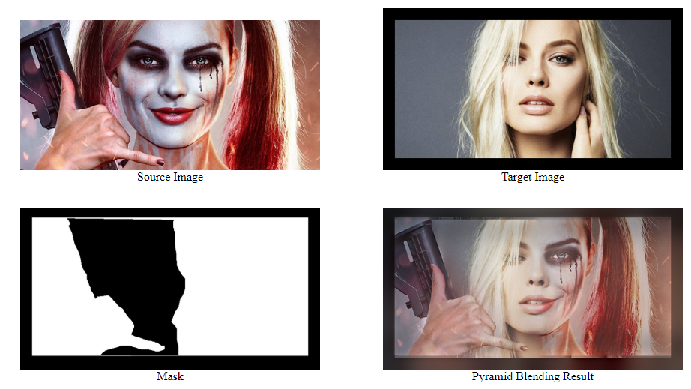
Laplacian pyramid
Kartikeya Sharma

Slide 5
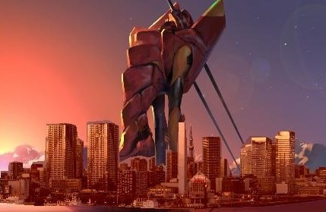
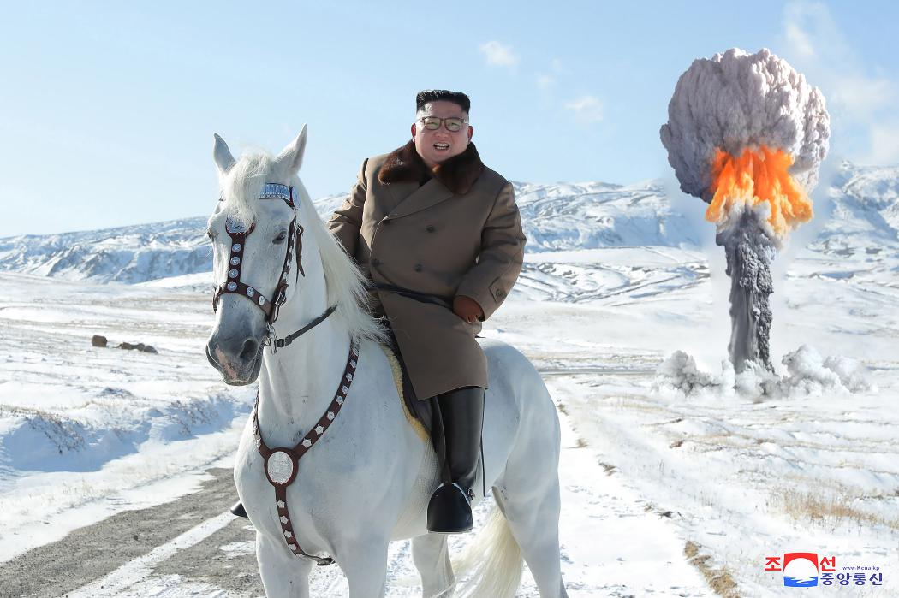
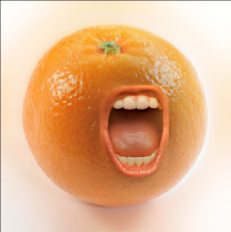
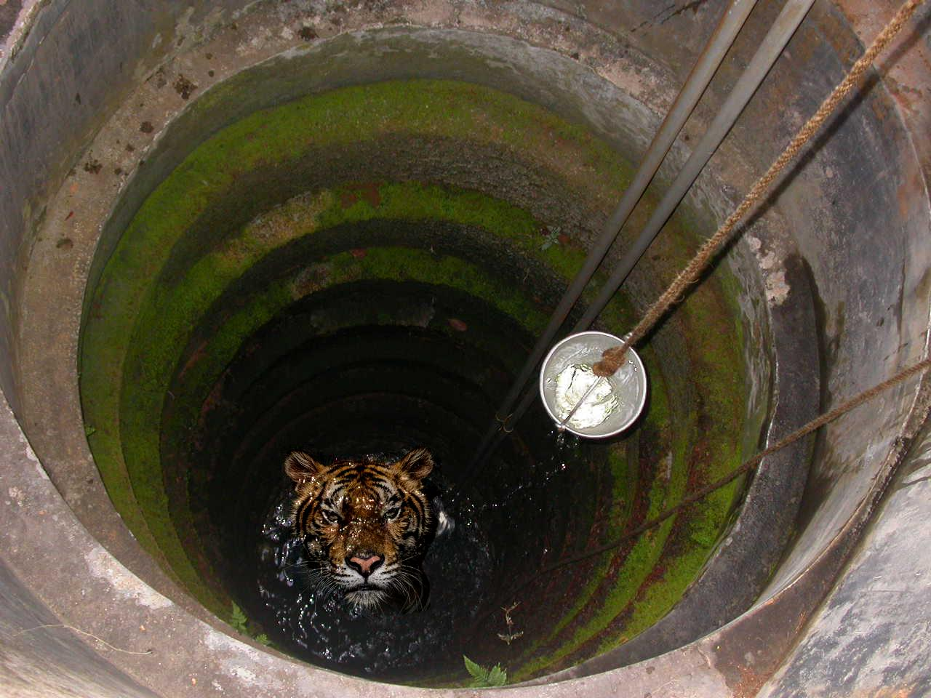
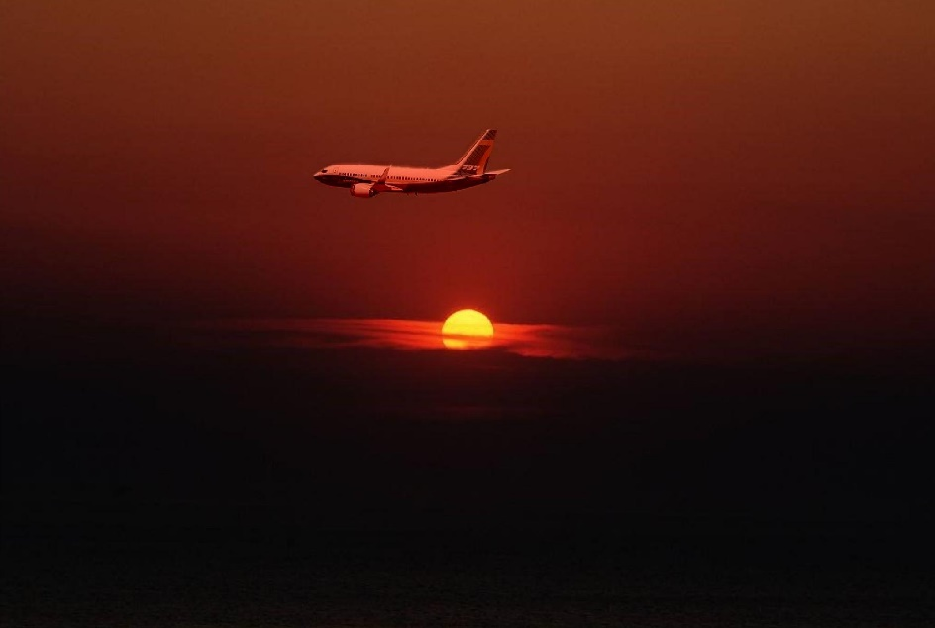
Anbang Ye
Ayushi Patel
Xiaohua Zhang
Liwen Wu

Slide 6
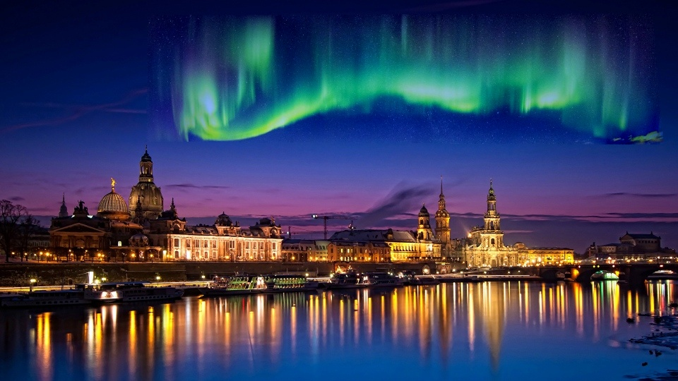
Bing-Yuan Hsieh

Slide 7
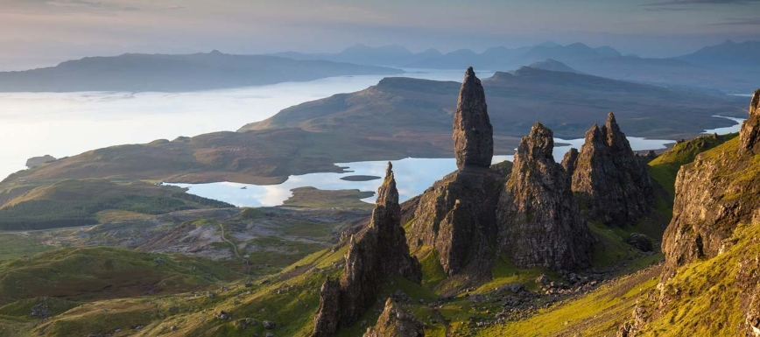
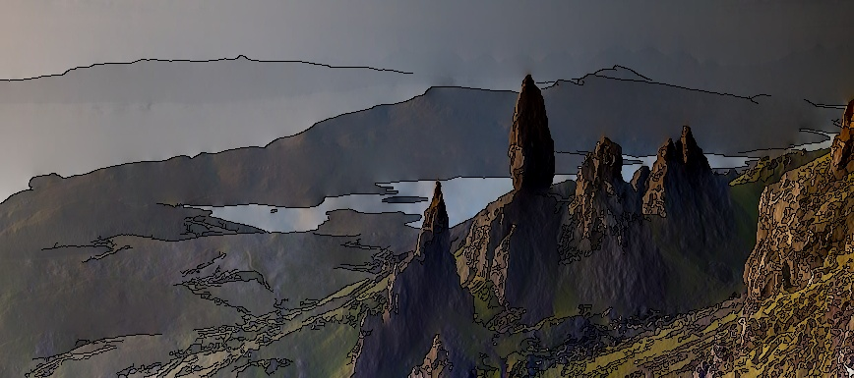
Bing-Yuan Hsieh

Slide 8
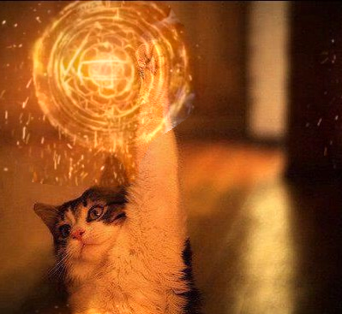
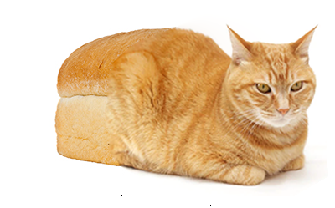
Yicheng Sun

Slide 9
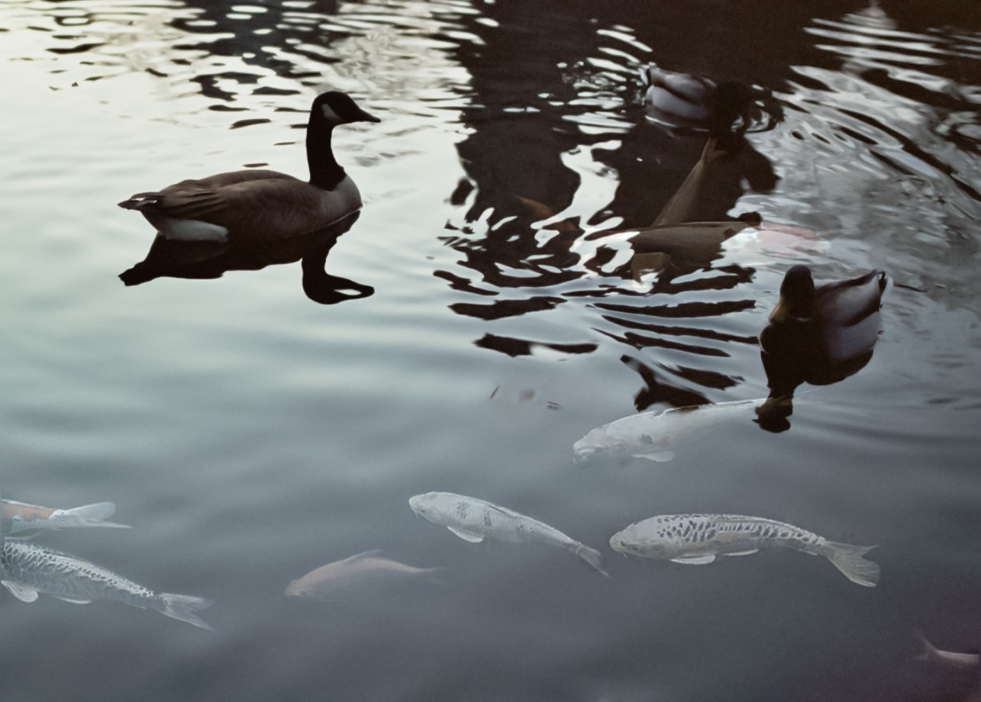
Ruicheng Xian

Slide 10
Image Stitching
Computational Photography
Derek Hoiem, University of Illinois
Photos by Russ Hewett

Slide 11
Project 5
Input video:
https://www.youtube.com/watch?v=agI5za_gHHU
Aligned frames:
https://www.youtube.com/watch?v=Uahy6kPotaE
Background:
https://www.youtube.com/watch?v=Vt9vv1zCnLA
Foreground:
https://www.youtube.com/watch?v=OICkKNndEt4

Slide 12
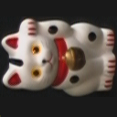
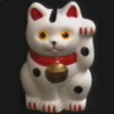


Last Class: Keypoint Matching
1. Find a set of
distinctive key-
points
A₁
B₃
2. Define a region
around each
keypoint
A₂
A₃
B₁
B₂
3. Extract and
normalize the
region content
4. Compute a local
descriptor from the
normalized region
5. Match local
descriptors

Slide 13
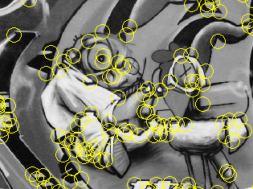
Last Class: Summary
Keypoint detection: repeatable and distinctive
  Corners, blobs
  Harris, DoG
Descriptors: robust and selective
  SIFT: spatial histograms of gradient orientation

Slide 14
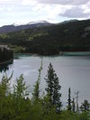
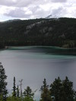
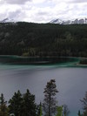
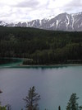
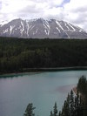
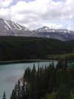
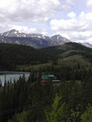
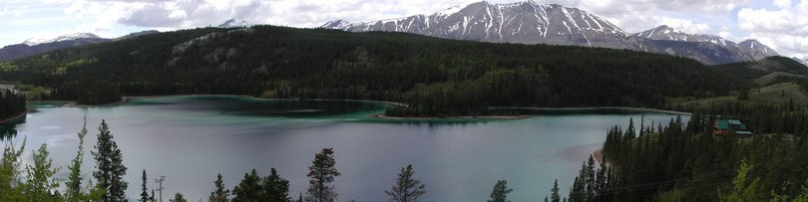
Today: Image Stitching
Combine two or more overlapping images to make one larger image
Add example
Slide credit: Vaibhav Vaish

Slide 15
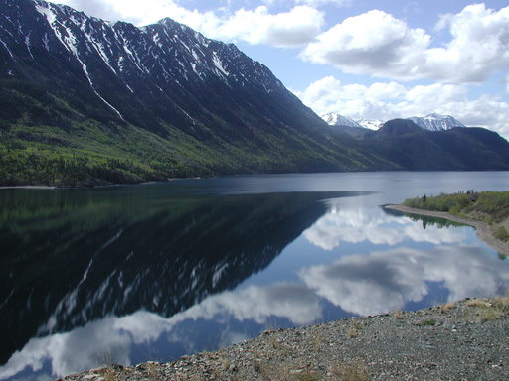
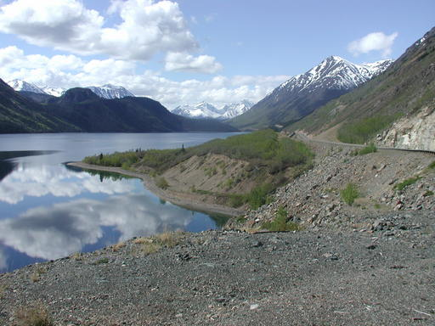
Views from rotating camera
Camera Center

Slide 16
Photo stitching
P
Q
Camera Center

Slide 17
Alignment of rotating camera
Draw

Slide 18
Correspondence of rotating camera
.
X
x = K [R t] X
x’ = K’ [R’ t’] X
t=t’=0
x’=Hx where H = K’ R’ R⁻¹ K⁻¹
Typically only R and f will change (4 parameters), but, in general, H has 8 parameters
x
x'
f
f'

Slide 19
Image Stitching Algorithm Overview
Detect keypoints
Match keypoints
Estimate homography with four matched keypoints (using RANSAC)
Project onto a surface and blend

Slide 20
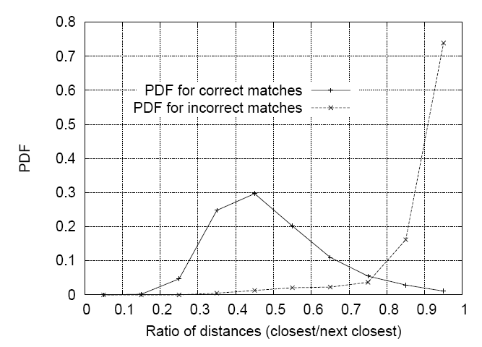

Image Stitching Algorithm Overview
Detect/extract keypoints (e.g., DoG/SIFT)
Match keypoints (most similar features, compared to 2nd most similar)
$$\frac{d1}{d2}<thresh$$

Slide 21
Computing homography
Assume we have four matched points: How do we compute homography H?
Direct Linear Transformation (DLT)

Slide 22
Computing homography
Direct Linear Transform
Apply SVD: UDV^{T} = A
h = V_{smallest} (column of V corr. to smallest singular value)
Matlab
[U, S, V] = svd(A);
h = V(:, end);
Notes:
SVD gives the homogeneous least squares solution constrained to have a norm of 1

Slide 23
Computing homography
Assume we have four matched points: How do we compute homography H?
Normalized DLT
Normalize coordinates for each image
  Translate for zero mean
  Scale so that u and v are ~=1 on average
  This makes problem better behaved numerically (see Hartley and Zisserman p. 107-108)
Compute using DLT in normalized coordinates
Unnormalize:

Slide 24
Computing homography
Assume we have matched points with outliers: How do we compute homography H?
Automatic Homography Estimation with RANSAC

Slide 25
RANSAC: RANdom SAmple Consensus
Scenario: We’ve got way more matched points than needed to fit the parameters, but we’re not sure which are correct
RANSAC Algorithm
Repeat N times
  Randomly select a sample
  Select just enough points to recover the parameters
  Fit the model with random sample
  See how many other points agree
Best estimate is one with most agreement
  can use agreeing points to refine estimate

Slide 26
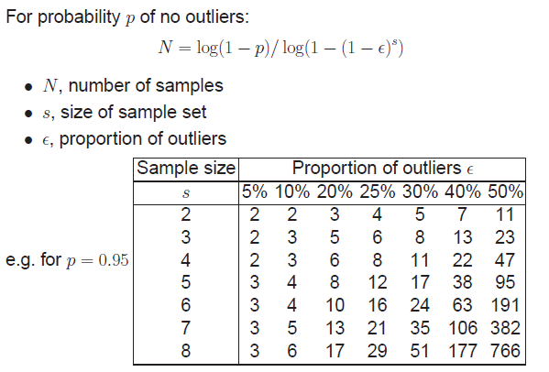
Computing homography
Assume we have matched points with outliers: How do we compute homography H?
Automatic Homography Estimation with RANSAC
Choose number of samples N
HZ Tutorial ‘99

Slide 27
Computing homography
Assume we have matched points with outliers: How do we compute homography H?
Automatic Homography Estimation with RANSAC
Choose number of iterations N
Choose 4 random potential matches
Compute H using normalized DLT
Project points from x to x’ for each potentially matching pair:
Count points with projected distance < t
  E.g., t = 3 pixels
Repeat steps 2-5 N times
  Choose H with most inliers
HZ Tutorial ‘99

Slide 28
Automatic Image Stitching
Compute interest points on each image
Find candidate matches
Estimate homography H using matched points and RANSAC with normalized DLT
Project each image onto the same surface and blend

Slide 29
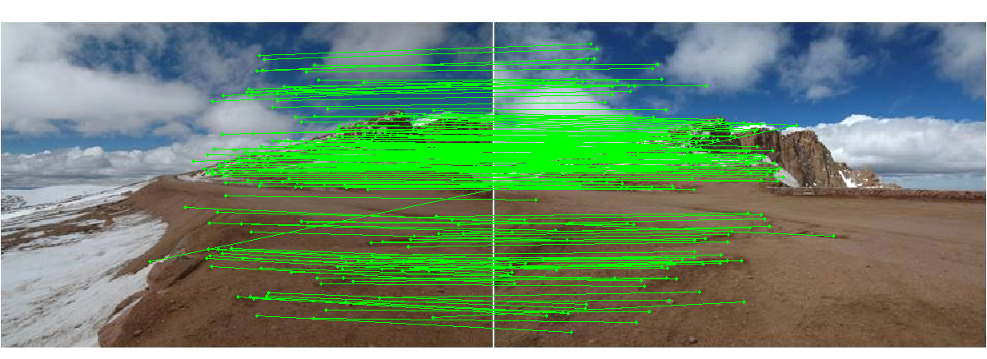
Choosing a Projection Surface
Many to choose: planar, cylindrical, spherical, cubic, etc.

Slide 30
Planar Mapping
x
x
f
f
For red image: pixels are already on the planar surface
For green image: map to first image plane

Slide 31
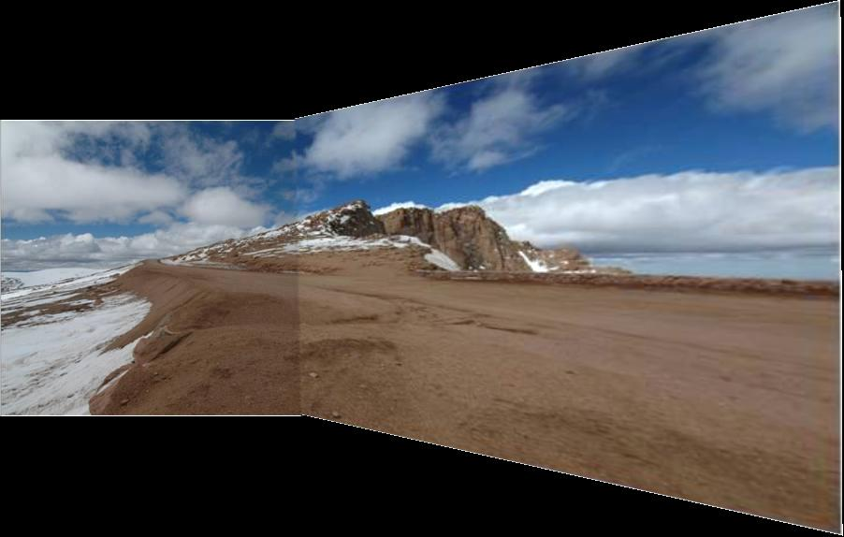
Planar Projection
Planar
Photos by Russ Hewett

Slide 32
Planar Projection
Planar

Slide 33
Cylindrical Mapping
x
x
f
f
For red image: compute h, theta on cylindrical surface from (u, v)
For green image: map to first image plane, than map to cylindrical surface

Slide 34
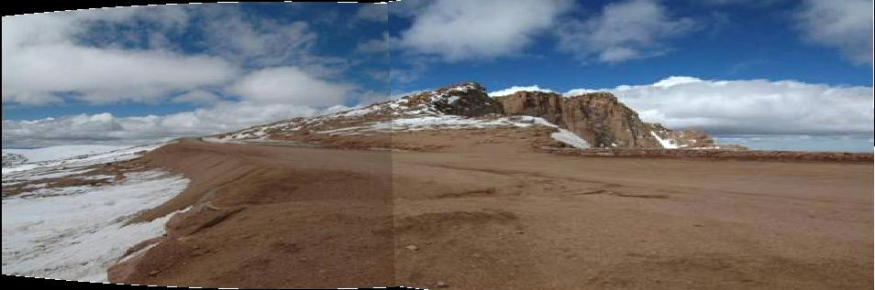
Cylindrical Projection
Cylindrical

Slide 35
Cylindrical Projection
Cylindrical

Slide 36
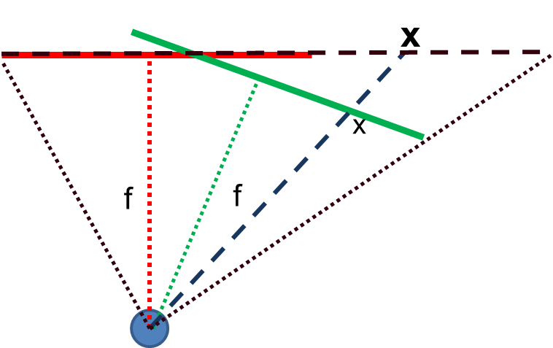
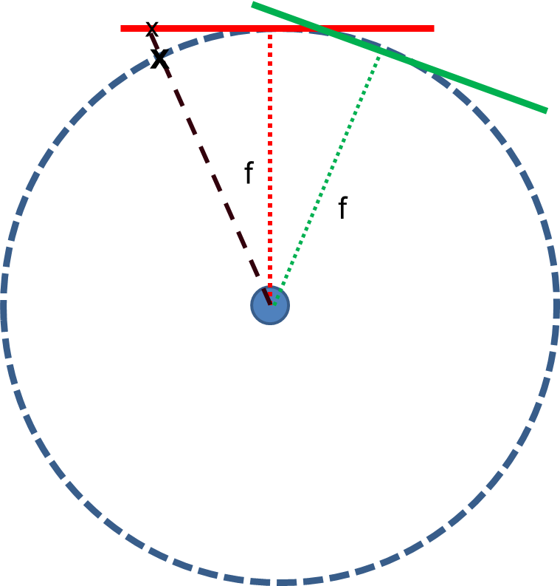
Planar vs. Cylindrical Projection
Planar
Cylindrical

Slide 37
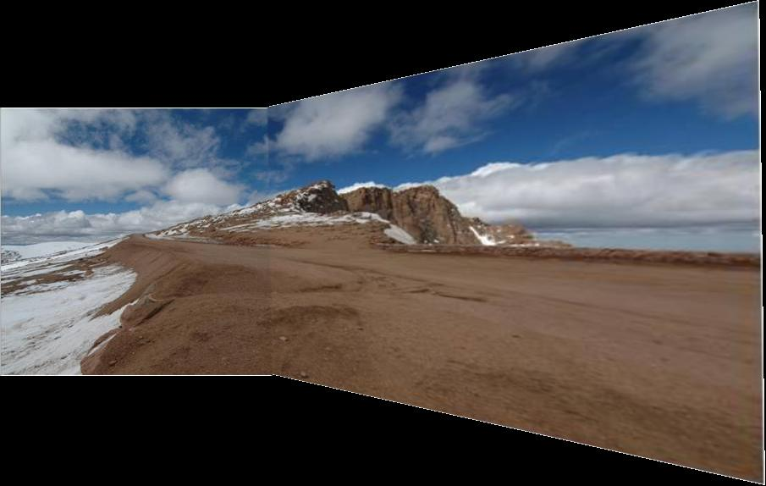
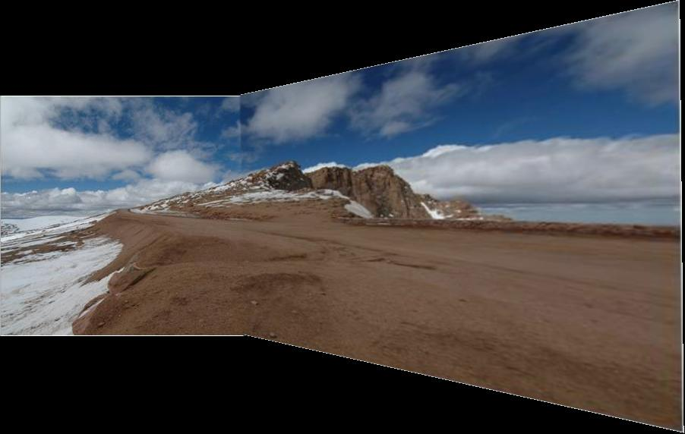
Simple gain adjustment

Slide 38
Automatically choosing images to stitch

Slide 39
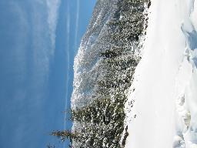
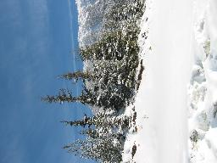
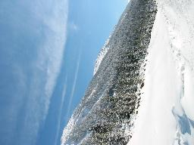
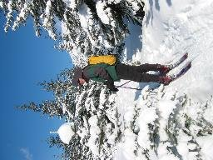
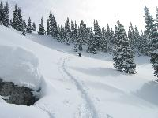
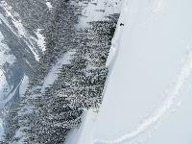
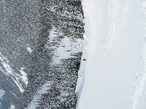
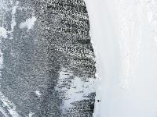
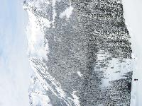
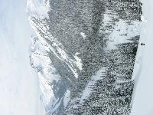
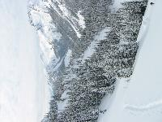

















Recognizing Panoramas
Some of following material from Brown and Lowe 2003 talk
Brown and Lowe 2003, 2007

Slide 40
Recognizing Panoramas
Input: N images
Extract SIFT points, descriptors from all images
Find K-nearest neighbors for each point (K=4)
For each image
  Select M candidate matching images by counting matched keypoints (M=6)
  Solve homography H_{ij} for each matched image

Slide 41
Recognizing Panoramas
Input: N images
Extract SIFT points, descriptors from all images
Find K-nearest neighbors for each point (K=4)
For each image
  Select M candidate matching images by counting matched keypoints (M=6)
  Solve homography H_{ij} for each matched image
  Decide if match is valid (n_{i} > 8 + 0.3 n_{f} )
# inliers
# keypoints in overlapping area

Slide 42




RANSAC for Homography
Initial Matched Points

Slide 43


RANSAC for Homography
Final Matched Points

Slide 44


Verification

Slide 45

RANSAC for Homography

Slide 46
Recognizing Panoramas (cont.)
(now we have matched pairs of images)
Find connected components

Slide 47
Finding the panoramas

Slide 48
Finding the panoramas

Slide 49
Finding the panoramas

Slide 50
Recognizing Panoramas (cont.)
(now we have matched pairs of images)
Find connected components
For each connected component
  Perform bundle adjustment to solve for rotation (θ₁, θ₂, θ₃) and focal length f of all cameras
  Project to a surface (plane, cylinder, or sphere)
  Render with multiband blending

Slide 51


Bundle adjustment for stitching
Non-linear minimization of re-projection error
where H = K’ R’ R⁻¹ K⁻¹
Solve non-linear least squares (Levenberg-Marquardt algorithm)
  See paper for details

Slide 52





































Bundle Adjustment
New images initialized with rotation, focal length of the best matching image

Slide 53

Bundle Adjustment
New images initialized with rotation, focal length of the best matching image

Slide 54
Details to make it look good
Choosing seams
Blending

Slide 55
Choosing seams
Easy method
  Assign each pixel to image with nearest center
im1
im2
x
x
Image 2
Image 1

Slide 56
Choosing seams
Easy method
  Assign each pixel to image with nearest center
  Create a mask:
    mask(y, x) = 1 iff pixel should come from im1
  Smooth boundaries (called “feathering”):
    mask_sm = imfilter(mask, gausfil);
  Composite
    imblend = im1_c.*mask + im2_c.*(1-mask);
im1
im2
x
x
Image 2
Image 1

Slide 57

Choosing seams
Better method: dynamic program to find seam along well-matched regions
Illustration: http://en.wikipedia.org/wiki/File:Rochester_NY.jpg

Slide 58
Gain compensation
Simple gain adjustment
  Compute average RGB intensity of each image in overlapping region
  Normalize intensities by ratio of averages

Slide 59


Multi-band (aka Laplacian Pyramid) Blending
Burt & Adelson 1983
  Blend frequency bands over range ∝ λ

Slide 60

Multiband Blending with Laplacian Pyramid
At low frequencies, blend slowly
At high frequencies, blend quickly
1
0
1
0
1
0
Left pyramid
blend
Right pyramid

Slide 61

Multiband blending
Laplacian pyramids
Compute Laplacian pyramid of images and mask
Create blended image at each level of pyramid
Reconstruct complete image

Slide 62

Blending comparison (IJCV 2007)

Slide 63

Blending Comparison

Slide 64


Straightening
Rectify images so that “up” is vertical

Slide 65
Further reading
Harley and Zisserman: Multi-view Geometry book
DLT algorithm: HZ p. 91 (alg 4.2), p. 585
Normalization: HZ p. 107-109 (alg 4.2)
RANSAC: HZ Sec 4.7, p. 123, alg 4.6
Tutorial: http://users.cecs.anu.edu.au/~hartley/Papers/CVPR99-tutorial/tut_4up.pdf
Recognising Panoramas: Brown and Lowe, IJCV 2007 (also bundle adjustment)

Slide 66
How does iphone panoramic stitching work?
Capture images at 30 fps
Stitch the central 1/8 of a selection of images
  Select which images to stitch using the accelerometer and frame-to-frame matching
  Faster and avoids radial distortion that often occurs towards corners of images
Alignment
  Initially, perform cross-correlation of small patches aided by accelerometer to find good regions for matching
  Register by matching points (KLT tracking or RANSAC with FAST (similar to SIFT) points) or correlational matching
Blending
  Linear (or similar) blending, using a face detector to avoid blurring face regions and choose good face shots (not blinking, etc)
http://www.patentlyapple.com/patently-apple/2012/11/apples-cool-iphone-5-panorama-app-revealed-in-5-patents.html

Slide 67
Tips and Photos from Russ Hewett

Slide 68
Capturing Panoramic Images
Tripod vs Handheld
  Help from modern cameras
  Leveling tripod
  Gigapan
  Or wing it
Image Sequence
  Requires a reasonable amount of overlap (at least 15-30%)
  Enough to overcome lens distortion
Exposure
  Consistent exposure between frames
  Gives smooth transitions
  Manual exposure
  Makes consistent exposure of dynamic scenes easier
  But scenes don’t have constant intensity everywhere
Caution
  Distortion in lens (Pin Cushion, Barrel, and Fisheye)
  Polarizing filters
  Sharpness in image edge / overlap region

Slide 69



Pike’s Peak Highway, CO
Photo: Russell J. Hewett
Nikon D70s, Tokina 12-24mm @ 16mm, f/22, 1/40s

Slide 70
Pike’s Peak Highway, CO
Photo: Russell J. Hewett
(See Photo On Web)

Slide 71














360 Degrees, Tripod Leveled
Photo: Russell J. Hewett
Nikon D70, Tokina 12-24mm @ 12mm, f/8, 1/125s

Slide 72
Howth, Ireland
Photo: Russell J. Hewett
(See Photo On Web)

Slide 73









Handheld Camera
Photo: Russell J. Hewett
Nikon D70s, Nikon 18-70mm @ 70mm, f/6.3, 1/200s

Slide 74

Handheld Camera
Photo: Russell J. Hewett

Slide 75

Les Diablerets, Switzerland
Photo: Russell J. Hewett
(See Photo On Web)

Slide 76




Macro
Photo: Russell J. Hewett & Bowen Lee
Nikon D70s, Tamron 90mm Micro @ 90mm, f/10, 15s

Slide 77

Side of Laptop
Photo: Russell J. Hewett & Bowen Lee

Slide 78
Considerations For Stitching
Variable intensity across the total scene
Variable intensity and contrast between frames
Lens distortion
  Pin Cushion, Barrel, and Fisheye
  Profile your lens at the chosen focal length (read from EXIF)
  Or get a profile from LensFun
Dynamics/Motion in the scene
  Causes ghosting
  Once images are aligned, simply choose from one or the other
Misalignment
  Also causes ghosting
  Pick better control points
Visually pleasing result
  Super wide panoramas are not always ‘pleasant’ to look at
  Crop to golden ratio, 10:3, or something else visually pleasing

Slide 79




Ghosting and Variable Intensity
Photo: Russell J. Hewett
Nikon D70s, Tokina 12-24mm @ 12mm, f/8, 1/400s

Slide 80


Photo: Russell J. Hewett

Slide 81


Ghosting From Motion
Photo: Bowen Lee
Nikon e4100 P&S

Slide 82


Motion Between Frames
Photo: Russell J. Hewett
Nikon D70, Nikon 70-210mm @ 135mm, f/11, 1/320s

Slide 83


Photo: Russell J. Hewett

Slide 84

Gibson City, IL
Photo: Russell J. Hewett
(See Photo On Web)

Slide 85







Mount Blanca, CO
Photo: Russell J. Hewett
Nikon D70s, Tokina 12-24mm @ 12mm, f/22, 1/50s

Slide 86

Mount Blanca, CO
Photo: Russell J. Hewett
(See Photo On Web)

Slide 87
Things to remember
Homography relates rotating cameras
  Homography is plane to plane mapping
Recover homography using RANSAC and normalized DLT
Can choose surface of projection: cylinder, plane, and sphere are most common
Refinement methods (blending, straightening, etc.)

Slide 88
Next class
Object recognition and retrieval

