Slide 1
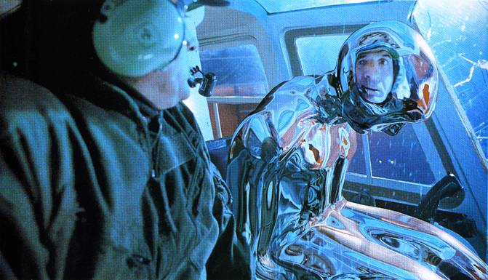
Image-based Lighting (Part 2)
10/18/19
T2
Computational Photography
Derek Hoiem, University of Illinois
Many slides from Debevec, some from Efros, Kevin Karsch

Slide 2
Today
Brief review of last class
Show how to get an HDR image from several LDR images, and how to display HDR
Show how to insert fake objects into real scenes using environment maps

Slide 3
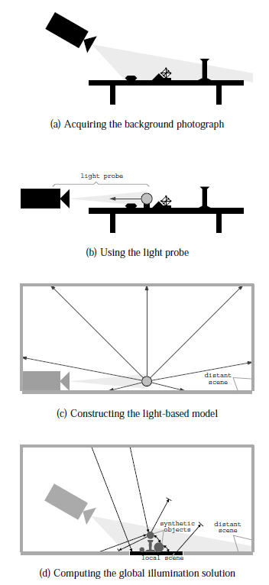
How to render an object inserted into an image?
Image-based lighting
Capture incoming light with a “light probe”
Model local scene
Ray trace, but replace distant scene with info from light probe
Debevec SIGGRAPH 1998

Slide 4

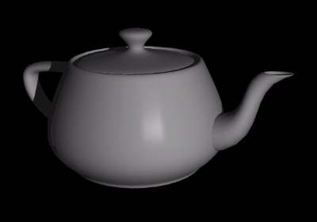
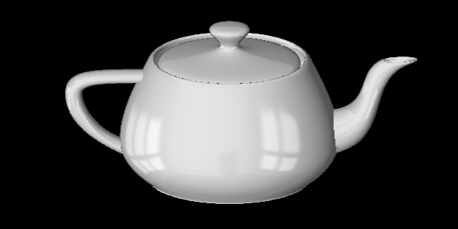
Key ideas for Image-based Lighting
Environment maps: tell what light is entering at each angle within some shell
+

Slide 5
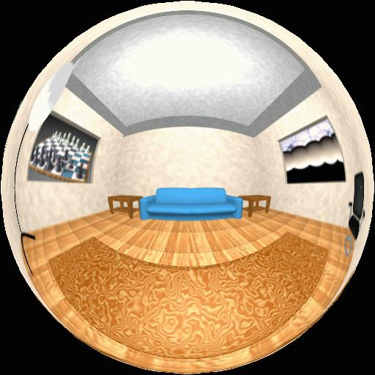
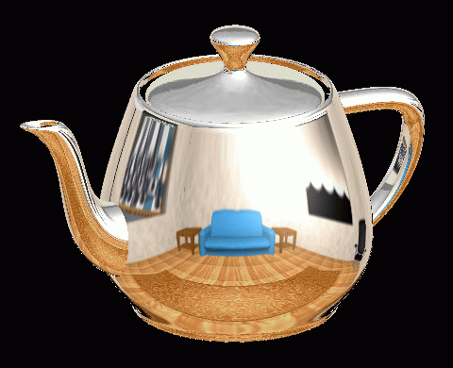
Spherical Map Example

Slide 6
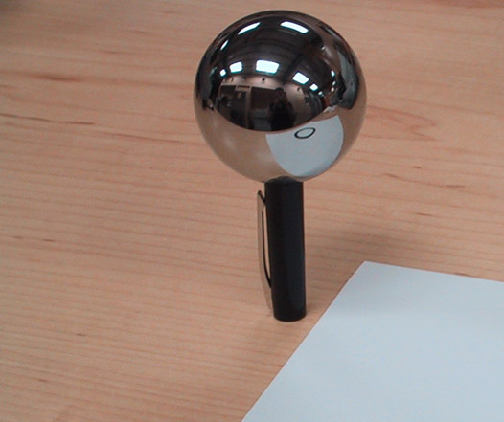
Key ideas for Image-based Lighting
Light probes: a way of capturing environment maps in real scenes

Slide 7
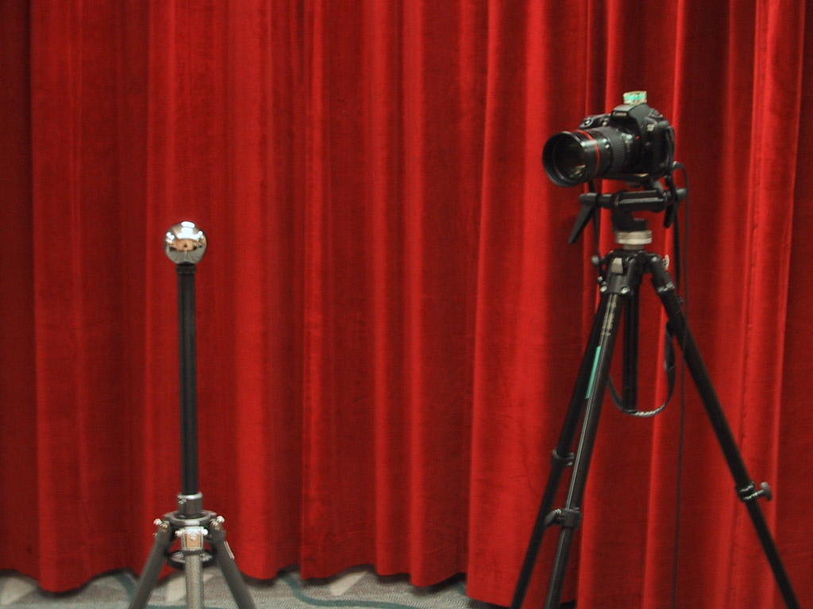
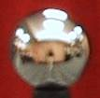
Mirrored Sphere

Slide 8
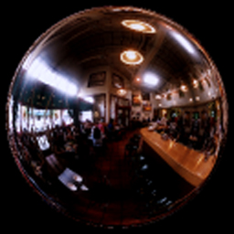
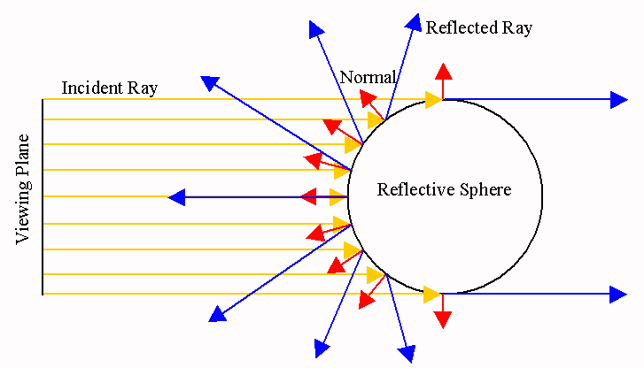
One picture of a mirrored ball received light coming into the ball from nearly all angles (including behind)
Assume camera is roughly same height as light probe and is sufficiently distant, so all viewing rays that hit light probe are roughly in direction of z-axis

Slide 9
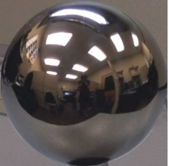
Solving for normal vector
x
N
(u, v) → (Nx, Ny, Nz)?
Nx = (u – center) / (width/2)
Ny = (v – center) / (height/2)
x
(-1,0,0)
(1,0,0)
(0,0,-1)
Nx^2 + Ny^2 + Nz^2 = 1
(0,-1,0)

Slide 10
Solving for reflection vector
dot(-V,N)*N
R = -V+2*( dot(-V,N)*N - (-V) )
= V – 2*dot(V,N)*N
x
N
V = [0 0 1]
(u, v) → (Nx, Ny, Nz)
x

Slide 11
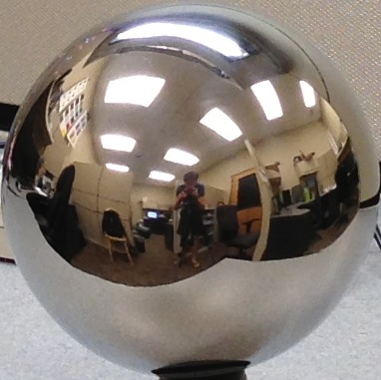



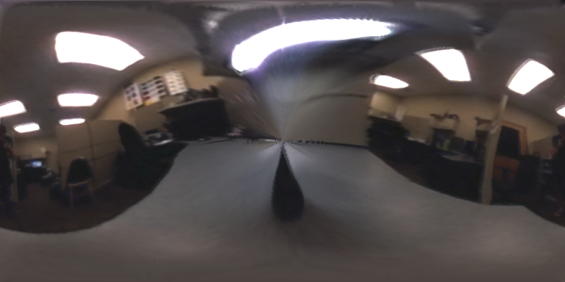

Mirror ball -> equirectangular
Mirror ball
Normals
Reflection
vectors
Phi/theta of reflection vecs
Equirectangular
Phi/theta equirectangular domain

Slide 12
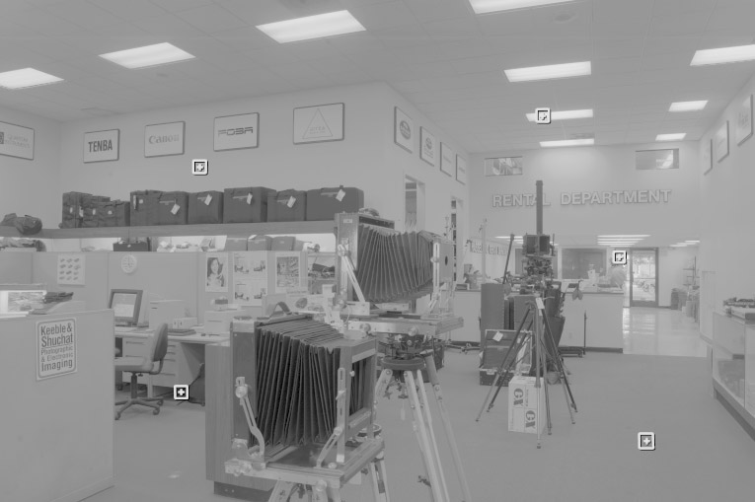
One small snag
How do we deal with light sources? Sun, lights, etc?
  They are much, much brighter than the rest of the environment
Use High Dynamic Range photography!
Relative Brightness
1907
.
46
.
.
15116
1
.
.
18

Slide 13
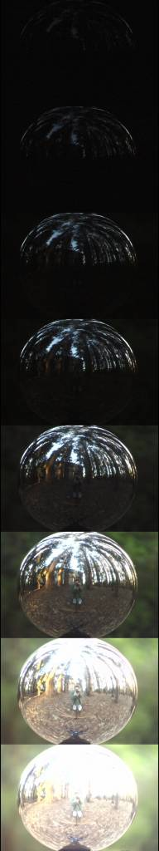
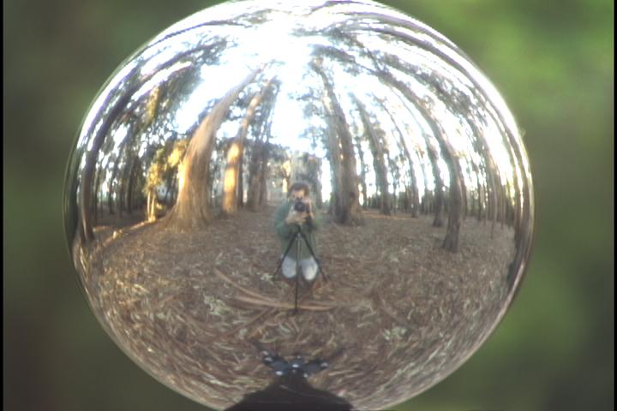
Key ideas for Image-based Lighting
Capturing HDR images: needed so that light probes capture full range of radiance

Slide 14
LDR->HDR by merging exposures
^{0 to 255}
Exposure 1
Exposure 2
…
Exposure n
10⁻⁶
10⁶
Real world
High dynamic range

Slide 15
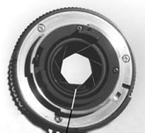
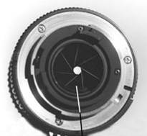
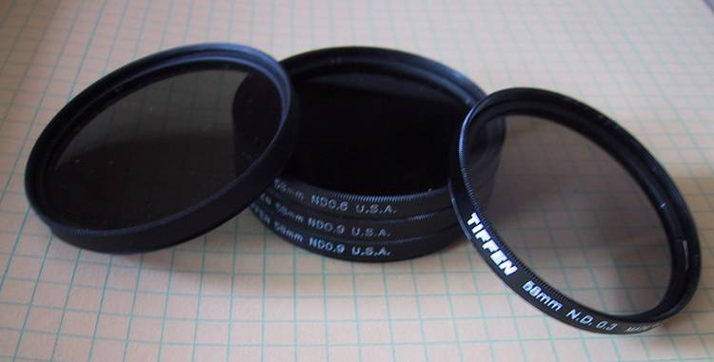
Ways to vary exposure
Shutter Speed
F/stop (aperture, iris)
Neutral Density (ND) Filters

Slide 16
SIGGRAPH 1997
Notes:
1

Slide 17
The Approach
Get pixel values Z_{ij} for image with shutter time Δt_{j} (i^{th} pixel location, j^{th} image)
Exposure is irradiance integrated over time:
Pixel values are non-linearly mapped E_{ij}’s:
Rewrite to form a (not so obvious) linear system:

Slide 18
The objective
Solve for radiance R and mapping g for each of 256 pixel values to minimize:
give pixels near 0 or 255 less weight
known shutter time for image j
exposure should smoothly increase as pixel intensity increases
irradiance at particular pixel site is the same for each image
exposure, as a function of pixel value

Slide 19
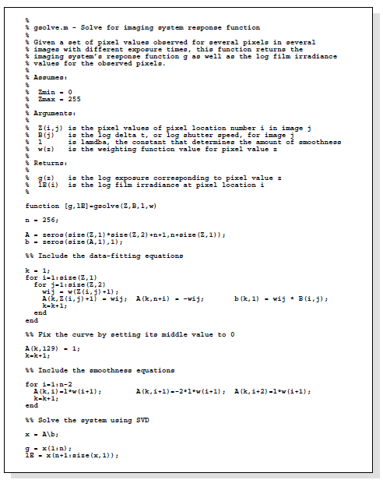
Matlab Code

Slide 20
Matlab Code
function [g,lE]=gsolve(Z,B,l,w)
n = 256;
A = zeros(size(Z,1)*size(Z,2)+n+1,n+size(Z,1));
b = zeros(size(A,1),1);
k = 1; %% Include the data-fitting equations
for i=1:size(Z,1)
for j=1:size(Z,2)
wij = w(Z(i,j)+1);
A(k,Z(i,j)+1) = wij; A(k,n+i) = -wij; b(k,1) = wij * B(j);
k=k+1;
end
end
for i=1:n-2 %% Include the smoothness equations
A(k,i)=l*w(i+1); A(k,i+1)=-2*l*w(i+1); A(k,i+2)=l*w(i+1);
k=k+1;
end
A(k,129) = 1; %% Fix the curve by setting its middle value to 0
k=k+1;
x = A\b; %% Solve the system using pseudoinverse
g = x(1:n);
lE = x(n+1:size(x,1));

Slide 21
Illustration
Image series
• 1
• 1
• 1
• 1
• 1
• 2
• 2
• 2
• 2
• 2
• 3
• 3
• 3
• 3
• 3
Δt =
1/64 sec
Δt =
1/16 sec
Δt =
1/4 sec
Δt =
1 sec
Δt =
4 sec
Pixel Value Z = f(Exposure)
Exposure = Radiance ∗ Δt
log Exposure = log Radiance + log Δt
Notes:
10

Slide 22
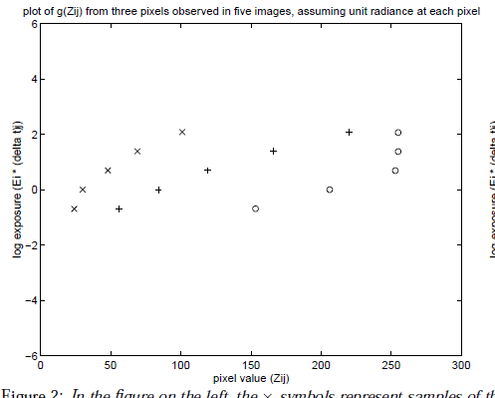
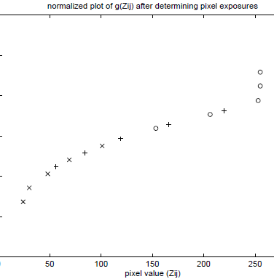
Illustration: Response Curve
ln(exposure)

Slide 23
Response Curve
Assuming unit radiance
for each pixel
After adjusting radiances to obtain a smooth response curve
3
2
Pixel value
Pixel value
1
ln Exposure
ln Exposure

Slide 24
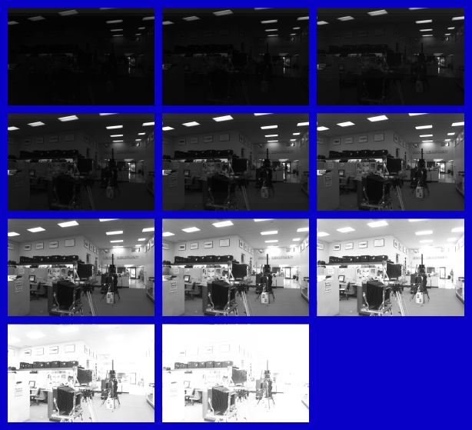
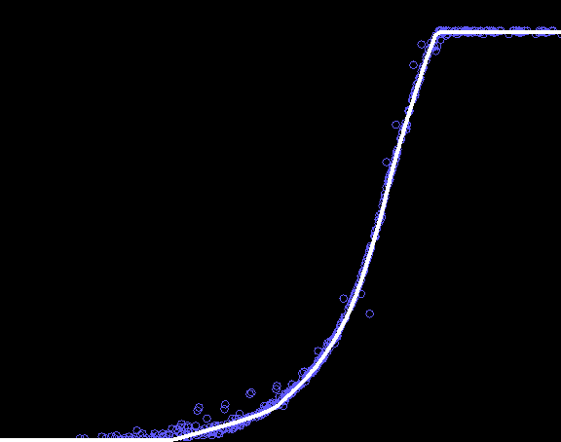
Results: Digital Camera
Kodak DCS460
1/30 to 30 sec
Recovered response curve
Pixel value
log Exposure
Notes:
13

Slide 25
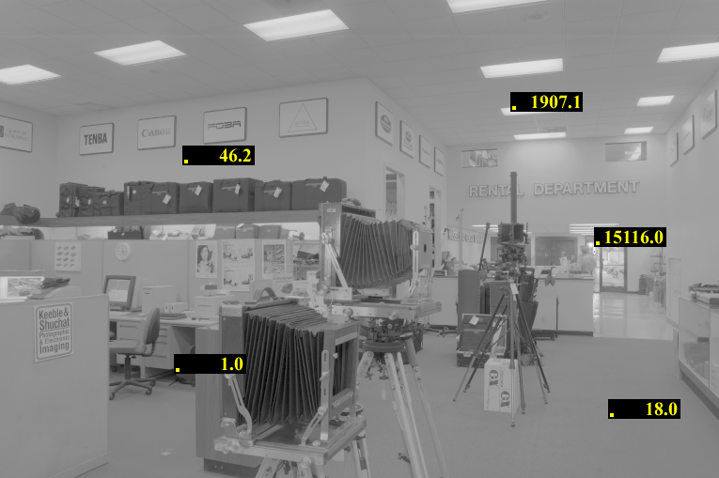
Reconstructed radiance map

Slide 26
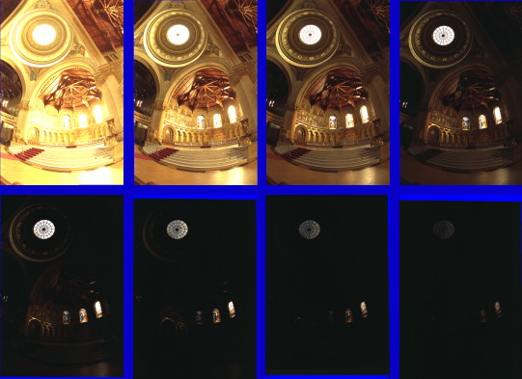
Results: Color Film
Kodak Gold ASA 100, PhotoCD
Notes:
14

Slide 27
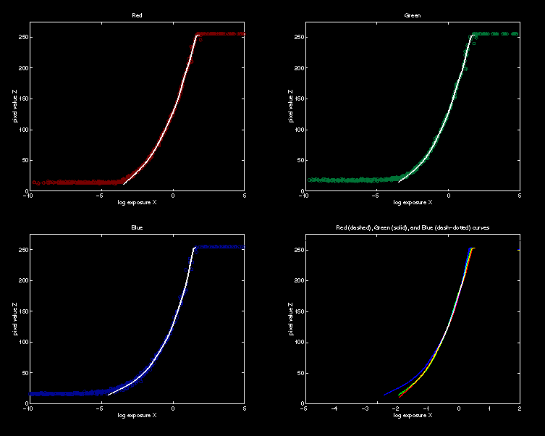
Recovered Response Curves
Red
Green
Blue
RGB
Notes:
15

Slide 28
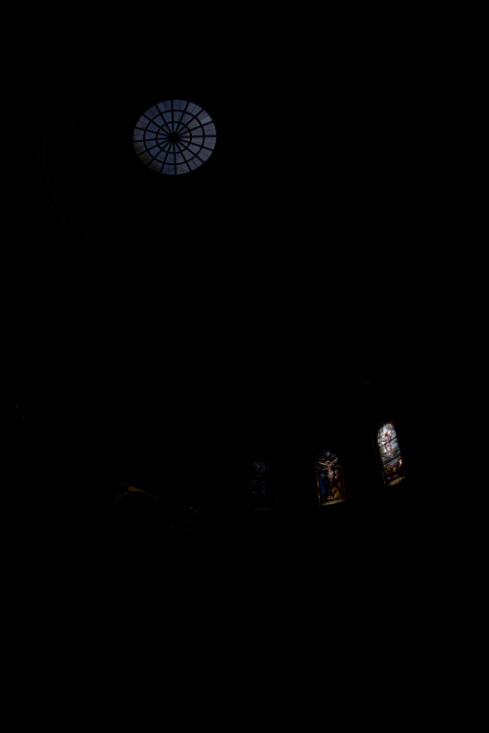
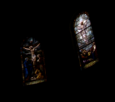
How to display HDR?
Linearly scaled to
display device

Slide 29
Simple Global Operator
Compression curve needs to
  Bring everything within range
  Leave dark areas alone
In other words
  Asymptote at 255
  Derivative of 1 at 0

Slide 30
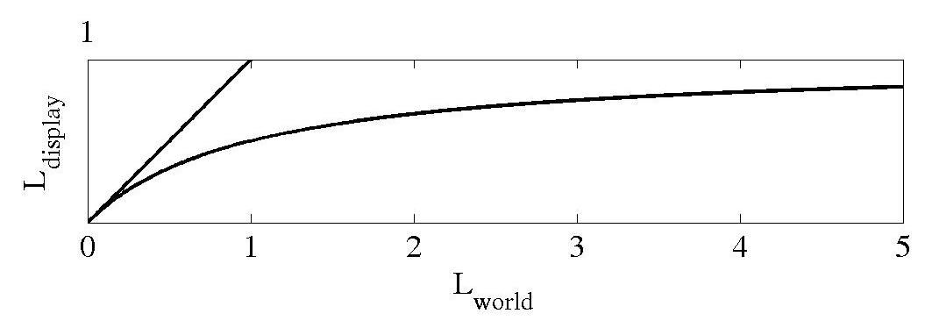
Global Operator (Reinhart et al)

Slide 31
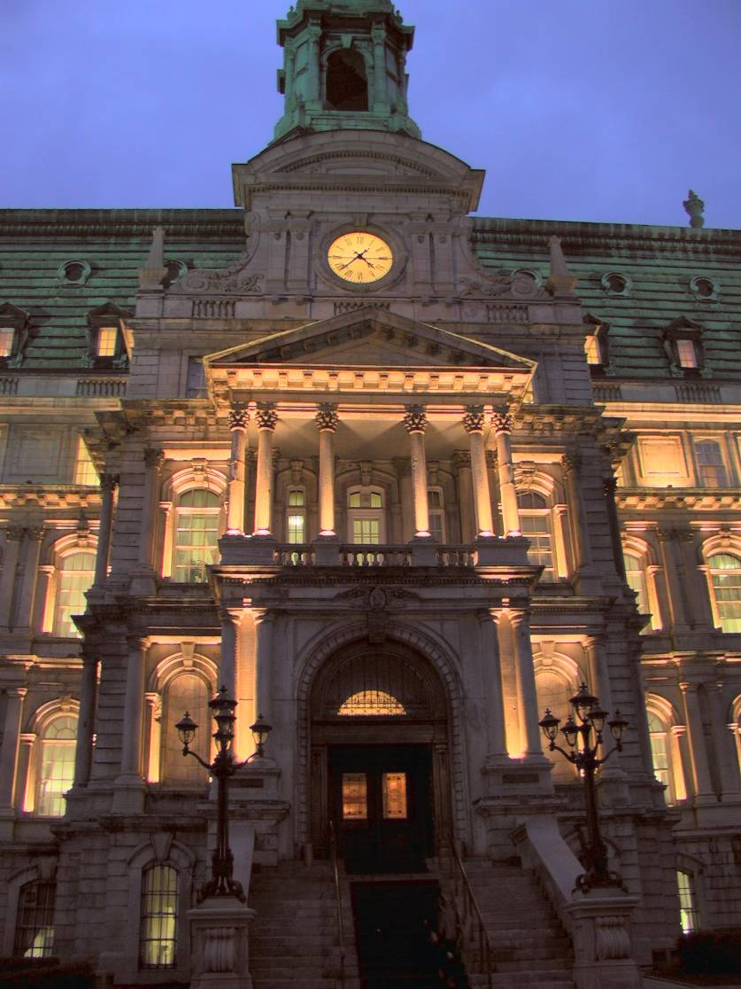
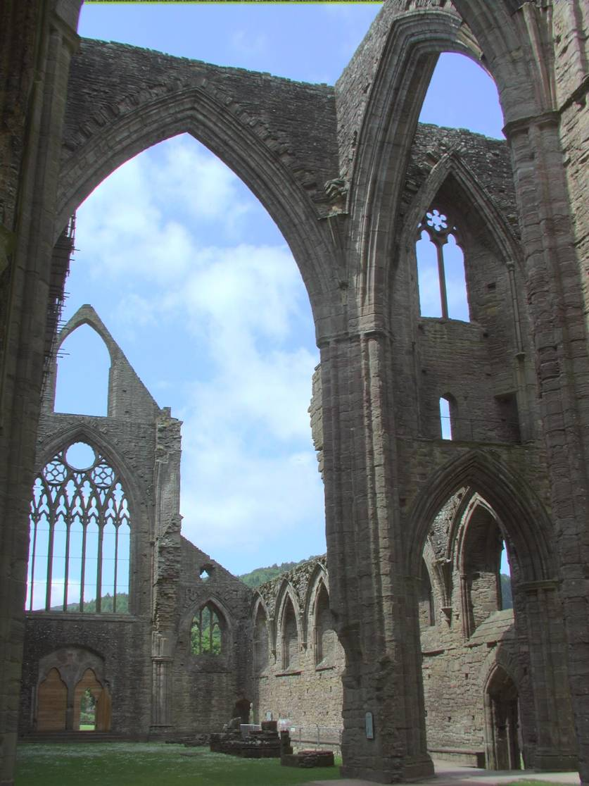
Global Operator Results

Slide 32
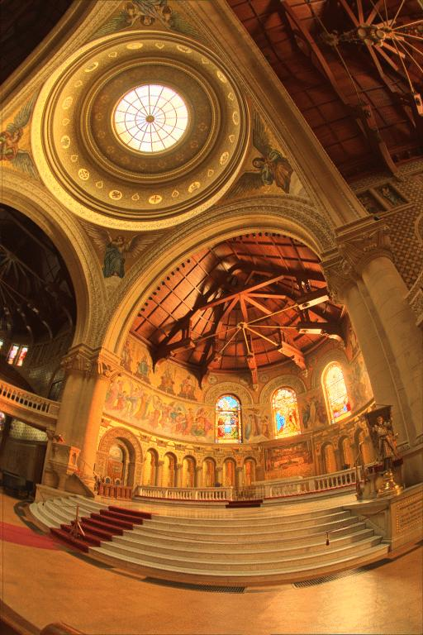
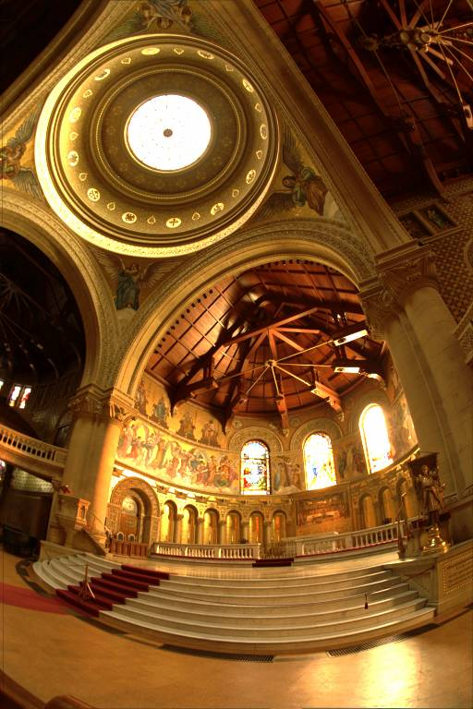
Reinhart Operator
Darkest 0.1% scaled linearly

Slide 33
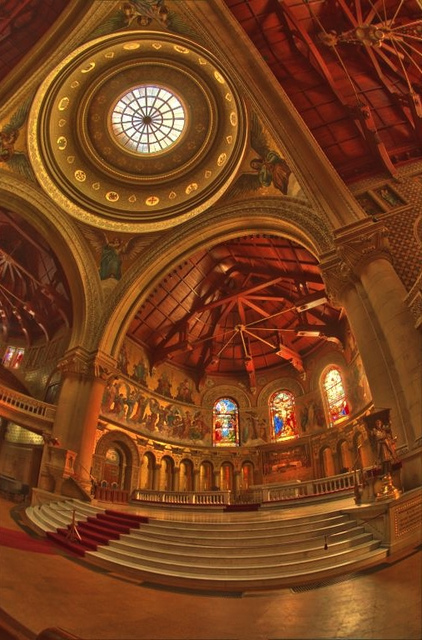
Local operator
http://people.csail.mit.edu/fredo/PUBLI/Siggraph2002/DurandBilateral.pdf

Slide 34
What do we see?
Vs.

Slide 35
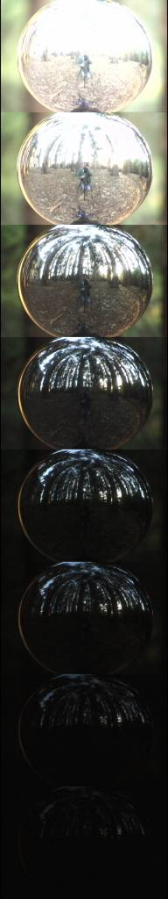
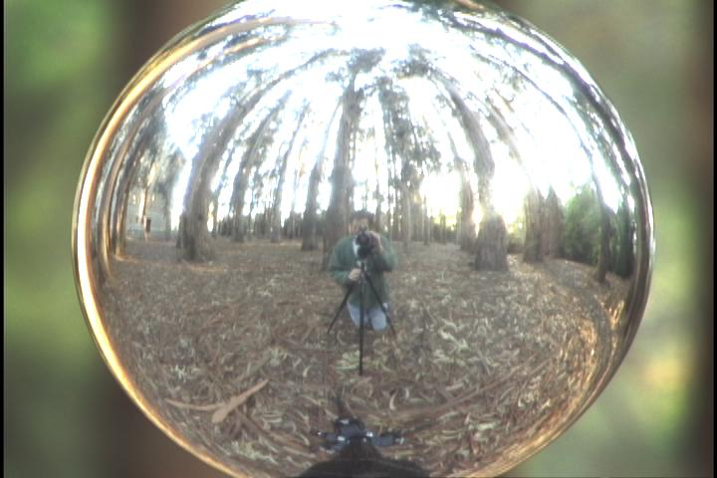
Acquiring the Light Probe

Slide 36
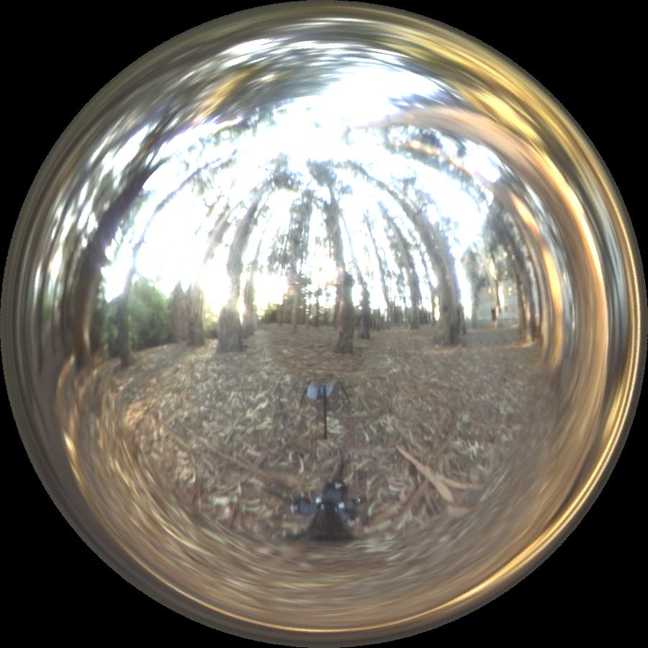
Assembling the Light Probe

Slide 37
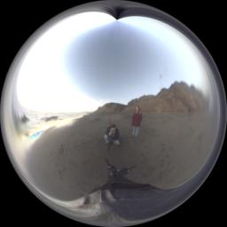
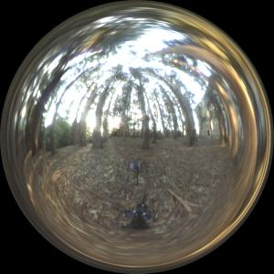
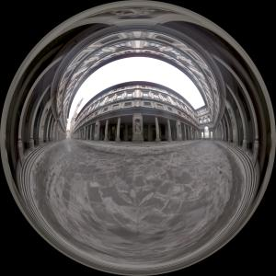
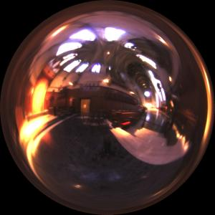
Real-World HDR Lighting Environments
Funston
Beach
Eucalyptus
Grove
Uffizi
Gallery
Grace
Cathedral
Lighting Environments from the Light Probe Image Gallery:
http://www.debevec.org/Probes/

Slide 38
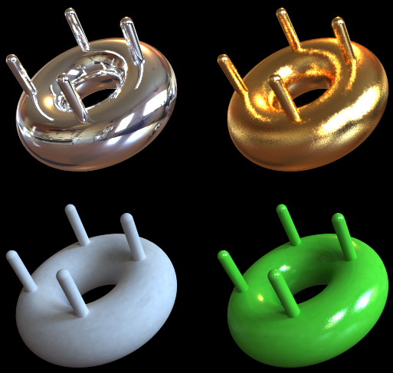
Illumination Results
Rendered with Greg Larson’s RADIANCE synthetic imaging system
Notes:
HDR is revealed with rough specularities.

Slide 39
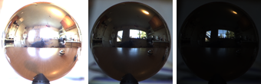
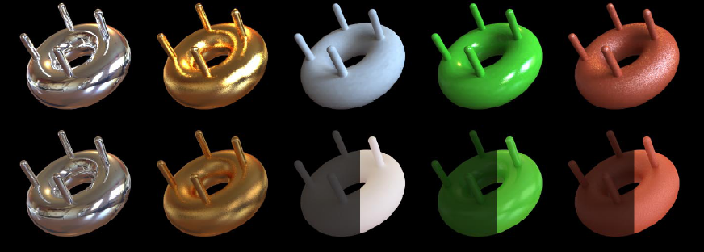
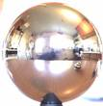
Comparison: Radiance map versus single image
HDR
LDR

Slide 40
Synthetic Objects
+
Real light!

Slide 41
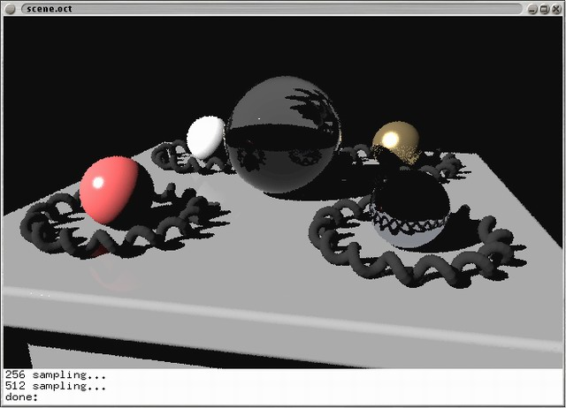
CG Objects Illuminated by a Traditional CG Light Source

Slide 42
Illuminating Objects using Measurements of Real Light
Light
Environment assigned “glow” material property in
Greg Ward’s RADIANCE system.
Object
http://radsite.lbl.gov/radiance/

Slide 43
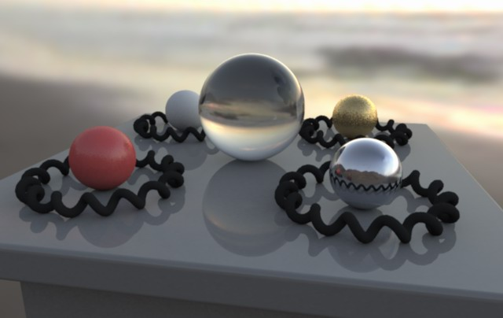
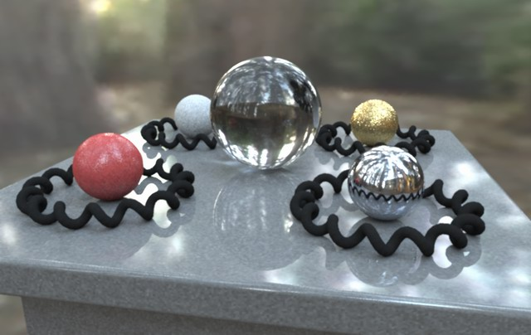


Paul Debevec. A Tutorial on Image-Based Lighting. IEEE Computer Graphics and Applications, Jan/Feb 2002.

Slide 44

Rendering with Natural Light
SIGGRAPH 98 Electronic Theater

Slide 45
Movie
http://www.youtube.com/watch?v=EHBgkeXH9lU
(stretch break during movie)

Slide 46

Illuminating a Small Scene

Slide 47


Slide 48
  We can now illuminate
  synthetic objects with real light.
  - Environment map
  - Light probe
  - HDR
  - Ray tracing
How do we add synthetic objects to a
real scene?

Slide 49

Real Scene Example
Goal: place synthetic objects on table

Slide 50
Modeling the Scene
light-based model
real scene

Slide 51
Light Probe / Calibration Grid

Slide 52

The Light-Based Room Model

Slide 53
Modeling the Scene
light-based model
local scene
synthetic objects
real scene

Slide 54
The Lighting Computation
distant scene (light-based, unknown BRDF)
synthetic objects
(known BRDF)
local scene
(estimated BRDF)

Slide 55
Rendering into the Scene
Background Image

Slide 56

Differential Rendering
Local scene w/o objects, illuminated by model

Slide 57

Rendering into the Scene
Objects and Local Scene matched to Scene

Slide 58

Differential Rendering
Difference in local scene
-
=

Slide 59

Differential Rendering
Final Result

Slide 60
How to render an object inserted into an image?
Image-based lighting
Capture incoming light with a “light probe”
Model local scene
Ray trace, but replace distant scene with info from light probe
Debevec SIGGRAPH 1998

Slide 61

IMAGE-BASED LIGHTING IN FIAT LUX
Paul Debevec, Tim Hawkins, Westley Sarokin, H. P. Duiker, Christine Cheng, Tal Garfinkel, Jenny Huang
SIGGRAPH 99 Electronic Theater

Slide 62
Fiat Lux
http://ict.debevec.org/~debevec/FiatLux/movie/
http://ict.debevec.org/~debevec/FiatLux/technology/

Slide 63


Slide 64






HDR Image Series
2 sec
1/4 sec
1/30 sec
1/250 sec
1/2000 sec
1/8000 sec

Slide 65











Slide 66

Assembled Panorama

Slide 67



Light Probe Images

Slide 68














Capturing a Spatially-Varying Lighting Environment

Slide 69



What if we don’t have a light probe?
Zoom in on eye
Insert Relit Face
Environment map from eye
http://www1.cs.columbia.edu/CAVE/projects/world_eye/ -- Nishino Nayar 2004

Slide 70


Slide 71

Environment Map from an Eye

Slide 72




Can Tell What You are Looking At
Eye Image:
Computed Retinal Image:

Slide 73





Slide 74
Video

Slide 75

Summary
Real scenes have complex geometries and materials that are difficult to model
We can use an environment map, captured with a light probe, as a replacement for distance lighting
We can get an HDR image by combining bracketed shots
We can relight objects at that position using the environment map

